Slide 1
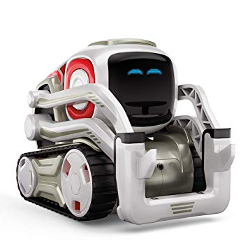
Novice Track Rules:
The robot starts in the starting square.
You have 10 minutes to collect as many cubes as possible.
Once Cozmo starts, you CANNOT modify or touch Cozmo.
The lines are considered boundaries, you cannot cross them.
8 cubes total
4 easy: 20 pts each
3 hard: 40 pts each
1 super hard: 75 pts
If you go inside a block you must come back out (no picking up).
3 tries to practice in the playing area, use this time wisely.

