Slide 1
Software Design And Analysis(CS:3004)
Course Instructor: Romasha Khurshid
Email Address: Romasha.Khurshid@nu.edu.pk
Reference Book: Applying UML and Patterns (An introduction to Object-Oriented Analysis and Design And Iterative Development)
BY Craig Larman
Third Edition

Slide 2
Rules that will be strictly followed:
All the assignments and projects will be uploaded and submitted via google classroom. (GCR)
No assignment will be accepted via email. (Excuses will not be accepted)
All the quizzes will be announced a week before.
Missed quiz will not be retaken. (Excuses will not be accepted)
Announcement:
Project details and course outline will be shared with you soon on GCR.

Slide 3
Tentative Marks distribution:
Assignments: 08 Marks
Quizzes: 06 Marks
Project: 08Marks
Mid-Exams: 14+14=28 Marks
Final-Exam: 50 Marks
PS: Absolute Grading scheme will be followed.

Slide 4
Course Goals:
After successful completion of this course, students should know how to "Think in objects”. Do modeling using UML and create diagrams like use-case, activity, class, sequence, collaboration etc.

Slide 5
Introduction to SDA:
Emphasizes on conceptual solution.
Need to define software objects and how they collaborates to fulfill requirements.
Designs are implemented in programming languages.

Slide 6
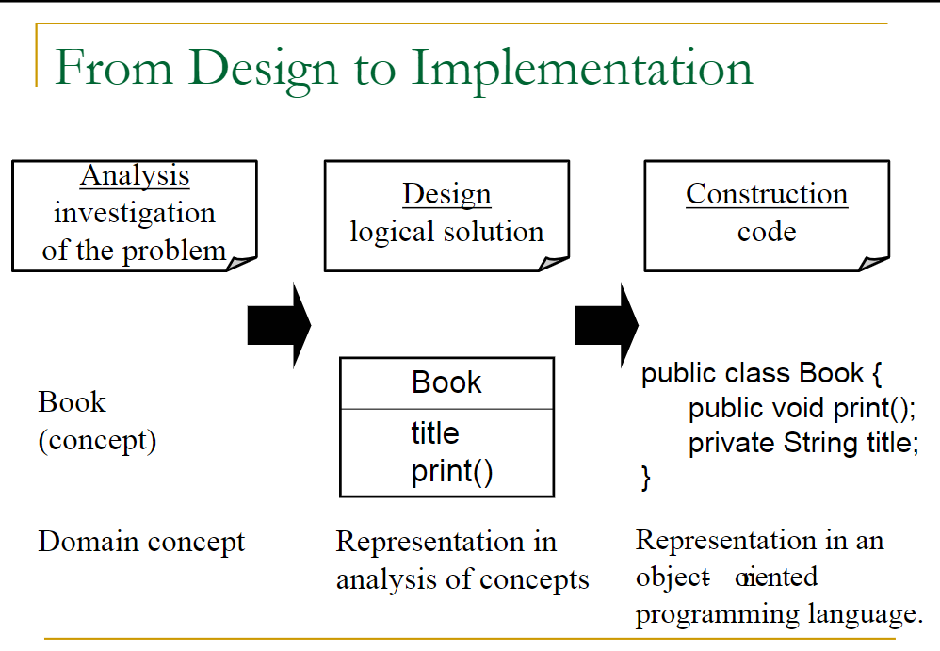

Slide 7

Basic OOP Concepts and Terms
Let’s begin with an object and class,
But before starting……
Can anybody differentiate between OOP and Procedural Programming?

Slide 8
Class And Objects:
Activity:
Annotate Around the
Circle.
Class

Slide 9
Class And Objects:
Activity:
Annotate Around the
Circle.
Object

Slide 10
Class And Object:
Object is an entity having their own attributes and operations.
Class is a blueprint, a design and we can say a mold through which different objects are created.

Slide 11
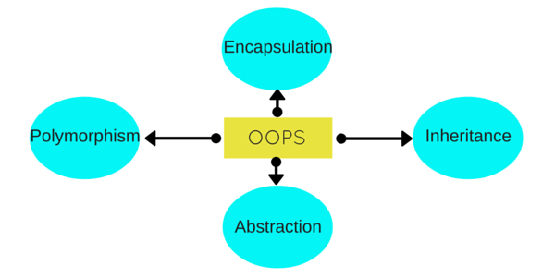
OPPs Pillars:
Activity:
Annotate around the Ellipse.

Slide 12
Inheritance:
Property of an object to acquire all the properties and behavior of its parent object.
Inheritance represents the “is-a” relationship.

Slide 13
Polymorphism:
Many forms
Compile time polymorphism or static polymorphism.(overloading)
Run time polymorphism or dynamic polymorphism.(overriding)

Slide 14
Abstraction:
An abstraction that hides the internal implementation details. (coffee machine example)
Abstraction means displaying only essential information and hiding the details.

Slide 15
Encapsulation:
In normal terms Encapsulation is defined as wrapping up of data and information under a single unit.
In Object Oriented Programming, Encapsulation is defined as binding together the data and the functions that manipulates them

Slide 16
Two Different Techniques of Developing Computer Systems:
Object-Oriented Programming | Procedural Programming
Bottom-up approach | Top-down Approach
Divides into objects | Divides into functions
Have access modifiers | Don’t have access modifier
Object can move and communicate with each other through member functions. | Data move freely from function to function of a system
More secure | Less secure
Support overloading | Does not support overloading.

Slide 17
SAD And OOAD:
SAD (Structured analysis) is a traditional systems development technique that is time-tested and easy to understand.
Structured analysis uses a set of process models to describe a system graphically.
Because it focuses on processes that transform data into information, structured analysis is called a process- centered technique
Whereas structured analysis treats processes and data as separate components, object-oriented analysis combines data and the processes that act on the data into things called objects.
System analysts use O-O to model real world business
processes and operation.
The result is a set of software objects that represent actual people, things, transactions and events

Slide 18
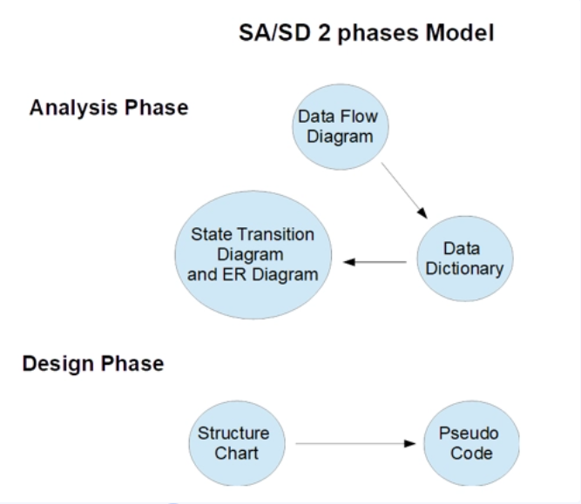

Slide 19
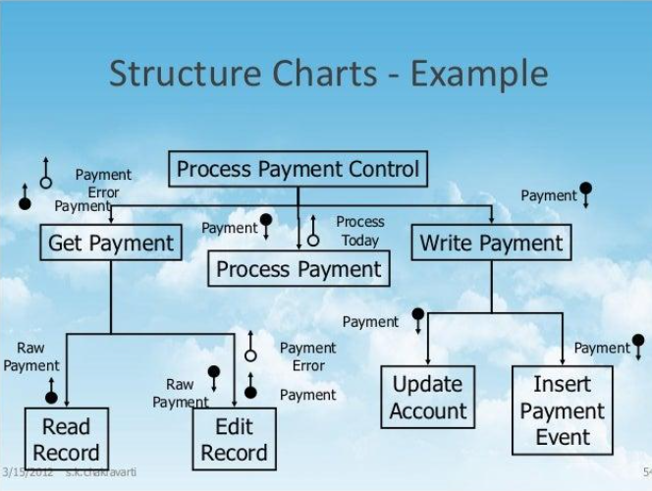
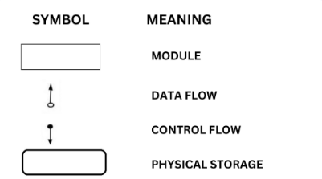

Slide 20
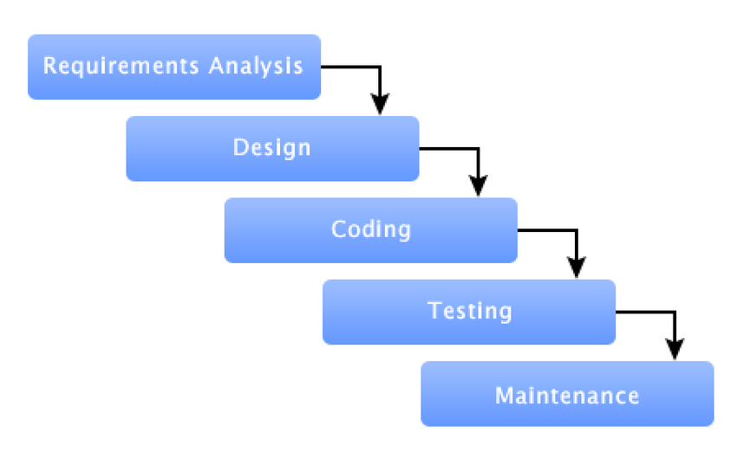
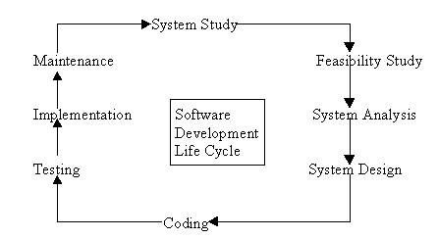

Software Development Lifecycle:
After UAT, the implementation phase begins.
All programs of the system are loaded onto the user's computer.
After loading the system, training of the users starts.
After the users are trained about the computerized system, manual working has to shift from manual to computerized working.

Slide 21

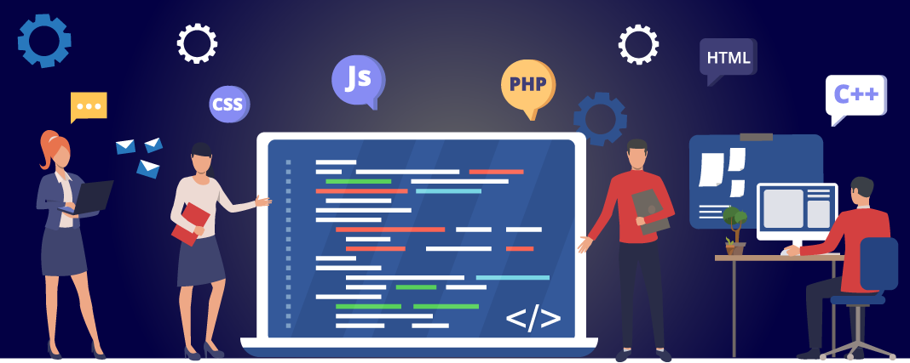
Software process activities:
1. Software specification, where customers and engineers define the software that is to be produced and the constraints on its operation.
2. Software development, where the software is designed and programmed.

Slide 22


Continue..
4. Software evolution, where the software is modified to reflect changing customer and market requirements.
3. Software validation, where the software is checked to ensure that it is what the customer requires.

Slide 23
Software Environments
Development
Test
Staging
Pre-Production
Production
Mirror
Roles involved:
D, DM, PM, TM, CM & DT.

