Slide 1
Software Design And Analysis Activity Diagram
Course Instructor: Romasha Khurshid
Email Address: Romasha.Khurshid@nu.edu.pk
Reference Book: Applying UML and Patterns (An introduction to Object-Oriented Analysis and Design And Iterative Development)
BY Craig Larman
Third Edition

Slide 2
What is an Activity Diagram?
Represent the dynamic (behavioral) view of a system
Used for business (transaction) process modeling
Used to represent flow across use cases or within a use case
UML activity diagrams are the object oriented equivalent of flow chart and DFDs in function-oriented design approach
Describes how activities are coordinated.
Records the dependencies between activities, such as which things can happen in parallel and what must be finished before something else can start.
Represents the workflow of the process.
Activity diagram contains activities, transitions between activities, decision points, synchronization bars, swim lanes and many more.

Slide 3





Notation
2. Transition
Activity1
Activity2
1. Activities

Slide 4




Notation - 2
[x>0]
[x>0]
Activity1
[x=0]
[x=0]
[x<0]
[x<0]
3. Decision Diamond

Slide 5
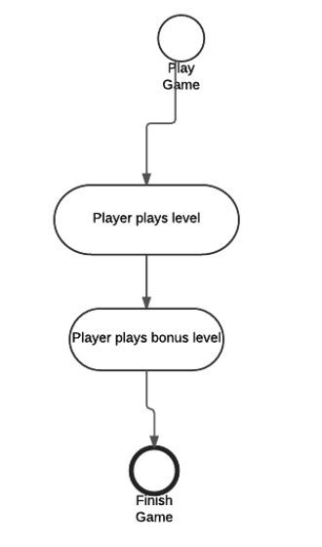
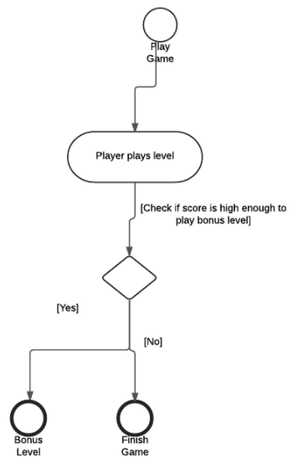
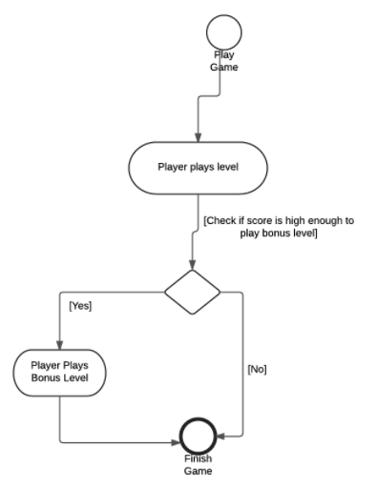
Quiz:
Choose the correct diagram that illustrates a video game?

Slide 6


Notation - 3
4.1 Synch. Bar (Join)
4.2 Splitting Bar (Fork)

Slide 7
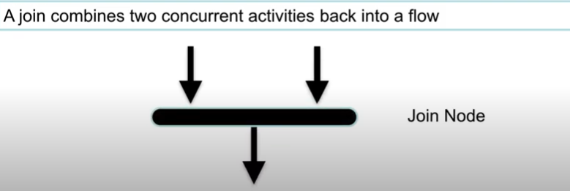
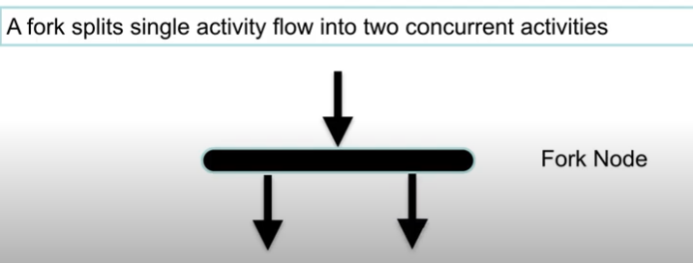
Forking and Joining
Use a synchronization bar to specify the forking and joining of parallel flows of control
A synchronization bar is rendered as a thick horizontal or vertical line

Slide 8



Notation - 3
Start Marker
Stop Marker
5. Start & Stop Markers

Slide 9
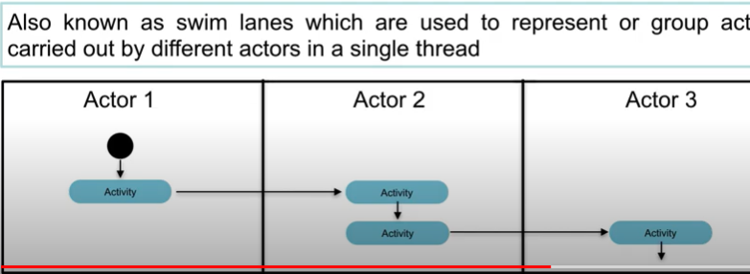
Notation-4
6.Partition

Slide 10
Activity Diagrams (1)
To model the dynamic aspects of a system
It is essentially a flowchart
Showing flow of control from activity to activity
Purpose
Model business workflows
Model operations

Slide 11
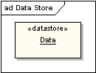
Data Store
 A data store is shown as an object with the «datastore»
keyword

Slide 12
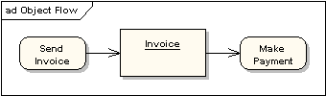
Object and Object Flow
There is no data flow in activity diagram. Object flow plays role of data flow as well.
An object flow is a path along which objects can pass. An
object is shown as a rectangle
An object flow is shown as a connector with an arrowhead denoting the direction the object is being passed.

Slide 13
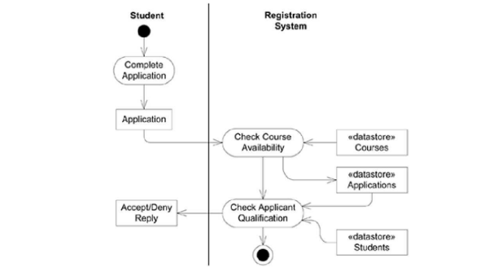
Activity Diagram: Example (1)

Slide 14
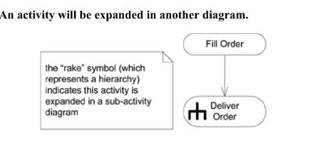
Rake Symbol:

Slide 15
Decision (1)
A branch specifies alternate paths taken based on some Boolean expression
A branch may have one incoming transition and two or more outgoing ones

Slide 16
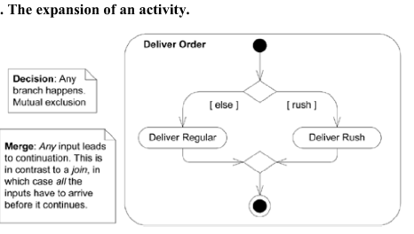
Decision (2)

Slide 17
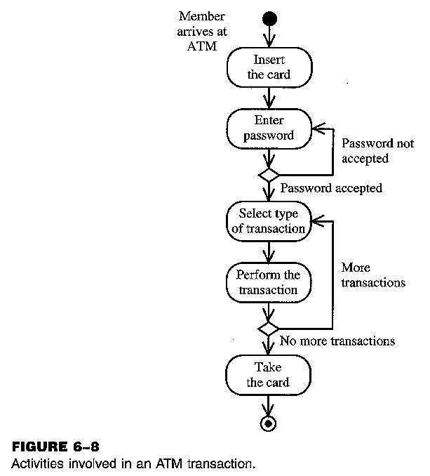
Activity Diagram: Example (2)

Slide 18
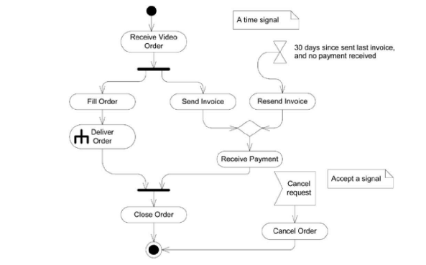
Signals:

Slide 19

SEIIT System
Student Enrollment in Institute of Information Technology (IIT)
Here different activities are:
Received enrollment form filled by the student
Registrar checks the form
Input data to the system
System authenticate the environment
Pay fees by the student
Registrar checks the amount to be remitted and prepare a bill
System acknowledge fee receipts and print receipt
Hostel allotment
Allot hostel
Receive hostel charge
Allot room
Medical check up
Create hostel record
Conduct medical bill
Enter record
Issue library card
Issue identity card

Slide 20

Activity Diagram for SEIIT
Received form
Payment fees
Hostel allotment
Medical check
Issue identity card
Issue library card

Slide 21

Basic Components in an Activity Diagram
 Initial node
 The filled circle is the starting point of the diagram
 Final node
Received form
 The filled circle with a boarder is the ending point. An activity diagram can have zero or more activity final state.
 Activity
Payment fees
Hostel allotment
Medical check
 The rounded circle represents
activities that occur. An activity is not necessarily a program, it may be a manual thing also
Issue identity card
Issue library card
 Flow/ edge
 The arrows in the diagram. No label is necessary

Slide 22

Basic Components in an Activity Diagram
 Fork
Received form
 A black bar ( horizontal/vertical ) with one flow going into it and several leaving it. This denotes the beginning of parallel activities
Join
A block bar with several flows entering it and one leaving it. this denotes the end of parallel activities
Merge
A diamond with several flows entering and one leaving. The implication is that all incoming flow to reach this point until processing continues
Payment fees
Hostel allotment
Medical check
Issue identity card
Issue library card

Slide 23
Basic Components in an Activity Diagram
Difference between Join and Merge
A join is different from a merge in that the join synchronizes two inflows and produces a single outflow. The outflow from a join cannot execute until all inflows have been received
A merge passes any control flows straight through it. When all incoming flow reach this point then processing continues

Slide 24
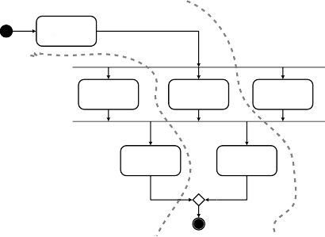
Basic Components in an Activity Diagram
Decision
A diamond with one flow entering and several leaving. The flow leaving includes conditions as yes/ no state
Flow final
The circle with X though it. This indicates that Process stop at this point
Swim lane
A partition in activity diagram by means of dashed line, called swim lane. This swim lane may be horizontal or vertical
Received form
Payment fees
Hostel allotment
Medical check
Issue identity card
Issue library card

Slide 25
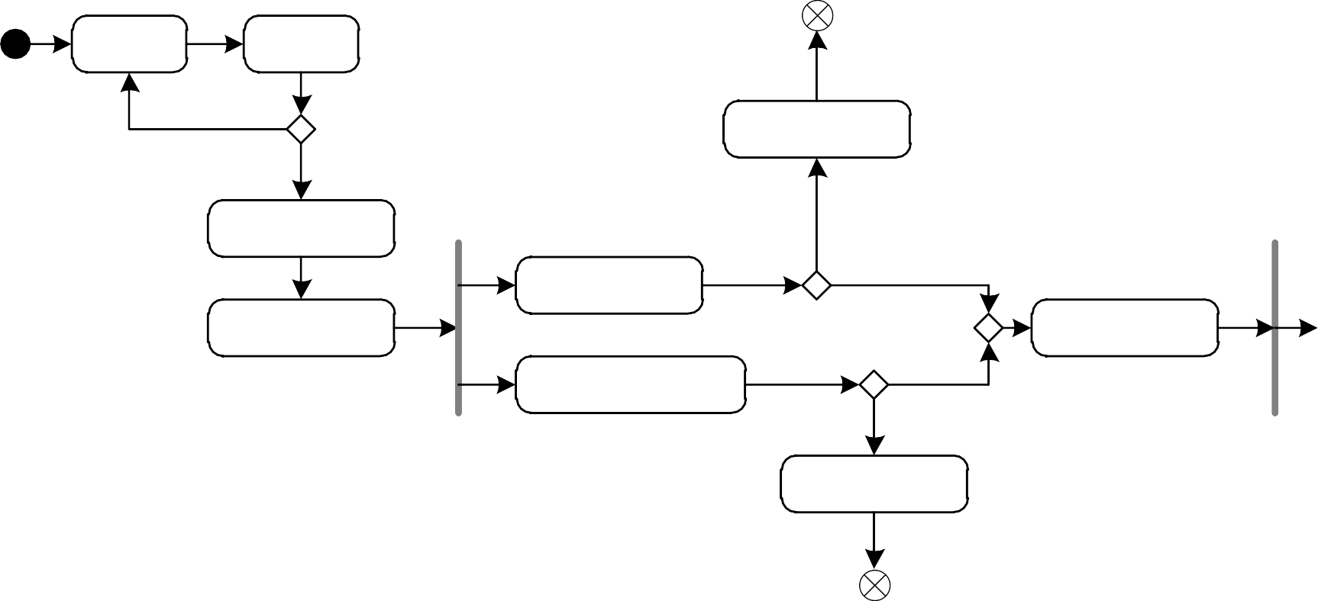
Detailed Activity Diagram of SEIIT
Fill-in form
Check form
[Incorrect]
Regret message
[Correct]
Display student screen
[No]
Verify the applications
[Yes]
Input student information
Create record
1
Search for Student selection list
[Match]
[No Match]
Regret registration

Slide 26


Detailed Activity Diagram of SEIIT
1
Display enrollment form
Calculate registration fees
Dispaly fees payable screen
Process payment
Pay fee
2
Print receipt

Slide 27

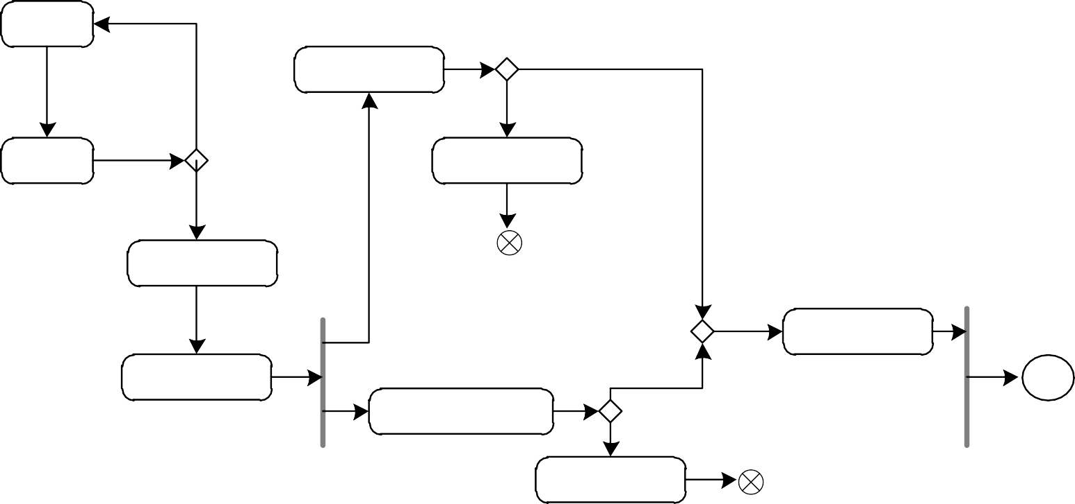
Activity Diagram of SEIIT with Swim Lane
Student
Fill-in form
Verify the applications
[Yes]
[Incorrect]
[No]
Check form
Regret message
Registrar
[Correct]
Display student screen
Create record
Input student information
[Match]
1
System
Search for Student selection list
[No Match]
Regret registration

Slide 28
Swimlanes
A swimlane delineates who does what in a process.
To partition the activity states on an activity diagram into groups
each group representing the business organization responsible for those activities
each group is called a swimlane
It provides clarity and accountability by placing process steps within the horizontal or vertical “swimlanes” of a particular employee, work group or department.

Slide 29
Swimlanes
Each swimlane has a name unique within its
diagram
Each swimlane may represent some real-world entity
Each swimlane may be implemented by one or more classes
Every activity belongs to exactly one swimlane, but transitions may cross lanes

Slide 30
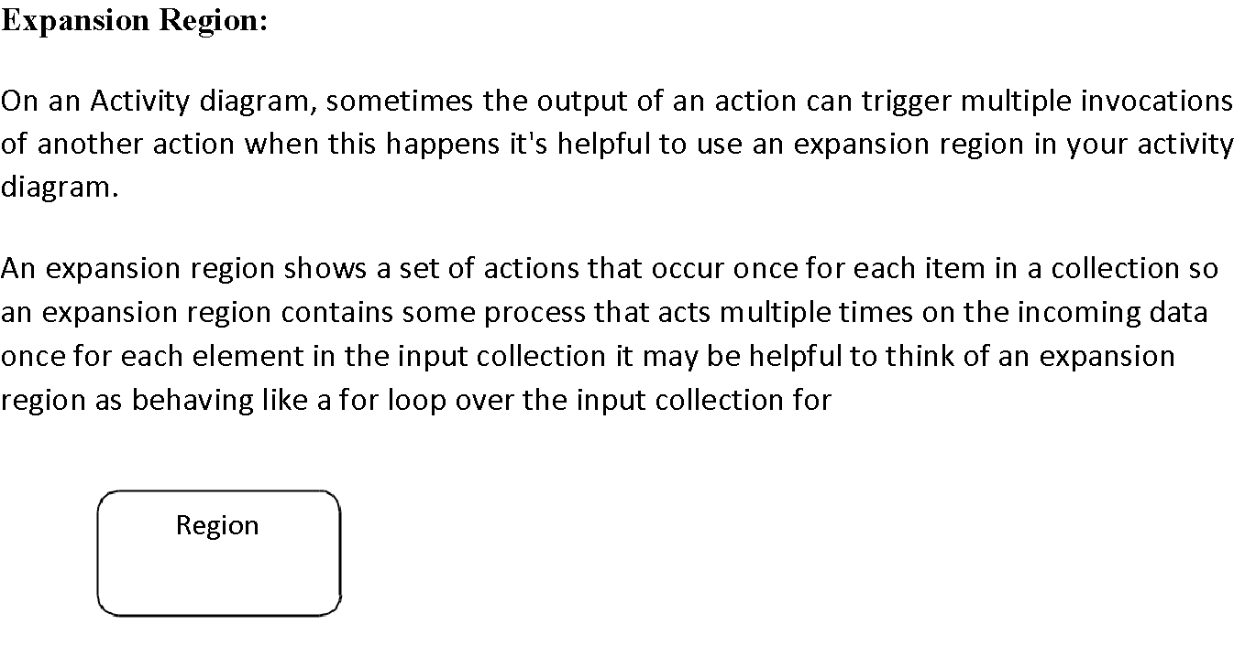
Some more features in Activity Diagrams:

Slide 31
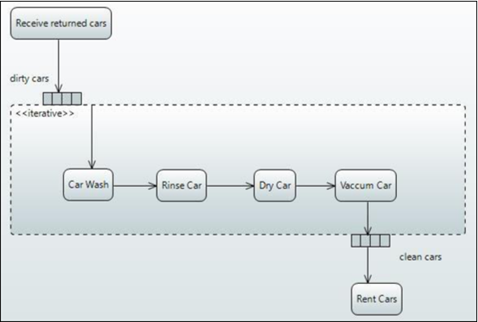
Example:
Imagine a car rental agency and when cars are returned to this agency they collect a batch of cars and then they send those cars through their one lane car wash one at a time so our action that would trigger this multiple invocation of the carwash would be receive returned cars and once they've received batch of cars they're going to send them one at a time through the carwash and so that will be our expansion region

Slide 32
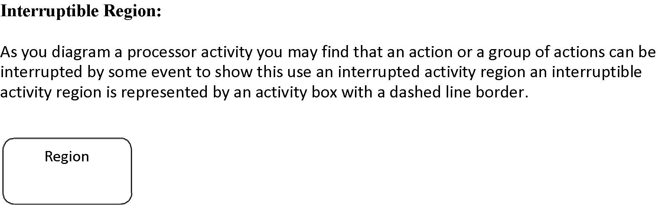
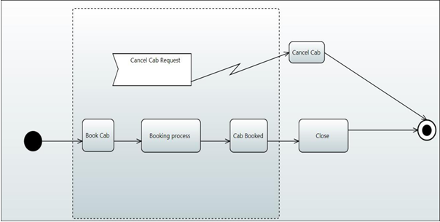

Slide 33
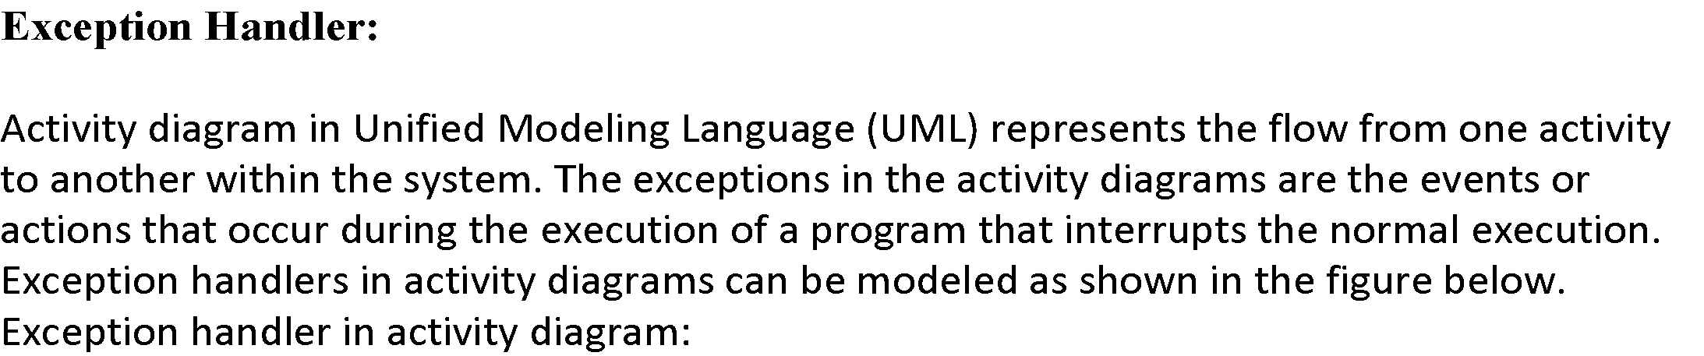
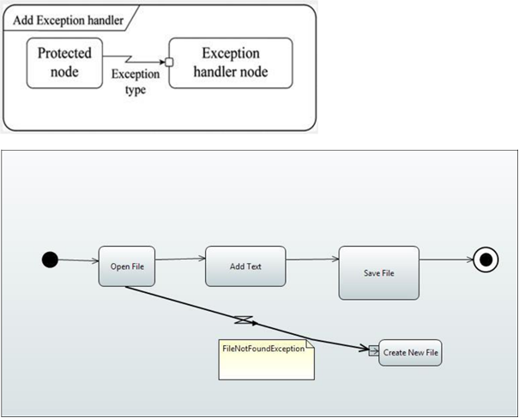

Slide 34
Practice Scenario:
The following text describes the operations of UAC bank.
UAC bank has two means of depositing cheques into an account. A customer can deposit the check by going to the teller sitting at the bank desk or the check(s) can be deposited through the cheque vending machine planted at the bank’s branch. In order to deposit the check with the help of the teller, the customer has to take a token and wait for his turn. Once his turn arrives, the token number appears on the screen along with a sound of bell. He can then go to the teller and present all the cheques he wants to deposit along with the deposit slip. The teller verifies all the cheques one by one and key in the cheque details and account details in the system. After completing entry of all the cheques, the system shows the cheque summary and total amount. The teller then stamps the deposit slips and the cheque deposit details are sent to the customer’s mobile number.
On the other hand, if the customer decides to deposit the cheques through vending machine, he can join the queue and wait for his turn. On his turn, the system will show the welcome message and ask the customer to key in the account number in which cheques are to be deposited. The name of the account holder and the number then appears on the screen. If the details are correct, the customer can start depositing the cheques else he is asked to key in the account details again. The customer then enters the cheque amount and deposit the cheque into the vending machine. The machine then accepts and scans the cheque. It takes 10 second to show the picture of the scanned cheque. The picture of the scanned cheque is displayed on the screen along with the cheque amount the customer entered. The customer then press ok. This process is repeated till all the cheques are deposited. Once the customer presses finish, the receipt is printed and the cheque details are sent to the customer’s mobile number.

Slide 35
