Slide 1
SOFTWARE QUALITY ASSURANCE
CH07: Quality Management Systems
Course Instructor: AMIR IMAM

Slide 2
Content
Quality Management Systems
CMMI
Six Sigma
Six Sigma Methodologies
DAMAIC
DMADV
Six Sigma Roles
Lean Six Sigma
Lean Six Sigma Wastes
Lean Six Sigma Roles
ISO
ISO 9001 Implementation

Slide 3
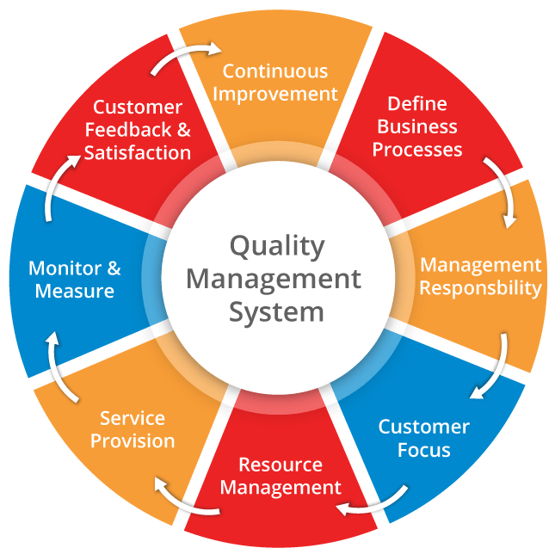
Quality Management System
A quality management system (QMS) is a collection of business processes focused on consistently meeting customer requirements and enhancing their satisfaction.

Slide 4
Quality Management System
The quality management system under which the software system is created is normally based on one or more of the following models/standards:
CMMI
Six Sigma
ISO 9000
The goal of SQA is to ensure that the SDLC processes are continuously improved to produce products that meet customer expectations and requirements
Note: There are many other models/standards for quality management but the ones mentioned above are the most popular.

Slide 5
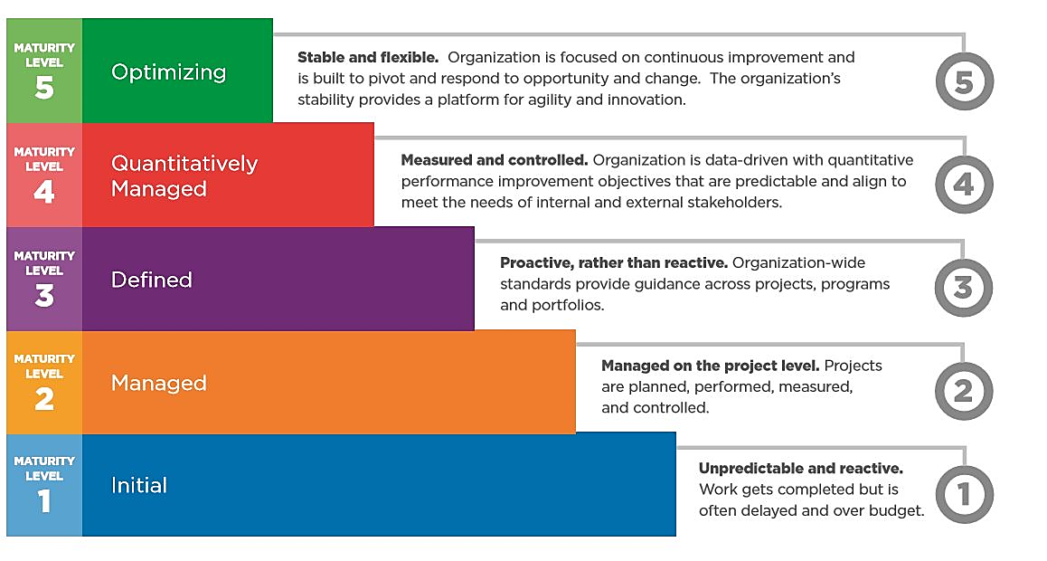
Capability Maturity Model Integration (CMMI)

Slide 6
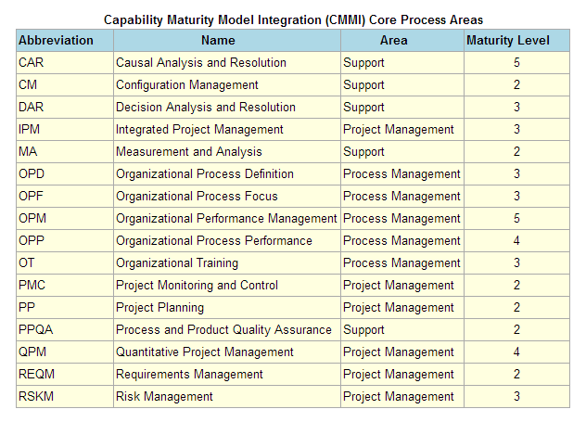
Capability Maturity Model Integration (CMMI)

Slide 7
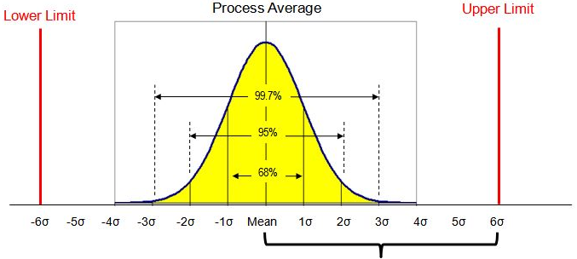
Six SIGMA
Six Sigma is a disciplined, data-driven approach and methodology for eliminating defects in any process
Manufacturing → Transactional
Product → Service
“To achieve Six Sigma — a process must not produce more than 3.4 defects per million opportunities.”

Slide 8
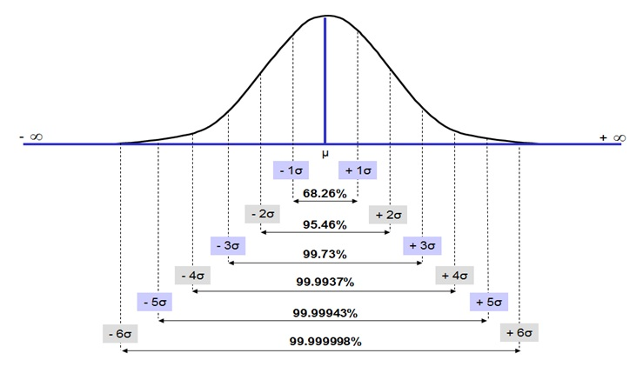
Six SIGMA

Slide 9
Six SIGMA Methodologies
Six σ
Defect Reduction
Cycle Reduction
DMADOV
DMADV
Define Measure Analyze Design Optimize Verify
Define Measure Analyze Design Verify
DMAIC
Define Measure Analyze Improve Control
Developing Six Sigma Software
CFPM
Cross Function Process Mapping
DSSS+
Design & Manufacturing
Designing New Processes
Improving Existing Cross-Functional Process
Software Development
Improving Cross-Functional Process

Slide 10
Six SIGMA Methodologies
6σ
Defect Reduction
Cycle Reduction
DMADOV
DMADV
Define Measure Analyze Design Optimize Verify
Define Measure Analyze Design Verify
DMAIC
Define Measure Analyze Improve Control
Developing Six Sigma Software
CFPM
Cross Function Process Mapping
DSSS+
Design & Manufacturing
Designing New Processes
Improving Existing Cross-Functional Process
Software Development
Improving Cross-Functional Process

Slide 11
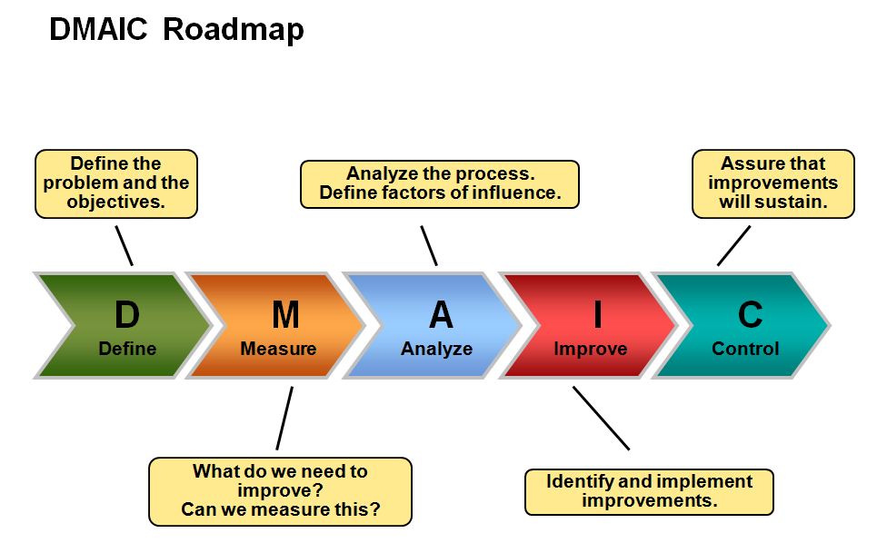
Six SIGMA - DMAIC
The Six Sigma DMAIC process is an improvement system for existing processes falling below specification and looking for incremental improvement.
DMAIC focuses on:
Defining business processes
Measuring the current performance of a business process
Finding the root cause of a problem
Making improvements to the business process to reduce defects
Implementing controls to alert leadership when the process is no longer in control.

Slide 12
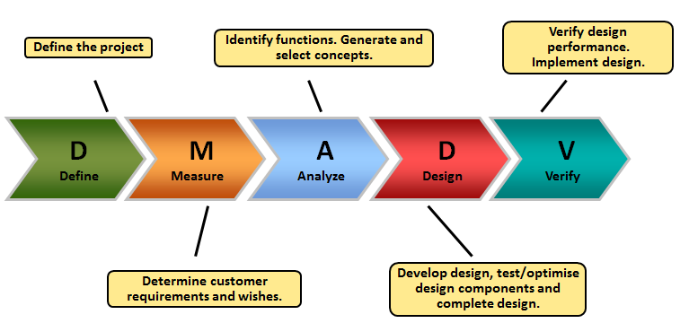
Six SIGMA - DMADV
The Six Sigma DMADV process (define, measure, analyze, design, verify) is an improvement system used to develop new processes or products. It can also be employed if a current process requires more than just incremental improvement.
DMADV focuses on:
Defining the customer’s needs
Measuring the customer’s needs
Finding process options that will meet the customer’s needs
Designing a business model that helps meet the customer’s needs
Verifying that the new model meets the customer’s needs

Slide 13
Six SIGMA – Roles
Quality Leader/Manager (QL/QM) – The quality leader’s responsibility is to represent the needs of the customer and to improve the operational effectiveness of the organization.
Master Black Belt (MBB) – Master Black Belts are typically assigned to a specific area or function of a business or organization. It may be a functional area such as human resources or legal, or process specific area such as billing. (assigned to…)
Process Owner (PO) – Process owners are exactly as the name sounds – they are the responsible individuals for a specific process. For instance, in the legal department there is usually one person in charge – maybe the VP of Legal – that’s the process owner. There may be a chief marketing officer for your business – that’s the process owner for marketing. (from organization…)
Black Belt (BB) – Black Belts are the heart and soul of the Six Sigma quality initiative. Their main purpose is to lead quality projects and work full time until they are complete. Black Belts also coach Green Belts on their projects.
Green Belt (GB) – Green Belts are employees trained in Six Sigma who spend a portion of their time completing projects, but maintain their regular work role and responsibilities. Depending on their workload, they can spend anywhere from 10 percent to 50 percent of their time on their project(s).

Slide 14
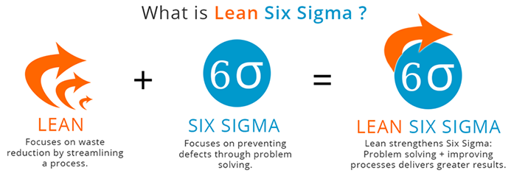
Lean Six SIGMA

Slide 15
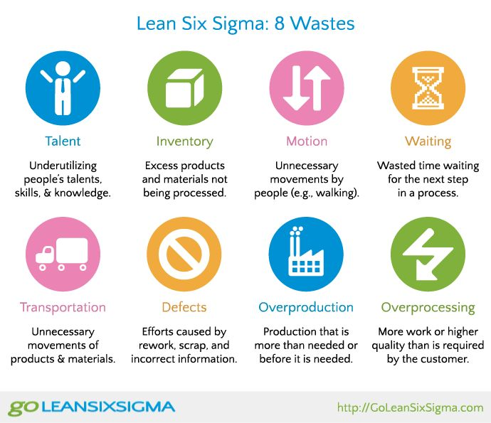
Lean Six SIGMA – 8 Wastes

Slide 16
Lean Six SIGMA – 8 Wastes
Quiz
Identify Eight Wastes in your organization with real time examples?

Slide 17

Six SIGMA

Slide 18
Lean Six SIGMA – 10 Troublesome Team Members
ASSIGNMENT
Suggest Solutions(can be multiple) for TEN Troublesome Team Members

Slide 19
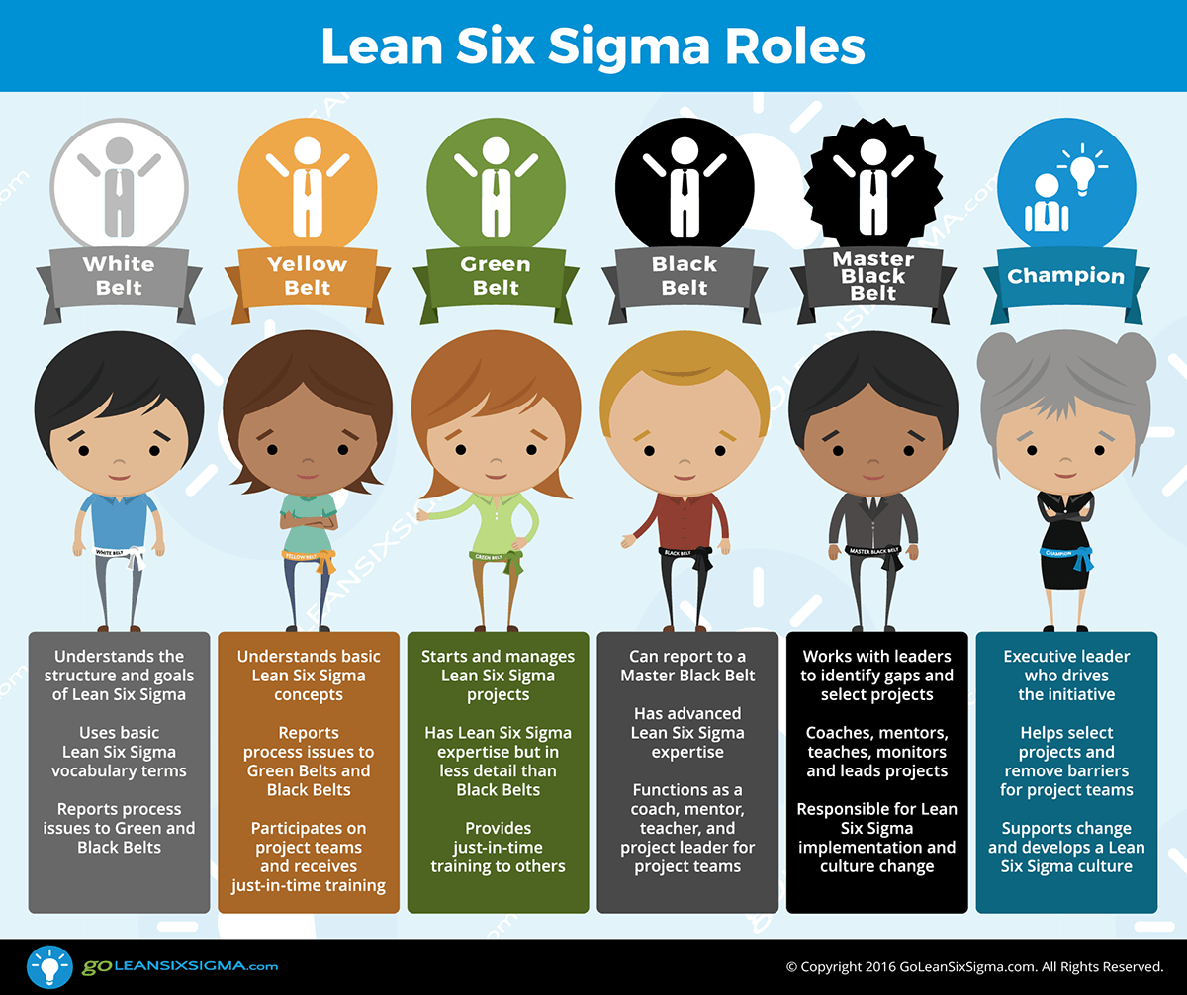
Lean Six SIGMA

Slide 20

ISO 9000
ISO 9000 is a series, or family, of quality management standards
They are not specific to any one industry and can be applied to organizations of any size.
ISO 9000 is defined as a set of international standards on quality management and quality assurance developed to help companies effectively document the quality system elements needed to maintain an efficient quality system.
ISO 9000 can help a company satisfy its customers, meet regulatory requirements, and achieve continual improvement. It should be considered to be a first step or the base level of a quality system.

Slide 21
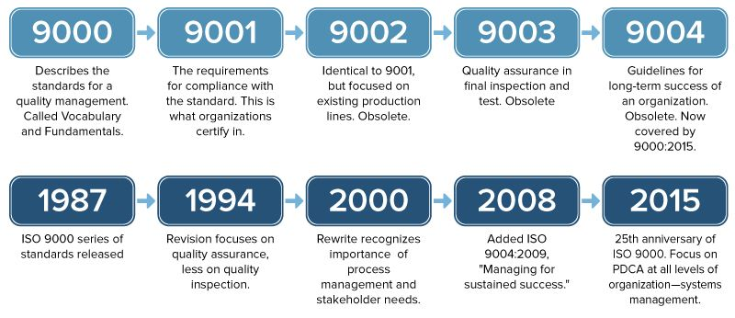
ISO 9000 Series

Slide 22
ISO 9001:2015 – Implementation
Step 1: Commitment From Top Management
Step 2: Establishing An Implementation Team
Step 3: Conducting ISO 9000 Awareness Programs
Step 4: Providing Training
Step 5: Conducting An Initial Status Survey
Step 6: Creating A Documented Implementation Plan
Step 7: Developing A Quality Management System Documentation
Step 8: Control Of Documents
Step 9: Implementation
Step 10: Internal Quality Audit
Step 11: Reviewing By Management
Step 12: Pre-assessment Audit
Step 13: Certification And Registration
Step 14: Continual Improvement

Slide 23



ISO 9001:2015 – Implementation
STEP 1: COMMITMENT FROM TOP MANAGEMENT
The top management of an organization should be determined and committed to implement a quality management system.
STEP 2: ESTABLISHING AN IMPLEMENTATION TEAM
People are responsible for the implementation of ISO 9000. An implementation team, headed by a Service Provider and a Management Representative (MR), is to be established.
STEP 3: CONDUCTING ISO 9000 AWARENESS PROGRAMS
Conducting ISO 9000 awareness programs will inform all employees about the aim of a quality management system. These include the advantages offered to customers and employees.

Slide 24



ISO 9001:2015 – Implementation
STEP 4: PROVIDING TRAINING:
Training regarding the quality management system should thus be provided for all employees because all areas and peoples are effected.
STEP 5: CONDUCTING AN INITIAL STATUS SURVEY:
A quality management system conforming to the ISO 9000 standard should be created. However, this does not preclude incorporating, adapting, or adding onto quality programs that already exists.
STEP 6: CREATING A DOCUMENTED IMPLEMENTATION PLAN:
A documented implementation plan is used to address any non-conformances. The documented implementation plan identifies and describes processes in order to make the organization’s current quality management system in full compliance with the ISO 9000 standard.

Slide 25

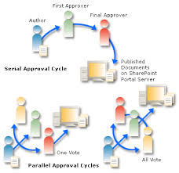

ISO 9001:2015 – Implementation
STEP 7: DEVELOPING A QUALITY MANAGEMENT SYSTEM DOCUMENTATION:
In order to avoid non-conformities, documentation of a quality management system should include the following:
Documented statements of a quality policy and quality objectives;
A quality manual
Documented procedures and records required by the standard of ISO 9001:2015; and
Documents needed to ensure effective planning, operation and control of its processes.
STEP 8: CONTROL OF DOCUMENTS:
A documented system should be created. The creation, approval, distribution, revision, storage, and disposal of various types of documentation are thus managed. Document control systems should be as easy and simple to operate as possible.
STEP 9: IMPLEMENTATION:
During phased implementation, an evaluation can take place regarding the effectiveness of the system in different areas. Through management review and an internal quality audit, the implementation progress is monitored to ensure that the quality management system is effective and thus conforms to the IS0 9000 standard.

Slide 26



ISO 9001:2015 – Implementation
STEP 10: INTERNAL QUALITY AUDIT:
The effectiveness of the installed system should be checked regularly by means of an internal quality audit. To ensure that the quality management system conforms to the quality management system requirements established by your organization.
STEP 11: REVIEWING BY MANAGEMENT:
A management review should be conducted three to six months after quality management system implementation took place. The reasons for conducting management reviews are to ensure continuous effectiveness, adequacy, and suitability of the quality management system.
STEP 12: PRE-ASSESSMENT AUDIT:
Before applying for certification, a pre-assessment audit usually takes place. Certification bodies provide a qualified but independent auditor to conduct this service. Some degree of confidence is gained before application for certification if the pre-assessment audit goes well.

Slide 27


ISO 9001:2015 – Implementation
STEP 13: CERTIFICATION AND REGISTRATION:
Once QMS has been operating and stabilized for a few months; an audit of the documents if it conforms to requirement followed by site audit. A certificate is awarded with a valid period of three years only, after which the certification body will carry out periodic surveillance audits.
STEP 14: CONTINUAL IMPROVEMENT:
Although an organization gained certification, it is important to note that it has to try and improve the suitability and effectiveness of the quality management system on a continuous basis.

Slide 28

Seven Quality Analysis Tools - * Ishikawa, 1991
"As much as 95% of quality related problems in the factory can be solved with seven fundamental quantitative tools."
Histogram
Pareto Diagram
Cause and Effect Diagram
Check Sheet (Checklist)
Control Chart
Scatter Diagram
Time Chart

Slide 29
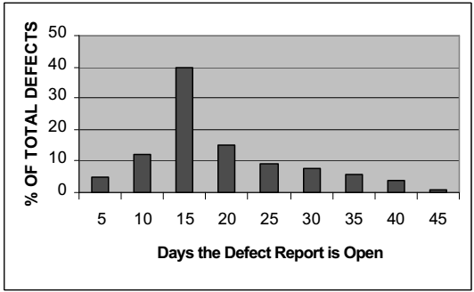
Histogram
A frequency distribution shows how often each different value in a set of data occurs.
A histogram is the most commonly used graph to show frequency distributions.

Slide 30
Histogram
When to Use a Histogram
When the data are numerical.
When you want to see the shape of the data’s distribution.
When analyzing whether a process can meet the customer’s requirements.
When determining whether the outputs of two or more processes are different.

Slide 31
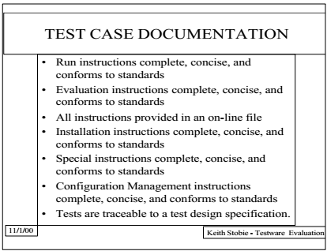
Check Sheet (Checklist)
A check sheet is a structured, prepared form for collecting and analyzing data.
Generic tool that can be adapted for a wide variety of purposes.

Slide 32
Check Sheet (Checklist)
When to Use a Check Sheet
When data can be observed and collected repeatedly by the same person or at the same location.
When collecting data on the frequency or patterns of events, problems, defects, defect location, defect causes, etc.
When collecting data from a production process.

Slide 33
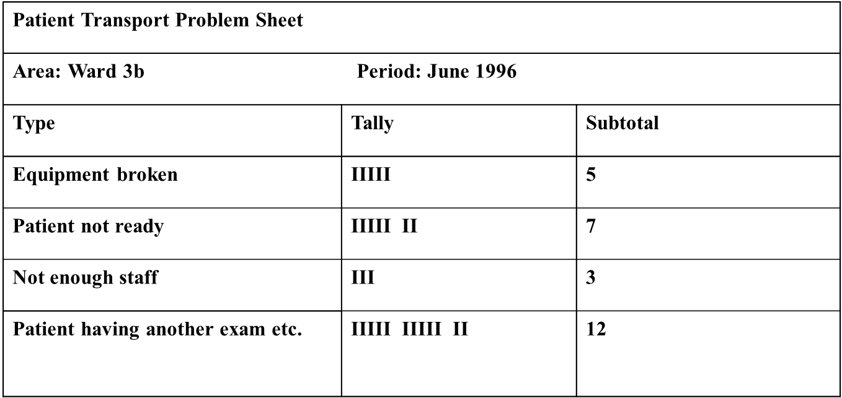
Check Sheet - EXAMPLE

Slide 34
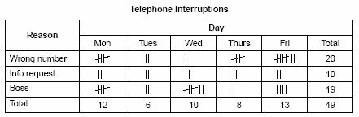
Check Sheet - EXAMPLE
The figure below shows a check sheet used to collect data on telephone interruptions. The tick marks were added as data was collected over several weeks.

Slide 35
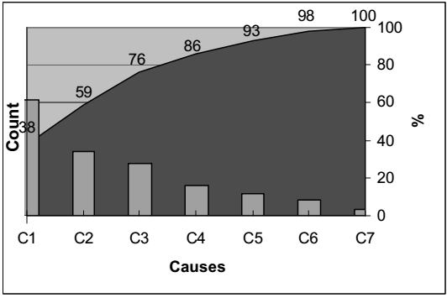
Pareto Diagram
Also called: Pareto diagram, Pareto analysis, 80/20 Rule
Variations: weighted Pareto chart, comparative Pareto charts
A Pareto chart is a bar graph.
The lengths of the bars represent frequency or cost (time or money), and are arranged with longest bars on the left and the shortest to the right.
In this way the chart visually depicts which situations are more significant.

Slide 36
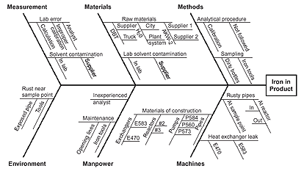
Fish Bone Diagram
Also Called: Cause–and–Effect Diagram, Ishikawa Diagram
The fishbone diagram identifies many possible causes for an effect or problem.
It can be used to structure a brainstorming session.
It immediately sorts ideas into useful categories.

Slide 37
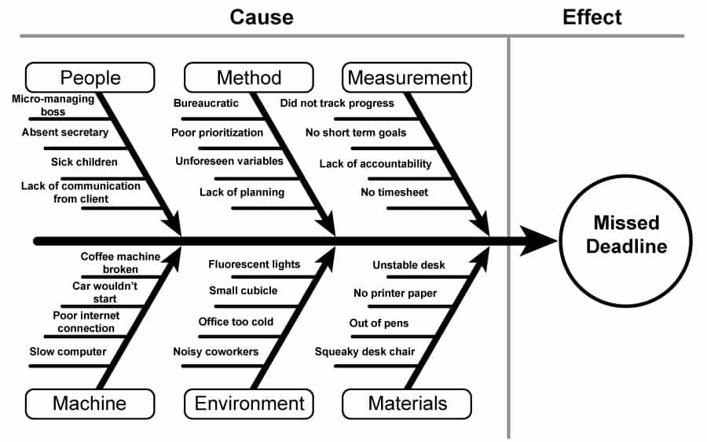
Fish Bone Diagram - EXAMPLE

Slide 38
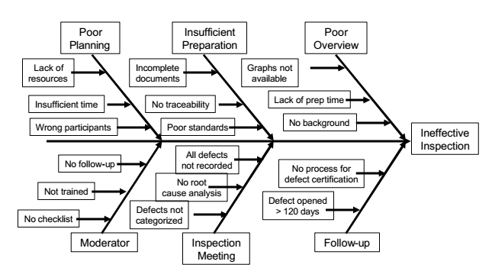
Fish Bone Diagram - EXAMPLE

Slide 39
Any Question?
End!

