Slide 1
SOFTWARE TESTING
CH04: Test Techniques
Course Instructor: AMIR IMAM

Slide 2
Test Design Techniques
Test Design Techniques
Static
Dynamic
Structured Based
Experienced Based
Specification Based
Reviews
Static Testing
Informal
Inspection
Technical
Walkthroughs
Static Analysis
Control Flow
Data Flow
Statement
Branch/Decision
Condition
Error Guessing
Exploratory
BVA
ECP
State Transition
Use Case
Decision Table

Slide 3
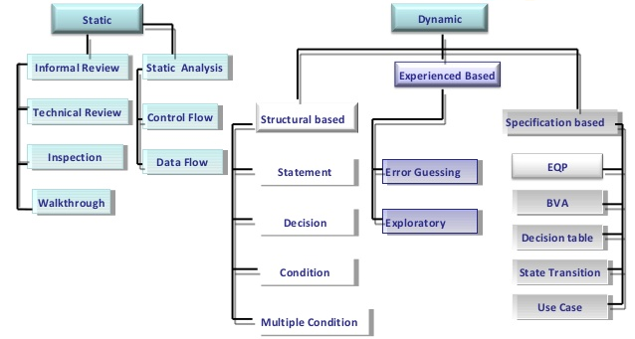
Test Design Techniques

Slide 4
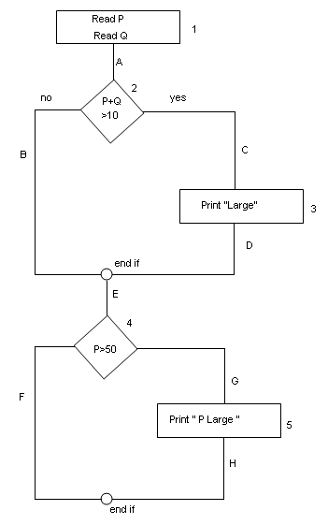
Structured Based – White Box Techniques
Statement Coverage
Decision/Branch Coverage
Condition Coverage

Slide 5
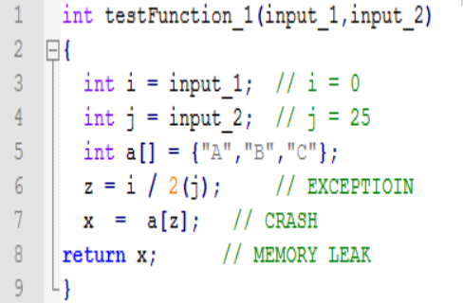
Statement Testing and Coverage
Test Data: input_1 = 2 input_2 = 3
Test Data: input_1 = 100 input_2 = 25
Test Data: input_1 = 0 input_2 = 25

Slide 6
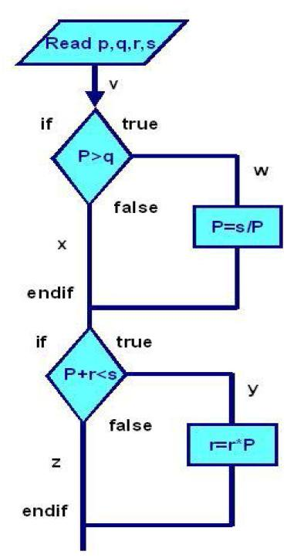
Statement Testing and Coverage
Test Data
Test Data: input_1 = 2 input_2 = 3
Test Data: input_1 = 100 input_2 = 25
Test Data: input_1 = 0 input_2 = 25

Slide 7
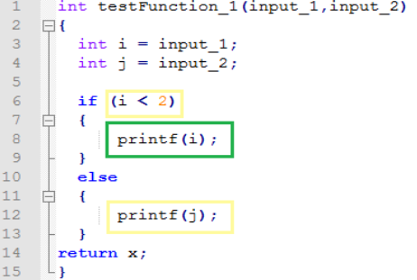
Decision and Condition Coverage
Test Data: input_1 = 2 input_2 = 3
Test Data: input_1 = 1 input_2 = 3

Slide 8
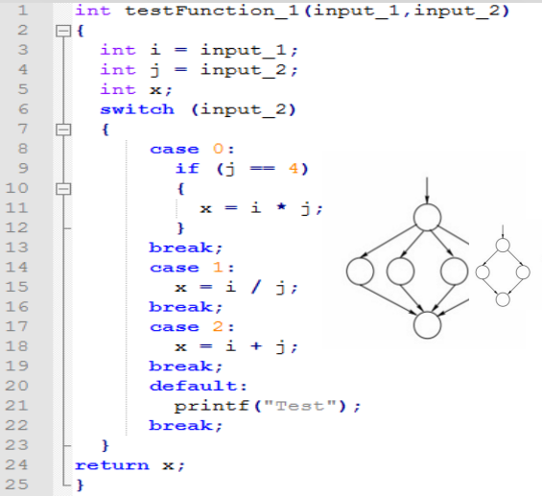
Decision and Condition Coverage
Test Data: input_1 = 1 input_2 = 0
Test Data: input_1 = 0 input_2 = 4
Test Data: input_1 = 0 input_2 = 1

Slide 9
Experienced Based Techniques
In experience-based techniques, people’s knowledge, skills and background are of prime importance.
The experience of both technical and business people is required.
Experience-based techniques go together with specification-based and structure-based techniques, and are also used when there is no specification, or if the specification is inadequate or out of date.
This may be the only type of technique used for low-risk systems, but this approach may be particularly useful under extreme time pressure – in fact this is one of the factors leading to exploratory testing.

Slide 10
Experienced Based Techniques - TYPES
Error Guessing
Exploratory Testing

Slide 11
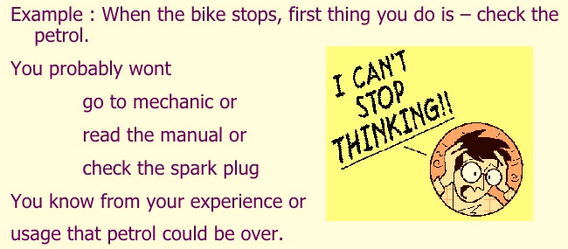
What is Error guessing in software testing?
A structured approach to the error-guessing technique is to list possible defects and attempt to produce them.
These lists can be built based on the tester’s own experience or that of other people experience.
EXAMPLES:
Divide by ZERO
Null inputs
Negative Numbers
Check fields on Maximum limits
Check by inserting special characters

Slide 12
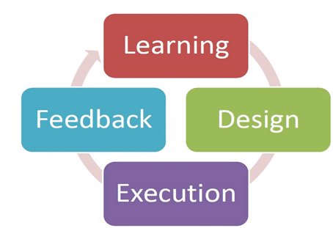
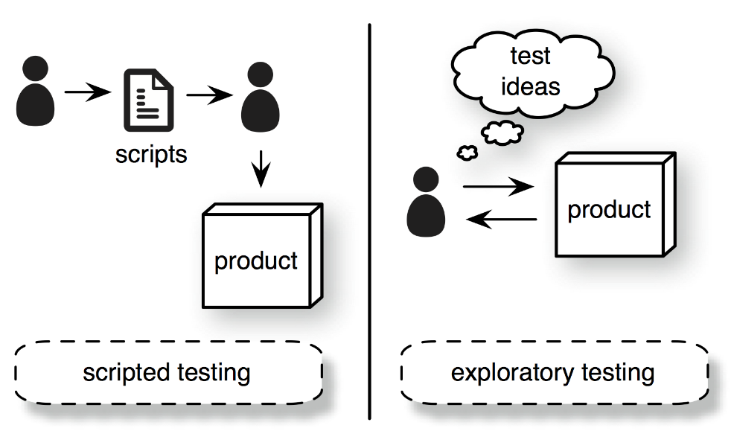
What is Exploratory Testing in software testing?
Exploratory testing is a hands-on approach in which testers are involved in minimum planning and maximum test execution.
The planning involves the creation of a test charter, a short declaration of the scope of a short (1 to 2 hour) time-boxed test effort, the objectives and possible approaches to be used.
Test logging is undertaken as test execution is performed, documenting the key aspects of what is tested, any defects found and any thoughts about possible further testing.

Slide 13
Specification Based Techniques
Equivalence Partitioning
Boundary Value Analysis
Decision Tables
Use Case Testing
State Transition Testing

Slide 14
Specification Based – Black Box
Boundary Value
VALID
LowerLimit - 1 | LowerLimit | UpperLimit | UpperLimit + 1
INVALID

Slide 15
Specification Based – Black Box
Equivalence Class Partitioning
VALID
0 to (LowerLimit – 1) | Lower Limit to Upper Limit | (UpperLimit + 1) to onward
INVALID

Slide 16
Specification Based – Black Box
RANGE: 8 - 30
0 - 7
8 - 30
31 - ∞
7
8
30
31

Slide 17
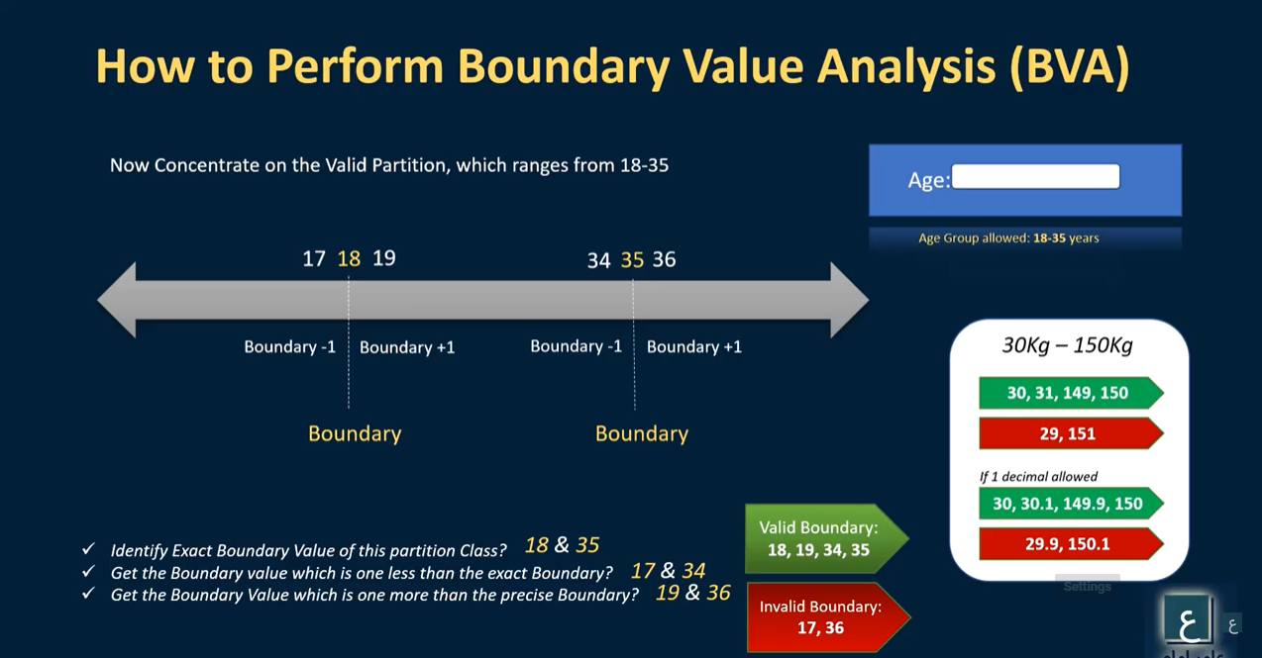

Slide 18
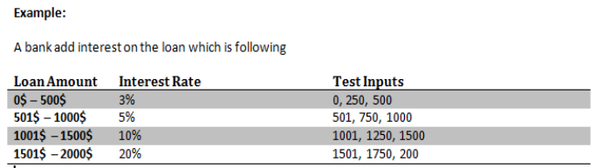
Specification Based – Black Box
Boundary Value
Equivalence Class Partitioning

Slide 19
Specification Based – Black Box
Order numbers on a stock control system can range between 10000 and 99999 inclusive. Which of the following inputs might be a result of designing tests for only valid equivalence classes and valid boundaries:
A. 1000, 5000, 99999 B. 9999, 50000, 100000 C. 10000, 50000, 99999 D. 10000, 99999 E. 9999, 10000, 50000, 99999, 10000

Slide 20
Specification Based – Black Box
In a system designed to work out the tax to be paid:
An employee has £4000 of salary tax free.
The next £1500 is taxed at 10%
The next £28000 is taxed at 22%
Any further amount is taxed at 40%
To the nearest whole pound, which of these is a valid Boundary Value Analysis test case?
a) £1500
b) £32001
c) £33501
d) £28000
0000 – 4000 → 0%
4001 – 5500 → 10%
5501 – 33500 → 22%
33501 – infi → 40 %

Slide 21
Specification Based – Black Box
A thermometer measures temperature in whole degrees only. If the temperature falls below 18 degrees, the heating is switched off. It is switched on again when the temperature reaches 21 degrees. What are the best values in degrees to cover all equivalence partitions?
A. 15, 19 and 25. B. 17, 18 and19. C. 18, 20 and22. D. 16, 26 and 32.

Slide 22
Specification Based – Black Box
In a system designed to work out the tax to be paid:
An employee has £4000 of salary tax free.
The next £1500 is taxed at 10%
The next £28000 is taxed at 22%
Any further amount is taxed at 40%
Which of these groups of numbers would fall into the same equivalence class?
a) £4800; £14000; £28000
b) £5200; £5500; £28000
c) £28001; £32000; £35000
d) £5800; £28000; £32000
0000 – 4000 → 0%
4001 – 5500 → 10%
5501 – 33500 → 22%
33501 – infi → 40 %

Slide 23
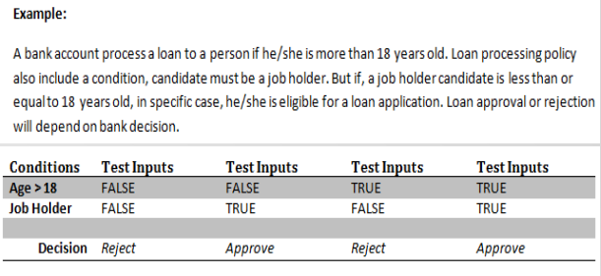
Specification Based – Black Box
Decision Table

Slide 24
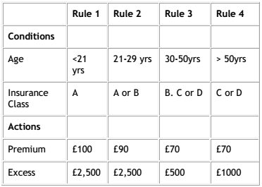
Specification Based – Black Box
Decision Table
Given the following decision table: Which of the following test cases and expected results is VALID?
A. 23 year old in insurance class A Premium is 90 and excess is,500. B. 51 year old in insurance class C Premium is 100 and excess is 1000. C. 31 year old in insurance class B Premium is 70 and excess is ,500. D. 43 year old in insurance class C Premium is 0 and excess is ,000.

Slide 25
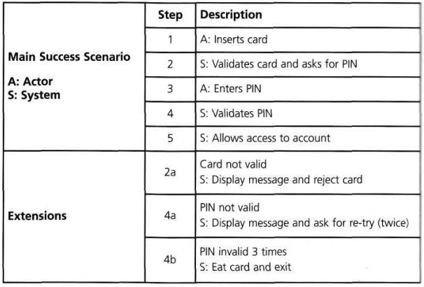
Specification Based – Black Box
Use Case Testing

Slide 26
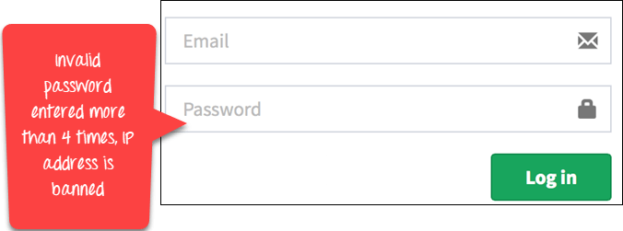
Specification Based – Black Box
Main Success Scenario | Step | Description
A:Actor S:System | 1 | A: Enter Agent Name & Password
 | 2 | S: Validate Password
 | 3 | S: Allow Account Access
Extensions | 2a | Password not valid S: Display Message and ask for re-try 4 times
 | 2b | Password not valid 4 times S: Close Application
Use Case Testing
In a use-case, an actor is represented by "A" and system by "S". We create Use for a login functionality of a Web Application as shown:
Consider the first step of an end to end scenario for a login functionality for web application where the Actor enters email and password.
In the next step, the system will validate the password
Next, if the password is correct, the access will be granted
There can be an extension of this use case. In case password is not valid system will display a message and ask for re-try four times
If Password, not valid four times system will ban the IP address.
Main Scenario | Step | Description
A:Actor S:System | 1 | A: Enter Agent Name & Password
 | 2 | S: Validate Password
 | 3 | S: Allow Account Access
Extensions | 2a | Password not valid S: Display Message and ask for re-try 4 times
 | 2b | Password not valid 4 times S: Close Application

Slide 27
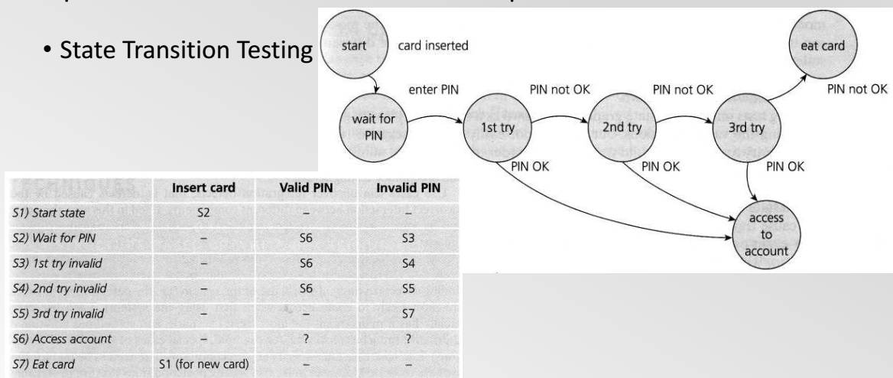
Specification Based – Black Box
State Transition

Slide 28
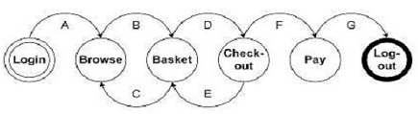
Specification Based – Black Box
Given the following state transition diagram Which of the following series of state transitions contains an INVALID transition which may indicate a fault in the system design?
State Transition
A. Login Browse Basket Checkout Basket Checkout Pay Logout. B. Login Browse Basket Checkout Pay Logout. C. Login Browse Basket Checkout Basket Logout. D. Login Browse Basket Browse Basket Checkout Pay Logout.

Slide 29
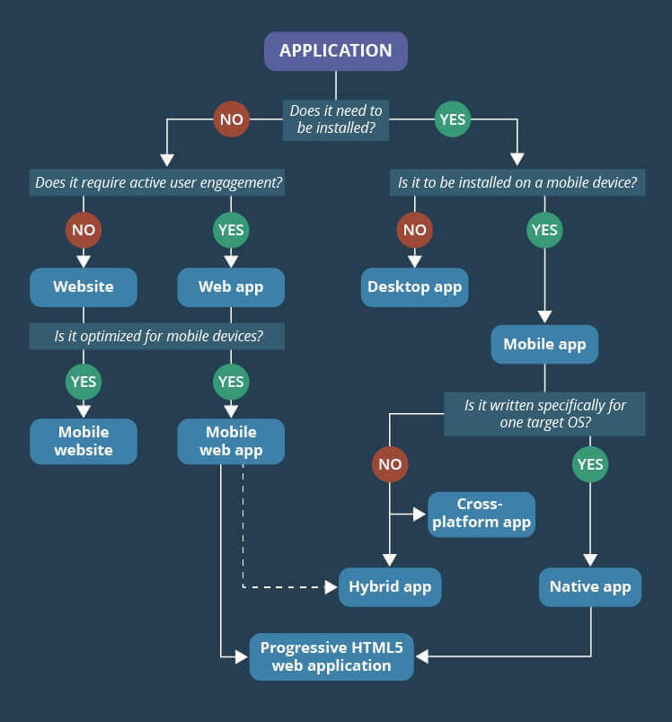
Mobile, Web and Desktop Testing
Types of Application and Application Testing
State Transition

Slide 30
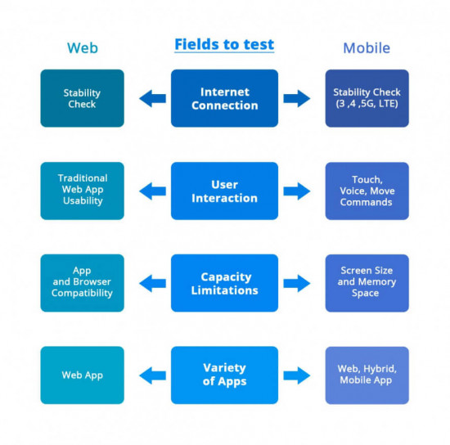

Slide 31
Any Question?
End!

