Slide 1
Project presentation Covid Simulator
NAME | ROLES
Ignacio Lopezosa | Coordination/Modeling
Alejandro Cano | Programming/Coordination
Carlos Javier Gutiérrez | Testing/Design
Jesús Villén | Testing/Programming
Adrián Méis | Testing/Design
Riccardo Capobianco | Coordination/Requirements
Sara Alfano | Requirements/Modeling
Pablo González | Testing/Programming
Daniel Delgado | Design/Modeling
Selim | Requirements/Programming
Konrad Kustra | Design/Modeling

Slide 2
Contents
Introduction – The problem
The team and teamwork
The solution
Sw engineering activities
Requirements
Architecture
Models
Principles/Patterns
Testing
Development/Deployment
Strategies and tools
Implementation model (what is and what is not real)
Deployment
Results
Conclusions

Slide 3
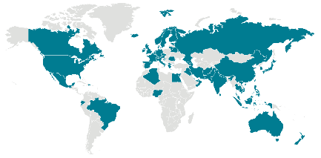
Introduction Problem to approach
With our SUD we intend to provide the pertinent organizations with a useful tool to guide them and give them valuable information in order to apply more efficient measures to reduce the spread of the COVID-19, minimizing externalities.
Esta foto de Autor desconocido está bajo licencia CC BY-SA

Slide 4

Team and teamwork
SCRUM
Why?
Frequency
Accountability system
Role-based accountability
Tools and resources
Trello
Discord
GitHub
WhatsApp

Slide 5
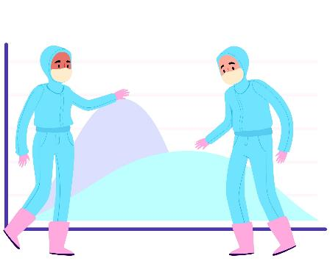
Solution
Create a program to simulate the spread of COVID-19.
Most commonly used measures against the virus can be tested.
Evolution of the virus in different regions and populations.

Slide 6

Software engineering activities (Requirements)
Modification parameters
Number of areas
Per area
Population
Size
Number of businesses
Restrictions
Curfew
Opening/closing businesses
Time restrictions
Mobility restrictions
Most effective measures

Slide 7
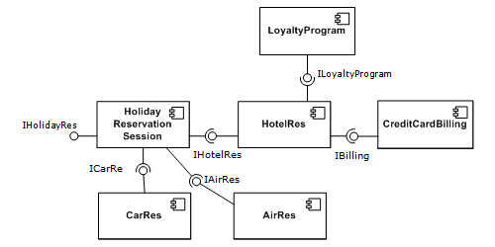
Software engineering activities (Architecture)
Component-based development (CBD)
What?
Why?
We could use the CBD as the higher abstraction Architectural style and then others for the implementation of the components

Slide 8
Software engineering activities (Design model)

Slide 9
Software engineering activities (Domain model)

Slide 10
Software engineering activities (Implementation model)

Slide 11
Software engineering activities (Principles/Patterns)
Principles
Single responsibility principle (SRP)
Interface segregation principle (ISP)
Dependency inversion principle (DIP)
Don’t repeat yourself (DRY)
Patterns
Singleton

Slide 12
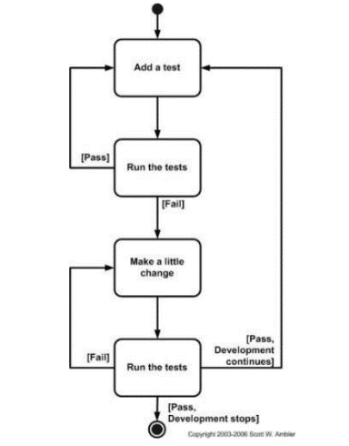
Software engineering activities (Testing)
Test-driven development (TDD)

Slide 13






Development/Deployment (Strategy and tools)
Upper-CASE tools
MagicDraw
Discord
Lower-CASE tools
Eclipse
GitHub
Spring
Spring Boot

Slide 14

Development/Deployment (Strategy and tools)
Strategy
Tasks sorted out into different groups.
Each group covers a specific domain (Programming, Design…).
Members are encouraged to help others regardless of the domain.

