Slide 1
Project presentation Covid Simulator
NAME | ROLES
Ignacio Lopezosa | Coordination/Modeling
Alejandro Cano | Programming/Coordination
Carlos Javier Gutiérrez | Testing/Design
Jesús Villén | Testing/Programming
Adrián Méis | Testing/Design
Riccardo Capobianco | Coordination/Requirements
Sara Alfano | Requirements/Modeling
Pablo González | Testing/Programming
Daniel Delgado | Design/Modeling
Selim Daouda | Requirements/Programming
Konrad Kustra | Design/Modeling

Slide 2
Contents
Introduction – The problem
The team and teamwork
The solution
Sw engineering activities
Requirements
Architecture
Models
Principles/Patterns
Testing
Development/Deployment
Strategies and tools
Implementation model (what is and what is not real)
Deployment
Results
Conclusions

Slide 3
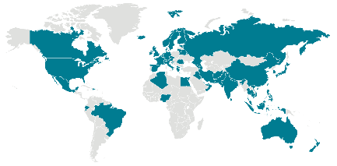
Introduction Problem to approach
With our SUD we intend to provide the pertinent organizations with a useful tool to guide them and give them valuable information in order to apply more efficient measures to reduce the spread of the COVID-19, minimizing externalities.
Esta foto de Autor desconocido está bajo licencia CC BY-SA

Slide 4

Team and teamwork
SCRUM
Why?
Frequency
Accountability system
Role-based accountability
Tools and resources
Trello
Discord
GitHub
WhatsApp

Slide 5
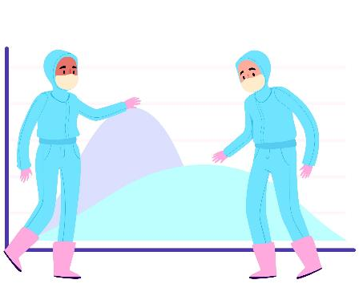
Solution
Create a program to simulate the spread of COVID-19.
Most commonly used measures against the virus can be tested.
Evolution of the virus in different regions and populations.

Slide 6

Software engineering activities (Requirements)
Modification parameters
Number of areas
Per area
Population
Size
Number of businesses
Restrictions
Curfew
Opening/closing businesses
Time restrictions
Mobility restrictions
Most effective measures

Slide 7
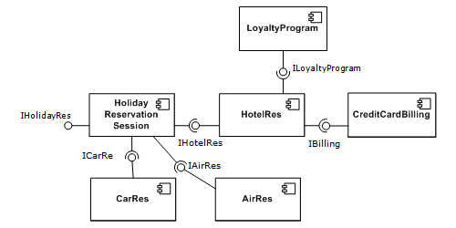
Software engineering activities (Architecture)
Component-based development (CBD)
What?
Why?
We could use the CBD as the higher abstraction Architectural style and then others for the implementation of the components

Slide 8
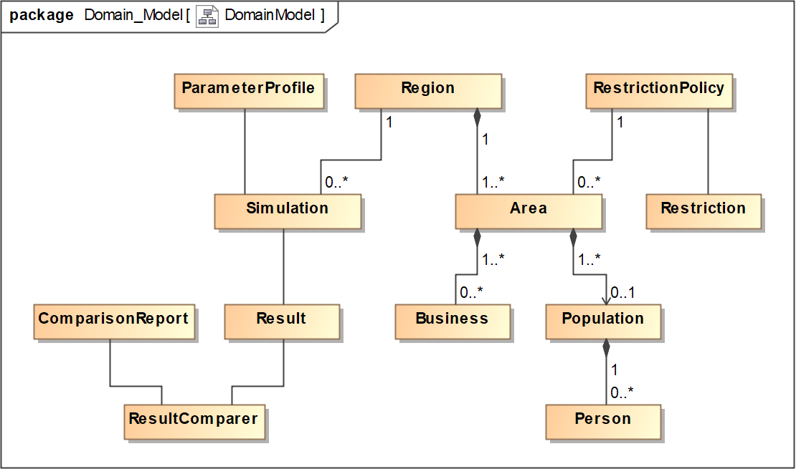
Software engineering activities (Domain model)

Slide 9
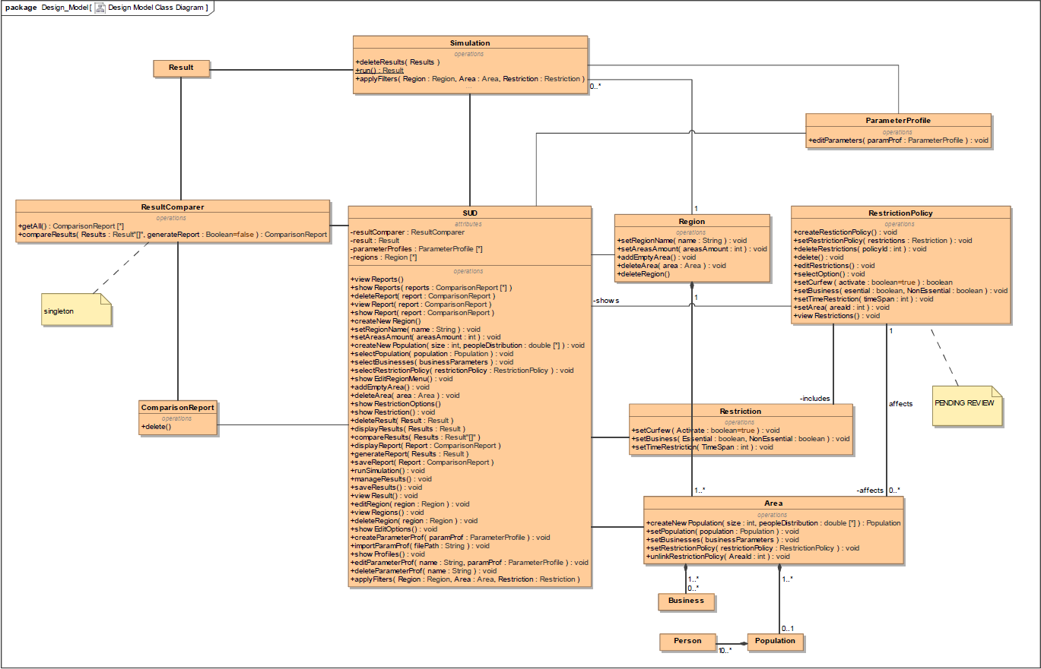
Software engineering activities (Design model)

Slide 10
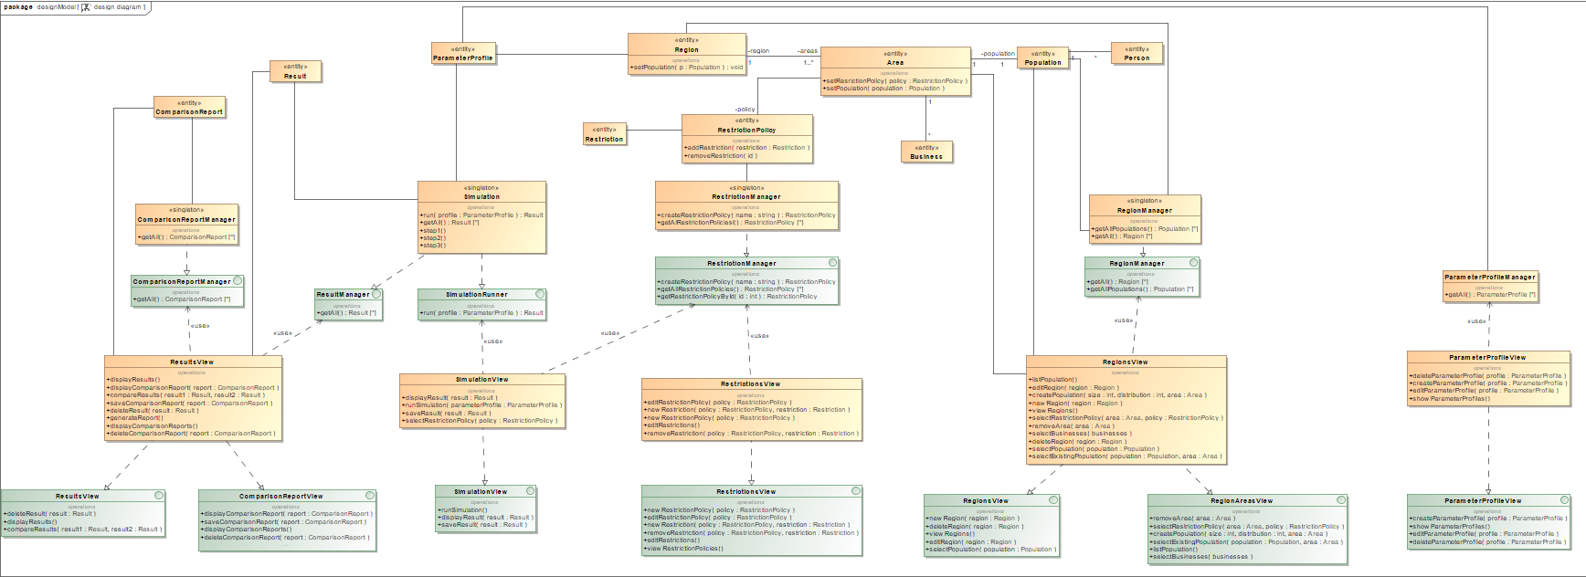
Software engineering activities (Implementation model)

Slide 11
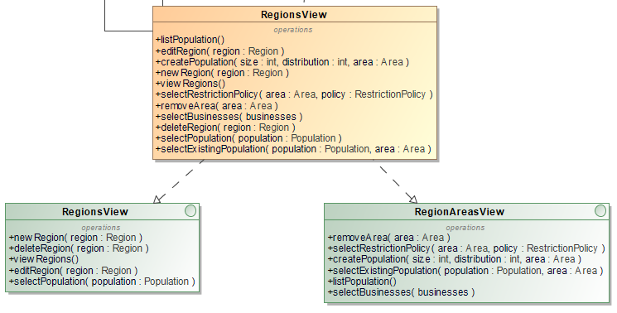
Software engineering activities (Principles/Patterns)
Principles
Single responsibility principle (SRP)
Interface segregation principle (ISP)

Slide 12
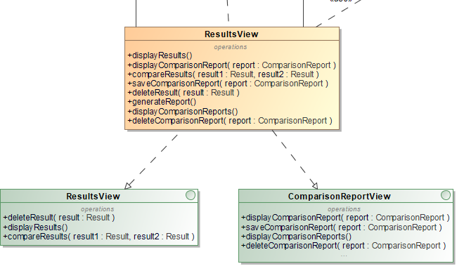
Software engineering activities (Principles/Patterns)
Principles
Dependency inversion principle (DIP)
Don’t repeat yourself (DRY)

Slide 13
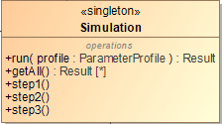

Software engineering activities (Principles/Patterns)
Patterns
Singleton
Strategy

Slide 14
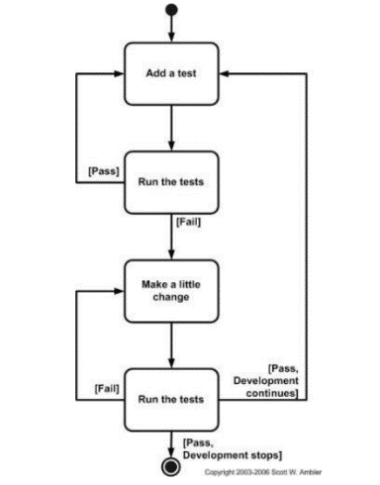
Software engineering activities (Testing)
Test-driven development (TDD)

Slide 15
Software engineering activities (Testing)
Different people will be involved in each step of the TDD
Circular

Slide 16






Development/Deployment (Strategy and tools)
Upper-CASE tools
MagicDraw
Discord
Lower-CASE tools
Eclipse
GitHub
Spring
Spring Boot
Strategy
Tasks sorted out into different groups.
Each group covers a specific domain (Programming, Design…).
Members are encouraged to help others regardless of the domain.

Slide 17


Development/Deployment (Implementation model)
Algorithm
Definition
Gatherings

Slide 18

Development/Deployment (Implementation model)
Algorithm
Immunity and contagiousness

Slide 19
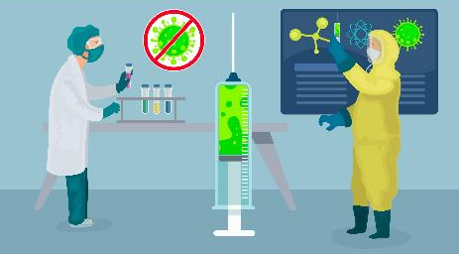
Development/Deployment (Implementation model)
Algorithm
Evolution
Results

Slide 20

Deployment
First idea
Docker
Not finished yet
Local webapp

Slide 21
Results
Project is not finished, but…
Documentation provided
Design completed
System partially working

Slide 22
Conclusion
In order to finish the final project:
More time is needed for:
Finish implementations
Perform tests to ensure reliability
Guarantee client’s satisfaction

