Slide 1
Project presentation Covid Simulator
NAME | ROLES
Ignacio Lopezosa | Coordination/Modeling
Alejandro Cano | Programming/Coordination
Carlos | Testing/Design
Jesús Villén | Testing/Programming
Adrián Méis | Testing/Design
Riccardo Capobianco | Coordination/Requirements
Sara Alfano | Requirements/Modeling
Pablo González | Testing/Programming
Daniel Delgado | Design/Modeling
Selim | Requirements/Programming
Konrad Kustra | Design/Modeling

Slide 2
Recommended Contents
Introduction – The problem
The team and teamwork
The solution
Sw engineering activities
Requirements
Architecture
Models
Principles/Patterns
Testing
Development/Deployment
Strategies and tools
Implementation model (what is and what is not real)
Deployment
Results
Conclusions

Slide 3
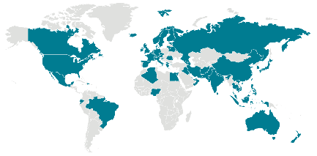
Introduction Problem to approach
With our SUD we intend to provide the pertinent organizations with a useful tool to guide them and give them valuable information in order to apply more efficient measures to reduce the spread of the COVID-19, minimizing externalities.
Esta foto de Autor desconocido está bajo licencia CC BY-SA

Slide 4
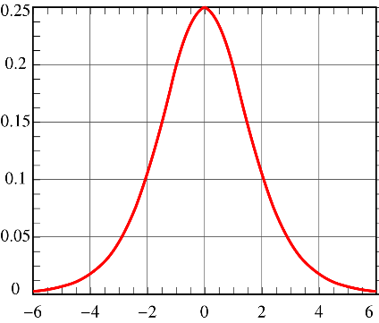
Solution
Create a program to simulate the spread of COVID-19.
Most commonly used measures against the virus can be tested.
Evolution of the virus in different regions and populations.
Esta foto de Autor desconocido está bajo licencia CC BY-SA

