Slide 1
202601_CYSE1006_4428 Cryptography & Data Encryption
Renz Dexter Ward

Slide 2
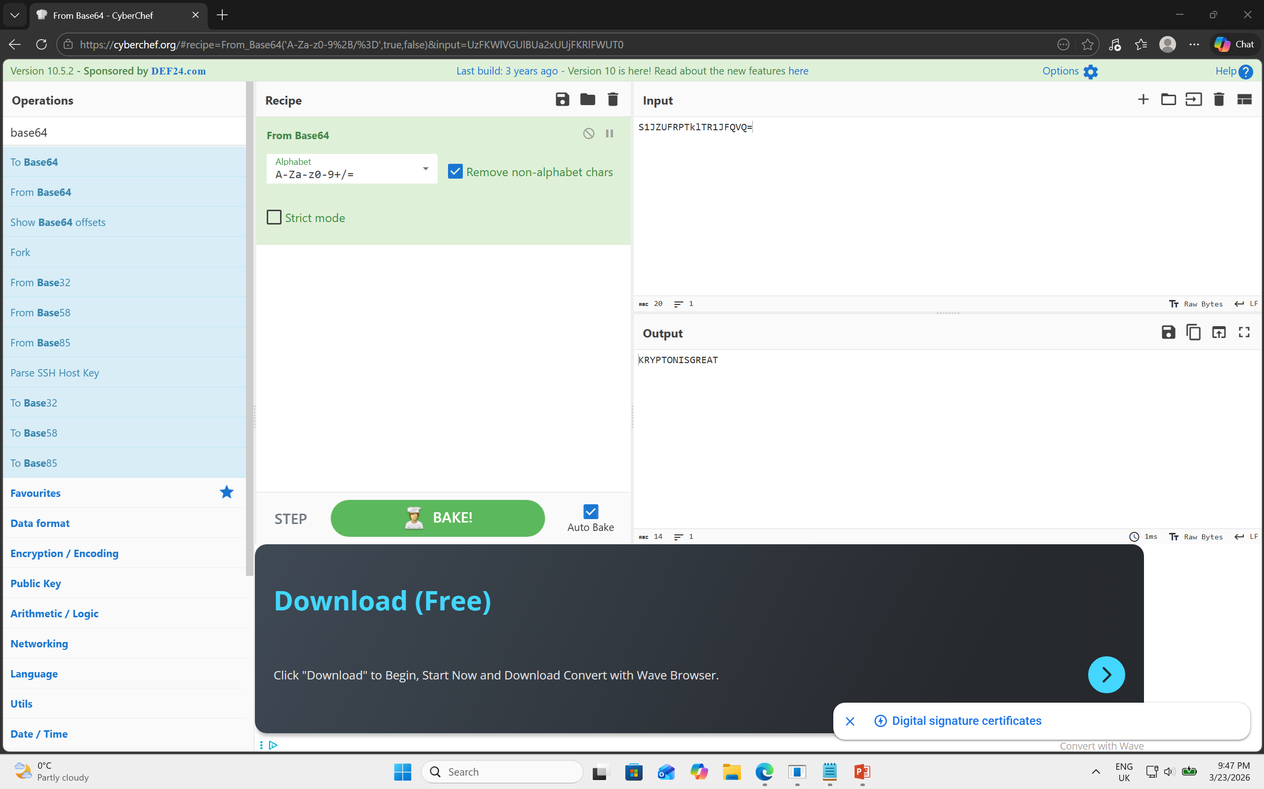
Level 1
Password : KRYPTONISGREAT
Explanation :
This is encoding and not encryption. Easy to decode since everyone has access to the base64 index table and can easily reverse it. There are no keys or passwords involved.

Slide 3
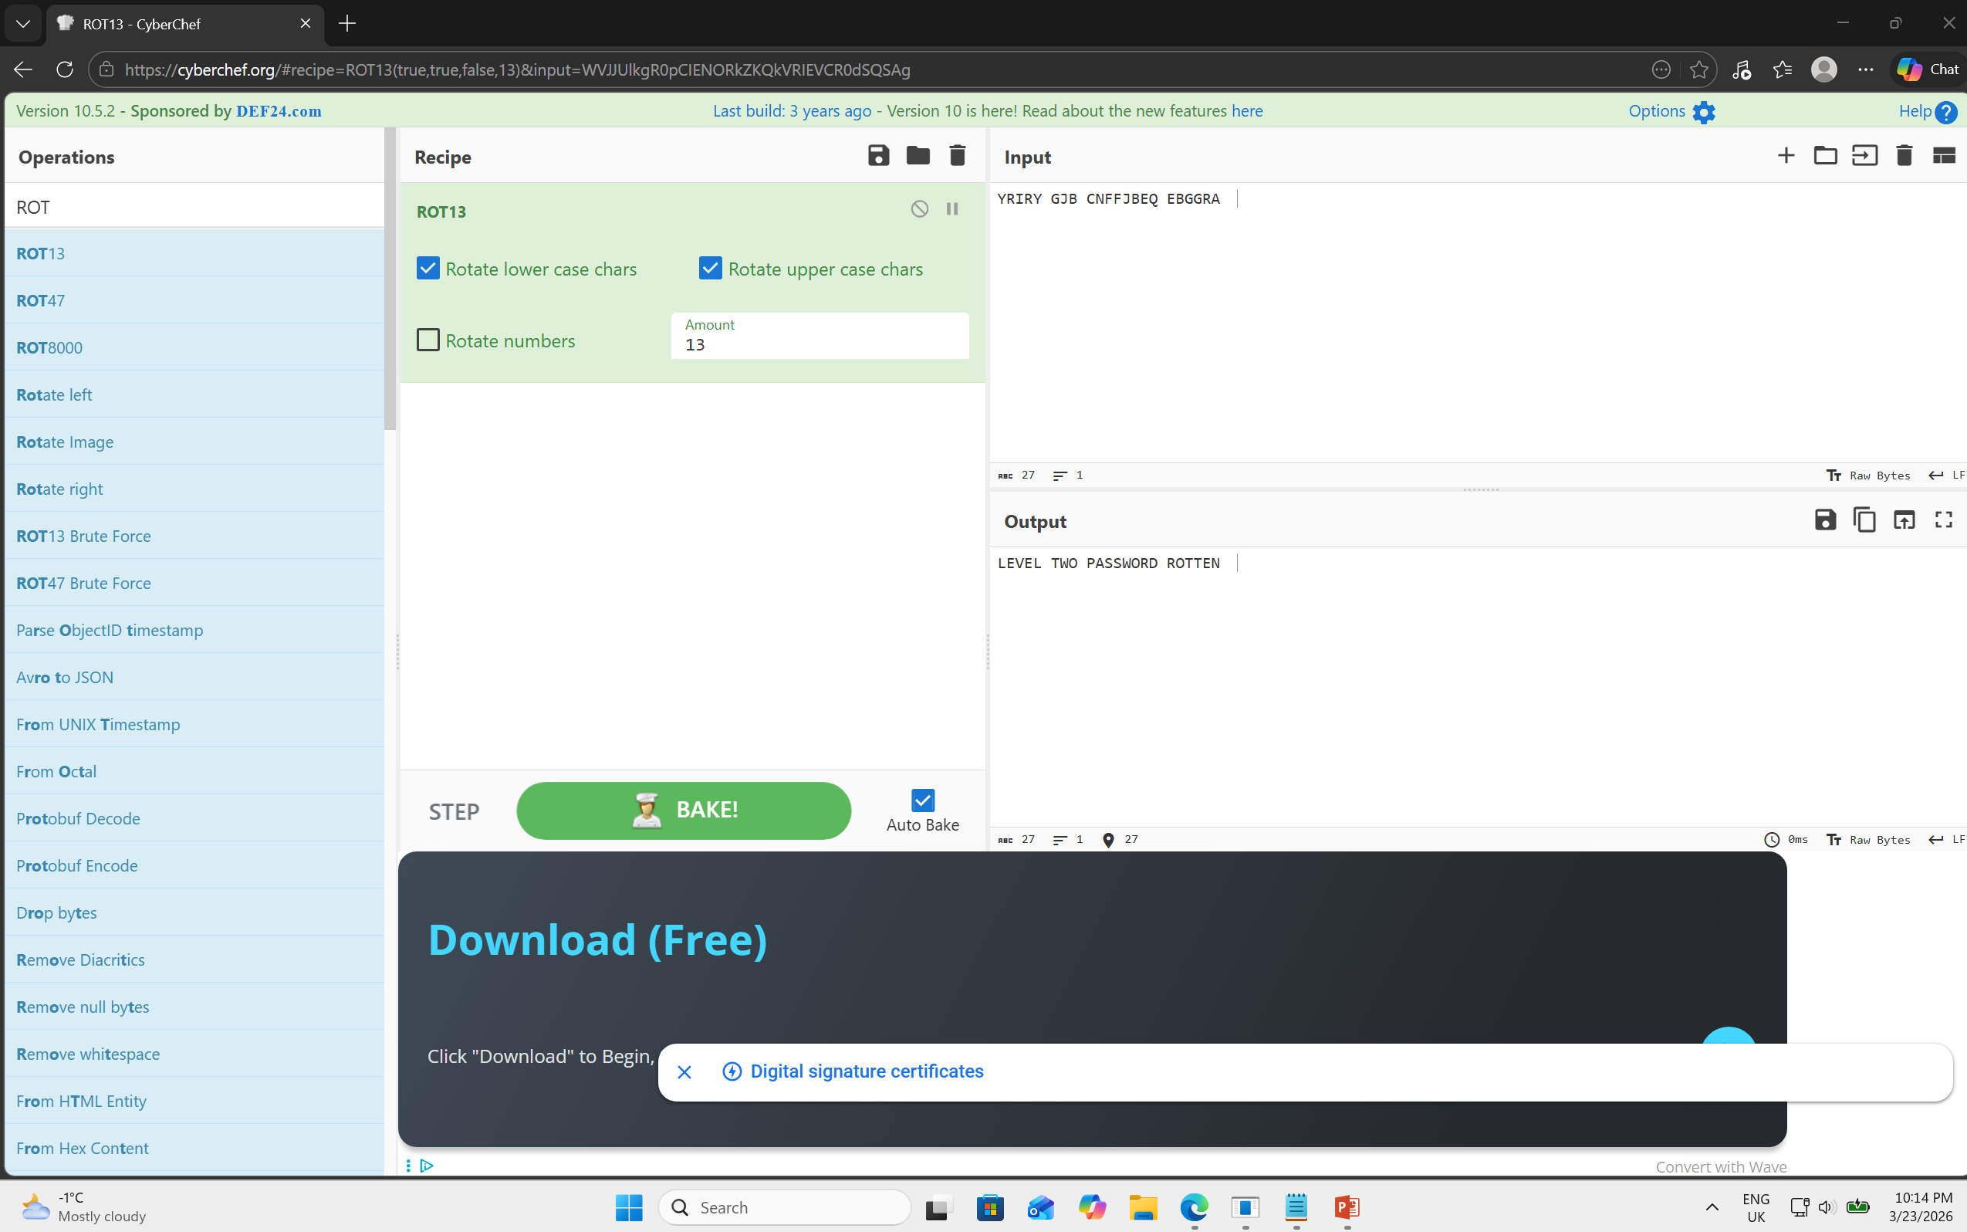
Level 2
Password : ROTTEN
Explanation :
The krypton challenge stated that it is ‘encrypted’ using a simple rotation. It was hinting that it could be a simple ROT13 cipher which is a substitution cipher.

Slide 4
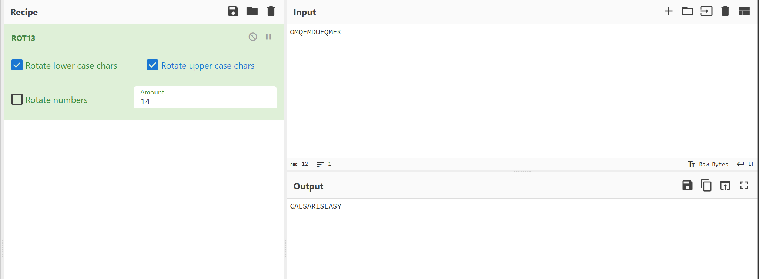
Level 3
Password : CAESARISEASY
Explanation:
We had access to an encrypt binary that can encrypt any text I provide(Chosen-Plain Text attack)
Brute-forced it using Caesar cipher, until it formed a word.
We chose letter ‘A’ because in a Caesar cipher the letter A represents position 0. Meaning the formula will just output the key
The encrypt binary runs with the permission of krypton3 because it has a setuid bit
Set up a temporary directory in /tmp and used symbolic link to point the binary to the keyfile.dat.
Permission to 777 so it can write the result into my folder.
The encrypt code’s output was M which was an offset. It was 12 instead of 2. But we just tried going up and down a couple of shifts and test it out.

Slide 5
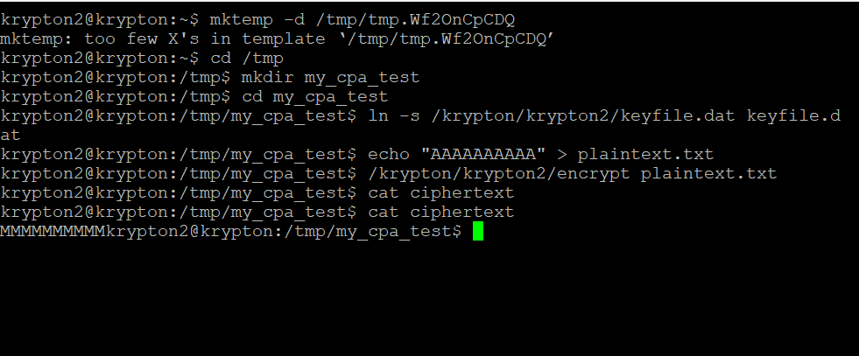

Slide 6
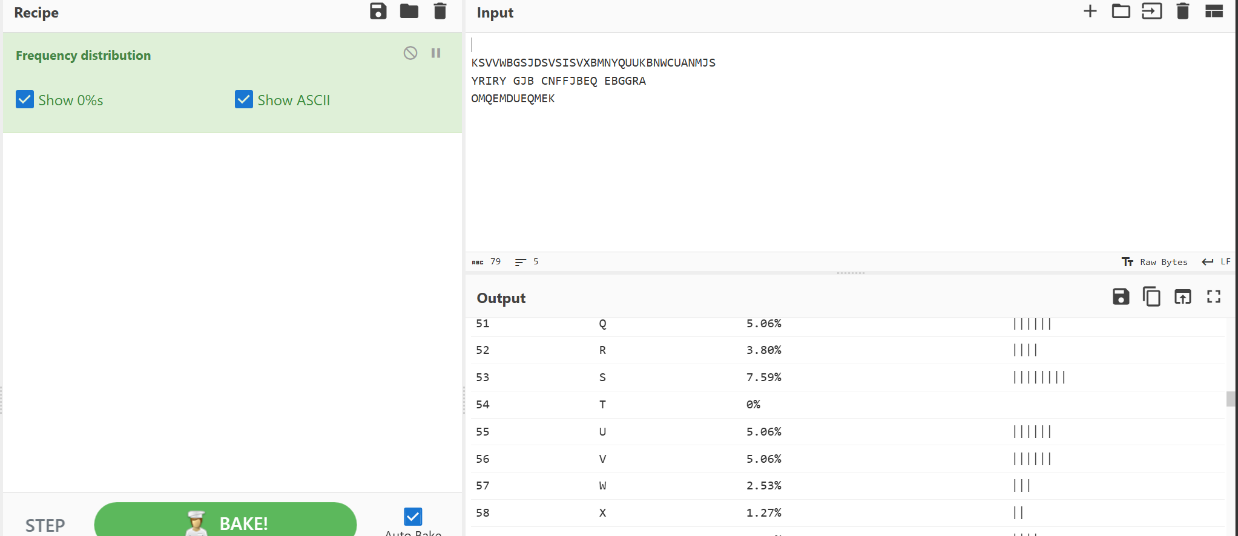
Level 4
Password : BRUTE
We used frequency analysis since we knew that the same key was used and the plaintext were in the English language.
We looked for patterns like the double ‘VV’ which the common short words could be ‘LL’ or ‘EE’.
The most common was S and it could be E, so we tried different values until it formed an English word.

Slide 7
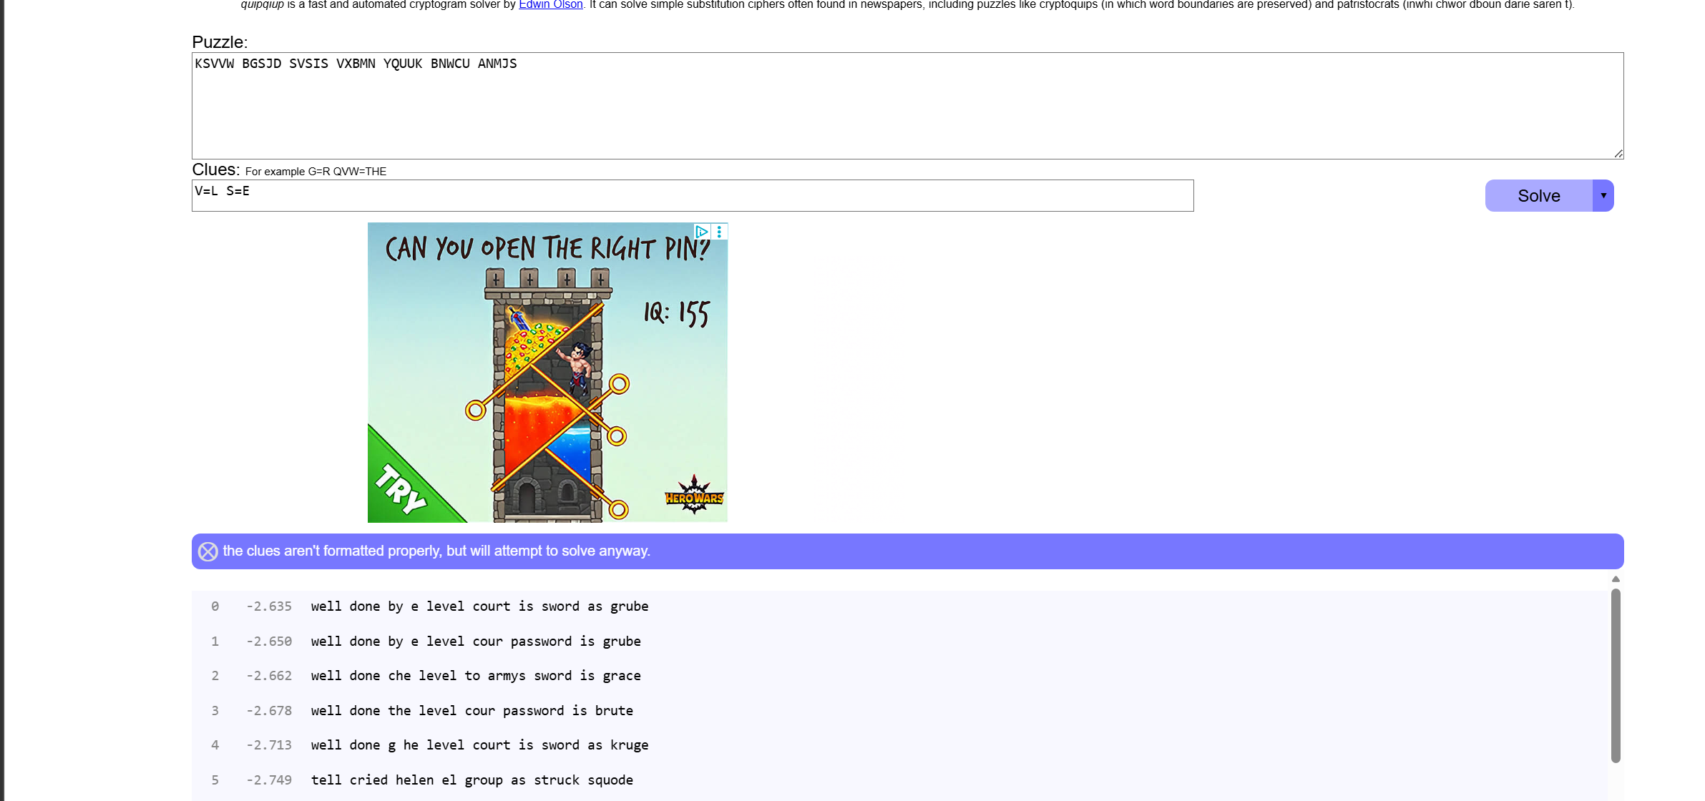

Slide 8
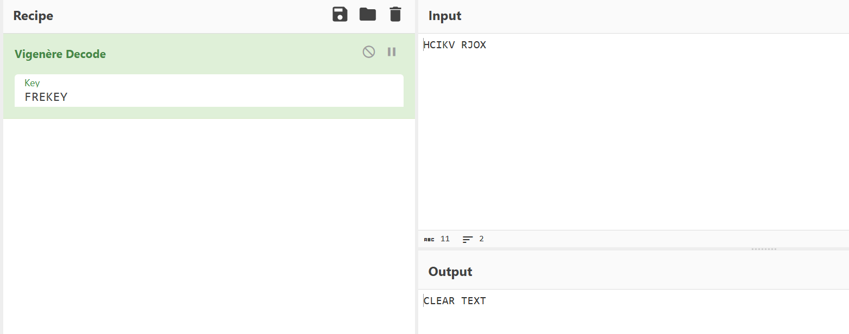
Level 5
Password : CLEARTEXT
Key used = FREKEY
The problem with the previous cipher was letter E always becomes the same cipher text. Making it vulnerable to frequency analysis.
We have the key length, so the key repeats every 6 characters. Using the exact same shift for every 1st 7th and 13th.
We performed a periodic analysis of the longer ciphertext files we found.

Slide 9
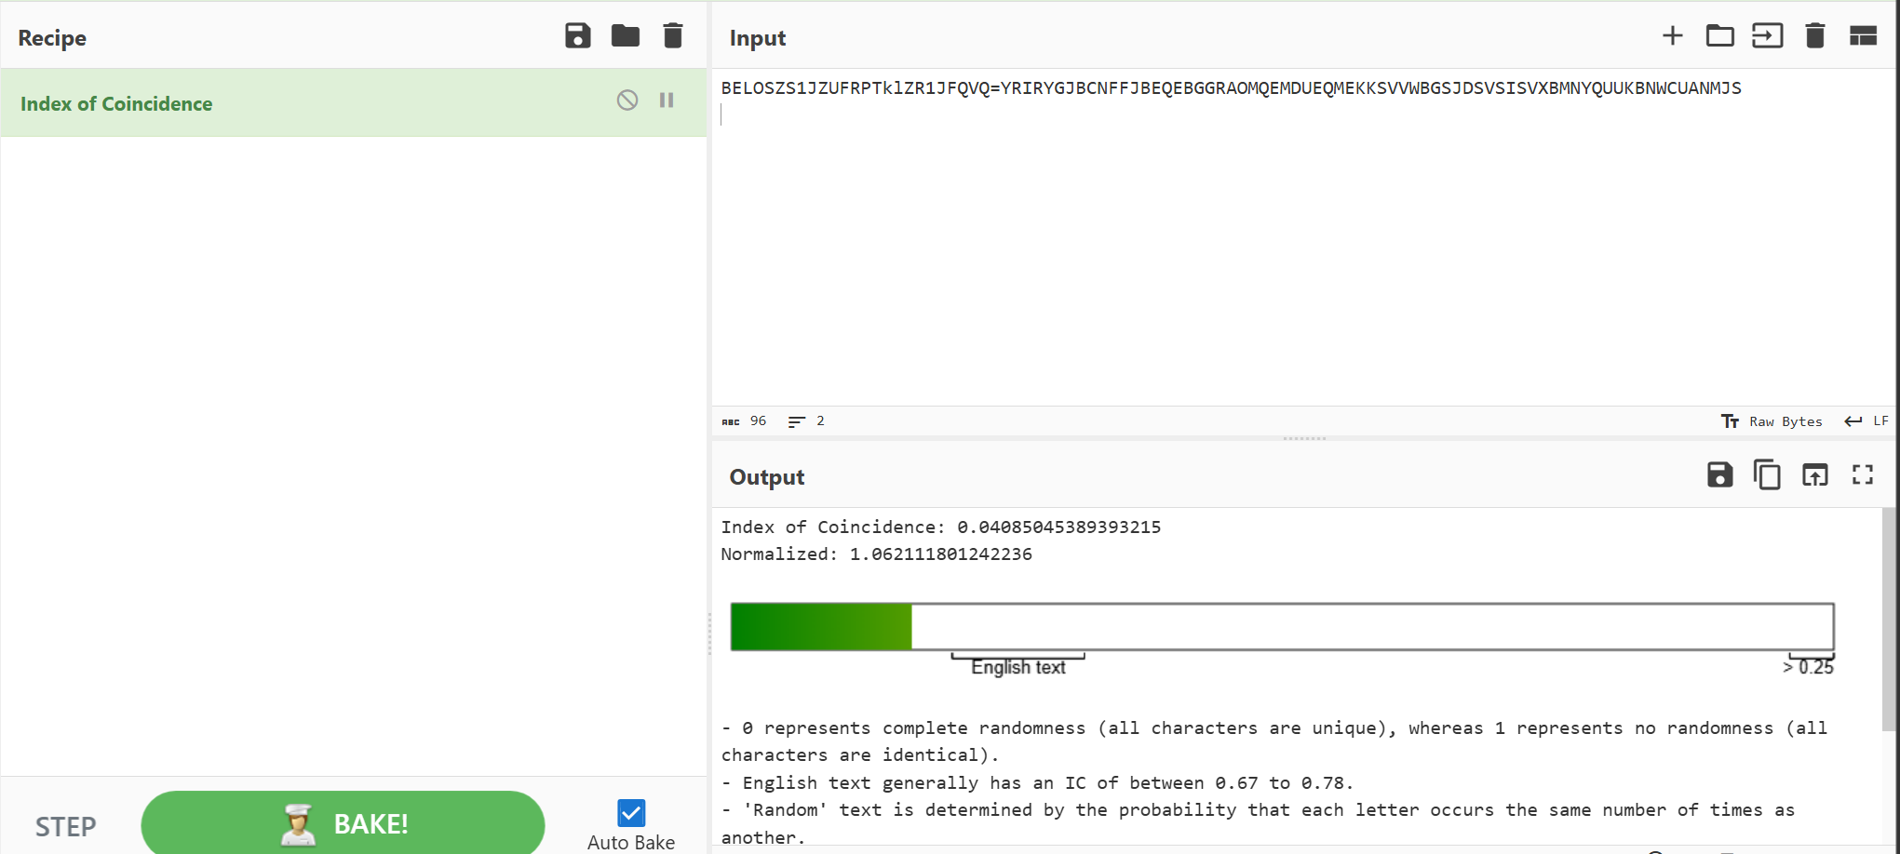
Level 6
Password : RANDOM
Here we have no clue of what the key length is. We used the data from the found files to do a frequency analysis.
The test proved it was randomized. We then split the Ciphertext into different sized groups or columns, 6 columns jumped the score. It tells us the secret password has 6 letters.
Frequency analysis was used on each of the 6 position or index.

Slide 11
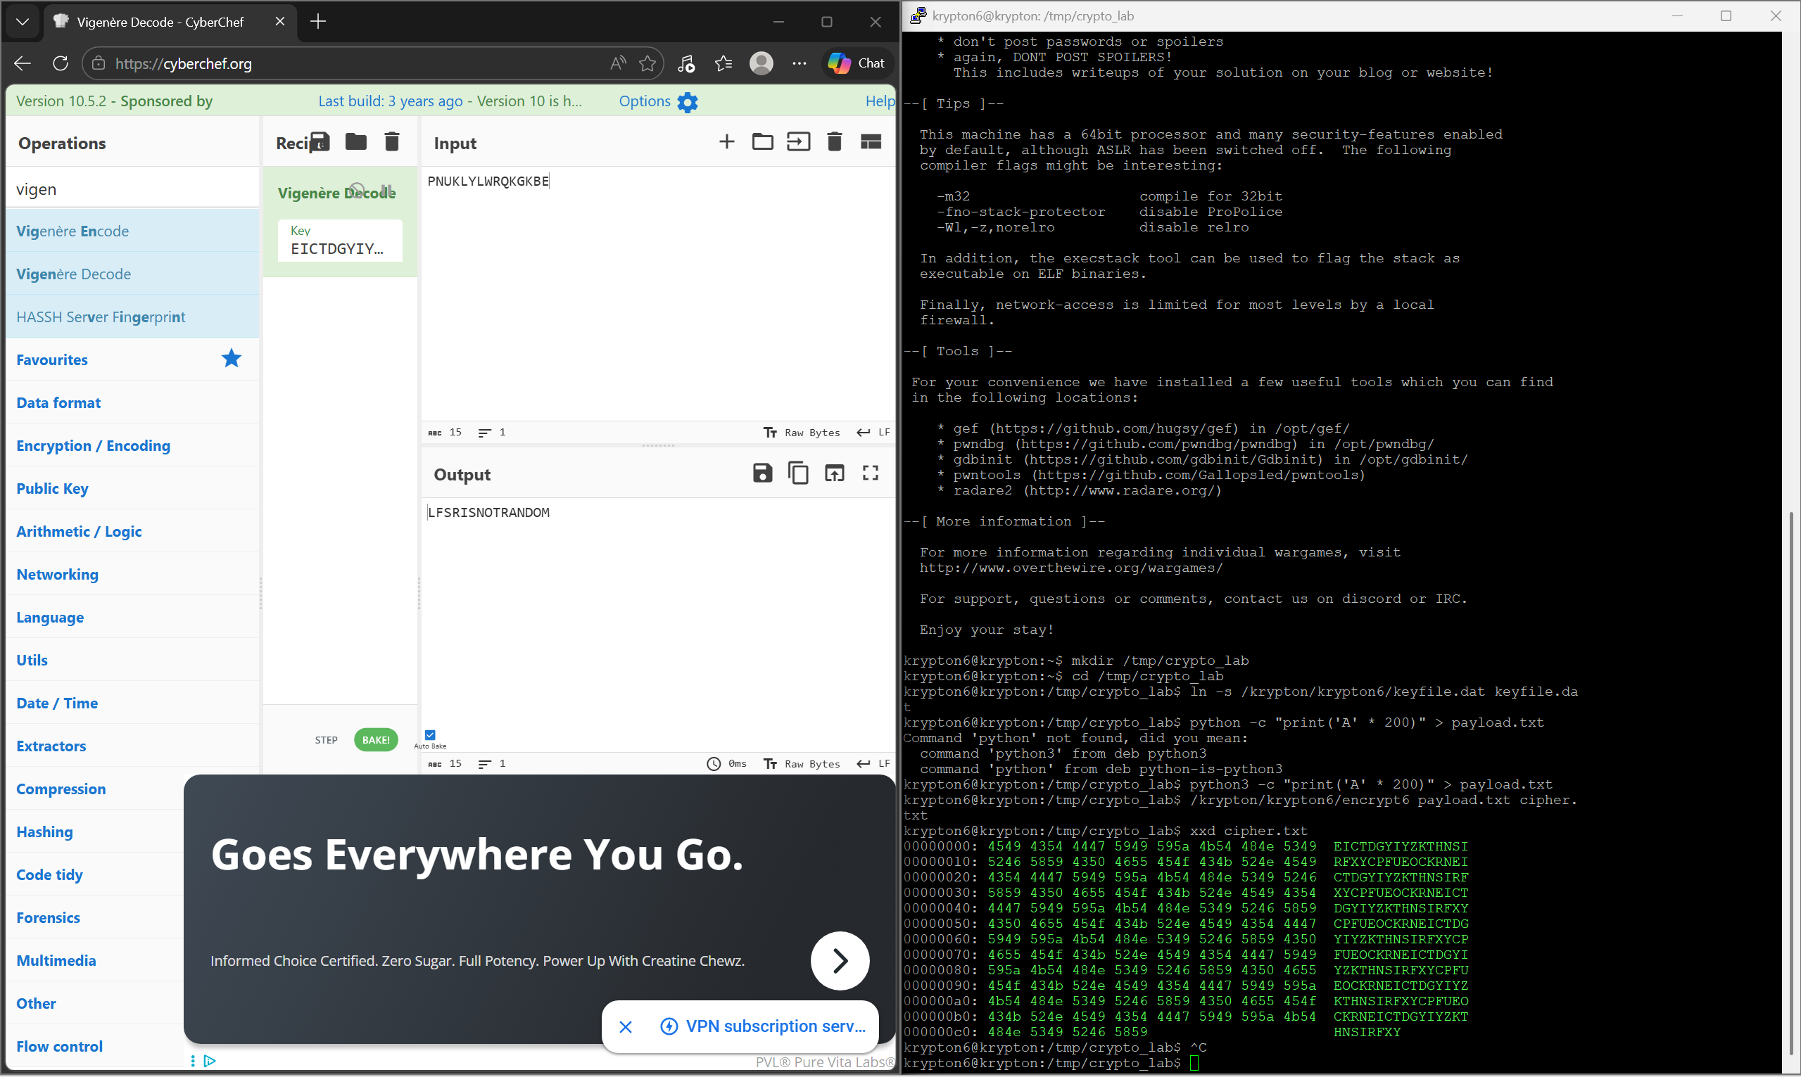
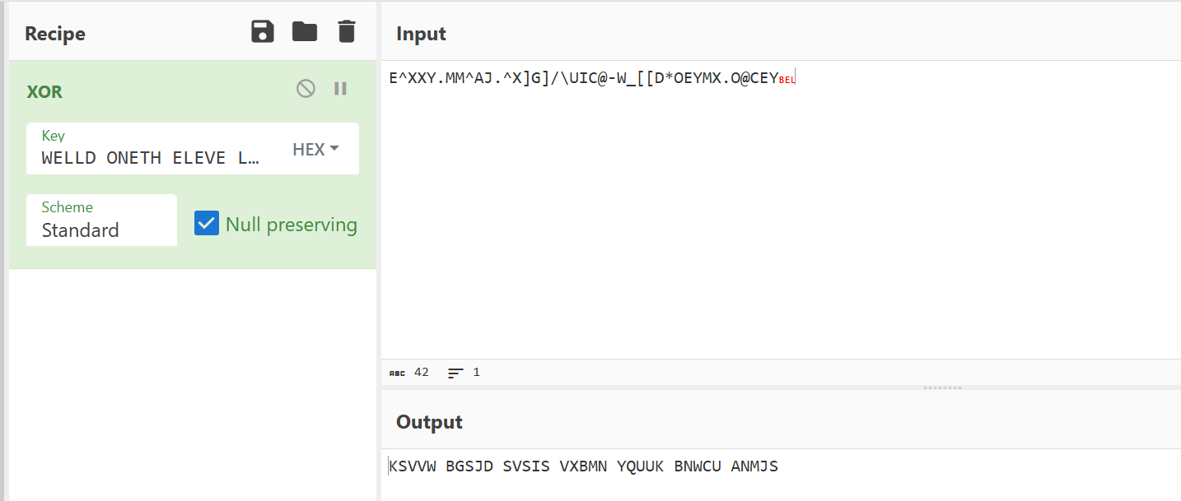
Level 7
Password : LSFRISNOTRANDOM
We used a custom plaintext attack
Compared the found files to the encrypted version
We used the repeating pattern from the “random” generator. Which outputted 30 repeating bytes.
We just put A since A = 0, so this would output the key itself.

