Slide 1

Heterogeneous Multi-Robot Collaboration Using Language Models
Rohit Joseph Mamutil
Master’s Thesis · Embedded Systems
Uppsala University
Master’s thesis · Uppsala University
1
Notes:
Good morning.
My name is Rohit Joseph Mamutil, and today I will present my Master’s
thesis, titled “Heterogeneous Multi-Robot Collaboration Using Language
Models”
This work was carried out within the Cyber-Physical Systems Lab at
Uppsala University, under the supervision of Xuezhi Niu and with
Professor Didem Gürdür Broo.
The overall question behind this thesis is quite simple to state:
Can a language model make useful decisions when several different robots
have to work together towards a common objective?
To answer that question, I designed a controlled experimental framework
around a warehouse environment, integrated several locally deployable
language models into the decision-making loop, and evaluated how
different design choices affected collaborative task performance.
I will first explain where this question came from, then how I converted
it into specific research questions, how I built the experimental
system, and finally what the experiments showed.
[Sources]
- User-provided thesis transcript and figure descriptions.

Slide 2
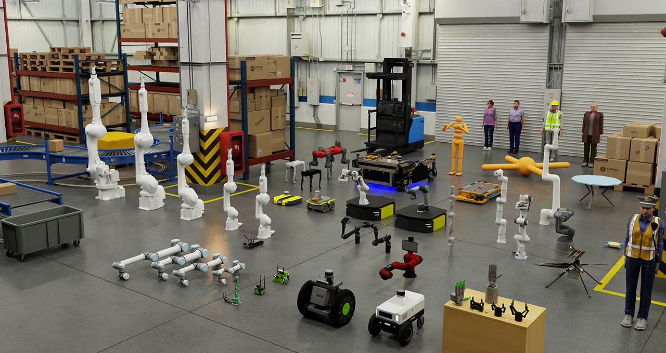
Why multi-robot collaboration?
2
Different robot roles create interdependent decisions
Shared resources and common goals require coordination
A warehouse provides a controlled, repeatable test setting
Source: Isaac Sim - Robotics Simulation and Synthetic Data Generation | NVIDIA Developer
Notes:
I would like to start with the problem that motivated this thesis.
This work was conducted in the context of research on collaboration
between multiple robots.
When we have only one robot, the decision problem is relatively
straightforward. The robot observes its environment, determines what it
needs to accomplish, and selects its next action.
But when we introduce multiple robots with different capabilities, the
problem changes.
Even more so when these robots may depend on one another, while also
sharing resources and working towards a common objective.
This is why an environment where these interactions could be
studied in a controlled and repeatable way was needed.
A warehouse provides such a setting. It naturally involves multiple
tasks, resource constraints, spatial interactions and different robot
roles, while still allowing us to define the environment and the
available actions precisely.
For this work, the warehouse consists of shelves, AGVs that transport
the shelves, and Picker robots that provide the support required for
shelf loading and unloading.
The important point here is that these two robot types have
complementary capabilities. The AGV cannot independently complete the
shelf-handling process; at certain stages it requires the Picker.
So a decision made by one robot can create a requirement for another
robot.
The problem is therefore not simply:
What should this robot do?
It becomes:
What should the robots do so that they can make progress together?
To make this dependency concrete, let us look at what actually happens
when a shelf is requested.
[Sources]
- User-provided thesis transcript and figure descriptions.
- Image source retained from the supplied deck: NVIDIA Isaac Sim robotics simulation page.

Slide 3
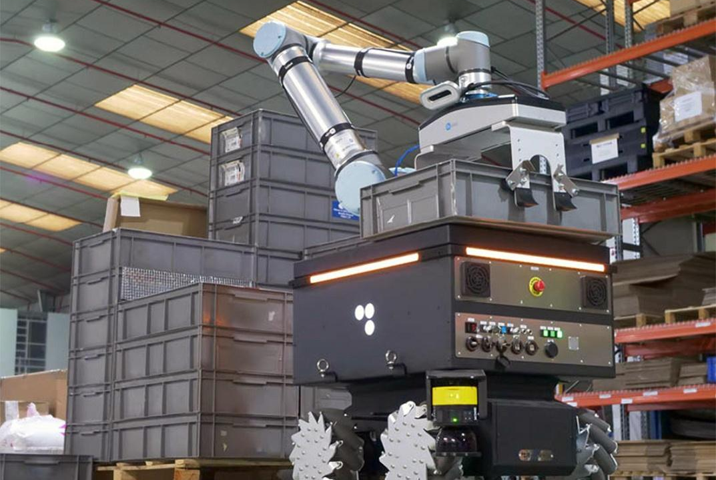
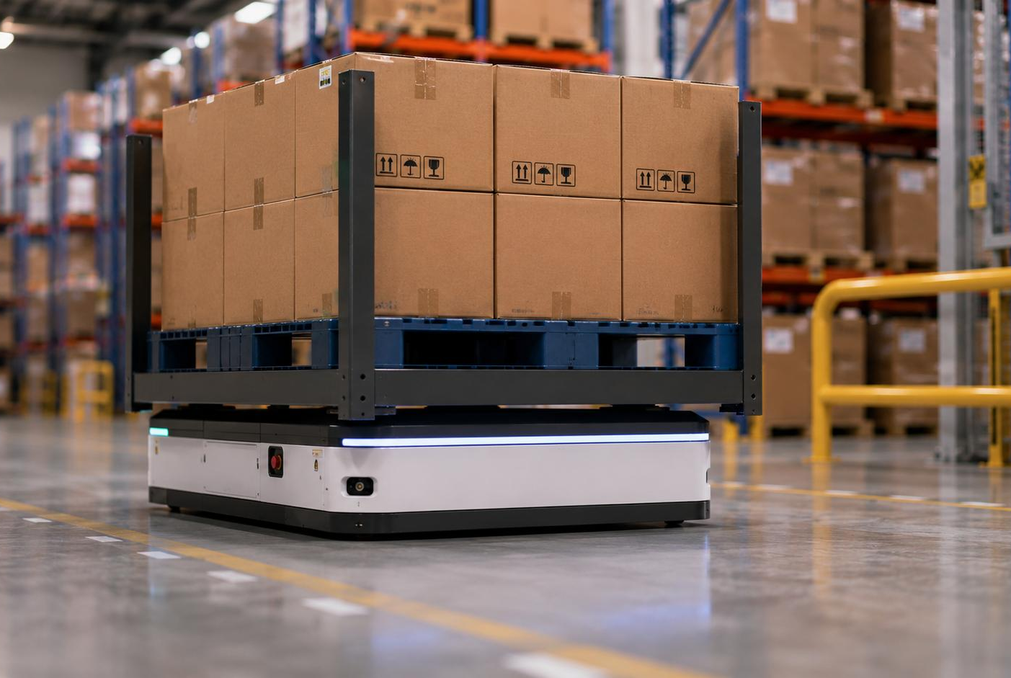
What does collaboration mean here?
3
AGVs transport shelves • Pickers support loading and unloading • Progress depends on timely coordination between roles
Source: https://www.interempresas.net/Robotica/FeriaVirtual/Producto-Robots-de-ensamblaje-RB-Kairos-227237.html?utm_source=chatgpt.com
Source: AGV Drive Wheels for AGV/AMR Warehouse Logistics Applications – AGV Motor
Notes:
This sequence is important because it defines what collaboration means
in this experiment.
Let us follow one shelf through the system.
First, a shelf is requested and an AGV travels to that shelf.
Once the AGV is waiting there, a Picker travels to the same shelf
location.
When both agents are there, the shelf can be loaded onto the AGV.
The AGV can then transport the shelf to the delivery goal. Picker
support is not required at the delivery location.
Once the AGV reaches the delivery goal, the delivery is recorded.
However, the AGV continues carrying the shelf.
It then moves to a vacant storage location, where another Picker
interaction is required.
The Picker meets the AGV at that storage location, the shelf is
unloaded, and the AGV becomes available for another task.
So the Picker is not another transport robot, and it is not performing a
separate product-picking operation in this simulation.
Its role is to provide the manipulation support required by the AGV for
loading and unloading.
This creates an explicit dependency between the two robot types.
The AGV cannot complete the shelf-handling cycle independently; it needs
the Picker at specific stages.
This is the collaboration problem that the language model is being asked
to coordinate.

Slide 4
Why language models?
Use the LLM for high-level task decisions
Keep navigation and execution in conventional components
Test whether planning capabilities extend to heterogeneous teams
Environment
State
Local LLM
High-level action
Master’s thesis · Uppsala University
4
Notes:
So far, I have described the problem from the perspective of the robots.
The next question is: what could we use to support this high-level
decision-making?
Recent research has shown that language models can be used for more than
generating text.
They have been investigated as planning components in robotic systems.
For example, previous approaches have used language models to select
actions, generate plans, interpret environmental feedback, or produce
programs over predefined robot actions.
An important idea across this work is that the language model can operate at a higher decision-making
level, while conventional components continue to handle things such as
navigation and execution.
In this, we are not asking an LLM to control a robot’s motors or
generate trajectories.
I wanted to investigate whether it could make high-level task decisions
within a constrained environment.
So the question became:
If a language model can perform high-level planning for an individual
robot, can it also support decision-making when several heterogeneous
robots have to coordinate?
That is where the research gap for this thesis comes in.
Previous work—including SayCan, Inner Monologue, and Code as Policies—shows that language models can support high-level planning while conventional components handle execution.
However, it remains unclear whether this approach can coordinate interdependent decisions between heterogeneous robot roles while ensuring that generated decisions correspond to valid actions in the environment.
This gap leads to the main research question.

Slide 5
From the problem to the research question
Multi-robot collaboration
LLM as a high-level planner
Grounded, executable decisions
Multi-robot
collaboration
LLM high-level
planning
Grounded
decisions
Research
questions
Master’s thesis · Uppsala University
5
Notes:
This gives us the central question of the thesis.
Can a prompted language model support grounded high-level
decision-making when several heterogeneous robots have to collaborate?
There are three important aspects here.
The first is grounded.
The model’s decision must correspond to something that actually exists
and is feasible in the environment.
The second is high-level decision-making.
The model is deciding which task or target an agent should pursue. It is
not controlling its low-level motion.
And the third is heterogeneous multi-robot collaboration.
The objective is not simply to maximise the performance of one robot,
but to support coordinated behaviour among robots with different roles.
This leads to the main research question.
[Sources]
- User-provided thesis transcript and figure descriptions.

Slide 6
Main research question
Can prompted LLMs support grounded high-level decisions for heterogeneous robot collaboration?
Constrained warehouse setting
Three design factors: model, architecture and representation
Master’s thesis · Uppsala University
6
Notes:
The main research question is:
Can prompted large language models support grounded high-level
decision-making for heterogeneous multi-robot collaboration in a
constrained warehouse environment?
There are three important terms here.
The first is grounded.
The model’s decision must correspond to something that actually exists
and is feasible in the environment.
The second is high-level decision-making.
The model is deciding which task or target an agent should pursue. It is
not controlling its low-level motion.
And the third is heterogeneous multi-robot collaboration.
The objective is not simply to maximise the performance of one robot,
but to support coordinated behaviour among robots with different roles.
However, this main question is still too broad to test directly.
To answer it systematically, I had to make several design decisions.
And these design decisions naturally became the three research
questions.
The thesis defines these around model choice, planning architecture, and
prompt configuration.
[Sources]
- User-provided thesis transcript and figure descriptions.

Slide 7
RQ1 — Which model?
Compare selected locally deployable models
Nominal scale ranges from 1B to 14B parameters
Test performance—not parameter count as a causal factor
Master’s thesis · Uppsala University
7
Notes:
The first question is about the language model itself.
If we are going to use an LLM as a planner, which model should we use?
There are obvious reasons to expect larger models to perform better.
A larger model may have greater representational and reasoning capacity.
But in an embedded or robotics context, model size also has practical
consequences.
Larger models generally require more memory, more computation, and
potentially more inference time.
Smaller models are more attractive for local deployment, but they may
have weaker capabilities.
So there is a practical engineering question:
Does increasing nominal model size actually result in better
collaborative task performance?
This became RQ1:
How does grounded collaborative task performance vary among selected
locally deployable language models spanning different nominal parameter
sizes?
The important wording here is “selected models”.
I am not claiming that parameter count is the only difference between
models.
The selected models come from different model families, so the
experiment allows us to observe whether performance increases
consistently across these selected model artefacts as nominal parameter
scale increases.
It does not allow us to claim that parameter count itself causes the
differences.
[Sources]
- User-provided thesis transcript and figure descriptions.

Slide 8
RQ2 — Who should plan?
Centralised: one call selects joint actions
Shared context: one decision per agent with common information
Compare delivery performance and model-interaction demand
Centralised
1 joint call
Shared context
1 call per agent
Global warehouse state
Master’s thesis · Uppsala University
8
Notes:
The second question concerns the organisation of decision-making.
Suppose we have four robots.
One possibility is to give the entire warehouse state to one language
model call and ask it to determine the actions for all four robots.
This is a centralised planning architecture.
The alternative is to make a separate decision for each robot.
However, each robot still receives relevant shared information about the
warehouse and the other agents.
This is the shared-context per-agent architecture.
So we have two different coordination mechanisms.
In the centralised case, coordination happens through explicit joint
action selection.
The model produces a set of actions for multiple agents together.
In the shared-context case, each agent makes its own decision, but the
decision is informed by common context.
This creates a trade-off.
Centralised planning can reason about multiple actions together and
requires fewer model calls.
But the output is more complex because the model must produce a
compatible action for each agent.
Shared-context planning simplifies each individual decision, but it
requires multiple model interactions.
So the second research question became:
How do centralized planning and shared-context per-agent planning differ
in their ability to support collaborative task performance across
scenarios with varying collaboration demands?
This distinction is explicitly implemented in the experimental
framework.
[Sources]
- User-provided thesis transcript and figure descriptions.

Slide 9
RQ3 — How should the world be represented?
Same simulator state, two complete prompt configurations
Structured JSON versus descriptive natural language
Comparison includes response contracts and parsing paths
Master’s thesis · Uppsala University
9
Notes:
The third question concerns the interface between the simulator and the
language model.
The simulator naturally stores information in a structured form.
For example, it has an agent identifier, position, battery level,
target, and so on.
A natural way to provide this information to a language model would
therefore be JSON.
But there is another possibility.
We can transform the same information into a natural-language
description.
For example, instead of giving:
“agent equals AGV1, battery equals 72, target equals shelf 24”,
we can say:
“AGV1 is at this position, has 72 percent battery, and is currently
considering shelf 24.”
This transformation introduces additional work in the system.
So the question is whether that additional representation actually
helps.
This gives RQ3:
How does collaborative task performance differ between the tested
natural-language and JSON-based prompt configurations?
This question is particularly interesting because the underlying
simulator state remains the same.
What changes is the way the information is communicated to the model
and, in the JSON condition, the structured response format.
The thesis therefore treats this as a comparison of complete prompt
configurations, rather than as a pure isolated test of JSON versus
natural language.
[Sources]
- User-provided thesis transcript and figure descriptions.

Slide 10
Experimental approach
Controlled, reproducible warehouse simulation
LLM operates at task-assignment level
Environment handles low-level execution
Master’s thesis · Uppsala University
10
Notes:
At this point, I had three research questions.
The next problem was:
How can I test them in a controlled way?
I needed an environment where collaboration was actually necessary.
At the same time, I needed the experiment to be reproducible.
I did not want the language model to control every aspect of the robot,
because then it would become difficult to distinguish planning
performance from low-level navigation behaviour.
Therefore, I used a warehouse simulator where the language model
operates at the task-assignment level.
The environment handles the lower-level execution.
[Sources]
- User-provided thesis transcript and figure descriptions.

Slide 11
Battery-TA-RWARE
Discrete-time, grid-based warehouse simulation
Heterogeneous AGV and Picker roles
Battery constraints and charging stations
Collaboration is required for shelf handling
Master’s thesis · Uppsala University
11
Notes:
The environment used in this thesis is Battery-TA-RWARE.
It is a discrete-time, grid-based warehouse simulation derived from
TA-RWARE.
There are two heterogeneous robot roles.
The first is the AGV, which transports shelves.
The second is the Picker, which supports shelf interactions.
A typical operation therefore looks something like this.
A requested shelf has to be transported.
An AGV selects the shelf.
The AGV moves towards it.
A Picker needs to support the shelf interaction.
The shelf can then be transported to the delivery location and
eventually returned.
The environment also includes battery state and charging stations.
So there are task dependencies as well as resource constraints.
This gives us the type of coordination problem that the thesis is
interested in.
[Sources]
- User-provided thesis transcript and figure descriptions.

Slide 12
What does the LLM actually control?
Selects a high-level target or action identifier
Does not generate trajectories or motor commands
Simulator handles paths, collisions, batteries and load mechanics
LLM
WHAT to pursue
Simulator
HOW to execute
Master’s thesis · Uppsala University
12
Notes:
It is important to clarify exactly what the language model controls.
It does not control movement directly.
For example, the language model does not say:
“move three cells north, then turn right.”
Instead, it selects a high-level target.
The action space contains discrete actions such as:
a no-operation action,
a shelf action,
a goal action,
or a charging action.
If the AGV selects a shelf action, the simulator handles the actual
navigation towards that shelf.
Path planning, collision handling, battery updates and the load and
unload mechanics remain inside the environment.
So the abstraction is:
The LLM decides what the robot should pursue.
The simulator decides how the robot physically gets there.
This separation is important because it keeps the experiment focused on
high-level decision-making.
[Sources]
- User-provided thesis transcript and figure descriptions.

Slide 13
Grounding: the LLM proposes; the environment validates
Candidate actions are derived from the valid-action mask
Model output is parsed and checked before execution
Invalid actions cannot redefine physical feasibility
State
Candidates
LLM proposal
Validate
Execute
Master’s thesis · Uppsala University
13
Notes:
This leads to the central engineering component of the thesis.
The language model cannot simply return arbitrary text and have that
text executed.
The system therefore creates a grounded interface between the simulator
and the model.
The process is approximately:
First, the controller reads the current environment state.
Then it determines which actions are currently valid.
From these valid actions, it constructs the candidate action set shown
to the model.
The state and candidate actions are then converted into the selected
prompt format.
The prompt is sent to the local Ollama server.
The model returns its proposed action.
That response is parsed.
The parsed action is then validated against the environment’s action
mask.
Only after validation is the action executed.
So there is a principle at the centre of this system:
The LLM proposes; the environment validates.
This is important both experimentally and from a safety perspective.
The model is given freedom to choose between candidate actions, but it
is not allowed to redefine the action space.
The implementation therefore uses action IDs and hard validation to
ground model output in executable simulator actions.
[Sources]
- User-provided thesis transcript and figure descriptions.

Slide 14
Prompt construction
Objective and environment description
Current-agent state and shared context
Candidate actions with guidance
Explicit output contract
Master’s thesis · Uppsala University
14
Notes:
The prompt contains several types of information.
First, there is the objective.
For example, the system can ask the model to maximise useful warehouse
progress under a particular objective.
Then there is the environment description.
The prompt explains the roles of AGVs and Pickers and the basic
warehouse operation.
Then there is the state of the current agent.
This includes information such as role, position, battery, load and busy
state.
There is also shared context.
This can include requested shelves, charging occupancy and support
requirements.
Then there are candidate actions.
Each candidate has an action identifier and relevant information such as
action type, distance and guidance.
Finally, there is an output contract.
The model is told exactly what it must return.
This is important because the simulator cannot execute a paragraph of
natural language.
It needs something such as an action identifier and a hold duration.
The prompt therefore acts as the interface between the symbolic
simulator and the language model.
[Sources]
- User-provided thesis transcript and figure descriptions.

Slide 15
Centralised and shared-context planning
Centralised planning returns a joint action list
Shared-context planning queries agents sequentially
Accepted decisions update the coordination context
Centralised
1 joint call
Shared context
1 call per agent
Global warehouse state
Master’s thesis · Uppsala University
15
Notes:
Now I can return to the second research question.
In the centralised architecture, one model call receives the relevant
global context and a planning block for each agent that requires a new
decision.
The model therefore returns a joint action list.
For example, conceptually:
AGV1 — shelf 24.
AGV2 — charging.
Picker1 — support shelf 24.
And so on.
The advantage is that the model can explicitly consider these decisions
together.
However, the output becomes more complicated as the number of agents
increases.
In the shared-context architecture, the model is queried separately for
each agent.
The current agent gets its local state, but it also receives relevant
shared information.
So the model might first decide what AGV1 should do.
That accepted action becomes part of the shared coordination context.
The next agent is then queried with the updated information.
The physical environment itself is executed only after the required
decisions have been collected.
So the key distinction is:
Centralised planning performs joint action selection.
Shared-context planning performs individual action selection with shared
information.
That is the architectural comparison evaluated in RQ2.
[Sources]
- User-provided thesis transcript and figure descriptions.

Slide 16
Natural language and JSON
Natural language uses semantic sections and descriptive actions
JSON preserves structured state and response fields
The experiment compares complete interfaces—not input syntax alone
Master’s thesis · Uppsala University
16
Notes:
The other experimental comparison is the prompt configuration.
In the natural-language configuration, the state is presented using
descriptive textual sections.
The response contains an action ID, a hold duration and a short reason.
In the JSON configuration, the state is represented as a structured
object, and the response is also required to follow a machine-readable
schema.
The JSON configuration additionally uses structured-output mode through
Ollama.
The important point is that both configurations are grounded in the same
underlying state abstraction and candidate action mechanism.
The question is whether the complete natural-language configuration or
the complete JSON configuration leads to better collaborative task
performance.
This distinction will become important later when interpreting the
results, because the experiment does not isolate only the formatting of
the input.
[Sources]
- User-provided thesis transcript and figure descriptions.

Slide 17
Models
Llama 1B and Llama 3B
Mistral 7B and Gemma 12B
Phi-4 and Qwen 14B
All models deployed locally through Ollama
Master’s thesis · Uppsala University
17
Notes:
For RQ1, I selected six locally deployable language models.
These were:
Llama 3.2 1B,
Llama 3.2 3B,
Mistral 7B,
Gemma 3 12B,
Phi-4,
and Qwen 2.5 14B.
They span approximately one to fourteen billion parameters.
The important methodological point is that these models come from
different model families.
Therefore, I use nominal parameter size as an experimental ordering
variable, but I do not interpret the results as a causal test of
parameter count.
All models were run locally using Ollama on the same NVIDIA RTX A4000
platform.
The models were used without task-specific fine-tuning.
The same simulator, action interface, prompt construction and evaluation
metrics were used across the comparison.
[Sources]
- User-provided thesis transcript and figure descriptions.

Slide 18
Scenarios
Tiny, small and medium warehouse settings
Balanced, AGV-heavy and Picker-heavy variants
Collaboration demand varies with fleet composition
Master’s thesis · Uppsala University
18
Notes:
The experiments used six scenarios.
The smallest is a tiny balanced 1-versus-1 scenario, with one AGV and
one Picker.
Then there is a small balanced 2-versus-2 scenario.
There are also role-imbalanced cases, including an AGV-heavy 4-versus-2
configuration and a Picker-heavy 2-versus-4 configuration.
Finally, there are larger configurations, including a medium balanced
4-versus-4 case and a medium AGV-heavy 6-versus-2 case.
The purpose of these scenarios is not simply to increase the number of
robots.
They allow the experiment to vary the collaboration demand.
For example, a 1-versus-1 scenario tests the basic heterogeneous
interaction.
A larger 4-versus-4 scenario introduces more concurrent decisions.
An AGV-heavy or Picker-heavy scenario changes the balance between the
two roles.
This gives us several environments in which to observe whether the same
planning approach behaves consistently.
[Sources]
- User-provided thesis transcript and figure descriptions.

Slide 19
Metrics
Mean completed shelf deliveries
Deliveries per 1,000 LLM calls
LLM-call count and descriptive battery indicators
Call normalisation is not latency or compute cost
Master’s thesis · Uppsala University
19
Notes:
The main measure of task performance is shelf deliveries.
The simulator can deliver up to 20 requested shelves in a run, so
delivery count provides a direct measure of task completion.
I also record the number of LLM calls.
This gives an indication of how frequently the planner needs to interact
with the model.
From these two values, I use a call-normalised measure:
deliveries per 1,000 LLM calls.
This measure is useful for comparing architectures that naturally use
different numbers of model calls.
However, I want to make one distinction very clear.
A model call is not equivalent to computational cost.
The call-normalised metric measures interaction frequency, not latency,
energy consumption or GPU cost.
The thesis therefore treats it as an efficiency-related planning measure
rather than a direct hardware-cost measurement.
[Sources]
- User-provided thesis transcript and figure descriptions.

Slide 20
Experimental control
Matched configurations across model, architecture and prompt
Fixed simulator rules and grounded action validation
Results interpreted descriptively within the tested setting
Master’s thesis · Uppsala University
20
Notes:
The experiments were designed as controlled comparisons.
For a given comparison, the simulator, action space, validation layer,
scenarios, local inference setup and metrics remain fixed.
The factors that change are the model, planning architecture, prompt
configuration and, in the supplementary experiment, the objective.
The simulator seed is recorded for reproducibility.
A run continues until either all 20 requested shelves are delivered or
the simulator reaches 500 consecutive steps without a delivery.
This gives a consistent stopping condition while allowing difficult
scenarios some time to recover.
The resulting runs contain both the task outcome and diagnostic
information such as LLM calls, invalid actions, generation failures and
elapsed time.
Repeated configurations are averaged before the matched comparisons are
performed.
[Sources]
- User-provided thesis transcript and figure descriptions.

Slide 21
Results overview
RQ1: scale alone did not predict performance
RQ2: shared context generally improved deliveries
RQ3: natural language generally improved call-normalised delivery
Successful collaborative deliveries occurred throughout
Master’s thesis · Uppsala University
21
Notes:
I will now move to the results.
I will discuss them in the same order as the research questions.
For each question, I will first show what the experiment measured, then
the observed result, and finally what I believe the result means.
This distinction is important.
The result is what the data show.
The interpretation is what we can reasonably infer from that
observation.
So I will start with model choice.
[Sources]
- User-provided thesis transcript and figure descriptions.

Slide 22
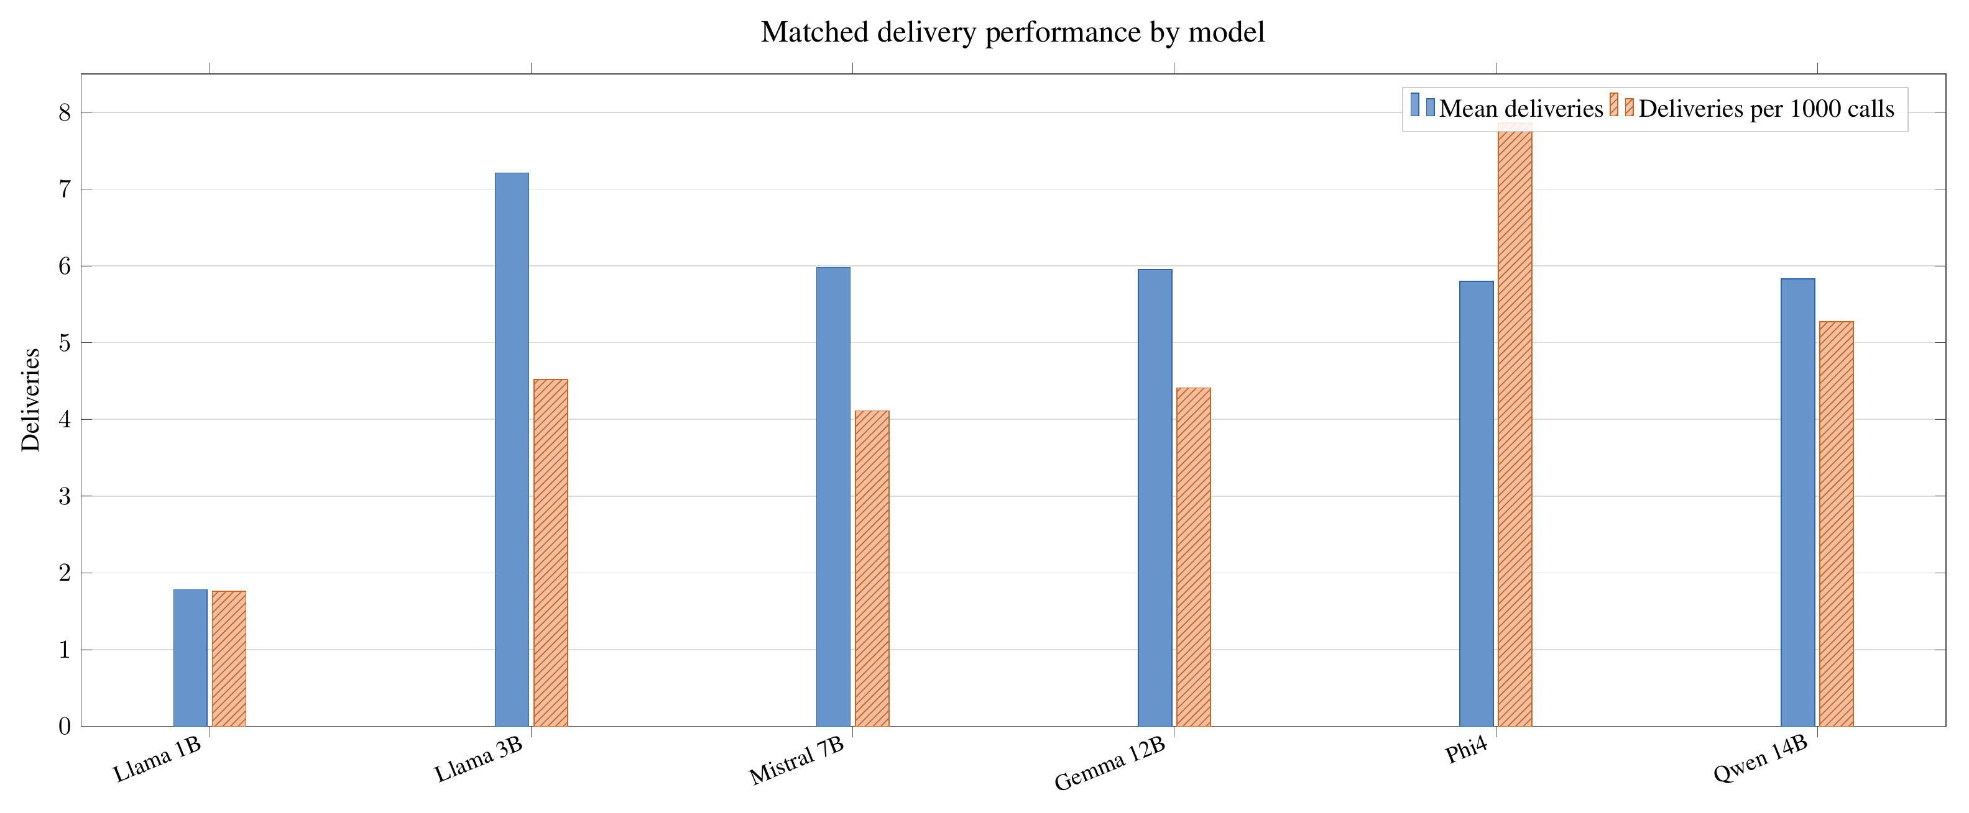
RQ1 — Larger did not consistently mean better
Llama 3B achieved the highest mean delivery count
Phi-4 achieved the highest deliveries per 1,000 calls
Performance was not monotonic with nominal model size
Master’s thesis · Uppsala University
22
Notes:
The first question was whether collaborative performance increases
consistently with nominal model size.
The short answer is:
No.
There was no consistent increase in collaborative task performance as
nominal parameter size increased.
Among the matched model comparison, Llama 3.2 3B produced the highest
mean delivery count.
Phi-4 produced the highest call-normalised delivery value.
The larger Gemma 3 12B and Qwen 2.5 14B models did not consistently
outperform the smaller models.
So if I simply ordered the models from one billion to fourteen billion
parameters, I would not see a steadily increasing performance curve.
That is the main finding for RQ1.
The important point is that this does not mean that larger models are
inherently worse.
The experiment contains different model families, different training
procedures and different model artefacts.
Therefore, the correct conclusion is more limited:
Among the selected model configurations, nominal parameter size alone
did not predict collaborative task performance.
The same models were compared over the same balanced set of
natural-language and JSON configurations, which supports this conclusion
at the level of the selected model artefacts.
[Sources]
- User-provided thesis transcript and figure descriptions.
- User-provided thesis result figure: rq1_matched_model_performance.png.

Slide 23
RQ1 — Model choice matters, but scale is insufficient
Differences may reflect training, architecture and instruction tuning
Cross-family comparisons cannot isolate parameter count
Small locally deployable models remain viable candidates
Master’s thesis · Uppsala University
23
Notes:
There are two interesting implications here.
First, increasing model size is not automatically the best engineering
strategy for this particular task.
A smaller locally deployable model can achieve competitive task
performance.
That matters in robotics because local deployment has constraints.
Memory, inference time and compute resources matter.
However, I did not directly measure energy or computational cost in the
model comparison.
Therefore, I cannot claim from these experiments that a smaller model is
computationally more efficient.
What I can say is that the smaller models demonstrated competitive task
performance despite their lower nominal parameter counts.
Second, the results suggest that model family and the surrounding system
may matter as much as nominal scale.
The performance ranking changes depending on what is being measured.
Llama 3B has the strongest mean delivery result, while Phi-4 has the
strongest call-normalised result.
So there is not a single universal ranking.
This leads to an important interpretation:
Model selection for a grounded robotic planner should not be based on
parameter count alone.
The model has to be considered together with the task, the prompt, the
planning architecture and the resource constraints.
That is the answer I take from RQ1.
[Sources]
- User-provided thesis transcript and figure descriptions.

Slide 24
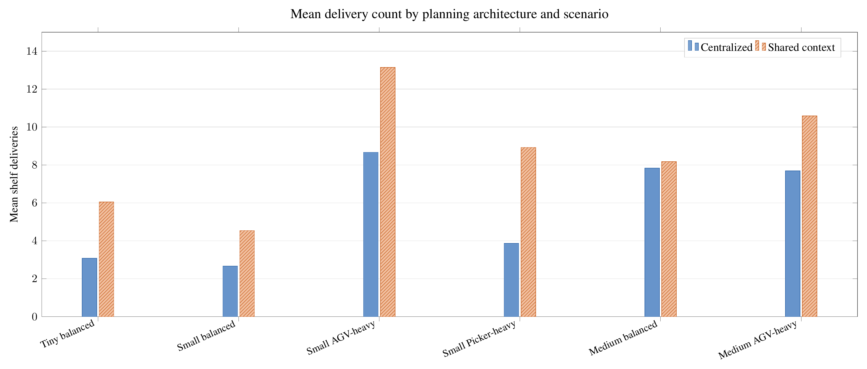
RQ2 — Shared context usually improved delivery
Higher mean deliveries in all six scenario groups
Higher deliveries for five of six models
Qwen was the model-level exception
Master’s thesis · Uppsala University
24
Notes:
The second research question concerns how planning responsibility should
be distributed.
Here the result is clearer.
Across all six scenario groups, the shared-context architecture produced
higher mean deliveries than the centralised architecture.
And this was also true for five of the six selected models.
The exception was Qwen, for which centralised planning eventually
produced higher delivery performance.
So the broad pattern is:
Shared-context planning gives better task performance in the tested
configurations.
But there is a corresponding trade-off.
Centralised planning uses fewer LLM calls.
This is expected from the architecture itself.
One centralised call can produce decisions for multiple agents.
Shared-context planning needs one model interaction per agent that
requires a decision.
So we have a genuine trade-off:
Shared context: more deliveries, more model interactions.
Centralised: fewer model interactions, lower delivery performance in
most tested configurations.
The thesis reports this pattern across all six scenario groups.
[Sources]
- User-provided thesis transcript and figure descriptions.
- User-provided thesis result figure: rq2_architecture_by_scenario.png.

Slide 25
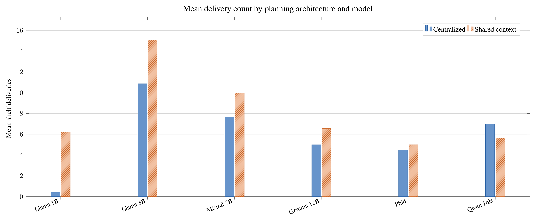
RQ2 — The architecture creates a trade-off
Per-agent queries simplify each output decision
Centralised planning needs fewer model interactions
Architecture effects interact with model capability
Master’s thesis · Uppsala University
25
Notes:
The next question is why this might be happening.
I would be careful here, because the experiment demonstrates the
difference but does not directly prove the mechanism.
One plausible explanation is the complexity of the output problem.
In the centralised architecture, the model has to generate a mutually
compatible set of actions for several agents in a single response.
That means the output space and the coordination problem become more
complex.
In the shared-context architecture, each query only has to produce one
agent’s action.
The model can therefore focus on one local decision while still seeing
relevant shared information.
So the architecture changes the cognitive structure of the problem
presented to the model.
There is also another interesting observation.
The difference between the two architectures tends to narrow for some of
the larger models, and Qwen eventually reverses the trend.
This means that the architecture effect is not completely independent of
the model.
Therefore, I would not conclude:
“Shared-context is always better.”
The more precise conclusion is:
Within this experimental setting, shared-context planning generally
produced better collaborative task performance, while centralised
planning required fewer LLM interactions.
And the model-dependent differences show that the two factors interact.
[Sources]
- User-provided thesis transcript and figure descriptions.
- User-provided thesis result figure: rq2_architecture_by_model.png.

Slide 26
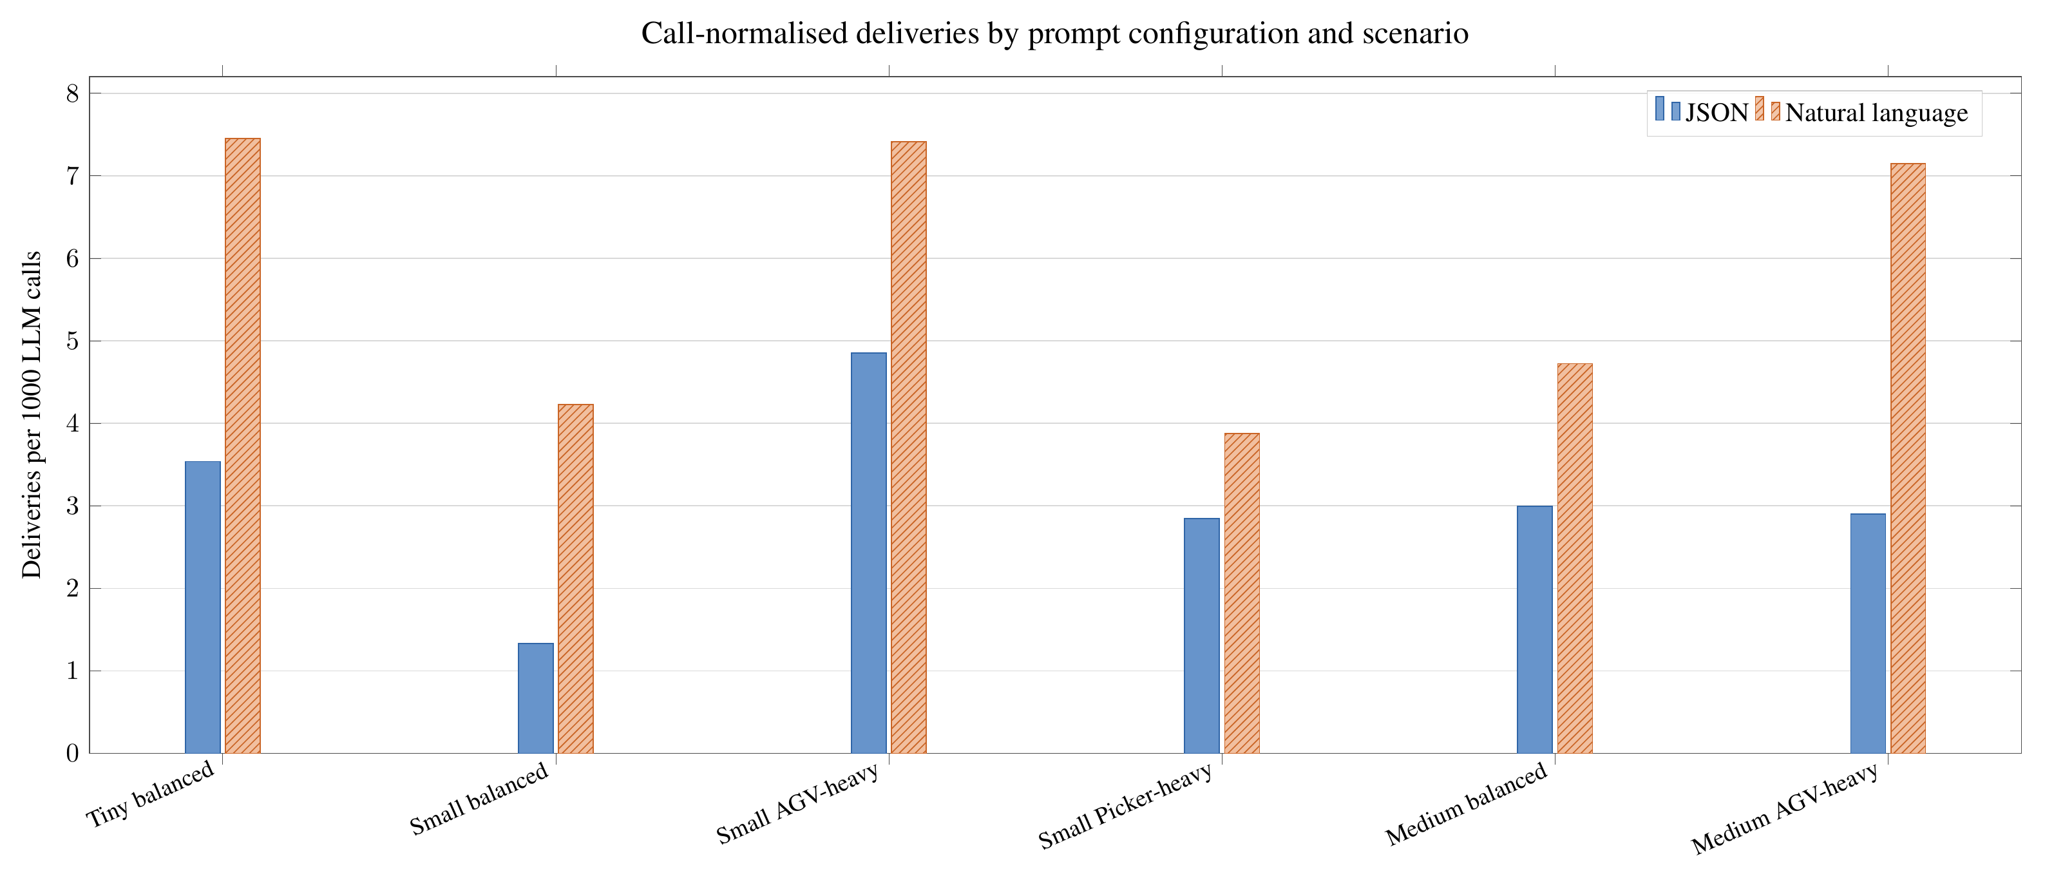
RQ3 — Natural language was stronger overall
Higher call-normalised delivery in all six scenarios
Advantage held within both planning architectures
The result concerns the complete prompt configuration
Master’s thesis · Uppsala University
26
Notes:
The third question was whether the representation used to communicate
the environment state affects collaborative performance.
Here the result was the most consistent of the three research questions.
Natural-language prompting produced higher mean deliveries than the
tested JSON configuration in all six scenario groups.
It also produced higher deliveries per 1,000 LLM calls in all six
scenario groups.
When grouping the results by model, natural language was better for five
of the six models.
The exception was Phi-4.
For Phi-4, the JSON configuration produced a small advantage on both
measures.
So again, the result is strong overall, but it is not universal.
The important observation is that the same underlying environment was
being described.
The difference was in the complete prompt configuration.
Therefore, the tested natural-language configuration was more effective
overall than the tested JSON configuration.
[Sources]
- User-provided thesis transcript and figure descriptions.
- User-provided thesis result figure: rq3_prompt_by_scenario.png.

Slide 27
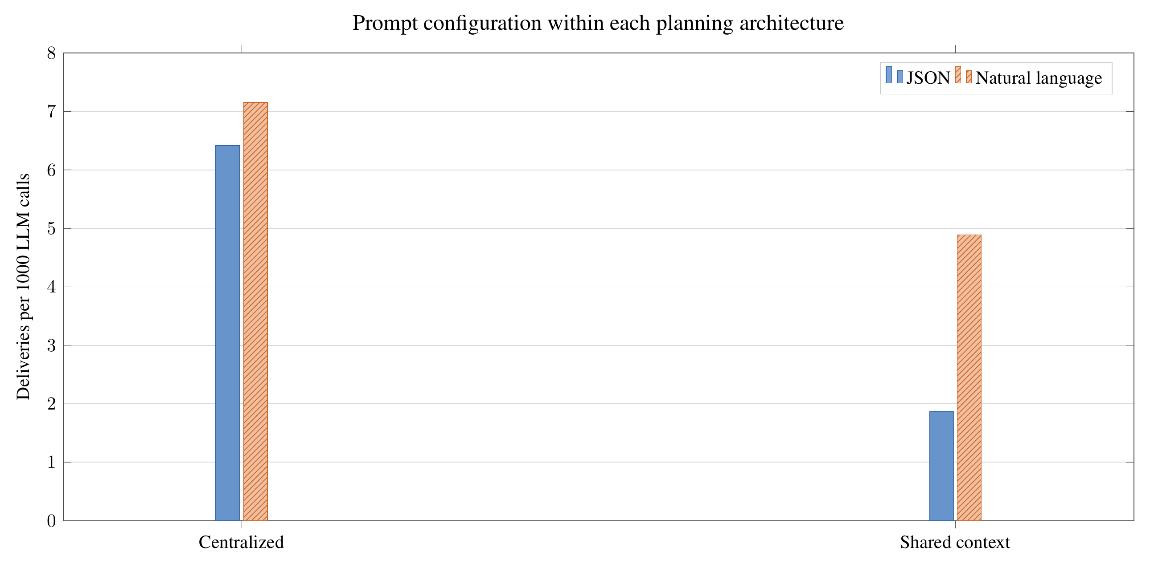
RQ3 — The advantage held within both architectures
Natural language led under centralised planning
The same pattern held under shared-context planning
Call normalisation measures interaction frequency—not compute cost
Master’s thesis · Uppsala University
27
Notes:
The third question was whether the representation used to communicate
the environment state affects collaborative performance.
Here the result was the most consistent of the three research questions.
Natural-language prompting produced higher mean deliveries than the
tested JSON configuration in all six scenario groups.
It also produced higher deliveries per 1,000 LLM calls in all six
scenario groups.
When grouping the results by model, natural language was better for five
of the six models.
The exception was Phi-4.
For Phi-4, the JSON configuration produced a small advantage on both
measures.
So again, the result is strong overall, but it is not universal.
The important observation is that the same underlying environment was
being described.
The difference was in the complete prompt configuration.
Therefore, the tested natural-language configuration was more effective
overall than the tested JSON configuration.
[Sources]
- User-provided thesis transcript and figure descriptions.
- User-provided thesis result figure: rq3_prompt_by_architecture.png.

Slide 28
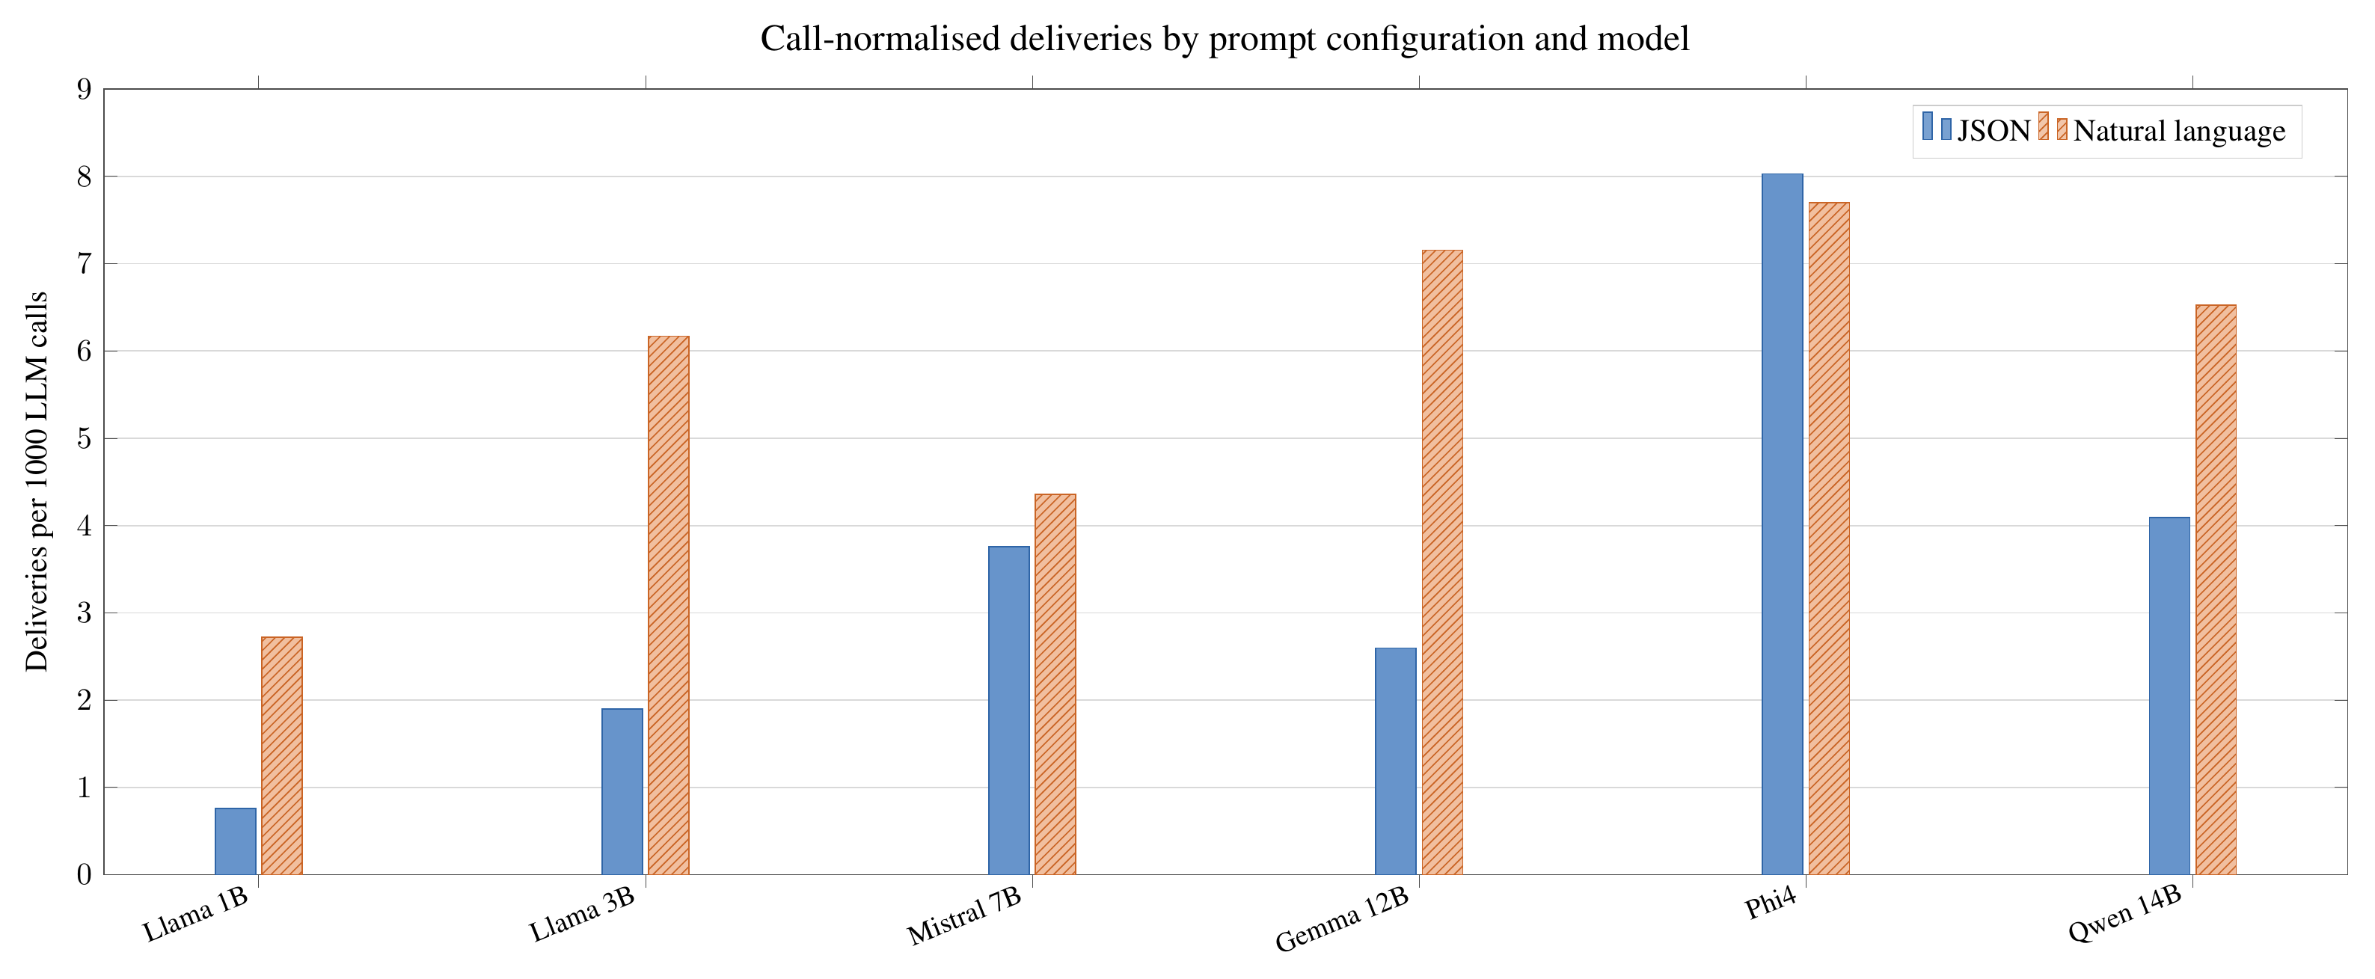
RQ3 — The effect remained model-dependent
Natural language led for five of six models
Phi-4 showed a small JSON advantage
Input representation and output format were not isolated
Master’s thesis · Uppsala University
28
Notes:
There are several possible interpretations.
One possibility is that the descriptive representation made
relationships between agents, targets and constraints easier for the
model to interpret.
The natural-language prompt was organised into semantic sections.
For example, it explicitly described the current agent, shared context,
candidate actions and coordination requirements.
This is closer to the instruction-following format that language models
are commonly used with.
However, there is an important limitation in how we interpret this
result.
The JSON configuration did not only change the input representation.
It also used a structured output format.
Therefore, this experiment does not allow me to say:
“Natural language input is inherently better than JSON input.”
The correct statement is:
The tested complete natural-language prompt configuration outperformed
the tested complete JSON configuration.
This is an important distinction.
The result tells us that, for this particular system design, the
additional transformation into descriptive language was beneficial.
It does not isolate which individual component of the prompt
configuration caused the difference.
The Phi-4 exception also shows that the effect is model-dependent.
[Sources]
- User-provided thesis transcript and figure descriptions.
- User-provided thesis result figure: rq3_prompt_by_model.png.

Slide 29
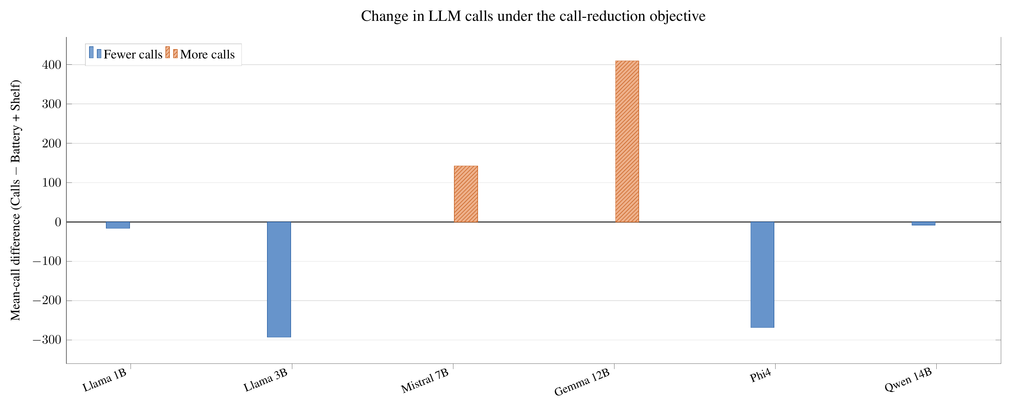
Objective sensitivity was limited
Four models reduced calls under the call-reduction objective
Mistral and Gemma increased calls
The response to the stated objective was model-dependent
Master’s thesis · Uppsala University
29
Notes:
In addition to the three main research questions, I also investigated
whether the models adapted their behaviour when the stated objective was
changed.
There were three objective families.
One focused on reducing LLM calls while still making progress.
One focused on battery and shelf delivery.
And one focused primarily on battery management.
The aggregate results were:
for the Calls objective, approximately 1,268 mean calls and 6.82 mean
deliveries;
for Battery plus Shelf, approximately 1,272 calls and 7.48 deliveries;
and for Battery, approximately 1,242 calls and 6.51 deliveries.
The important result is that the models did not consistently adapt their
behaviour to the call-reduction objective.
Four models reduced their mean calls under the Calls objective, but two
models actually increased them.
So the response to the objective was model-dependent.
Similarly, the battery-related indicators showed relatively small and
mixed differences.
Therefore, I treat this as evidence of limited objective sensitivity,
rather than strong evidence that the models reliably optimise whatever
objective is placed in the prompt.
[Sources]
- User-provided thesis transcript and figure descriptions.
- User-provided thesis result figure: supplementary_call_objective_response.png.

Slide 30
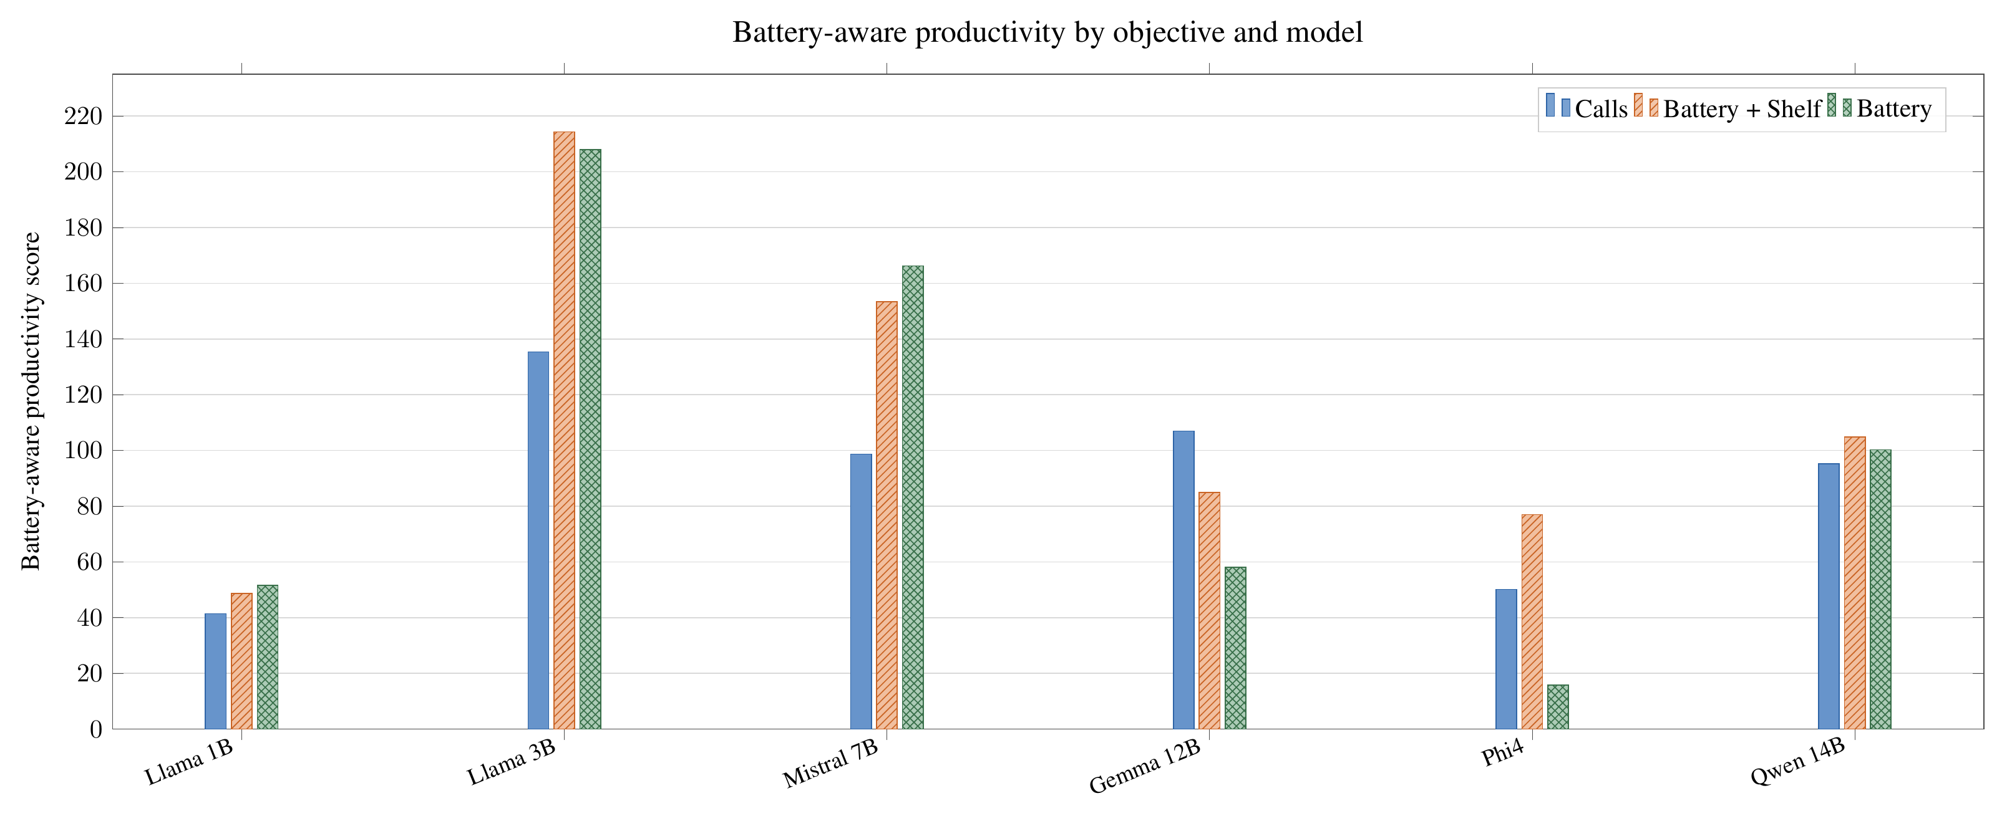
Battery productivity also varied by model
The highest-scoring objective differed across models
Battery prompting did not produce a consistent improvement
The score is descriptive, not an optimality measure
Master’s thesis · Uppsala University
30
Notes:
In addition to the three main research questions, I also investigated
whether the models adapted their behaviour when the stated objective was
changed.
There were three objective families.
One focused on reducing LLM calls while still making progress.
One focused on battery and shelf delivery.
And one focused primarily on battery management.
The aggregate results were:
for the Calls objective, approximately 1,268 mean calls and 6.82 mean
deliveries;
for Battery plus Shelf, approximately 1,272 calls and 7.48 deliveries;
and for Battery, approximately 1,242 calls and 6.51 deliveries.
The important result is that the models did not consistently adapt their
behaviour to the call-reduction objective.
Four models reduced their mean calls under the Calls objective, but two
models actually increased them.
So the response to the objective was model-dependent.
Similarly, the battery-related indicators showed relatively small and
mixed differences.
Therefore, I treat this as evidence of limited objective sensitivity,
rather than strong evidence that the models reliably optimise whatever
objective is placed in the prompt.
[Sources]
- User-provided thesis transcript and figure descriptions.
- User-provided thesis result figure: supplementary_battery_productivity.png.

Slide 31
What did the three questions tell us?
Model choice matters; nominal scale alone does not predict results
Shared context generally raises deliveries at the cost of more calls
Natural language generally beats the tested JSON configuration
The study demonstrates feasibility—not superiority
Master’s thesis · Uppsala University
31
Notes:
At this point, I can return to the three research questions.
For RQ1:
Model choice mattered, but nominal parameter size alone did not predict
performance.
For RQ2:
Shared-context planning generally produced higher delivery performance,
but required more LLM interactions.
For RQ3:
The tested natural-language prompt configuration generally outperformed
the tested JSON configuration.
And across all of these experiments, successful shelf deliveries were
observed.
That means the main research question can be answered positively within
the tested simulator.
Prompted language models were able to produce grounded high-level
decisions that could be validated and executed to complete collaborative
warehouse tasks.
But there is an important qualification.
The thesis demonstrates feasibility.
It does not demonstrate superiority.
There was no non-language-model baseline in the experiment.
Therefore, I cannot claim that LLM-based planning is better than a
conventional planner or a reinforcement-learning approach.
The conclusion is specifically that the approach is feasible within the
tested Battery-TA-RWARE setting.
[Sources]
- User-provided thesis transcript and figure descriptions.

Slide 32
The LLM is one component of a larger planning system
State representation and candidate-action design shape decisions
Parsing, validation and replanning determine execution
Observed behaviour belongs to the complete supervisory loop
State
Prompt
LLM
Parse + validate
Execute
Master’s thesis · Uppsala University
32
Notes:
There is one broader observation that I think is important beyond the
individual research questions.
It would be tempting to look at these results and say:
“The language model performed well.”
But that is not really what the experiment tested.
The observed behaviour is produced by the entire planning system.
The simulator state is transformed into a prompt.
Candidate actions are shaped.
The language model selects an action.
The response is parsed.
The action is validated.
The environment executes it.
The system decides when replanning is required.
And the resulting state becomes the input for the next decision.
So the behaviour is an interaction between:
the model,
the prompt,
the candidate-action mechanism,
the planning architecture,
the validation layer,
and the environment.
This is why the three research questions produced different effects.
Changing the model changes the behaviour.
Changing the architecture changes the behaviour.
Changing the representation changes the behaviour.
The LLM is therefore not an isolated planner operating independently of
the system.
It is one component of a grounded supervisory planning loop.
This is also why the thesis describes the complete framework rather than
attributing all performance differences directly to the underlying
language model.
[Sources]
- User-provided thesis transcript and figure descriptions.

Slide 33
Why grounding matters
Linguistically plausible outputs may still be physically invalid
Environment-defined action IDs establish an execution boundary
Validation improves feasibility, but does not guarantee optimality
Master’s thesis · Uppsala University
33
Notes:
This also has an engineering implication.
If a language model is used in a robotic system, allowing it to directly
produce unrestricted actions creates an obvious reliability problem.
The model can produce an output that is linguistically reasonable but
physically invalid.
In this thesis, the output is therefore constrained to
environment-defined action identifiers.
The valid-action mask is calculated from the simulator.
Invalid actions are rejected before execution.
There is also fallback handling.
This does not guarantee that the robot will always behave optimally.
A valid action can still be unproductive.
The system can still experience waiting loops, deadlocks, starvation or
battery-related problems.
But the grounding mechanism establishes an important boundary:
The model is not trusted to define what is physically possible.
The environment remains responsible for feasibility.
This distinction becomes particularly important if such a system were
eventually deployed on physical robots.
The thesis therefore treats grounding and validation as an essential
part of the planning architecture, not simply as an implementation
detail.
[Sources]
- User-provided thesis transcript and figure descriptions.

Slide 34
What this study does not establish
Simulation does not capture physical sensing and hardware uncertainty
Symbolic state is not raw perception
No conventional-planner or reinforcement-learning baseline
Limited runs and coupled prompt-format differences constrain inference
Master’s thesis · Uppsala University
34
Notes:
There are several limitations that are important when interpreting these
results.
First, the evaluation is simulation-based.
The robots were not physically deployed.
Therefore, the study does not evaluate physical sensing uncertainty,
hardware failures, communication delays or real-world execution.
Second, the language model receives a symbolic representation of the
simulator state.
It is not interpreting raw camera images or noisy sensor data.
So this is a study of high-level decision-making under a structured
state interface, rather than an end-to-end embodied robotics system.
Third, there is no non-LLM baseline.
Therefore, the results cannot establish that language models outperform
conventional planning or multi-agent reinforcement learning.
Fourth, the number of completed runs and simulator initialisations is
limited.
The results should therefore be interpreted primarily as descriptive
observations rather than as definitive statistical evidence.
Finally, the prompt representation comparison should be interpreted
carefully because the natural-language and JSON configurations differ in
both representation and output format.
These limitations define the boundary of what the thesis can
legitimately conclude.
[Sources]
- User-provided thesis transcript and figure descriptions.

Slide 35
Future work
Increase runs, initialisations and scenario coverage
Add non-LLM planning baselines
Explore retrieval and Model Context Protocol tools
Study explicit inter-agent communication and its cost
Master’s thesis · Uppsala University
35
Notes:
There are several directions in which this work could be extended.
The first is stronger evaluation.
More runs, more simulator initialisations and additional scenarios would
improve the statistical confidence of the comparisons.
A particularly important extension would be to introduce a non-LLM
baseline.
That would allow us to answer a different and stronger question:
Not simply whether an LLM can perform the task,
but whether it provides an advantage over established planning methods.
The second direction is richer interaction with external information.
The current system constructs a prompt directly from simulator state.
A future system could use retrieval-augmented generation or external
tools to provide relevant information when it is needed.
The thesis specifically identifies Model Context Protocol-based tools as
one possible direction.
The third direction is communication.
The shared-context architecture gives agents common information, but
that is not the same as studying communication as a behaviour.
A future system could allow agents to explicitly communicate their local
state, intended actions or requests for assistance.
Then we could investigate questions such as:
What information should be communicated?
When should an agent communicate?
Who should receive the message?
And does communication improve coordination enough to justify its cost?
These would move the research from shared information towards actual
emergent or learned communication between agents.
[Sources]
- User-provided thesis transcript and figure descriptions.

Slide 36
Conclusions
Prompted LLMs produced grounded, executable collaborative decisions
Effectiveness depended on model, planning architecture and prompt design
The environment must retain authority over feasibility
A promising research direction, with reliability still unresolved
Master’s thesis · Uppsala University
36
Notes:
So I will conclude by returning to the question with which I started.
The thesis asked:
Can prompted language models support grounded high-level decision-making
for heterogeneous multi-robot collaboration in a constrained warehouse
environment?
Within the tested Battery-TA-RWARE environment, the answer is yes.
The language models produced executable high-level decisions that
resulted in successful collaborative shelf deliveries across the
evaluated models, architectures, prompt configurations and scenarios.
However, the experiments also showed that the language model itself is
only part of the picture.
For model choice, increasing nominal parameter size did not consistently
improve collaborative performance.
For planning architecture, shared-context planning generally produced
higher delivery performance, while centralised planning required fewer
model interactions.
For prompt configuration, the tested natural-language configuration
generally outperformed the tested JSON configuration.
And the supplementary objective experiment showed that changing the
objective did not always produce the expected behavioural adaptation.
So the broader conclusion is not simply:
“LLMs can control robots.”
It is more specific:
Prompted language models can function as grounded high-level
decision-making components for heterogeneous robot collaboration, but
their effectiveness depends strongly on how the surrounding planning
system represents information, distributes decision-making, constrains
actions and interacts with the environment.
That, in my view, is the main contribution of this work.
The study provides a controlled framework for examining these design
choices and empirical observations showing how they affected
collaborative performance in the tested environment.
The results demonstrate feasibility, while also showing that there are
significant open questions before such systems can be considered
reliable alternatives to established multi-robot planning approaches.
Thank you.
I am happy to take your questions.
[Sources]
- User-provided thesis transcript and figure descriptions.

