Slide 1
Heterogeneous Multi-Robot Collaboration
Using Language Models
Can locally deployable language models support
collaborative high-level decisions in a warehouse simulator?
LLM
→
team decision
Rohit Joseph Mamutil
Master’s Thesis · Embedded Systems
Uppsala University
Battery-TA-RWARE · local inference · controlled simulation
Notes:
Good morning. I am Rohit Joseph Mamutil, and this thesis asks a focused question: can locally deployable language models support high-level decisions when robots with different roles must work together? I study that question in a controlled warehouse simulator. The language model chooses task-level actions; the simulator retains navigation and execution. I will first define the collaboration problem, then show the experimental system and scenarios, and finally present the three main comparisons and their limits.

Slide 2
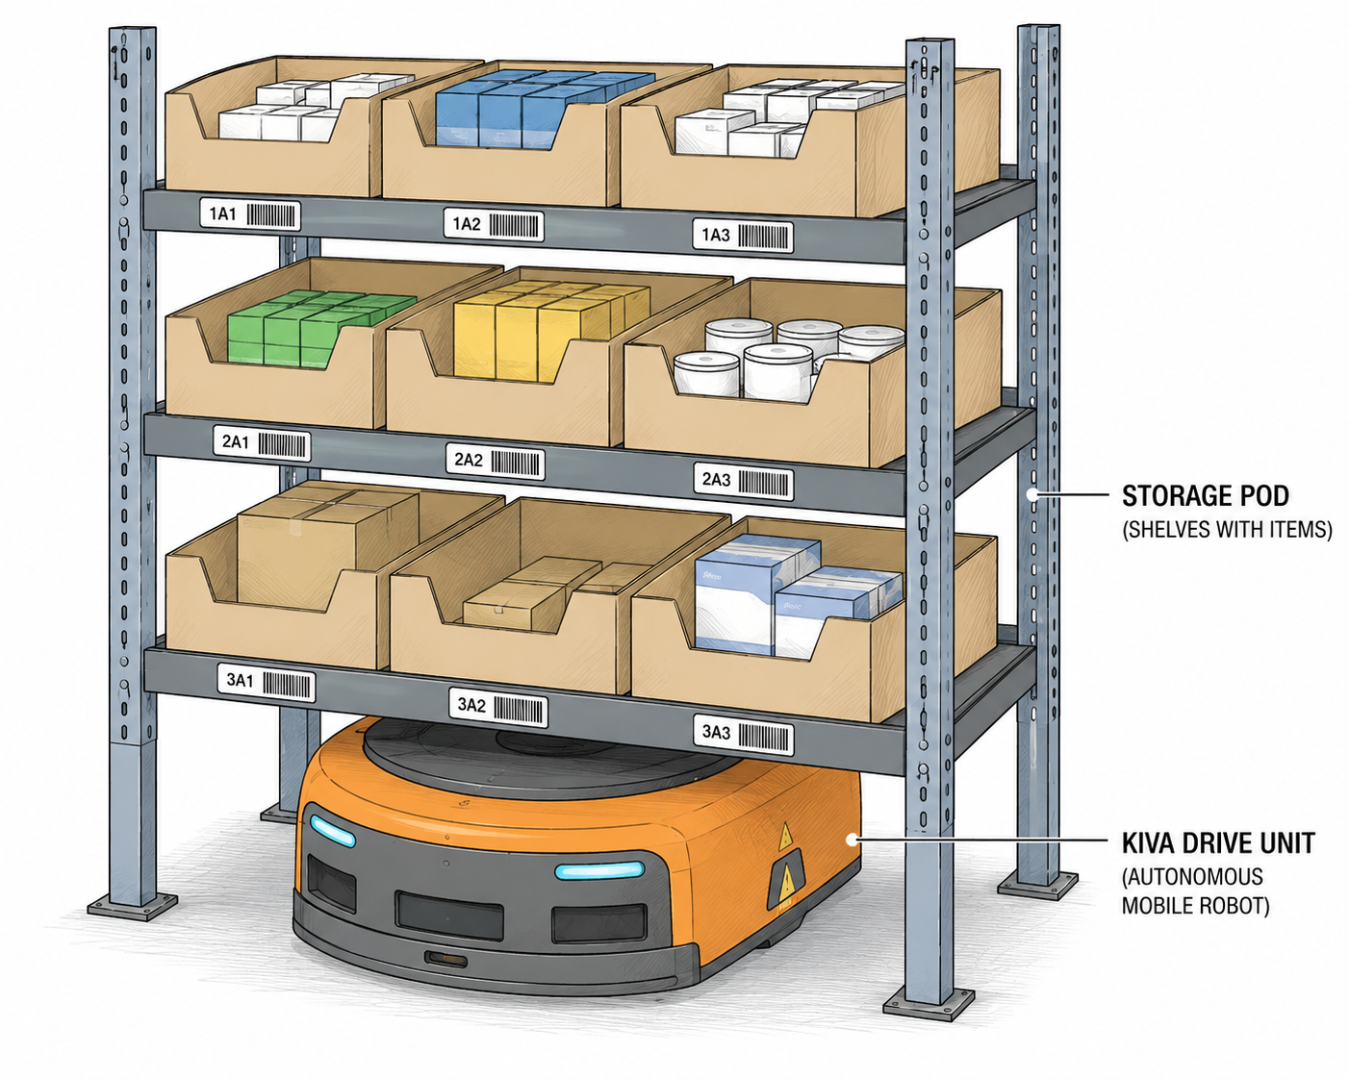
Why heterogeneous robot collaboration?
The decision problem becomes interdependent
• AGVs transport movable shelves
• Pickers support loading and unloading
• Roles share paths, goals, and chargers
• One robot’s choice creates work for another
Question: can an LLM choose useful task-level actions for the team?
Master’s thesis · Uppsala University
MOTIVATION
Notes:
A warehouse makes interdependence visible. An AGV can move a shelf, while a Picker provides support at shelf interaction points. Neither role completes the full cycle alone. At the same time, robots share paths, shelves, goals, and charging stations. The research problem is therefore not simply which action is best for one robot, but whether a language model can choose high-level actions that let complementary roles make progress together.

Slide 3
The collaboration cycle
1
2
3
4
5
Requested shelf
Load together
Deliver
Return shelf
Unload together
AGV selects and travels
Picker meets the AGV
AGV moves shelf to goal
AGV selects empty location
Picker support completes cycle
Collaboration is required at shelf pickup and shelf return—not at the delivery goal.
Master’s thesis · Uppsala University
PROBLEM
Notes:
This cycle defines collaboration in the simulator. An AGV first travels to a requested shelf. A Picker must meet it at the same shelf action so loading can occur. The AGV then delivers the shelf to a goal; no Picker is needed there. Finally, the AGV returns the shelf to an empty storage location, where Picker support is required again. The key experimental dependency is the two support events: pickup and return.

Slide 4
Research focus and boundary
Can prompted LLMs support executable high-level decisions
for heterogeneous robot collaboration?
IN SCOPE
IN SCOPE
OUT OF SCOPE
High-level decisions
Collaborative outcome
Low-level robotics
Choose a shelf, goal, return location, charger, or no-op.
Successful shelf deliveries across heterogeneous AGV–Picker teams.
No motor control, trajectory generation, or raw sensor perception.
Master’s thesis · Uppsala University
QUESTIONS
Notes:
The thesis evaluates LLMs as high-level decision components, not as end-to-end robot controllers. The model sees a symbolic snapshot and candidate actions, then selects what an agent should pursue. The simulator handles how that action is executed. The main question is whether prompted LLMs can produce executable decisions that lead to successful heterogeneous collaboration in this constrained setting.

Slide 5
Three design questions
RQ1 · MODEL
RQ2 · ARCHITECTURE
RQ3 · PROMPT
Which model?
Who plans?
How is state presented?
Six locally deployable models
1B–14B nominal scale
Does task performance increase consistently with size?
Centralized joint planning
versus
shared-context per-agent planning
Descriptive natural language
versus
structured JSON configuration
Master’s thesis · Uppsala University
QUESTIONS
Notes:
The broad question becomes three controlled comparisons. RQ1 varies the selected local model and asks whether performance rises consistently with nominal parameter size. RQ2 compares one joint planning call with separate per-agent decisions informed by shared context. RQ3 compares the complete natural-language and JSON prompt interfaces. These are system-design questions about how an LLM is used, not only which model is used.

Slide 6
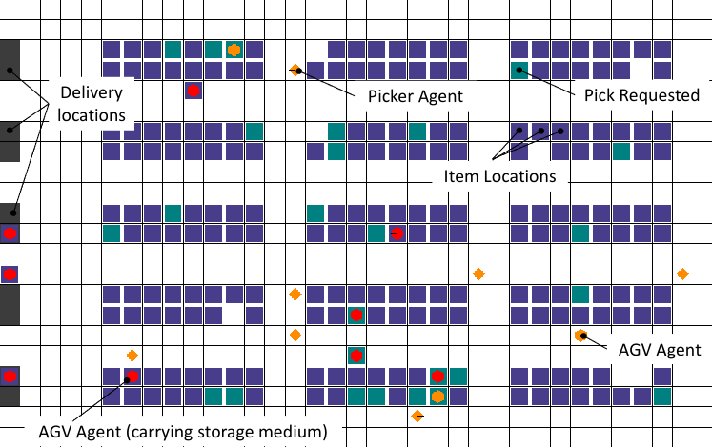
Battery-TA-RWARE environment
ROLES
AGV + Picker
Transport and support are complementary capabilities.
RESOURCES
Shared workspace
Shelves, goals, travel lanes, and charging stations.
EXECUTION
Simulator-owned
A* navigation, collisions, battery dynamics, loading and unloading.
Master’s thesis · Uppsala University
ENVIRONMENT
Notes:
Battery-TA-RWARE is a discrete-time grid warehouse derived from TA-RWARE. Purple cells are shelf positions, green cells mark requested shelves, the lower edge contains delivery goals, and the top edge contains charging stations. AGVs and Pickers move through shared lanes. The environment supplies a global symbolic state for these experiments and handles A-star paths, collision resolution, battery updates, and shelf mechanics.

Slide 7
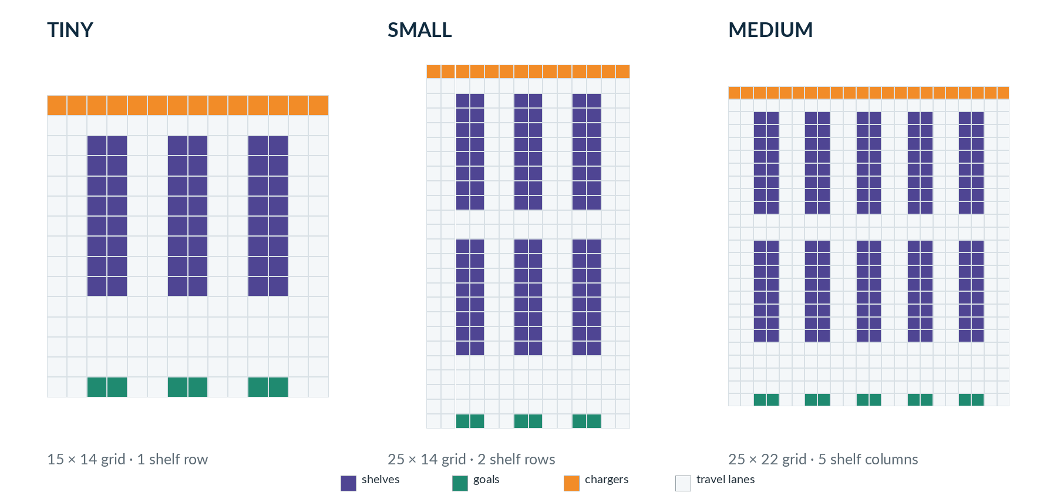
Three warehouse layouts
Master’s thesis · Uppsala University
SCENARIOS
Notes:
The scenario set varies spatial scale as well as team composition. The tiny layout is a 15 by 14 grid with one shelf row. The small layout extends this to 25 by 14 with two shelf rows. The medium layout is also 25 cells high but widens to 22 cells and five shelf columns. Larger layouts increase path length, shelf positions, and the number of simultaneous decisions.

Slide 8
Six scenarios: scale × role balance
LAYOUT
BALANCED
AGV-HEAVY
PICKER-HEAVY
TINY
1 AGV + 1 Picker
Minimal collaboration loop
—
—
SMALL
2 AGVs + 2 Pickers
More concurrency
4 AGVs + 2 Pickers
Support bottleneck
2 AGVs + 4 Pickers
Surplus support
MEDIUM
4 AGVs + 4 Pickers
Longer paths + more decisions
6 AGVs + 2 Pickers
Strong bottleneck
—
Master’s thesis · Uppsala University
SCENARIOS
Notes:
The six scenarios are not six arbitrary maps. They vary two sources of difficulty. Spatial scale changes from tiny to small to medium. Role balance changes from balanced teams to AGV-heavy or Picker-heavy teams. AGV-heavy cases make Picker support scarce; the Picker-heavy case tests whether surplus support capacity is used productively. This design lets the results be compared across distinct collaboration demands.

Slide 9
What the LLM controls
LANGUAGE MODEL
SIMULATOR
WHAT should this agent pursue?
HOW is the action executed?
Shelf · Goal · Empty return
Charging · No-op
A* path · Collisions · Battery
Load / unload mechanics
Master’s thesis · Uppsala University
IMPLEMENTATION
Notes:
The model operates only at the task-assignment level. Its output is an integer action ID and a short persistence duration. Depending on role and state, that ID may refer to a requested shelf, a goal, an empty return location, a charging station, or no-op. The simulator translates that target into motion and physical interaction. This boundary keeps the experiment focused on high-level decisions rather than navigation quality.

Slide 10
Implementation: the supervisory decision loop
1
2
3
4
5
6
State
Candidates
Prompt
Local LLM
Parse + check
Execute
agents · shelves
battery · support
role + state
allowed actions
objective + context
output contract
Ollama
temperature 0.1
action ID + steps
fallback on failure
macro action
selective replanning
The observed behaviour belongs to this complete loop—not to the model in isolation.
Master’s thesis · Uppsala University
IMPLEMENTATION
Notes:
At a planning event, the controller reads the current simulator state and builds a symbolic snapshot. It then computes currently allowed actions and shapes a compact role-specific candidate set. A prompt is sent to a locally hosted Ollama model. The response is parsed, checked against the current action set, and either accepted or replaced by a fallback. The simulator executes the macro action, while selective replanning is triggered by completion, expiry, invalidation, or coordination needs.

Slide 11
Prompt interface: symbolic state → action ID
REPRESENTATIVE INPUT
NATURAL-LANGUAGE OUTPUT
Current agent
agent_0 · AGV · position (8,3)
battery 72 · carrying none
Candidate actions
0 NOOP distance 0
50 SHELF distance 8
7 CHARGING distance 11
Shared context
requested shelves · support needs
charging occupancy · conflict warnings
Action: 50
Steps: 8
Reason: Move to the requested shelf.
JSON OUTPUT
{"reason":"Move to the requested shelf.",
"action":50, "steps":8}
Master’s thesis · Uppsala University
IMPLEMENTATION
Notes:
The prompt does not expose the entire raw grid. It provides task semantics, the current agent state, relevant shared context, candidate actions, warnings, and a precise output contract. This example from the thesis shows the same choice in both prompt configurations. The experiment therefore compares complete interfaces: descriptive text and text parsing versus structured JSON and structured-output mode.

Slide 12
Two planning architectures
CENTRALIZED
SHARED CONTEXT
One joint call
One call per agent
Global snapshot
+ all replanned agents
Output: joint action list
Fewer model interactions,
but a more complex output problem.
Current-agent state
+ relevant shared information
+ accepted commitments
Output: one action
Simpler decisions, but more calls.
VS
Master’s thesis · Uppsala University
IMPLEMENTATION
Notes:
RQ2 changes who receives each planning problem. Centralized planning sends one global prompt containing a block for every agent needing a decision, and asks for a joint action list. Shared-context planning queries agents one at a time. Each query receives the current agent’s state plus relevant shared information and prior accepted commitments. The state is executed only after the required decisions are collected.

Slide 13
Models and fixed inference conditions
Llama 3.2
1B
Llama 3.2
3B
Mistral
7B
local · unchanged weights
local · unchanged weights
local · unchanged weights
Gemma 3
12B
Phi-4
≈14B
Qwen 2.5
14B
local · unchanged weights
local · unchanged weights
local · unchanged weights
Fixed platform: NVIDIA RTX A4000 · Ollama · temperature 0.1
Master’s thesis · Uppsala University
EXPERIMENT
Notes:
Six released, locally deployable models were evaluated without task-specific fine-tuning. They span multiple families, so parameter count is not isolated as a causal variable. All models used the same fixed hardware platform, an NVIDIA RTX A4000, and were served locally through Ollama. Prompt templates, state abstraction, parsing, action checks, and metrics were held constant for each matched comparison.

Slide 14
Controlled comparison and outcome measures
SYSTEMATICALLY VARIED
REPORTED MEASURES
Model
PRIMARY
Mean shelf deliveries
Architecture
How much of the common collaborative task was completed.
Prompt
SECONDARY
Mean LLM calls
Scenario
Frequency of model interactions during a run.
SECONDARY
Objective
Deliveries / 1000 calls
Call-normalised productivity; not latency or compute cost.
Master’s thesis · Uppsala University
EXPERIMENT
Notes:
The experiment varies five factors: model, planning architecture, prompt configuration, scenario, and objective wording. The main RQ comparisons use matched configuration-level observations; repeated executions with the same configuration identifiers are averaged before matching. Mean completed shelf deliveries is the primary outcome. LLM calls and deliveries per one thousand calls are secondary measures of interaction frequency, not compute cost.

Slide 15
Results at a glance
RQ1
RQ2
RQ3
Model choice mattered
Shared context delivered more
Natural language led overall
Llama 3B: highest mean deliveries
Phi-4: highest call-normalised value
Nominal size alone did not predict performance.
Higher mean deliveries in all six scenarios and for five of six models.
Centralized planning required fewer calls.
Higher deliveries and call-normalised values in all six scenarios.
Phi-4 was the model-level exception.
Main claim: feasible in Battery-TA-RWARE—not proven better than established planners.
Master’s thesis · Uppsala University
RESULTS
Notes:
The three comparisons produce a coherent answer. First, model choice matters, but the ranking does not rise consistently with nominal size. Second, shared-context planning produced more deliveries across all six scenarios, while centralized planning used fewer calls. Third, the complete natural-language prompt configuration outperformed the JSON configuration in all six scenarios. These findings demonstrate feasibility within the simulator, not superiority over non-LLM planners.

Slide 16
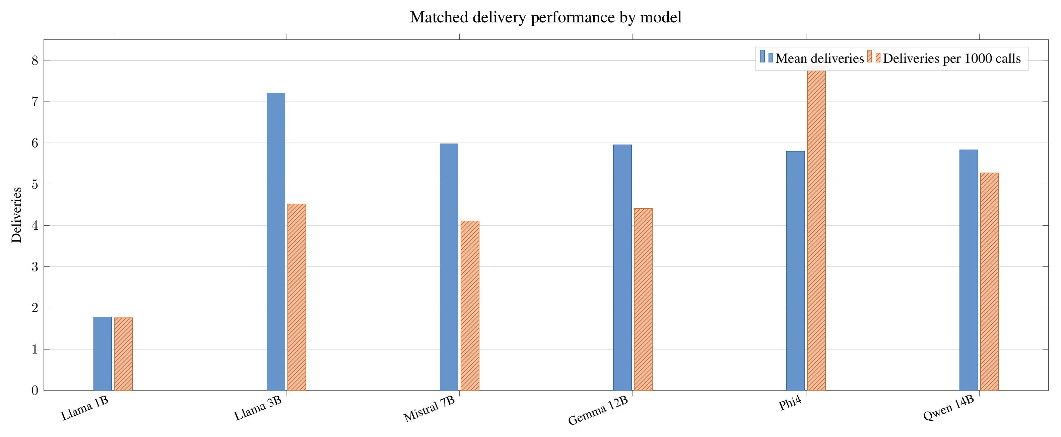
RQ1 — performance did not scale monotonically
Master’s thesis · Uppsala University
RESULTS
Notes:
This balanced comparison uses the same 48 matched configurations for every model: 24 natural-language and 24 JSON configurations. Llama 3B achieved the highest mean delivery count at 7.21. Phi-4 achieved the highest call-normalised value at 7.86 deliveries per thousand calls. Larger selected models did not uniformly dominate, so nominal parameter size alone did not predict collaborative task performance among these model artefacts.

Slide 17
RQ1 — the engineering takeaway
OBSERVED
DO NOT CLAIM
IMPLICATION
Rankings changed
Size caused the result
Benchmark the full setup
Llama 3B led mean deliveries.
Phi-4 led the call-normalised measure.
No monotonic size trend appeared.
Models come from different families and differ in training, architecture, and post-training.
Choose the model together with the prompt, architecture, task, and deployment constraints.
Master’s thesis · Uppsala University
RESULTS
Notes:
The result is not that larger models are worse. These are cross-family comparisons involving different training and post-training choices, so parameter count is not a causal variable. The useful conclusion is narrower: selecting a planner by nominal size alone would have missed strong smaller-model performance. Smaller locally deployable models therefore remain viable candidates, although this study did not directly measure latency, energy, or memory use.

Slide 18
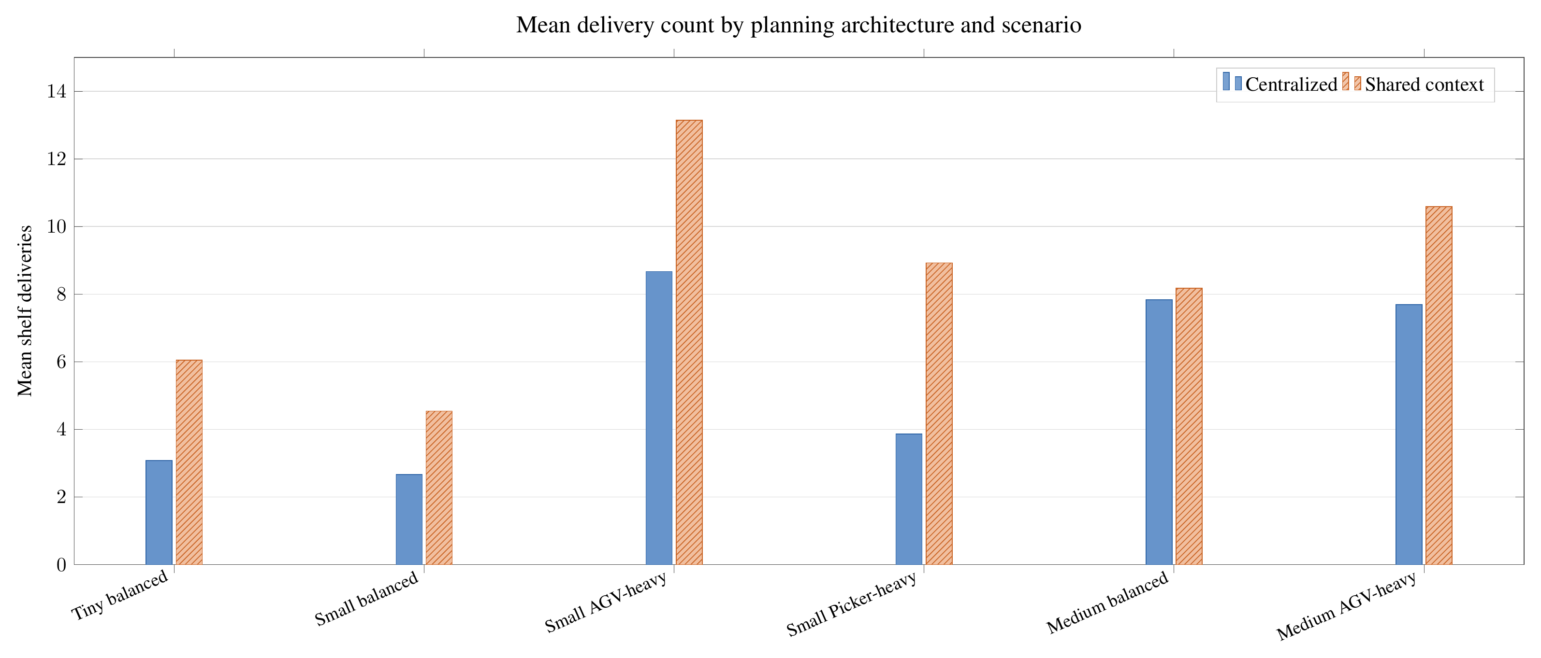
RQ2 — shared context improved deliveries
Master’s thesis · Uppsala University
RESULTS
Notes:
Across 16 matched configuration-level observations per architecture and scenario, shared-context planning produced higher mean deliveries in all six scenario groups. The advantage therefore was not restricted to a single warehouse size or role balance. However, shared-context planning structurally makes separate per-agent calls, so raw deliveries—not call-normalised efficiency—is the primary architecture measure.

Slide 19
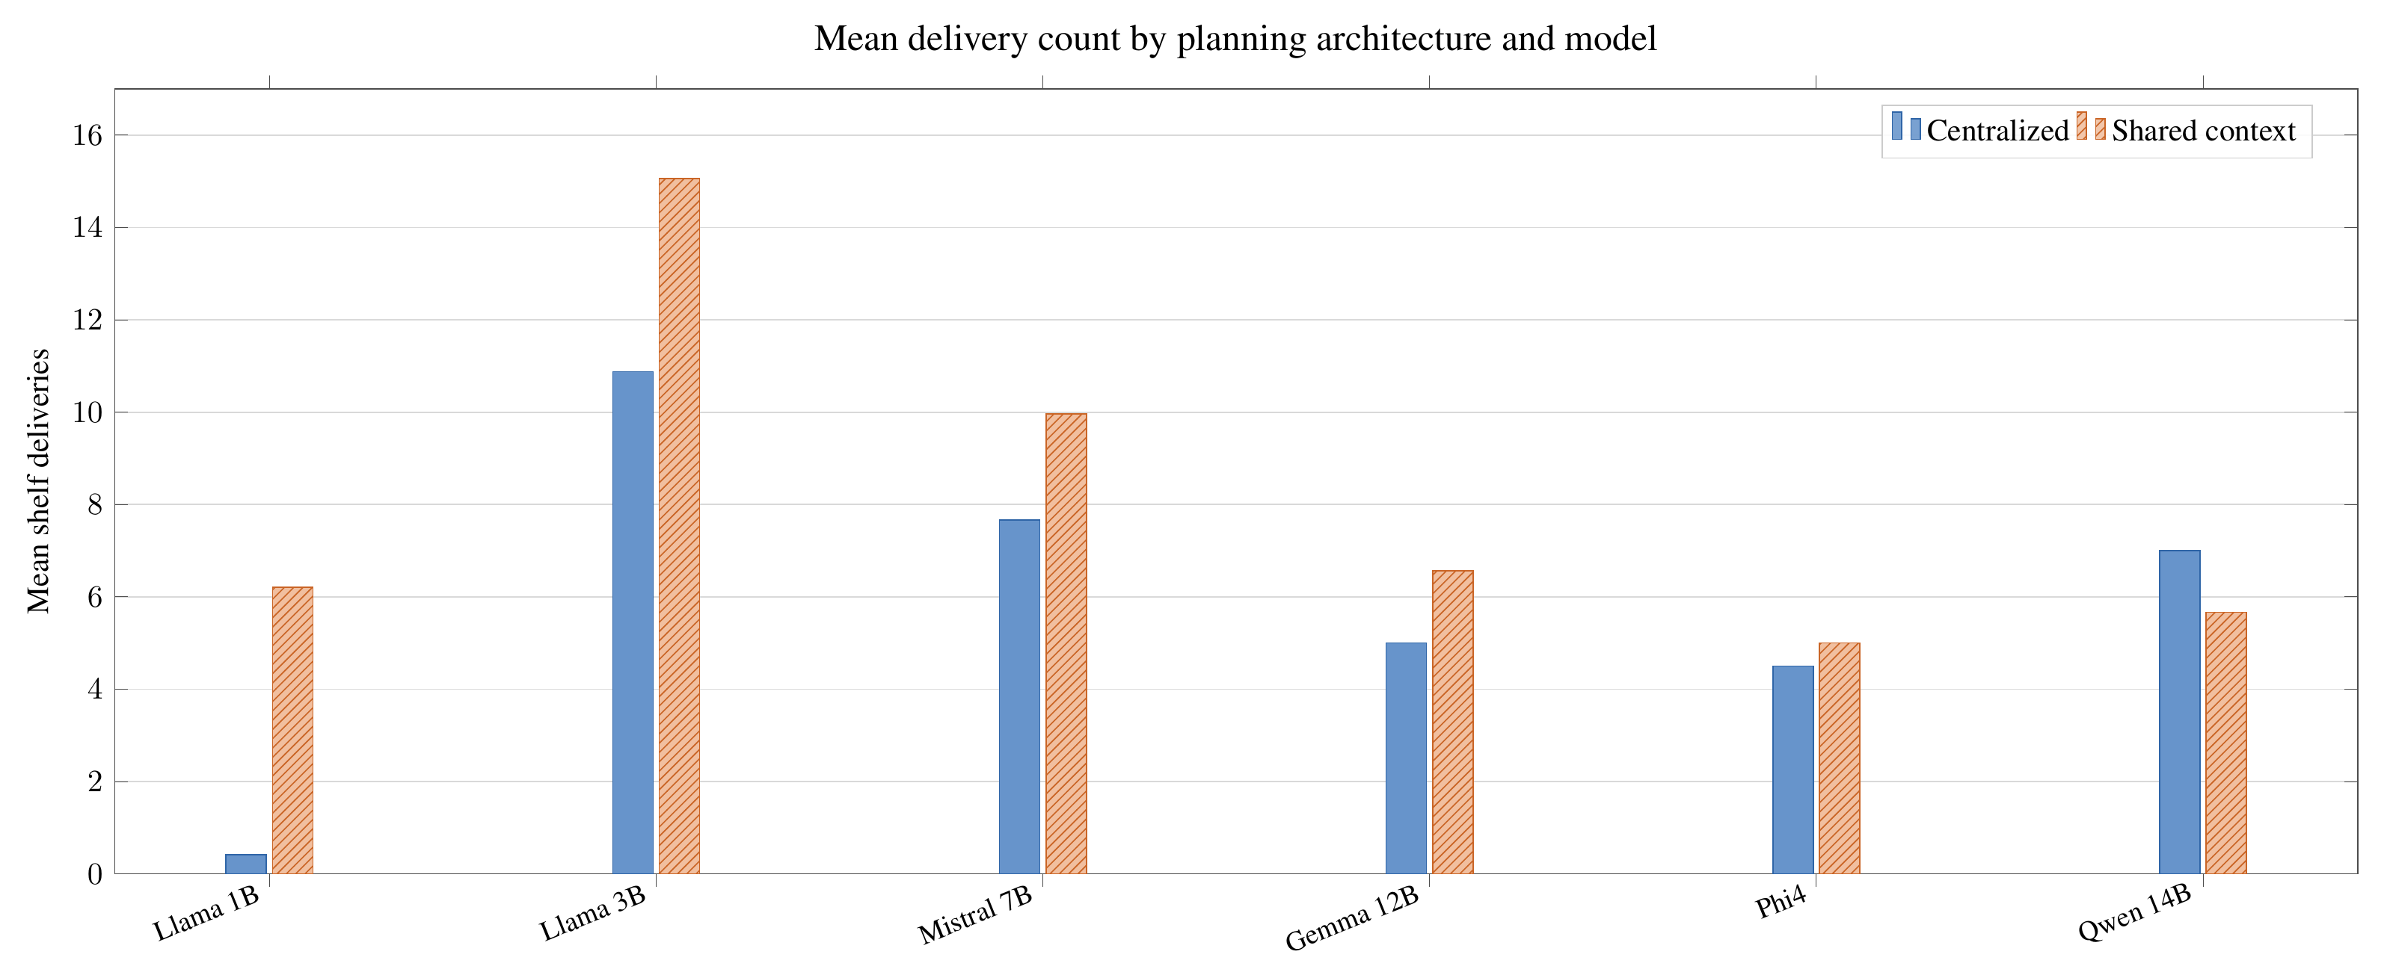
RQ2 — an architecture–model trade-off
GENERAL PATTERN
Shared context
Higher delivery performance
5 of 6 models
TRADE-OFF
Centralized
Fewer model interactions
Qwen reversed the trend
Master’s thesis · Uppsala University
RESULTS
Notes:
At model level, shared-context planning produced more deliveries for five models. Qwen was the exception and produced more under centralized planning. A plausible interpretation is that single-agent outputs simplify each decision, while centralized planning asks the model to construct a compatible joint action. This mechanism was not isolated experimentally. The safe conclusion is a trade-off: shared context generally improved delivery, while centralized planning required fewer model interactions.

Slide 20
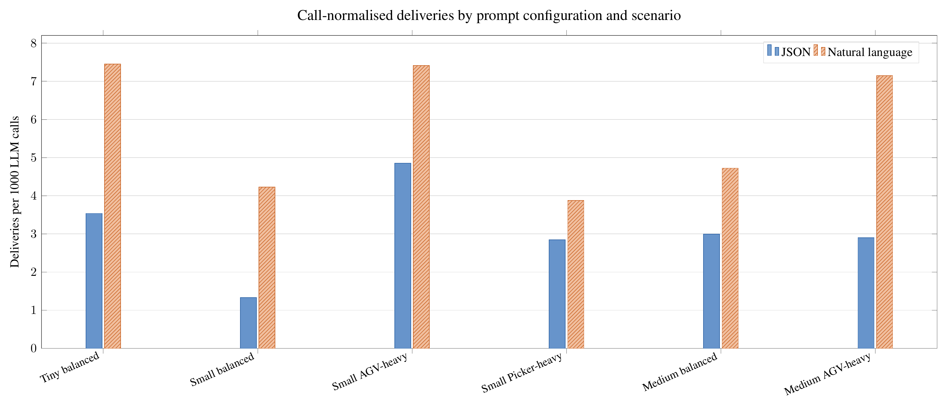
RQ3 — natural language was stronger across scenarios
Master’s thesis · Uppsala University
RESULTS
Notes:
For each scenario, 24 matched configurations were compared per prompt condition. The complete natural-language configuration produced both higher mean deliveries and higher deliveries per one thousand calls in all six scenarios. The same underlying state variables were available in both conditions. The result concerns the complete interface, including response constraints and parsing, rather than input syntax alone.

Slide 21
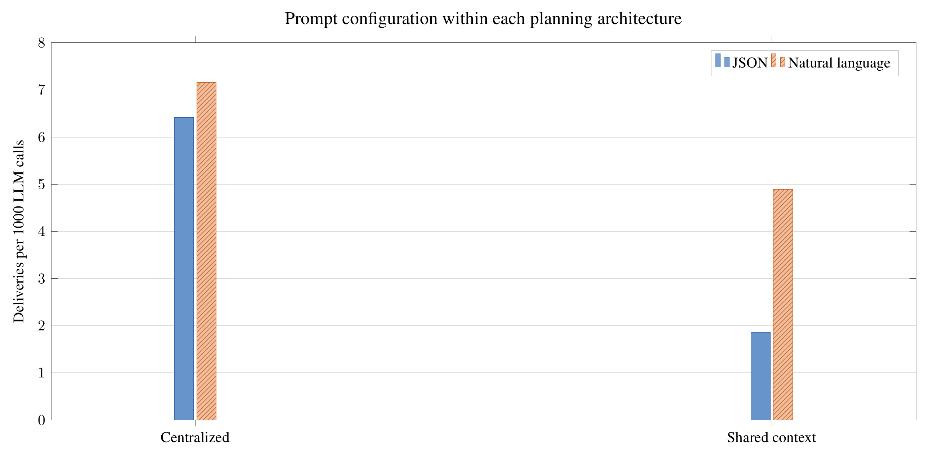
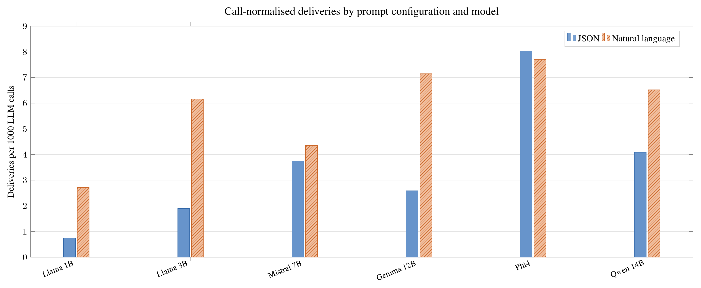
RQ3 — consistent overall, but model-dependent
Interpretation boundary: compare complete prompt configurations—not JSON syntax alone.
Master’s thesis · Uppsala University
RESULTS
Notes:
Natural language also led within both planning architectures and for five of the six models. Phi-4 showed a small JSON advantage. This exception matters because it prevents a universal claim that natural language is inherently better. A reasonable interpretation is that the descriptive prompt made roles, dependencies, and candidate meanings explicit for most models, but the experiment did not isolate input representation from output format.

Slide 22
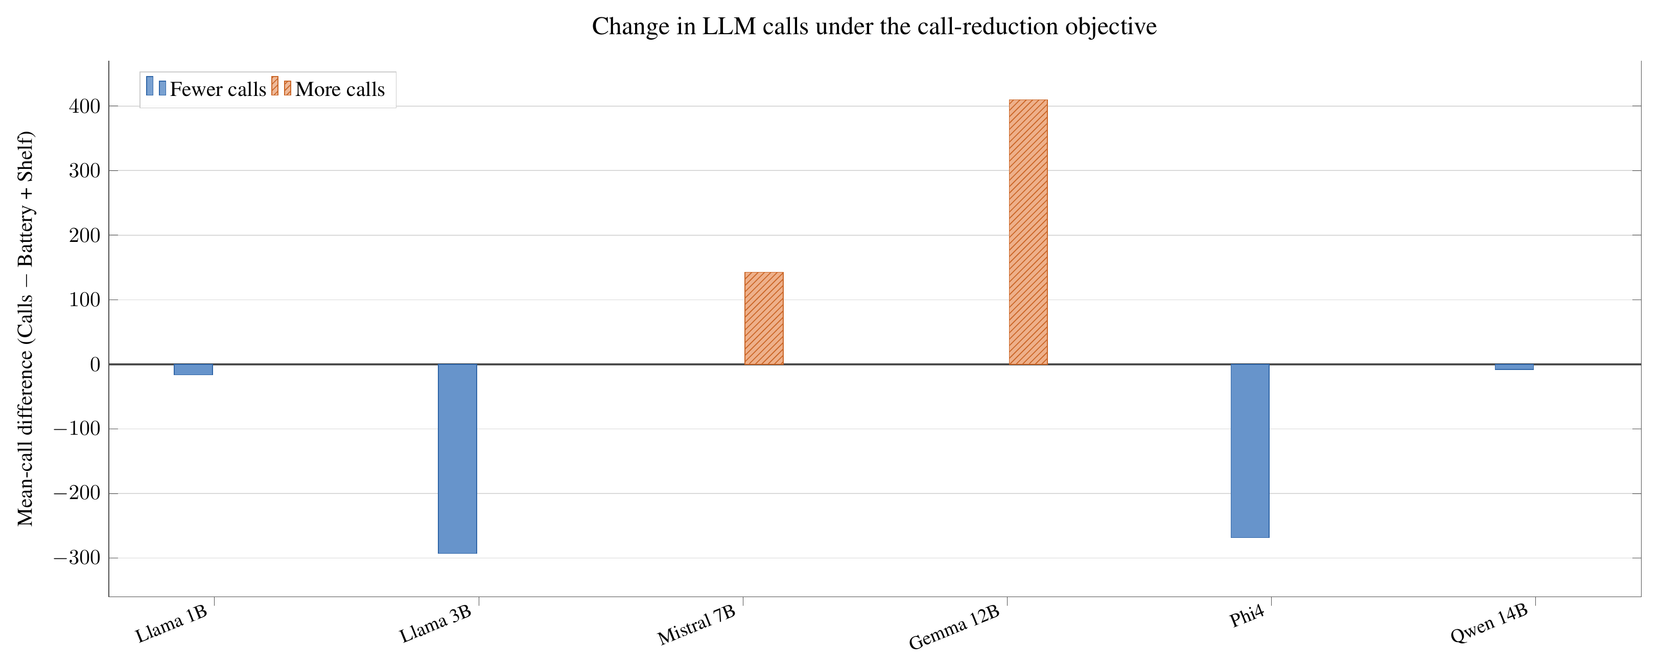
Supplementary result — objective sensitivity was limited
CALL OBJECTIVE
Mixed response
4 models reduced calls; 2 increased them.
BATTERY OBJECTIVE
Small, mixed changes
No consistent improvement across direct battery outcomes.
Master’s thesis · Uppsala University
RESULTS
Notes:
Objective wording was an exploratory analysis, not one of the three main research questions. Four models reduced calls when asked to do so, but Mistral and Gemma increased them. Battery-focused prompting also produced small, mixed changes across battery indicators and deliveries. The models were sensitive to wording, but they did not consistently optimize the requested objective. I therefore treat this as limited objective sensitivity rather than strong adaptation.

Slide 23
Answer to the main question
YES—prompted LLMs produced executable decisions that completed
collaborative shelf-delivery cycles in the tested simulator.
SUPPORTED
NOT ESTABLISHED
Feasibility
Superiority
Observed across models, architectures, prompts, and scenarios.
No conventional-planner or reinforcement-learning baseline.
Master’s thesis · Uppsala University
SYNTHESIS
Notes:
Within Battery-TA-RWARE, the answer is yes. Successful shelf deliveries occurred across the evaluated models, architectures, prompt configurations, and scenarios. That shows that prompted language models can participate in a constrained high-level decision loop for heterogeneous robot collaboration. The claim is feasibility within this simulator. Because there is no non-LLM baseline, it is not a claim of superiority over conventional planning or reinforcement learning.

Slide 24
The contribution is a complete decision system
State abstraction
Candidate design
Prompt interface
LLM selection
Checks + fallback
Replanning
Observed collaboration = model behaviour × interface × controller × environment
Master’s thesis · Uppsala University
SYNTHESIS
Notes:
The results should not be attributed to the language model alone. The controller decides what state to expose, which candidate actions to show, how planning is distributed, how outputs are parsed, and when replanning occurs. The model contributes the high-level selection within that system. This system-level view explains why prompt configuration and planning architecture had large effects and is the main engineering lesson of the thesis.

Slide 25
What this study does not establish
SIMULATION
SYMBOLIC STATE
No physical sensing, hardware uncertainty, or communication delays.
The LLM does not interpret raw camera or sensor observations.
NO BASELINE
EVIDENCE
Feasibility is shown; comparative advantage is not.
Limited runs and initialisations constrain inference.
COUPLED PROMPTS
SYSTEM VERSION
Input representation and response format are not isolated.
Results apply to the modified simulator and controller.
Master’s thesis · Uppsala University
LIMITATIONS
Notes:
The evaluation is simulation-based and receives symbolic state rather than raw perception. There is no conventional planning or reinforcement-learning baseline. The number of completed runs and simulator initialisations limits statistical strength. The natural-language and JSON conditions differ in both representation and response path. Finally, results belong to the modified Battery-TA-RWARE system and should not be treated as a direct benchmark comparison with published TA-RWARE results.

Slide 26
Future work
1
Stronger evaluation
2
Baselines
3
Prompt ablation
More runs, seeds, and scenario coverage
Conventional planning and reinforcement learning
Separate input representation from output format
4
Communication
5
Tools and retrieval
6
Physical validation
What, when, and with whom agents should communicate
Provide external information only when needed
Sensor uncertainty, latency, and hardware constraints
Master’s thesis · Uppsala University
OUTLOOK
Notes:
The next step is stronger comparative evidence: more seeds, more runs, broader scenarios, and explicit non-LLM baselines. The interface can also be studied more carefully by separating input representation from output constraints. Additional directions include explicit inter-agent communication, retrieval or tool use when external knowledge is actually needed, and eventual validation with physical robots and uncertain sensing.

Slide 27
Conclusions
Prompted LLMs can support collaborative high-level decisions—
within a carefully designed supervisory system.
MODEL
ARCHITECTURE
Nominal size alone did not predict performance
Shared context raised deliveries; centralized used fewer calls
PROMPT
CLAIM
Natural language led overall; the effect remained model-dependent
Feasibility demonstrated; reliability and superiority unresolved
Thank you · Questions
Master’s thesis · Uppsala University
CONCLUSION
Notes:
To conclude, prompted language models supported executable high-level decisions for heterogeneous collaboration in the tested warehouse simulator. Performance depended strongly on the selected model, the planning architecture, and the complete prompt interface. Smaller models remained competitive; shared context generally improved deliveries; and natural language performed best overall. The contribution is a controlled framework and evidence of feasibility. Reliability and superiority over established methods remain open questions. Thank you.

