Slide 1
CodeAlpha Cyber Security Internship - Task 2
PHISHING AWARENESS
TRAINING MODULE
🎣
Recognize phishing emails and fake websites. Understand social engineering. Practice safe response habits.
Prepared by: Keerit Kapoor
Date: June 2026
Notes:
Speaker notes: Introduce the purpose of the module and explain that all examples are simulated for safe training.

Slide 2
Learning goals
By the end, the viewer can spot, avoid, and report phishing attempts.
1. Spot red flags
2. Verify safely
3. Practice decisions
Sender spoofing
Urgent threats
Suspicious links
Unexpected attachments
Use official websites
Avoid email links
Enable MFA
Report suspicious emails
Classify examples as:
Safe
Suspicious
Phishing
Then explain why
This module includes simulated examples, quick checks, and a short quiz.
CodeAlpha Cyber Security Internship | Phishing Awareness Training | Keerit Kapoor
02
Notes:
Speaker notes: Explain the three goals: recognition, verification, and practical decision-making.

Slide 3
What phishing is
Phishing uses deception to trick people into sharing information, clicking links, or opening malware.
Phishing is a social-engineering attack: the attacker pretends to be trusted so the victim acts quickly.
Attacker formula
Trust
+
Urgency
+
Action link
=
Risk
Common channels: email, SMS, calls, fake websites, and social media messages.
Common goals: steal passwords, capture OTPs, collect payment details, or install malware.
Main tactic: make the request feel urgent, familiar, or official.
CodeAlpha Cyber Security Internship | Phishing Awareness Training | Keerit Kapoor
03
Notes:
Speaker notes: Define phishing in simple words and focus on deception rather than technical complexity.

Slide 4
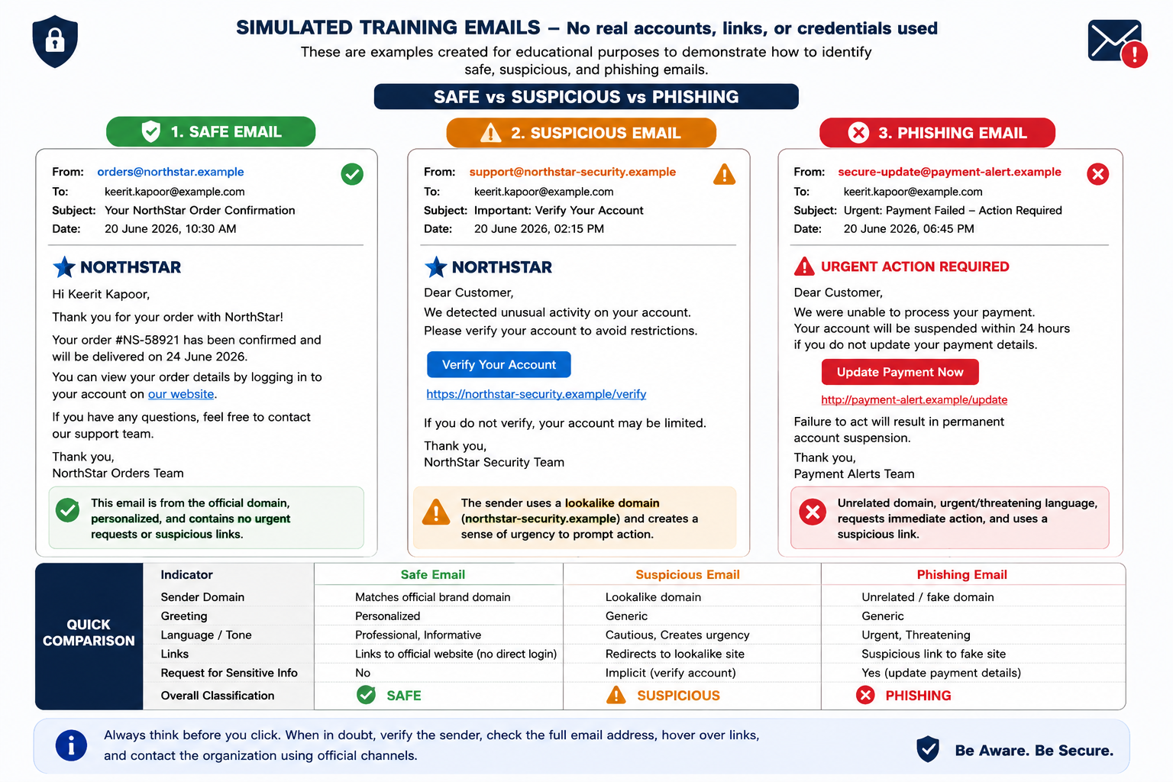
Email examples: safe vs suspicious vs phishing
All examples are simulated for training and contain no real links or accounts.
CodeAlpha Cyber Security Internship | Phishing Awareness Training | Keerit Kapoor
04
Notes:
Speaker notes: Walk through the three example emails and compare the sender, greeting, tone, and link behavior.

Slide 5
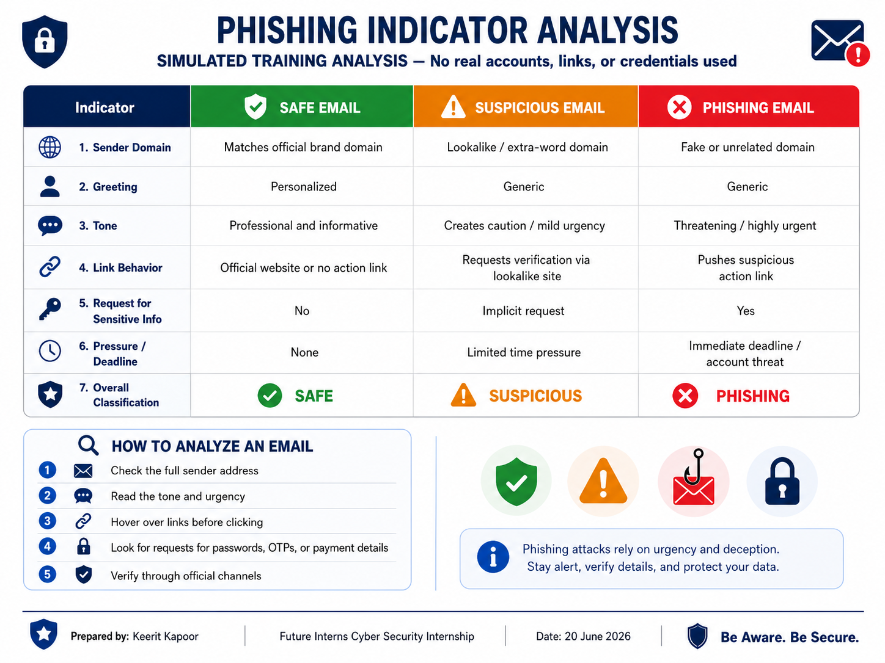
Email red flags to check
Do not trust the display name alone. Read the full email address and the message behavior.
CodeAlpha Cyber Security Internship | Phishing Awareness Training | Keerit Kapoor
05
Notes:
Speaker notes: Use the indicator table as a checklist for analysing any message.

Slide 6
Fake website warning signs
A phishing email often sends victims to a fake page that imitates a real brand.
Warning signs
secure-login-northstar.example
The domain is slightly different from the real website.
The page asks for passwords or OTPs after an unexpected email.
The page uses pressure: “verify now” or “account blocked”.
The safest route is to type the official website manually.
Username
Password
Verify Account
Fake login page mockup
Rule: If the message is unexpected, do not use its link. Open the official website or app directly.
CodeAlpha Cyber Security Internship | Phishing Awareness Training | Keerit Kapoor
06
Notes:
Speaker notes: Show how a fake website can look professional but have a suspicious address and credential request.

Slide 7
Social-engineering tactics
Attackers target human reactions: fear, curiosity, authority, and reward.
⚠️
🏢
📎
🎁
Fear
Authority
Curiosity
Reward
“Your account will be suspended”
“From IT / bank / admin”
“See attached invoice”
“You won a gift card”
Defence habit: pause, verify through a separate trusted channel, and report suspicious messages.
CodeAlpha Cyber Security Internship | Phishing Awareness Training | Keerit Kapoor
07
Notes:
Speaker notes: Explain the emotions attackers use to make victims act without checking.

Slide 8
Best practices to avoid phishing
Use this simple process before clicking, downloading, or replying.
1
Check sender
Verify the full email address and domain.
2
Inspect links
Hover first. Do not click unexpected links.
3
Protect credentials
Never share passwords, OTPs, or card details by email.
4
Use MFA
Enable multi-factor authentication wherever possible.
5
Report
Use your email provider or IT/security reporting channel.
Quick rule: When in doubt, do not click. Verify through an official website, app, or phone number you already trust.
CodeAlpha Cyber Security Internship | Phishing Awareness Training | Keerit Kapoor
08
Notes:
Speaker notes: Summarize defensive habits and remind viewers to report rather than ignore suspicious messages.

Slide 9
Interactive quiz
Pause the video and answer before revealing the answers on the next slide.
Q1
An email says your account closes in 2 hours unless you click a link. What is the safest action?
A) Click quickly B) Verify through the official website C) Reply with your password
Q2
The display name says “Bank Support,” but the sender domain is bank-security-login.example. What is the red flag?
A) Lookalike domain B) Too much punctuation C) The time of day
Q3
A message asks for your OTP to “complete verification.” What should you do?
A) Send it B) Ask a friend C) Never share OTPs by email
CodeAlpha Cyber Security Internship | Phishing Awareness Training | Keerit Kapoor
09
Notes:
Speaker notes: Use this as the interactive section. Ask the viewer to pause and choose an answer.

Slide 10
Quiz answers + closing
Q1
B - Verify through the official website or app.
Q2
A - The sender uses a lookalike domain.
Q3
C - Never share OTPs, passwords, or payment data by email.
Remember: Stop. Check. Verify. Report.
References: CISA Recognize and Report Phishing; FTC How to Recognize and Avoid Phishing Scams; CISA Avoiding Social Engineering and Phishing Attacks; FBI Spoofing and Phishing.
10
Notes:
Speaker notes: Reveal the answers and end with a memorable call to action.

