Slide 1


India–Mongolia Cooperation in Cyber Security Education
National Defence University of Mongolia
Military Institute · Cyber Security Department
The Cyber Security Training Centre, 2015–2026, and the road to 2030
Briefing for the delegation of the Ministry of Defence, Government of India
14th Meeting of the India–Mongolia Joint Working Group on Defence Cooperation
Ulaanbaatar · 2026
Notes:
МН: Нээлтийн үг. Төлөөлөгчдийг угтаж, илтгэлийн зорилгыг нэг өгүүлбэрээр хэлнэ.
Good morning. On behalf of the National Defence University of Mongolia, welcome to the Cyber Security Department. This Department exists because of our partnership with India, so it is a particular pleasure to host the Ministry of Defence delegation during the 14th Joint Working Group. In the next twenty-three minutes I will show where the cooperation came from, what has been built here with India's support, what it has delivered since 2022, and what we propose for the next phase.

Slide 2

Welcome to the Cyber Security Department
Briefing outline · about 23 minutes
Distinguished guests
Delegation of the Ministry of Defence, Government of India
01
Partnership context
3 min
Ms Ishita Ganguli Tripathy
70 years of relations; four pillars of defence cooperation
Joint Secretary, Ministry of Defence
02
Establishing the Centre
6 min
Mr Vikash Kumar
Director
2015 MoU, 2022 inauguration, India's contribution, people
Col Baljit Singh
03
Results 2022–2026
9 min
Director
Training output, curriculum, research, 2025 upgrade
Col Mupparty Sanjeev
Defence Attaché, Embassy of India, Ulaanbaatar
04
The road ahead
5 min
Proposals for the next phase and for the 14th JWG
Followed by questions and a tour of the laboratories
Notes:
МН: Төлөөлөгчдийг нэрээр нь хүндэтгэн дурдаж, илтгэлийн 4 хэсэг, хугацааг танилцуулна.
Let me first acknowledge our guests: Ms Ishita Ganguli Tripathy, Joint Secretary; Mr Vikash Kumar and Colonel Baljit Singh, Directors; and Colonel Mupparty Sanjeev, Defence Attaché, who already knows this Department from his visit last year. The briefing has four parts: the partnership context, how the Centre was established, what it has delivered since 2022, and our proposals for the next phase. We will then take questions and walk through the laboratories.

Slide 3
Partnership context
01
Seven decades of friendship, a decade of strategic partnership
Notes:
МН: Хэсгийн хуудас.
Part one: the context in which this Centre was created.

Slide 4

Seven decades of friendship, a decade of strategic partnership
1955
1994
2001
2015
2022
2025
Diplomatic relations
Treaty of Friendly Relations and Cooperation
Agreement on Defence Cooperation
Strategic Partnership
Cyber Security Training Centre opens
70 years · State visit to India
24 December. India becomes the first country outside the Soviet bloc to establish relations with Mongolia
Legal foundation of the modern partnership
Followed by the Joint Working Group of the two Defence Ministries, now meeting every year
First visit of an Indian Prime Minister; 17 May: Memorandum to establish a Cyber Security Training Centre at the Ministry of Defence
6 September. First visit of an Indian Defence Minister; Centre inaugurated at NDU by the two Defence Ministers
13–16 October. President Khurelsukh in New Delhi; India to open a Defence Wing in Ulaanbaatar
The Cyber Security Training Centre was agreed in 2015, built in 2021–2022 and has run with Indian training teams since 2023. It is the most tangible institution of the defence partnership.
Notes:
МН: Түүхэн замнал: 1955 → 1994 гэрээ → 2001 БХ-ын хэлэлцээр → 2015 стратегийн түншлэл + Кибер төвийн санамж бичиг (05.17) → 2022 нээлт → 2025 Төрийн айлчлал.
India was the first country outside the Soviet bloc to recognise Mongolia, in December 1955. The 1994 Treaty and the 2001 Agreement on Defence Cooperation gave the relationship its legal frame, and the Joint Working Group grew out of that agreement. The Strategic Partnership of 2015 opened the current chapter, and on 17 May 2015 the two governments signed the Memorandum to establish a Cyber Security Training Centre at our Ministry of Defence. That Centre was inaugurated on 6 September 2022 during the first-ever visit of an Indian Defence Minister. Last October, President Khurelsukh's state visit marked seventy years of relations and India decided to open a Defence Wing in Ulaanbaatar.

Slide 5




Defence cooperation today rests on four pillars
Policy dialogue
Exercises
Training
Institutions
14th
18
200
2022
Joint Working Group meeting, 2026
editions of Nomadic Elephant since 2004
ITEC slots a year for Mongolia
Cyber Security Training Centre, NDU
Annual JWG of the two Defence Ministries
11th · New Delhi, Feb 2023
12th · Ulaanbaatar, May 2024
13th · New Delhi, Feb 2025
Nomadic Elephant 2026 · Pithoragarh, Sept 2026 – cyber security in the curriculum
Nomadic Elephant 2025 · Ulaanbaatar
Khaan Quest – Indian contingent every year
3,500+ Mongolian professionals trained under ITEC
Mongolian officers at Indian military institutions
Border security forces capacity-building programme (2025)
Agreed in the 2015 MoU; built with Government of India assistance
Defence Wing at the Embassy of India, Ulaanbaatar (announced Oct 2025)
India–Mongolia Friendship School
Notes:
МН: Дөрвөн тулгуур: зөвлөлдөх уулзалт, хамтарсан сургууль, сургалт (ITEC), байгууллагууд. Кибер төв нь 4 дэх тулгуурын гол хэсэг.
Our defence cooperation rests on four pillars. Policy dialogue: the Joint Working Group meets every year, alternating between New Delhi and Ulaanbaatar; this is its fourteenth meeting. Exercises: Nomadic Elephant has run since 2004 and in its last two editions included cyber security training, and India sends a contingent to Khaan Quest every year. Training: two hundred ITEC slots a year and more than three and a half thousand Mongolians trained. Institutions: this Centre, the new Defence Wing and the Friendship School. The Cyber Security Department sits at the centre of the fourth pillar and feeds the other three.

Slide 6



Why cyber: a shared priority for both armed forces
Mongolia's cyber security baseline
Cyber on the bilateral agenda
56.4
+17
The 2022 Centre – described by the Indian MoD as a one-of-its-kind cyber-related international cooperation project
Mongolia's score in the ITU Global Cybersecurity Index 2024 – ranked 103rd of 193
places gained in the Index since 2020, still below the Asian average
Cyber security training built into Nomadic Elephant 2025 (Ulaanbaatar) and 2026 (Pithoragarh)
90,000+
2021
The Cyber Security Military Command of the Mongolian Armed Forces is the Centre's principal partner and customer
cyber attacks detected in Mongolia every week (national cyber security officials, Jan 2024)
first Law on Cyber Security (17 Dec 2021, in force 1 May 2022); the Armed Forces named as a supporting authority
Both armed forces face the same threats – ransomware, espionage, attacks on critical infrastructure – and the same skills gap
Notes:
МН: Яагаад кибер: Монголын GCI үзүүлэлт (56.4, 103-р байр), долоо хоногт 90 мянган халдлага, 2021 оны хууль. Кибер аюулгүй байдлын цэргийн командлал – төвийн гол түнш.
Why cyber? Mongolia scores 56 in the ITU Global Cybersecurity Index, 103rd of 193. We have climbed seventeen places since 2020, but we remain below the Asian average. National authorities detect more than ninety thousand attacks a week. The 2021 Law on Cyber Security gives the Armed Forces a supporting role in protecting critical infrastructure, and that requires trained people. On the bilateral side, cyber is now a standing item: this Centre, the cyber modules of the last two Nomadic Elephant exercises, and the Cyber Security Military Command, which sent the first cohorts here and is our principal partner.

Slide 7
Establishing the Centre
02
From the 2015 Memorandum to a university department
Notes:
МН: Хэсгийн хуудас.
Part two: how the Centre came into being.

Slide 8
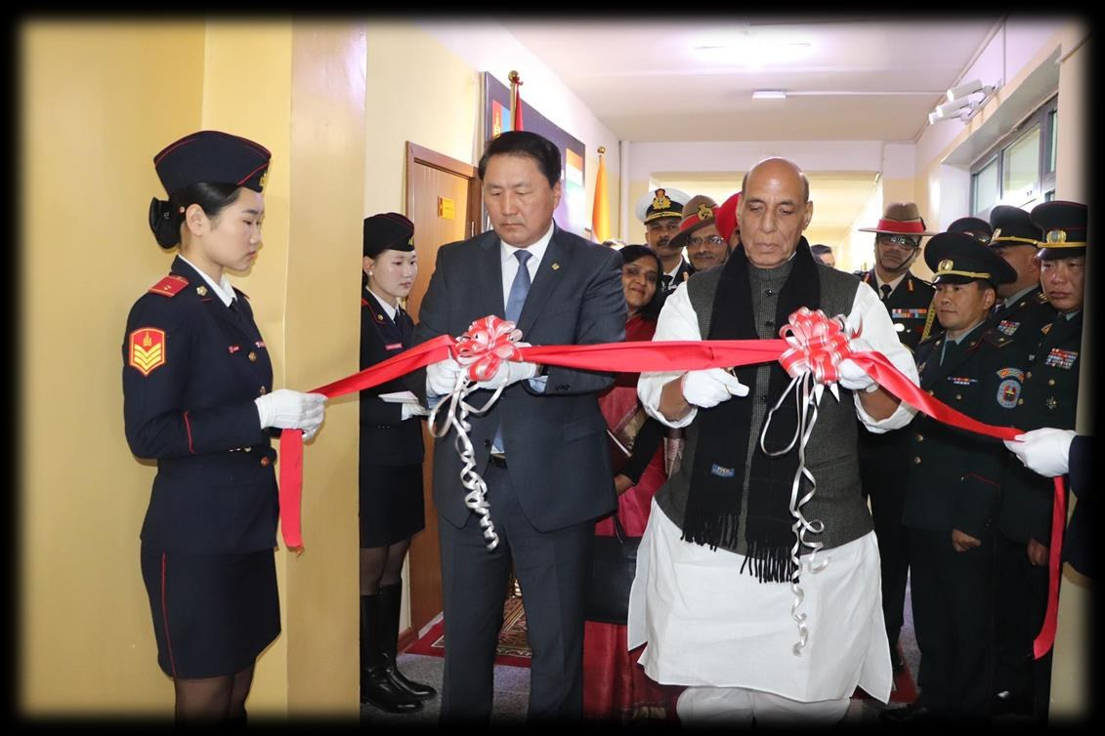
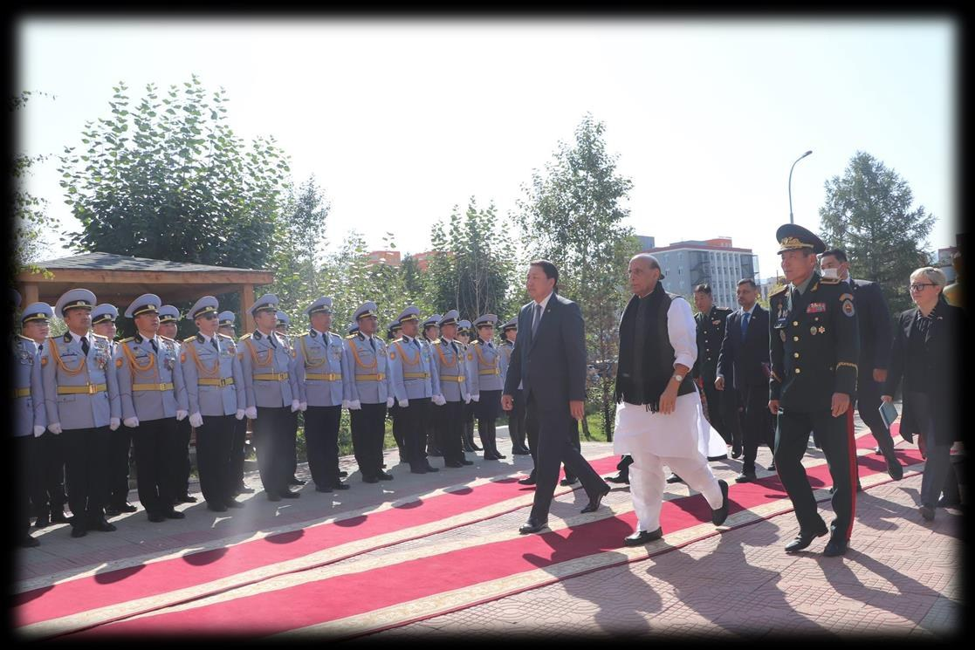
From the 2015 Memorandum to the 2022 inauguration
17 May 2015
Intergovernmental Memorandum. Governments of Mongolia and India agree to establish a Cyber Security Training Centre at the Ministry of Defence of Mongolia
2021
Site prepared, equipment shipped. First floor of the Military Institute building at NDU renovated; two containers dispatched from India (Jul–Nov 2021)
Feb 2022
Delivery to NDU. 93 types of equipment, software and furniture received in Ulaanbaatar
Mar–Jul 2022
Installation and commissioning. C-DAC engineer Sandeep Kumar with the NDU team; LMS and course content installed 20 Jul 2022
Inauguration. Defence Minister G. Saikhanbayar and Raksha Mantri Shri Rajnath Singh open the Centre
6 September 2022: Defence Minister G. Saikhanbayar and Raksha Mantri Shri Rajnath Singh cut the ribbon
6 Sep 2022
Jan 2023
Centre staffed. Head and three teachers appointed (five posts) under the NDU Training Department
Aug 2023
First Indian training team. Mobile training teams of two instructors rotate every four months
Jul 2025
University department. Centre becomes the Cyber Security Department of the Military Institute, NDU
Guard of honour for the Indian Defence Minister at NDU
Notes:
МН: 2015.05.17 санамж бичиг → 2021 барилга бэлтгэл, тээвэрлэлт → 2022.02 хүлээн авалт → 2022.03–07 угсралт (C-DAC, Sandeep Kumar) → 2022.09.06 нээлт → 2023.01 орон тоо → 2023.08 эхний баг → 2025.07 тэнхим.
The Centre took seven years from agreement to opening. The Memorandum was signed on 17 May 2015. In 2021 NDU renovated the first floor of the Military Institute building while two containers of equipment were dispatched from India. They were delivered in February 2022, and from March to July C-DAC's engineer Sandeep Kumar installed and commissioned the laboratories with our team; the e-learning platform went live on 20 July. On 6 September 2022 Defence Minister Saikhanbayar and Raksha Mantri Shri Rajnath Singh opened the Centre. In January 2023 the Ministry created five posts and appointed the head and three teachers; in August 2023 the first Indian training team arrived; and in July 2025 the Centre became a full department of the Military Institute.

Slide 9





India's contribution: a complete, equipped training centre
₮1.3 bn
Compute and network
Digital forensics
7 Cisco UCS C240 servers, NetApp SAN, Cisco switches, WatchGuard M470 firewall and IPS, 37 HP EliteDesk workstations
Tableau duplicators and write-blockers, Cellebrite UFED, Oxygen Forensics, FTK, forensic workstations, Faraday bags
value of Indian supplies (MNT 1,303 million)
₮984.0 m
Malware analysis
Incident response and audit
equipment, furniture and materials – 93 items in two containers
IDA Pro, Hex-Rays x86/x64 decompilers, Sandboxie
Belkasoft, F-Response, Splunk, Nessus, Burp Suite, Acunetix, Netsparker
₮68.9 m
cyber security software and tools – 5 product families
E-learning
Cyber forensic tool kits
₮250.4 m
C-DAC LMS with five courses: awareness, network security, cyber crime investigation, cyber forensics, mobile forensics
CyberCheck, MobileCheck, CDR analyser, SIMXtractor, network session analysers
C-DAC e-learning system and course content
Mongolia provided the premises on the first floor of the Military Institute, their renovation, the Centre's staff and its day-to-day operation.
Notes:
МН: Энэтхэгийн хувь нэмэр: нийт 1.3 тэрбум төгрөгийн тоног төхөөрөмж (984 сая), программ (68.9 сая), e-learning систем (250.4 сая); 37 компьютер, 3 лаборатори, дата төв.
India delivered a complete, equipped centre, not just a classroom. The supplies were worth about 1.3 billion tugrik: 984 million in equipment, furniture and materials, 93 items in two containers; 69 million in cyber security software; and 250 million for C-DAC's e-learning system with five courses. The systems cover the full cyber security workflow: servers, storage and a WatchGuard firewall; Tableau, Cellebrite and Oxygen forensic kits; IDA Pro and Hex-Rays for malware analysis; Belkasoft, Splunk, Nessus, Burp Suite and Acunetix for incident response and audit; and C-DAC's own cyber forensic tool kits. Mongolia provided the premises, their renovation, the staff and the operation.

Slide 10
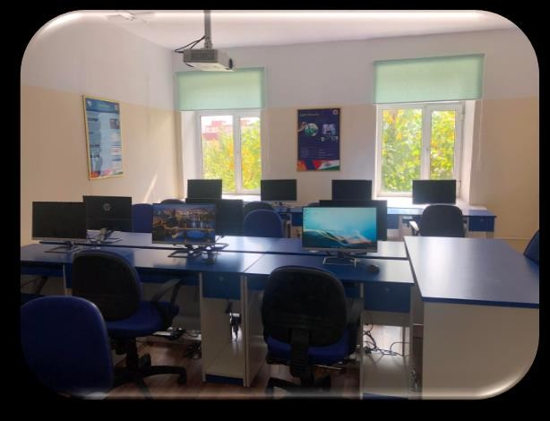
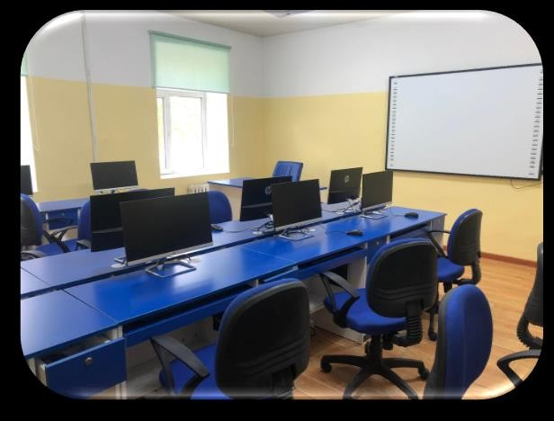
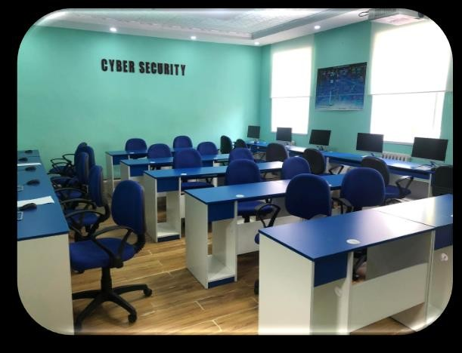
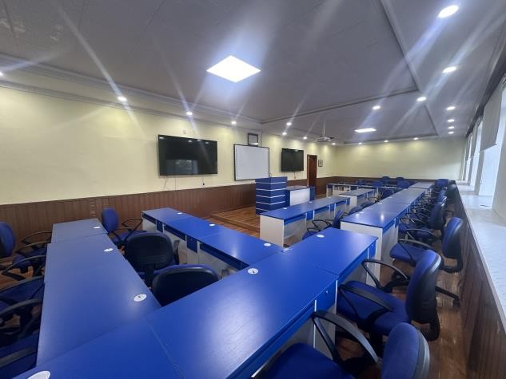
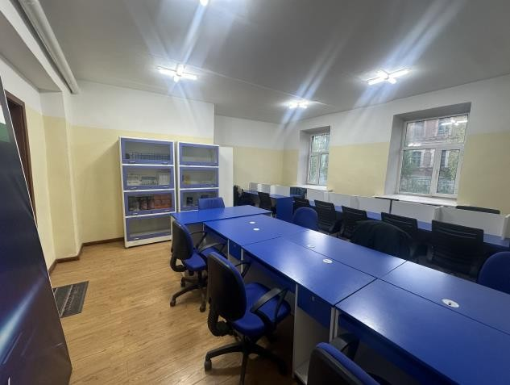
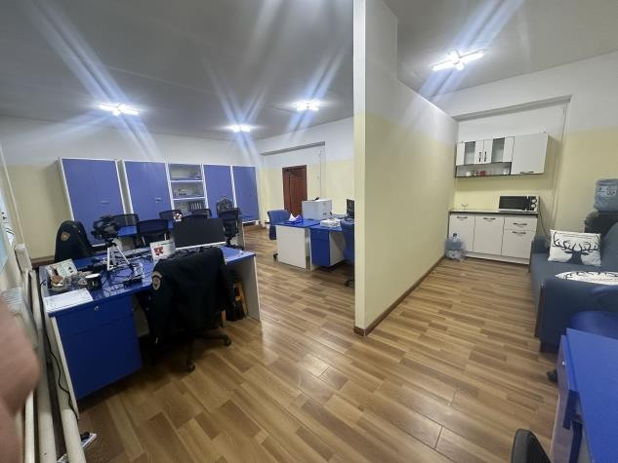
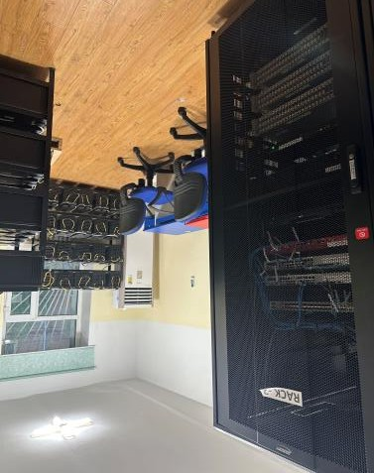
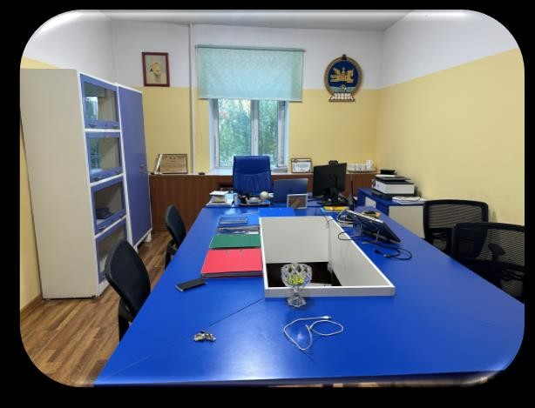
The learning environment: three laboratories and a data centre
Digital forensics laboratory
Malware analysis laboratory
Incident and audit laboratory
Lecture hall
12 workstations
14 workstations
11 workstations
34 seats, smart board, 2 displays
Library
Staff room
Data centre
Head of department
Textbooks and study desks
8 instructor desks
2 racks, servers, SAN, firewall
Office and meeting table
Notes:
МН: Сургалтын орчин: Тоон ул мөрийн лаборатори (12), Хортой код шинжлэх (14), Халдлага илрүүлэх ба аудит (11), 34 суудалтай лекцийн танхим, номын сан, багшийн өрөө (8), 2 рактай серверийн өрөө, даргын өрөө.
This is what the delegation will see on the tour: three laboratories with 37 workstations in total – digital forensics with twelve, malware analysis with fourteen, incident response and audit with eleven – each with smart boards and printers; a 34-seat lecture hall; a library; a staff room for eight instructors; a data centre with two racks hosting the servers, storage, firewall and the e-learning platform; and the head's office.

Slide 11
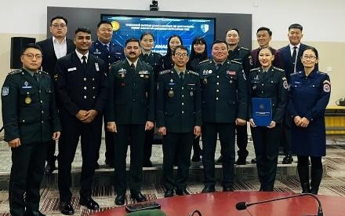

From a training centre to a university department
Mongolian faculty
January 2023: Cyber Security Training Centre, five posts under the NDU Training Department · July 2025: Cyber Security Department of the Military Institute
Captain S. Bilegt Head of Department (since Jan 2023)
Lt Ch. Enkhbaatar Senior teacher · trained in India 2024–25 · MSc 2026
Dr E. Munkhtsetseg Senior teacher · PhD 2026
Faculty, trainees and the Indian training team at the Military Institute
Lt D. Khulan Teacher · MSc 2026
3
162
Ts. Ochir-Erdene Teacher
bachelor programmes: cyber security, network engineering, software engineering (military)
credits of bachelor teaching in the first half of 2026 (156 in all of 2025)
G. Enkhtuul Teacher
13
1st
J. Munguntsetseg Teacher
specialised course units rewritten in 2026 to the national standard
civilian cyber security cohort graduated, state exam 27 May 2026
Notes:
МН: 2023 оны 1 сард 5 орон тоотой төв → 2025 оны 7 сард ЦНС-ийн Кибер аюулгүй байдлын тэнхим: 7 багш, 3 бакалаврын хөтөлбөр, 162 кредит, анхны төгсөлт 2026.05.27.
The Centre began in January 2023 with five posts: Captain Bilegt as head and three teachers. In July 2025 it was restructured into the Cyber Security Department of the Military Institute, which now runs NDU's bachelor programmes in cyber security, network engineering and software engineering. The faculty has grown to seven; two defended master's degrees and one a doctorate this year, and Lieutenant Enkhbaatar trained in India. In 2026 the Department delivered 162 credits of bachelor teaching, rewrote thirteen course units to the national standard, and graduated its first civilian cyber security cohort in May.

Slide 12
Indian engineers and training teams at the Centre, 2022–2026
Team | Period | Members | Courses and contribution
C-DAC | Mar 2022 – Apr 2023 | Sandeep Kumar; resident engineers Vikash Sharma, Taranjeet Singh | Installation and commissioning (13 months); teacher training Sep–Oct 2022; laboratory tools course Apr 2023
1 | Sep – Dec 2023 | Gp Capt (Dr) M.K. Sharma, Sgt Vinod Kumar Sharma | Instructor programme (4 modules); network security; malware analysis
2 | Jan – Apr 2024 | Gp Capt Saurabh Malhotra, Sgt Durairaj A. | Cyber security basic course (networking, network security, cyber security)
3 | May – Aug 2024 | Wg Cdr P.A. Siddapur, Hav Amal Raj | Ethical hacking (10 weeks)
4 | Sep – Dec 2024 | Wg Cdr Rakesh Kumar Siwal, Sgt Mohit Panchal | SOC analyst; digital forensics
5 | Jan – Apr 2025 | Lt Cdr Vikash, Sgt Rajendra Kumar Jat | Network administration; cryptography and data security
6 | May – Aug 2025 | Lt Cdr Shubham Singh, Hav Ponnaganti Srinivasulu | Vulnerability assessment and penetration testing; cyber security audit
7 | Sep – Dec 2025 | Wg Cdr Kishore Yadav, PO Harisankar P.P. | Foundation of cyber security (10 weeks): OS, network security, programming, data security, red/blue team
8 | Dec 2025 – Mar 2026 | Names per department records | Blue team: SOC analyst, malware analysis, digital forensics, audit
9 | Mar – Jul 2026 | Names per department records | Advanced: VAPT, CERT operations, military cyber security operations
Two-instructor mobile training teams from the Indian Air Force, Navy and Army rotate every four months under the jointly approved training plan.
RED ROWS – names to be completed from records
Notes:
МН: Энэтхэгийн инженерүүд (C-DAC, 13 сар) болон 9 сургалтын баг (2023.09–2026.07), баг тус бүр 2 багш, 4 сар. 8, 9-р багийн нэрсийг тэнхимийн бүртгэлээс нөхнө.
Indian expertise has been on site continuously since March 2022. C-DAC's engineers stayed for thirteen months, trained our teachers in September 2022 and ran the laboratory tools course in April 2023. Since August 2023 nine mobile training teams of two instructors, drawn from the Indian Air Force, Navy and Army, have rotated every four months under the plan the two sides approved for 2024–2026, each delivering one or two specialised courses. [Walk through the table.] Beyond the classroom, the rotation keeps our curriculum aligned with Indian service practice and has built personal links between the two services.

Slide 13
Results 2022–2026
03
What the partnership has delivered in four years
Notes:
МН: Хэсгийн хуудас.
Part three: results.

Slide 14
More than 300 specialists trained with Indian teams since 2022
Trainees per course cohort, September 2022 – June 2025
300+
specialists of military and law-enforcement agencies trained with Indian teams, 2022–2026 (NDU letter, Oct 2026)
211
trainees in the 13 cohorts charted here (Sep 2022 – Jun 2025); the 7th–9th team cycles add the balance
20
credits of specialised training delivered with the Indian team in the first half of 2026 alone
Notes:
МН: Сургалтын үр дүн: 2022.09–2025.06-д 13 ээлжид 211 хүн (график); 2022–2026 онд нийт 300 гаруй мэргэжилтэн (ҮБХИС-ийн 2026.10.09-ний албан бичиг); 2026 оны эхний хагаст 20 кредит.
The chart shows every course cohort from the first teacher training in September 2022 to the audit course in June 2025: thirteen cohorts, 211 trainees, with the largest intakes in the basic course, network administration and penetration testing. The seventh, eighth and ninth teams then ran the foundation, blue-team and advanced cycles through July 2026. In total, as NDU reported to the Ministry this month, more than three hundred specialists of the military and law-enforcement agencies have been trained with the Indian teams, and in the first half of 2026 alone the Department delivered twenty credits of specialised training with them.

Slide 15
A jointly approved curriculum: nine training phases, 2023–2026
1
Sep–Dec 2023
2
Jan–Apr 2024
3
May–Aug 2024
Instructor programme · Certificate course (network security, malware analysis)
Basic and intermediate cyber security: networking, network security, cyber security
Certified Ethical Hacker (12 weeks) · Coding basics (4 weeks)
4
Sep–Dec 2024
5
Jan–Apr 2025
6
May–Aug 2025
Malware analysis (8 weeks) · Digital forensics (8 weeks)
Network administrator (8 weeks) · Data security · Cryptography
Vulnerability assessment and penetration testing (12 weeks) · Cyber security audit
7
Sep–Dec 2025
8
Dec 2025–Mar 2026
9
Mar–Jul 2026
Foundation: operating systems, network security, programming, data security and cryptography, red/blue team concepts
Defensive (Blue Team): SOC analyst, malware analysis, digital forensics, cyber security audit
Advanced: VAPT (5 weeks), CERT operations (5 weeks), military cyber security operations (4 weeks)
Plan approved by the NDU Rector with the Indian training teams in 2024; phases 7–9 (orange) are the 2025–26 professional cycle. Course programmes exist in English and Mongolian.
Notes:
МН: 2024–2026 оны хамтарсан сургалтын төлөвлөгөө: 9 үе шат – багш бэлтгэх, үндсэн курс, CEH, хортой код/тоон ул мөр, сүлжээний админ/крипто, VAPT/аудит, суурь, хамгаалалт (Blue Team), ахисан түвшин.
Rather than ad-hoc courses, the two sides agreed a nine-phase curriculum running from instructor training in 2023 through basic, ethical hacking, malware and forensics, network administration and cryptography, penetration testing and audit, to the 2025–26 professional cycle: a ten-week foundation, a defensive blue-team block and an advanced block ending with CERT operations and military cyber security operations. Each phase matches one training team. All course programmes were written in English and Mongolian, so the Department can repeat them without the Indian team.

Slide 16

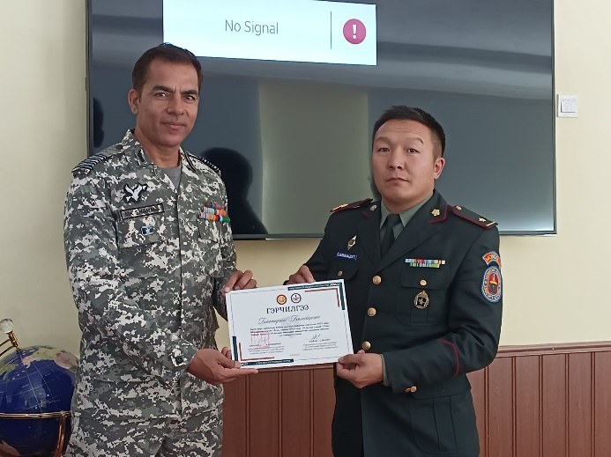

Who we train: the whole military and law-enforcement sector
Cyber Security Military Command of the Armed Forces – principal partner; its officers formed the first cohorts (2023)
8
22
Armed Forces units and the General Staff – e.g. awareness training for units 016 and 011 (2025–2026)
training contracts with agencies and individuals for paid specialised courses (2025–2026)
high-school pupils certified in the 2025 career-outreach programme
3
27 May 2026
NDU faculty, cadets and students – instructor programme (2023) and 156–162 credits of bachelor teaching a year
bachelor programmes run by the Department: cyber security, network engineering, software engineering (military)
state examination of the first civilian cyber security bachelor cohort
Law-enforcement and security agencies – General Intelligence Agency, State Special Protection, Capital Emergency Department
National programmes – executor of the National Security Council's cyber capacity programme (2025)
Certificates presented with the Indian training team
Notes:
МН: Сургалтад хамрагдагчид: Кибер аюулгүй байдлын цэргийн командлал, ЗХ-ний нэгтгэл, анги (016, 011), ҮБХИС-ийн багш, сонсогч, ТЕГ, ТТХГ, НОБГ, ҮАБЗ-ийн хөтөлбөр; 8 гэрээ, 22 сурагч, 3 бакалаврын хөтөлбөр, анхны төгсөлт.
The Centre serves the whole sector, not only the Armed Forces. The Cyber Security Military Command sent the very first cohort in April 2023 and remains our principal partner. Units and the General Staff receive awareness training; NDU's own faculty and cadets were trained first so that the courses could be repeated; the General Intelligence Agency, the State Special Protection Agency and the Capital Emergency Department send specialists under training contracts; and in 2025 the Department was selected to execute the National Security Council's cyber capacity programme. The Department also runs three bachelor programmes and graduated its first civilian cohort in May.

Slide 17
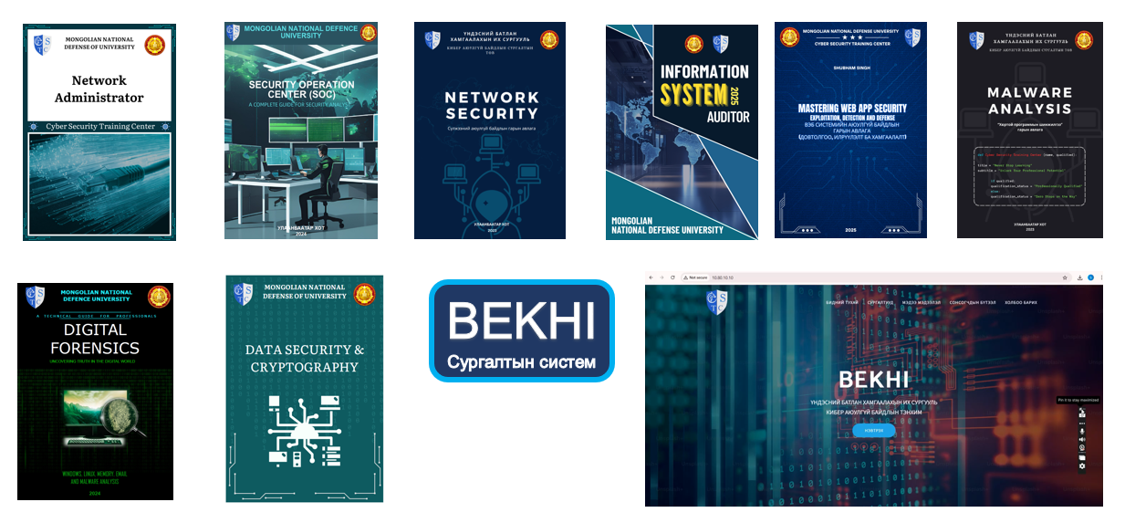
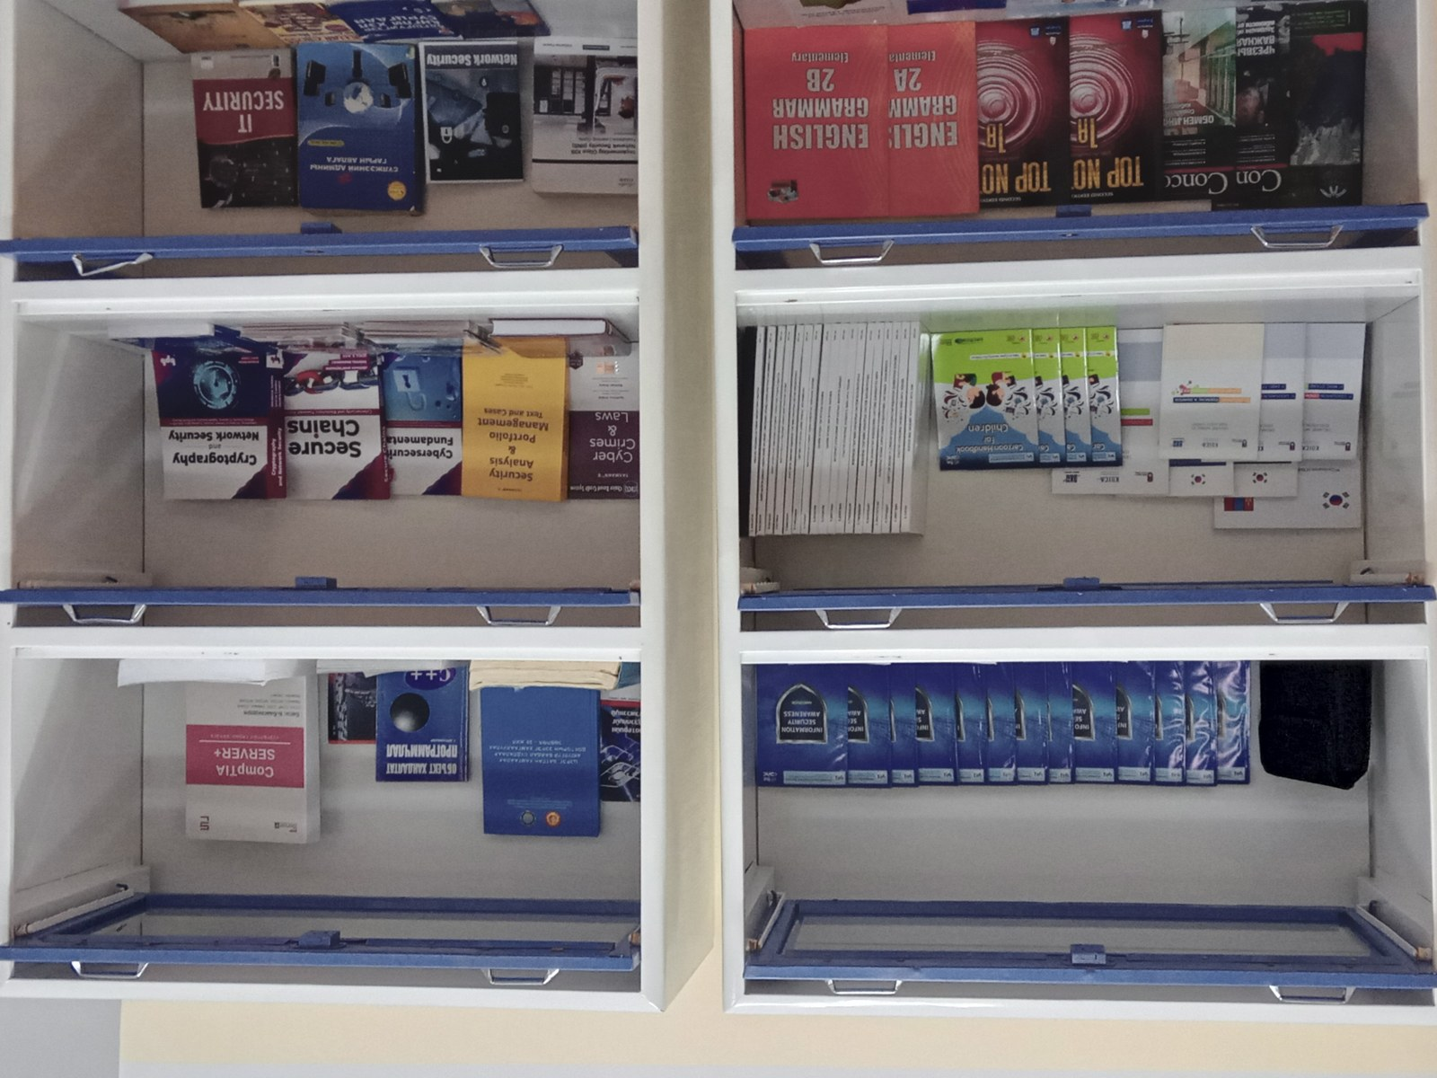


Research, textbooks and innovation built on the Centre
8 English-language textbooks with ISBN (2025)
Network security, malware analysis, digital forensics, SOC analyst, network administrator, data security and cryptography, web security, information systems audit – 20 copies each in the NDU library
BEKHI learning system
Developed by the faculty; in use since 2025–26 with BigBlueButton, Articulate 360 and H5P. Best innovation, NDU Academic Conference 2025; 2nd place, Defence Minister's STI award 2025
Eight English-language textbooks compiled by the Department (2025) and the BEKHI learning system
Publications and conferences
8 journal articles in 2025 (MN/EN/RU); sector conference 'Cyber security: current state, change and reform', 2–3 Feb 2026, with five universities and academies
Competitions
DefendX-2024 and DefendX-2026 skills competitions; 1st place at the 14th National Computer Network Olympiad 2026 (cadet B. Bat-Orgil)
Notes:
МН: Судалгаа, инновац: ISBN бүхий 8 сурах бичиг (2025), БЭХИ сургалтын систем (ҮБХИС-ийн шилдэг инновац 2025, БХ-ын сайдын шагналын дэд байр), 8 өгүүлэл, 2026.02 салбарын ЭШ хурал + DefendX, олимпиадын тэргүүн байр.
The Indian curriculum has become the seed of our own research and teaching material. In 2025 the faculty compiled eight English-language textbooks with ISBNs, from network security to information systems audit, now in the NDU library. They built the BEKHI learning system, which won the best-innovation award at the 2025 NDU Academic Conference and second place in the Defence Minister's science and technology award, and published eight articles. In February 2026 the Department hosted the sector conference with five universities and academies alongside the DefendX-2026 competition, and our cadet won the national computer network olympiad.

Slide 18
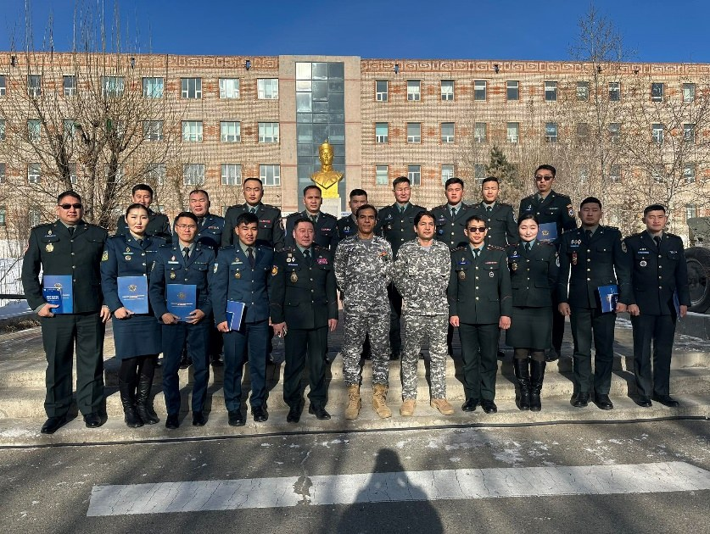
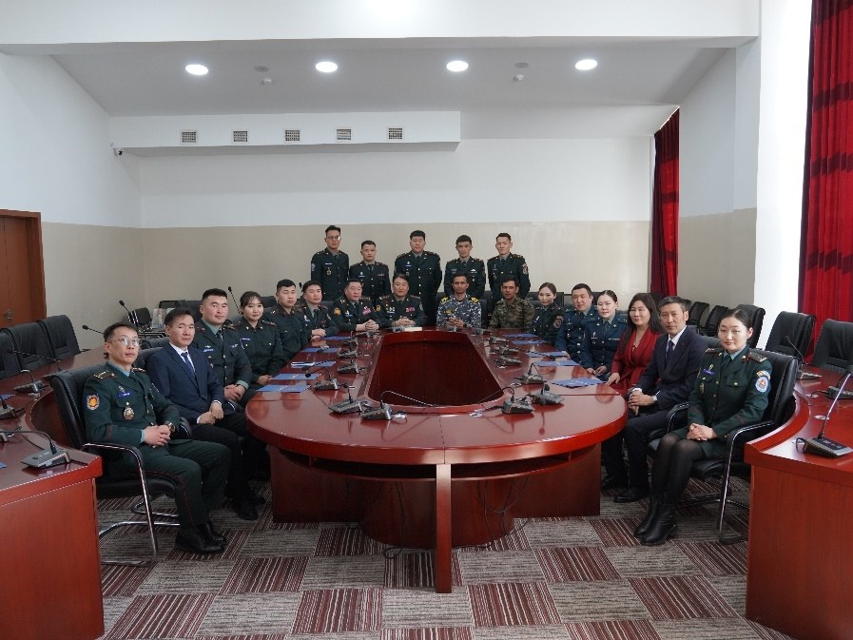
Faculty development and a widening partner network
Faculty development
Partners beyond India
Lt Ch. Enkhbaatar completed a cyber security professional course in India (2024–25)
One PhD and two master's degrees defended by the faculty (2026)
Short courses in Germany, Japan and the USA (2026); APNIC network security training
Pacific Endeavor 2023 (US INDOPACOM); ITACTIC incident-response command-post exercise and the Asia-Pacific cyber exercise (2025)
Cyber Security Military Command – joint training with US INDOPACOM cyber specialists (2025), DefendX competitions
National Security Council working office – executor of the national cyber capacity programme (2025)
MNCERT/CC, MUST, NUM, Internal Affairs University, Network Engineers' Association
Industry – 'Cyber and Digital Defense' day with Ember Cyber Service (Jan 2026); cadet internships at the national CERT, ICN and Unitel
Notes:
МН: Багшийн хөгжил: Энэтхэгт суралцсан, доктор 1, магистр 2, ХБНГУ/Япон/АНУ-ын сургалт, Pacific Endeavor, ITACTIC. Түншүүд: КАБЦК, ҮАБЗ, MNCERT, их сургуулиуд, хувийн хэвшил, дадлага.
The Indian investment is multiplied by the growth of our own people. Lieutenant Enkhbaatar trained in India; this year the faculty defended one doctorate and two master's degrees and attended courses in Germany, Japan and the United States; and the head took part in Pacific Endeavor and the ITACTIC incident-response exercise. The Centre also anchors a wider network: joint training with the Cyber Security Military Command and US Indo-Pacific Command specialists, the National Security Council's capacity programme, the national CERT, three universities, and industry partners who host our cadets for internships.

Slide 19

Continued Indian support: the 2025 upgrade and licence renewal
37
Supply order IDS/DCyA/D/Mongolia/2025-26 of 10 June 2025 – Defence Cyber Agency and C-DAC
workstations upgraded: 16 GB RAM, 2 GB graphics card and 1 TB disk each – commissioned 6 Nov 2025
Forensics
Exterro FTK · Cellebrite Inseyets · Oxygen Detective · Belkasoft Evidence Center · F-Response Tactical · Stellar Data Recovery
15
Malware and vulnerability
software products renewed or newly licensed, activated 30 Sep – 7 Nov 2025
IDA Pro · Nessus Pro (128 IPs) · Burp Suite ×5 · Acunetix · Invicti
Data centre racks
2
Platform
VMware vSphere Foundation · VMware Workstation Pro ×10 · Red Hat Enterprise Linux ×5 · WatchGuard M470 subscription ×2
shipments cleared through Mongolian customs, 7 Sep and 13 Oct 2025
Upgraded workstations
Notes:
МН: 2025 оны шинэчлэл: 2025.06.10-ны нийлүүлэлтийн захиалга (DCyA/C-DAC), 37 компьютерийн RAM/видео карт/диск шинэчлэл (2025.11.06 суурилуулсан), 15 программын лиценз (2025.09.30–11.07), гааль 09.07, 10.13.
India's support did not stop at the inauguration. Under a supply order of 10 June 2025 from the Defence Cyber Agency, executed by C-DAC, all 37 workstations received new memory, graphics cards and one-terabyte disks, commissioned on 6 November 2025, and fifteen professional licences were renewed or newly issued between September and November: the forensic suites FTK, Cellebrite, Oxygen and Belkasoft, IDA Pro, Nessus, Burp Suite, Acunetix and Invicti, the VMware and Red Hat platforms and the firewall subscription. The Department organised customs clearance with the Ministry and installed the items with the C-DAC engineer.

Slide 20
Milestones of the cooperation, 2022–2026
Sep 2022
Centre inaugurated
Feb 2025
13th Joint Working Group
Raksha Mantri's first visit to Mongolia
New Delhi
Jan 2023
Centre staffed
Jul 2025
University department
Head and three teachers appointed by the MoD
Centre becomes the Cyber Security Department
Feb 2023
11th Joint Working Group
Oct 2025
State visit to India
New Delhi – first in-person JWG after the pandemic
70 years of relations; Defence Wing in Ulaanbaatar announced
Aug 2023
First training team
Nov 2025
Upgrade commissioned
Indian mobile training teams begin four-month rotations
Hardware and licence renewal; Defence Attaché visits the Department
May 2024
12th Joint Working Group
Jul 2026
Project phase completed
Ulaanbaatar; 2024–2026 joint training plan approved
Instructor deployment extended to 2029 under the MoU
2024
Ambassador's visit
2026
14th Joint Working Group
Indian Ambassador reviews the Centre and upgrade needs
Ulaanbaatar – delegation visits the Department
India-led
Joint
Mongolia-led
Notes:
МН: Он дарааллын гол үйл явдлууд: нээлт, орон тоо, JWG 11–13, эхний баг, 2024–26 төлөвлөгөө, Элчин сайдын айлчлал, тэнхим, Төрийн айлчлал, 2025 шинэчлэл ба Атташегийн айлчлал, төсөл дууссан 2026.07, багш 2029 хүртэл, JWG-14.
Put on one timeline, the cooperation shows a steady rhythm: an institutional step on the Indian side, a step on ours, and a Joint Working Group each year to review it. The Ambassador's visit in 2024 led to the 2025 upgrade; the President's visit in October 2025 and the new Defence Attaché, who visited the Department last November, have given the partnership a permanent channel in Ulaanbaatar. The project phase formally ended in July 2026, but under the intergovernmental Memorandum instructor deployment has already been extended to 2029 – which brings us to the proposals.

Slide 21


Lessons learned and current challenges
What worked
Challenges for the next phase
Shared model: Indian technology, curriculum and instructors; Mongolian premises, staff and management
Resident C-DAC engineers for 13 months – courses started within weeks of inauguration
A jointly approved three-year training plan (2024–2026) with two-instructor teams rotating every four months
Course programmes written in English and Mongolian and run under MoD and NDU orders
Trainees drawn from the whole military and law-enforcement sector
India's 2025 licence and hardware renewal kept the laboratories current
2023 review: faculty at 100% load while classrooms were 50% used – more instructors needed (addressed by the 2025 restructuring into a department)
Nationally recognised professional certification for the Centre's courses is still pending
No cyber range or online training platform for units outside Ulaanbaatar – requested since 2024
Budget limits: the 2025 sector conference and the 2026 e-learning research laboratory (MNT 30 m) were postponed
Continuity between four-month instructor rotations
The project phase ended in July 2026 – a Phase II framework is needed beyond instructor deployment
Notes:
МН: Сургамж: хамтын загвар, суурин инженер, 3 жилийн төлөвлөгөө, хоёр хэлний хөтөлбөр, салбар даяар сонголт, 2025 шинэчлэл. Сорилт: багшийн хүрэлцээ (2023), гэрчилгээ, кибер полигон/онлайн платформ, төсөв, залгамж халаа, II шатны хүрээ.
Let me be candid, because the lessons shape our proposals. What worked: the shared delivery model, resident engineers in the first year, a three-year plan with four-month rotations, bilingual course programmes, sector-wide recruitment, and India's 2025 renewal. The challenges: our 2023 review found the faculty fully loaded while classrooms were half used – more instructors were needed, which the 2025 restructuring partly addressed; our certificates still lack national professional recognition; we have no cyber range or online platform for units outside the capital, which we have asked for since 2024; budget limits postponed a conference and a laboratory; each rotation needs a handover; and with the project phase closed in July 2026 we need a Phase II framework.

Slide 22
The road ahead
04
Proposals for the next phase of cooperation, 2026–2030
Notes:
МН: Хэсгийн хуудас.
Part four: our proposals.

Slide 23

Four directions proposed by NDU on 9 October 2026
1 · Joint education
2 · Laboratories and research
Joint bachelor, master's and doctoral programmes in cyber security
Exchange of faculty, cadets and researchers
Double-degree programmes with Indian universities
Cyber Range and Security Operations Centre laboratory
Joint research centre: IoT, AI, big data, quantum cryptography
Cyber security laboratory for UAV and remotely operated systems
3 · Faculty capacity
4 · International cooperation
Train Mongolian faculty and researchers at Indian defence universities and research institutions
Joint programme for cyber security instructors
Joint participation in ITU Cyberdrill, FIRST and APCERT exercises
Biennial Mongolia–India Cyber Security Forum
Regular joint conferences, seminars, courses and exercises
Instructor deployment has already been extended to 2029 under the intergovernmental Memorandum; these directions build the next layer on it.
Notes:
МН: ҮБХИС-ийн 2026.10.09-ний 01/1171 албан бичгийн 4 чиглэл: хамтарсан сургалт (бакалавр/магистр/доктор, солилцоо, хос диплом); лаборатори (Cyber Range, SOC, IoT/AI/их өгөгдөл/квант, НННХ); багшийн чадавх; олон улсын хамтын ажиллагаа (ITU Cyberdrill, FIRST, APCERT, 2 жил тутмын форум).
On 9 October NDU sent the Ministry of Defence four directions for the next phase, and we are grateful that the Ministry proposed them for this Joint Working Group. First, joint education: joint bachelor, master's and doctoral programmes, exchanges, and double degrees. Second, laboratories and research: a cyber range and SOC laboratory, a joint research centre on IoT, AI, big data and quantum cryptography, and a laboratory for the cyber security of unmanned and remotely operated systems. Third, faculty capacity: training our faculty at Indian defence universities and a joint programme for cyber security instructors. Fourth, international cooperation: joint participation in ITU Cyberdrill, FIRST and APCERT exercises, a biennial Mongolia–India Cyber Security Forum, and regular joint events.

Slide 24
Proposed roadmap 2026–2030
2026
2027
2028
2029
2030
Indian training teams (to 2029 under the MoU)
continuous four-month rotations
Cyber Range and SOC laboratory
assessment, design
install, commission
Joint and double-degree programmes
design, accredit
first intakes
Faculty training in India
two faculty a year
Joint research centre (IoT, AI, quantum)
establish and operate
Mongolia–India Cyber Security Forum
1st forum
2nd forum
ITU Cyberdrill · FIRST · APCERT
joint participation every year
India-led
Joint
Mongolia-led
Milestones: 14th JWG (2026) agrees the package · C-DAC / Defence Cyber Agency technical assessment (2027) · first Forum (2027) · Cyber Range and SOC laboratory operational (2028) · review of the Memorandum's instructor term (2029)
Notes:
МН: Замын зураг 2026–2030: багш нар 2029 хүртэл; Cyber Range/SOC 2027 үнэлгээ → 2028 ашиглалт; хамтарсан хөтөлбөр 2027 боловсруулах → 2028 элсэлт; багш нарын сургалт жил бүр; судалгааны төв 2028–; форум 2027, 2029; ITU/FIRST/APCERT жил бүр.
Put on a timeline, the package looks like this. Instructor rotations continue to 2029 as already agreed. A technical assessment in 2027 leads to a cyber range and SOC laboratory operational in 2028. Joint and double-degree programmes are designed and accredited in 2027 so that the first intakes start in 2028. Two faculty members a year train in India from 2027. The joint research centre follows in 2028. The first Mongolia–India Cyber Security Forum is held in 2027 and the second in 2029, and from 2027 we take part together in the ITU, FIRST and APCERT exercises. In 2029 the Memorandum's instructor term comes up for review.

Slide 25
Proposals for the 14th Joint Working Group
We respectfully request the Indian side to consider:
1
Include the expansion of the Cyber Security Training Centre project (Phase II) in the agenda and minutes of the 14th Joint Working Group
2
Confirm instructor deployment to 2029 and approve a 2027–2029 joint training plan on the model of the 2024–2026 plan, with a train-the-trainer track for Mongolian faculty.
3
Agree a Phase II laboratory project – Cyber Range and SOC laboratory with a C-DAC / Defence Cyber Agency technical assessment in 2027.
4
Open seats for Mongolian faculty at Indian defence universities and research institutions from 2027 and start the design of joint and double-degree programmes.
5
Hold the first Mongolia–India Cyber Security Forum in 2027 and take part together in ITU Cyberdrill, FIRST and APCERT exercises.
Notes:
МН: 14 дэх зөвлөлдөх уулзалтад оруулах 5 санал: II шатыг протоколд тусгах; багш 2029 хүртэл + 2027–2029 төлөвлөгөө; Cyber Range/SOC лаборатори (2027 үнэлгээ); багшийн суудал, хамтарсан хөтөлбөр; 2027 форум, ITU/FIRST/APCERT.
To turn the roadmap into decisions, we put five proposals to the fourteenth Joint Working Group. One: record the expansion of the Centre project, Phase II, in the agenda and minutes. Two: confirm instructor deployment to 2029 and approve a 2027–2029 joint training plan with a train-the-trainer track. Three: agree a Phase II laboratory project – cyber range and SOC – with a technical assessment in 2027. Four: open seats for our faculty at Indian defence universities from 2027 and start designing joint and double-degree programmes. Five: hold the first Mongolia–India Cyber Security Forum in 2027 and take part together in the international exercises. Each builds directly on what already exists in this building.

Slide 26
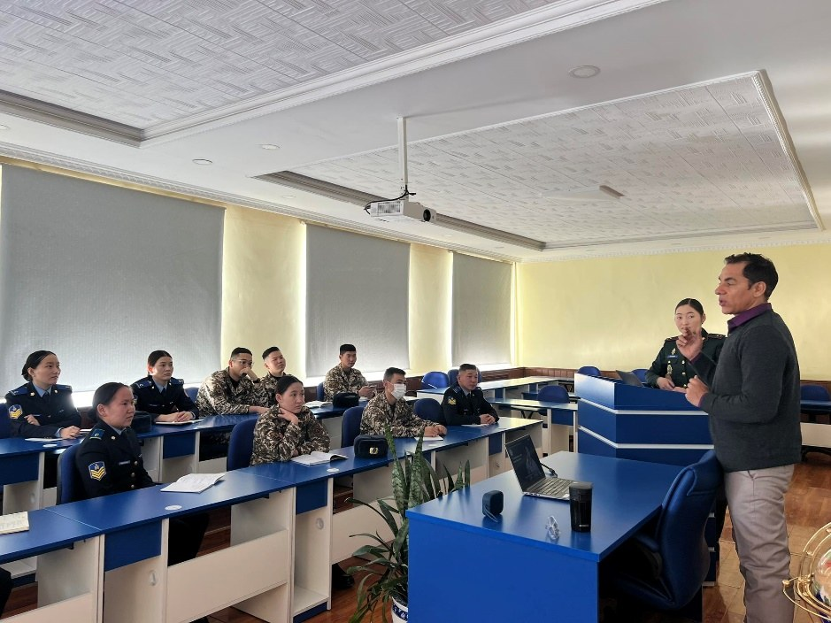
Thank you
Cyber Security Department, Military Institute, National Defence University of Mongolia
Built with India. Run by Mongolia. Serving the whole sector.
Head of Department: Captain S. Bilegt · www.mndu.gov.mn
Graduates with the Indian training team, NDU
Questions and discussion, followed by a tour of the laboratories
Notes:
МН: Баярлалаа. Асуулт, хэлэлцүүлэг; лабораторийн аялал.
Thank you. This Department is the most tangible product of India–Mongolia defence cooperation: built with India, run by Mongolia, and serving the whole security sector. We welcome your questions, and then invite you to see the laboratories.

