Slide 1
Analysis of Dark Ship-to-Ship Transfer Patterns
in the Eastern Mediterranean
SAMPLE OSINT TRAINING REPORT | Portfolio Demonstration
Prepared by: Mohanad Issa
Aspiring CTI & OSINT Analyst
Certified: ArcX CTI 101 | Basel OSINT | Google Cybersecurity
DISCLAIMER: Training report using simulated & public data for portfolio only. No real vessels accused.

Slide 2
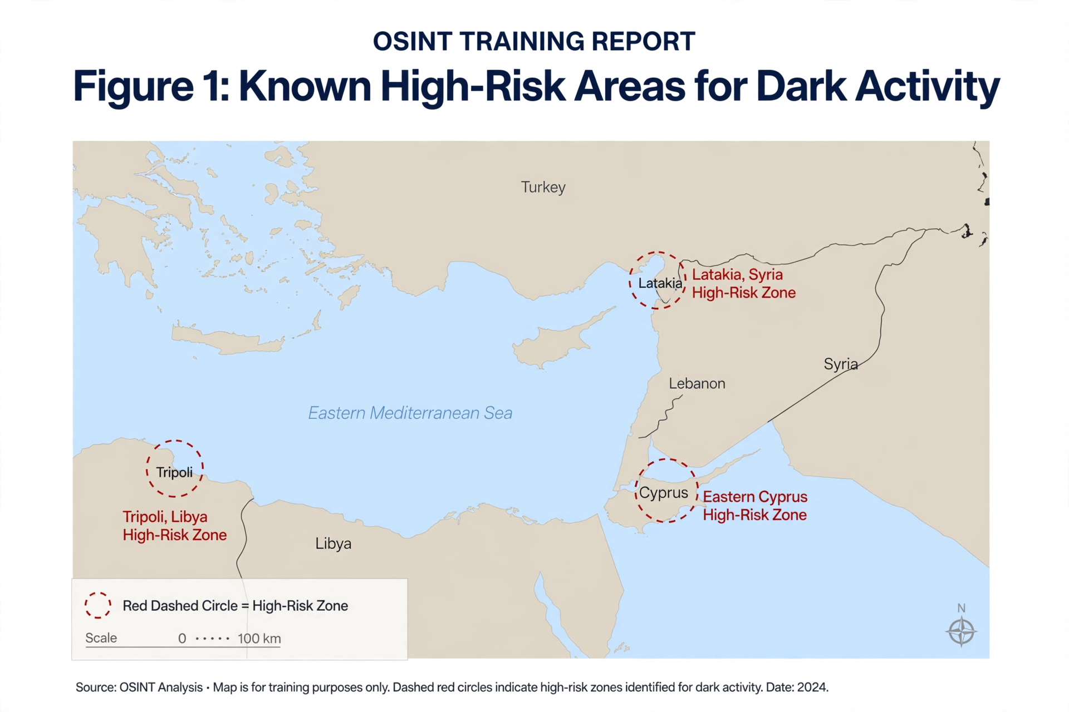
01 | Executive Summary & Objective
Objective:
Analyze common tactics used for dark STS operations to evade sanctions in Eastern Mediterranean using OSINT.
Key Findings:
• Most common pattern = AIS gap 48-72h + proximity to sanctioned coastlines
• Open-source imagery verification is critical
• Combination of AIS data + imagery = strongest indicator
Confidence Level: N/A - Training Purposes
Classification: UNCLASSIFIED - Training Example
Why This Matters:
Companies like Kpler, ZeroFox, Airbus use same methodology.

Slide 3
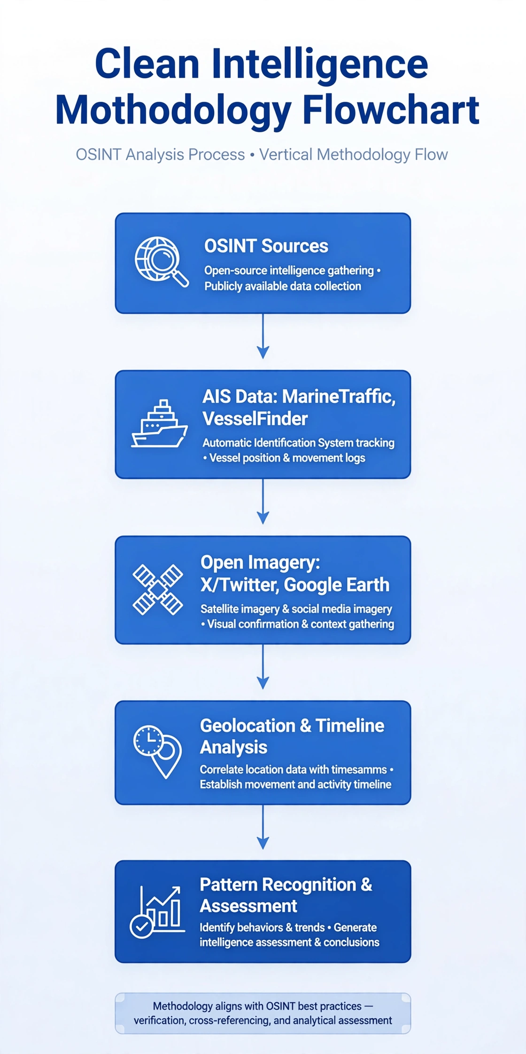
02 | Methodology & OSINT Tradecraft
Tools Used:
• MarineTraffic - Tracking vessel movements & AIS gaps
• VesselFinder - Cross-referencing AIS data
• Google Earth Pro - Geolocation verification
• X Advanced Search - Open imagery discovery
• Canva / PowerPoint - Visualization
MITRE ATT&CK Mapping:
Tactic: Defense Evasion
Technique: T1070 - Impair Defenses
OSINT Best Practices:
Verification, Cross-referencing, Analytical Assessment, Transparency
Skills: AIS Analysis, Geolocation, Timeline, Report Writing

Slide 4
03 | High-Risk Areas - Eastern Mediterranean

Slide 5
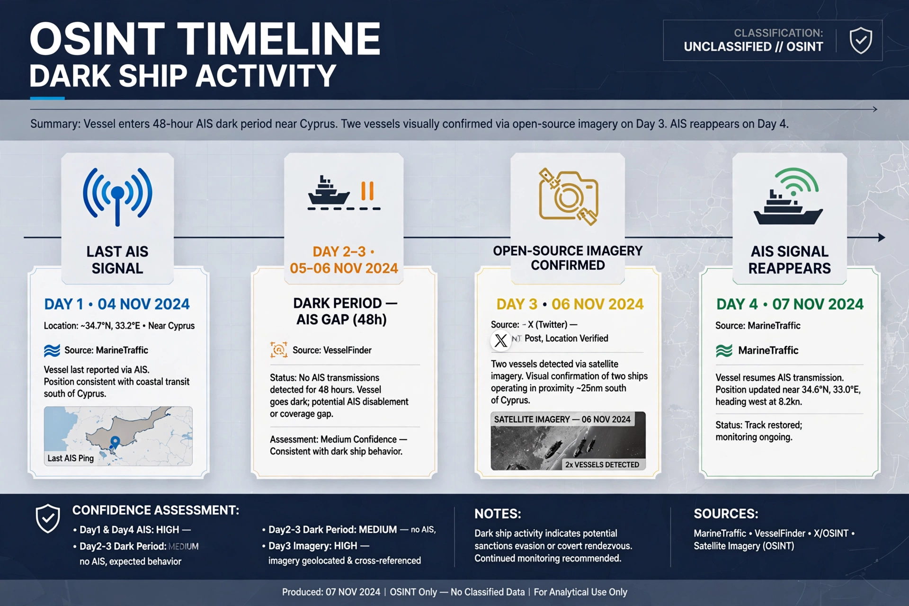
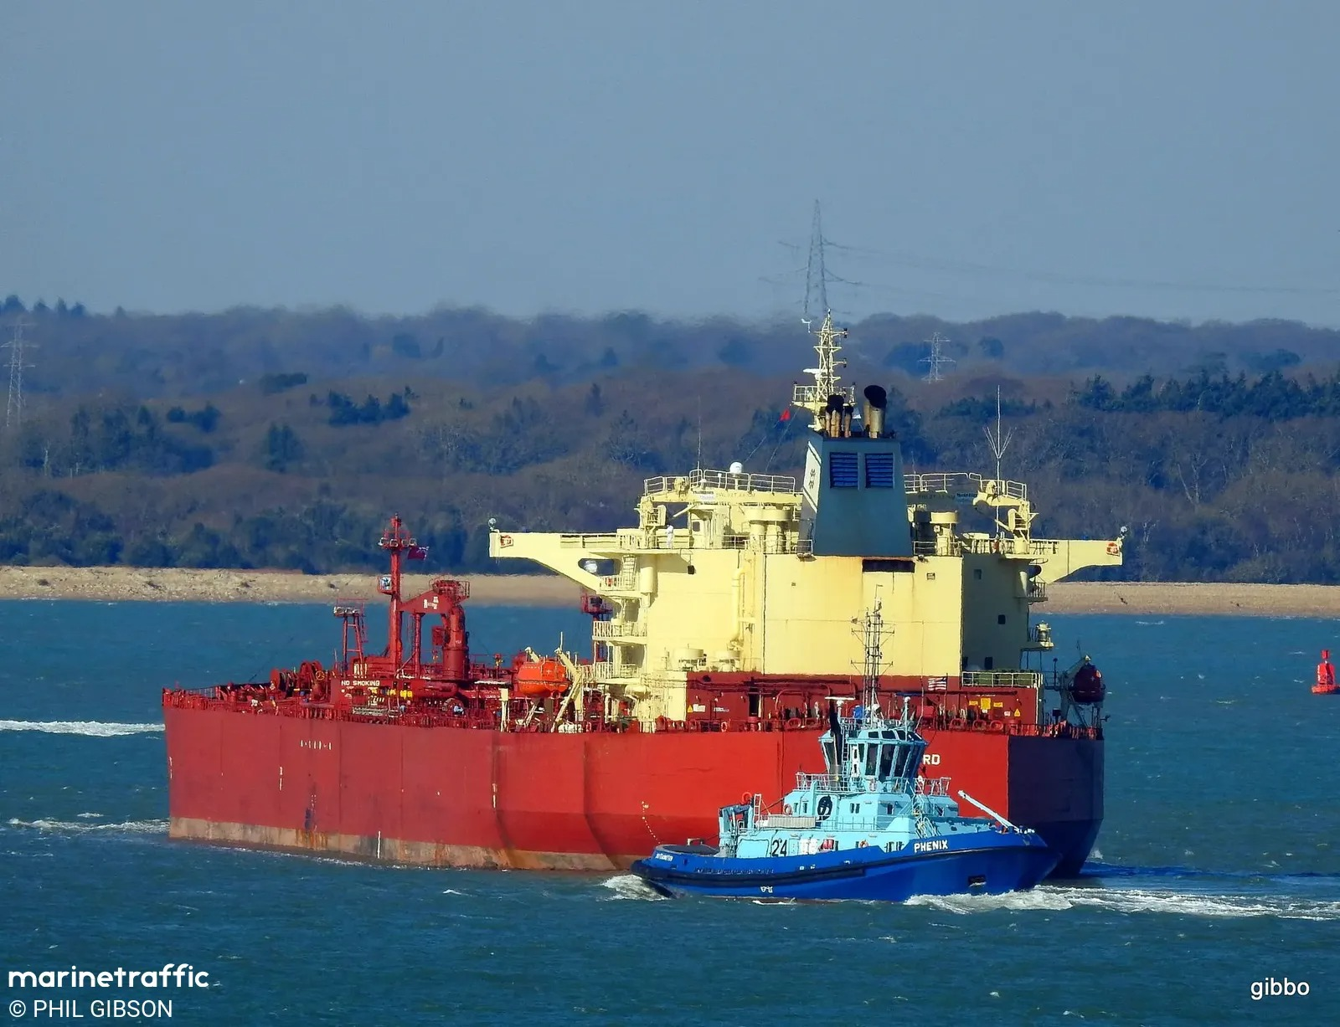
04 | Simulated Case Study - Illustrative Scenario (No Real Vessel)
Scenario: Tanker A enters region, exhibits 48h AIS gap near Cyprus, open-source image shows two vessels in proximity. This is a FICTIONAL example.
Timeline (Simulated Data):
Day 1 | Last AIS signal near Cyprus | MarineTraffic (Illustrative)
Day 2-3 | Dark Period 48h AIS gap | VesselFinder (Simulated)
Day 3 | Open-source image | X Post - Location Verified (Training)
Day 4 | AIS reappears | MarineTraffic
Figure 4a: Illustrative Crude Oil Tanker - Training Example | Source: MarineTraffic © PHIL GIBSON - Vessel identity redacted.

Slide 6
05 | Key Indicators, Recommendations & Skills
Key Indicators of Dark STS:
1. Long AIS Gap (>24h) in high-risk zones
2. Proximity to sanctioned coastlines
3. STS-capable vessels in same area
4. Imagery corroboration from open sources
Recommendations:
• Continuous monitoring of high-risk zones
• Automated AIS anomaly detection
• Analyst training on geolocation
• Integration of satellite imagery + AIS
In a real investigation, these would warrant further monitoring.
Skills Demonstrated:
- OSINT Collection & Verification
- AIS Data Analysis
- Geolocation & Timeline Analysis
- MITRE ATT&CK Mapping
- Report Writing & Visualization
- Critical Thinking
Contact:
Mohanad Issa
Aspiring CTI / OSINT Analyst
Certified: ArcX CTI 101, Basel OSINT, Google Cybersecurity
Ready for: SOC Analyst, Threat Intel Analyst, OSINT Analyst (Remote)
LinkedIn: Ready to connect
GitHub: Portfolio with sample reports

