Slide 1
HDLC
High-level Data Link Control (HDLC) is a bit-oriented protocol for communication over point-to-point and multipoint links.
High-level Data Link Control (HDLC) is a bit-oriented protocol for communication over point-to-point and multipoint links.
It implements the Stop-and-Wait protocol
11.<number>

Slide 2
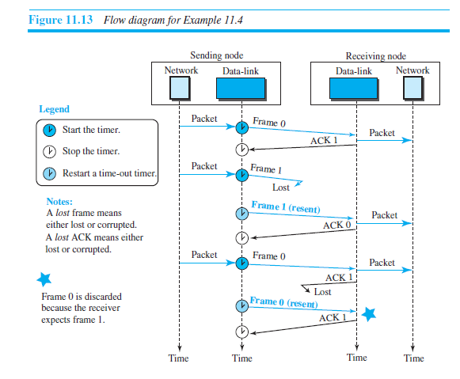

Slide 3
Configurations and Transfer Modes
HDLC provides two common transfer modes that can be used in different configurations:
normal response mode (NRM) and asynchronous balanced mode (ABM): In normal response mode (NRM), the station configuration is unbalanced. We have one primary station and multiple secondary stations. A primary station can send commands; a secondary station can only respond.

Slide 4
HDLC
Unbalanced Mode
Commands
Primary
Responses
Secondary
Secondary
Balanced mode
Combined
Combined
commands/Responses

Slide 5
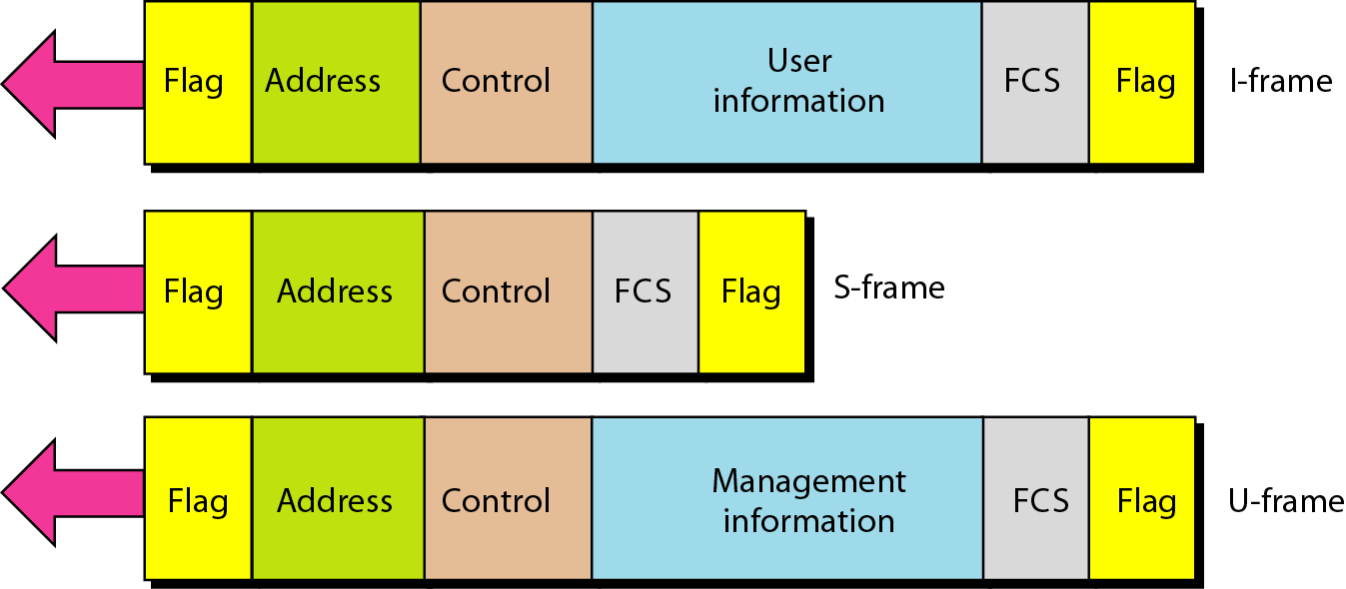
Figure 11.27 HDLC frames
11.<number>

Slide 6
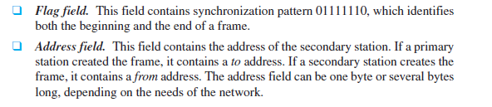
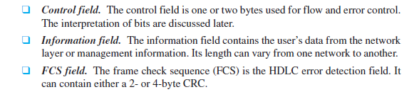

Slide 7
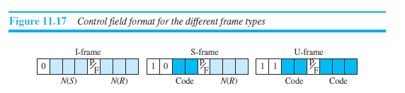
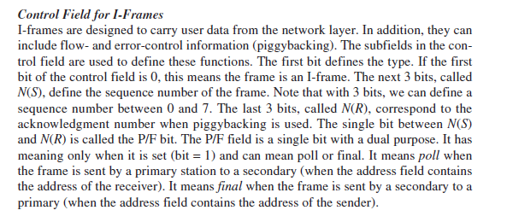

Slide 8
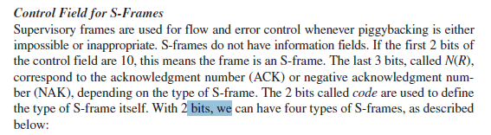
Code:
00- Receive ready (RR)
01- Receive not ready (RNR)
10- Reject (REJ)
11- Selective reject (SREJ)

Slide 9
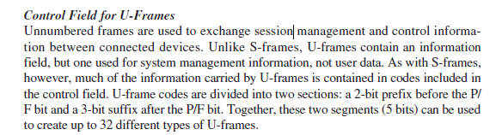

Slide 10
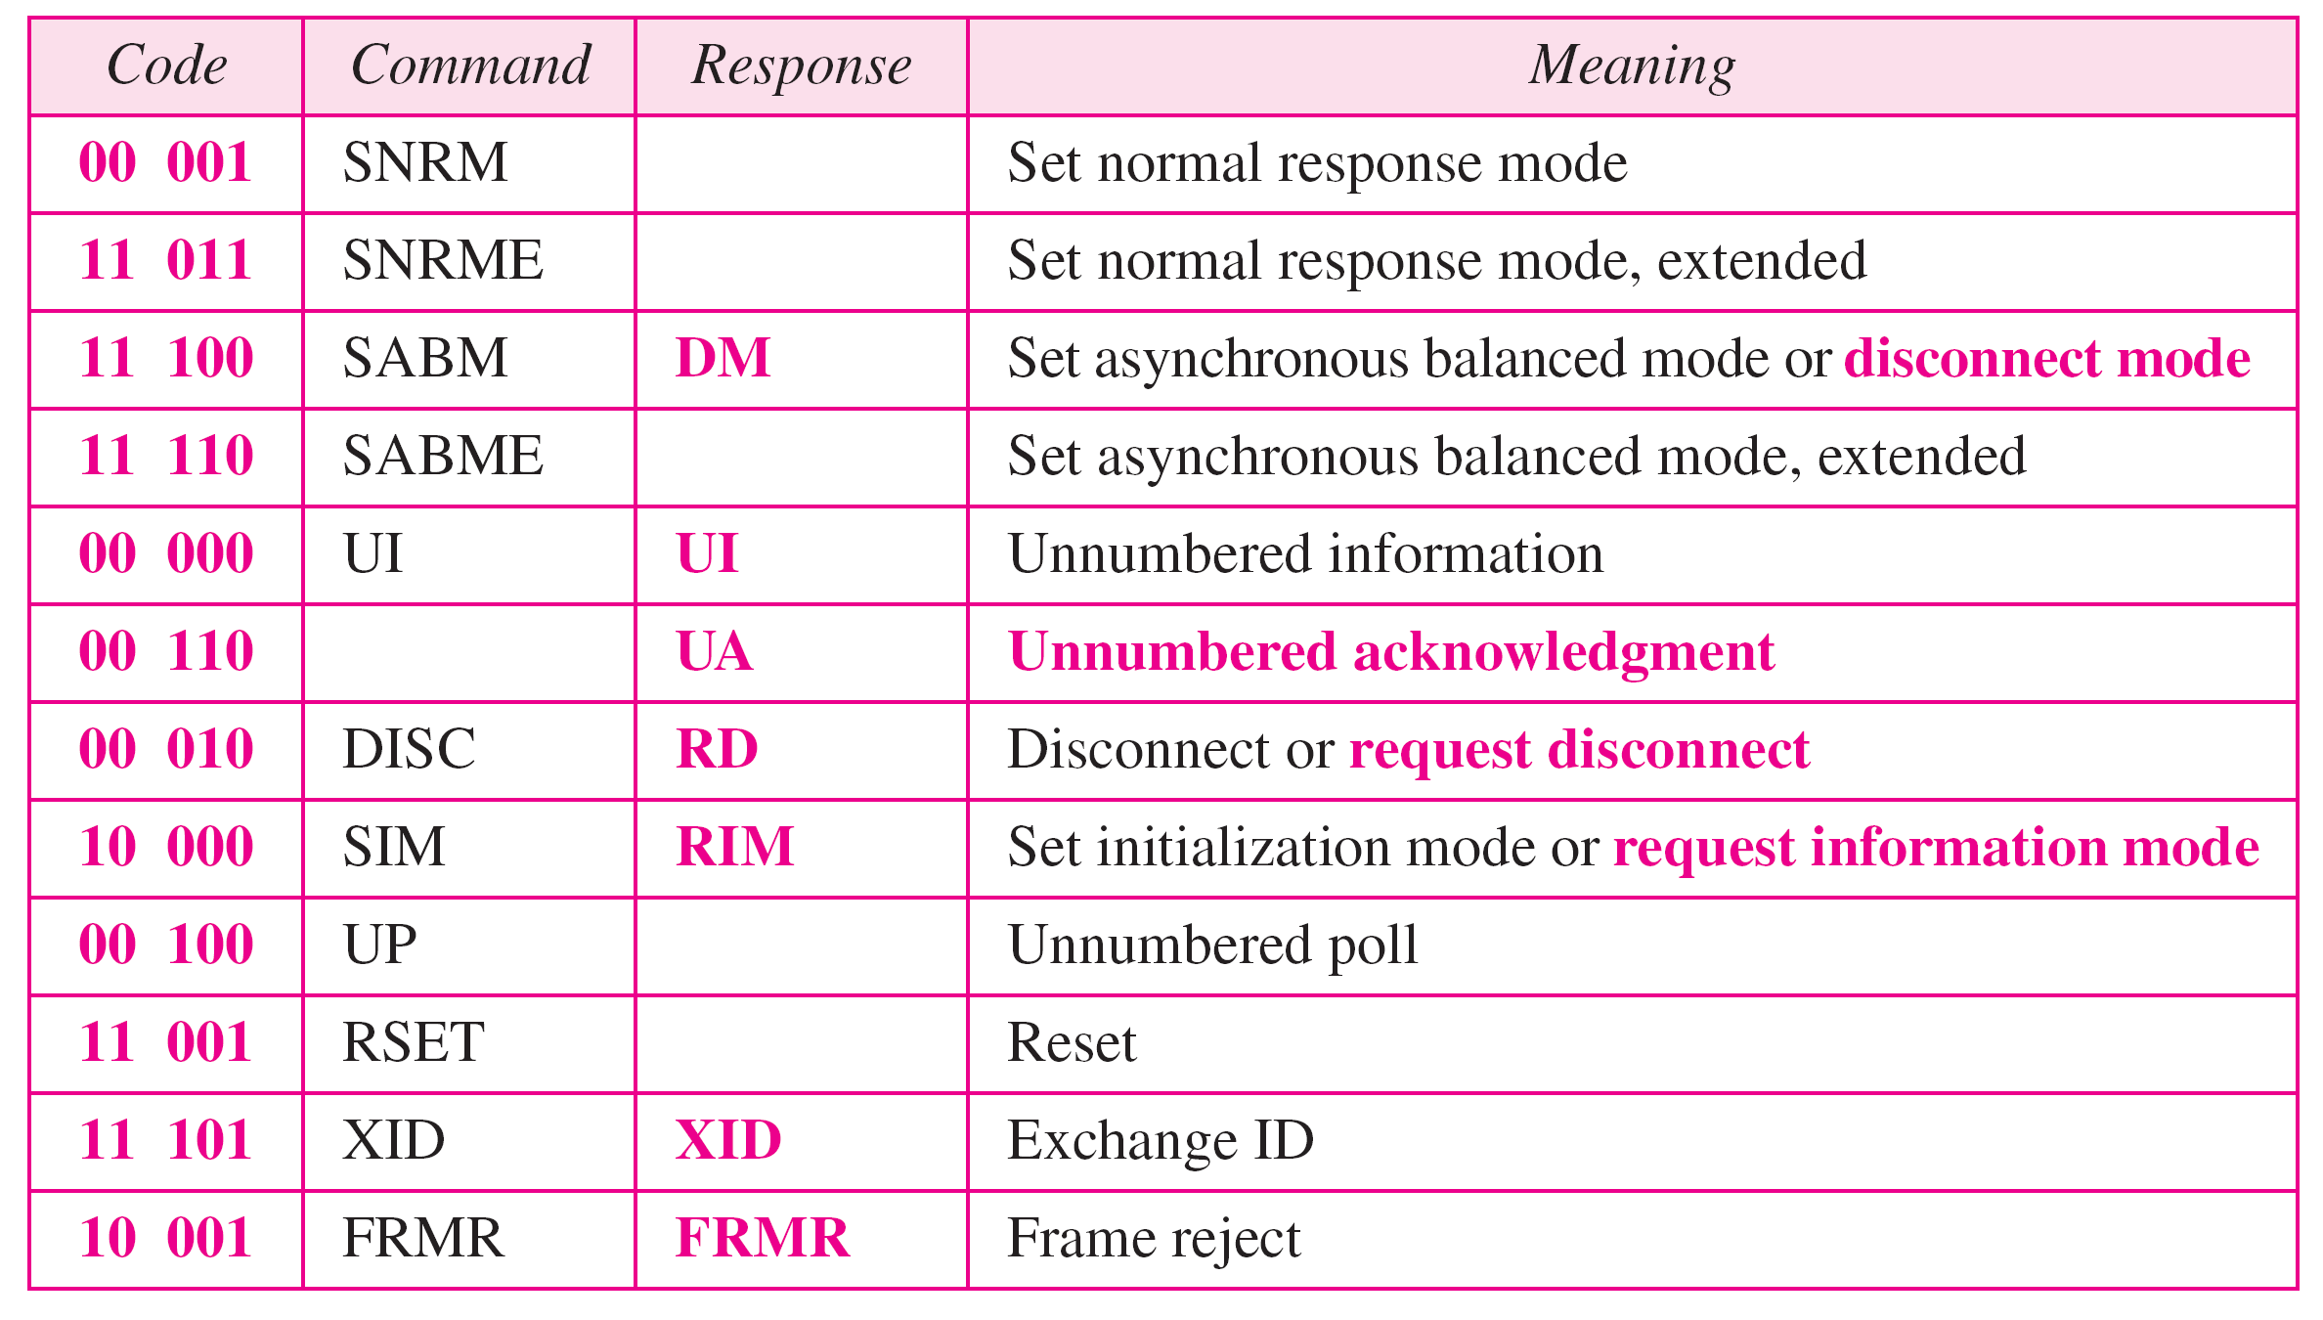
Table 11.1 U-frame control command and response
11.<number>

