Slide 1

Chapter 1
Introduction
1.<number>
Copyright © The McGraw-Hill Companies, Inc. Permission required for reproduction or display.
Notes:
1.#

Slide 2
1-1 DATA COMMUNICATIONS
The term telecommunication means communication at a distance. The word data refers to information presented in whatever form is agreed upon by the parties creating and using the data. Data communications are the exchange of data between two devices via some form of transmission medium such as a wire cable.
1.<number>
Notes:
1.#

Slide 3
The effectiveness of a data communications system depends on four fundamental characteristics:
delivery,
accuracy,
timeliness, and
jitter.
1.<number>

Slide 4
Delivery: The system must deliver data to the correct destination. Data must be received by the intended device or user and only by that device or user.
Accuracy: The system must deliver the data accurately. Data that have been altered in transmission and left uncorrected are unusable.
1.<number>

Slide 5
Timeliness: The system must deliver data in a timely manner. Data delivered late are useless.
In the case of video and audio, timely delivery means delivering data as they are produced, in the same order that they are produced, and without significant delay.
This kind of delivery is called real-time transmission.
1.<number>

Slide 6
Jitter: Jitter refers to the variation in the packet arrival time.
It is the uneven delay in the delivery of audio or video packets.
For example, let us assume that video packets
are sent every 30 ms.
If some of the packets arrive with 30-ms delay and others with 40-ms delay, an uneven quality in the video is the result.
1.<number>

Slide 7

Figure 1.1 Components of a data communication system
1.<number>
Notes:
1.#

Slide 8
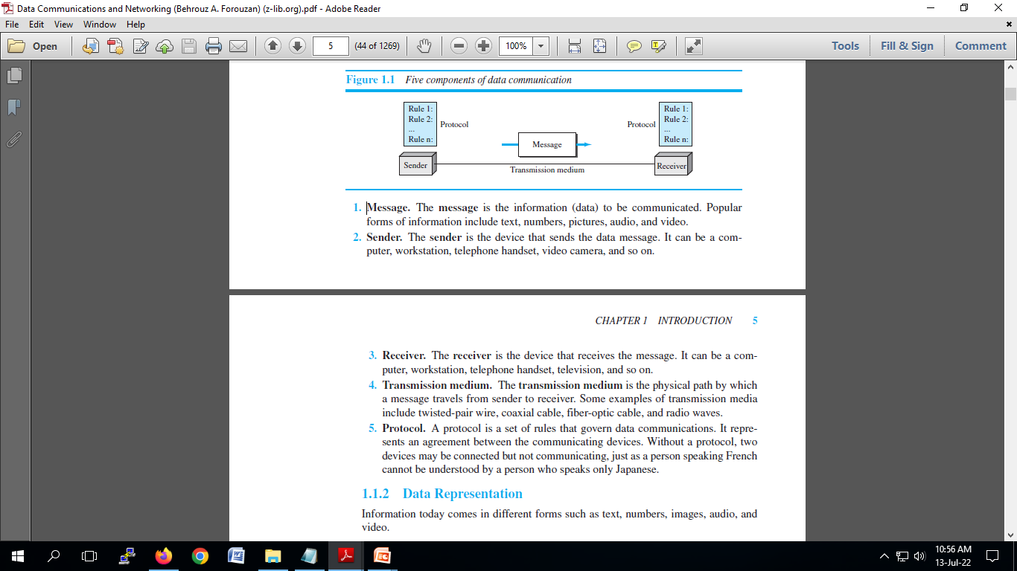
1.<number>

Slide 9
Data Representation
Text
In data communications, text is represented as a bit pattern, a sequence of bits (0s or 1s).
Different sets of bit patterns have been designed to represent text symbols.
Each set is called a code, and the process of representing symbols is called coding.
1.<number>

Slide 10
Images
Images are also represented by bit patterns.
In its simplest form, an image is composed
of a matrix of pixels (picture elements), where each pixel is a small dot.
The size of the pixel depends on the resolution.
1.<number>

Slide 11
Audio
Audio refers to the recording or broadcasting of sound or music.
Audio is by nature different from text, numbers, or images.
It is continuous, not discrete.
1.<number>

Slide 12
Video
Video refers to the recording or broadcasting of a picture or movie.
Video can either be produced as a continuous entity (e.g., by a TV camera), or it can be a combination of images, each a discrete entity, arranged to convey the idea of motion.
1.<number>

Slide 13

Figure 1.2 Data flow (simplex, half-duplex, and full-duplex)
1.<number>
Notes:
1.#

Slide 14
Simplex
In simplex mode, the communication is unidirectional, as on a one-way street.
Only one of the two devices on a link can transmit; the other can only receive.
Keyboards and traditional monitors are examples of simplex devices.
The keyboard can only introduce input; the monitor can only accept output.
1.<number>

Slide 15
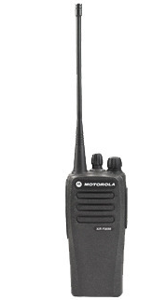
Half-Duplex
In half-duplex mode, each station can both transmit and receive, but not at the same time.
When one device is sending, the other can only receive, and vice versa.
Eg: Walkie-talkies
1.<number>

Slide 16
Full-Duplex
In full-duplex mode (also called duplex), both stations can transmit and receive simultaneously
One common example of full-duplex communication is the telephone network.
When two people are communicating by a telephone line, both can talk and listen at the same time.
1.<number>

Slide 17
1-2 NETWORKS
A network is a set of devices (often referred to as nodes) connected by communication links. A node can be a computer, printer, or any other device capable of sending and/or receiving data generated by other nodes on the network. A link can be a cable, air, optical fiber, or any medium which can transport a signal carrying information.
1.<number>
Notes:
1.#

Slide 18
Network Criteria
Performance
  Depends on Network Elements
  Measured in terms of Delay and Throughput
Reliability
  Failure rate of network components
  Measured in terms of availability/robustness
Security
  Data protection against corruption/loss of data due to:
      Errors
      Malicious users
1.<number>
Notes:
1.#

Slide 19
_x0010_Physical Structures
Type of Connection
  Point to Point - single transmitter and receiver
  Multipoint - multiple recipients of single transmission
    In a multipoint environment, the capacity of the channel is shared, either spatially or temporally. If several devices can use the link simultaneously, it is a spatially shared connection.
Physical Topology
  Connection of devices (The term physical topology refers to the way in which a network is laid out physically.)
  Type of transmission - unicast, multicast, broadcast
1.<number>
Notes:
1.#

Slide 20

Figure 1.3 Types of connections: point-to-point and multipoint
1.<number>
Notes:
1.#

Slide 21

Figure 1.4 Categories of topology
1.<number>
Notes:
1.#

Slide 22

Figure 1.5 A fully connected mesh topology (five devices)
1.<number>
Notes:
1.#

Slide 23
In a mesh topology, every device has a dedicated point-to-point link to every other device.
The term dedicated means that the link carries traffic only between the two
devices it connects. To find the number of physical links in a fully connected mesh network with n nodes, we first consider that each node must be connected to every other node.
Node 1 must be connected to n – 1 nodes, node 2 must be connected to n – 1 nodes, and finally node n must be connected to n – 1 nodes. We need n (n – 1) physical links.
However, if each physical link allows communication in both directions (duplex mode), we can divide the number of links by 2. In other words, we can say that in a mesh topology, we need n (n – 1) / 2 duplex-mode links.
1.<number>

Slide 24
Advantages
A mesh offers several advantages over other network topologies. First, the use of dedicated links guarantees that each connection can carry its own data load, thus eliminating the traffic problems that can occur when links must be shared by multiple devices.
Second, a mesh topology is robust. If one link becomes unusable, it does not incapacitate the entire system.
Third, there is the advantage of privacy or security. When every message travels along a dedicated line, only the intended recipient sees it.
1.<number>

Slide 25
Drawbacks
The amount of cabling and the number of I/O ports required.
First, because every device must be connected to every other device, installation and reconnection are difficult.
Second, the sheer bulk of the wiring can be greater than the available space (in walls, ceilings, or floors) can accommodate.
Finally, the hardware required to connect each link (I/O ports and cable) can be prohibitively expensive.
1.<number>

Slide 26

Figure 1.6 A star topology connecting four stations
1.<number>
Notes:
1.#

Slide 27
In a star topology, each device has a dedicated point-to-point link only to a central controller, usually called a hub.
The devices are not directly linked to one another.
Unlike a mesh topology, a star topology does not allow direct traffic between devices. The controller acts as an exchange:
  If one device wants to send data to another, it sends the data to the controller, which then relays the data to the other connected device
1.<number>

Slide 28
Pros and Cons
Other advantages include robustness. If one link fails, only that link is affected. All other links remain active. This factor also lends itself to easy fault identification and fault isolation.
As long as the hub is working, it can be used to monitor link problems and bypass defective links.
One big disadvantage of a star topology is the dependency of the whole topology on one single point, the hub. If the hub goes down, the whole system is dead.
1.<number>

Slide 29

Figure 1.7 A bus topology connecting three stations
1.<number>
Notes:
1.#

Slide 30
Nodes are connected to the bus cable by drop lines and taps.
A drop line is a connection running between the device and the main cable.
A tap is a connector that either splices into the main cable or punctures the sheathing of a cable to create a contact with the metallic core.
As a signal travels along the backbone, some of its energy is transformed into heat. Therefore, it becomes weaker and weaker as it travels farther and farther.
For this reason there is a limit on the number of taps a bus can support and on the distance between those taps.
1.<number>

Slide 31
Advantages of a bus topology include ease of installation. Backbone cable can be laid along the most efficient path, then connected to the nodes by drop lines of various lengths.
In this way, a bus uses less cabling than mesh or star topologies. In a star, for example, four network devices in the same room require four lengths of cable reaching all the way to the hub.
In a bus, this redundancy is eliminated. Only the backbone cable
stretches through the entire facility.
Each drop line has to reach only as far as the nearest point on the backbone.
1.<number>

Slide 32
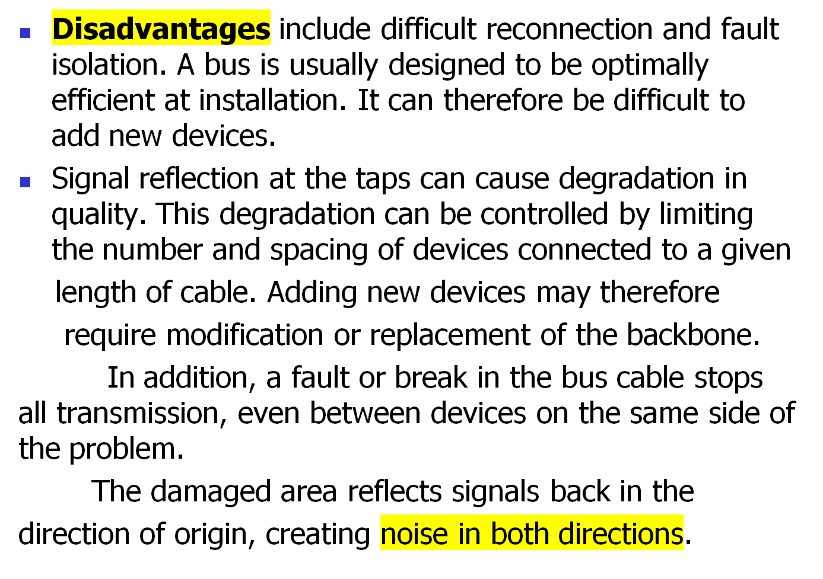
1.<number>

Slide 33

Figure 1.8 A ring topology connecting six stations
1.<number>
Notes:
1.#

Slide 34

Figure 1.9 A hybrid topology: a star backbone with three bus networks
1.<number>
Notes:
1.#

Slide 35
_x0010_Categories of Networks
Local Area Networks (LANs)
  Short distances
  Designed to provide local interconnectivity
Wide Area Networks (WANs)
  Long distances
  Provide connectivity over large areas
Metropolitan Area Networks (MANs)
  Provide connectivity over areas such as a city, a campus
1.<number>
Notes:
1.#

Slide 36
Local Area Network
A local area network (LAN) is usually privately owned and connects some hosts in a single office, building, or campus.
Depending on the needs of an organization, a LAN can be as simple as two PCs and a printer in someone’s home office, or it can extend throughout a company and include audio and video devices.
Each host in a LAN has an identifier, an address, that uniquely defines the host in the LAN. A packet sent by a host to another host carries both the source host’s and the destination host’s addresses.
1.<number>

Slide 37

Figure 1.10 An isolated LAN connecting 12 computers to a hub in a closet
1.<number>
Notes:
1.#

Slide 38
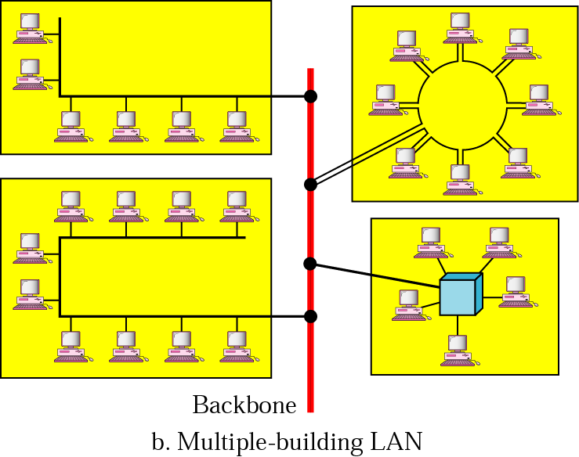
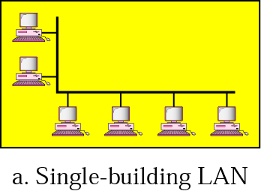
Local Area Networks
Network in a single office, building, or campus

Slide 39

Figure 1.11 WANs: a switched WAN and a point-to-point WAN
1.<number>
Notes:
1.#

Slide 40
A wide area network (WAN) is also an interconnection of devices capable of communication.
However, there are some differences between a LAN and a WAN.
A LAN is normally limited in size, spanning an office, a building, or a campus; a WAN has a wider geographical span, spanning a town, a state, a country, or even the world.
A LAN interconnects hosts; a WAN interconnects connecting devices such as switches, routers, or modems.
1.<number>

Slide 41
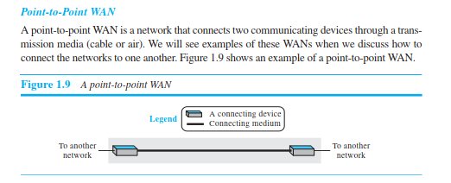

1.<number>

Slide 42
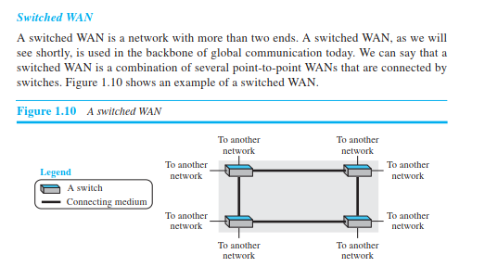
1.<number>

Slide 43

Figure 1.12 A heterogeneous network made of four WANs and two LANs
1.<number>
Notes:
1.#

Slide 44
1-3 THE INTERNET
The Internet has revolutionized many aspects of our daily lives. It has affected the way we do business as well as the way we spend our leisure time. The Internet is a communication system that has brought a wealth of information to our fingertips and organized it for our use.
1.<number>
Notes:
1.#

Slide 45
When two or more networks are connected, they make an internetwork, or internet.
As an example, assume that an organization has two offices, one on the east coast and the other on the west coast. Each office has a LAN that allows all employees in the office to communicate with each other. To make the communication between employees at different offices possible, the management leases a point-to-point dedicated WAN from a service provider, such as a telephone company, and connects the two LANs. Now the company has an internetwork, or a private internet (with lowercase i). Communication between offices is now possible.
1.<number>

Slide 46
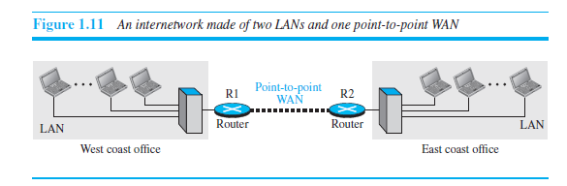
1.<number>

Slide 47
When a host in the west coast office sends a message to another host in the same office, the router blocks the message, but the switch directs the message to the destination.
On the other hand, when a host on the west coast sends a message to a host on the east coast, router R1 routes the packet to router R2, and the packet reaches the destination.
1.<number>

Slide 48
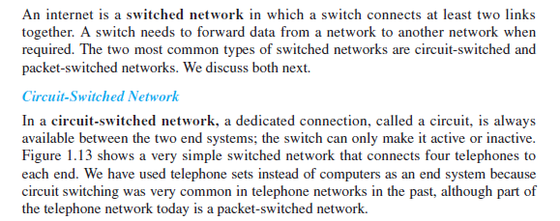
Switching
1.<number>

Slide 49
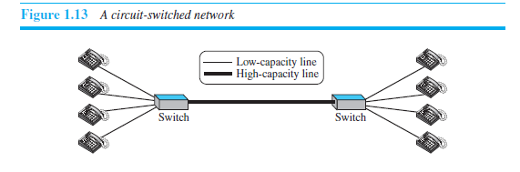
1.<number>

Slide 50
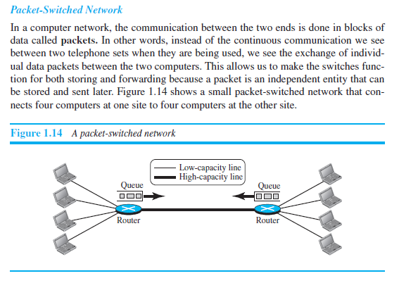
1.<number>

Slide 51

Figure 1.13 Hierarchical organization of the Internet
1.<number>
Notes:
1.#

Slide 52
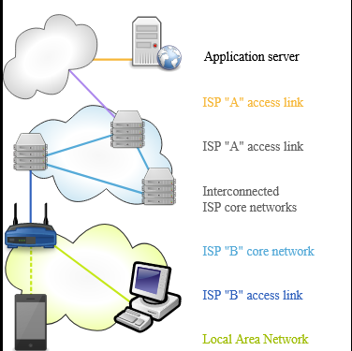
1.<number>

