Slide 1
Decipher program
Utilizing frequency analysis to make guesses at a substitution cipher.
By Matt Perry

Slide 2
The idea
The goal of the program was to take in a file that was encrypted and use frequency analysis to make a few guesses at the encryption.
The key and deciphered message are output in a file for the user to read.
The idea was not to fully break the cipher but aid in getting to the point where words are starting to show up.

Slide 3
Interesting things along the way
I started with a Ceaser cipher pattern based, easy to break not that interesting.
I then moved to a random substitution.
Most frequency analysis were looking at large amounts of words around 30,000 to 40,000
I found that one key did not always work that well, because of the length
A Multi key system that user could add keys too if they wanted. Or even change them

Slide 4
How it worked
Used range based loops ASCII numbers and vectors
for (int j = 97; j < 123; j++){ // ascii number count for loop
int lcount = 0; // creating our counter
for(int i = 0; i < eSize; i++){ // takes the size of the vector with strings from file
string text = encrypted[i]; // passes the string that is at i
int tSize = text.size(); // takes size to create for loop
for(int ii = 0; ii < tSize; ii++){ // for loop to look at each char in the string
if(text[ii] == j || text[ii] == (j-32)){ //-32 to check if the char is capital
lcount ++; // our letter count that we push to a vector.

Slide 5
How it worked continued
Creating a struct to hold a double for frequency and a char to hold the letter.
Then making a vector of the struct
for(int i = 0; i < sortSize; i++){
EncLet a;
a.f = freqOfChars[i];
a.letter = vchar[i];
sortVector.push_back(a);
}
Then using a Lambda function to sort the vector<struct> by the highest frequency
sort (sortVector.begin(), sortVector.end(), [](const EncLet & lh, const EncLet & rh){
return lh.f > rh.f; // sorting with the greatest value to the beginning .
});

Slide 6
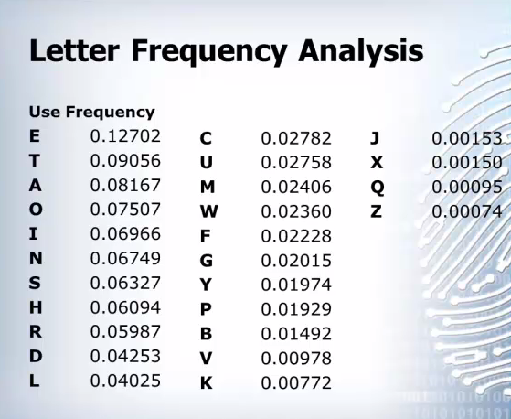
The Key system
With frequency analysis we have this table
I grouped letters that were close in frequencies, to populate a multi key system.
ETAOINSH->ETOAINHS
For example

Slide 7
The key system inaction
After the sorting was complete the final step was replacing letters based off the key.
for(int l = 0; l < eSize; l++){ // range based loop for the size of the encrypted vector
string change = encrypted[l]; // passing each line to the string
int thing; // this is to count if we replaced a letter or not, important for placing spaces and commas
int cSize = change.size();
for (int k = 0; k < cSize; k++){ // size of the string
thing = 0; // each time we try to replace a letter thing set to 0
for (int i =0; i < sortSize; i++){ // checks all chars in sort against the letter we are at in string.
if(change[k] == sortVector[i].letter){
decipher << decryptedBig[d][i];
thing++; // increment if letter changed
}
}
if(thing != 1){ // if not one then a char not found in the key was located and is to be printed out
decipher << change[k] ;

