Slide 1

Triple Des Encryption System
Group Members:
Tushar Patil (59)
Atharva Dhuri (68)
Pranay Patil (57)

Slide 2


CONTENT
1.Abstract
2. DES
3. Triple DES
4. Encryption Decryption
5. Triple DES Algorithm
6. Process
7. Implementation
8. References

Slide 3
ABSTRACT
In today’s world almost all digital services like internet communication, medical and military imaging systems, multimedia system needs a high level and Protected security.
There is a need for security level in order to safely store and
transmit digital images containing critical information.
Therefore, there is a need for image encryption techniques in order to hide images from such attacks.
In this system we use Triple DES (Data Encryption Standard) in order to hide image. Such Encryption technique helps to avoid Active and Passive Attacks.

Slide 4
DES: Data Encryption Standard
The Data Encryption Standard (DES) is a symmetric-key block cipher published
by the National Institute of Standards and Technology (NIST).
DES is an implementation of a Feistel Cipher, it uses 16 round Feistel structure and the block size is 64-bit.
Though, key length is 64-bit, DES has an effective key length of 56 bits, since 8 of the 64 bits of the key are not used by the encryption algorithm (function as check bits only)

Slide 5
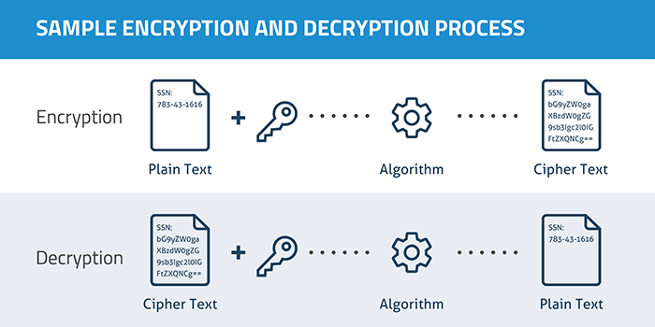
ENCRYPTION AND DECRYPTION PROCESS

Slide 6
TRIPLE DES ENCRYPTION
In cryptography, Triple DES, officially the Triple Data Encryption Algorithm, is a symmetric-key block cipher, which applies the DES cipher algorithm three times to each data block.
Block sizes: 64 bits Key sizes: 168, 112 or 56 bits (keying option 1, 2, 3 respectively)
Triple DES is an encryption technique which uses three instance of DES on same
plain text.
It uses their different types of key choosing technique in first all used keys are different and in second two keys are same and one is different and in third all keys are same.

Slide 7

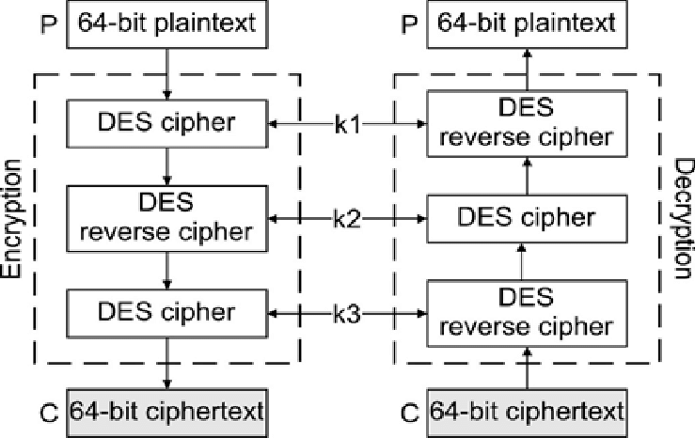

TRIPLE DES STRUCTURE

Slide 8
TRIPLE DES ALGORITHM
TDES has a fixed data block size of 8 bytes. It consists of the cascade of 3 Single DES ciphers (EDE: Encryption - Decryption - Encryption), where each stage uses an independent DES sub-key.
The standard defines 2 Keying Options:
Option 1: all sub-keys take different values (parity bits ignored). The TDES key is therefore 24 bytes long (concatenation of K1, K2, and K3) , to achieve 112 bits of effective security.
Option 2: K1 matches K3 but K2 is different (parity bits ignored). The TDES key is 16 bytes long(concatenation of K1 and K2), to achieve 90 bits of effective security. In this mode, the cipher is also termed 2TDES.

Slide 9
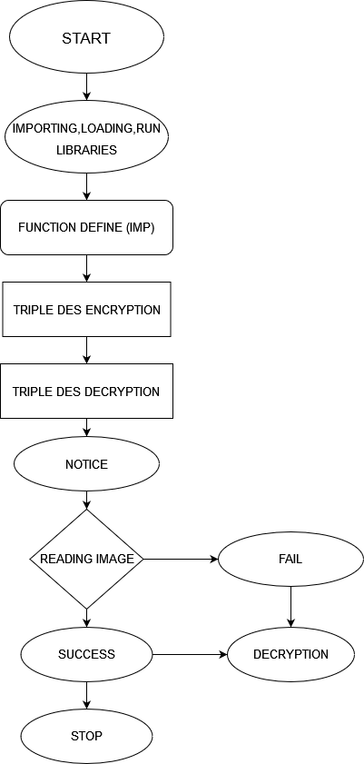
FLOW DIAGRAM

Slide 10
WORKING
1. Running of the Libraries
2. Selecting(Uploading) the Image
3. Triple DES Process
4. Encryption Process
5. Decryption Process

Slide 11
REFERENCES
1. https://www.tutorialspoint.com/cryptography/data_encryption_standard.htm
2. https://www.simplilearn.com/what-is-des-article
3. https://pycryptodome.readthedocs.io/en/latest/src/cipher/des3.html
4. https://www.hypr.com/data-encryption-standard-des/
5. https://www.geeksforgeeks.org/data-encryption-standard-des-set-1

Slide 12

Thank You

