Slide 1
TempoPeak: Temporal Head Ablation for Single-Impact Localization in Sports Video
Haochuan Zhang
Mar-18-2026
Notes:
Slide 1 — Title
Speaker note
TempoPeak: hit frame detection in tennis video. Core question: which temporal architecture is best for this task, and why.
Extra info
This project covers dataset construction, temporal head ablation across 5 architectures and 3 window sizes, and a loss function analysis that reveals an unexpected ranking flip. All experiments run on H100 80GB with pre-extracted ViT-B-16 features.

Slide 2
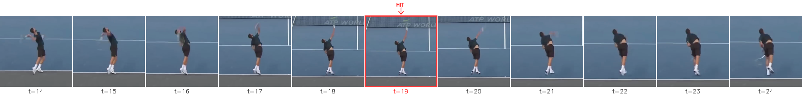


Problem Definition
Task
Given a tennis video clip, predict the exact frame where the racket-ball impact occurs. Controlled ablation: fixed window. Ultimate goal: full-match inference.
Notes:
Slide 2 — Problem Definition
Speaker note
The task: given a video clip of a tennis player, predict the exact frame where racket meets ball. One frame — not a segment, not a window. This is a localization problem over time, not classification.
Extra info
Formally: input is a sequence of per-frame player crops [T, 3, H, W], output is a scalar t* ∈ {0, ..., T-1}. The controlled ablation fixes T=32 per sample. Ultimate target is full-match inference where T can be thousands of frames.

Slide 3
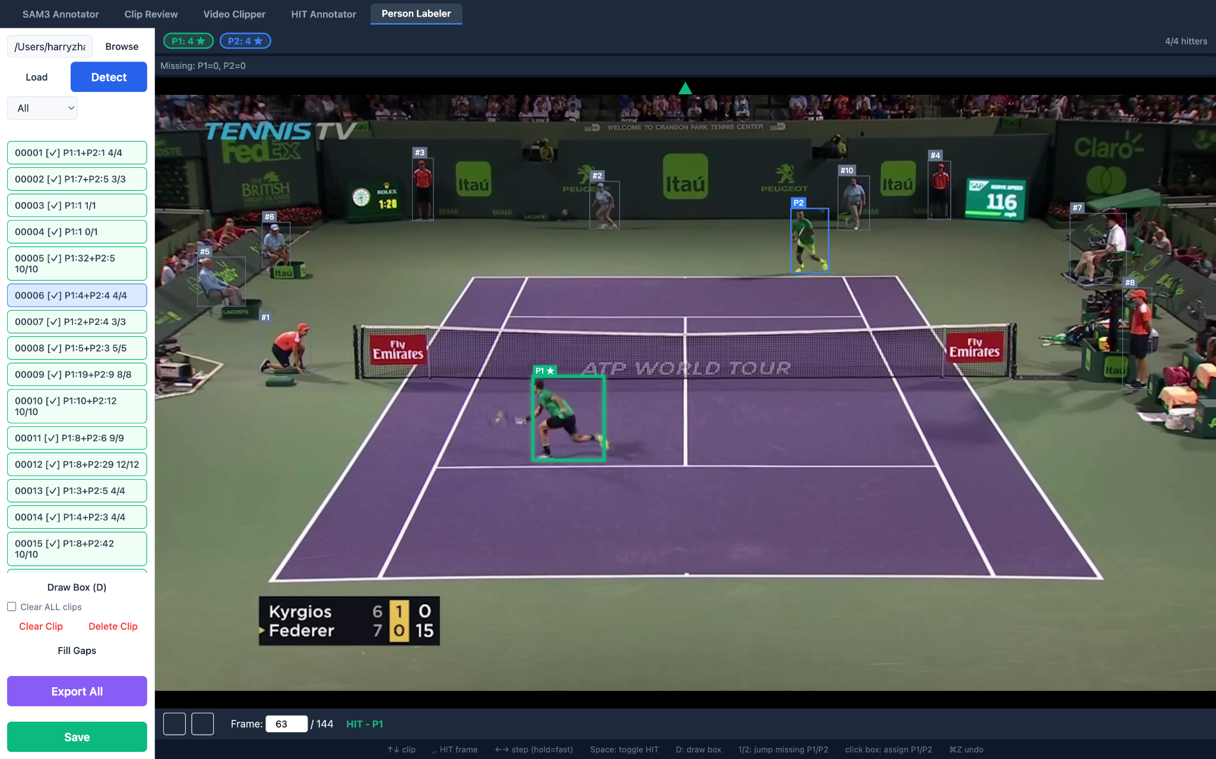
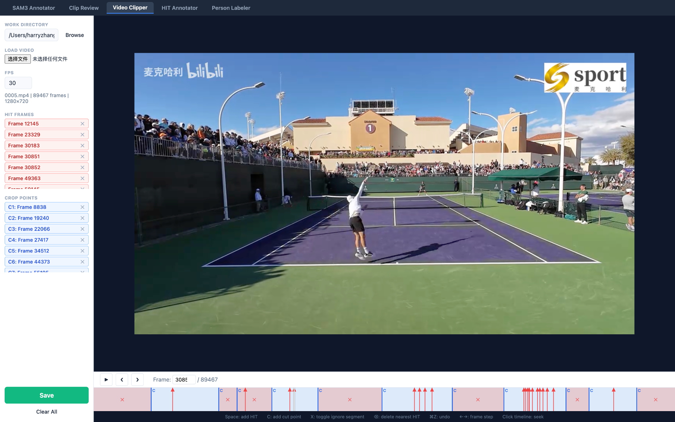
Dataset Construction
No existing dataset. We built one from scratch
27 clips 178 hits 30 fps broadcast footage
Each clip stores hit frame indices, hitter identity (p1/p2), and per-frame player bounding boxes. Hitter identity is required — the model only sees the hitting player's crop, not both players.
Notes:
{
"clip": "00001", "total_frames": 167,
"hits": [4, 28, 61, 95],
"hitters": [2, 1, 2, 1],
"frames": {
"0": {"p1": {"x1":...,"y1":...,"x2":...,"y2":...}, "p2": {...}}
}
} Slide 3 — Dataset Construction
Speaker note
No existing dataset for this. Built from scratch: 27 match clips, 178 labeled hit frames, all from 30fps broadcast footage. Critical design choice: we record which player hits each shot, so the model only sees that player's crop, not both.
Extra info
Data format per clip: {"hits": [4, 28, 61], "hitters": [2,1,2], "frames": {"0": {"p1": {bbox}, "p2": {bbox}}}}. Minimum adjacent hit gap: 13 frames (~0.43s), found in net-exchange rallies. HIT_MARGIN=6 pads both sides of each training window to prevent neighboring hit contamination. Annotation toolchain: 5 custom modules — Video Clipper, HIT Annotator, Person Labeler, SAM3 Mask Extractor, Clip Review. Final hit frame accuracy: ±1 frame, human-verified.

Slide 4
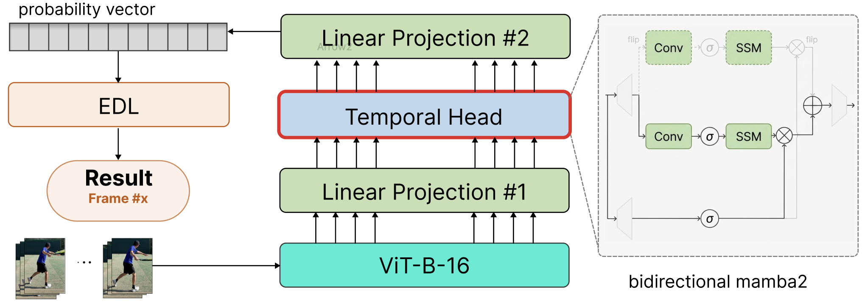
Pipeline
Notes:
Slide 4 — Pipeline
Speaker note
Three stages: ViT-B-16 extracts per-frame features — frozen, temporally blind. Then a temporal head processes the sequence. Then EDL loss trains the model to locate the hit. We only swap the temporal head; everything else is fixed.
Extra info
ViT-B-16 (86M params, frozen) outputs 768-dim CLS tokens. A linear projection maps 768→512 before the head. The head outputs [B, T] logits; EDL loss computes |Σ t·softmax(logits) - t_gt|. Note: the CLI flag is --backbone=vit_small but this loads models.vit_b_16 — a naming alias, confirmed by D=768 in all training logs.

Slide 5
Variants
IIdentity (baseline) 0.4M
BiLSTM + dropout 1997 1.1M
Transformer 2017 6.8M
Mamba2 2024 1.4M
BiMamba2 2024 2.3M ← proposed
Notes:
Slide 5 — Variants
Speaker note
Five heads, same everything else. Identity is the no-op baseline — it tells us how much ViT features alone can do without any temporal reasoning. BiLSTM is the 1997 RNN benchmark. Transformer is the 2017 attention baseline. Mamba2 and BiMamba2 are the 2024 SSM candidates.
Extra info
Parameter counts: Identity 0.4M, BiLSTM 1.1M (+ dropout=0.3), Transformer 6.8M (d_model=512, nhead=8, 2 layers, learnable positional encoding), Mamba2 1.4M (d_model=256, d_state=64, headdim=64, 2 layers), BiMamba2 2.3M (same but forward + backward scan concatenated). All trained with AdamW lr=1e-3, batch=256, 30 epochs, CosineAnnealingLR, grad clip 1.0.

Slide 6
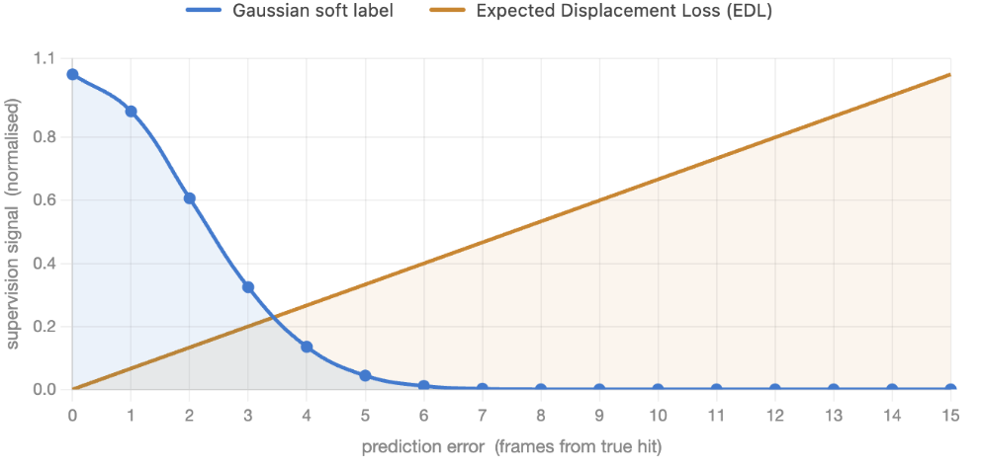
Loss: Why EDL? Expected Displacement Loss
Notes:
Slide 6 — Why EDL?
Speaker note
Gaussian soft label: gradient nearly disappears more than 5 frames from the hit. The model can't tell how wrong it is when it's far off. EDL directly optimizes the expected position of the probability distribution — penalty grows linearly with distance. Off by 10 frames gets 10× the gradient of off by 1.
Extra info
EDL formula: loss = mean(|Σ_t t·softmax(logits_t) - t_gt|). Gradient flows to every frame proportional to its distance from the hit. Gaussian CE: loss = -Σ_t q_t · log p_t where q_t = exp(-(t-t*)²/2σ²). At t=t*±5 with σ=2, q_t ≈ 0.002 — gradient effectively zero. EDL removes this dead zone.

Slide 7
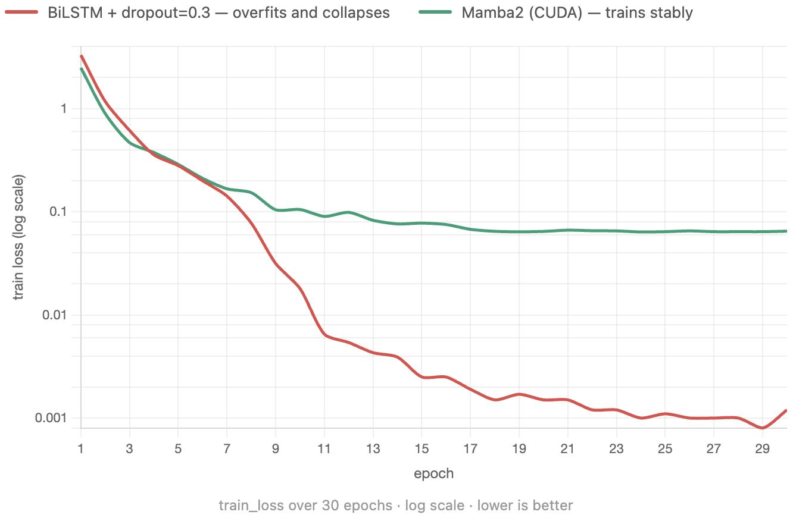
The Collapse
Notes:
Slide 7 — The Collapse
Speaker note
BiLSTM's train loss hits 0.0001 by epoch 30. Val Acc@1 peaks at epoch 2 and never recovers. It memorized the training windows. Mamba2 train loss stabilizes at 0.065 — and val holds at 58.6%. Same loss, same data, different architecture, completely different behavior.
Extra info
Mechanism: EDL's sharp distance-proportional gradient pushes the model to assign all probability mass to one frame. BiLSTM's gating finds a shortcut — it memorizes each window's hit position rather than learning visual features. Adding dropout=0.3 raises train loss slightly (0.001) but val drops further to 48.3% — regularization damaged the signal without fixing the structural problem. Mamba2's conv1d local mixing enforces temporal smoothing: probability mass can't concentrate arbitrarily fast, acting as implicit regularization. This is a structural property of the SSD algorithm, not a tuned hyperparameter.
Loss: Expected Displacement Loss (EDL) — loss = |E[t·p(t)] - t_gt|
Backbone: ViT-B-16, frozen, D=768 (note: CLI flag is --backbone=vit_small but loads vit_b_16)
Features: pre-extracted per-frame crops → 768-dim CLS token
Window: T_max=32, HIT_MARGIN=6, MIN_LEN=12
Training: lr=1e-3, batch=256, epochs=30, CosineAnnealingLR(→1e-5), grad clip max_norm=1.0
Val eval: Gaussian smooth σ=1.5 on logits before argmax
Val size: 58 samples (27 clips, 178 hits, ~20% held out)
GPU: NVIDIA H100 80GB HBM3 · ~1-2 sec/epoch
BiLSTM config: hidden=128, layers=2, bidirectional, dropout=0.3, params=1,119,105
Mamba2 config: d_model=256, d_state=64, d_conv=4, expand=2, headdim=64, layers=2, params=1,388,849
Key finding: BiLSTM (red) reaches train_loss = 0.0004 by epoch 29 — effectively memorizing the training set. Val Acc@1 peaks at epoch 2 (41.4%) and never recovers, ending at 48.3%. Mamba2 (green) stabilizes at train_loss ≈ 0.065 and achieves val Acc@1 = 58.6% at epoch 3. The gap is structural: Mamba2's conv1d local mixing enforces temporal smoothing that prevents the probability mass from collapsing to a single frame under EDL's sharp distance-proportional gradient.

Slide 8
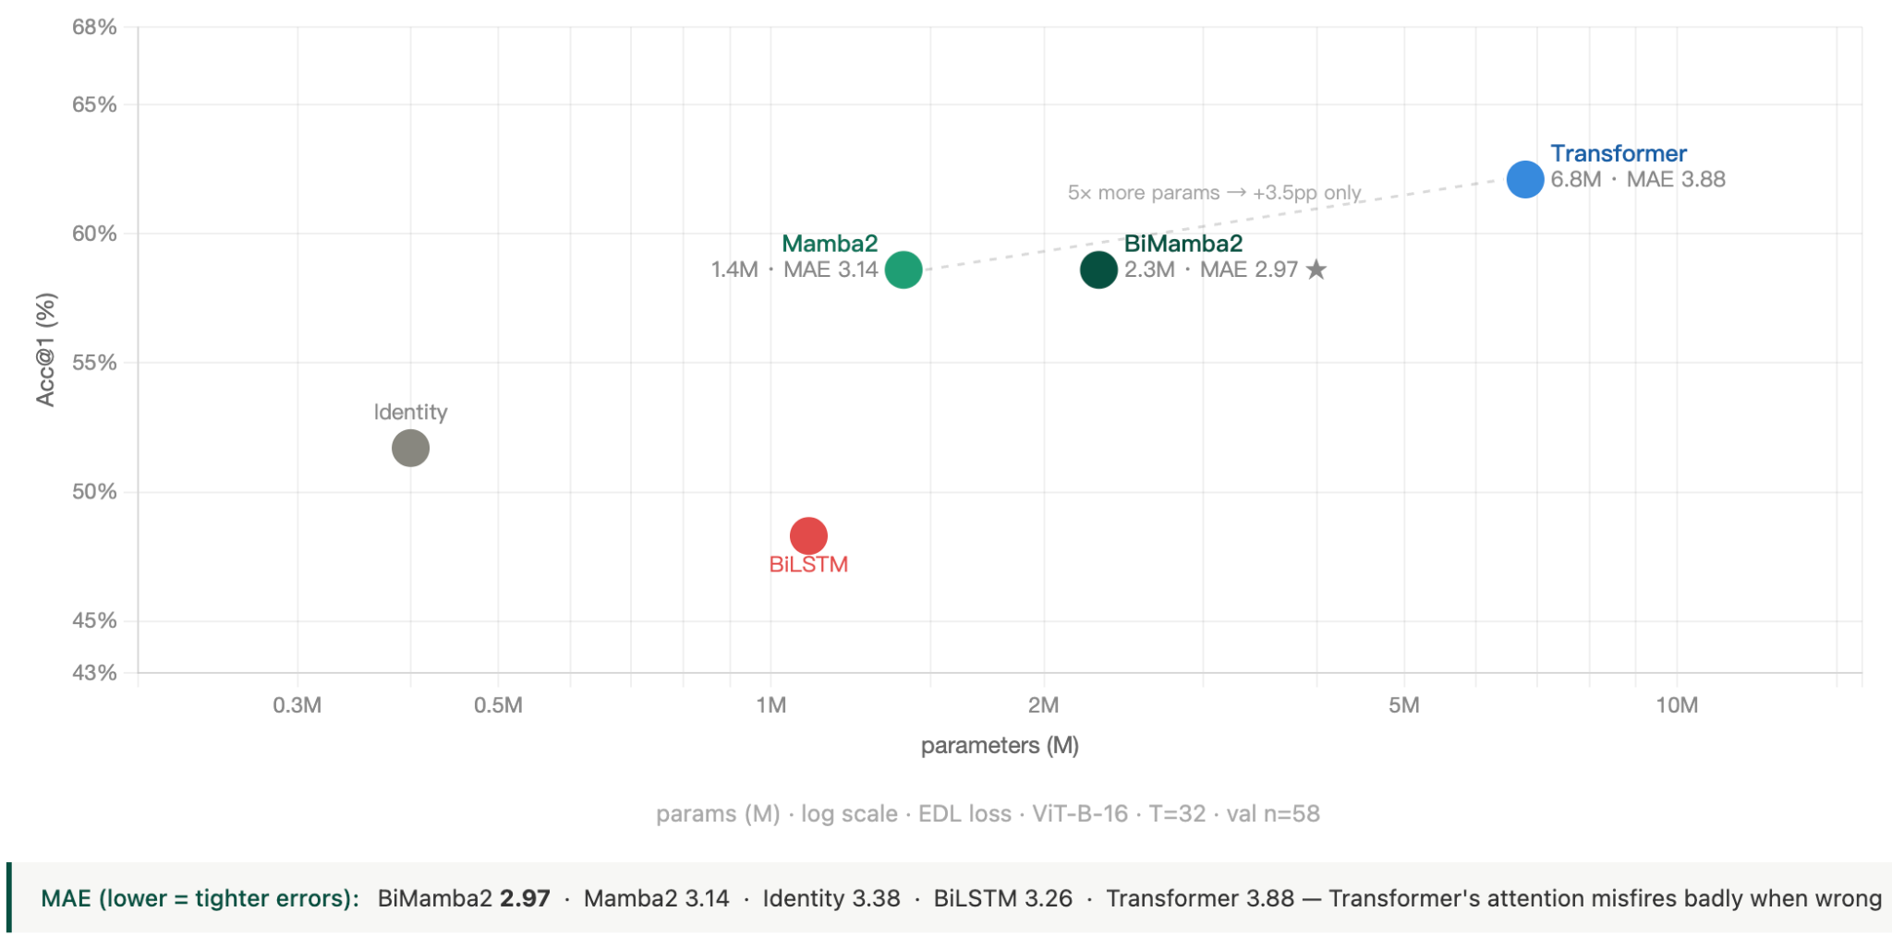
Result
Notes:
Task: Given a T=32 frame window known to contain one tennis hit, predict the exact hit frame index.
Backbone: ViT-B-16 (86M params, frozen) — CLI flag is --backbone=vit_small but loads vit_b_16. D=768.
Features: pre-extracted per-frame player crops → CLS token → 768-dim vectors cached on RAM.
Pipeline: feat_proj (768→512) → temporal head → Linear(→1) → logits [B,T] → EDL loss
Loss: Expected Displacement Loss (EDL): loss = mean(|Σ t·softmax(logits) - t_gt|)
Training: AdamW lr=1e-3, weight_decay=1e-4, batch=256, epochs=30, CosineAnnealingLR(→1e-5), grad clip max_norm=1.0
Data: 27 clips / 178 hits · HIT_MARGIN=6 · MIN_LEN=12 · train ~5800 samples / val 58 samples (80/20 clip split)
Eval: Gaussian smooth σ=1.5 on logits before argmax · best checkpoint = highest val Acc@1
GPU: NVIDIA H100 80GB HBM3 · ~1–2 sec/epoch (feature mode, no backbone forward)
Slide 8 — Results (T=32)
Speaker note
Mamba2 matches Transformer Acc@1 — 58.6% vs 62.1%, within noise — at 5× fewer parameters. And Mamba2's MAE is better: 2.97 vs 3.88. When Transformer is wrong, it's more wrong. BiMamba2 has the tightest error distribution of all five heads.
Extra info
Val n=58 → binomial CI ±6.4pp. The 3.5pp gap between Mamba2 and Transformer is not statistically distinguishable at this sample size. The honest claim is "we cannot separate them" not "they are equal." MAE is a more reliable metric here (continuous mean, lower variance) — BiMamba2's 2.97 vs Transformer's 3.88 is a 0.91-frame difference on a 32-frame window, practically significant. Transformer's "all-or-nothing" attention pattern explains the MAE discrepancy: when attention fires correctly it's very precise; when it misfires it lands far off.

Slide 9
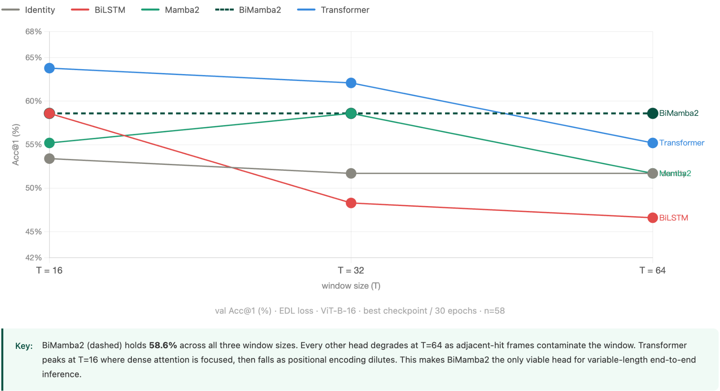
Window Robustness
Notes:
Slide 9 — Window Robustness
Speaker note
We tested three window sizes. Transformer is best at T=16 where attention is most focused, but drops 8.6pp by T=64. BiLSTM recovers at T=16 — cleaner windows — but degrades as the window grows and neighboring hit frames contaminate its state. BiMamba2 holds exactly 58.6% across all three. That's not a coincidence.
Extra info
Why BiMamba2 is window-invariant: the forward scan sees the hit from the left, the backward scan sees it from the right. Wherever the hit falls in the window, one direction always has a clean lead-in. Mamba2 (causal only) peaks at T=32 then drops to 51.7% at T=64 — the forward scan accumulates state drift from contaminating frames before it reaches the hit. This result directly motivates BiMamba2 as the temporal head for end-to-end inference, where context length around each hit is not fixed.

Slide 10
Key Finding
[3×] BiMamba2 matches Transformer Acc@1 3× fewer params. MAE 2.97 vs 3.88.
[★] Only head stable at T = 16 / 32 / 64 Bidirectional scan ignores hit position.
[↕] Loss function flips the ranking EDL exposes LSTM. SSM absorbs it.
Notes:
Slide 10 — Key Finding
Speaker note
Three things. One: BiMamba2 reaches Transformer accuracy at 3× fewer params, with better MAE. Two: it's the only head that doesn't degrade across window sizes — structural robustness from bidirectional scan. Three: swapping the loss function changes the winner. BiLSTM leads under Gaussian CE, collapses under EDL. The architecture you choose matters less than you think — the training signal exposes what each architecture actually does.
Extra info
Finding 3 is the most surprising and the most scientifically interesting. BiLSTM under Gaussian CE: 58.6% (best). BiLSTM under EDL: 48.3% (collapses). Same model, same data, same optimizer — only loss changed. This means any benchmark comparing temporal architectures on frame detection tasks is confounded by loss design. A fair comparison requires specifying the loss explicitly. EDL is the more principled choice for localization tasks because it encodes distance information.

Slide 11
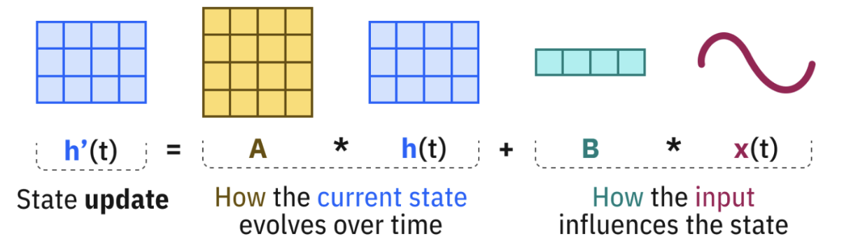
why SSM works better

Slide 12
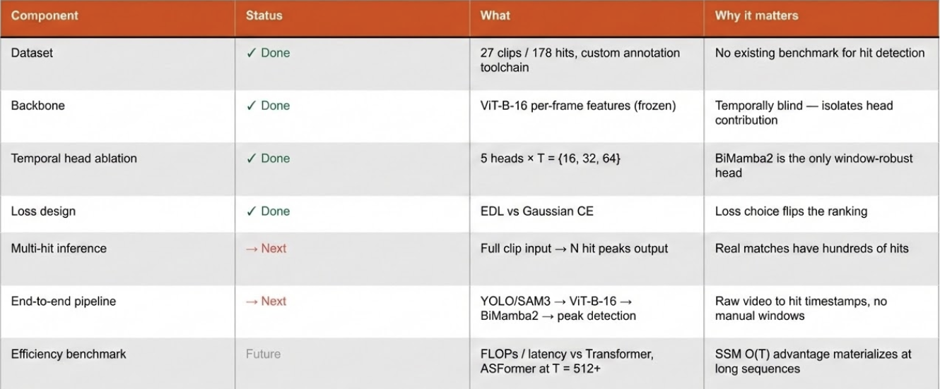
Future Experimental Plan
Notes:
Slide 11 — Future Work
Speaker note
Top half is done — dataset, backbone, ablation, loss. Next two steps: multi-hit inference on full clips, then close the loop from raw video to hit timestamps. That's where SSM's O(T) stops being a nice property and becomes a hard requirement.
Extra info
Multi-hit inference requires: (1) multi-peak label — sum of Gaussians centered at each hit, normalized; (2) inference-time peak detection — scipy.signal.find_peaks on logit curve with distance=HIT_MARGIN, height=threshold; (3) new eval — precision/recall matching predicted peaks to GT hits within ±2 frames. BiMamba2's recurrent state handles multi-peak outputs naturally; it makes no unimodal assumption. Efficiency benchmark at T=512+: Transformer attention is 262,144 pairs per layer — this is where O(T) vs O(T²) becomes empirically testable, not just theoretical. Comparison target: ASFormer (ICCV 2021), currently SOTA for temporal action segmentation on long sequences.

Slide 13
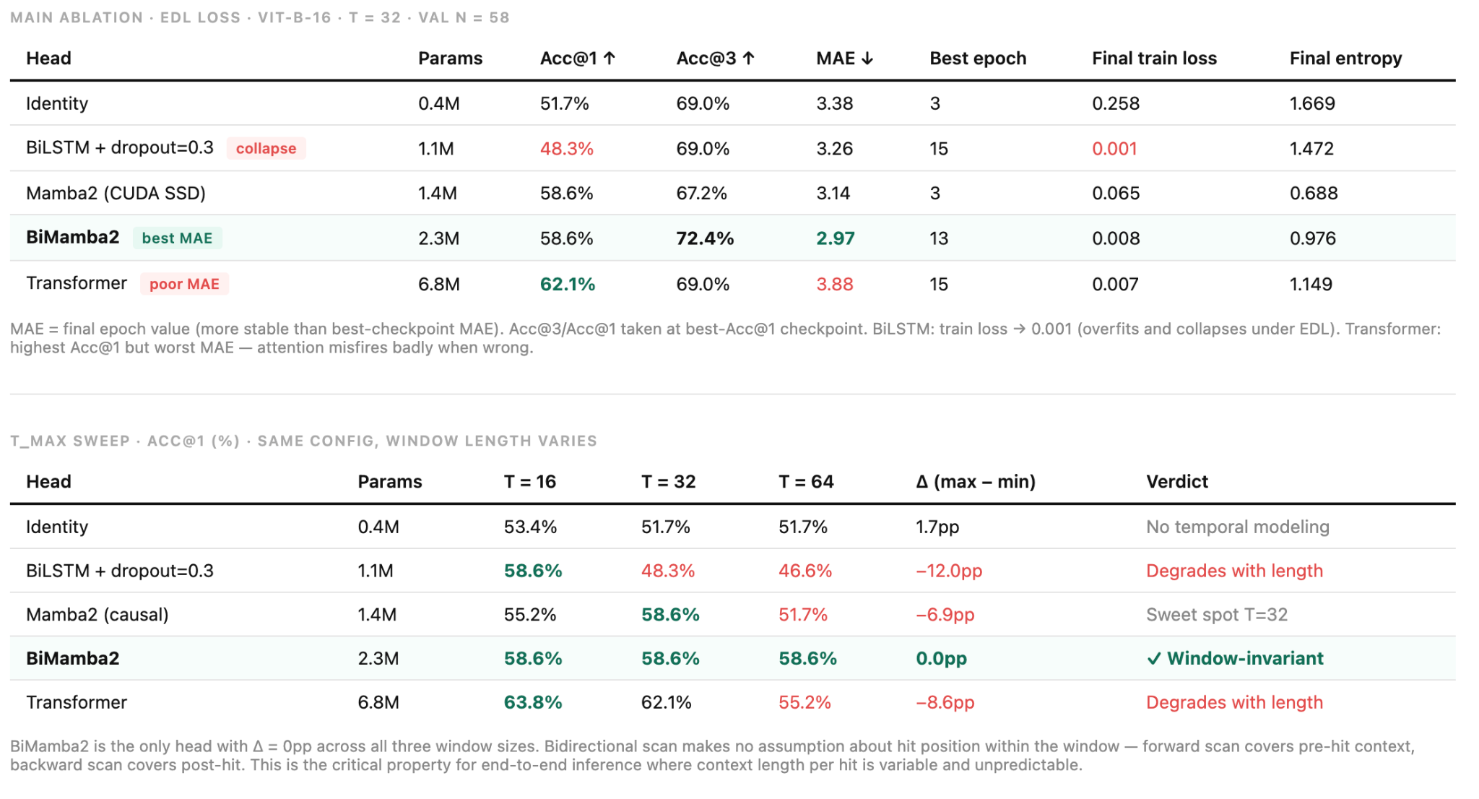

Slide 14
Thank you
Notes:
Slide 13 — Thank you
Speaker note
Happy to take questions on the ablation design, the loss function choice, or the architectural tradeoffs.
Extra info
Code and data available on request. Annotation toolchain is fully functional and can be extended to other racket sports. Next experiment (multi-hit full-clip inference) can start immediately — all infrastructure is in place.

