Slide 1
Classes
AI2C Tech Intro

Slide 2
Objectives
Implement classes in a python program to encapsulate functionality
Discuss uses of classes and their interactions in python

Slide 3
Object Oriented Programming
Things in the real world are objects
Objects interact with each other
Similar types of objects operate in the same manner
Seems like a good way to model software

Slide 4
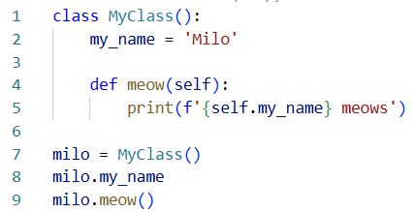
Objects
Attributes – stored data / properties of the class
Methods – what the class can do
Objects are instantiations of classes
Notes:
Defining the class is different than instantiating the class
Line 7 instantiates the class, lines 1-5 define the class.
Just like defining a function and calling the function.

Slide 5
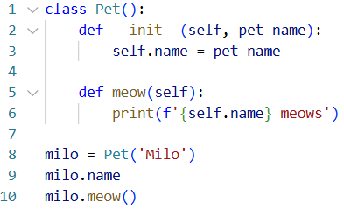
Other class ideas
Objects are constructed from classes
The constructor defines that behavior
We can set attributes during the constructor
The self keyword references an instantiated object

Slide 6
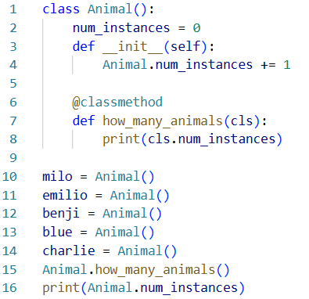
Class properties
Classes can have their own properties and methods as well
Pay special attention to the example on the right

Slide 7
Other other class ideas
The type of a class is type class
The type of an object is class name
See object’s options using dir()
By convention, things with ‘__’ or ‘_’ are not to be used outside the class

Slide 8
Hands-On #1

Slide 9
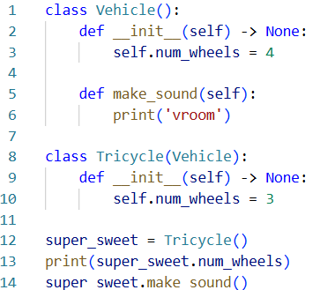
Inheritance
Classes can inherit from other classes
Receives all those classes properties and methods
Can overwrite properties / methods with your own
All classes inherit from object

