Slide 1
Classes
AI2C Tech Intro

Slide 2
Objectives
Implement classes in a python program to encapsulate functionality
Discuss uses of classes and their interactions in python

Slide 3
Object Oriented Programming
Things in the real world are objects
Objects interact with each other
Similar types of objects operate in the same manner
Seems like a good way to model software
Encapsulation – hiding complexity behind an interface

Slide 4
Objects Example

Slide 5
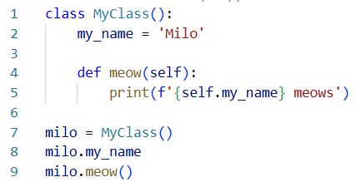
Objects
Attributes – stored data / properties of the class
Methods – what the class can do
Objects are instantiations of classes
Notes:
Defining the class is different than instantiating the class
Line 7 instantiates the class, lines 1-5 define the class.
Just like defining a function and calling the function.

Slide 6
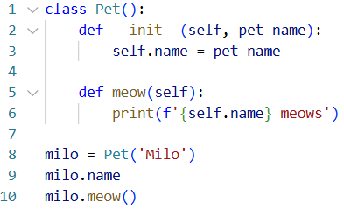
Other class ideas
Objects are constructed from classes
The constructor defines that behavior
We can set attributes during the constructor
The self keyword references an instantiated object

Slide 7
RPS Example

Slide 8
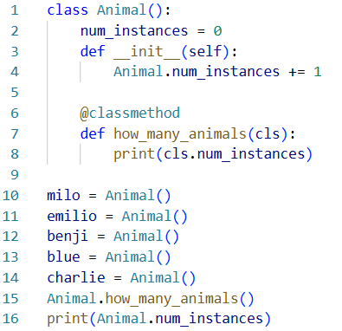
Class attributes
Classes can have their own attributes and methods
Instances can have their own properties and methods
Pay special attention to the example on the right

Slide 9
Other other class ideas
The type of a class is type class
The type of an object is class name
See object’s options using dir()
By convention, things with ‘__’ or ‘_’ are not to be used outside the class

Slide 10
Hands-On #1
Create a Spacecraft class

Slide 11

Polymorphism
One interface that accepts multiple types
Can you think of any that we’ve used?

Slide 12
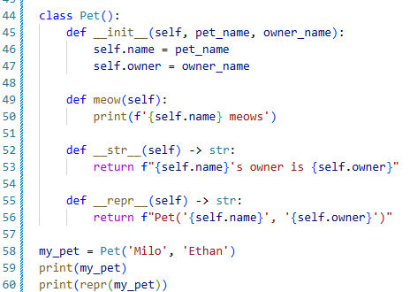
Magic Methods and Overloads
Python has many “magic methods” built-in¹
'__bool__’, '__class__’, '__delattr__’, '__dir__’, '__doc__’, '__eq__’, '__format__’, '__ge__’, '__getattribute__’, '__getstate__’, '__gt__’, '__hash__’, '__init__’, '__init_subclass__’, '__le__’, '__lt__’, '__ne__’, '__new__’, '__reduce__’, '__reduce_ex__’, '__repr__’, '__setattr__’, '__sizeof__’, '__str__’, '__subclasshook__'
These methods are called by python to do many operations like sorting or printing
You can “overload” or override these methods by defining your own method in a class.
Notes:
¹ https://docs.python.org/3/reference/datamodel.html#basic-customization

Slide 13
Other Magic Methods
Initialization & Representation
__init__ (the constructor)
__str__ (used by print)
__repr__ (official representation)
Comparison
__eq__ (==)
__ne__ (!=)
__lt__ (<)
__le__ (<=)
__gt__ (>)
__ge__ (>=)
Arithmetic
__add__ (+)
__sub__ (-)
__mul__ (*)
__truediv__ (/)
__floordiv__ (//)
__mod__ (%)
__pow__ (**)
Container
__len__
And many more!

Slide 14
Hands-On #2
Create your own Planet class

Slide 15
Final
Create a Player class
Build the terminal instructions for the game!

Slide 16
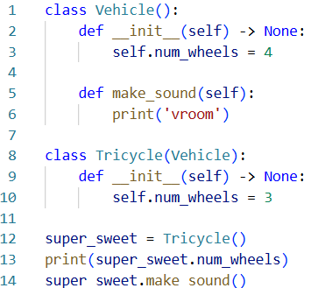
Inheritance
Classes can inherit from other classes
Receives all those classes properties and methods
Can overwrite properties / methods with your own
All classes inherit from object

