Slide 1
Classes
AI2C Tech Intro

Slide 2
Objectives
Implement classes in a python program to encapsulate functionality
Discuss uses of classes and their interactions in python

Slide 3
Object Oriented Programming
Things in the real world are objects
Objects interact with each other
Similar types of objects operate in the same manner
Seems like a good way to model software
Encapsulation – hiding complexity behind an interface

Slide 4
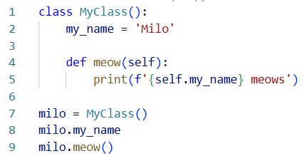
Objects
Attributes – stored data / properties of the class
Methods – what the class can do
Objects are instantiations of classes
Notes:
Defining the class is different than instantiating the class
Line 7 instantiates the class, lines 1-5 define the class.
Just like defining a function and calling the function.

Slide 5
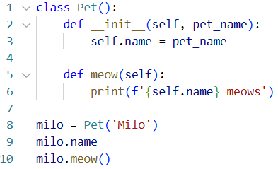
Other class ideas
Objects are constructed from classes
The constructor defines that behavior
We can set attributes during the constructor
The self keyword references an instantiated object

Slide 6
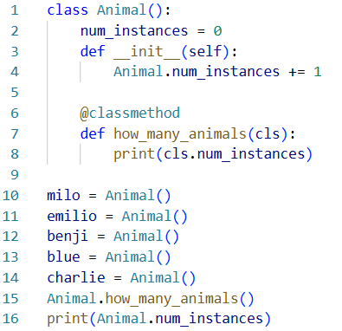
Class properties
Classes can have their own properties and methods
Instances can have their own properties and methods
Pay special attention to the example on the right

Slide 7
Other other class ideas
The type of a class is type class
The type of an object is class name
See object’s options using dir()
By convention, things with ‘__’ or ‘_’ are not to be used outside the class

Slide 8
Hands-On #1
Create a Spacecraft class

Slide 9

Polymorphism
One interface that accepts multiple types
Can you think of any that we’ve used?

Slide 10
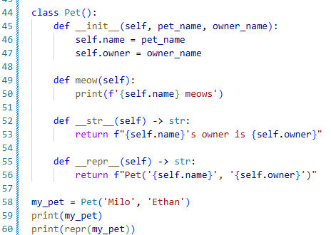
Magic Methods and Overloads
Python has many “magic methods” built-in¹
'__bool__’, '__class__’, '__delattr__’, '__dir__’, '__doc__’, '__eq__’, '__format__’, '__ge__’, '__getattribute__’, '__getstate__’, '__gt__’, '__hash__’, '__init__’, '__init_subclass__’, '__le__’, '__lt__’, '__ne__’, '__new__’, '__reduce__’, '__reduce_ex__’, '__repr__’, '__setattr__’, '__sizeof__’, '__str__’, '__subclasshook__'
These methods are called by python to do many operations like sorting or printing
You can “overload” or override these methods by defining your own method in a class.
Notes:
¹ https://docs.python.org/3/reference/datamodel.html#basic-customization

Slide 11
Other Magic Methods
Initialization & Representation
__init__ (the constructor)
__str__ (used by print)
__repr__ (official representation)
Comparison
__eq__ (==)
__ne__ (!=)
__lt__ (<)
__le__ (<=)
__gt__ (>)
__ge__ (>=)
Arithmetic
__add__ (+)
__sub__ (-)
__mul__ (*)
__truediv__ (/)
__floordiv__ (//)
__mod__ (%)
__pow__ (**)
Container
__len__
And many more!

Slide 12
Hands-On #2
Create your own Planet class

Slide 13
Final
Create a Player class
Build the terminal instructions for the game!

Slide 14
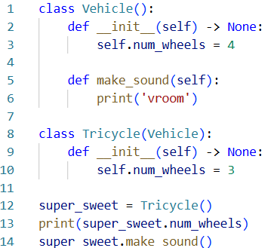
Inheritance
Classes can inherit from other classes
Receives all those classes properties and methods
Can overwrite properties / methods with your own
All classes inherit from object

