Slide 1
✦
HiperMeal
FROM FOOD PHOTO
to nutrition
insight
An AI-assisted visual nutrition diary powered by Gemma 4
SEE IT • REVIEW IT • LOG IT
UPLOAD
ANALYZE
REVIEW
SAVE
PROJECT OVERVIEW • WORKFLOW • AI ROLE • ARCHITECTURE • LIMITATIONS

Slide 2
✦
HiperMeal
01 · THE PROBLEM
Food logging is useful, but often tedious
Manual entry asks people to identify every item, estimate portions, and search nutrition tables.
Too many steps
Portions are uncertain
Data can be hard to interpret
Find the food name, choose a serving size, and enter nutrition details one item at a time.
A photo gives visual clues, but it cannot reliably reveal exact weight, hidden ingredients, or cooking oil.
People need a simple workflow that turns a meal image into an editable log, not a black-box answer.
Opportunity: make the first draft of a food log faster, while keeping the user in control.
AI-ASSISTED VISUAL NUTRITION DIARY • PROJECT PRESENTATION
02

Slide 3
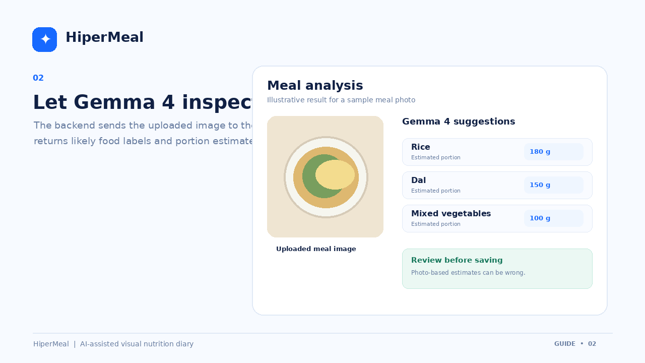
✦
HiperMeal
02 · OUR SOLUTION
HiperMeal turns a photo into an editable meal log
The app combines image understanding, backend nutrition logic, and a simple review-first interface.
1
Upload a meal photo
2
Gemma 4 suggests foods
3
Review and edit portions
4
Save to meal history
AI-ASSISTED VISUAL NUTRITION DIARY • PROJECT PRESENTATION
03

Slide 4
✦
HiperMeal
03 · USER EXPERIENCE
A short, understandable workflow
The interface is designed around four clear actions rather than a complicated nutrition form.
1
2
3
4
→
→
→
Upload
Analyze
Review
Save
Choose or drop a meal image.
Request AI-generated food suggestions.
Correct food labels and portions.
Store the meal and view its summary.
Core principle: AI suggests; the user reviews and decides what gets saved.
AI-ASSISTED VISUAL NUTRITION DIARY • PROJECT PRESENTATION
04

Slide 5
✦
HiperMeal
04 · THE AI CONTRIBUTION
What Gemma 4 does in HiperMeal
Gemma 4 is the vision-language component: it interprets visible content in the uploaded meal photo and returns structured suggestions.
Image understanding
Suggested portions
Natural-language output
Identify likely foods and describe visible meal components from the photo.
Provide approximate portion suggestions when the image offers enough visual evidence.
Return results that the backend can turn into editable food entries for the interface.
Gemma 4 assists with image interpretation; it does not guarantee exact ingredients, weights, or calories.
AI-ASSISTED VISUAL NUTRITION DIARY • PROJECT PRESENTATION
05

Slide 6
✦
HiperMeal
05 · TECHNICAL ARCHITECTURE
A clear separation of responsibilities
The frontend handles interaction; the backend coordinates AI requests, nutrition lookup, and persistence.
FRONTEND
FASTAPI
GEMMA 4
NUTRITION + SQLITE
→
→
→
HTML • CSS • JavaScript
HTTP endpoints
Image analysis
Lookup and saved meals
Typical flow: browser upload → API request → Gemma 4 result → nutrition calculation → saved meal record
Stack: Python • FastAPI • Google Gen AI SDK • SQLite • HTML/CSS/JavaScript
AI-ASSISTED VISUAL NUTRITION DIARY • PROJECT PRESENTATION
06

Slide 7
✦
HiperMeal
06 · EXAMPLE INTERACTION
From a single image to a reviewable result
Illustrative UI example only. Food labels and portion amounts below are placeholders, not a claim about a live recognition result.
Suggested food labels
Example: rice, dal, mixed vegetables.
Portion review
Check or correct serving amounts before saving.
Nutrition summary
Calories and macros depend on the food data used.
AI-ASSISTED VISUAL NUTRITION DIARY • PROJECT PRESENTATION
07

Slide 8
✦
HiperMeal
07 · TRUST AND LIMITATIONS
Useful estimates, not unquestionable facts
HiperMeal should communicate uncertainty clearly and let people correct model output.
Photo limitations
Nutrition-data limits
Privacy and security
Hidden ingredients, cooking oil, depth, and exact serving weight may not be visible.
The current prototype uses a small sample dataset. Production use needs verified food-composition data.
Keep API keys on the server. Add authentication and access controls before public deployment.
Design choice: keep results editable and make the user the final reviewer.
AI-ASSISTED VISUAL NUTRITION DIARY • PROJECT PRESENTATION
08

Slide 9
✦
HiperMeal
08 · NEXT STEPS
How HiperMeal can grow beyond the prototype
A realistic roadmap focuses on validation and data quality before adding complexity.
NOW
Test image recognition across varied meals
NEXT
Use reliable, cited food-composition data
THEN
Improve daily totals, trends, and meal history
BEFORE LAUNCH
Add privacy controls, authentication, and deployment hardening
AI-ASSISTED VISUAL NUTRITION DIARY • PROJECT PRESENTATION
09

Slide 10
✦
HiperMeal
Make food logging easier.
Gemma 4 helps interpret meal images. HiperMeal turns those suggestions into an editable nutrition log.
VISION
REVIEW
NUTRITION
HISTORY
Thank you • Questions?

