Slide 1
Ultrasonic-Based
Anti-Theft Alarm System
Arduino UNO · HC-SR04 Ultrasonic Sensor · LED Indicators · Buzzer Alert
Arduino Project
Embedded Systems
Security & IoT

Slide 2
Project Overview
02
The Ultrasonic-Based Anti-Theft Alarm System is an Arduino-powered security device that uses sound waves to detect nearby objects or intruders. When armed, it continuously measures distance — triggering a buzzer alarm and flashing red LED when anything moves within 200 cm. A green LED confirms the system is active and clear.
Arm / Disarm
Real-Time Detection
Dual Alerts
Push-button toggle arms or disarms the entire system instantly
HC-SR04 pings 20×/sec with a 200 cm detection range
1 kHz buzzer tone + flashing red LED on intrusion detection

Slide 3
Components
03
Arduino UNO
HC-SR04
Buzzer (Passive)
Microcontroller
Ultrasonic Sensor
Audio Alert
ATmega328P, 14 digital I/O pins, runs at 16 MHz. The brain of the system.
Sends 40 kHz pulses; measures echo return time to calculate distance (2–400 cm).
Piezoelectric buzzer driven by tone() at 1000 Hz when an intruder is detected.
📌 Power: 5V & GND
📌 TRIG→D7, ECHO→D6
📌 Signal→D12
Red LED + 330Ω
Green LED + 330Ω
Push Button
Visual Alert
Status Indicator
Arm/Disarm Toggle
Flashes at 200 ms intervals when armed and an object enters the detection zone.
Stays solid ON when the system is armed and no threat is detected.
Connected with INPUT_PULLUP. Single press toggles system state; 300 ms debounce.
📌 Anode→D11
📌 Anode→D10
📌 Signal→D2

Slide 4
Circuit & Wiring
04
Component
Arduino Pin
Wire Color
330Ω Resistors
HC-SR04 VCC
5V
Red
Each LED must use a 330 Ω resistor in series to limit current to ~10 mA and protect the Arduino pin.
HC-SR04 GND
GND
Black
HC-SR04 TRIG
D7
Yellow
HC-SR04 ECHO
D6
Green
INPUT_PULLUP
Button uses internal pull-up; LOW = pressed. Eliminates need for external resistor.
Buzzer (+)
D12
Purple
Red LED (+)
D11 via 330Ω
Red
Green LED (+)
D10 via 330Ω
Green
Breadboard GND
Button Pin 1
D2
Orange
All GND connections share the breadboard rail tied to Arduino GND.
Button Pin 2
GND
Black

Slide 5
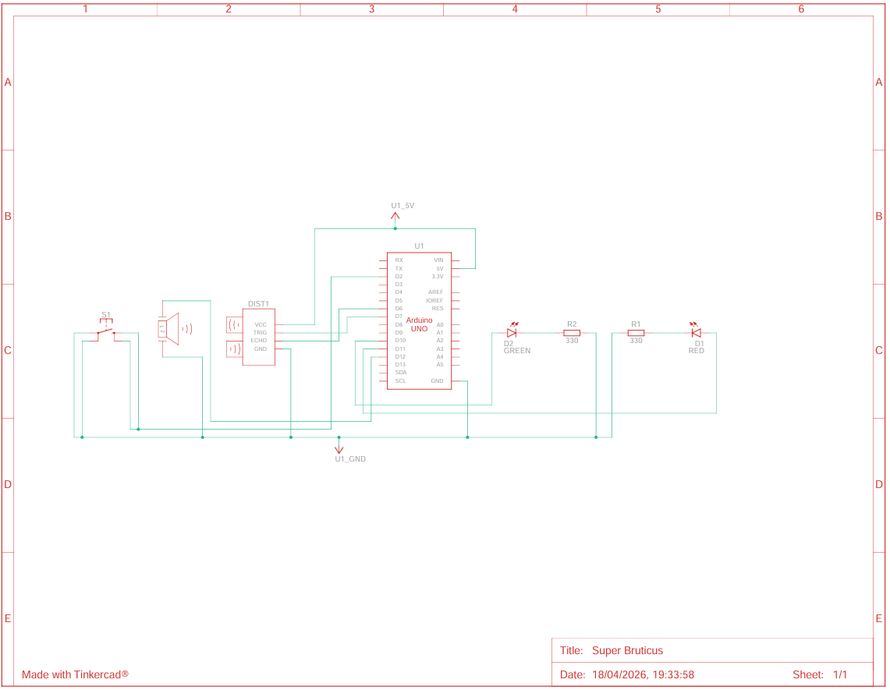
Schematic Diagram
05
Arduino UNO
HC-SR04 Sensor
Buzzer
LEDs + Resistors
Made with Tinkercad® — Super Bruticus · 18/04/2026

Slide 6
How It Works
08
1
2
3
4
5
Button Press
Ultrasonic Ping
Echo Timing
Distance Calc
Threat Check
User presses button → systemArmed toggles. 300 ms debounce prevents double-trigger.
TRIG goes HIGH for 10 µs → sensor fires 8 x 40 kHz pulses toward target.
pulseIn() measures how long ECHO stays HIGH (µs). Speed of sound = 0.0343 cm/µs.
distance = duration × 0.0343 ÷ 2. Divides by 2 because pulse travels TO object and back.
If distance < 100 cm → tone(buzzer,1000) + red LED flash. Else → green LED on, silence.

Slide 7
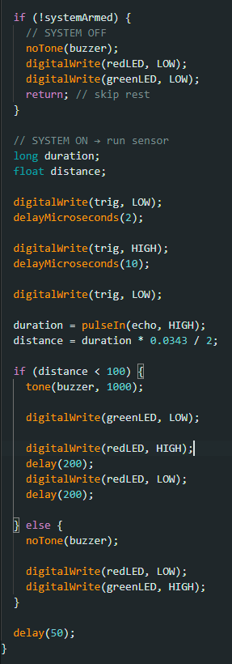
Code Walkthrough
06
sketch.ino
#define trig 7 echo 6 buzzer 12
#define greenLED 10 redLED 11 button 2
bool systemArmed = false;
void setup() {
pinMode(trig, OUTPUT);
pinMode(echo, INPUT);
pinMode(buzzer, OUTPUT);
pinMode(greenLED, OUTPUT);
pinMode(redLED, OUTPUT);
pinMode(button, INPUT_PULLUP);
}
void loop() {
// Toggle system ON/OFF when button pressed
if (digitalRead(button) == LOW) {
systemArmed = !systemArmed; // switch state
delay(300); // debounce delay
}

Slide 8
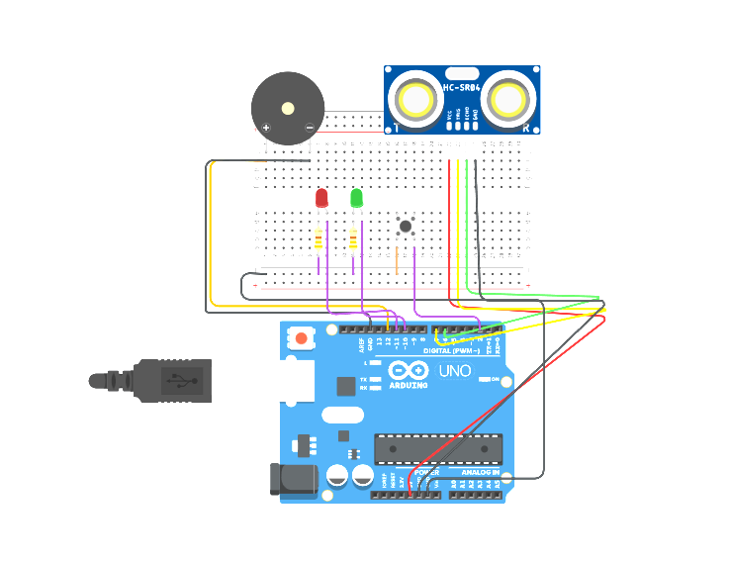
Summary & Upgrades
07
What We Built
Circuit Diagram
Arduino UNO as the central controller
HC-SR04 sensor measuring distance in real-time
Button to toggle armed / disarmed state
Red LED + buzzer for intrusion alert
Green LED for armed + clear confirmation
Resistor-protected LEDs for circuit safety
Clean loop() with no blocking beyond debounce

