Slide 1



Paper ID: 810
Real-Time Multimodal Detection of Fraud and Scam Calls Using Conversation Stage Modeling and Ensemble Learning
Subhalaxmi Chakraborty
Department of CST & CSIT
Institute of Engineering and Management
University of Engineering & Management
Kolkata, India
subhalaxmi2008@gmail.com
Krishna Kumar Jha
Guru Nanak Institute of Technology
Kolkata, India
krishnakumar.jha@gnit.ac.in
ORCID: 0000-0002-3210-5187
Pritam Paul
Department of CST & CSIT
Institute of Engineering and Management
University of Engineering & Management
Kolkata, India
paulpritam417@gmail.com
Arya Gupta
Department of CST & CSIT
Institute of Engineering and Management
University of Engineering & Management
Kolkata, India
aryagupta.dev@gmail.com
Srijan Sarkar
Department of CST & CSIT
IEM & UEM
Kolkata, India
srijansarkar.coding@gmail.com
Shinjan Saha
Department of CST & CSIT
IEM & UEM
Kolkata, India
shinjansaha00@gmail.com
github.com/CyberKnight-cmd/spam-call-detection
Notes:
Good morning. Our paper detects scam phone calls while the call is still happening. I will start from the basics, explain each of our four models with its maths, show how we combine them, and then present results and limitations.

Slide 2
Outline
Introduction and motivation
Signal processing: cleaning audio, MFCC features
CNN fundamentals: the maths
The four models, one by one
Ensemble: weighted fusion and EMA smoothing
Results and discussion
Conclusion and references
Notes:
This is the plan. First the problem, then the signal processing, the CNN maths, the four models one by one, how they are combined, and finally results.

Slide 3
Introduction
Why scam calls need real-time detection
Notes:
Let us start with the problem.

Slide 4
Why Scam Calls Are a Problem
Social engineering: a person is persuaded; nothing is hacked
Goal: OTP, bank details or money
Hard to block: fluent speech, new numbers every day
Damage happens during the call
Key question
Can we warn the user while the call is still going on?
Notes:
A scam call is social engineering: nothing is hacked, a person is persuaded. The caller wants an OTP, bank details or money. Modern scammers speak fluently and change numbers daily, so blacklists fail. And because the damage happens during the call, a warning after the call is useless.

Slide 5
How a Scam Call Unfolds
risk
Data request
Urgency
“Tell me the OTP”
Problem
“Do it right now”
Authority
“Your KYC is incomplete”
Greeting
“Calling from your bank”
“Hello sir, good morning”
call progresses →
Scam calls follow a fixed script [6]. Know the stage → know the danger.
Notes:
This is the key observation of the paper. Scam calls follow a script in a fixed order: greeting, a claim of authority, a made-up problem, pressure, and finally the request for data. Each step up the staircase is more dangerous. If we know which step the call has reached, we know the risk. Wood et al. showed this staged structure in real scam-baiting calls.

Slide 6
Related Work and the Gap
Approach | Main idea | Limitation
Blacklists & rules [1], [2] | Block known numbers; rules on call duration | Numbers change; false alarms
Call-record ML [3], [4] | Clustering / DTW on call statistics | Never listens to the call
Content analysis [5], [6] | NLP / deep learning on transcripts | After the call; one modality
Gap: no real-time system combines voice + text + conversation order.
Notes:
Three families of earlier work. Blacklists and rules are cheap but scammers change numbers. Call-record methods cluster call statistics or use dynamic time warping, but never listen to the conversation. Content methods analyse transcripts, but usually after the call ends and with one modality. Nobody combines voice, text and conversation order in real time. That is our gap.

Slide 7
Our Contributions
1
Conversation-stage modelling
2
Four-model ensemble
Track the scam script live
Phoneme, prosody, repetition, stage
3
Weighted fusion + EMA
4
Working open system
A stable risk score every 4 s
Android app + FastAPI server + public code
Notes:
Four contributions. Conversation-stage modelling is the main one. Around it we build a four-model ensemble, fuse the scores with fixed weights, smooth them over time, and run the whole thing live in a working app with public code.

Slide 8
Proposed Framework
From raw audio to a live risk score
Notes:
Now the method, step by step, with the maths.

Slide 9
System Architecture
① Phoneme CNN
w = 0.10
② Prosody / urgency
w = 0.10
Android app
captures caller audio
Preprocess
VAD + dominant speaker
Fusion + EMA
one risk score
Risk label
5 levels
③ Repetition CNN
w = 0.20
④ Stage (Whisper + MiniLM)
w = 0.60
Every 4 s: 16 kHz · 16-bit PCM over WebSocket → 4 models in parallel → label back to the phone
Notes:
The full pipeline. Every 4 seconds the Android app sends the caller's audio to a FastAPI server over a WebSocket. The server cleans the audio, then runs four models at the same time. Their scores are combined with fixed weights, smoothed over time, and one of five risk labels goes back to the phone. The weights you see, 0.60, 0.20, 0.10 and 0.10, are the ensemble, explained later.

Slide 10
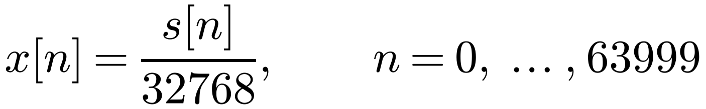
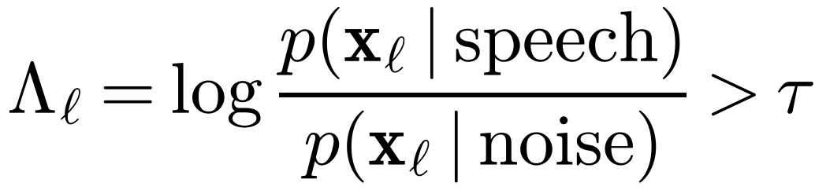
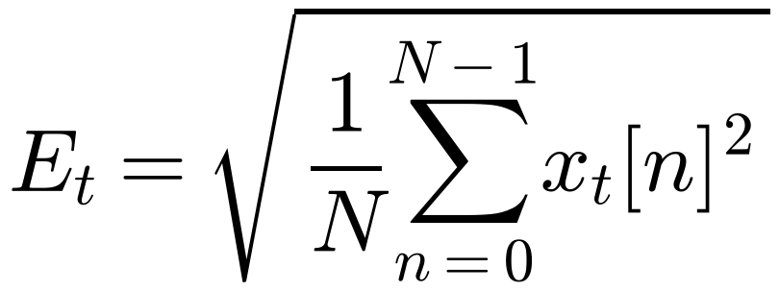
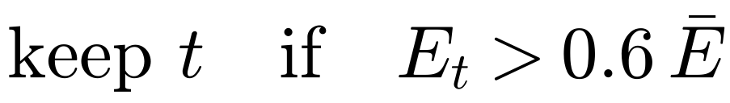
Step 1: Cleaning the Audio
Normalise
int16 → [−1, 1]
Voice activity [25]
30 ms frames; skip window if speech < 1 s
Frame energy (RMS)
loudness of frame t
Dominant speaker
runs ≥ 1.2 s; else fall back to VAD
Notes:
Before any model, we clean the audio. The phone sends 16-bit integers; we divide by 32768 to get values between minus one and one. 4 seconds at 16 kHz is 64,000 samples. Voice activity detection checks each 30 ms frame: it compares how likely the frame is under a speech model versus a noise model, a log-likelihood ratio. Windows with under one second of speech are skipped. Then the dominant-speaker filter computes the RMS energy of each frame and keeps only long, loud runs, at least 1.2 seconds above 0.6 times the mean energy. If too little remains, we fall back to the VAD output.

Slide 11
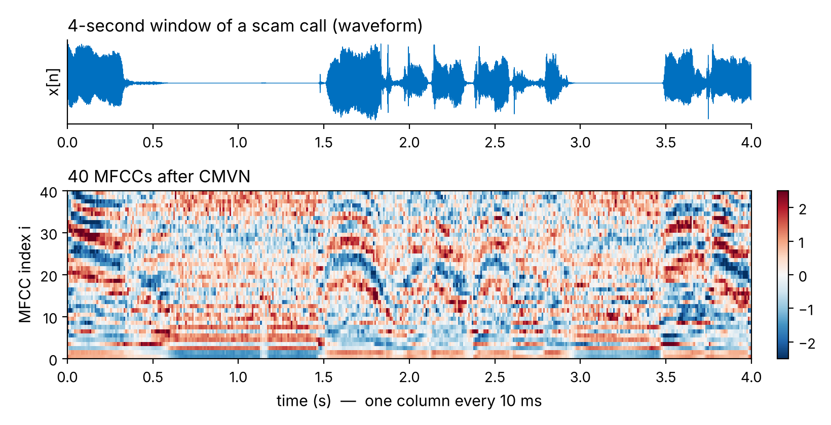
Step 2: From Sound to MFCC Features
Frames 25 ms
FFT
Mel filters
log
DCT
+ Δ, ΔΔ
Phoneme CNN input per window: 370 × 120 (40 MFCC + 40 Δ + 40 ΔΔ) [7], [9]
Notes:
A computer cannot use raw sound well, so we turn it into MFCCs: Mel-frequency cepstral coefficients. The chain is: cut into 25 ms frames every 10 ms, take the FFT, pass through a Mel filterbank that mimics the human ear, take the log, then a DCT. We add first and second time-derivatives, called deltas. This picture is a real 4-second scam window from our dataset and its 40 MFCCs. Each column is one 10 ms frame. The phoneme CNN receives a 370 by 120 matrix: 40 MFCCs plus 40 deltas plus 40 delta-deltas.

Slide 12
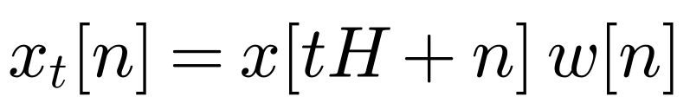
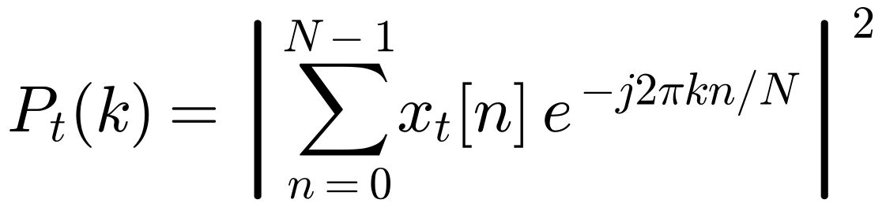
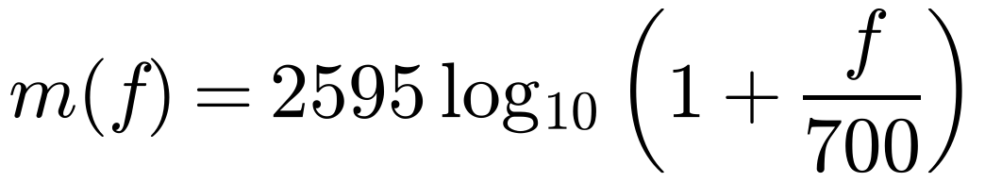
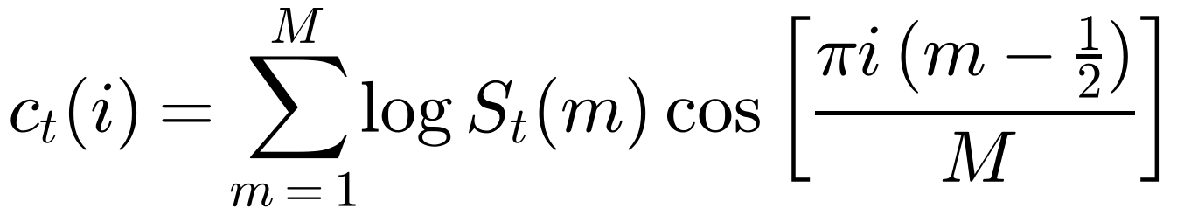
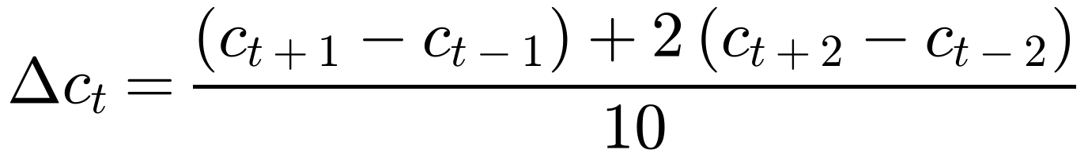
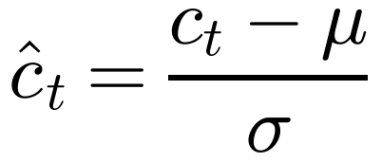
MFCC: The Maths
Framing
N = 400, H = 160
Power spectrum
FFT of each frame
Mel scale [8]
ear-like frequency axis
Filterbank → log → DCT
keep i = 0 … 39
Deltas [9]
change over time
Normalise (CMVN)
per coefficient
Notes:
The same chain as equations. Frame t is a 400-sample slice, hopped by 160 samples, times a Hann window. The FFT gives the power at each frequency. The Mel scale compresses high frequencies the way our ears do. We sum the power in each Mel filter, take the log, and a DCT decorrelates the result; we keep 40 coefficients. Deltas measure how fast each coefficient changes over time. Finally CMVN subtracts the mean and divides by the standard deviation, so loud and quiet phones look alike.

Slide 13
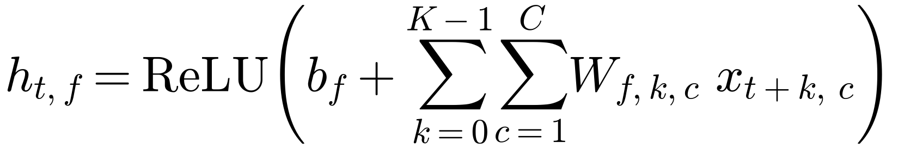
CNN Basics: 1-D Convolution
input X (time × 120 features)
kernel W: K = 5 frames
output h (time − 4) × 64
Weight sharing: same W at every time step [10]
Output length: T′ = T − K + 1 (no padding)
Notes:
Both of our audio networks are 1-D convolutional neural networks. Think of the MFCC matrix as a row of columns, one per 10 ms frame. A filter, or kernel, looks at K neighbouring frames at once, here 5 frames, multiplies by learned weights, adds a bias, and applies ReLU. Then it slides one step and repeats. The same weights are used at every position, called weight sharing, so a pattern is recognised wherever it occurs in time. With 64 filters we get 64 output channels. With no padding, the output is K minus 1 frames shorter.

Slide 14
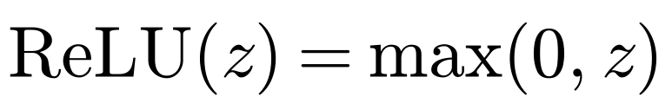
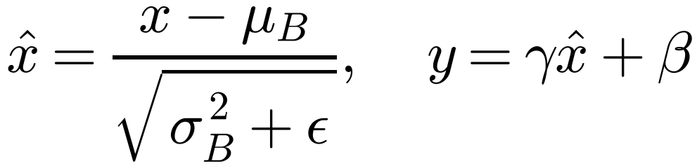
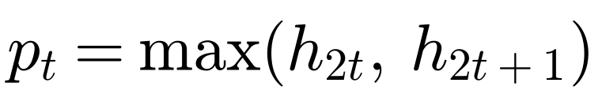
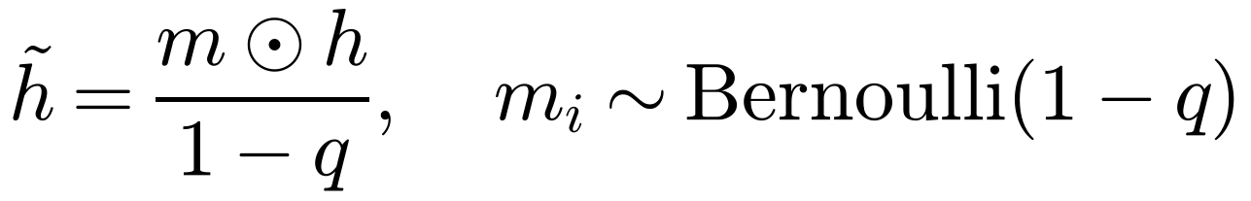
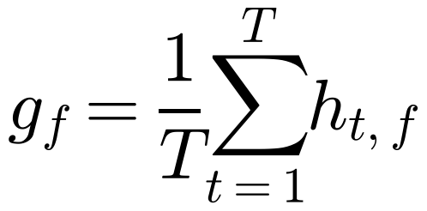
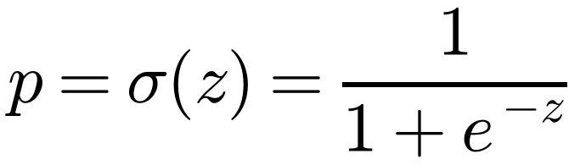
CNN Building Blocks: The Maths
ReLU [11]
non-linearity
BatchNorm [12]
stable training
MaxPool
halve length
Dropout [13]
stop overfitting
Global avg pool [14]
fixed-size vector
Sigmoid
probability (0, 1)
Notes:
Each block has one job. ReLU adds non-linearity and keeps gradients healthy. Batch normalisation rescales each channel using the batch mean and variance, then learns a scale gamma and shift beta; this stabilises training. Max-pooling halves the length and keeps the strongest response. Dropout randomly switches off neurons during training, with probability q, so the network cannot memorise our small dataset. Global average pooling turns any number of frames into one fixed vector. The sigmoid squashes the final number into a probability between 0 and 1.

Slide 15
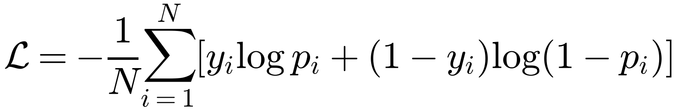
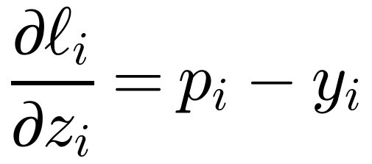
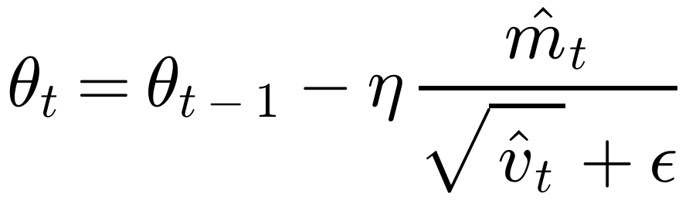
How the CNNs Are Trained
Binary cross-entropy loss (y = 1 scam, 0 normal)
Gradient at the output = the error
Adam optimiser [15]
η = 5×10⁻⁴ (phoneme CNN) · 10⁻³ (repetition CNN) · β₁ = 0.9, β₂ = 0.999
Notes:
Both CNNs are binary classifiers: label 1 for scam, 0 for normal. The loss is binary cross-entropy, the negative log-likelihood of a coin flip with probability p. It punishes confident wrong answers heavily. With a sigmoid output its gradient is simply p minus y, the error itself, which makes training simple and stable. Weights are updated with Adam, which keeps a running average of the gradient, m, and of its square, v, so each weight gets its own step size. We used learning rates of 0.0005 for the phoneme CNN and 0.001 for the repetition CNN.

Slide 16
Model 1: Phoneme CNN
Input
MFCC
Conv1D
64, k=5
BN·ReLU
MaxPool ÷2
Drop 0.3
Conv1D
128, k=3
BN·ReLU
MaxPool ÷2
Drop 0.3
Global
avg pool
Dense 128
Drop 0.4
Dense 1
sigmoid
370×120
366×64
183×64
181×128
90×128
128
128
1
≈ 80.6 k
≈ 120 ms
Why CNN?
parameters → fast
receptive field ≈ one phoneme
local patterns, shared weights [10]
Notes:
Model one looks at how the voice sounds at the level of phonemes. Input: the 370 by 120 MFCC matrix of the dominant speaker. Two convolution blocks with 64 and 128 filters, each followed by batch norm, max-pooling and dropout. The numbers under each block are the shapes: 370 frames shrink to 90. Global average pooling gives 128 numbers, a dense layer, and a sigmoid gives the scam probability. The whole network has about 80,600 parameters, small enough to run in real time. Its receptive field is about 12 frames, 120 milliseconds, which is roughly one phoneme or syllable. That is exactly why a CNN fits here.

Slide 17
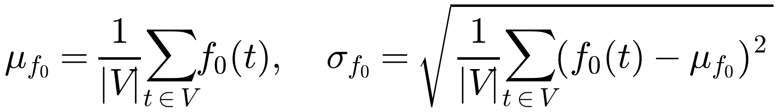
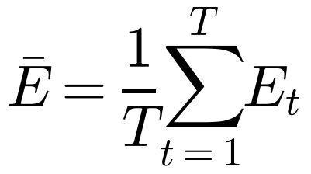
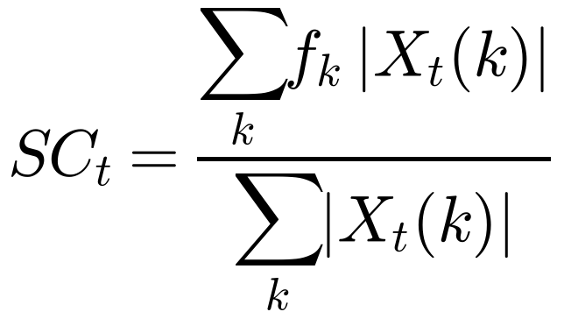
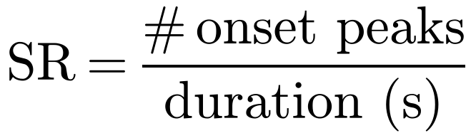
Model 2: Prosody Features
Pitch mean & variation
raised, agitated voice
Loudness (RMS)
speaking forcefully
Spectral centroid
sharp, tense tone
Speech rate
rushing the victim
Notes:
Model two listens to how something is said, not what. Four measurements. Pitch: the mean and standard deviation of the fundamental frequency over voiced frames; a raised, agitated voice increases both. Loudness: the average RMS energy. Spectral centroid: the centre of mass of the spectrum; a sharp, tense voice has a higher centroid. Speech rate: the number of onset peaks per second; scammers rush their victims.

Slide 18
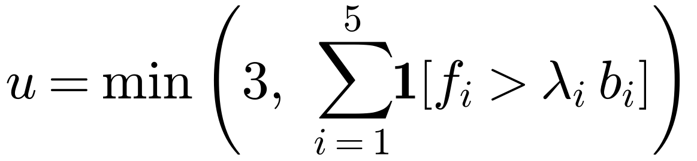
Model 2: Urgency Score
Cue fᵢ | Factor λᵢ
RMS energy | 1.8
Pitch mean | 1.3
Pitch variation | 1.5
Speech rate | 1.5
Spectral centroid | 1.25
bᵢ = baseline from normal speech · silence gate: Ē < 0.005 ⇒ u = 0
Notes:
We turn the prosody features into an urgency score with a transparent rule. For each of the five cues we check whether it is above the speaker baseline b times a factor lambda; for example energy must be 1.8 times the baseline. We count how many cues fire, capped at 3. The count goes through a lookup table that grows faster than linear: one cue alone is weak evidence, three cues together strongly suggest pressure. If the window is nearly silent, the score is zero. Being rule-based, it needs no labelled urgency data and it is easy to explain.

Slide 19
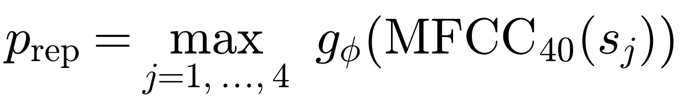
Model 3: Script-Repetition CNN
s₁ 0–1 s
s₂ 1–2 s
s₃ 2–3 s
s₄ 3–4 s
CNN
CNN
CNN
CNN
p₁
p₂
p₃
p₄
max
one scripted phrase anywhere is enough
470×40
Conv 32, k5
Pool·Drop
Conv 64, k3
Pool·Drop
GAP
Dense 64
σ → p
≈ 17.2 k parameters · augmentation: time-stretch 0.85× / 1.15×, pitch ±2 semitones, volume 0.8–1.2× · keyword-spotting CNN idea [16]
Notes:
Model three catches recorded or scripted phrases, the kind a scam call centre repeats all day. The 4-second window is cut into four 1-second segments. Each segment becomes a 40-MFCC matrix padded to 470 frames, and the same small CNN gives a probability. We take the maximum: one scripted phrase anywhere in the window is enough. The CNN has the same design as model one but is smaller, about 17,200 parameters. It learns sound patterns, not words, so it can work in regional languages. To make it robust to different speakers we trained with time-stretching, pitch shifting and volume changes. This follows the CNN keyword-spotting idea of Sainath and Parada.

Slide 20
Model 4: Conversation Stage
4-s audio
xₜ
Whisper [18]
speech → text
MiniLM [20]
text → meaning
Intent bank
5 stages × ~20 examples
Stage update
forward only
speech
“your KYC update is pending”
eₜ ∈ ℝ³⁸⁴
best: PROBLEM
stage 3 → r = 0.50
illustrative example
Meaning, not exact words: a rephrased script still matches
Intent bank: English and Hindi examples, for Indian users
Notes:
Model four understands what the caller is trying to do. Whisper turns the audio into text. MiniLM turns the text into a vector of 384 numbers that captures its meaning. We compare that vector with an intent bank: five stages, about twenty example sentences each, in English and Hindi. The best match updates the conversation stage, and the stage gives a risk value. Because we compare meaning, a scammer who rephrases the script is still caught. The values here are illustrative.

Slide 21
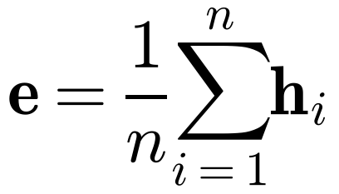
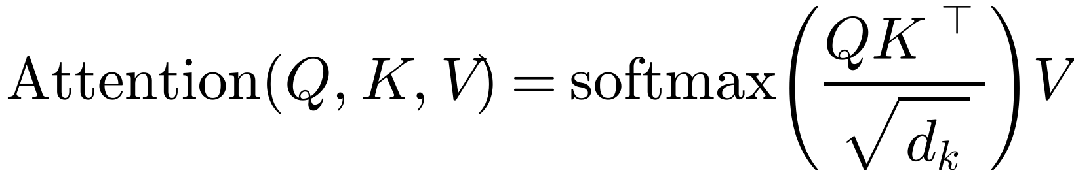
Inside Whisper and MiniLM
Whisper [18]: speech → text
MiniLM-L6-v2 [19], [20]: text → meaning
80-channel log-Mel input
CNN stem: 2 × Conv1D (k = 3, GELU)
Encoder–decoder Transformer → text
6 Transformer layers, 384-d
Mean pooling over tokens:
Self-attention [17]: every word looks at every other word
Notes:
Both tools are Transformers. Whisper takes an 80-channel log-Mel spectrogram, very close to our MFCC pipeline, and its encoder actually begins with two 1-D convolution layers, so there is a CNN here too, before an encoder-decoder Transformer writes out the text. MiniLM is a small 6-layer Transformer that outputs one 384-dimensional vector per sentence by averaging its token vectors. The core operation of every Transformer is self-attention: each word builds a query, key and value; the softmax of query times key, scaled by the square root of the dimension, says how much each word should look at every other word.

Slide 22
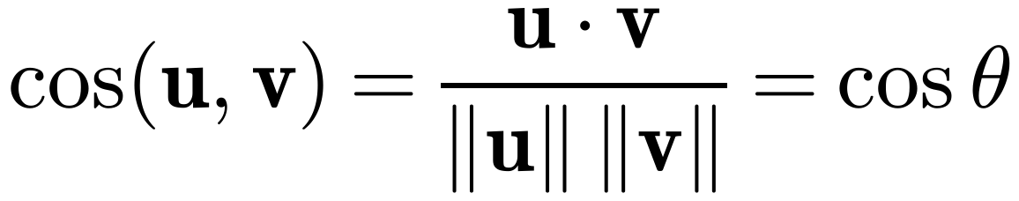
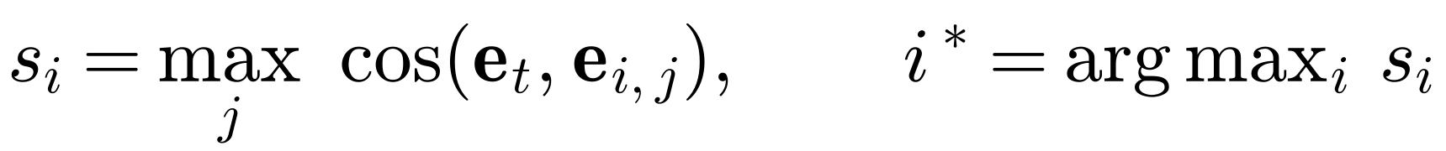
Matching Meaning: Cosine Similarity
eₜ (caller)
Score each stage by its best example
Pick the highest-scoring stage i*
Accept only if s(i*) ≥ 0.55
Small talk below the gate is ignored
PROBLEM
small θ
GREETING
large θ
Notes:
How do we compare two meanings? Each sentence is an arrow in 384-dimensional space. Cosine similarity is the cosine of the angle between two arrows: 1 means same direction, same meaning; near 0 means unrelated. For each stage we take its best-matching example sentence, then pick the stage with the highest score. If even the best score is below 0.55, we ignore the window; this gate stops random small talk from moving the stage.

Slide 23
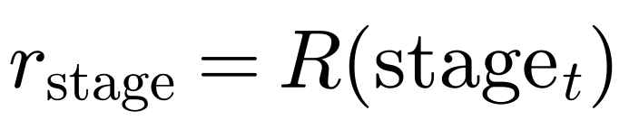
Stage Tracking: A Forward-Only State Machine
0
1
2
3
4
5
None
Greeting
Authority
Problem
Urgency
Data req.
R = 0.05
R = 0.10
R = 0.25
R = 0.50
R = 0.70
R = 0.95
otherwise the stage stays the same
Scam scripts move forward, so the stage never steps back
One innocent sentence cannot hide earlier pressure
Notes:
The stage is a counter from 0 to 5 that can only go up. If the best intent passes the 0.55 gate, the new stage is the maximum of the old stage and the matched one. Otherwise it stays. Real scam scripts move forward, so going backwards adds nothing, and this rule means one innocent sentence cannot hide earlier pressure. Each stage maps to a risk value, from 0.05 when nothing is detected to 0.95 when the caller asks for data.

Slide 24
Ensemble: Weighted Late Fusion
Stage
× 0.60
Input | value | × w | =
Stage (PROBLEM) | 0.50 | 0.60 | 0.30
Repetition | 0.70 | 0.20 | 0.14
Phoneme | 0.60 | 0.10 | 0.06
Urgency (u = 2) | 0.50 | 0.10 | 0.05
Raw risk rₜ |  |  | 0.55
Repetition
× 0.20
Σ
rₜ
Phoneme
× 0.10
Urgency
× 0.10
illustrative values
Weighted soft voting [21]: the stage gets the largest weight because it is the most reliable cue
Notes:
Now the ensemble. Each model gives a number between 0 and 1. We combine them with a weighted sum, called late fusion or weighted soft voting. The weights add up to one, so the result also stays between 0 and 1. The stage gets 0.60 because it is the most reliable signal and gave the largest gain in the ablation; repetition gets 0.20; phoneme and urgency 0.10 each. Example: stage at PROBLEM gives 0.50 times 0.60, which is 0.30; repetition 0.70 gives 0.14; phoneme 0.60 gives 0.06; urgency 0.5 gives 0.05; total 0.55 for this window.

Slide 25
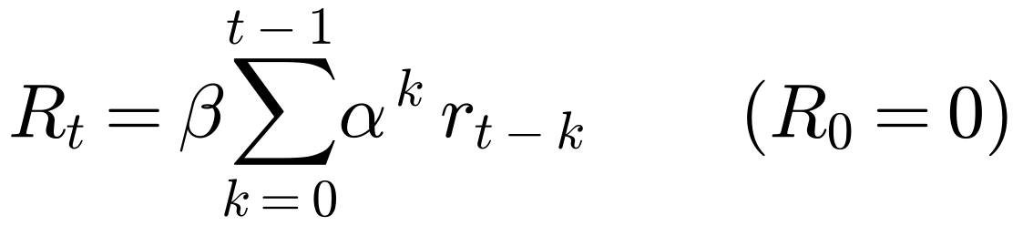
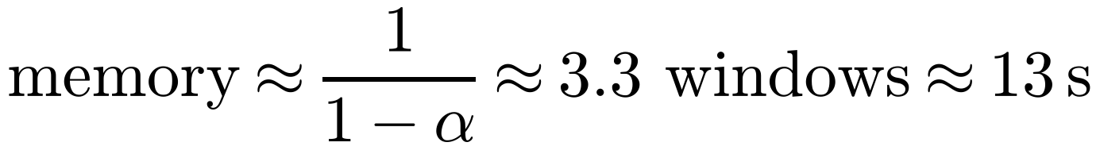
Smoothing Over Time: EMA
Spike → only 0.34 (MODERATE), then fades · Sustained scam crosses 0.60 at window 4 (16 s) · [22]
Notes:
One noisy window should not raise an alarm. So we smooth the raw risk with an exponential moving average: 70 percent of the previous running risk plus 30 percent of the new raw risk. Unrolled, it is a weighted sum of all past windows with weights that shrink geometrically; it remembers roughly the last 3.3 windows, about 13 seconds. The chart shows the effect. A single spike to 1.0 only lifts the running risk to 0.34, which is MODERATE, and then it fades. A call that is consistently suspicious, at 0.8 per window, crosses the 0.60 scam-alert line after four windows, 16 seconds.

Slide 26
Risk Levels and Real-Time Execution
SAFE
LOW
MODERATE
HIGH
SCAM ALERT
0.0
0.15
0.25
0.45
0.6
1.0
running risk Rₜ
Sequential: time = sum
Parallel, 4 workers: time = max
Stage (Whisper)
Repetition
Phoneme
Urgency
done
done
Notes:
The running risk is mapped to five labels using these cut-offs from our server: below 0.15 safe, up to 0.25 low, up to 0.45 moderate, up to 0.60 high, and above 0.60 scam alert. To stay real-time, the four models run at the same time in a thread pool with four workers. So the time per window is the slowest model, not the sum of all four, and the answer is ready before the next 4-second chunk arrives. Bar lengths here are illustrative.

Slide 27
Results and Discussion
Does it work, and where are its limits?
Notes:
Now, how well does it work?

Slide 28
Dataset and Evaluation Setup
Training data (built by us, public)
16
full calls: 7 normal, 9 scam
No public real-time scam-call dataset exists
Phoneme & urgency: ≈ 28 min scam + ≈ 23 min normal
Repetition: ≈ 80 clips × 15 keywords + 800–900 negatives
Stage model: intent example sentences
Same
pipeline as live deployment
Final Rₜ
of each call = its score
Notes:
There is no public dataset of real-time scam calls, so we built our own, one part per model, and released it. The phoneme and urgency models used about 28 minutes of scam and 23 minutes of normal speech in 4-second windows. The repetition CNN used about 80 clips for each of 15 fraud keywords, plus 800 to 900 negative clips with noise and other speech. For evaluation we played 16 full calls, 7 normal and 9 scam, through exactly the same pipeline as live use, window by window. The prediction for a call is its final running risk.

Slide 29
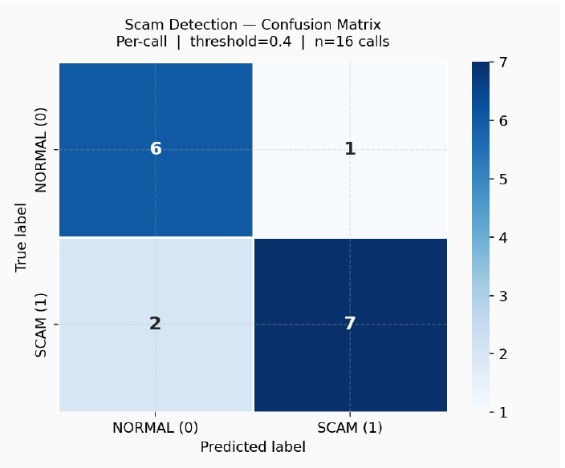
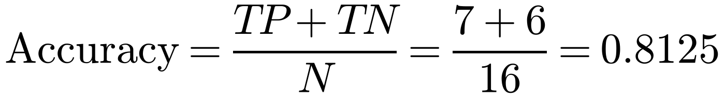
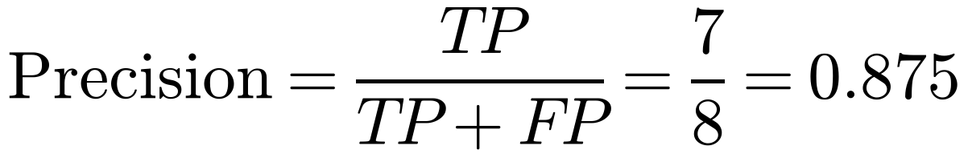
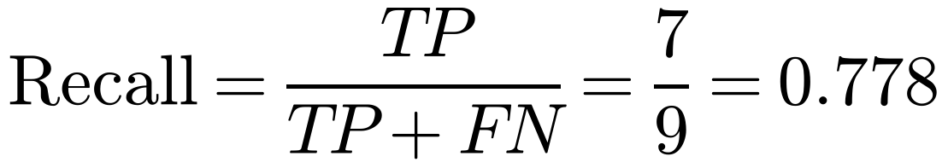
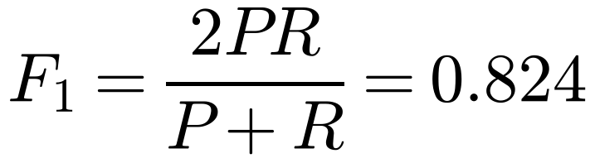
From Confusion Matrix to Metrics
TP = 7 caught · FN = 2 missed · FP = 1 false alarm · TN = 6
High precision → few false alarms → users keep trusting the alert
Notes:
The confusion matrix at threshold 0.40. Of 9 scam calls, 7 were caught: true positives. 2 were missed: false negatives. Of 7 normal calls, 6 were correct and 1 was a false alarm. From these four numbers: accuracy is 13 out of 16, 81.25 percent. Precision for the scam class is 7 out of 8, 0.875: when we raise an alarm we are usually right, which matters for user trust. Recall is 7 out of 9. F1, the harmonic mean of precision and recall, is 0.824.

Slide 30
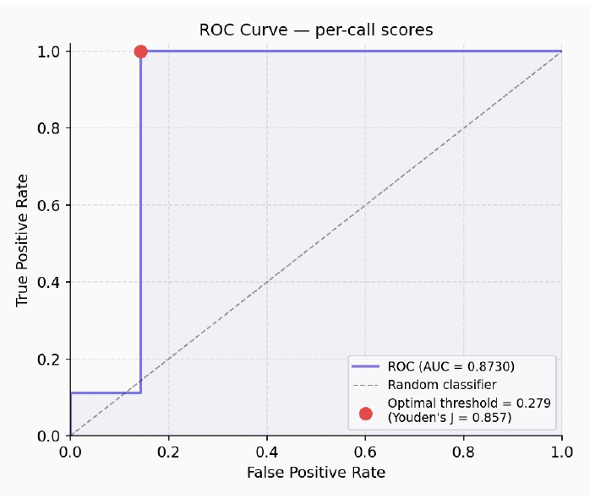
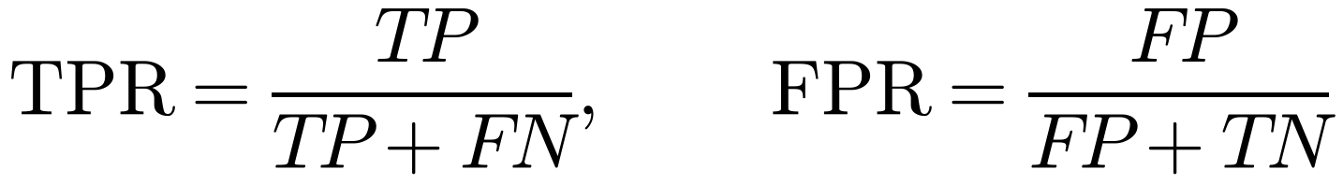
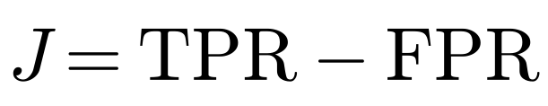
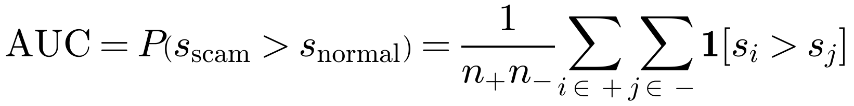
ROC Curve, AUC and the Threshold
Threshold | TPR | FPR | J
0.279 (max J) | 1.000 | 0.143 | 0.857
0.40 (reported) | 0.778 | 0.143 | 0.635
0.279 is tuned on the same 16 calls, so we report the stricter 0.40.
AUC = chance a random scam call scores higher than a random normal call [23], [24]
Notes:
The ROC curve plots true-positive rate against false-positive rate as the threshold moves. The area under it, 0.873, has a simple meaning: pick a random scam call and a random normal call, and 87 percent of the time the scam call gets the higher risk score. It does not depend on any threshold. Youden's J, TPR minus FPR, is highest at 0.279, where all 9 scams are caught with the same single false alarm. But that threshold is tuned on the same 16 calls, so it would be optimistic. We report the stricter 0.40.

Slide 31
Results and Ablation Study
81.25%
0.813
0.873
0.875
Accuracy
Weighted F1
ROC-AUC
Scam precision
Take-aways
Stage alone: already 75%
Every module adds accuracy
Full ensemble: +6.25 points
Notes:
The headline numbers: 81.25 percent accuracy, weighted F1 of 0.813, ROC-AUC of 0.873 and scam precision of 0.875. The ablation answers whether every model earns its place. The stage model alone gives 75 percent. Adding the phoneme CNN gives 77.5, prosody 79.4, and the full system with repetition 81.25. Accuracy rises at every step: no module is dead weight, and the stage model alone is already a strong baseline, which supports our main idea.

Slide 32
Strengths and Limitations
Strengths
Limitations → our answer
Understands intent, not keywords
Live risk every 4 s
Four modalities back each other up
EMA → few false alarms (87.5% precision)
Complete, open system
16 test calls → proof of concept; no public dataset exists
Whisper errors on noise → 3 acoustic models + EMA
Hand-set urgency thresholds → explainable; learn next
Needs internet → on-device models next
Notes:
Strengths first: the system understands intent rather than keywords, gives a risk every 4 seconds during the call, uses four modalities that back each other up, keeps false alarms low thanks to smoothing, and is a complete open system. We are open about the limits too. The test set has 16 calls because no public real-time dataset exists; this paper is a proof of concept, evaluated with the exact live pipeline. Whisper can mis-hear noisy audio, but three acoustic models and the EMA soften single errors. Urgency thresholds are hand-set, which keeps them explainable; learning them is next. And the server needs internet; on-device models are the next step.

Slide 33
Conclusion and Future Work
Scam calls follow a script; its stage reveals intent
Four models + weighted fusion + EMA → stable live risk
81.25% accuracy · 0.873 ROC-AUC · every module helps
Future work
Larger multilingual dataset · on-device inference
Learned fusion weights · telecom integration
Thank you · Questions?
Notes:
To conclude: scam calls follow a script, and tracking its stage live reveals the caller's intent. Four models, phoneme, prosody, repetition and stage, are fused with fixed weights and smoothed over time to give a stable live risk score: 81.25 percent accuracy and 0.873 ROC-AUC, with every module contributing. Next we want a larger multilingual dataset, on-device inference, learned fusion weights and integration with telecom operators. Thank you, I am happy to take questions.

Slide 34
References (1/2)
[1] R. S. S. Kumar et al., “Scam calls detection using machine learning approaches,” in Proc. IEEE Int. Conf. Advanced Machine Learning and Artificial Intelligence, 2023, pp. 1–6.
[2] M. Young and A. West, “Evaluating the limitations of rule-based fraud detection systems,” J. Telecommunication Security, vol. 14, no. 3, pp. 112–120, 2019.
[3] N. Hidayati, M. I. Herdiansyah, and A. S. R. M. Sinaga, “Fraud detection call detail record using machine learning in telecommunications company,” Adv. Sci. Technol. Eng. Syst. J., vol. 5, no. 4, pp. 9–16, 2020.
[4] X. Yin, Y. Li, and Z. Chen, “Temporal pattern recognition in fraudulent call detection using dynamic time warping,” IEEE Access, vol. 8, pp. 45012–45022, 2020.
[5] B. Hong, T. Connie, T. S. Ong, and A. B. J. Teoh, “Classifying scam calls through content analysis with dynamic sparsity top-k attention regularization,” IEEE Access, vol. 13, pp. 111733–111751, 2025.
[6] I. Wood, M. Kepkowski, L. Zinatullin, T. Darnley, and M. A. Kaafar, “An analysis of scam baiting calls: Identifying and extracting scam stages and scripts,” arXiv:2307.01965, 2023.
[7] S. Davis and P. Mermelstein, “Comparison of parametric representations for monosyllabic word recognition in continuously spoken sentences,” IEEE Trans. ASSP, vol. 28, no. 4, pp. 357–366, 1980.
[8] S. S. Stevens, J. Volkmann, and E. B. Newman, “A scale for the measurement of the psychological magnitude pitch,” J. Acoust. Soc. Am., vol. 8, no. 3, pp. 185–190, 1937.
[9] S. Furui, “Speaker-independent isolated word recognition using dynamic features of speech spectrum,” IEEE Trans. ASSP, vol. 34, no. 1, pp. 52–59, 1986.
[10] Y. LeCun, L. Bottou, Y. Bengio, and P. Haffner, “Gradient-based learning applied to document recognition,” Proc. IEEE, vol. 86, no. 11, pp. 2278–2324, 1998.
[11] V. Nair and G. E. Hinton, “Rectified linear units improve restricted Boltzmann machines,” in Proc. ICML, 2010, pp. 807–814.
[12] S. Ioffe and C. Szegedy, “Batch normalization: Accelerating deep network training by reducing internal covariate shift,” in Proc. ICML, 2015, pp. 448–456.
Notes:
References: related work, MFCC and Mel scale, deltas, and the CNN building blocks we use.

Slide 35
References (2/2)
[13] N. Srivastava, G. Hinton, A. Krizhevsky, I. Sutskever, and R. Salakhutdinov, “Dropout: A simple way to prevent neural networks from overfitting,” JMLR, vol. 15, pp. 1929–1958, 2014.
[14] M. Lin, Q. Chen, and S. Yan, “Network in network,” in Proc. ICLR, 2014.
[15] D. P. Kingma and J. Ba, “Adam: A method for stochastic optimization,” in Proc. ICLR, 2015.
[16] T. N. Sainath and C. Parada, “Convolutional neural networks for small-footprint keyword spotting,” in Proc. Interspeech, 2015, pp. 1478–1482.
[17] A. Vaswani et al., “Attention is all you need,” in Proc. NeurIPS, 2017, pp. 5998–6008.
[18] A. Radford, J. W. Kim, T. Xu, G. Brockman, C. McLeavey, and I. Sutskever, “Robust speech recognition via large-scale weak supervision,” in Proc. ICML, 2023, pp. 28492–28518.
[19] N. Reimers and I. Gurevych, “Sentence-BERT: Sentence embeddings using Siamese BERT-networks,” in Proc. EMNLP-IJCNLP, 2019, pp. 3982–3992.
[20] W. Wang, F. Wei, L. Dong, H. Bao, N. Yang, and M. Zhou, “MiniLM: Deep self-attention distillation for task-agnostic compression of pre-trained transformers,” in Proc. NeurIPS, 2020.
[21] J. Kittler, M. Hatef, R. P. W. Duin, and J. Matas, “On combining classifiers,” IEEE Trans. PAMI, vol. 20, no. 3, pp. 226–239, 1998.
[22] S. W. Roberts, “Control chart tests based on geometric moving averages,” Technometrics, vol. 1, no. 3, pp. 239–250, 1959.
[23] T. Fawcett, “An introduction to ROC analysis,” Pattern Recognition Letters, vol. 27, no. 8, pp. 861–874, 2006.
[24] W. J. Youden, “Index for rating diagnostic tests,” Cancer, vol. 3, no. 1, pp. 32–35, 1950.
[25] Google, “WebRTC voice activity detector (VAD),” WebRTC open-source project; used via the py-webrtcvad interface.
Notes:
References continued: Transformers, Whisper, Sentence-BERT and MiniLM, classifier fusion, EMA, ROC analysis, Youden's index and the WebRTC VAD.

