Slide 1
Competitive Cyber Security Organization
General - Reversing
By attending today’s meeting you acknowledge that you may be photographed or recorded for club use

Slide 2
Announcements

Slide 3
Learning Objectives:
How does reversing work?
What are the benefits of reversing?
Are you just making exploits?

Slide 4
What is Reverse Engineering
What happens when a program is compiled?
Binary
Byte code
Disassembled
Decompiled

Slide 5
Binary
Add screenshot of xxd of some program
NOTE: explain binary is base 2 and hex is base 16, hex is easier to look at and why hex is used for many things

Slide 6
Bytecode
Add screenshot of raw bytes

Slide 7
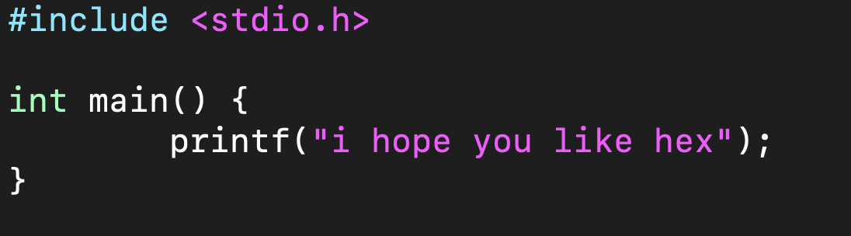
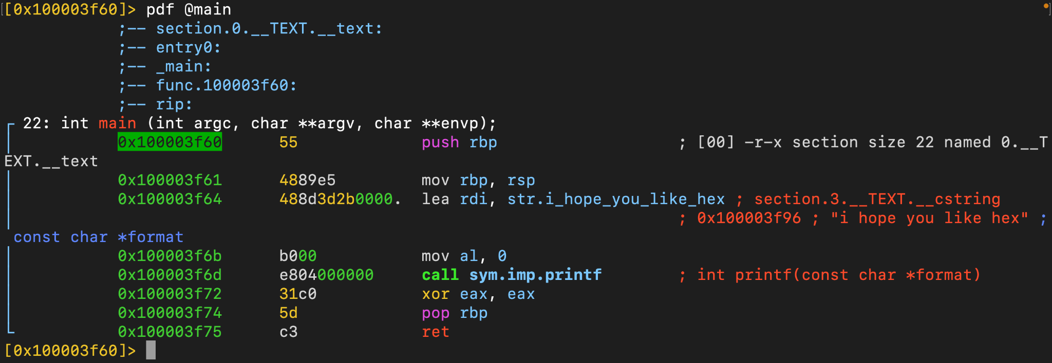
Disassembly

Slide 8
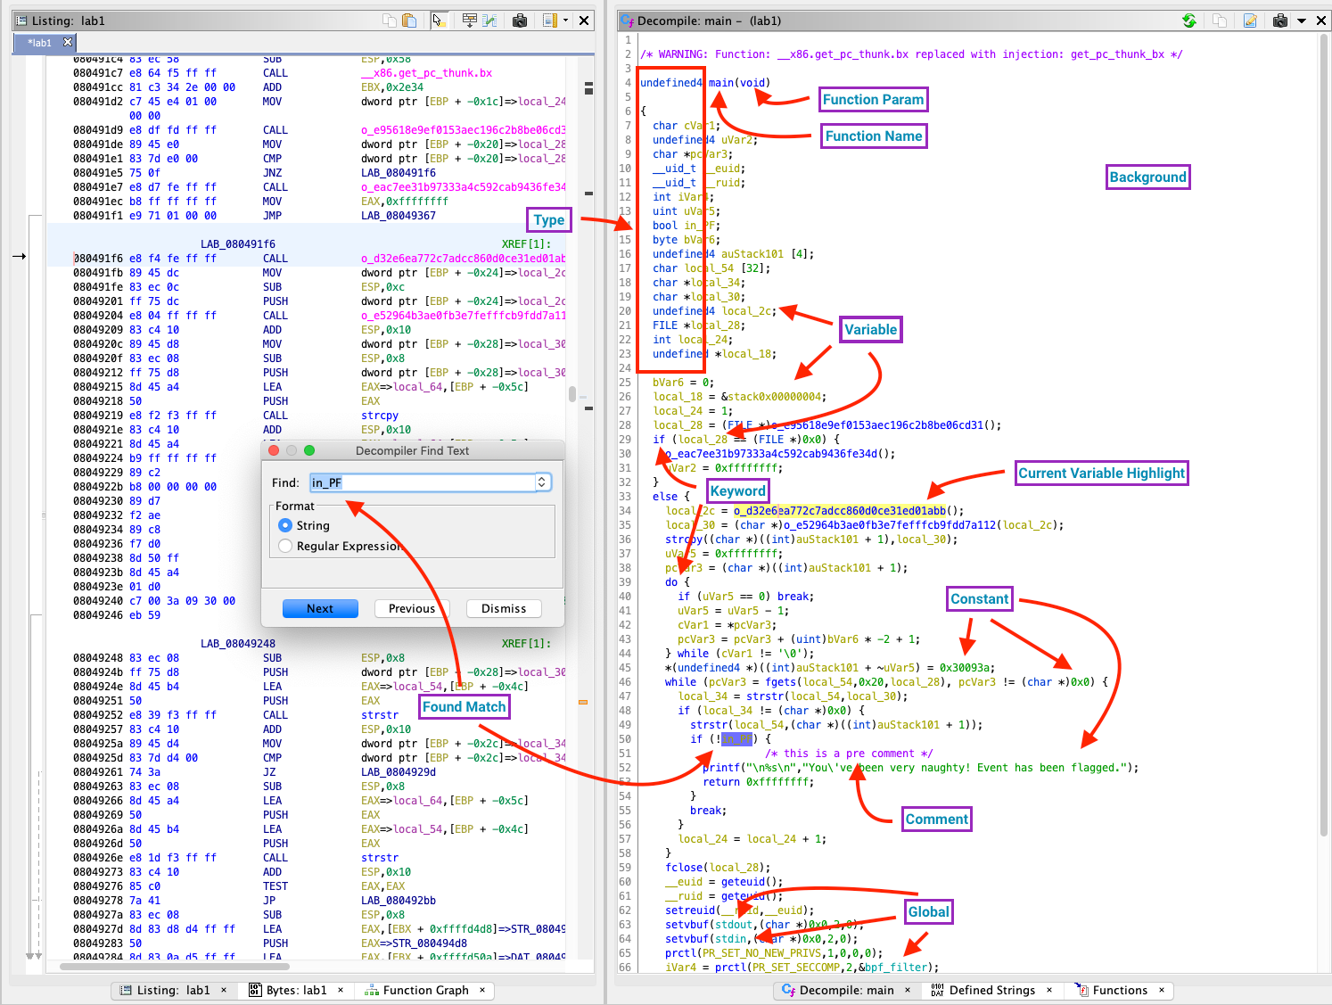
Decompilation

Slide 9


Why do People Reverse?
Legal purposes (good):
Find issues in code (and report it)
Understand how protocols
Illegal purposes (bad):
Circumvent security measures
Make exploits

Slide 10
Reversing vs. Binary Exploitation
Often used together
Parts of larger “exploit development”
Reversing = taking closed source software and making it open source :)

Slide 11
Challenges
Look at crackmes

