Slide 1
Competitive Cyber Security Organization
General - Scripting
By attending today’s meeting you acknowledge that you may be photographed or recorded for club use

Slide 2
Prerequisites
VSCode
(Or your favorite Python IDE)
https://code.visualstudio.com/download
Python 3
Please use your Kali VM if on MacOS
Check installation with `python3 –version`
If not installed: python.org/downloads

Slide 3
Learning Objectives:
What is scripting?
What scripting languages exist?
How do scripts help us?
Make a keylogger
Good programming practices
Threading

Slide 4
Scripting vs. Programming
Scripting is a subset of programming
Scripting favors high level languages
Programming uses more data structure and algorithms

Slide 5



Scripting Languages
Python
Pros: Universal, simple language, big community
Cons: Bulky, (relatively) slow, dependency hell
Bash
Pros: Built into linux, light weight
Cons: No OOP, not universal
PowerShell
Pros: Windows, Powerful on Windows
Cons: Not installed by default on Linux
Go
Pros: Quick, simple, compiled.
Cons: New language, low community support

Slide 6
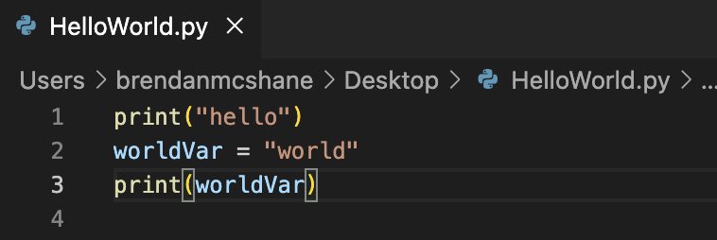
Python Hello World
Create a .py file in an IDE (VSCode is great)
Add print(“hello”)
Define a var with worldVar = “world”
Print the var with print(worldVar)
Save the file (HelloWorld.py)
Open terminal
Run python3 /path/to/HelloWorld.py

Slide 7
Keylogger Demo
Goal
Basic keylogger that writes to a file
Learn good programming practices
Foundation for you to build from
GitHub for reference
https://github.com/bman46/py-logger
More advanced version (By Josh)
https://github.com/stackviolator/py-logger
A feat of modern engineering and software development (according to Josh)

Slide 8
Threading Diagram
Threads
Main Program Thread
timer.Start()
Wait interval
Keylogging to log var
Write Log var to file and clear
Time
.Start()
Wait interval
Dispose this thread
Write Log var to file and clear

Slide 9

CTF Resources
Google is your friend
Docs.python.org
Stackoverflow.com
Pypi.org packages (pip)
Ask us

Slide 10
Challenge Ideas
Basic file management
Loops
Decode a base64 file multiple times with Python
Port knocking with Python
Custom web directory fuzzing script
Prevent use of existing tools by naming the directory a mathematical equation (multiples)
Decrypt a file with a custom encryption algorithm
API Calls

