Slide 1
Competitive Cyber Security Organization
General – Networking
By attending today’s meeting you acknowledge that you may be photographed or recorded for club use

Slide 2
Announcements

Slide 3
Learning Objectives:
What is the OSI model?
Low level networking (1-4)
Network commands
Types of Connections
Better understanding of how the internet works!

Slide 4
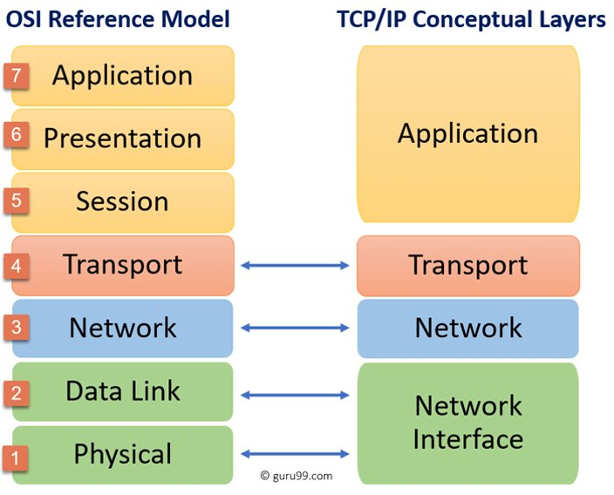
Introduction

Slide 5
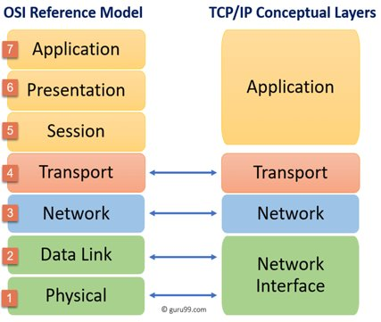
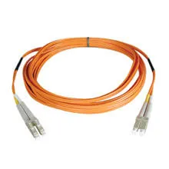
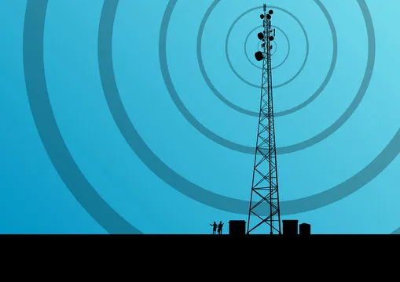
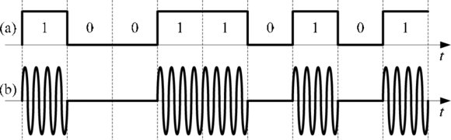
Layer 1 - Physical
Boils down to electrical signals
Includes cables and radio frequencies
Ethernet
WiFi
Sometimes represented by "on / off" (Binary)

Slide 6

Layer 1 Attacks
Cutting of cables / powerlines
EMP attacks
Signal jamming

Slide 7
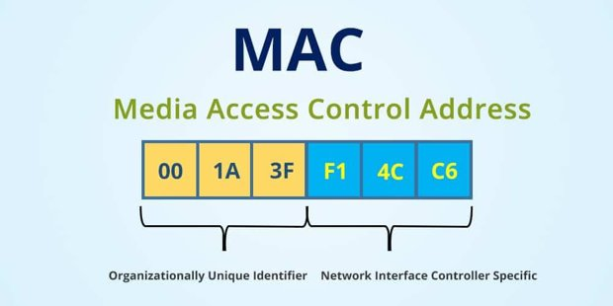
Layer 2 - Data Link
Initial process for connecting to the network
LAN (local area network)
Involves MAC addresses
Network / Physical Identifier
Also shows manufacturer
Sometimes used to assign an IP address

Slide 8
Layer 2 Demo
ARP command
Windows: arp -a
Linux: arp -a

Slide 9
Layer 2 Demo Overview
ARP is used to map MAC addresses to IP addresses
Required for communication on a L2 network
Static addresses don't change
Used for devices which must always know their address
Dynamic addresses do change occasionally
Used for everything else for easier management

Slide 10

Layer 2 Attacks
MAC spoofing
Changing the MAC address to seem like you are someone legit
ARP poisoning/spoofing
MITM (man in the middle) or DoS (Denial of service)
Computer A can use ARP to ask for the MAC address of Computer B, but Compter C can respond with an incorrect MAC

Slide 11
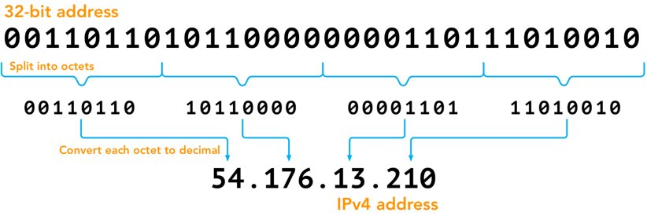
Layer 3 - Network
Most relevant to us
Makes the internet work
Uses IP addresses
Based on Binary arithmetic
32 bit address

Slide 12
Layer 3 Demo
IP Table command
Windows: ipconfig
Linux: ifconfig or ip -a

Slide 13
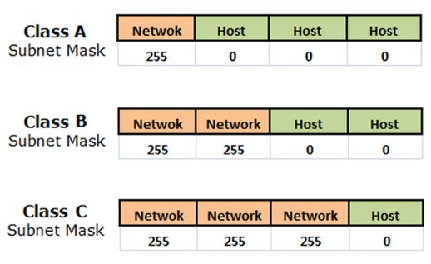
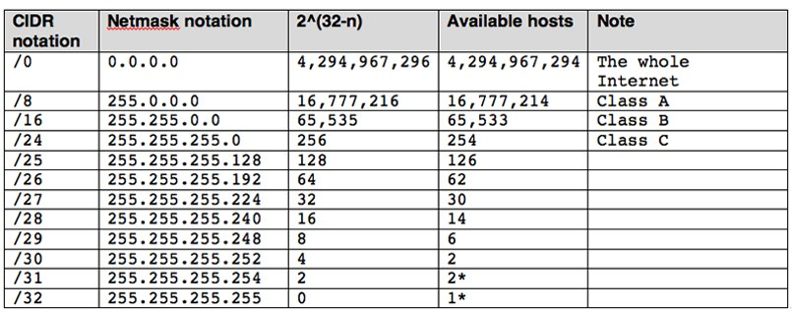
Layer 3 – Network Cont.
Subnet overview
How IP addresses are split up
CIDR notation makes it easier

Slide 14
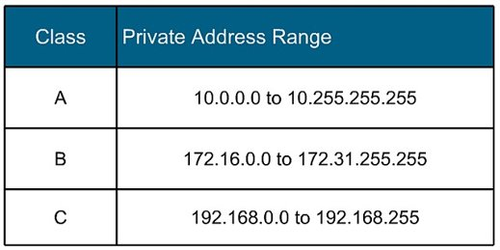
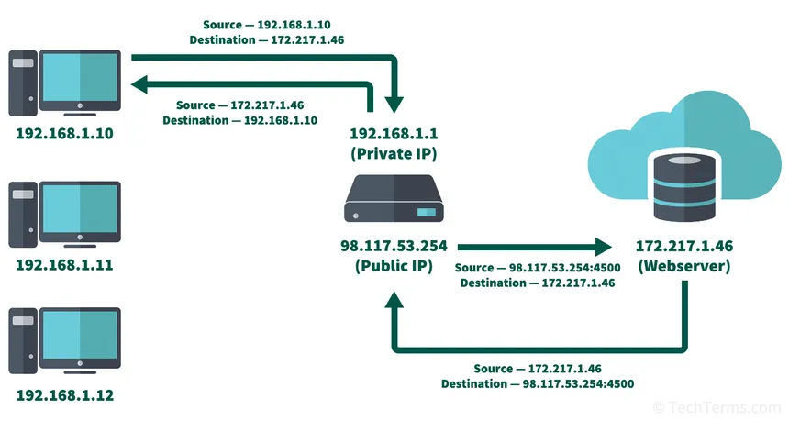
Layer 3 – Network Cont.
But there are only 4 billion addresses (estimated 38.6 billion devices by 2025)?
Use NAT (network address translation) protocol
Switches private IP address to public one
Each router only has one public address
Created IPv6 addresses
128 bit addresses
340 undecillion total addresses
3.4 * 10³⁸

Slide 15
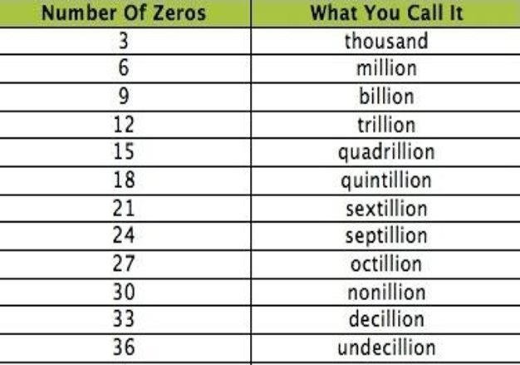
Undecillion?
340 of these
1,000,000,000,000,000,000,000,000,000,000,000,000
Trillion

Slide 16
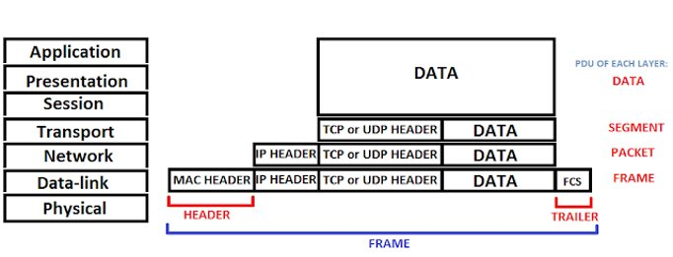
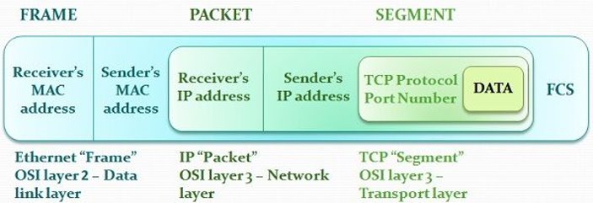
Layer 3 – Network Cont.
How do we communicate to the internet?
By using packets
Like mail
Has a destination and return address

Slide 17
Layer 3 Demo
ping command
Windows: ping
Linux: ping

Slide 18
Layer 3 Demo
Trace route command
Windows: tracert
Linux: traceroute
https://www.youtube.com/watch?v=SXmv8quf_xM

Slide 19
Layer 3 Demo Overview
ping is used to test connectivity
Trace route shows stops (hops) before final destination

Slide 20
Layer 3 Attacks

Slide 21
Layer 4 - Transport
What if I have a specific message that only specific
programs understand? Is there only one way to send
A message?
Use of TCP and UDP
And ports

Slide 22
Layer 4 – Transport Cont.
Transmission Control Protocol vs. User Datagram Protocol
TCP is connection oriented
Three-way handshake
UDP is connectionless

Slide 23
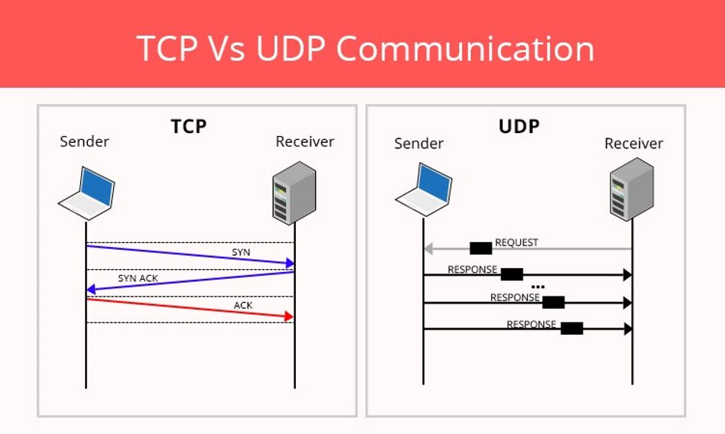
Layer 4 – Transport Cont.

Slide 24
Layer 4 – Transport Cont.
What if there is more that one TCP and UDP service?
Ports
0-65,535 ports
0-1,023 : well known
1,024-49,151 : registered
49,152-65,535 : private / dynamic

Slide 25
Layer 4 – Transport Cont.
Port 21: File Transport Protocol
FTP
Used for transferring files
Port 22: Secure Shell
SSH
Used to securely connect to another computer
Port 80: Hypertext Transfer Protocol
HTTP
Used for web pages
Port 443: HTTPS
Secure way of using web pages

Slide 26
Layer 4 Demo
netstat -ano

Slide 27
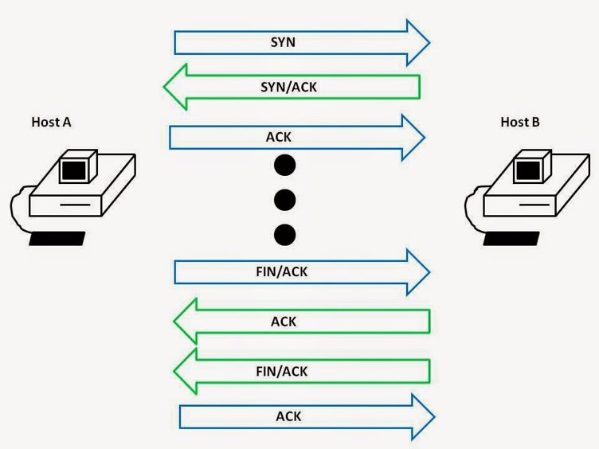
Layer 5 - Session
Controls the communication between two applications (or hosts)
Establish
Maintain
Terminate

Slide 28
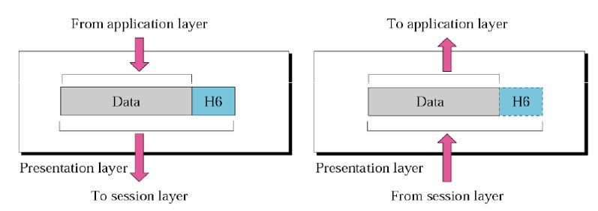
Layer 6 - Presentation
Translates data into something readable (for the next layer)
Data conversion
Encryption
Compression

Slide 29
Layer 7 - Application
What is displayed, takes data input, turning it into output
Web browser
Common protocols
HTTP
RDP
SSH

Slide 30

Layer 8 – You!

