Slide 1
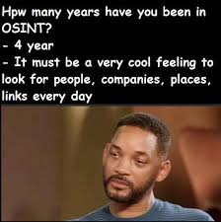
Competitive Cyber Security Organization
General - OSINT
By attending today’s meeting you acknowledge that you may be photographed or recorded for club use

Slide 2
Announcements

Slide 3
Legal Debrief
CCSO does not endorse, condone, or encourage any illegal, malicious, or unethical activities involving OSINT. It is the responsibility of the individuals or entities using OSINT techniques to ensure that they adhere to all applicable laws, regulations, and ethical standards in their respective jurisdictions.
We strongly advise all users to conduct OSINT activities in a lawful and ethical manner and to respect the privacy and rights of individuals and organizations.
By using any information or resources provided by CCSO, you agree to do so at your own risk and take full responsibility for your actions and any consequences that may result.

Slide 4

Learning Objectives:
What is OSINT?
OSINT Sources
OSINT in Cybersecurity
OSINT Tools
Protecting Against OSINT

Slide 5
What is OSINT?
Open Source Intelligence is the process of gathering data from public sources.
It is essential for understanding our external environment, to include potential threats.

Slide 6
OSINT Sources
Anything that is publicly available
Social Media
Search Engines
Forums and Discussion Boards
Government Websites
News Outlets

Slide 7
How is OSINT used?
Threat Intelligence
OSINT helps organizations stay ahead of potential threats by collecting information on emerging threats, attack vectors, and threat actors.
Attack Surface Analysis
OSINT is used to map out an organization's attack surface to include digital assets, services, and other information
Social Engineering
OSINT provides threat actors with information that can be leveraged for social engineering attacks.
Reconnaissance
OSINT helps attackers gain information that can be used for planning and executing attacks

Slide 8
Real-Life Example
Operation Martyr Soleimani
Iran launched several ballistic missiles into Iraq targeting U.S. bases.
We used Twitter to confirm areas affected by that attack.
By watching Twitter I was able to do a rough estimated count for rocket impacts and points of origin.

Slide 9
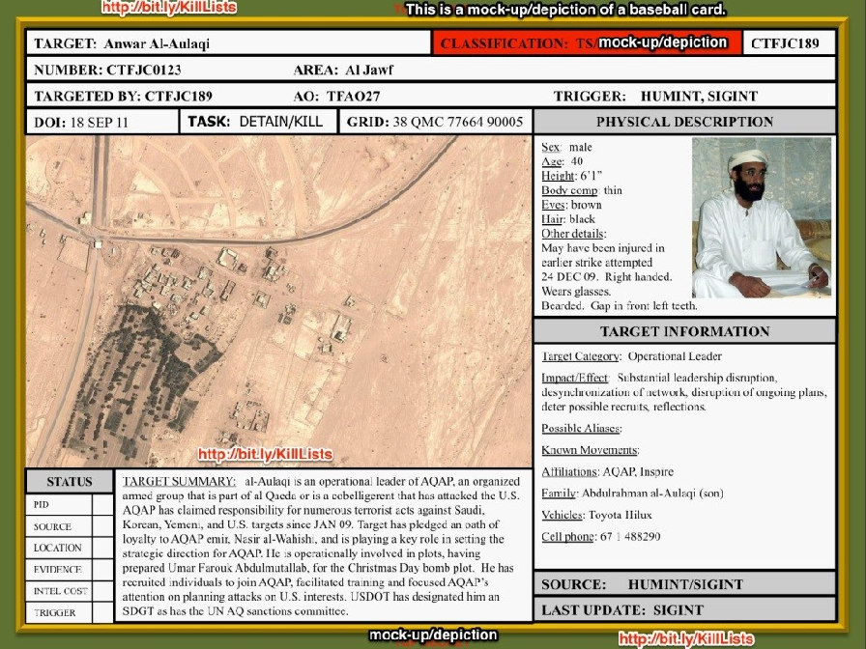
Baseball Cards
Used for maintaining target details.
Physical Descriptions
Target Information
Target Summary
Target Status
Task to be completed

Slide 10

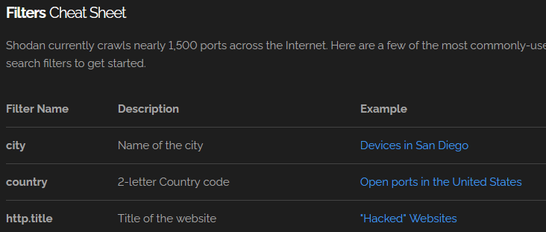
Shodan
Search engine that indexes the internet
Account needed to use filters, has restrictions on amount of searches per day

Slide 11

Google Dorking
Operators include site:, inurl:, intext:, etc.
Use quotation marks to only get results including exact quotation
https://ahrefs.com/blog/google-advanced-search-operators/
https://www.exploit-db.com/google-hacking-database

Slide 12
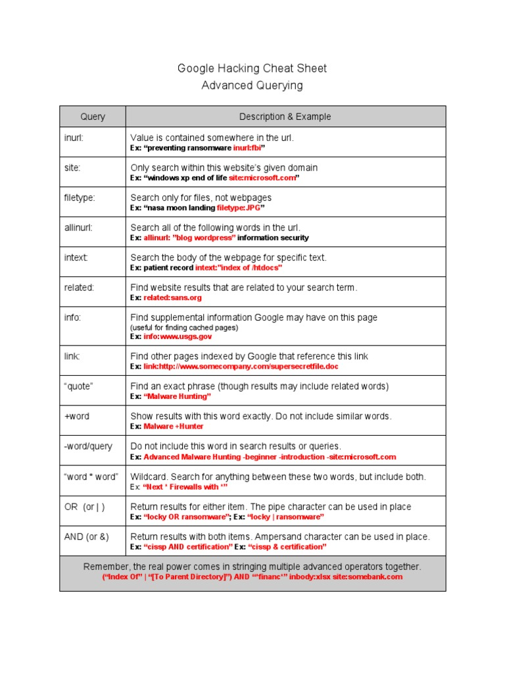

Slide 13


Various tools
https://osintframework.com/
Haveibeenpwned
Check if your password have been leaked
Cellmapper
User contributed map of cell towers
IntelligenceX
Dehashed
WHOIS

Slide 14
Social Media
Twitter, LinkedIn, Facebook, etc..
See what systems are used
Who they are, what they do, etc..

Slide 15
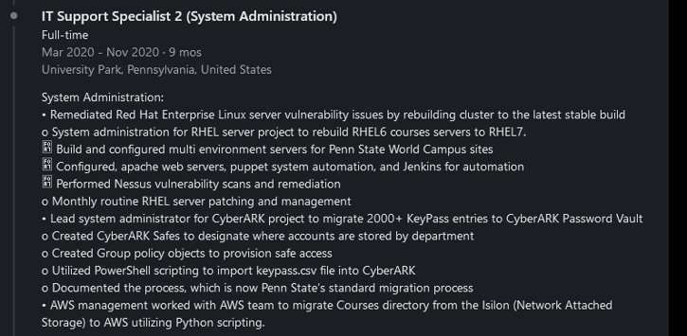

Slide 16
Google Maps – Street View
Location Verification
Surveillance and Reconnaissance
Identifying Businesses and Establishments
Route Planning
Social Engineering
Investigating Remote or Restricted Areas

Slide 17
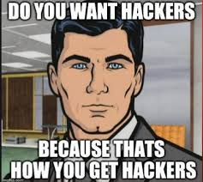
Ways to protect yourself!
Limit Personal Information
Review your privacy settings
Regularly Google yourself
Stay informed on new TTPs.

