Slide 1
Competitive Cyber Security Organization
General - PicoGym
By attending today’s meeting you acknowledge that you may be photographed or recorded for club use

Slide 2
Announcements

Slide 3


Slide 4
What is PicoCTF?
CTF = Capture The Flag
  Cybersecurity challenges
PicoCTF = Carnegie Mellon's CTF
PicoGym = All past challenges available
Different categories
Helps build knowledge, good training for larger CTFs

Slide 5
Making a PicoCTF Account
Go to picoctf.org
Click "Login" at the top right
Choose "Sign Up" and create an account
Navigate to the PicoGym by clicking "Practice" at the top of webpage, or by going to play.picoctf.org/practice

Slide 6
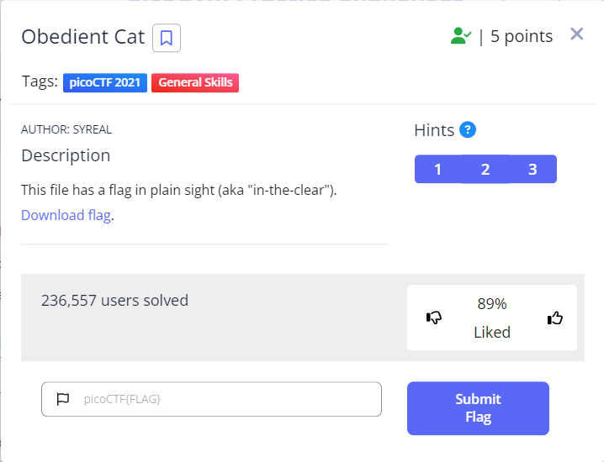
Demo Challenge

Slide 7
 | Web Exploitation | Cryptography | Reverse Engineering | Forensics | General Skills | Binary Exploitation
Beginner | Insp3ct0r | Mod 26 | crackme-py | Matryoshka doll | what's a net cat? | STONKS
Easy | GET aHEAD | The Numbers | Safe Opener 2 | Shark on wire 1 | Repetitions | RPS
Medium | Secrets | Dachshund Attacks | Ready Gladiator 1 | hideme | Special | two-sum
Hard | More SQLi | triple-secure | No way out | SideChannel | Specialer | Here's a LIBC
Challenges: play.picoctf.org/practice
Hints: asareynolds.com/picogym

