Slide 1
Competitive Cyber Security Organization
System Hardening GBM
By attending today’s meeting you acknowledge that you may be photographed or recorded for club use

Slide 2
Agenda
What is System Hardening?
Why Linux and Windows?
Linux OS Checklists
Windows OS Checklists
Workshop Time! (:

Slide 3
Good Cyber Hygiene

Slide 4
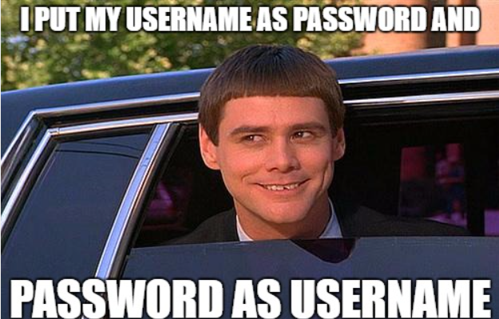
Password Policies
Store passwords through salting and hashing
Lock after multiple attempts
Set password aging
Length over complexity
NIST Special Publication 800-63-3

Slide 5

Enabling auto-updates
Security patching
Improved stability
Saved time
sudo apt-get install unattended-upgrades
Settings > Windows Update > Advanced options

Slide 6
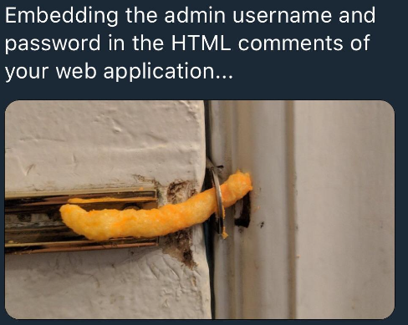
Unnecessary Ports/Services Open
nmap <hostname or IP address>
sudo netstat -tulpn
corroborate with etc/services
Service auditing!

Slide 7
Linux

Slide 8
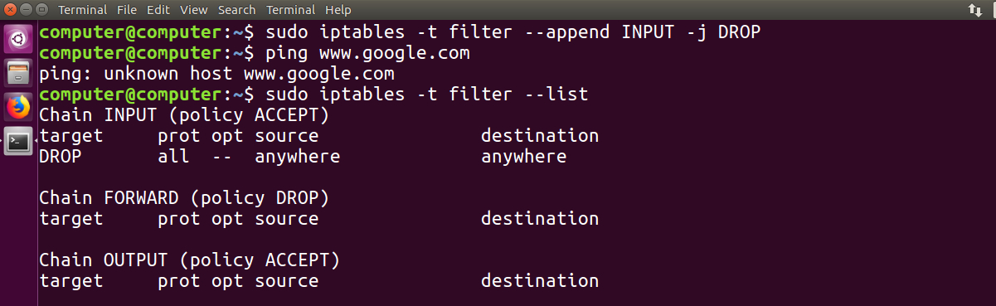
Firewalls
Iptables: default firewall config
Uncomplicated firewall (UFW): simplified iptables
Default Deny Rule
Regular Audits
Monitor Logs
cat /var/log/ufw.log
grep 'DENIED' /var/log/ufw.log
sudo ufw status verbose

Slide 9
SUID bins
Find SUID and SGID files
find . -perm /4000
Use chmod to change file permissions
This can prevent an attacker from being able to execute or access files that they shouldn't be allowed to execute!

Slide 10
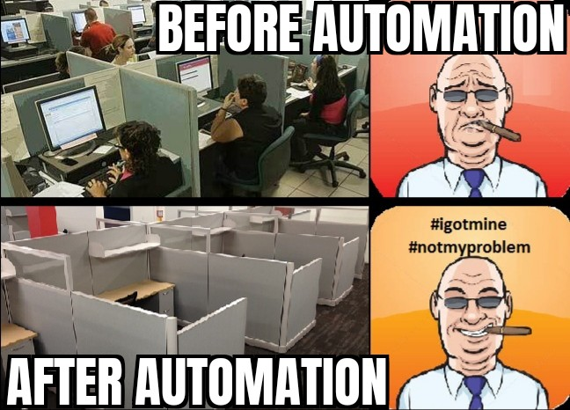
Cronjobs
Automated tasks that run at scheduled times
Crontab
-l: list current user cronjobs
-e: edit user's cronjobs
-r: remove all user's cronjobs
Minimize privileges
Validate inputs
Monitor execution

Slide 11
Windows

Slide 12

User configs
Local user/ roaming user/ mandatory user
User groups (Administrators, Users, Guests, etc.) vs. Custom groups
Least privilege principle
Limit Remote Desktop Access

Slide 13
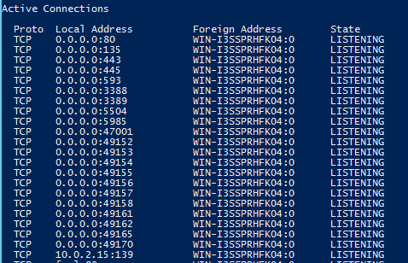
Network config
Public vs. Private networks
Ipconfig: shows ip config info
ping <url>: tests network connectivity
Tracert <url>: traces the route of a packet to its destination

Slide 14
Windows Defender/Firewall
Defender can block the execution of unwanted programs on Windows.
Useful for automating the deletion of malicious software running on your host.
Windows Advanced Firewall can be used to allow or deny inbound or outbound network traffic.
Useful to block unwanted network

Slide 15
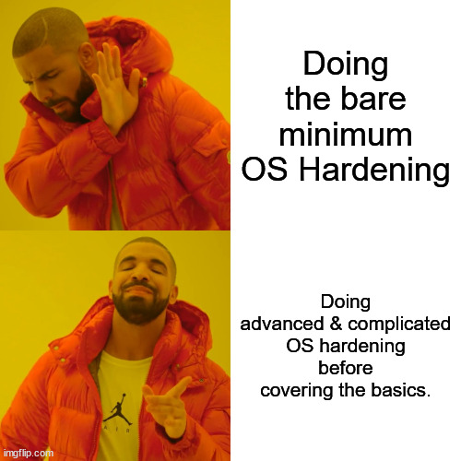
Service Config
Services can be managed in a Server Manager dashboard on most
PowerShell can also be used to enable and disable services
> Get-Service
> Set-Service –Name "<NAME>" -Status Started/Stopped

Slide 16
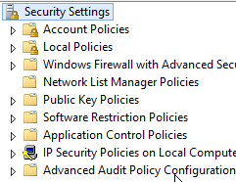
GPOs & LSPs
GPO (Group Policy Objects)
LSP (Local Security Policy)
Set up policies specific to users or groups to manage system interactions or requirements.
Minimum password length
User Permissions

