Slide 1
Please sit near the front :)

Slide 2
Competitive Cyber Security Organization
General - Liam’s super cool and awesome forensics presentation that will teach you so much cool stuff about forensics you aren’t even prepared for how much learning is about to occur strap in your seatbelts
By attending today’s meeting you acknowledge that you may be photographed or recorded for club use

Slide 3
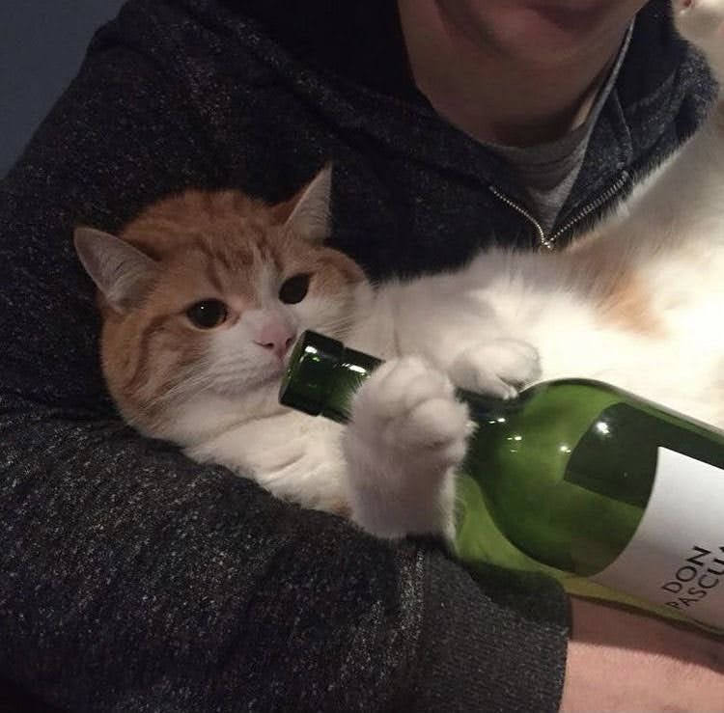
Start downloading now or I’ll cry
ctf.psuccso.org
Challenges > Login with CCSO > Login with Discord
Disk Forensics 1 - download zip

Slide 4
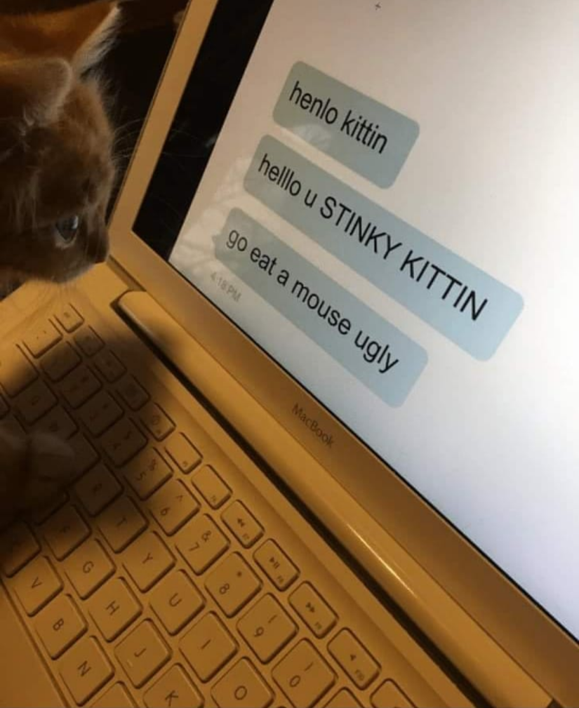
Learning Objectives:
What is Forensics?
Different types of forensics
Who uses Forensics?
Real world applications of forensics
Try out some forensic techniques

Slide 5
Forensics
Investigating digital content and media
Different types
Network
Disk (Files, etc.)
Memory
Malware
Mobile

Slide 6
Practical Applications
Incident Response
Finding root cause
Log analysis; understanding what happened
Recovering lost data
Understanding network traffic
Law enforcement

Slide 7
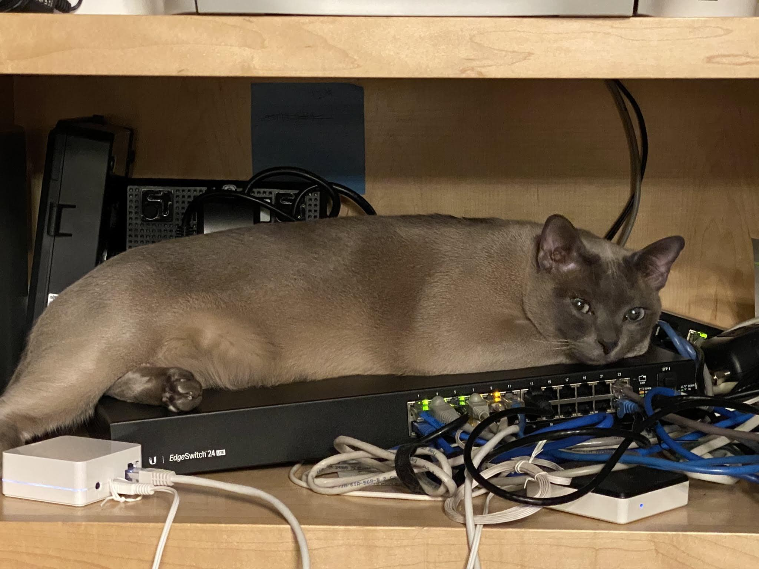
Network Forensics
Diving deep into network traffic
Analyzing host behavior
Requires an in depth understanding of a network
Packet analysis
Wireshark, networkminer, etc.

Slide 8

Disk Forensics
Deriving information from digital media
Filesystem, or physical (ex. HDD recovery)
Recovery of deleted or encrypted information
Disk Images - FTK, Autopsy, etc.
Ex: Analyze a copy of a machine affected by malware

Slide 9
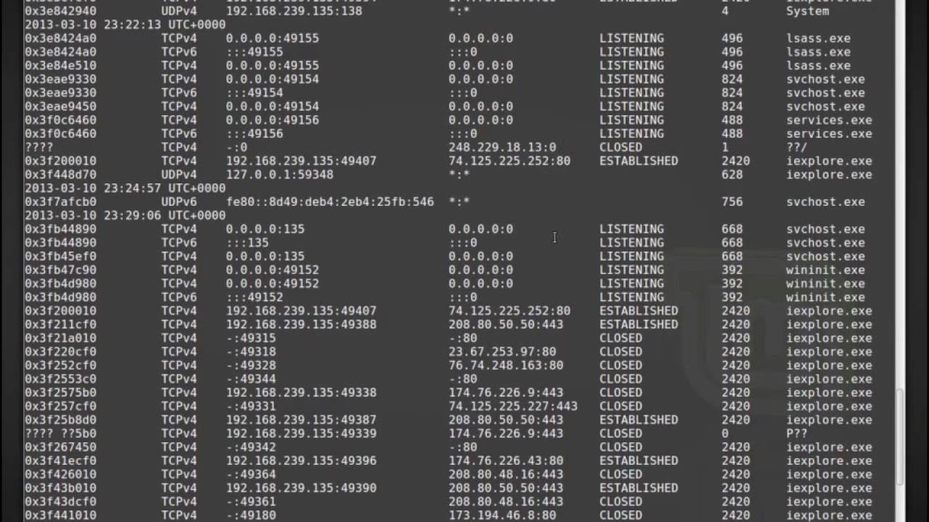
Memory Forensics
Analyzing a system based on a RAM snapshot
Volatile memory - provides a moment in time
Only focuses on what’s running
Geared towards malware analysis
Preserves network connections and processes
Volatility framework

Slide 10
Super Cool and Awsome Walkthrough Time (CTF Style)
ctf.psuccso.org
Challenges > Login with CCSO > Login with Discord

Slide 11
Linux Command History Analysis
What nonroot user is present on the server?
Daniel
What script did the attacker try to download to the server?
Linux-exploit-suggester.sh
What packet analyzer tool did the attacker try to download to the server?
tcpdump

Slide 12
Linux Command History Analysis Contd.
What file extension did the attacker use to bypass the file upload filter implemented by the developer?
.phtml
Based on the commands run by the attacker before removing the php shell, what misconfiguration in the python binary was exploited for privesc?
SUID

Slide 13
Image Steganography
Various tools and ways to hide information in images, can you find any of the flags hidden in kitten.jpg?
Steghide –extract -sf kitten.jpg (nopass)
Image metadata, exiftool, cyberchef, etc.
Kitten2?
Least Significant Bit Stego
StegOnline

Slide 14
CTF Time! - ctf.psuccso.org
If you’re working on disk forensics and it’s slow get a flashdrive from us to download the image

