Slide 1

Cisco Network Malicious Traffic Detection Challenge
Written by:
Amit Karach, Aviv Danino and Amichai Bitan

Slide 2
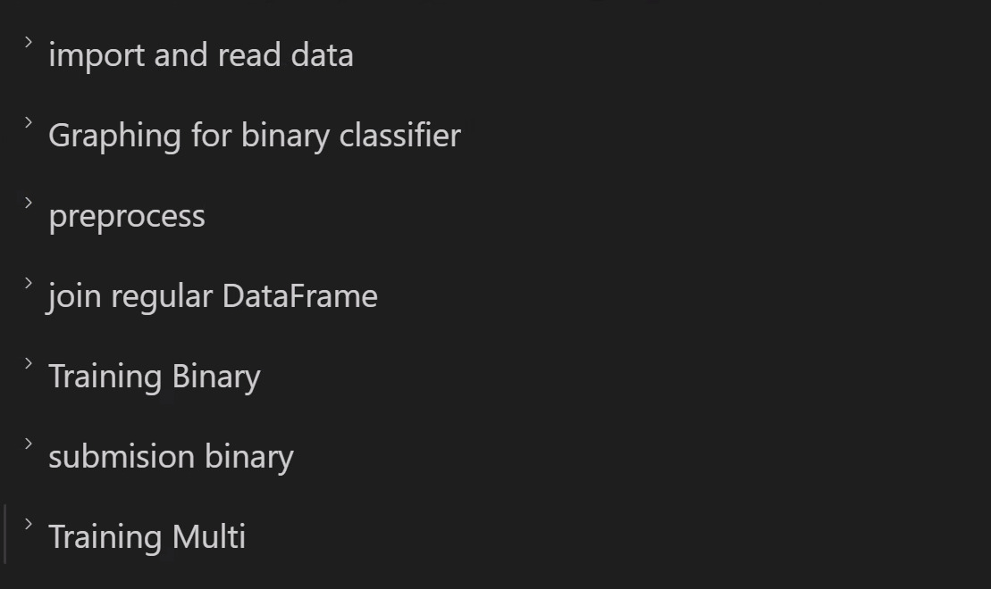
Table of Contents:

Slide 3

First filtering
We manually searched and read about every label to see if it contribute and if it will be robastic enough.

Slide 4

preprocessing
To extract data, we need to check for labels that are difficult to use and make them easier to manipulate.

Slide 5

Extract data
We extracted the data from label holding image (5,14) using NumPy from pandas to manipulate the in easier way to us data and then attach to pandas data frame

Slide 6

graphing
Used binary graph to check for differences in scoring of the machine.

Slide 7
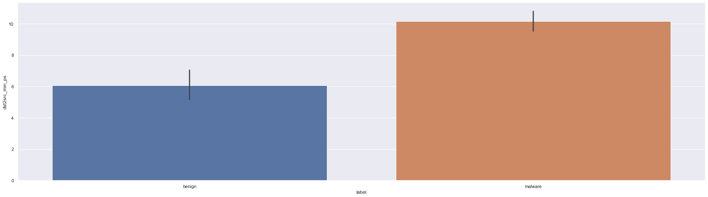
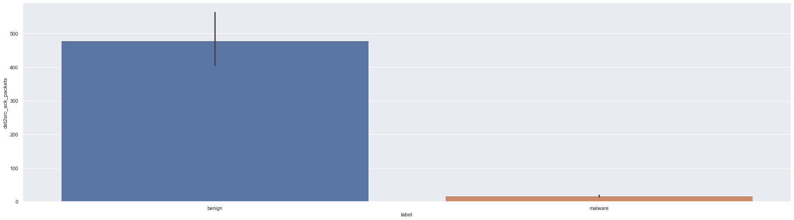
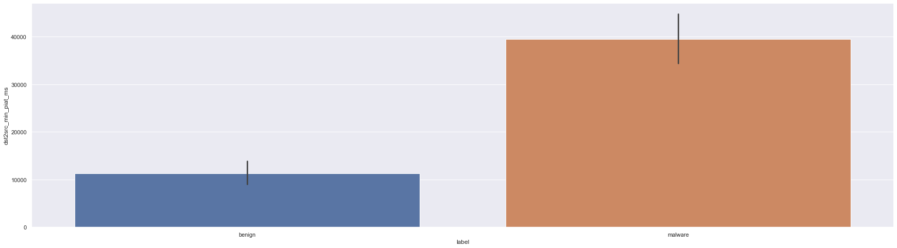
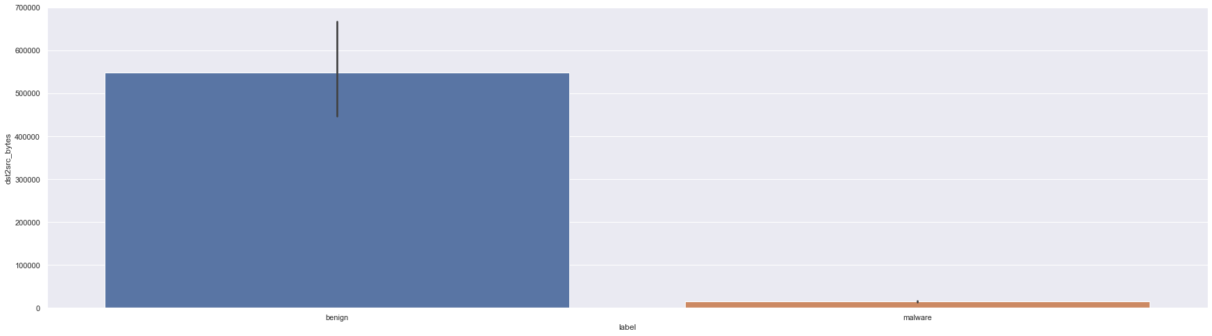

Slide 8
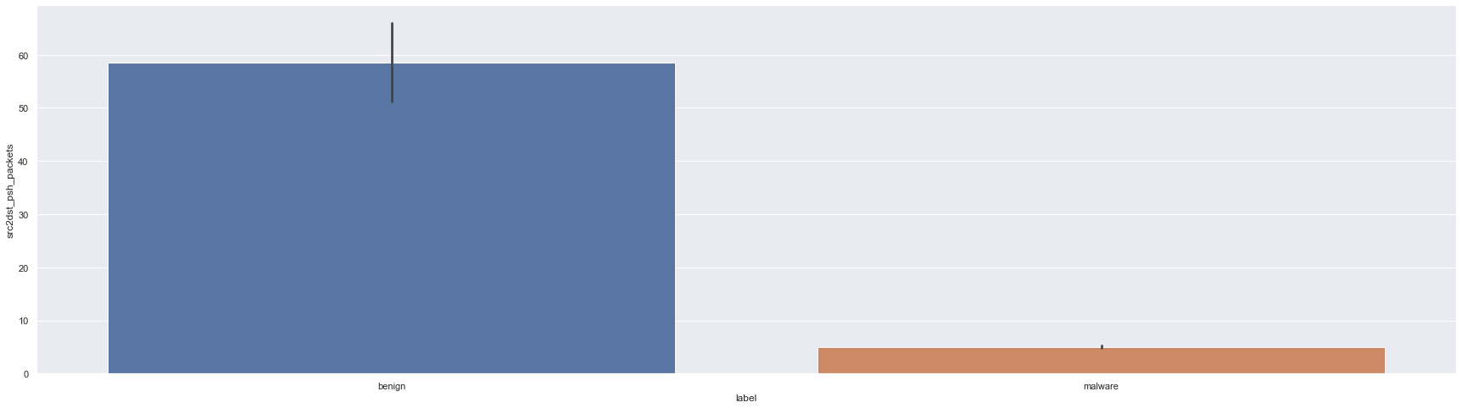

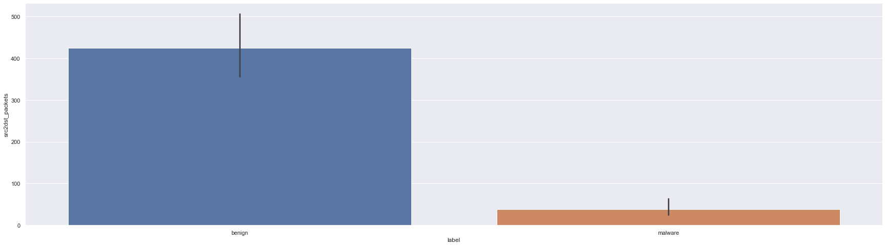
more chart bars

Slide 9

Merge
We merged the extracted data and the filtered data.

Slide 10

Model selection
We checked about decision tree (default), random forest and more but we got good score with random forest model so we chose use it.
Then tried to use Adaboost over and decided that we rather keep labels then using Adaboost in normal time (less than a minute) and losing labels for it.

Slide 11

playing with labels
We add and delete labels to the model in order to improve our score.

Slide 12
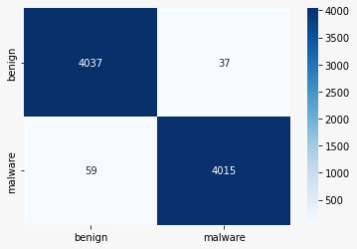
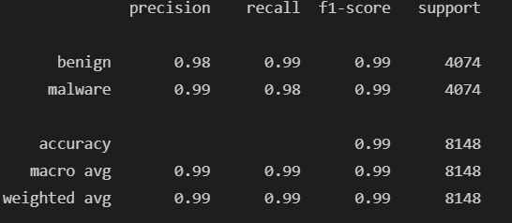
Result of binary classifier

Slide 13
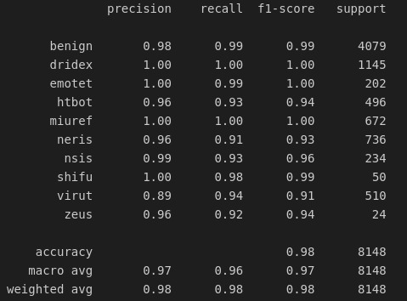
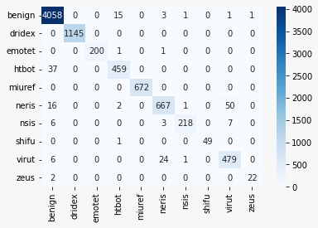
Result of multi classifier

Slide 14
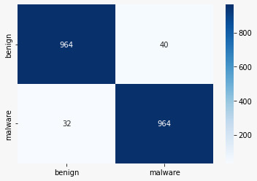
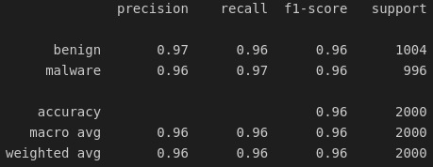
Result of zero day

Slide 15

Final touch
We tried to implement changes such as subtract labels, using labels that are not flags and even remove bidirectional label data at the end we only removed bidirectional label data.

Slide 16

Difference between eval.ai and test

