Slide 1
Cyber Operations in the Canadian Armed Forces
Master Warrant Officer Alex Arndt
Canadian Forces Network Operations Centre

Slide 2
Agenda
Problem Space
Definition of Cyber Warfare
Key Terminology
Defence Policy Review: Overview of Cyber-related Initiatives
Realities versus Expectations
Challenges
Cyber Operator Occupation

Slide 3
MWO Alex Arndt
MOSID 00378 – Cyber Operator
27 years in the CAF
Experience includes Infantry, SIGINT, EW and Cyber
Graduate of the Army Technical Warrant Officer Programme
Expertise in Capability Development, Project Management, Trials Management and Procurement
Nearly 15 years of Cyber Operations experience
Several Industry Certifications
CISSP, SANS GCIA and GCIH, EC-Council ECIH

Slide 4
Problem Space
Canada through its new Defence Policy, has announced its intention to develop active cyber capabilities
Up until recently,Canada lacked dedicated Cyber Forces to conduct Cyber Operations
Legal, Policy and Authority challenges required Legislative and Procedural review

Slide 5
Problem Space
Clear direction and resource management required to ensure the appropriate personnel and budget are available
Expectations need to be managed

Slide 6
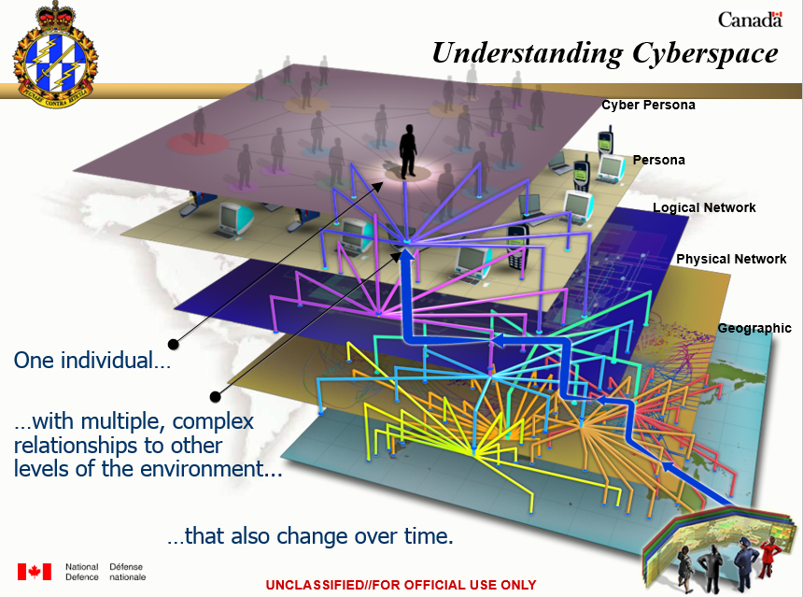
Problem Space

Slide 7
Definition of Cyber Warfare
“The use of computer technology to disrupt the activities of a state or organization, especially the deliberate attacking of information systems for strategic military purposes.”
Reference: NATO AJP-3.20

Slide 8
Key Terminology
Cyber operational preparation of the Environment (Cyber OPE)
Cyber activities conducted to prepare and enable cyber intelligence, surveillance, and reconnaissance in support of cyber operations.
Reference: Joint Doctrine Note – Cyber Operations
Notes:
8

Slide 9
Key Terminology
Defensive cyber operation (DCO)
A defensive operation conducted in or through cyberspace to detect, defeat and/or mitigate offensive and exploitive actions to maintain freedom of action. A DCO may include internal defensive measures and response actions.
Reference: Joint Doctrine Note – Cyber Operations
Notes:
9

Slide 10
Key Terminology
Defensive cyber operation - Internal defensive measures (DCO-IDM)
In DCOs, measures and activities conducted within one’s own cyberspace to ensure freedom of action.
Reference: Joint Doctrine Note – Cyber Operations
Notes:
10

Slide 11
Key Terminology
Defensive cyber operation - response action (DCO-RA)
In DCOs, measures and activities conducted in or through cyberspace, outside of one’s own cyberspace, against ongoing or imminent threats to preserve freedom of action.
Reference: Joint Doctrine Note – Cyber Operations

Slide 12
Key Terminology
Key Cyber Terrain
Key terrain in the cyber context still needs to be defined. It is currently defined as “Any locality, or area, the seizure or retention of which affords a marked advantage to either combatant.
Reference: Joint Doctrine Note – Cyber Operations

Slide 13
Key Terminology
Support cyber operation (SCO)
A network operation tasked by, or under direct control of, a commander to support offensive and defensive cyber operations.
Reference: Joint Doctrine Note – Cyber Operations

Slide 14
Key Terminology
Offensive cyber operation (OCO)
An active operation intended to project power in or through cyberspace to achieve effects in support of military objectives.
Reference: Joint Doctrine Note – Cyber Operations

Slide 15
Key Terminology – So what?
The CDS Initiating Directive for Defensive Cyber Operations defined cyberspace as a new domain for DND/CAF, complementary to the traditional domains. The cyber domain requires that the same functions of C2 be exercised to prepare, deploy, employ, and redeploy forces and capabilities in support of CAF objectives. A flexible, efficient, and responsive C2 of cyber capabilities must permit the delivery of comprehensive, operationally responsive, and decisive effects at the place and time of the commander’s choosing. Operations within cyberspace must be integrated, planned, and executed coherently within the DND/CAF, across OGDA, and with military allies and partners.
Reference: Joint Doctrine Note – Cyber Operations

Slide 16
Key Terminology – So what?
Terminology is derived from Doctrine
Provides the basis upon which Operational Planning Process is undertaken to define Cyber Operations and synchronize them with other Forces conducting Operations (e.g. coordinating DoS attack of adversary C2 network with the advance of ground forces into a given area)

Slide 17
Defence Policy Review – Cyber Related Initiatives
The Canadian Government has laid out 7 initiatives that are related to Cyber in the new defence policy Strong, Secure, Engaged
All initiatives provide the strategic direction necessary to realign resources and define, in broad terms, what is required to meet declared objectives

Slide 18
Defence Policy Review – Cyber Related Initiatives
Represents the basis upon which future Doctrine, and Tactics, Training and Procedures (TTPs) for Cyber Operations will be developed

Slide 19
Defence Policy Review – Cyber Related Initiatives
Initiative 65
Improve cryptographic capabilities, information operations capabilities, and cyber capabilities to include: cyber security and situational awareness projects, cyber threat identification and response, and the development of military-specific information operations and offensive cyber operations capabilities able to target, exploit, influence, and attack in support of military operations.
Reference: “Enhancing Defence Intelligence” in Strong, Secure, Engaged. Canada’s Defence Policy

Slide 20
Defence Policy Review – Cyber Related Initiatives
Initiative 71
Build CFINTCOM’s capacity to provide more advanced intelligence support to operations, including through an enhanced ability to forecast flashpoints and emerging threats, better support next generation platforms, and understand rapid developments in space, cyber, information and other emerging domains.
Reference: “Enhancing Defence Intelligence” in Strong, Secure, Engaged. Canada’s Defence Policy
Notes:
20

Slide 21
Defence Policy Review – Cyber Related Initiatives
Initiative 75
Assign Reserve Force units and formations new roles that provide full-time capability to the Canadian Armed Forces through part-time service, including:
Light Urban Search and Rescue;
Chemical, Biological, Radiological and Nuclear Defence;
Combat capabilities such as direct fire, mortar and pioneer platoons;
Cyber Operators;
Intelligence Operators;
Naval Security Teams; and
Linguists.
Reference: “A New Vision for the Reserve Force” in Strong, Secure, Engaged. Canada’s Defence Policy
Notes:
21

Slide 22
Defence Policy Review – Cyber Related Initiatives
Initiative 87
Protect critical military networks and equipment from cyber attack by establishing a new Cyber Mission Assurance Program that will incorporate cyber security requirements into the procurement process.
Reference: “Cyber Capabilities” in Strong, Secure, Engaged. Canada’s Defence Policy
Notes:
22

Slide 23
Defence Policy Review – Cyber Related Initiatives
Initiative 88
Develop active cyber capabilities and employ them against potential adversaries in support of government-authorized military missions.
Reference: “Cyber Capabilities” in Strong, Secure, Engaged. Canada’s Defence Policy
Notes:
23

Slide 24
Defence Policy Review – Cyber Related Initiatives
Initiative 89
Grow and enhance the cyber force by creating a new Canadian Armed Forces Cyber Operator occupation to attract Canada’s best and brightest talent and significantly increasing the number of military personnel dedicated to cyber functions.
Reference: “Cyber Capabilities” in Strong, Secure, Engaged. Canada’s Defence Policy
Notes:
24

Slide 25
Defence Policy Review – Cyber Related Initiatives
Initiative 90
Use Reservists with specialized skill-sets to fill elements of the Canadian Armed Forces cyber force.
Reference: “Cyber Capabilities” in Strong, Secure, Engaged. Canada’s Defence Policy
Notes:
25

Slide 26
Realities versus Expectations
Active Cyber Capabilities
In Strong, Secure, Engaged, it states that the CAF will assume a more assertive posture in the cyber domain by hardening our defences, and by conducting active cyber operations…
- Rules of Engagement will need to be clarified
- Investments will be required to explore and develop appropriate capabilities

Slide 27
Realities versus Expectations
Availability of Cyber Operators
Recruiting will take place in a ‘competitive environment’ to attract Canada’s best and brightest talent
Significant training will be required to develop specialists in this domain
It will be challenging to meet all current and future demands.

Slide 28
Challenges
National and International Laws
Cyber operations will be subject to all applicable domestic law, international law with proven checks and balances.

Slide 29
Challenges
National Security Policy and Legislation
They are constantly being reviewed to ensure that the CAF have the appropriate framework to conduct its operations as mandated by the Government.

Slide 30
Challenges
Recruitment, Training and Retention
The Canadian Government and CAF recognize that the pool of talent is shared with Industry
Salary considerations are only a small part of the problem

Slide 31
Cyber Operator Occupation
Authorized in 2016
Created on 31 January 2017
First round of Regular Force selection occurred in summer 2017
First Regular Force Cyber Operators selected and converted in October 2017

Slide 32
Cyber Operator Occupation
Second round of Cyber Operator selection for Reg F and Reserves is currently underway; completion expected in Feb 2018
Direct Entry with CAF-endorsed programs by Summer 2018. Direct Entry with minimum entry standards by Summer 2019. Minimum entry standards to be promulgated by Jan 2018
Opportunity for Reservists with unique set of skills and knowledge to be part of the CAF Cyber Force either as Cyber Operators or in other capacities

Slide 33
Cyber Operator Occupation Primary Reserve
The Primary Reserve provides an opportunity for the CAF to identify and harness Cyber talents
Information Systems Security Professionals working in the Private or Public Sector across the country have an opportunity to support the Canadian Armed Forces (CAF) Cyber Force through part-time employment

Slide 34
Cyber Operator Occupation Primary Reserve
Please contact your local Recruiting Centre to get information about the Regular Force and Reserve Force opportunities in the new Cyber Operator (MOSID 00378) occupation
Notes:
Rewrote Slide 34.
Comment: It is not that the CAF don’t have these skills sets but more a function of augmenting and contribution to the overall CAF

Slide 35
Questions?

