Slide 2
Bus Reservation System Using python
By:Hitendra Sinh

Slide 3
Table of Contents
01
02
03
03
Introduction
Overview of the Bus Reservation System
Purpose and Object
Features of the System
Secure Login authentication
View Available Buses
Book a Ticket
View a Ticket
Delete Ticket
Exit System
Technology Used
Programming Language:Python

Slide 4
Table of Contents
04
02
05
04
System Workflow
User Login Process
Main menu Option
Booking Process
Ticket Management
Exit System
Benefits of the System
User-Friendly Interface
Secure Access
Efficient Ticket Management
Data Validation

Slide 5
Table of Contents
06
02
07
08
Future Enhancement
Database Intergration
Payment Gateway
Seat Selection Feature
Admin Panel for Bus Management
Conclusion
Summary of the Project
Key Takeways
Thank You & Feedback
Question & Feedback

Slide 6
01
Introduction
Overview of the Bus Reservation System
Purpose and Objectives

Slide 7
Bus Reservation System
Content:
The Bus Reservation System is a Python-based project designed to simplify ticket booking.
Users must log in with a username and password for security.
The system allows users to:
View available buses
Book tickets
Check reservations
Delete tickets
Exit the system
📌 Design Tip: Use icons for each feature to make the slide engaging.

Slide 8
Features of the System
Secure Login Authentication – Users must enter valid credentials to access the system.
View Available Buses – Displays bus names, sources , destinations and ticket prices.
Book a Ticket- Users enter passenger details and book tickets.
View Ticket- Displays booked ticket details.
Delete Ticket- Allow users to cancel reservations.
Exit System- Provides an option to safely exit.

Slide 9
Concept Used
Programming language used :- Python
User authentication
Data handling with lists and dictionaries
01
02
Conditional Statements and loops
Exception Handling for input validation
03
04

Slide 10
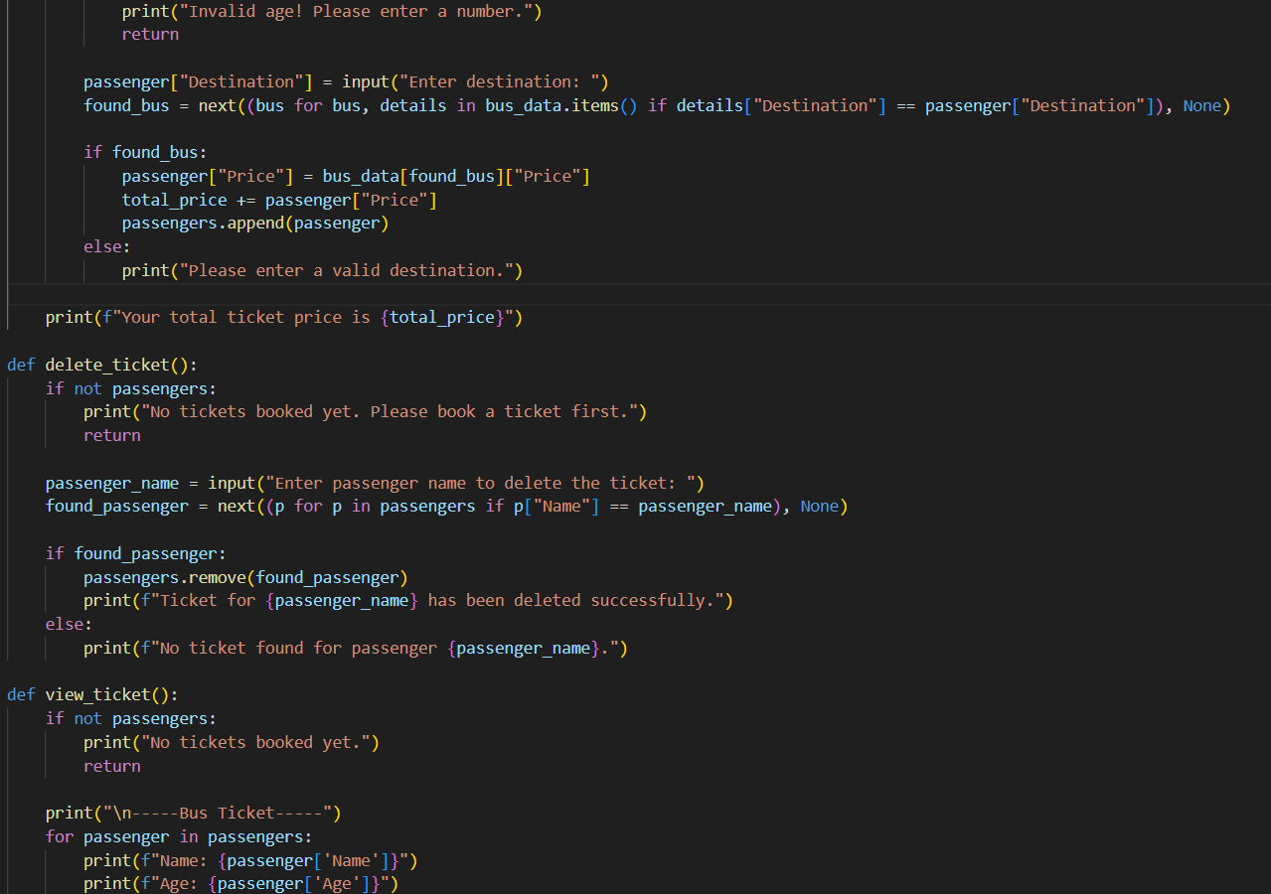
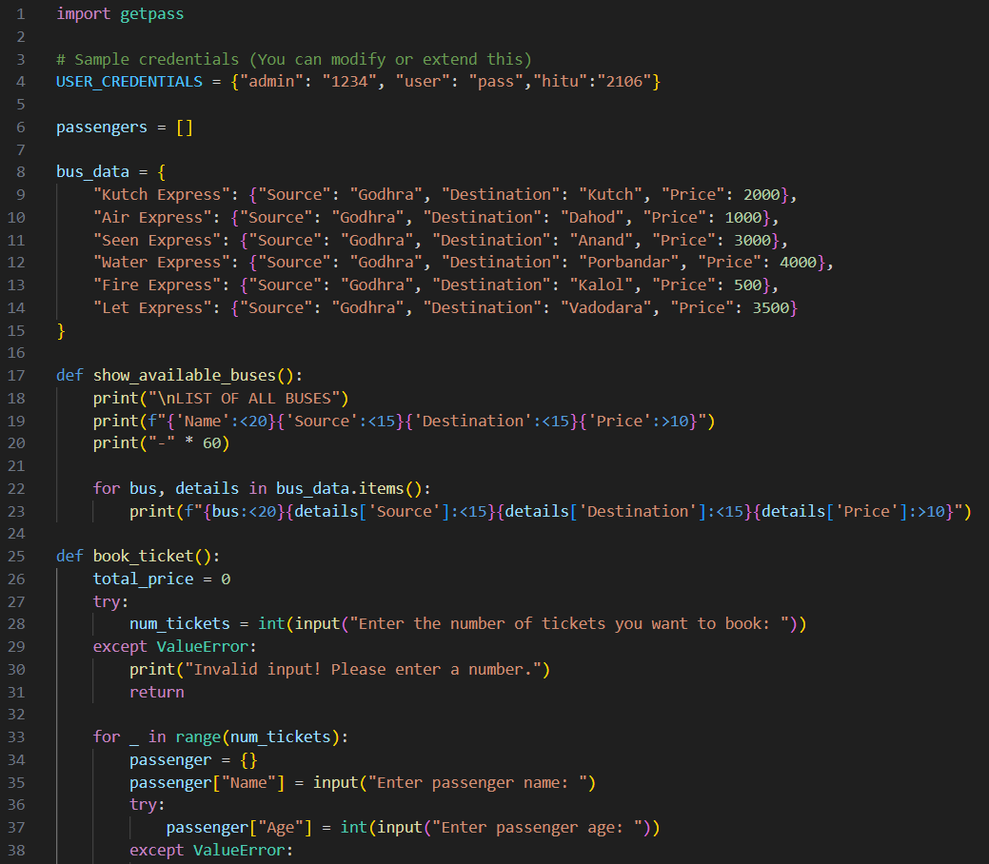
Code

Slide 11
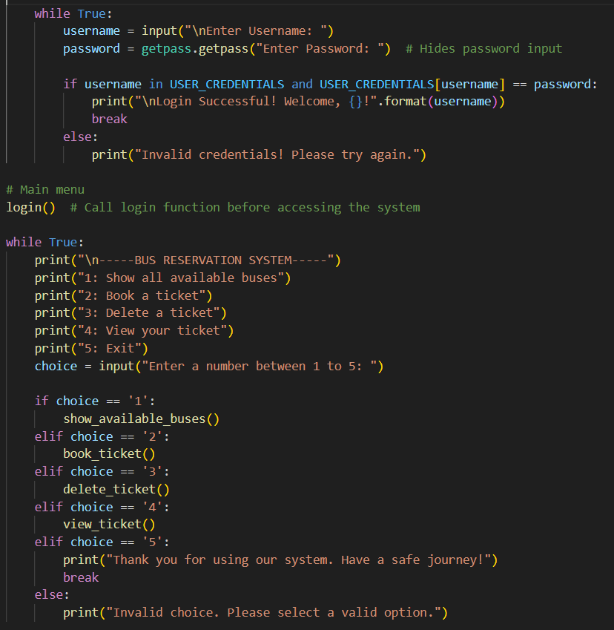
Awesome Words

Slide 12
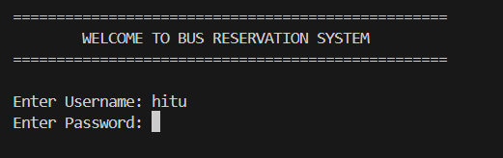
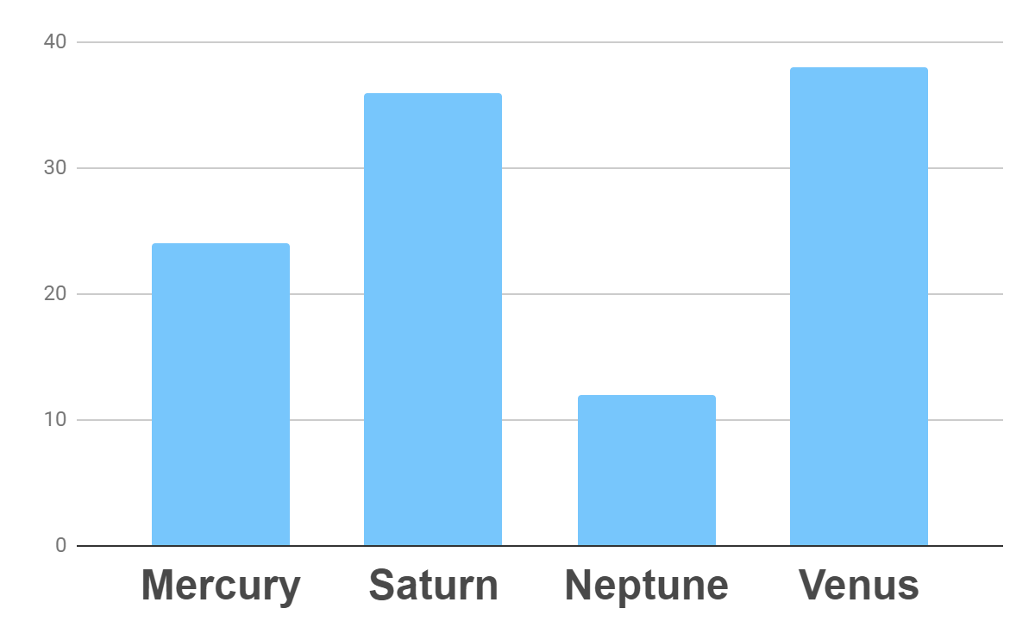
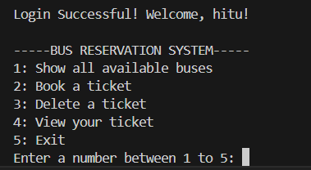
Code’s Output
User’s Login page
Home Page
To modify this graph, click on it, follow the link, change the data and paste the new graph here

Slide 13
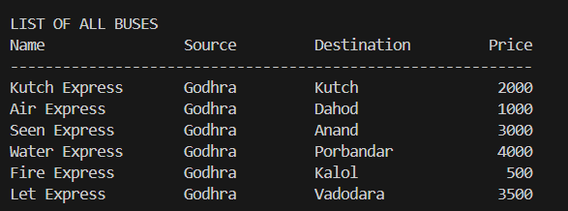
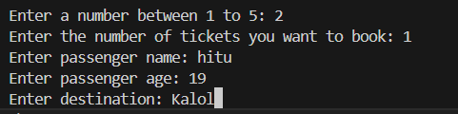
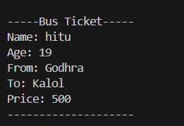


333,000.00
24h 37m 23s
386,000 km
Option-1:
(show all available buses)
earths is the sun’s mass
Option-2:
(book a ticket)
Option-3:
(delete a ticket)
is Jupiter’s rotation period
Option-5:
(exit)
Option-4:
(view your ticket)
is the distance to the Moon

Slide 14
System Workflow
User Login: enter username and password
Booking & viewing booked ticket
1
2
3
4
Main menu-
View available buses
Book a ticket
View booked tickets
Delete a ticket
exit
Delete booked ticket or exit the system safely

Slide 15
Benefits of the System
User Friendly interface
Simple and easy to navigate.
Secure Access
Login authentication prevents unauthorized use.
Data validation
Ensure correct input for passenger details.

Slide 16
Benefits of the System
Efficient Ticket Management
Ensures that users can book , view and delete tickets seamlessly.

Slide 17
Conclusion

Slide 18
Conclusion
The Bus Reservation System is a great example of how Python can be used to build interactive and secure applications.
This project enhances the user experience by providing a structured and efficient way to book bus tickets.
Looking forward to feedback and suggestions for improvements!

Slide 19

Thank You! Any question ?

