Slide 1
Dual Encoder Interest Network for Job Recommendation
Tyler Tang

Slide 2
Contents
Data Analysis
Problem Formulation: Job Recommendation System for Click Prediction
Model Architecture: Dual-Encoder Interest Network
Data Preparation
Experiment and Result Analysis
Future work

Slide 3
Data Analysis
Data analysis for job ads data
ip-dual-encoder-interest-network/notebooks/step1_EDA/EDA_ads.ipynb
Data analysis for events data
ip-dual-encoder-interest-network/notebooks/step1_EDA/EDA_events.ipynb
Merged data analysis
ip-dual-encoder-interest-network/notebooks/step1_EDA/EDA_final_merge_analysis.ipynb

Slide 4
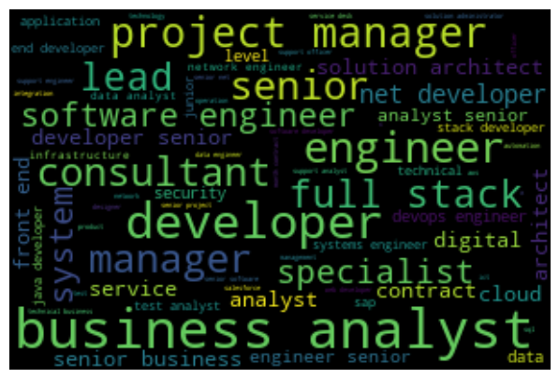





Data analysis for job ads data
The word cloud for the `title` of the jobs in `Information & Communication Technology`
The word cloud for the `abstract` of the jobs in `Information & Communication Technology`
The word cloud for the `title` of the jobs in `Engineering`
The word cloud for the `abstract` of the jobs in `Engineering`
The word cloud for the `title` of the jobs in `Sales`
The word cloud for the `abstract` of the jobs in `Sales`

Slide 5
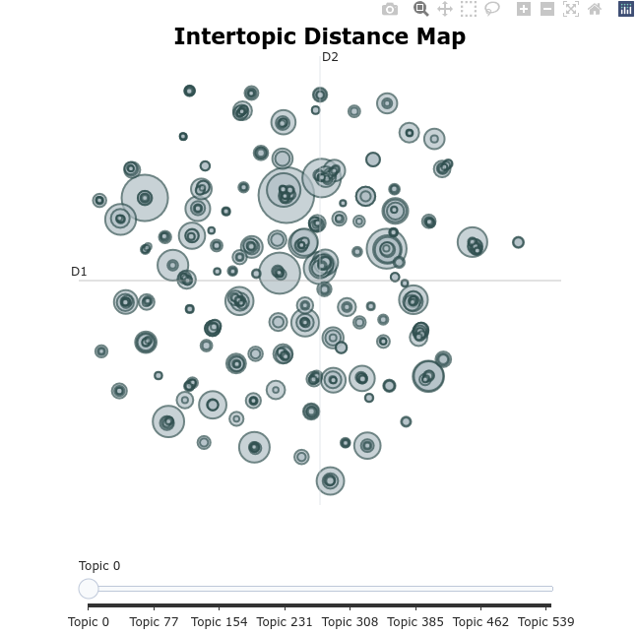
Topic extraction with BERTopic from `abstract` column

Slide 6
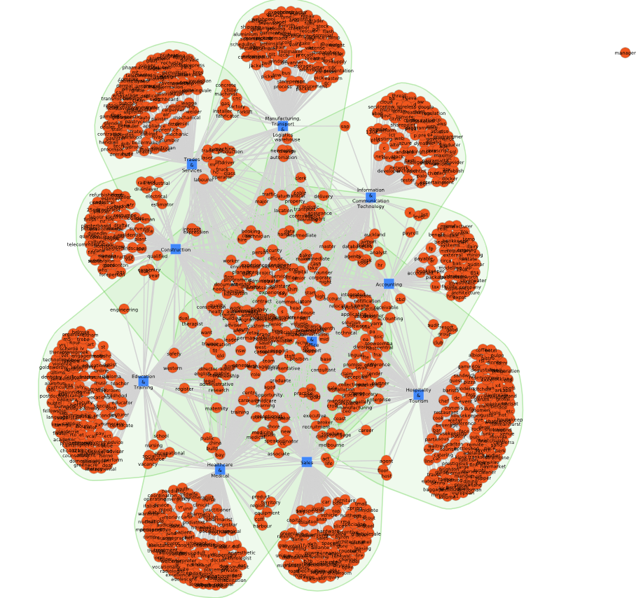
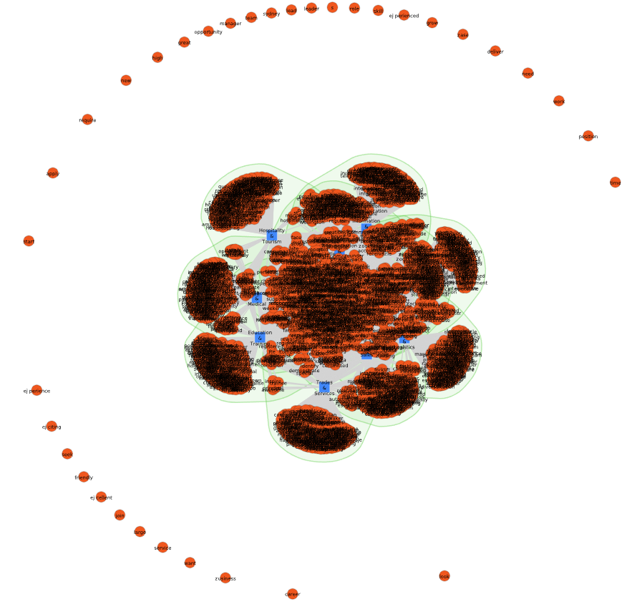
Word networks for top 10 classes with 100 randomly sampled jobs for each
Text Network (`title` column)
Text Network (`abstract` column)

Slide 7
Data analysis summary for job ads data
1) Judging from a keyword search page on SEEK (https://www.seek.com.au/machine-learning-jobs): `title` + `abstract` is for "V" behaviour; `title` + `content` is for "A" behaviour.
2) Discarded `additionalSalaryText` column, since 33000 out of 50000 are None, and the other values are difficult to process at the moment
3) Discarded `suburb` or `area`, since `location` already represents similar info. And `suburb` or `area` have more Nones and are of higher dimensionality
5) Discarded `standout` column since over 23000 values are None, and other text columns have similar info
6) For `location` and `subClassification`, the least frequent values ( e.g., with less than 10 appearances) are assigned as "Other"
7) Majority of `workType` are "Full Time"
8) From the word clouds, for differerent classes (`classification`), `title` of the jobs contain unique words exclusively relevant to the classes of the jobs, while `abstract` also contain some typical common words, such as 'join', 'team', 'role'.
9) The text network analysis for `title` and `abstract` also confirms the above observation.

Slide 8
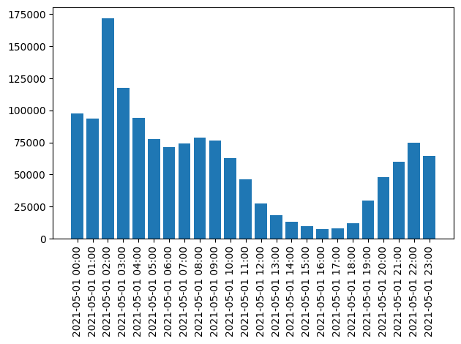
Data analysis for events data
column `event_datetime`

Slide 9
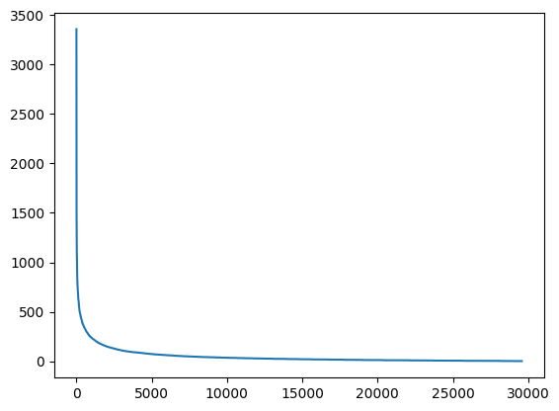
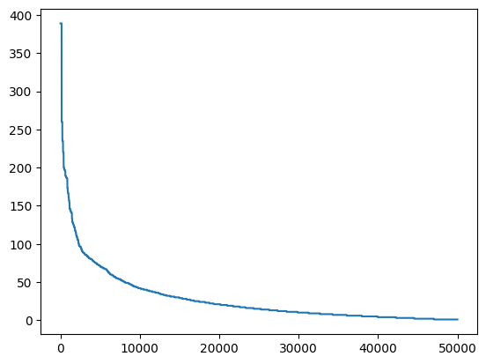
column `resume_id`: Per-user event number distribution
column `job_id`: Per-job event number distribution
Number of events per user / job

Slide 10
column `event_platform` and `kind`:
event_platform
WEB 506668
IOS_APP 474427
ANDROID_APP 453801
kind
V 1314401
A 120495

Slide 11
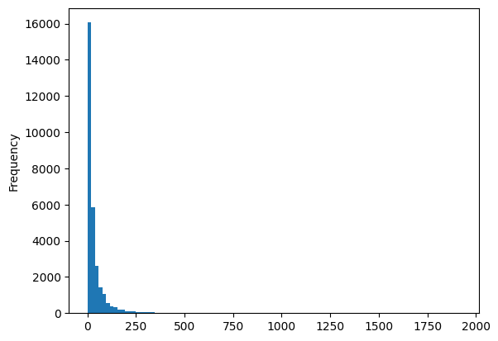
`resume_id` VS. `job_id`
Most users have interactions (view) with very small numbers of jobs
When generating the training data, we choose only the active users with View interactions with at least 10 unique jobs.

Slide 12
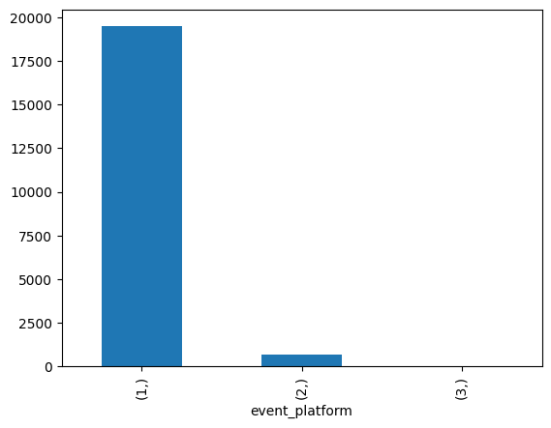
`resume_id` vs. `platform`
`event_platform` can be discarded because most users use only 1 platform.

Slide 13
Data analysis summary for events data
1) On this particular day, there are much fewer events in the afternoon.
2) On this particular day, for most users, his/her events happen within 1-3 hours.
3) Some users, e.g. user#245, have much more events than others.
4) The distributions of numbers of events per user and per job are long tail: most users/jobs have small numbers of events, very few users/jobs have large number of events.
The data sparsity issue is expected in recommendation systems in general. However, in the job recommendation setting, the sparsity issue and cold start problem are exacerbated due to the short-lived nature of jobs. This is similar to news recommendation. This likely causes higher data sparsity to CF and thus prediction difficulty. Therefore, maybe it’s preferable to focus on content-based approaches.
5) Duplicated view and application events can be removed. The duplications could be due to logging methods or users' repeated activities (https://medium.com/pinterest-engineering/building-a-real-time-user-action-counting-system-for-ads-88a60d9c9a).

Slide 14
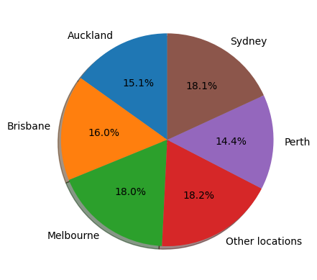
Merged data analysis
Job seekers' location distribution

Slide 15
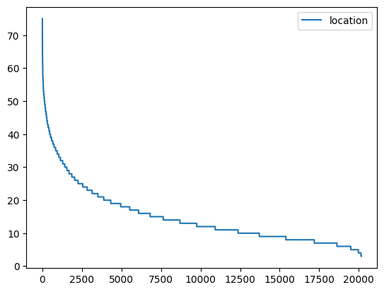
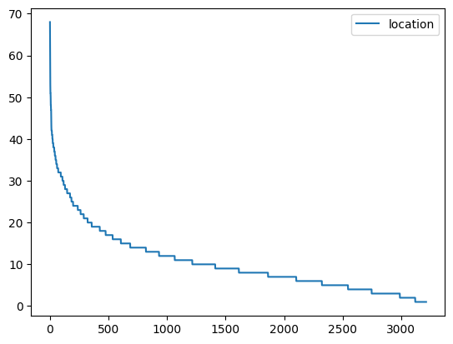
kind=V: user_count=20159 mode(location_count)=8
kind=A: user_count=3214 mode(location_count)=8
Users access (V/A) jobs in multiple locations.

Slide 16
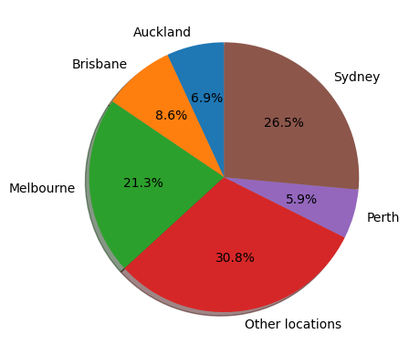
Jobs' location distribution

Slide 17
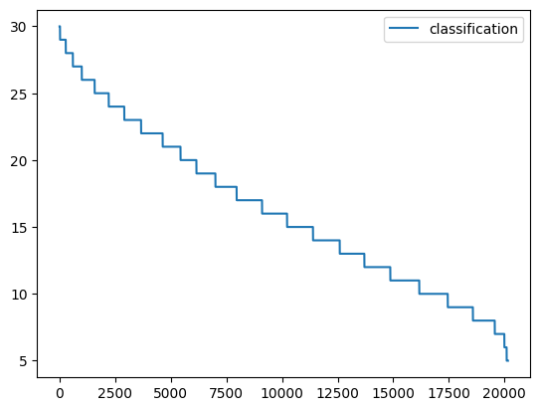
People often interact with diverse job categories. Some people are generalists, while some people are specialists.
Meanwhile, it is important to note that the same type of jobs may be classified under different categories. For example, "data scientist" jobs can be categorized as "Information & Communication Technology," and at times they may also fall under "Science & Technology" or "Engineering."
`resume_id` vs. `classification`: how diverse users' job interests are

Slide 18
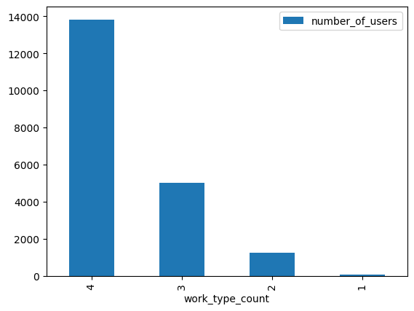
`resume_id` vs. `work_type`

Slide 19
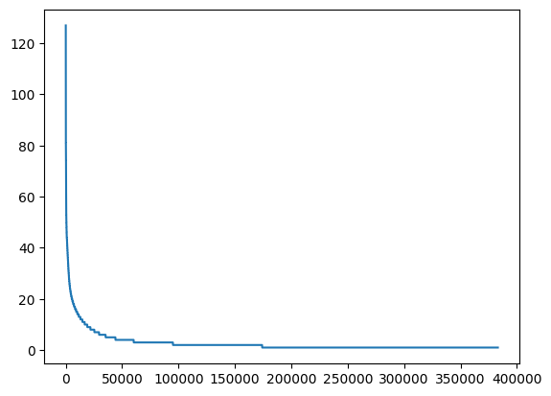
Analysis of job click/application sequences of users
Frequencies of repeated job pairs (kind=V)

Slide 20
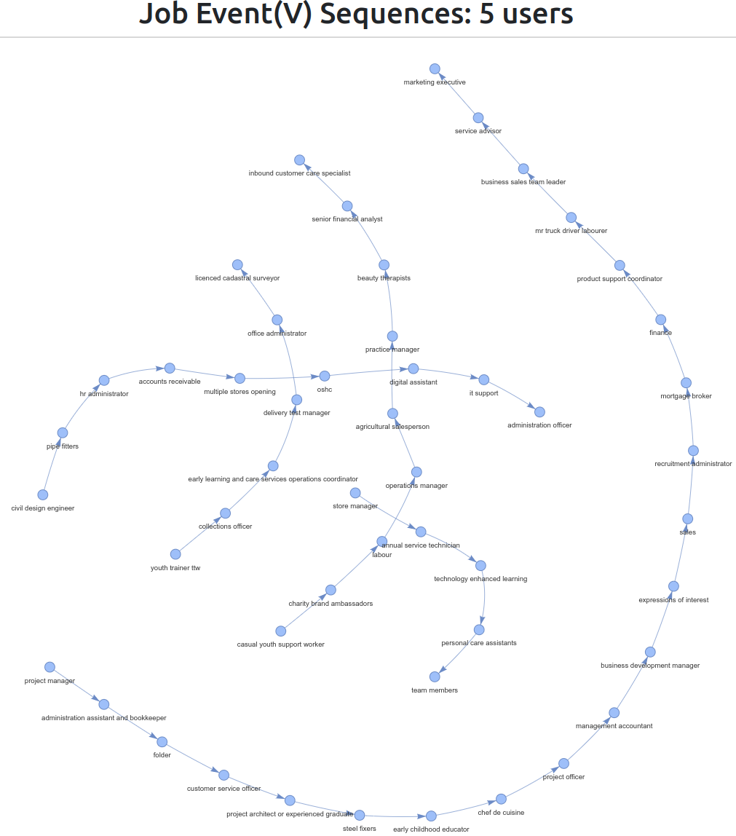
Visualised job event sequences of 5 randomly sampled users as a network
(project/notebooks/step1_EDA/network_vis/)
Very often people have very diverse job interests (View type events). Judging from the job titles, many jobs in the same sequence don't seem directly relevant to each other.

Slide 21
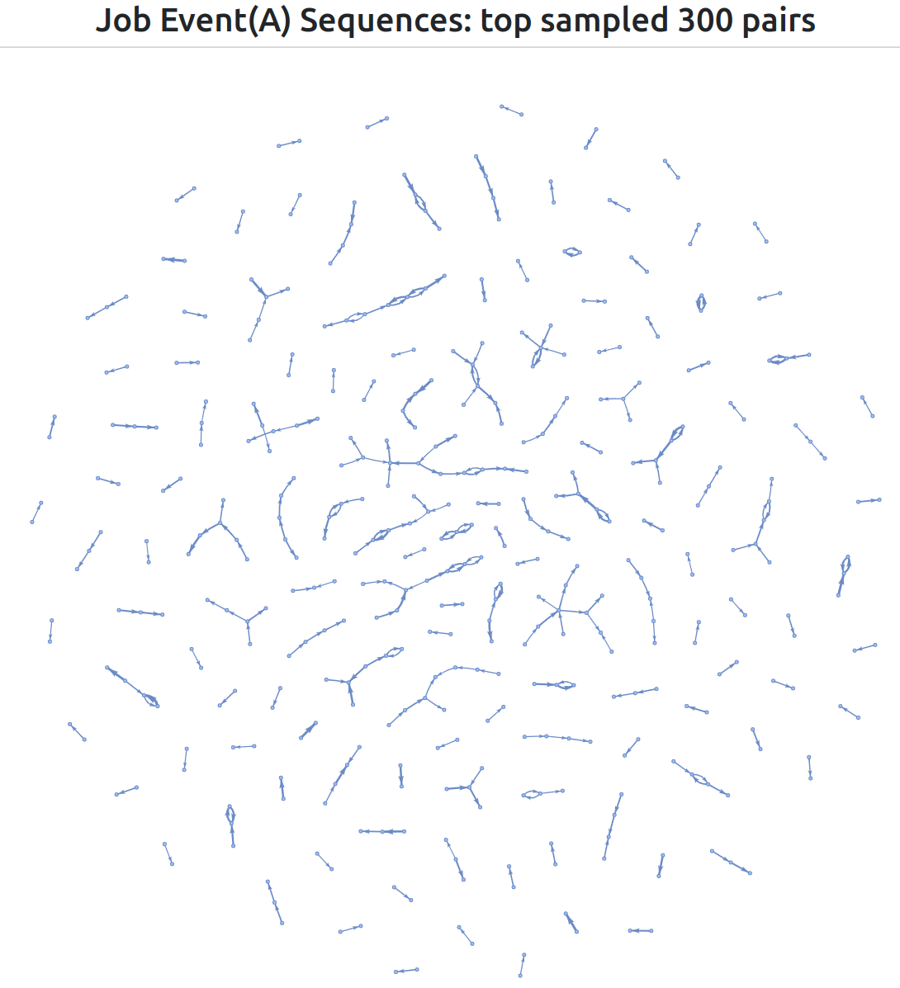
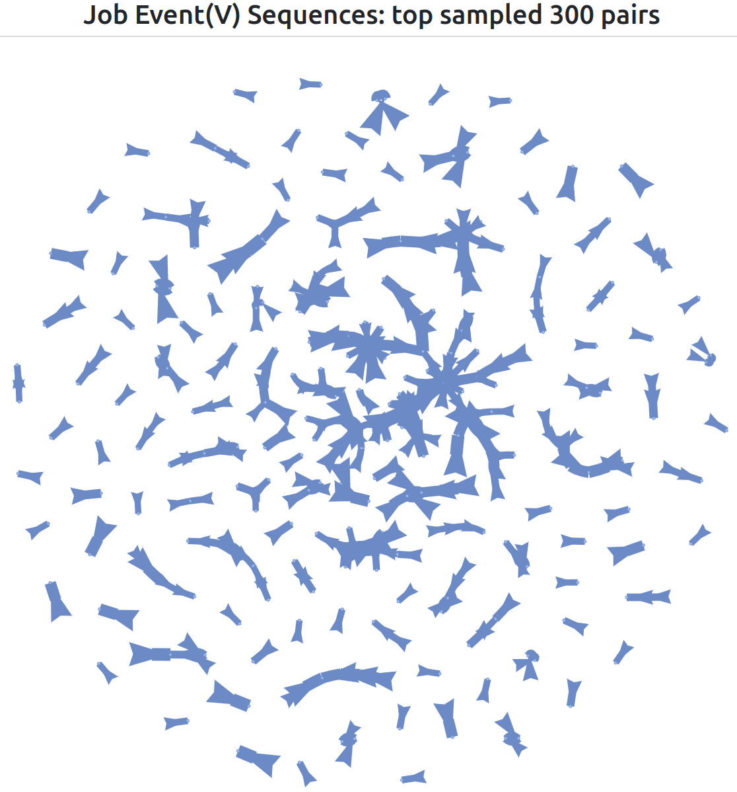

Slide 22
Problem Formulation: Job Recommendation System for Click Prediction
User profile: a user u_{i} and all of his/her job click history can be noted together as:
(u_{i}, j₁, j₂, j₃, ..., j_{k}, ..., j_{n})
The job click history (j₁, j₂, j₃, ..., j_{k}, ..., j_{n}) can be formulated as a sequence or a set.
Item profile: for a given item j_{k}, the title, abstract, job ID, and all of its metadata information constitute the job profile of item j_{k}. Since the task objective is to prediction click prediction, the job content text is therefore not considered. The metadata columns included are location, classification, sub classification, work type, etc.
To formulate the recommendation task for job click prediction, for a user u_{i} , we consider the most recent clicked job j_{n} as the targeted job to be predicted, and we use user u_{i}’s information and his/her click sequence (j₁, j₂, ..., j_{n-1}) as the user profile. The objective of the recommendation task is to predict the job j_{n} based on u_{i}’s user profile.
(u_{i}, j₁, j₂, ..., j_{n-1}) ----> j_{n}

Slide 23
Model Architecture: Dual-Encoder Interest Network
Model Details
Model Architecture
Model code: ip-dual-encoder-interest-network/model_ddp_trainer/model.py
Data Input
Training
Trained in DDP mode
Training code: ip-dual-encoder-interest-network/model_ddp_trainer/ddp_trainer.py

Slide 24
Model Details
User Encoder: A user u_{i} and his/her job click history together are modeled with a Transformer encoder, without (/with) the positional encoding layers.
Item Encoder: In order to represent a single job j₂, we can use the text content of the jobs (title, abstract, etc.) and pass it through a pre-trained BERT encoder. The first token [CLS]’s last hidden state vector is used assuming it captures the entire text context. Following this, we compute the inner product of the first token (u_{i}) of user encoder and the first token (j₂) of job encoder for prediction. This will be aligned to factorisation models.
User-Item Interaction: The interaction between u_{i} and j₂ can be modeled with an inner product layer and fully connected layers.
We also added other features (e.g., locations, categories) in the computation to enhance the expressiveness of the embeddings and the interactions.
Loss function: Binary Cross-Entropy loss

Slide 25
Pre-trained BERT models
bert-base-cased (https://huggingface.co/bert-base-cased)
jjzha/jobbert-base-cased (https://huggingface.co/jjzha/jobbert-base-cased) Zhang, Mike, et al. "SkillSpan: Hard and soft skill extraction from English job postings." arXiv preprint arXiv:2204.12811 (2022).

Slide 26
Overall Model Architecture
click prediction
interaction layers
Transformer Encoder
Transformer Encoder
User click sequence
document+ or document-

Slide 27

Sigmoid
Dual Encoder Interest Network
+
Transformer encoder
BERT encoder (pretrained & fine tuning)
LeakyReLU
LeakyReLU
Add & Norm
Add & Norm
×
LeakyReLU
Feed
Forward
Feed
Forward
N×
N×
Add & Norm
Add & Norm
Multi-Head
Attention
Multi-Head
Attention
user ID embedding
job ID embedding sequence
candidate job ID embedding
candidate job CLS embedding
+
token type (segment) embedding
Positional
Embedding
Job metadata
embeddings
Input
Embedding
Input
Embedding
+
Inputs
job location embedding
job classification embedding
job subclass embedding
work type embedding
Inputs
CONCAT(user ID, clicked job ID sequence)
candidate job token sequence (title and abstract)

Slide 28
Data input
Input to user encoder: u_{i}, (j₁, j₂, j₃, ..., j_{n-1})
Input to item encoder: j_{n}, (t_{t1},... ,t_{tm}), (t_{a1},... ,t_{an}), where (t_{t1},... ,t_{tm}) is the token sequence of job j_{n}’s title, (t_{a1},... ,t_{an}) is the token sequence of job j_{n}’s abstract.

Slide 29
Input to User Encoder (the “query”): A User U(i)’s Job Click Sequence
E_{U(i)}
E_{J(1)}
E_{J(2)}
E_{J(3)}
E_{J(4)}
E_{J(5)}
E_{J(6)}
E_{J(7)}
E_{[SEP]}
U_{i}
J₇
Job ID
Embeddings
[CLS]
J₁
J₂
J₃
J₄
J₅
J₆
J₈
[CLS]
User ID
Embedding
J₀
[SEP]
+
+
+
+
+
+
+
+
+
Position
Embeddings (optional)
P₀
P₁
P₂
P₃
P₄
P₅
P₆
P₇
P₈
time
old
recent

Slide 30
Input to Item Encoder (the “document”): Candidate Job’s job ID, and the title and abstract token sequences
E_{J(1)}
E_{[CLS]}
E_{senior}
E_{data}
E_{scientist}
E_{[SEP]}
E_{we}
E_{are}
E_{seeking}
E_{[SEP]}
Job ID
Embedding
J₁
Token
Embeddings
[CLS]
T₁
T₂
T₃
[SEP]
T₀
T₁
T₂
[SEP]
[CLS]
+
+
+
+
+
+
+
+
+
Segment
Embeddings
S_{A}
S_{A}
S_{A}
S_{A}
S_{A}
S_{B}
S_{B}
S_{B}
S_{B}
+
+
+
+
+
+
+
+
+
Position
Embeddings
P₀
P₁
P₂
P₃
P₄
P₅
P₆
P₇
P₈
Title
Abstract
Two text columns input like BERT NSP task

Slide 31
Job Embeddings
A job is modeled by two embeddings mainly: CLS token embedding and job ID embedding.
Without fine-tuning the BERT encoder, the CLS token embedding contains pure textual content information. It can be compensated by the job ID embedding, which is learnt from both relational data and text data and thus further contains latent relations between user, item, and side features. In my experiments, the fine tuning starts at the 10,000th step.
The two job embeddings are further enriched by metadata embeddings. Job emtadata embeddings are mainly job classification embedding and job location embedding.

Slide 32
Data Preparation
Training data generation
ip-dual-encoder-interest-network/notebooks/step2_feature_engineering/generate_final_dataset_removed_a_user_example.ipynb
Training, validation, testing data split
ip-dual-encoder-interest-network/notebooks/step2_feature_engineering/generate_final_dataset_removed_a_user_example.ipynb
Tokenization and dynamic padding
/media/tyler/MyPassport/Projects/PythonProjects/ip-dual-encoder-interest-network/notebooks/step3_model/prepare_data_dict_for_ddp.ipynb

Slide 33
Training data generation
Generating the positive samples
For a user u_{i} ’s job click sequence (j₁, j₂, j₃, ..., j_{n-1}, j_{n}), we generate n-1 positive training samples, where (j₁, j₂, j₃, ..., j_{k-1}) is assumed to be the current job click sequence and job j_{k} is the positive candidate job to be predicted.
Popularity-based negative sampling
We then use 1:1 ratio to sample the negative candidate job for each job click sequence. The negative sampling strategy is popularity-based. We can also use larger ratios to generate more negative samples for each job click sequence. In order to reduce the training cost, we have used 1:1 ratio. There are also other negative sampling strategies.

Slide 34
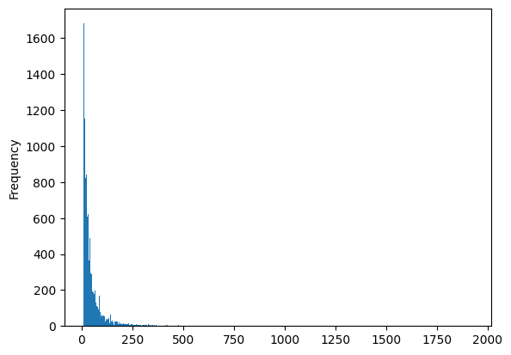
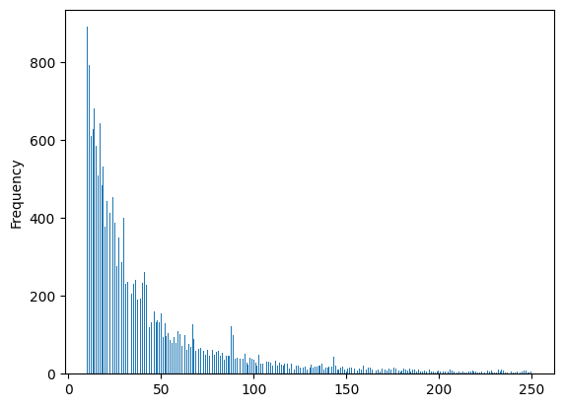
Selected Users with number of unique clicked `job_id` between 10 and 250

Slide 35
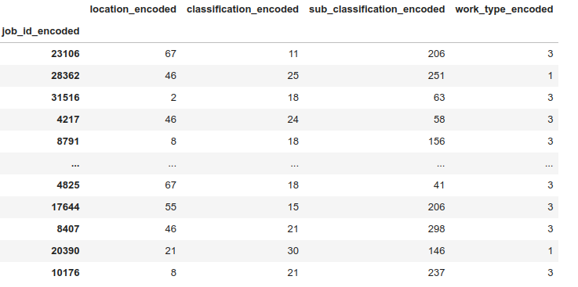
user ids, job ids as well as the metadata columns of the jobs are all encoded as 0-based indices

Slide 36
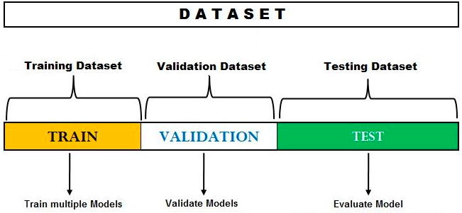
Training, validation, testing data split
After the data generation, the dataset is splitted into training, validation and testing datasets based on Time Series Split (https://scikit-learn.org/stable/modules/generated/sklearn.model_selection.TimeSeriesSplit.html) for each user.
Training, validation, testing datasets split proportion: 8:1:1.
Number of unique users: 19672. Number of unique job ids: 47844.

Slide 37
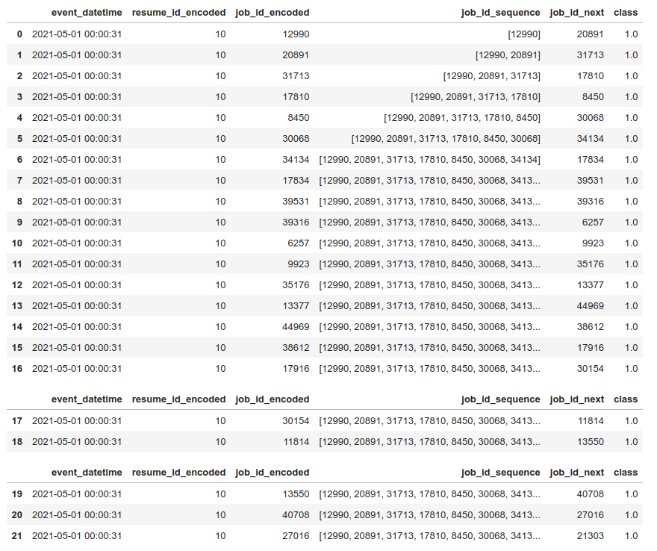
event time in ASC order
user#10
current job click sequence
next clicked
job
label
training data
Data split for user #10
validation data
testing data

Slide 38
Experiment and Result Analysis
Model Hyperparameters
ip-dual-encoder-interest-network/model_ddp_trainer/ddp_trainer.py
Training Configurations
ip-dual-encoder-interest-network/model_ddp_trainer/ddp_trainer.py
Noam Learning Rate Schedule and Adam Optimizer
Hardware
Evaluation

Slide 39
Model Hyperparameters
my_model_config['nuser'] = 19672 + 1 # NUM_USERS, 0th token is the padding token
my_model_config['nitem'] = 47844 + 1 # NUM_ITEMS, 0th token is the padding token
my_model_config['d_model'] = 768
my_model_config['nhead'] = 4
my_model_config['d_hid'] = 1024 # dim_feedforward
my_model_config['dropout'] = 0.1
my_model_config['nlayers'] = 2
my_model_config['checkpoint'] = 'bert-base-cased' # 'jjzha/jobbert-base-cased'

Slide 40
Training Configurations
batch_size = 256
my_train_config['total_epochs'] = 10
my_train_config['batch_size'] = int(batch_size / my_world_size)
my_train_config['validate_every_n_steps'] = 2000
my_train_config['lr_scheduler_warmup_steps'] = 3000
my_train_config['lr_scheduler_scale_factor'] = 0.5
my_train_config['unfreeze_bert_after_step'] = 10000
my_train_config['save_model_stop_at_step'] = 26000
my_train_config['weight_decay'] = 1e-6

Slide 41
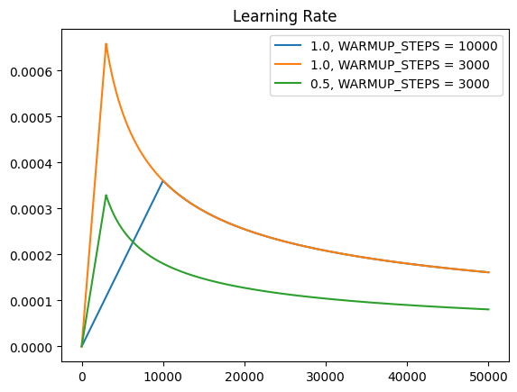
Noam Learning Rate Schedule and Adam Optimizer

Slide 42
Hardware
AWS EC2 p3.8xlarge instance
https://aws.amazon.com/ec2/instance-types/p3/
4 GPUs - Tesla V100
64 GPU Memory (GB)
32 vCPUs

Slide 43
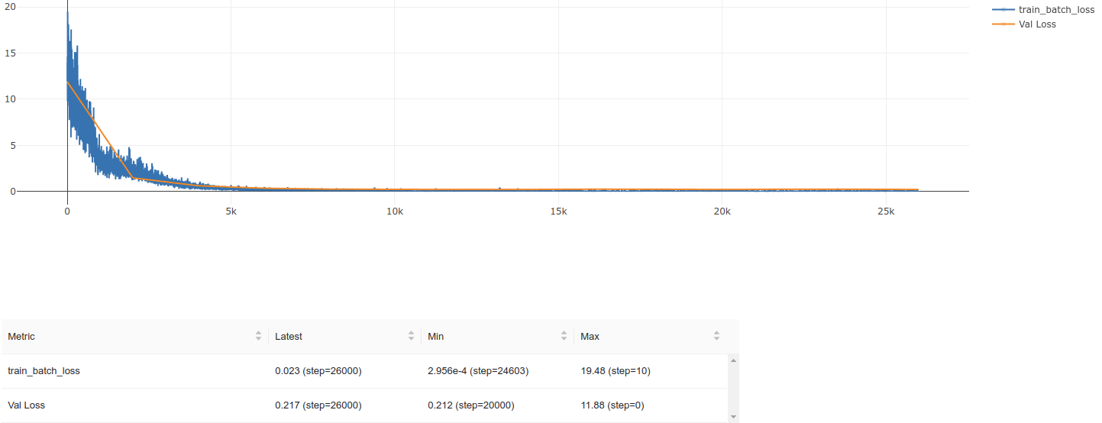
Evaluation
Losses on training and validation datasets

Slide 44
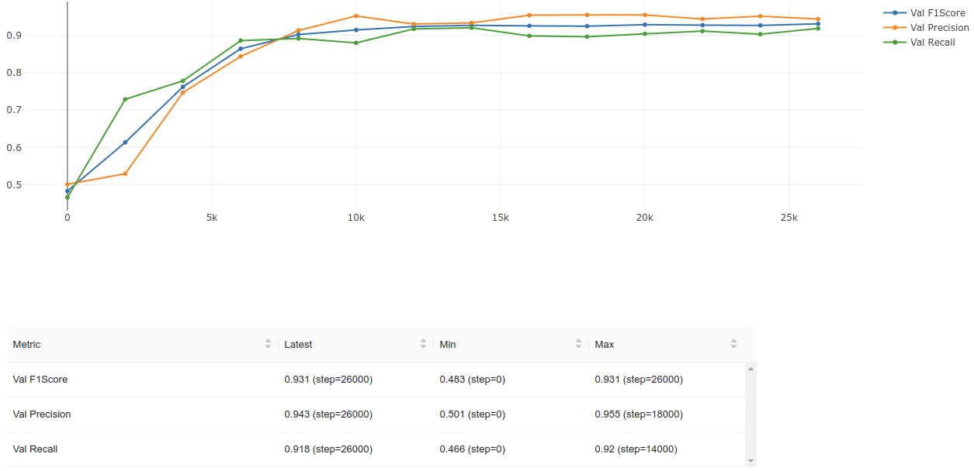
Precision, Recall and F1 Score on validation dataset

Slide 45
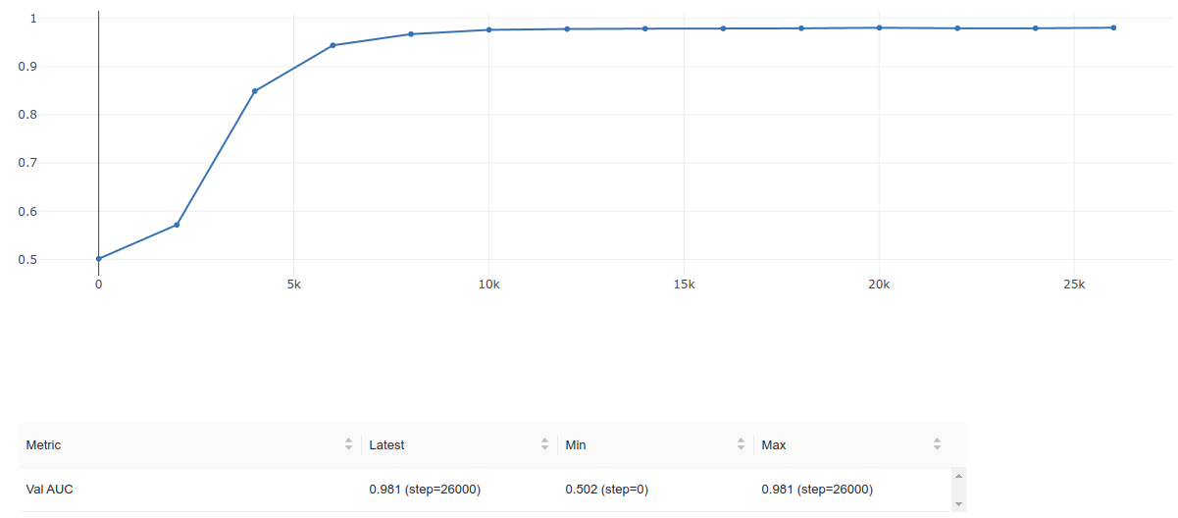
AUROC on validation dataset

Slide 46
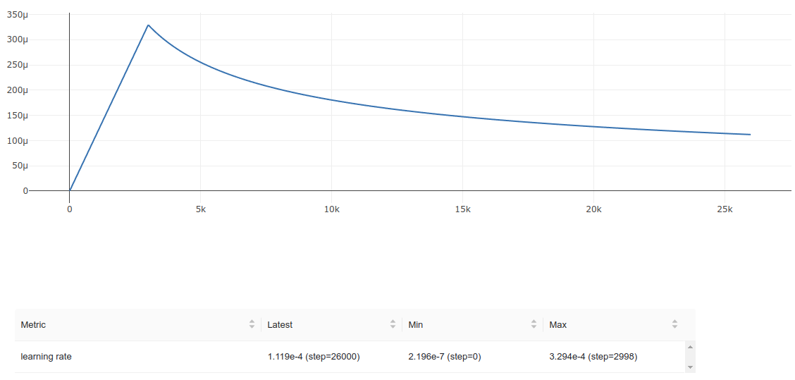
Learning Rate

Slide 47
Performance on testing dataset
ip-dual-encoder-interest-network/notebooks/step3_model/model_evaluation_test_dataset.ipynb
'test Loss': 0.2982197403907776,
'test AUC': 0.9672754406929016,
'test Precision': 0.9273624420166016,
'test Recall': 0.8761467933654785,
'test F1Score': 0.9010273814201355

Slide 48
Future Work
Better recommendation generation and evaluation for Top-N Recommendations
Loss function
Click and application behaviours
Better interaction layers
Scaling problem - long behaviour sequence (recent Alibaba papers)

