Slide 1
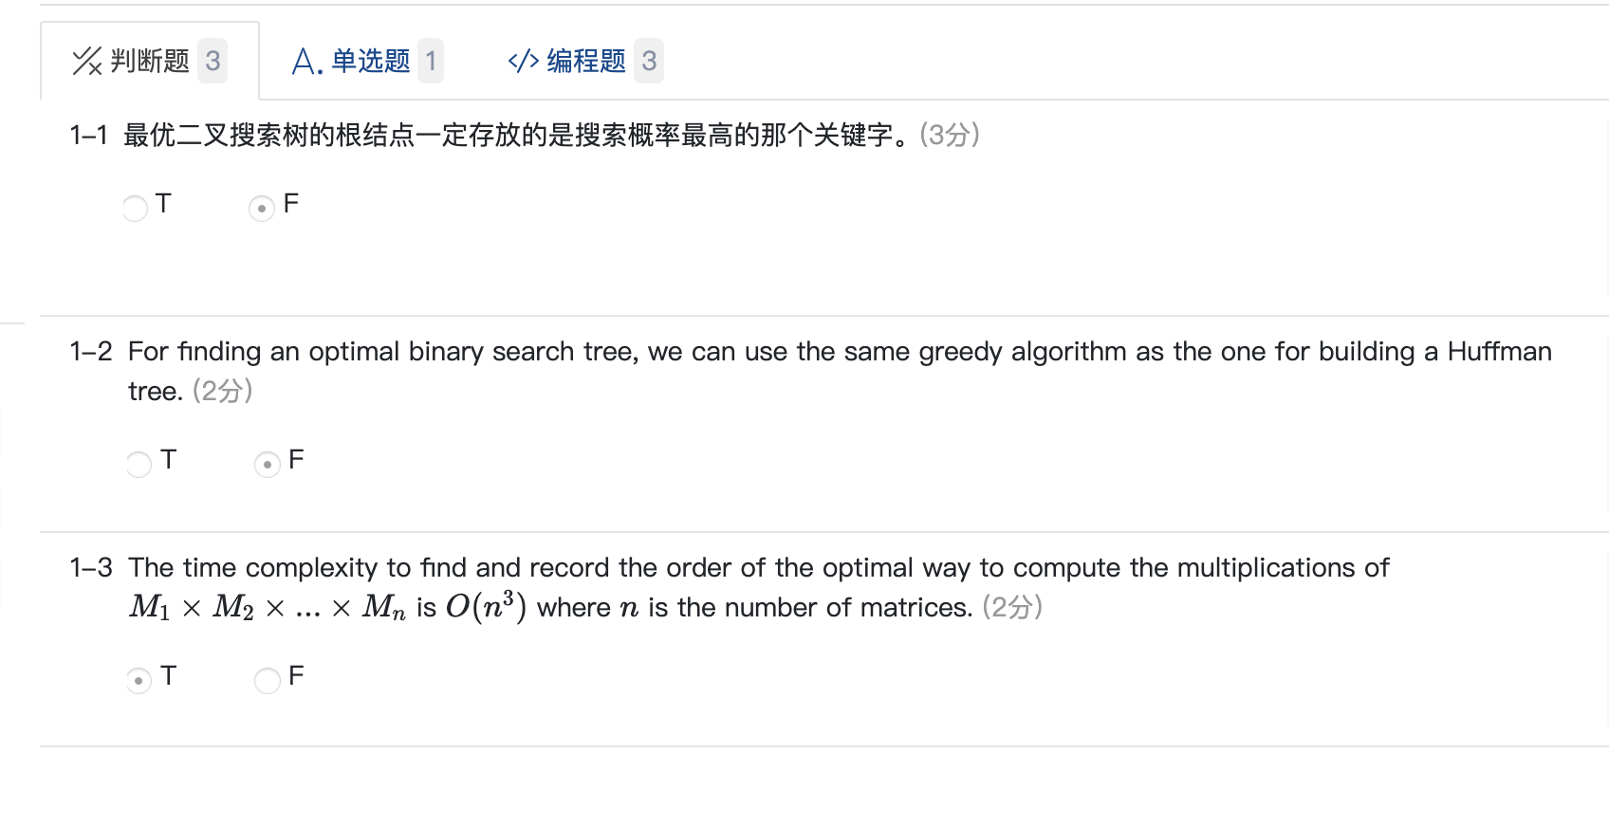
作业

Slide 2
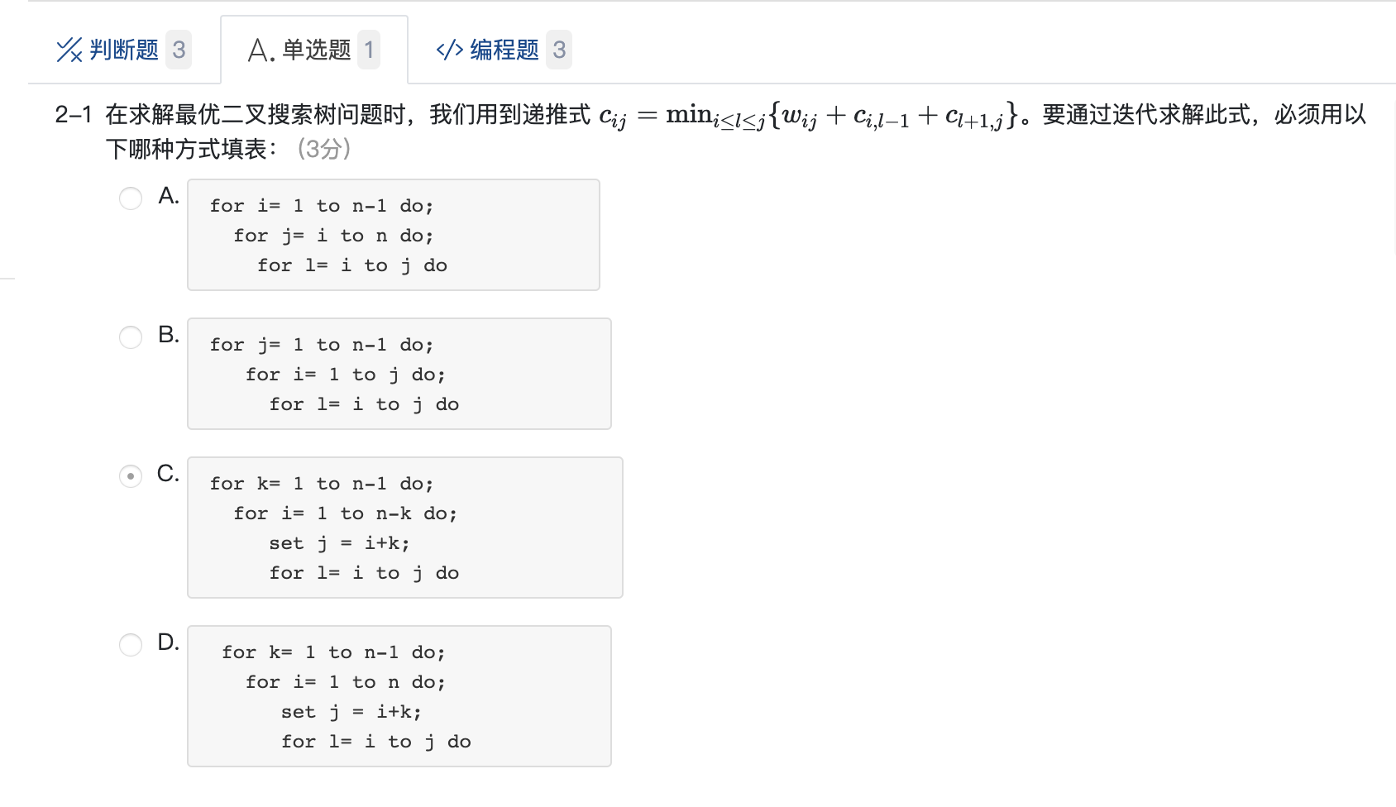
作业

Slide 3
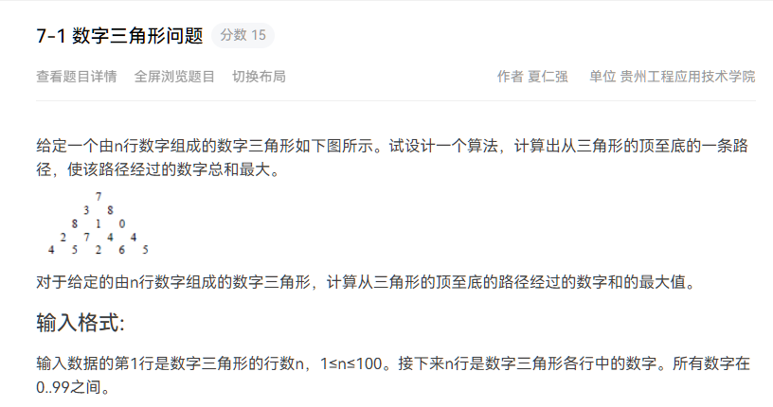
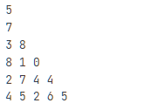
作业
经典的DP问题！

Slide 4
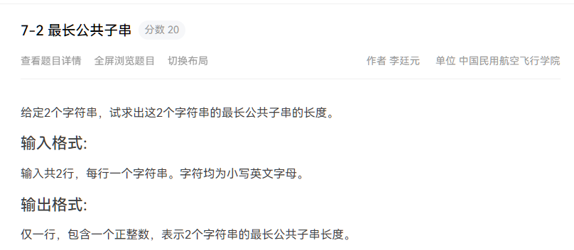
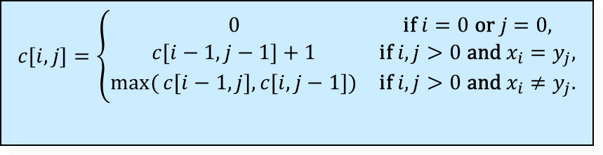
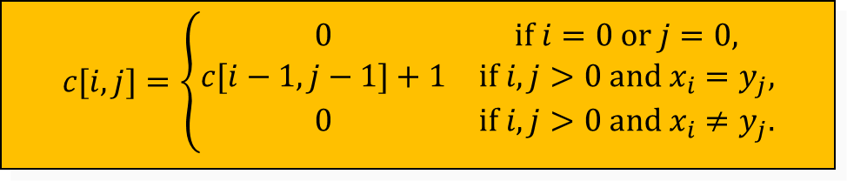
作业
最长公共子串
最长公共子序列
$$c[i,j]=\left\{\begin{matrix}0 & \text{if} i=0 \text{or} j=0, \\ c[i−1,j−1]+1 & \text{if} i,j>0 \text{and} x_{i}=y_{j}, \\ \max{(}c[i−1,j],c[i,j−1]) & \text{if} i,j>0 \text{and} x_{i}≠y_{j}.\end{matrix}\right.$$
$$c[i,j]=\left\{\begin{matrix}0 & \text{if} i=0 \text{or} j=0, \\ c[i−1,j−1]+1 & \text{if} i,j>0 \text{and} x_{i}=y_{j}, \\ 0 & \text{if} i,j>0 \text{and} x_{i}≠y_{j}.\end{matrix}\right.$$

