Slide 1
Algorithm Analysis & Design Introduction to Algorithm
T&R Team of Algorithm Design
College of Computer Science and Engineering, CQU
Notes:
本人是国际视觉电生理学会(ISCEV)的会员。

Slide 2
Dynamic PROGRAMMING
15
Overlapped sub-problems

Slide 3
Those who cannot remember the past are doomed to repeat it.
-----George Santayana,
The life of Reason,
Book I: Introduction and
Reason in Common
Sense (1905)

Slide 4

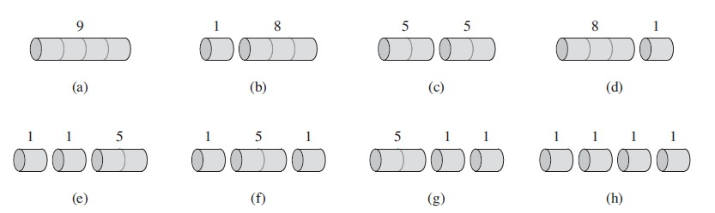
Rod cutting
Given a rod of length n inches and a table of prices p_{i} for i = 1,2,3,…,n, determine the maximum revenue r(n) obtainable by cutting up the rod and selling the pieces.
For n = 4, which one is best ?
How many different ways of cutting rod with length n ?

Slide 5
Optimal substructure – Rod cutting
In the best solution, we cut i inch from rod at the first time,
r(n)= p_{i} + r(n-i)
r (n-i) is totally the same problem with just smaller size.
&
The n-i part of best solution must be the best solution for problem n-i;
Why r(n-i)must be the best solution for problem n-i ?

Slide 6

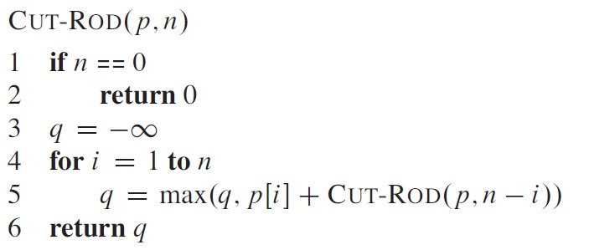
Recursive top-down implementation
The length of first piece have n possibilities: 1,2,….n inches long

Slide 7
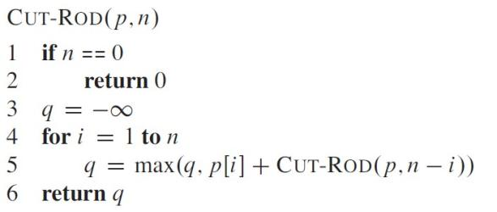
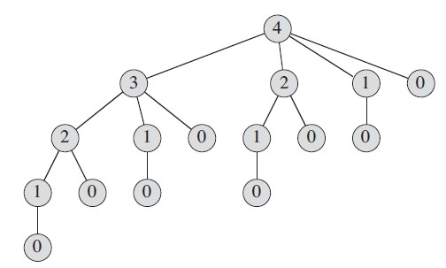
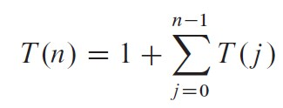

Recursive top-down implementation – good ?

Slide 8
Recursive top-down implementation – good ?

Slide 9
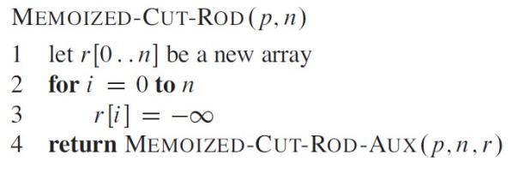
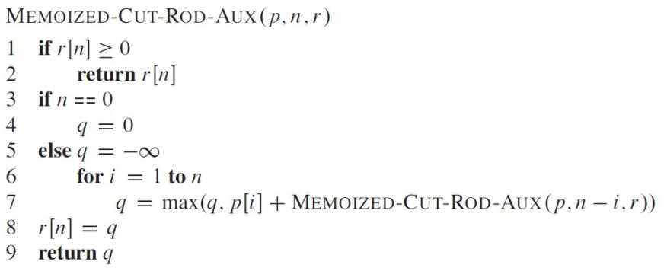
Dynamic Programming – top down memoization
Avoid resolving same sub-problem

Slide 10
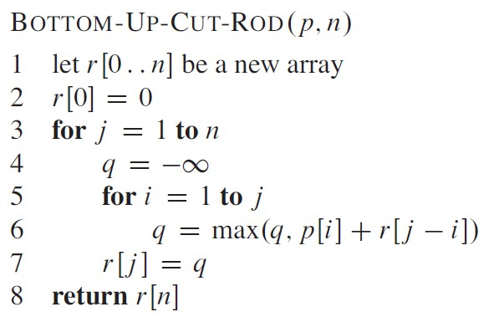
Dynamic Programming – Bottom up
Avoid resolving same sub-problem

Slide 11
Dynamic Programming – Bottom up
In class exercise:
compute r[1] – r[10]with bottom up method.

Slide 12
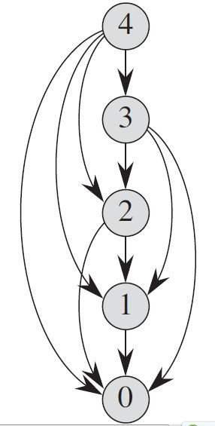

Dynamic Programming – Efficiency
Avoid resolving same sub-problem

Slide 13
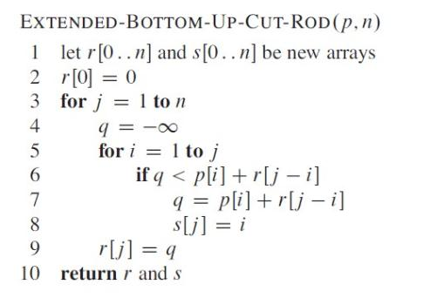
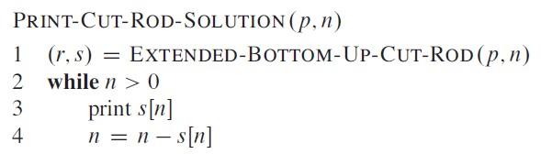
Reconstructing the solution

Slide 14
Homework
CLRS 15.1-3
CLRS 15.1-5

Slide 15
Knapsack Problem

Slide 16
The Knapsack Problem
The famous knapsack problem:
A thief breaks into a museum. Fabulous paintings, sculptures, and jewels are everywhere. The thief has a good eye for the value of these objects, and knows that each will fetch hundreds or thousands of dollars on the clandestine art collector’s market. But, the thief has only brought a single knapsack to the scene of the robbery, and can take away only what he can carry. What items should the thief take to maximize the haul?

Slide 17
0-1 Knapsack problem
Given a knapsack with maximum capacity W, and a set S consisting of n items
Each item i has some weight w_{i} and benefit value b_{i} (all w_{i} , b_{i} and W are integer values)
Problem: How to pack the knapsack to achieve maximum total value of packed items?

Slide 18
0-1 Knapsack problem: a picture
Weight
Benefit value
w_{i}
b_{i}
Items
3
2
This is a knapsack
Max weight: W = 20
3
4
4
5
5
8
W = 20
9
10

Slide 19
The Knapsack Problem
More formally, the 0-1 knapsack problem:
The thief must choose among n items, where the ith item worth v_{i} dollars and weighs w_{i} pounds
Carrying at most W pounds, maximize value
Note: assume v_{i}, w_{i}, and W are all integers
“0-1” each item must be taken or left in entirety
Generalization, the unbounded knapsack problem:
No bound on the number of each item
Think about the thief ran into a bank…

Slide 20
0-1 Knapsack – Formulation
The problem is called a “0-1” problem, because each item must be entirely accepted or rejected.

Slide 21
Unbounded Knapsack – Formulation
The problem is called a unbounded problem, because each item has no bound on its number that can be accepted.

Slide 22
0-1 Knapsack problem: brute-force approach
Let’s first solve this problem with a straightforward algorithm
Since there are n items, there are 2^{n} possible combinations of items.
We go through all combinations and find the one with the most total value and with total weight less or equal to W
Running time will be O(2^{n})

Slide 23
0-1 Knapsack problem: brute-force approach
Can we do better?
Yes, with an algorithm based on dynamic programming
We need to carefully identify the subproblems
Let’s try this:
If items are labeled 1..n, then a subproblem
would be to find an optimal solution for
OPT(k) = {items labeled 1, 2, .. k}

Slide 24
Defining a Subproblem
If items are labeled 1..n, then a subproblem would be to find an optimal solution for OPT(k)= {items labeled 1, 2, .. k}

Slide 25
Defining a Subproblem
If items are labeled 1..n, then a subproblem would be to find an optimal solution for OPT(k)= {items labeled 1, 2, .. k}
This is a valid subproblem definition.

Slide 26
Defining a Subproblem
If items are labeled 1..n, then a subproblem would be to find an optimal solution for OPT(k)= {items labeled 1, 2, .. k}
This is a valid subproblem definition.
The question is: can we describe the final solution OPT(n) in terms of subproblems OPT(1),OPT(2),…,OPT(n-1)?

Slide 27
Defining a Subproblem
If items are labeled 1..n, then a subproblem would be to find an optimal solution for OPT(k)= {items labeled 1, 2, .. k}
This is a valid subproblem definition.
The question is: can we describe the final solution OPT(n) in terms of subproblems OPT(1),OPT(2),…,OPT(n-1)?
Unfortunately, we can’t do that. Explanation follows….

Slide 28
Defining a Subproblem
Weight
Benefit
Item
#
w_{i}
b_{i}
1
2
3
OPT(4)
2
3
4
OPT(5)
3
4
5
4
5
8
5
9
10

Slide 29
Defining a Subproblem
w₁ =2
b₁ =3
w₂ =3
b₂ =4
w₃ =4
b₃ =5
w₄ =5
b₄ =8
Weight
Benefit
Item
#
w_{i}
b_{i}
1
2
3
OPT(4)
2
3
4
OPT(5)
3
4
5
4
5
8
5
9
10

Slide 30
Defining a Subproblem
w₁ =2
b₁ =3
w₂ =3
b₂ =4
w₃ =4
b₃ =5
w₄ =5
b₄ =8
Weight
Benefit
Item
#
w_{i}
b_{i}
1
2
3
Max weight: W = 20
For S₄:
Total weight: 14;
total benefit: 20
OPT(4)
2
3
4
OPT(5)
3
4
5
4
5
8
5
9
10

Slide 31
Defining a Subproblem
w₁ =2
b₁ =3
w₂ =3
b₂ =4
w₃ =4
b₃ =5
w₄ =5
b₄ =8
Weight
Benefit
Item
#
w_{i}
b_{i}
1
2
3
Max weight: W = 20
For S₄:
Total weight: 14;
total benefit: 20
OPT(4)
2
3
4
OPT(5)
3
4
5
4
5
8
5
9
10
w₁ =2
b₁ =3
w₃ =4
b₃ =5
w₄=5
b₄ =8
w₅ =9
b₅ =10

Slide 32
Defining a Subproblem
w₁ =2
b₁ =3
w₂ =3
b₂ =4
w₃ =4
b₃ =5
w₄ =5
b₄ =8
Weight
Benefit
Item
#
w_{i}
b_{i}
1
2
3
Max weight: W = 20
For S₄:
Total weight: 14;
total benefit: 20
OPT(4)
2
3
4
OPT(5)
3
4
5
4
5
8
5
9
10
w₁ =2
b₁ =3
w₃ =4
b₃ =5
w₄=5
b₄ =8
w₅ =9
b₅ =10
For S₅:
Total weight: 20
total benefit: 26

Slide 33
Defining a Subproblem
w₁ =2
b₁ =3
w₂ =3
b₂ =4
w₃ =4
b₃ =5
w₄ =5
b₄ =8
Weight
Benefit
Item
#
w_{i}
b_{i}
1
2
3
Max weight: W = 20
For S₄:
Total weight: 14;
total benefit: 20
OPT(4)
2
3
4
OPT(5)
3
4
5
4
5
8
5
9
10
w₁ =2
b₁ =3
w₃ =4
b₃ =5
w₄=5
b₄ =8
w₅ =9
b₅ =10
OPT(4) is not part of the solution for OPT(5)!!!
For S₅:
Total weight: 20
total benefit: 26

Slide 34
Defining a Subproblem
w₁ =2
b₁ =3
w₂ =3
b₂ =4
w₃ =4
b₃ =5
w₄ =5
b₄ =8
Weight
Benefit
Item
#
w_{i}
b_{i}
?
1
2
3
Max weight: W = 20
For S₄:
Total weight: 14;
total benefit: 20
OPT(4)
2
3
4
OPT(5)
3
4
5
4
5
8
5
9
10
w₁ =2
b₁ =3
w₃ =4
b₃ =5
w₄=5
b₄ =8
w₅ =9
b₅ =10
OPT(4) is not part of the solution for OPT(5)!!!
For S₅:
Total weight: 20
total benefit: 26

Slide 35
Defining a Subproblem (continued)
As we have seen, the solution for OPT(4) is not part of the solution for OPT(5)
So our definition of a subproblem is flawed and we need another one!
Let’s add another parameter: w, which will represent the exact weight for each subset of items
The subproblem then will be to compute OPT[i,w]

Slide 36
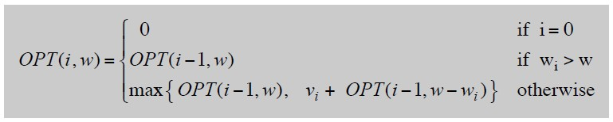
Dynamic Programming – Adding a New Variable
Def. OPT(i, w) = max profit subset of items 1, …, i with weight limit w.
Case 1: OPT does not select item i.
–OPT selects best of { 1, 2, …, i-1 } using weight limit w
Case 2: OPT selects item i.
–new weight limit = w – wi
–OPT selects best of { 1, 2, …, i–1 } using this new weight limit

Slide 37
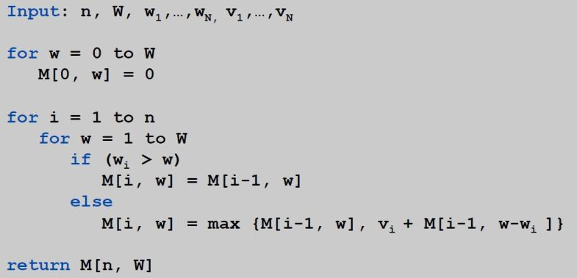
Knapsack – Bottom-Up
Knapsack. Fill up an n-by-W array.

Slide 38
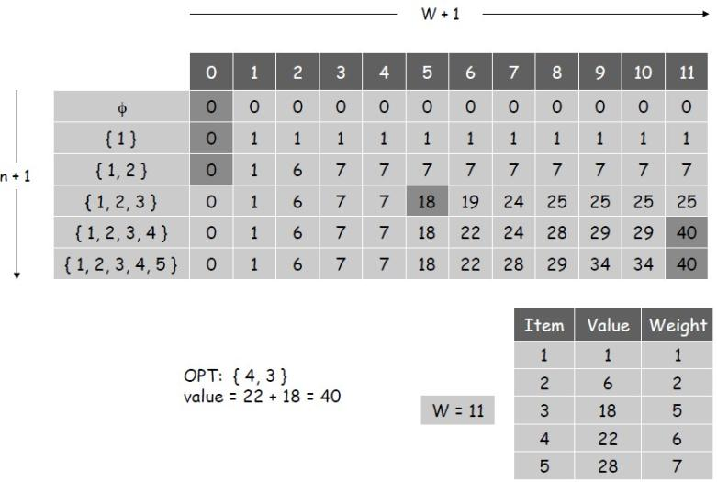
Knapsack Algorithm

Slide 39
Knapsack Problem: Running Time
Running time. θ(n W).
Not polynomial in input size!
"Pseudo-polynomial."
Decision version of Knapsack is NP-complete.

Slide 40
Exercise in Class: 0-1 Knapsack Problem
Compute OPT(5,11)

Slide 41
Q: Unbounded Knapsack – Formulation
The problem is called a unbounded problem, because each item has no bound on its number that can be accepted.

Slide 42
Q: Unbounded Knapsack – Formulation
0-1 Knapsack Problem
Case 1: OPT does not select item i.
–OPT selects best of { 1, 2, …, i-1 } using weight limit w
Case 2: OPT selects item i.
–new weight limit = w – wi
–OPT selects best of { 1, 2, …, ? } using this new weight limit

Slide 43
Exercise in Class: Unbounded Knapsack Problem
Compute OPT(5,11)

Slide 44
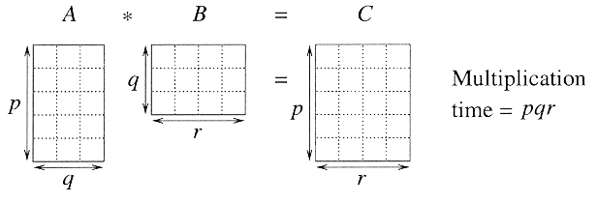
Matrix chain multiplication
In particular for 1 ≤ i ≤ p and 1 ≤ j ≤ r,
C[i, j] = ∑_{k = 1 to q} A[i, k] B[k, j]
Observe that there are pr total entries in C and each takes O(q) time to compute, thus the total time to multiply 2 matrices is pqr.

Slide 45
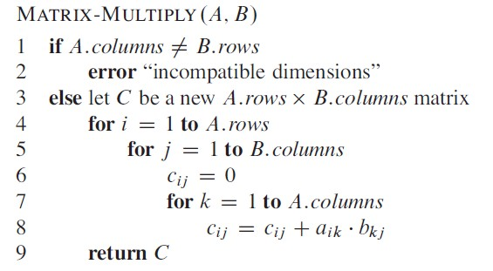
Matrix chain multiplication
If A is a p x q matrix and B is a q x r matrix, the resulting matrix C is a p x r matrix;
Total times of multiplication is p x q x r;

Slide 46
Matrix chain multiplication
Given a sequence of matrices A₁ A₂…A_{n} , and dimensions p₀ p₁…p_{n} where A_{i} is of dimension p_{i-1} x p_{i} , determine multiplication sequence that minimizes the number of operations.
This algorithm does not perform the multiplication, it just figures out the best order in which to perform the multiplication.

Slide 47
Matrix chain multiplication
Matrix multiplication is associative, and so all parenthesizations yield the same product.
16000, 10500, 36000, 87500, 34500

Slide 48
Counting the number of parenthesizations
If we have just 1 item, then there is only one way to parenthesize. If we have n items, then there are n-1 places where you could break the list with the outermost pair of parentheses, namely just after the first item, just after the 2nd item, etc. and just after the (n-1)th item.
When we split just after the kth item, we create two sub-lists to be parenthesized, one with k items and the other with n-k items. Then we consider all ways of parenthesizing these. If there are L ways to parenthesize the left sub-list, R ways to parenthesize the right sub-list, then the total possibilities is L∗R.

Slide 49
Counting the number of parenthesizations
Catalan number

Slide 50
Counting the number of parenthesizations
Catalan number

Slide 51
Counting the number of parenthesizations
Catalan number

Slide 52
DP Solution(I)
Let A_{i…j} be the product of matrices i through j. A_{i…j} is a p_{i-1} x p_{j} matrix. At the highest level, we are multiplying two matrices together. That is, for any k, 1 ≤ k ≤ n-1,
A_{1…n} = (A_{1…k})(A_{k+1…n})
The problem of determining the optimal sequence of multiplication is broken up into 2 parts:
: How do we decide where to split the chain (what k)?
A : Consider all possible values of k.
: How do we parenthesize the subchains A_{1…k} & A_{k+1…n}?
A : Solve by recursively applying the same scheme.
NOTE: this problem satisfies the “principle of optimality”.
Next, we store the solutions to the sub-problems in a table and build the table in a bottom-up manner.

Slide 53
DP Solution(II)
For 1 ≤ i ≤ j ≤ n, let m[i, j] denote the minimum number of multiplications needed to compute A_{i…j} .
Example: Minimum number of multiplies for A_{3…7}
In terms of p_{i} , the product A_{3…7} has dimensions ____.

Slide 54
DP Solution(III)
The optimal cost can be described be as follows:
i = j ⇒ the sequence contains only 1 matrix, so m[i, j] = 0.
i < j ⇒ This can be split by considering each k, i ≤ k < j,
as A_{i…k} (p_{i-1} x p_{k} ) times A_{k+1…j} (p_{k} x p_{j}).
This suggests the following recursive rule for computing m[i, j]:
m[i, i] = 0
m[i, j] = min_{i ≤ k < j} (m[i, k] + m[k+1, j] + p_{i-1}p_{k}p_{j} ) for i < j

Slide 55
Computing m[i,j]
For a specific k, (A_{i} …A_{k})( A_{k+1} … A_{j}) =
m[i, j] = min_{i ≤ k < j} (m[i, k] + m[k+1, j] + p_{i-1}p_{k}p_{j} )

Slide 56
Computing m[i,j]
For a specific k, (A_{i} …A_{k})( A_{k+1} … A_{j}) = A_{i…k}( A_{k+1} … A_{j}) (m[i, k] mults)
m[i, j] = min_{i ≤ k < j} (m[i, k] + m[k+1, j] + p_{i-1}p_{k}p_{j} )

Slide 57
Computing m[i,j]
For a specific k, (A_{i} …A_{k})( A_{k+1} … A_{j}) = A_{i…k}( A_{k+1} … A_{j}) (m[i, k] mults) = A_{i…k} A_{k+1…j} (m[k+1, j] mults)
m[i, j] = min_{i ≤ k < j} (m[i, k] + m[k+1, j] + p_{i-1}p_{k}p_{j} )

Slide 58
Computing m[i,j]
For a specific k, (A_{i} …A_{k})( A_{k+1} … A_{j}) = A_{i…k}( A_{k+1} … A_{j}) (m[i, k] mults) = A_{i…k} A_{k+1…j} (m[k+1, j] mults) = A_{i…j} (p_{i-1} p_{k} p_{j} mults)
m[i, j] = min_{i ≤ k < j} (m[i, k] + m[k+1, j] + p_{i-1}p_{k}p_{j} )

Slide 59
Computing m[i,j]
For a specific k, (A_{i} …A_{k})( A_{k+1} … A_{j}) = A_{i…k}( A_{k+1} … A_{j}) (m[i, k] mults) = A_{i…k} A_{k+1…j} (m[k+1, j] mults) = A_{i…j} (p_{i-1} p_{k} p_{j} mults)
For solution, evaluate for all k and take minimum.
m[i, j] = min_{i ≤ k < j} (m[i, k] + m[k+1, j] + p_{i-1}p_{k}p_{j} )

Slide 60
Applying dynamic programming

Slide 61
Applying dynamic programming

Slide 62
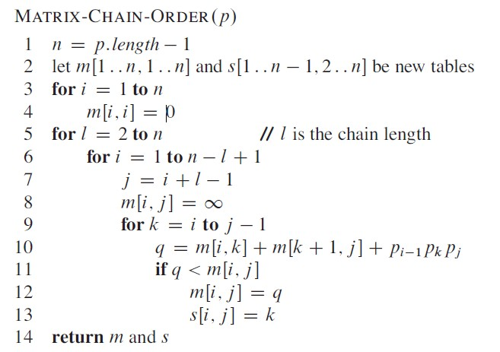
Implementation

Slide 63
A₁ A₂ A₃ A₄ A₅ A₆ A₇ A₈
l=2
l=3
l=4
l=5
l=6
l=7
l=8

Slide 64

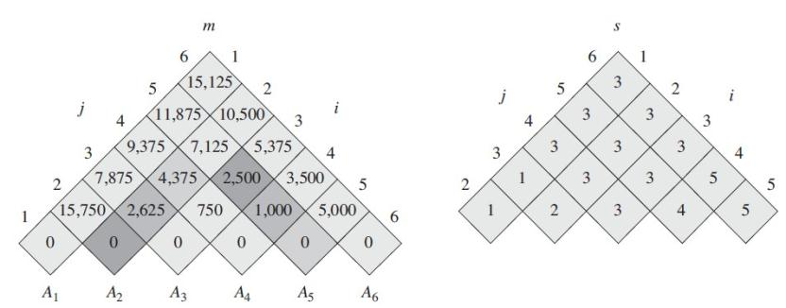
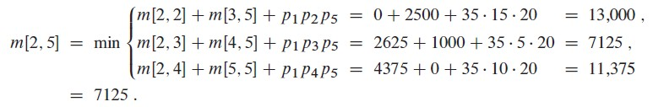
Applying dynamic programming
s[2,5] = 3

Slide 65
Analysis
The array s[i, j] is used to extract the actual sequence (see next).
There are 3 nested loops and each can iterate at most n times, so the total running time is Θ(n³).
For A₁*A₂…*A_{n-1}*A_{n}, How many different sub-problems ?

Slide 66
Extracting Optimum Sequence
Leave a split marker indicating where the best split is (i.e. the value of k leading to minimum values of m[i, j]). We maintain a parallel array s[i, j] in which we store the value of k providing the optimal split.
If s[i, j] = k, the best way to multiply the sub-chain A_{i…j} is to first multiply the sub-chain A_{i…k} and then the sub-chain A_{k+1…j} , and finally multiply them together. Intuitively s[i, j] tells us what multiplication to perform last. We only need to store s[i, j] if we have at least 2 matrices & j > i.

Slide 67
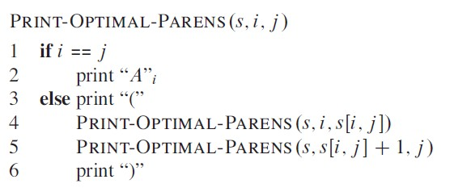
Constructing optimal solution

Slide 68
Mult (A, i, j)
1. if (j > i)
2. then k = s[i, j]
3. X = Mult(A, i, k) // X = A[i]...A[k]
4. Y = Mult(A, k+1, j) // Y = A[k+1]...A[j]
5. return X*Y // Multiply X*Y
6. else return A[i] // Return ith matrix

Slide 69
Exercise in Class
20 X 30 30 x 35 35 x 10 10 x 20 20 x 15 15 x 25

Slide 70
Finding a Recursive Solution
Figure out the “top-level” choice you have to make (e.g., where to split the list of matrices)
List the options for that decision
Each option should require smaller sub-problems to be solved
Recursive function is the minimum (or max) over all the options
m[i, j] = min_{i ≤ k < j} (m[i, k] + m[k+1, j] + p_{i-1}p_{k}p_{j} )

Slide 71
Steps in DP: Step 1
Think what decision is the “last piece in the puzzle”
Where to place the outermost parentheses in a matrix chain multiplication
(A₁) (A₂ A₃ A₄)
(A₁ A₂) (A₃ A₄)
(A₁ A₂ A₃) (A₄)

Slide 72
DP Step 2
Ask what subproblem(s) would have to be solved to figure out how good your choice is
How to multiply the two groups of matrices, e.g., this one (A₁) (trivial) and this one (A₂ A₃ A₄)

Slide 73
DP Step 3
Write down a formula for the “goodness” of the best choice
m[i, j] = min_{i ≤ k < j} (m[i, k] + m[k+1, j] + p_{i-1}p_{k}p_{j} )

Slide 74
DP Step 4
Arrange subproblems in order from small to large and solve each one, keeping track of the solutions for use when needed
Need 2 tables
One tells you value of the solution to each subproblem
Other tells you last option you chose for the solution to each subproblem

Slide 75
Matrix-Chain-Order(p)
1. n ← length[p] - 1
2. for i ← 1 to n // initialization: O(n) time
3. do m[i, i] ← 0
4. for L ← 2 to n // L = length of sub-chain
5. do for i ← 1 to n - L+1
6. do j ← i + L - 1
7. m[i, j] ← ∞
8. for k ← i to j - 1
9. do q ← m[i, k] + m[k+1, j] + p_{i-1} p_{k} p_{j}
10. if q < m[i, j]
11. then m[i, j] ← q
12. s[i, j] ← k
13. return m and s

Slide 76
Homework
CLRS 15.2-1

Slide 77
Elements of Dynamic Programming
Optimal substructure
Overlapping subproblems

Slide 78
Optimal Substructure
Show that a solution to a problem consists of making a choice, which leaves one or more subproblems to solve.
Suppose that you are given this last choice that leads to an optimal solution.
Given this choice, determine which subproblems arise and how to characterize the resulting space of subproblems.
Show that the solutions to the subproblems used within the optimal solution must themselves be optimal. Usually use cut-and-paste.
Need to ensure that a wide enough range of choices and subproblems are considered.

Slide 79
Optimal Substructure
Optimal substructure varies across problem domains:
1. How many subproblems are used in an optimal solution.
2. How many choices in determining which subproblem(s) to use.
Informally, running time depends on (# of subproblems overall) × (# of choices).
How many subproblems and choices do the examples considered contain?
Dynamic programming uses optimal substructure bottom up.
First find optimal solutions to subproblems.
Then choose which to use in optimal solution to the problem.

Slide 80
Optimal Substucture
Does optimal substructure apply to all optimization problems? No.
Applies to determining the shortest path but NOT the longest simple path of an unweighted directed graph.
Why?
Shortest path has independent subproblems.
Solution to one subproblem does not affect solution to another subproblem of the same problem.
Subproblems are not independent in longest simple path.
Solution to one subproblem affects the solutions to other subproblems.

Slide 81
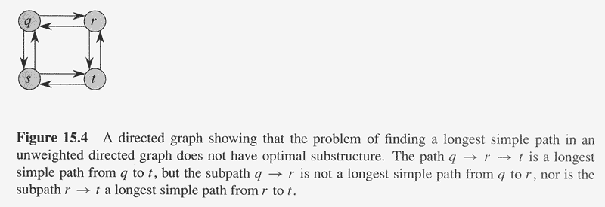

Slide 82
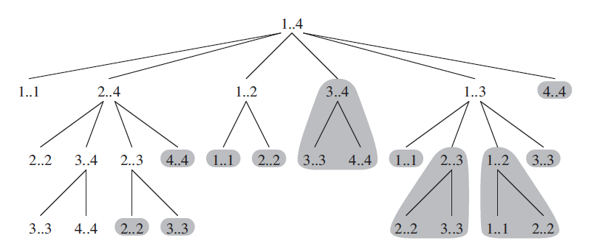
Overlapping Subproblems
The space of subproblems must be “small”.
The total number of distinct subproblems is a polynomial in the input size.
A recursive algorithm is exponential because it solves the same problems repeatedly.
If divide-and-conquer is applicable, then each problem solved will be brand new.

Slide 83
Dynamic Programming
Similar to divide-and-conquer, it breaks problems down into smaller problems that are solved recursively.
In contrast, DP is applicable when the sub-problems are not independent, i.e. when sub-problems share sub-sub-problems. It solves every sub-sub-problem just once and save the results in a table to avoid duplicated computation.

Slide 84
Elements of DP Algorithms
Sub-structure: decompose problem into smaller sub-problems. Express the solution of the original problem in terms of solutions for smaller problems.
Table-structure: Store the answers to the sub-problem in a table, because sub-problem solutions may be used many times.
Bottom-up computation: combine solutions on smaller sub-problems to solve larger sub-problems, and eventually arrive at a solution to the complete problem.

Slide 85
Applicability to Optimization Problems
Optimal sub-structure (principle of optimality): for the global problem to be solved optimally, each sub-problem should be solved optimally. This is often violated due to sub-problem overlaps. Often by being “less optimal” on one problem, we may make a big savings on another sub-problem.
Small number of sub-problems: Many NP-hard problems can be formulated as DP problems, but these formulations are not efficient, because the number of sub-problems is exponentially large. Ideally, the number of sub-problems should be at most a polynomial number.

Slide 86
Homework
CLRS 15.3-2
CLRS 15.3-3

Slide 87
Longest Common Subsequence
Problem: Given 2 sequences, X = ⟨x₁,...,x_{m}⟩ and Y = ⟨y₁,...,y_{n}⟩, find a common subsequence whose length is maximum.
springtime ncaa tournament basketball
printing north carolina snoeyink
Subsequence need not be consecutive, but must be in order.

Slide 88
Naïve Algorithm
For every subsequence of X, check whether it’s a subsequence of Y .
Time: Θ(n2^{m}).
2^{m} subsequences of X to check.
Each subsequence takes Θ(n) time to check: scan Y for first letter, for second, and so on.

Slide 89
Optimal Substructure
Theorem
Let Z = ⟨z₁, . . . , z_{k}⟩ be any LCS of X and Y .
1. If x_{m} = y_{n}, then z_{k} = x_{m} = y_{n} and Z_{k-1} is an LCS of X_{m-1} and Y_{n-1}.
2. If x_{m} ≠ y_{n}, then either z_{k} ≠ x_{m} and Z is an LCS of X_{m-1} and Y .
3. or z_{k} ≠ y_{n} and Z is an LCS of X and Y_{n-1}.
Notation:
prefix X_{i} = ⟨x₁,...,x_{i}⟩ is the first i letters of X.
This says what any longest common subsequence must look like; do you believe it?

Slide 90
Optimal Substructure
Theorem
Let Z = ⟨z₁, . . . , z_{k}⟩ be any LCS of X and Y .
1. If x_{m} = y_{n}, then z_{k} = x_{m} = y_{n} and Z_{k-1} is an LCS of X_{m-1} and Y_{n-1}.
2. If x_{m} ≠ y_{n}, then either z_{k} ≠ x_{m} and Z is an LCS of X_{m-1} and Y .
3. or z_{k} ≠ y_{n} and Z is an LCS of X and Y_{n-1}.
Proof: (case 1: x_{m} = y_{n})

Slide 91
Optimal Substructure
Theorem
Let Z = ⟨z₁, . . . , z_{k}⟩ be any LCS of X and Y .
1. If x_{m} = y_{n}, then z_{k} = x_{m} = y_{n} and Z_{k-1} is an LCS of X_{m-1} and Y_{n-1}.
2. If x_{m} ≠ y_{n}, then either z_{k} ≠ x_{m} and Z is an LCS of X_{m-1} and Y .
3. or z_{k} ≠ y_{n} and Z is an LCS of X and Y_{n-1}.
Proof: (case 1: x_{m} = y_{n})
Any sequence Z’ that does not end in x_{m} = y_{n} can be made longer by adding x_{m} = y_{n} to the end. Therefore,
longest common subsequence (LCS) Z must end in x_{m} = y_{n}.
Z_{k-1} is a common subsequence of X_{m-1} and Y_{n-1}, and
there is no longer CS of X_{m-1} and Y_{n-1}, or Z would not be an LCS.

Slide 92
Optimal Substructure
Theorem
Let Z = ⟨z₁, . . . , z_{k}⟩ be any LCS of X and Y .
1. If x_{m} = y_{n}, then z_{k} = x_{m} = y_{n} and Z_{k-1} is an LCS of X_{m-1} and Y_{n-1}.
2. If x_{m} ≠ y_{n}, then either z_{k} ≠ x_{m} and Z is an LCS of X_{m-1} and Y .
3. or z_{k} ≠ y_{n} and Z is an LCS of X and Y_{n-1}.
Proof: (case 2: x_{m} ≠ y_{n}, and z_{k} ≠ x_{m})

Slide 93
Optimal Substructure
Theorem
Let Z = ⟨z₁, . . . , z_{k}⟩ be any LCS of X and Y .
1. If x_{m} = y_{n}, then z_{k} = x_{m} = y_{n} and Z_{k-1} is an LCS of X_{m-1} and Y_{n-1}.
2. If x_{m} ≠ y_{n}, then either z_{k} ≠ x_{m} and Z is an LCS of X_{m-1} and Y .
3. or z_{k} ≠ y_{n} and Z is an LCS of X and Y_{n-1}.
Proof: (case 2: x_{m} ≠ y_{n}, and z_{k} ≠ x_{m})
Since Z does not end in x_{m},
Z is a common subsequence of X_{m-1} and Y, and
there is no longer CS of X_{m-1} and Y, or Z would not be an LCS.

Slide 94
Recursive Solution
Define c[i, j] = length of LCS of X_{i} and Y_{j} .
We want c[m,n].
This gives a recursive algorithm and solves the problem. But does it solve it well?

Slide 95
Recursive Solution
c[springtime, printing]

Slide 96
Recursive Solution
c[springtime, printing]

Slide 97
Recursive Solution
c[springtime, printing]
c[springtim, printing] c[springtime, printin]

Slide 98
Recursive Solution
c[springtime, printing]
c[springtim, printing] c[springtime, printin]

Slide 99
Recursive Solution
c[springtime, printing]
c[springtim, printing] c[springtime, printin]
[springti, printing] [springtim, printin] [springtim, printin] [springtime, printi]

Slide 100
Recursive Solution
c[springtime, printing]
c[springtim, printing] c[springtime, printin]
[springti, printing] [springtim, printin] [springtim, printin] [springtime, printi]

Slide 101
Recursive Solution
c[springtime, printing]
c[springtim, printing] c[springtime, printin]
[springti, printing] [springtim, printin] [springtim, printin] [springtime, printi]

Slide 102
Recursive Solution
c[springtime, printing]
c[springtim, printing] c[springtime, printin]
[springti, printing] [springtim, printin] [springtim, printin] [springtime, printi]
[springt, printing] [springti, printin] [springtim, printi] [springtime, print]

Slide 103
Recursive Solution
 |  | p | r | i | n | t | i | n | g
s
p
r
i
n
g
t
i
m
e
Keep track of c[α,β] in a table of nm entries:
top/down
bottom/up

Slide 104
Computing the length of an LCS
LCS-LENGTH (X, Y)
m ← length[X]
n ← length[Y]
for i ← 1 to m
do c[i, 0] ← 0
for j ← 0 to n
do c[0, j ] ← 0
for i ← 1 to m
do for j ← 1 to n
do if x_{i} = y_{j}
then c[i, j ] ← c[i−1, j−1] + 1
b[i, j ] ← “ ”
else if c[i−1, j ] ≥ c[i, j−1]
then c[i, j ] ← c[i− 1, j ]
b[i, j ] ← “↑”
else c[i, j ] ← c[i, j−1]
b[i, j ] ← “←”
return c and b
b[i, j ] points to table entry whose subproblem we used in solving LCS of X_{i} and Y_{j}.
c[m,n] contains the length of an LCS of X and Y.
Time: O(mn)

Slide 105
Constructing an LCS
PRINT-LCS (b, X, i, j)
if i = 0 or j = 0
then return
if b[i, j ] = “ ”
then PRINT-LCS(b, X, i−1, j−1)
print x_{i}
elseif b[i, j ] = “↑”
then PRINT-LCS(b, X, i−1, j)
else PRINT-LCS(b, X, i, j−1)
Initial call is PRINT-LCS (b, X,m, n).
When b[i, j ] = , we have extended LCS by one character. So LCS = entries with in them.
Time: O(m+n)

Slide 106
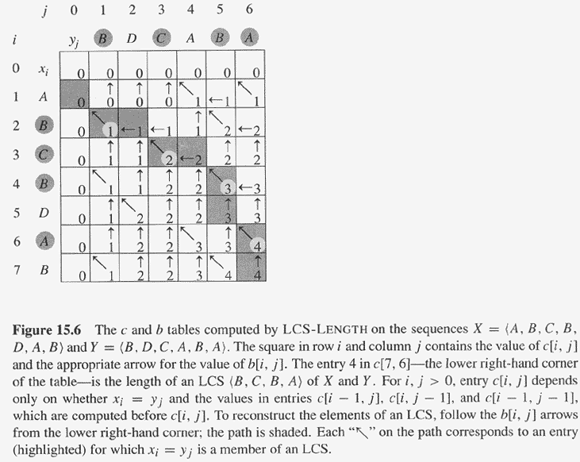
Copyright © The McGraw-Hill Companies, Inc. Permission required for reproduction or display.

Slide 107
Homework
CLRS 15.4-1
CLRS 15.4-3

Slide 108
Dynamic Programming

Slide 109
Dynamic Programming
Problem:
The Palmia country is divided by a river into the north and south bank. There are N towns on both the north and south bank. Each town on the north bank has its unique friend town on the south bank. No two towns have the same friend. Each pair of friend towns would like to have a ship line connecting them. They applied for permission to the government. Because it is often foggy on the river the government decided to prohibit intersection of ship lines (if two lines intersect there is a high probability of ship crash).

Slide 110
Dynamic Programming

Slide 111
Dynamic Programming
Problem (in mathematical terms)
There exists a sequences a_{1,}, a₂,… a_{n} and
b_{1,},b₂,… b_{n} such that
a_{s} < a_{j} if s<j
b_{s} < b_{j} if s<j
for each s, there exists a s’ such that a_{s} and b_{s’} connected.
Find the maximum value m such that there exist x₁ <x₂<x₃ <… x_{m.} m<=n such that
b_{x0’} < b_{x1’}<b_{x2’}<…. b_{xm’}

Slide 112
Dynamic Programming
Example Problem
a: 2 4 9 10 15 17 22
b: 2 3 4 6 8 12 17

Slide 113
Dynamic Programming
Example Problem
a: 2 4 9 10 15 17 22
b: 2 3 4 6 8 12 17

Slide 114
Dynamic Programming

Slide 115
Dynamic Programming
Simple Brute Force Algorithm

Slide 116
Dynamic Programming
Simple Brute Force Algorithm
Pick all possible sets of routes.

Slide 117
Dynamic Programming
Simple Brute Force Algorithm
Pick all possible sets of routes.
Check if selection of routes is valid

Slide 118
Dynamic Programming

Slide 119
Dynamic Programming
Simple Brute Force Algorithm (Analysis)

Slide 120
Dynamic Programming
Simple Brute Force Algorithm (Analysis)
Pick all possible sets of routes. …. O(2^{n)} possible routes

Slide 121
Dynamic Programming
Simple Brute Force Algorithm (Analysis)
Pick all possible sets of routes. …. O(2^{n)} possible routes
Check if selection of routes is valid… O(n) time to check

Slide 122
Dynamic Programming
Simple Brute Force Algorithm (Analysis)
Pick all possible sets of routes. …. O(2^{n)} possible routes
Check if selection of routes is valid… O(n) time to check
In total will take O(2^{n} * n) time.

Slide 123
Dynamic Programming
Simple Brute Force Algorithm (Analysis)
Pick all possible sets of routes. …. O(2^{n)} possible routes
Check if selection of routes is valid… O(n) time to check
In total will take O(2^{n} * n) time.
EXPONENTIAL TIME = SLOW!!!!!

Slide 124
Dynamic Programming

Slide 125
Dynamic Programming
Elegant Solution

Slide 126
Dynamic Programming
Elegant Solution
Let c(i,j) be the maximum possible routes using the first i sequences in a, and j sequences in b.

Slide 127
Dynamic Programming
Elegant Solution
Let c(i,j) be the maximum possible routes using the first i sequences in a, and j sequences in b.
We notice that c(I,j) is connected to c(i-1,j), c(i,j-1) and c(i-1,j-1).

Slide 128
Dynamic Programming
RULE 1 of Dynamic Programing

Slide 129
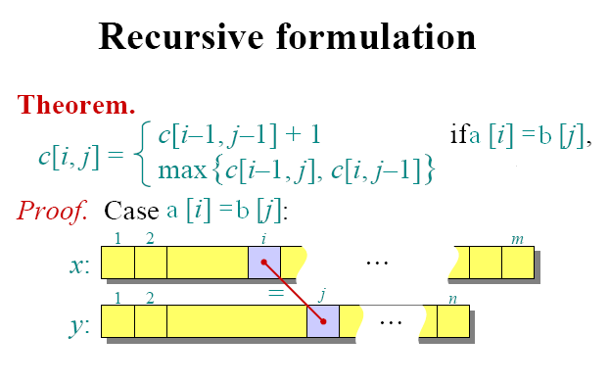
Dynamic Programming
We notice that if a[i] = b[j] (connected), then we can use them in our solution and
optimal solution becomes c[i-1,j-1]+1(because we just used a new route). In all other cases, we just consider the case where we do not use b[j] (i.e c[i,j-1])
or we do not use a[i] (i.e c[i-1,j]

Slide 130
Another example: Sequence partitioning
[solve in class]
Sequence of n tasks to do in order
Let amount of work per task be s₁, s₂, … s_{n}
Divide into k shifts so that no shift gets too much work
i.e., minimize the max amount of work on any shift

Slide 131
Another example: Sequence partitioning
[solve in class]
Sequence of n tasks to do in order
Let amount of work per task be s₁, s₂, … s_{n}
Divide into k shifts so that no shift gets too much work
i.e., minimize the max amount of work on any shift
Note: solution at http://snipurl.com/23c2xrn

Slide 132
Another example: Sequence partitioning
[solve in class]
Sequence of n tasks to do in order
Let amount of work per task be s₁, s₂, … s_{n}
Divide into k shifts so that no shift gets too much work
i.e., minimize the max amount of work on any shift
Note: solution at http://snipurl.com/23c2xrn
What is the runtime? Can we improve it?

Slide 133
Another example: Sequence partitioning
[solve in class]
Sequence of n tasks to do in order
Let amount of work per task be s₁, s₂, … s_{n}
Divide into k shifts so that no shift gets too much work
i.e., minimize the max amount of work on any shift
Note: solution at http://snipurl.com/23c2xrn
What is the runtime? Can we improve it?
Variant: Could use more than k shifts, but an extra cost for adding each extra shift

Slide 134
Another example: Sequence partitioning Divide sequence of n=9 tasks into k=4 shifts – need to place 3 boundaries
Branch and bound: place 3rd boundary, then 2nd, then 1st
5 2 3 7 6 8 1 9
600.325/425 Declarative Methods - J. Eisner
134
Notes:
134

Slide 135
Another example: Sequence partitioning Divide sequence of n=9 tasks into k=4 shifts – need to place 3 boundaries
Branch and bound: place 3rd boundary, then 2nd, then 1st
5 2 3 7 6 8 1 9
5 2 3 7 6 8 1 9|
5 2 3 7 6 8 1|9
5 2 3 7 6 8|1 9
5 2 3 7 6|8 1 9
…
600.325/425 Declarative Methods - J. Eisner
135
Notes:
135

Slide 136
Another example: Sequence partitioning Divide sequence of n=9 tasks into k=4 shifts – need to place 3 boundaries
Branch and bound: place 3rd boundary, then 2nd, then 1st
5 2 3 7 6 8 1 9
5 2 3 7 6 8 1 9|
5 2 3 7 6 8 1|9
5 2 3 7 6 8|1 9
5 2 3 7 6|8 1 9
…
…
5 2 3 7 6|8 1|9
5 2 3 7|6 8 1|9
…
600.325/425 Declarative Methods - J. Eisner
136
Notes:
136

Slide 137
Another example: Sequence partitioning Divide sequence of n=9 tasks into k=4 shifts – need to place 3 boundaries
Branch and bound: place 3rd boundary, then 2nd, then 1st
5 2 3 7 6 8 1 9
5 2 3 7 6 8 1 9|
5 2 3 7 6 8 1|9
5 2 3 7 6 8|1 9
5 2 3 7 6|8 1 9
…
…
5 2 3 7 6|8 1|9
5 2 3 7|6 8 1|9
…
…
5 2 3|7 6|8 1|9
…
…
600.325/425 Declarative Methods - J. Eisner
137
Notes:
137

Slide 138
Another example: Sequence partitioning Divide sequence of n=9 tasks into k=4 shifts – need to place 3 boundaries
Branch and bound: place 3rd boundary, then 2nd, then 1st
5 2 3 7 6 8 1 9
5 2 3 7 6 8 1 9|
5 2 3 7 6 8 1|9
5 2 3 7 6 8|1 9
5 2 3 7 6|8 1 9
…
…
5 2 3 7 6|8 1|9
5 2 3 7|6 8 1|9
…
…
5 2 3|7 6|8 1|9
…
…
Longest shift has length 13
600.325/425 Declarative Methods - J. Eisner
138
Notes:
138

Slide 139
Another example: Sequence partitioning Divide sequence of n=9 tasks into k=4 shifts – need to place 3 boundaries
Branch and bound: place 3rd boundary, then 2nd, then 1st
5 2 3 7 6 8 1 9
5 2 3 7 6 8 1 9|
5 2 3 7 6 8 1|9
5 2 3 7 6 8|1 9
5 2 3 7 6|8 1 9
…
…
5 2 3 7 6|8 1|9
5 2 3 7|6 8 1|9
…
…
5 2 3|7 6|8 1|9
5 2|3 7|6 8 1|9
…
…
…
Longest shift has length 13
600.325/425 Declarative Methods - J. Eisner
139
Notes:
139

Slide 140
Another example: Sequence partitioning Divide sequence of n=9 tasks into k=4 shifts – need to place 3 boundaries
Branch and bound: place 3rd boundary, then 2nd, then 1st
5 2 3 7 6 8 1 9
5 2 3 7 6 8 1 9|
5 2 3 7 6 8 1|9
5 2 3 7 6 8|1 9
5 2 3 7 6|8 1 9
…
…
5 2 3 7 6|8 1|9
5 2 3 7|6 8 1|9
…
…
5 2 3|7 6|8 1|9
5 2|3 7|6 8 1|9
…
…
…
Longest shift has length 13
Longest shift has length 15
600.325/425 Declarative Methods - J. Eisner
140
Notes:
140

Slide 141
Another example: Sequence partitioning Divide sequence of n=9 tasks into k=4 shifts – need to place 3 boundaries
Branch and bound: place 3rd boundary, then 2nd, then 1st
5 2 3 7 6 8 1 9
5 2 3 7 6 8 1 9|
5 2 3 7 6 8 1|9
5 2 3 7 6 8|1 9
5 2 3 7 6|8 1 9
…
…
5 2 3 7 6|8 1|9
5 2 3 7|6 8 1|9
…
…
5 2 3 7 6|8|1 9
5 2 3 7|6 8|1 9
…
…
5 2 3|7 6|8 1|9
5 2|3 7|6 8 1|9
…
…
…
Longest shift has length 13
Longest shift has length 15
600.325/425 Declarative Methods - J. Eisner
141
Notes:
141

Slide 142
Another example: Sequence partitioning Divide sequence of n=9 tasks into k=4 shifts – need to place 3 boundaries
Branch and bound: place 3rd boundary, then 2nd, then 1st
5 2 3 7 6 8 1 9
5 2 3 7 6 8 1 9|
5 2 3 7 6 8 1|9
5 2 3 7 6 8|1 9
5 2 3 7 6|8 1 9
…
…
5 2 3 7 6|8 1|9
5 2 3 7|6 8 1|9
…
…
5 2 3 7 6|8|1 9
5 2 3 7|6 8|1 9
…
…
5 2 3|7 6|8 1|9
5 2|3 7|6 8 1|9
5 2 3|7 6|8|1 9
…
…
…
…
…
…
Longest shift has length 13
Longest shift has length 15
600.325/425 Declarative Methods - J. Eisner
142
Notes:
142

Slide 143
Another example: Sequence partitioning Divide sequence of n=9 tasks into k=4 shifts – need to place 3 boundaries
Branch and bound: place 3rd boundary, then 2nd, then 1st
5 2 3 7 6 8 1 9
5 2 3 7 6 8 1 9|
5 2 3 7 6 8 1|9
5 2 3 7 6 8|1 9
5 2 3 7 6|8 1 9
…
…
5 2 3 7 6|8 1|9
5 2 3 7|6 8 1|9
…
…
5 2 3 7 6|8|1 9
5 2 3 7|6 8|1 9
…
…
5 2 3|7 6|8 1|9
5 2|3 7|6 8 1|9
5 2 3|7 6|8|1 9
…
…
…
…
…
…
Longest shift has length 13
Longest shift has length 15
Longest shift has length 13
600.325/425 Declarative Methods - J. Eisner
143
Notes:
143

Slide 144
Another example: Sequence partitioning Divide sequence of n=9 tasks into k=4 shifts – need to place 3 boundaries
Branch and bound: place 3rd boundary, then 2nd, then 1st
5 2 3 7 6 8 1 9
5 2 3 7 6 8 1 9|
5 2 3 7 6 8 1|9
5 2 3 7 6 8|1 9
5 2 3 7 6|8 1 9
…
can prune: already know longest shift ≥ 18
…
5 2 3 7 6|8 1|9
5 2 3 7|6 8 1|9
…
…
5 2 3 7 6|8|1 9
5 2 3 7|6 8|1 9
…
…
5 2 3|7 6|8 1|9
5 2|3 7|6 8 1|9
5 2 3|7 6|8|1 9
…
…
…
…
…
…
Longest shift has length 13
Longest shift has length 15
Longest shift has length 13
600.325/425 Declarative Methods - J. Eisner
144
Notes:
144

Slide 145
Another example: Sequence partitioning Divide sequence of n=9 tasks into k=4 shifts – need to place 3 boundaries
Branch and bound: place 3rd boundary, then 2nd, then 1st
5 2 3 7 6 8 1 9
5 2 3 7 6 8 1 9|
5 2 3 7 6 8 1|9
5 2 3 7 6 8|1 9
5 2 3 7 6|8 1 9
…
can prune: already know longest shift ≥ 18
…
5 2 3 7 6|8 1|9
5 2 3 7|6 8 1|9
…
…
5 2 3 7 6|8|1 9
5 2 3 7|6 8|1 9
…
can prune: already know longest shift ≥ 14
…
5 2 3|7 6|8 1|9
5 2|3 7|6 8 1|9
5 2 3|7 6|8|1 9
…
…
…
…
…
…
Longest shift has length 13
Longest shift has length 15
Longest shift has length 13
600.325/425 Declarative Methods - J. Eisner
145
Notes:
145

Slide 146
Another example: Sequence partitioning Divide sequence of n=9 tasks into k=4 shifts – need to place 3 boundaries
Branch and bound: place 3rd boundary, then 2nd, then 1st
5 2 3 7 6 8 1 9
5 2 3 7 6 8 1 9|
5 2 3 7 6 8 1|9
5 2 3 7 6 8|1 9
5 2 3 7 6|8 1 9
…
can prune: already know longest shift ≥ 18
…
5 2 3 7 6|8 1|9
5 2 3 7|6 8 1|9
…
…
5 2 3 7 6|8|1 9
5 2 3 7|6 8|1 9
…
can prune: already know longest shift ≥ 14
…
5 2 3|7 6|8 1|9
5 2|3 7|6 8 1|9
5 2 3|7 6|8|1 9
…
…
…
…
…
…
Longest shift has length 13
Longest shift has length 15
Longest shift has length 13
600.325/425 Declarative Methods - J. Eisner
146
Notes:
146

Slide 147
Another example: Sequence partitioning Divide sequence of n=9 tasks into k=4 shifts – need to place 3 boundaries
Branch and bound: place 3rd boundary, then 2nd, then 1st
5 2 3 7 6 8 1 9
5 2 3 7 6 8 1 9|
5 2 3 7 6 8 1|9
5 2 3 7 6 8|1 9
5 2 3 7 6|8 1 9
…
can prune: already know longest shift ≥ 18
…
5 2 3 7 6|8 1|9
5 2 3 7|6 8 1|9
…
…
5 2 3 7 6|8|1 9
5 2 3 7|6 8|1 9
…
can prune: already know longest shift ≥ 14
…
5 2 3|7 6|8 1|9
5 2|3 7|6 8 1|9
5 2 3|7 6|8|1 9
…
…
…
…
…
…
Longest shift has length 13
Longest shift has length 15
Longest shift has length 13
These are really solving the same subproblem (n=5, k=2)
600.325/425 Declarative Methods - J. Eisner
147
Notes:
147

Slide 148
Another example: Sequence partitioning Divide sequence of n=9 tasks into k=4 shifts – need to place 3 boundaries
Branch and bound: place 3rd boundary, then 2nd, then 1st
5 2 3 7 6 8 1 9
5 2 3 7 6 8 1 9|
5 2 3 7 6 8 1|9
5 2 3 7 6 8|1 9
5 2 3 7 6|8 1 9
…
can prune: already know longest shift ≥ 18
…
5 2 3 7 6|8 1|9
5 2 3 7|6 8 1|9
…
…
5 2 3 7 6|8|1 9
5 2 3 7|6 8|1 9
…
can prune: already know longest shift ≥ 14
…
5 2 3|7 6|8 1|9
5 2|3 7|6 8 1|9
5 2 3|7 6|8|1 9
…
…
…
…
…
…
Longest shift has length 13
Longest shift has length 15
Longest shift has length 13
These are really solving the same subproblem (n=5, k=2)
Longest shift in this subproblem = 13
600.325/425 Declarative Methods - J. Eisner
148
Notes:
148

Slide 149
Another example: Sequence partitioning Divide sequence of n=9 tasks into k=4 shifts – need to place 3 boundaries
Branch and bound: place 3rd boundary, then 2nd, then 1st
5 2 3 7 6 8 1 9
5 2 3 7 6 8 1 9|
5 2 3 7 6 8 1|9
5 2 3 7 6 8|1 9
5 2 3 7 6|8 1 9
…
can prune: already know longest shift ≥ 18
…
5 2 3 7 6|8 1|9
5 2 3 7|6 8 1|9
…
…
5 2 3 7 6|8|1 9
5 2 3 7|6 8|1 9
…
can prune: already know longest shift ≥ 14
…
5 2 3|7 6|8 1|9
5 2|3 7|6 8 1|9
5 2 3|7 6|8|1 9
…
…
…
…
…
…
Longest shift has length 13
Longest shift has length 15
Longest shift has length 13
These are really solving the same subproblem (n=5, k=2)
Longest shift in this subproblem = 13
So longest shift in full problem = max(13,9) or max(13,10)
600.325/425 Declarative Methods - J. Eisner
149
Notes:
149

Slide 150
Another example: Sequence partitioning Divide sequence of N tasks into K shifts
int best(N,K): // memoize this!
600.325/425 Declarative Methods - J. Eisner
150
Notes:
150

Slide 151
Another example: Sequence partitioning Divide sequence of N tasks into K shifts
int best(N,K): // memoize this!
if K=0 // have to divide N tasks into 0 shifts
if N=0 then return 0 else return ∞ // impossible for N > 0
600.325/425 Declarative Methods - J. Eisner
151
Notes:
151

Slide 152
Another example: Sequence partitioning Divide sequence of N tasks into K shifts
int best(N,K): // memoize this!
if K=0 // have to divide N tasks into 0 shifts
if N=0 then return 0 else return ∞ // impossible for N > 0
else // consider # of tasks in last shift
bestanswer = ∞ // keep a running minimum here
600.325/425 Declarative Methods - J. Eisner
152
Notes:
152

Slide 153
Another example: Sequence partitioning Divide sequence of N tasks into K shifts
int best(N,K): // memoize this!
if K=0 // have to divide N tasks into 0 shifts
if N=0 then return 0 else return ∞ // impossible for N > 0
else // consider # of tasks in last shift
bestanswer = ∞ // keep a running minimum here
lastshift = 0 // total work currently in last shift
while N ≥ 0 // number of tasks not currently in last shift
bestanswer min= max(best(N,K-1),lastshift)
lastshift += s[N] // move another task into last shift
N = N-1
return bestanswer
600.325/425 Declarative Methods - J. Eisner
153
Notes:
153

Slide 154
Another example: Sequence partitioning Divide sequence of N tasks into K shifts
int best(N,K): // memoize this!
if K=0 // have to divide N tasks into 0 shifts
if N=0 then return 0 else return ∞ // impossible for N > 0
else // consider # of tasks in last shift
bestanswer = ∞ // keep a running minimum here
lastshift = 0 // total work currently in last shift
while N ≥ 0 // number of tasks not currently in last shift
if (lastshift > bestglobalsolution) then break // prune node
bestanswer min= max(best(N,K-1),lastshift)
lastshift += s[N] // move another task into last shift
N = N-1
return bestanswer
600.325/425 Declarative Methods - J. Eisner
154
Notes:
154

Slide 155
Another example: Sequence partitioning Divide sequence of N tasks into K shifts
Dyna version?
600.325/425 Declarative Methods - J. Eisner
155
Notes:
155

Slide 156
Recursive Solution
Define d[n, k] = optimal solution for dividing n tasks into k shifts .
We want d[N,K].
s[i,j]= s[i]+s[i+1]+…+s[j], (s[i,j]=0, if i>j)
This gives a recursive algorithm and solves the problem. But does it solve it well?

Slide 157
Recursive Solution
Define d[n, k] = optimal solution for dividing n tasks into k shifts .
We want d[N,K].
s[i,j]= s[i]+s[i+1]+…+s[j]
This gives a recursive algorithm and solves the problem. But does it solve it well?

Slide 158
Optimal binary search trees
e.g. binary search trees for 3, 7, 9, 12;

Slide 159
Optimal Binary Search Trees
Problem
Given sequence K = k₁ < k₂ <··· < k_{n} of n sorted keys, with a search probability p_{i} for each key k_{i}.
Want to build a binary search tree (BST) with minimum expected search cost.
Actual cost = # of items examined.
For key k_{i}, cost = depth_{T}(k_{i})+1, where depth_{T}(k_{i}) = depth of k_{i} in BST T .

Slide 160
Expected Search Cost
Sum of probabilities is 1.
(1)

Slide 161
Example
Consider 5 keys with these search probabilities: p₁ = 0.25, p₂ = 0.2, p₃ = 0.05, p₄ = 0.2, p₅ = 0.3.
k₂
i depth_{T}(k_{i}) depth_{T}(k_{i})·p_{i}
1 1 0.25
2 0 0
3 2 0.1
4 1 0.2
5 2 0.6
1.15
k₁
k₄
k₃
k₅
Therefore, E[search cost] = 2.15.

Slide 162
Example
p₁ = 0.25, p₂ = 0.2, p₃ = 0.05, p₄ = 0.2, p₅ = 0.3.
k₂
i depth_{T}(k_{i}) depth_{T}(k_{i})·p_{i}
1 1 0.25
2 0 0
3 3 0.15
4 2 0.4
5 1 0.3
1.10
k₁
k₅
k₄
Therefore, E[search cost] = 2.10.
k₃
This tree turns out to be optimal for this set of keys.

Slide 163
Example
Observations:
Optimal BST may not have smallest height.
Optimal BST may not have highest-probability key at root.
Build by exhaustive checking?
Construct each n-node BST.
For each, assign keys and compute expected search cost.
But there are Ω(4^{n}/n^{3/2}) different BSTs with n nodes.

Slide 164
Optimal Substructure
Any subtree of a BST contains keys in a contiguous range k_{i}, ..., k_{j} for some 1 ≤ i ≤ j ≤ n.
If T is an optimal BST and T contains subtree T′ with keys k_{i}, ... ,k_{j} , then T′ must be an optimal BST for keys k_{i}, ..., k_{j}.
Proof: Cut and paste.
T
T′

Slide 165
Optimal Substructure
One of the keys in k_{i}, …,k_{j}, say k_{r}, where i ≤ r ≤ j, must be the root of an optimal subtree for these keys.
Left subtree of k_{r} contains k_{i},...,k_{r−1}.
Right subtree of k_{r} contains k_{r}+1, ...,k_{j}.
To find an optimal BST:
Examine all candidate roots k_{r} , for i ≤ r ≤ j
Determine all optimal BSTs containing k_{i},...,k_{r−1} and containing k_{r+1},...,k_{j}
k_{r}
k_{i}
k_{r-1}
k_{r+1}
k_{j}

Slide 166
Recursive Solution
Find optimal BST for k_{i},...,k_{j}, where i ≥ 1, j ≤ n, j ≥ i−1. When j = i−1, the tree is empty.
Define e[i, j ] = expected search cost of optimal BST for k_{i},...,k_{j}.
If j = i−1, then e[i, j ] = 0.
If j ≥ i,
Select a root k_{r}, for some i ≤ r ≤ j .
Recursively make an optimal BSTs
for k_{i},..,k_{r−1} as the left subtree, and
for k_{r+1},..,k_{j} as the right subtree.

Slide 167
Recursive Solution
When the OPT subtree becomes a subtree of a node:
Depth of every node in OPT subtree goes up by 1.
Expected search cost increases by
If k_{r} is the root of an optimal BST for k_{i},..,k_{j} :
e[i, j ] = p_{r} + (e[i, r−1] + w(i, r−1))+(e[r+1, j] + w(r+1, j))
= e[i, r−1] + e[r+1, j] + w(i, j).
But, we don’t know k_{r}. Hence,
from Eq. 1
(because w(i, j)=w(i,r−1) + p_{r} + w(r + 1, j))

Slide 168
Computing an Optimal Solution
For each subproblem (i,j), store:
expected search cost in a table e[1 ..n+1 , 0 ..n]
Will use only entries e[i, j ], where j ≥ i−1.
root[i, j ] = root of subtree with keys k_{i},..,k_{j}, for 1 ≤ i ≤ j ≤ n.
w[1..n+1, 0..n] = sum of probabilities
w[i, i−1] = 0 for 1 ≤ i ≤ n.
w[i, j ] = w[i, j-1] + p_{j} for 1 ≤ i ≤ j ≤ n.

Slide 169
Pseudo-code
OPTIMAL-BST(p, q, n)
for i ← 1 to n + 1
do e[i, i− 1] ← 0
w[i, i− 1] ← 0
for l ← 1 to n
do for i ← 1 to n−l + 1
do j ←i + l−1
e[i, j ]←∞
w[i, j ] ← w[i, j−1] + p_{j}
for r ←i to j
do t ← e[i, r−1] + e[r + 1, j ] + w[i, j ]
if t < e[i, j ]
then e[i, j ] ← t
root[i, j ] ←r
return e and root
Consider all trees with l keys.
Fix the first key.
Fix the last key
Determine the root
of the optimal
(sub)tree
Time: O(n³)

Slide 170
Homework
CLRS 15.5-2

Slide 171
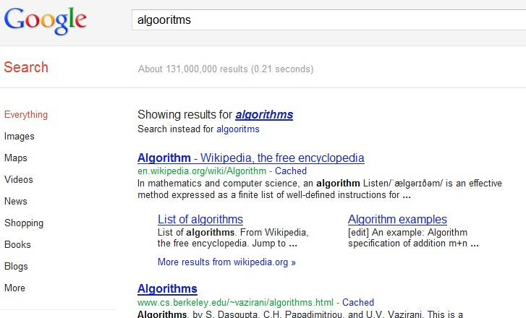
Sequence Alignment
TYPO

Slide 172
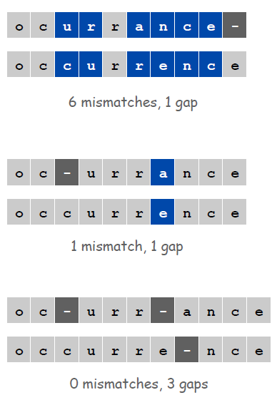
Sequence Alignment
How similar are two strings ?
ocurrance
occurrence

Slide 173
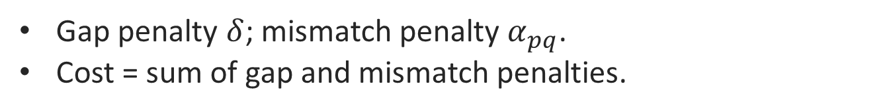
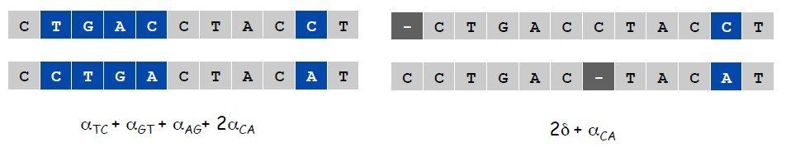
Edit Distance
Applications.
Basis for Unix diff.
Speech recognition.
Computational biology.c
Edit Distance. [Levenshtein 1966, Needleman-Wunsch 1970]

Slide 174
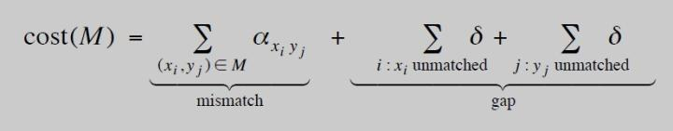
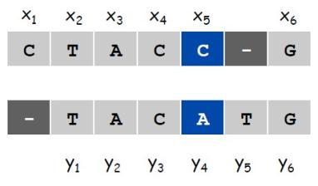

Sequence Alignment
Goal: Given two strings X = x1 x2 . . . xm and Y = y1 y2 . . . yn find
alignment of minimum cost.
Def. An alignment M is a set of ordered pairs xi-yj such that each item occurs in at most one pair and no crossings.
Def. The pair xi-yj and xi'-yj' cross if i < i', but j > j'.

Slide 175
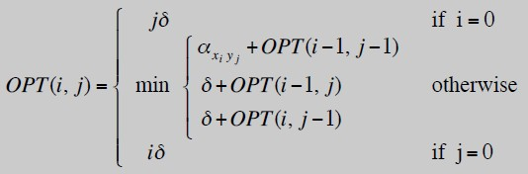
Sequence Alignment: Problem Structure
Def. OPT(i, j) = min cost of aligning strings x1 x2 . . . xi and y1 y2 . . . yj.
Case 1: OPT matches xi-yj.
–pay mismatch for xi-yj + min cost of aligning two strings
x1 x2 . . . xi-1 and y1 y2 . . . yj-1
Case 2a: OPT leaves xi unmatched.
–pay gap for xi and min cost of aligning
x1 x2 . . . xi-1 and y1 y2 . . . Yj
Case 2b: Case 2b: OPT leaves yj unmatched.
–pay gap for yj and min cost of aligning
x1 x2 . . . xi and y1 y2 . . . yj-1

Slide 176
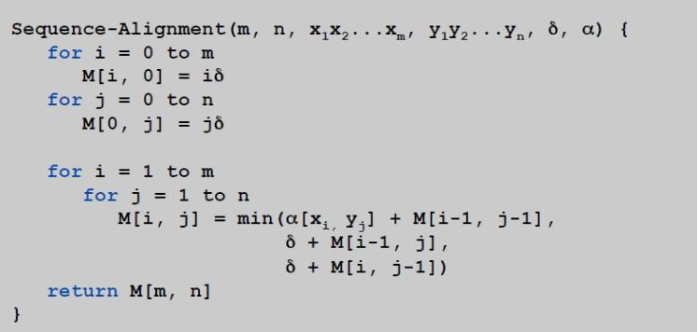
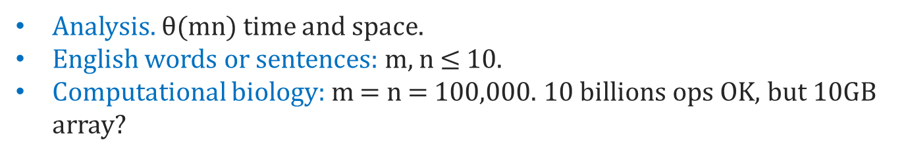
Sequence Alignment: Algorithm
Sequence-Alignment. Fill up an m-by-n array.

Slide 177
（问题）有m排n列的柱桩，每一排的柱桩从左向右标号为1,2,…,n，且在每个柱桩上预先放好价值不一样的宝石。现在有位杂技演员从第一排的第1号柱桩开始跳跃，每次都必须跳到下一排的柱桩上，且每次跳跃最多只能向左或向右移动一个桩子。也就是说如果现在杂技演员站在第j号桩上，那么他可跳到下一排的第j号桩上，也可跳到下一排的第j-1 (if j>1)或者 j+1 (if j<n) 号桩上，并得到桩上的宝石。计算出一条最佳的跳跃顺序，使杂技演员获得的宝石的总价值最大。 （输入） 4 4 （4排4列的柱桩，空格隔开） 1,1, 1, 1 （放在第1排各桩上的宝石价值，逗号隔开） 1, 5, 1, 1 。 2 ,1, 10, 1 。 20 ,1, 1, 1 （放在第4排各桩上的宝石价值） （输出） 28 （最大价值） 1 (开始位置，固定) 2 (在第二排的位置) 1 (在第三排的位置) 1 (在第四排的位置)
Project

Slide 178
要求： a.单人独立完成； b.提交名为 学号_姓名_SA.rar 的压缩文件，含如下内容：1). 完整的源码 2).不依赖于IDE环境的可执行文件及测试数据 3).电子版本项目报告，报告中至少包括对算法思想、递推方程式及该问题的最优子结构性质、程序结构的描述以及计算复杂度分析, 以及测试结果 c. 第15周交（每班统一U盘拷贝) 说明： 1. 不依赖于IDE环境的可执行文件指exe及其支持dll，测试数据均在同一目录中，在任意一台Win XP机器上直接双击exe即可运行。 2. 测试数据不少于20排20列，按照前述的格式放在test.txt文件里，执行结果存入output.txt文件里 参考资料： Algorithm Design, Jon Kleiberg. Eva Tardos, Cornell University
Project

