Slide 1
Algorithm Analysis & Design Introduction to Algorithm
T&R Team of Algorithm Design
College of Computer Science and Engineering, CQU
Notes:
本人是国际视觉电生理学会(ISCEV)的会员。

Slide 2
GREEDY ALGORITHM
16
Locally optimal choice

Slide 3
Overview
Like dynamic programming, used to solve optimization problems.
Dynamic programming can be overkill; greedy algorithms tend to be easier to code
Problems exhibit optimal substructure (like DP).
Problems also exhibit the greedy-choice property.
When we have a choice to make, make the one that looks best right now.
Make a locally optimal choice in hope of getting a globally optimal solution.

Slide 4
Greedy Strategy
The choice that seems best at the moment is the one we go with.
Prove that when there is a choice to make, one of the optimal choices is the greedy choice. Therefore, it’s always safe to make the greedy choice.
Show that all but one of the subproblems resulting from the greedy choice are empty.

Slide 5
Activity-Selection Problem
Problem: get your money’s worth out of a festival
Buy a wristband that lets you onto any ride
Lots of rides, each starting and ending at different times
Your goal: ride as many rides as possible
Another, alternative goal that we don’t solve here: maximize time spent on rides
Welcome to the activity selection problem

Slide 6
Activity-selection Problem
Input: Set S of n activities, a₁, a₂, …, a_{n}.
s_{i} = start time of activity i.
f_{i} = finish time of activity i.
Output: Subset A of maximum number of compatible activities.
Two activities are compatible, if their intervals don’t overlap.
Example:
Activities in each line
are compatible.
2
5
3
6
1
4
7

Slide 7
Optimal Substructure
Assume activities are sorted by finishing times.
f₁ ≤ f₂ ≤ … ≤ f_{n}.
Suppose an optimal solution includes activity a_{k}.
This generates two subproblems.
Selecting from a₁, …, a_{k-1}, activities compatible with one another, and that finish before a_{k} starts (compatible with a_{k}).
Selecting from a_{k+1}, …, a_{n}, activities compatible with one another, and that start after a_{k} finishes.
The solutions to the two subproblems must be optimal.
Prove using the cut-and-paste approach.

Slide 8
Optimal Substructure
Assume activities are sorted by finishing times.
f₁ ≤ f₂ ≤ … ≤ f_{n}.
Suppose an optimal solution includes activity a_{k}.
This generates two subproblems.
Selecting from a₁, …, a_{k-1}, activities compatible with one another, and that finish before a_{k} starts (compatible with a_{k}).
Selecting from a_{k+1}, …, a_{n}, activities compatible with one another, and that start after a_{k} finishes.
The solutions to the two subproblems must be optimal.
Prove using the cut-and-paste approach.

Slide 9
Activity Selection: Repeated Subproblems
Consider a recursive algorithm that tries all possible compatible subsets to find a maximal set, and notice repeated subproblems:
S 1∈A?
yes
no
S’ 2∈A?
S-{1} 2∈A?
yes
no
yes
no
S’’
S’-{2}
S’’
S-{1,2}

Slide 10
Recursive Solution
Let S_{ij} = subset of activities in S that start after a_{i} finishes and finish before a_{j} starts.
Subproblems: Selecting maximum number of mutually compatible activities from S_{ij}.
Let c[i, j] = size of maximum-size subset of mutually compatible activities in S_{ij}.
Recursive
Solution:

Slide 11
Greedy Choice Property
Dynamic programming? Memoize? Yes, but…
Activity selection problem also exhibits the greedy choice property:
Locally optimal choice ⇒ globally optimal sol’n
Them 16.1: if S is an activity selection problem sorted by finish time, then ∃ optimal solution A ⊆ S such that {1} ∈ A
Sketch of proof: if ∃ optimal solution B that does not contain {1}, can always replace first activity in B with {1} (Why?). Same number of activities, thus optimal.

Slide 12
Greedy-choice Property
The problem also exhibits the greedy-choice property.
There is an optimal solution to the subproblem S_{ij}, that includes the activity with the smallest finish time in set S_{ij}.
Can be proved easily.
Hence, there is an optimal solution to S that includes a₁.
Therefore, make this greedy choice without solving subproblems first and evaluating them.
Solve the subproblem that ensues as a result of making this greedy choice.
Combine the greedy choice and the solution to the subproblem.

Slide 13
Recursive Algorithm
Recursive-Activity-Selector (s, f, i, j)
m ← i+1
while m < j and s_{m} < f_{i}
do m ← m+1
if m < j
then return {a_{m}} ∪
Recursive-Activity-Selector(s, f, m, j)
else return φ
Initial Call: Recursive-Activity-Selector (s, f, 0, n+1)
Complexity: Θ(n)
Straightforward to convert the algorithm to an iterative one.

Slide 14
Typical Steps
Cast the optimization problem as one in which we make a choice and are left with one subproblem to solve.
Prove that there’s always an optimal solution that makes the greedy choice, so that the greedy choice is always safe.
Show that greedy choice and optimal solution to subproblem ⇒ optimal solution to the problem.
Make the greedy choice and solve top-down.
May have to preprocess input to put it into greedy order.
Example: Sorting activities by finish time.

Slide 15
Activity Selection: A Greedy Algorithm
So actual algorithm is simple:
Sort the activities by finish time
Schedule the first activity
Then schedule the next activity in sorted list which starts after previous activity finishes
Repeat until no more activities
Intuition is even more simple:
Always pick the shortest ride available at the time

Slide 16
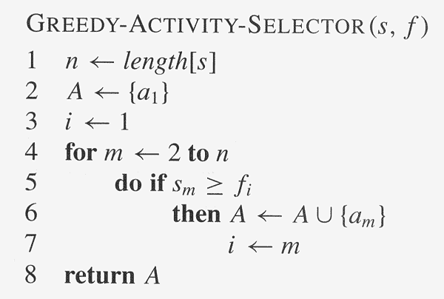
Copyright © The McGraw-Hill Companies, Inc. Permission required for reproduction or display.

Slide 17
Elements of Greedy Algorithms
Greedy-choice Property.
A globally optimal solution can be arrived at by making a locally optimal (greedy) choice.
Optimal Substructure.

Slide 18
Knapsack Problem

Slide 19
The Knapsack Problem
The famous knapsack problem:
A thief breaks into a museum. Fabulous paintings, sculptures, and jewels are everywhere. The thief has a good eye for the value of these objects, and knows that each will fetch hundreds or thousands of dollars on the clandestine art collector’s market. But, the thief has only brought a single knapsack to the scene of the robbery, and can take away only what he can carry. What items should the thief take to maximize the haul?

Slide 20
0-1 Knapsack problem
Given a knapsack with maximum capacity W, and a set S consisting of n items
Each item i has some weight w_{i} and benefit value b_{i} (all w_{i} , b_{i} and W are integer values)
Problem: How to pack the knapsack to achieve maximum total value of packed items?

Slide 21
0-1 Knapsack problem: a picture
Weight
Benefit value
w_{i}
b_{i}
Items
3
2
This is a knapsack
Max weight: W = 20
3
4
4
5
5
8
W = 20
9
10

Slide 22
The Knapsack Problem
More formally, the 0-1 knapsack problem:
The thief must choose among n items, where the ith item worth v_{i} dollars and weighs w_{i} pounds
Carrying at most W pounds, maximize value
Note: assume v_{i}, w_{i}, and W are all integers
“0-1” b/c each item must be taken or left in entirety
A variation, the fractional knapsack problem:
Thief can take fractions of items
Think of items in 0-1 problem as gold ingots, in fractional problem as buckets of gold dust

Slide 23
0-1 Knapsack problem
Problem, in other words, is to find
The problem is called a “0-1” problem, because each item must be entirely accepted or rejected.
Just another version of this problem is the “Fractional Knapsack Problem”, where we can take fractions of items.

Slide 24
0-1 Knapsack problem: brute-force approach
Let’s first solve this problem with a straightforward algorithm
Since there are n items, there are 2^{n} possible combinations of items.
We go through all combinations and find the one with the most total value and with total weight less or equal to W
Running time will be O(2^{n})

Slide 25
0-1 Knapsack problem: brute-force approach
Can we do better?
Yes, with an algorithm based on dynamic programming
We need to carefully identify the subproblems
Let’s try this:
If items are labeled 1..n, then a subproblem
would be to find an optimal solution for
S_{k} = {items labeled 1, 2, .. k}

Slide 26
Defining a Subproblem

Slide 27
Defining a Subproblem
If items are labeled 1..n, then a subproblem would be to find an optimal solution for S_{k} = {items labeled 1, 2, .. k}

Slide 28
Defining a Subproblem
If items are labeled 1..n, then a subproblem would be to find an optimal solution for S_{k} = {items labeled 1, 2, .. k}
This is a valid subproblem definition.

Slide 29
Defining a Subproblem
If items are labeled 1..n, then a subproblem would be to find an optimal solution for S_{k} = {items labeled 1, 2, .. k}
This is a valid subproblem definition.
The question is: can we describe the final solution (S_{n} ) in terms of subproblems (S_{k})?

Slide 30
Defining a Subproblem
If items are labeled 1..n, then a subproblem would be to find an optimal solution for S_{k} = {items labeled 1, 2, .. k}
This is a valid subproblem definition.
The question is: can we describe the final solution (S_{n} ) in terms of subproblems (S_{k})?
Unfortunately, we can’t do that. Explanation follows….

Slide 31
Defining a Subproblem
Weight
Benefit
Item
#
w_{i}
b_{i}
1
2
3
S₄
2
3
4
S₅
3
4
5
4
5
8
5
9
10

Slide 32
Defining a Subproblem
w₁ =2
b₁ =3
w₂ =4
b₂ =5
w₃ =5
b₃ =8
w₄ =3
b₄ =4
Weight
Benefit
Item
#
w_{i}
b_{i}
1
2
3
S₄
2
3
4
S₅
3
4
5
4
5
8
5
9
10

Slide 33
Defining a Subproblem
w₁ =2
b₁ =3
w₂ =4
b₂ =5
w₃ =5
b₃ =8
w₄ =3
b₄ =4
Weight
Benefit
Item
#
w_{i}
b_{i}
1
2
3
Max weight: W = 20
For S₄:
Total weight: 14;
total benefit: 20
S₄
2
3
4
S₅
3
4
5
4
5
8
5
9
10

Slide 34
Defining a Subproblem
w₁ =2
b₁ =3
w₂ =4
b₂ =5
w₃ =5
b₃ =8
w₄ =3
b₄ =4
Weight
Benefit
Item
#
w_{i}
b_{i}
1
2
3
Max weight: W = 20
For S₄:
Total weight: 14;
total benefit: 20
S₄
2
3
4
S₅
3
4
5
4
5
8
5
9
10
w₁ =2
b₁ =3
w₂ =4
b₂ =5
w₃ =5
b₃ =8
w₄ =9
b₄ =10

Slide 35
Defining a Subproblem
w₁ =2
b₁ =3
w₂ =4
b₂ =5
w₃ =5
b₃ =8
w₄ =3
b₄ =4
Weight
Benefit
Item
#
w_{i}
b_{i}
1
2
3
Max weight: W = 20
For S₄:
Total weight: 14;
total benefit: 20
S₄
2
3
4
S₅
3
4
5
4
5
8
5
9
10
w₁ =2
b₁ =3
w₂ =4
b₂ =5
w₃ =5
b₃ =8
w₄ =9
b₄ =10
For S₅:
Total weight: 20
total benefit: 26

Slide 36
Defining a Subproblem
w₁ =2
b₁ =3
w₂ =4
b₂ =5
w₃ =5
b₃ =8
w₄ =3
b₄ =4
Weight
Benefit
Item
#
w_{i}
b_{i}
1
2
3
Max weight: W = 20
For S₄:
Total weight: 14;
total benefit: 20
S₄
2
3
4
S₅
3
4
5
4
5
8
5
9
10
w₁ =2
b₁ =3
w₂ =4
b₂ =5
w₃ =5
b₃ =8
w₄ =9
b₄ =10
Solution for S₄ is not part of the solution for S₅!!!
For S₅:
Total weight: 20
total benefit: 26

Slide 37
Defining a Subproblem
w₁ =2
b₁ =3
w₂ =4
b₂ =5
w₃ =5
b₃ =8
w₄ =3
b₄ =4
Weight
Benefit
Item
#
w_{i}
b_{i}
?
1
2
3
Max weight: W = 20
For S₄:
Total weight: 14;
total benefit: 20
S₄
2
3
4
S₅
3
4
5
4
5
8
5
9
10
w₁ =2
b₁ =3
w₂ =4
b₂ =5
w₃ =5
b₃ =8
w₄ =9
b₄ =10
Solution for S₄ is not part of the solution for S₅!!!
For S₅:
Total weight: 20
total benefit: 26

Slide 38
Defining a Subproblem (continued)
As we have seen, the solution for S₄ is not part of the solution for S₅
So our definition of a subproblem is flawed and we need another one!
Let’s add another parameter: w, which will represent the exact weight for each subset of items
The subproblem then will be to compute B[k,w]

Slide 39
Recursive Formula for subproblems
Recursive formula for subproblems:
It means, that the best subset of S_{k} that has total weight w is one of the two:
1) the best subset of S_{k-1} that has total weight w, or
2) the best subset of S_{k-1} that has total weight w-w_{k} plus the item k

Slide 40
Recursive Formula

Slide 41
Recursive Formula
The best subset of S_{k} that has the total weight w, either contains item k or not.

Slide 42
Recursive Formula
The best subset of S_{k} that has the total weight w, either contains item k or not.
First case: w_{k}>w. Item k can’t be part of the solution, since if it was, the total weight would be > w, which is unacceptable

Slide 43
Recursive Formula
The best subset of S_{k} that has the total weight w, either contains item k or not.
First case: w_{k}>w. Item k can’t be part of the solution, since if it was, the total weight would be > w, which is unacceptable
Second case: w_{k} <=w. Then the item k can be in the solution, and we choose the case with greater value

Slide 44
The Knapsack Problem And Optimal Substructure

Slide 45
The Knapsack Problem And Optimal Substructure
Both variations exhibit optimal substructure

Slide 46
The Knapsack Problem And Optimal Substructure
Both variations exhibit optimal substructure
To show this for the 0-1 problem, consider the most valuable load weighing at most W pounds

Slide 47
The Knapsack Problem And Optimal Substructure
Both variations exhibit optimal substructure
To show this for the 0-1 problem, consider the most valuable load weighing at most W pounds
If we remove item j from the load, what do we know about the remaining load?

Slide 48
The Knapsack Problem And Optimal Substructure
Both variations exhibit optimal substructure
To show this for the 0-1 problem, consider the most valuable load weighing at most W pounds
If we remove item j from the load, what do we know about the remaining load?
A: remainder must be the most valuable load weighing at most W - w_{j} that thief could take from museum, excluding item j

Slide 49
Solving The Knapsack Problem

Slide 50
Solving The Knapsack Problem
The optimal solution to the fractional knapsack problem can be found with a greedy algorithm
How?

Slide 51
Solving The Knapsack Problem
The optimal solution to the fractional knapsack problem can be found with a greedy algorithm
How?
The optimal solution to the 0-1 problem cannot be found with the same greedy strategy
Greedy strategy: take in order of dollars/pound
Example: 3 items weighing 10, 20, and 30 pounds, knapsack can hold 50 pounds
Suppose item 2 is worth $100. Assign values to the other items so that the greedy strategy will fail

Slide 52
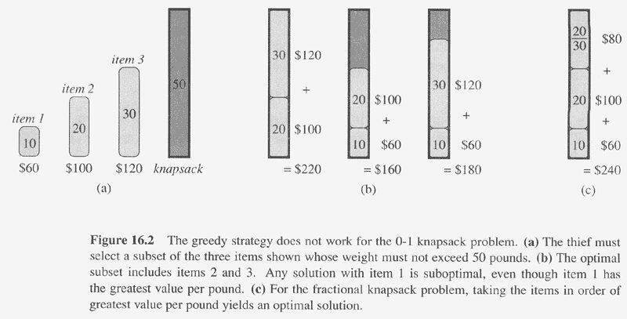
Copyright © The McGraw-Hill Companies, Inc. Permission required for reproduction or display.

Slide 53
The Knapsack Problem: Greedy Vs. Dynamic
The fractional problem can be solved greedily
The 0-1 problem cannot be solved with a greedy approach
As you have seen, however, it can be solved with dynamic programming

Slide 54
0-1 Knapsack Algorithm

Slide 55
0-1 Knapsack Algorithm
for w = 0 to W

Slide 56
0-1 Knapsack Algorithm
for w = 0 to W
B[0,w] = 0

Slide 57
0-1 Knapsack Algorithm
for w = 0 to W
B[0,w] = 0
for i = 0 to n

Slide 58
0-1 Knapsack Algorithm
for w = 0 to W
B[0,w] = 0
for i = 0 to n
B[i,0] = 0

Slide 59
0-1 Knapsack Algorithm
for w = 0 to W
B[0,w] = 0
for i = 0 to n
B[i,0] = 0
for w = 0 to W

Slide 60
0-1 Knapsack Algorithm
for w = 0 to W
B[0,w] = 0
for i = 0 to n
B[i,0] = 0
for w = 0 to W
if w_{i} <= w // item i can be part of the solution

Slide 61
0-1 Knapsack Algorithm
for w = 0 to W
B[0,w] = 0
for i = 0 to n
B[i,0] = 0
for w = 0 to W
if w_{i} <= w // item i can be part of the solution
if b_{i} + B[i-1,w-w_{i}] > B[i-1,w]

Slide 62
0-1 Knapsack Algorithm
for w = 0 to W
B[0,w] = 0
for i = 0 to n
B[i,0] = 0
for w = 0 to W
if w_{i} <= w // item i can be part of the solution
if b_{i} + B[i-1,w-w_{i}] > B[i-1,w]
B[i,w] = b_{i} + B[i-1,w- w_{i}]

Slide 63
0-1 Knapsack Algorithm
for w = 0 to W
B[0,w] = 0
for i = 0 to n
B[i,0] = 0
for w = 0 to W
if w_{i} <= w // item i can be part of the solution
if b_{i} + B[i-1,w-w_{i}] > B[i-1,w]
B[i,w] = b_{i} + B[i-1,w- w_{i}]
else

Slide 64
0-1 Knapsack Algorithm
for w = 0 to W
B[0,w] = 0
for i = 0 to n
B[i,0] = 0
for w = 0 to W
if w_{i} <= w // item i can be part of the solution
if b_{i} + B[i-1,w-w_{i}] > B[i-1,w]
B[i,w] = b_{i} + B[i-1,w- w_{i}]
else
B[i,w] = B[i-1,w]

Slide 65
0-1 Knapsack Algorithm
for w = 0 to W
B[0,w] = 0
for i = 0 to n
B[i,0] = 0
for w = 0 to W
if w_{i} <= w // item i can be part of the solution
if b_{i} + B[i-1,w-w_{i}] > B[i-1,w]
B[i,w] = b_{i} + B[i-1,w- w_{i}]
else
B[i,w] = B[i-1,w]
else B[i,w] = B[i-1,w] // w_{i} > w

Slide 66
Running time
for w = 0 to W
B[0,w] = 0
for i = 0 to n
B[i,0] = 0
for w = 0 to W
< the rest of the code >

Slide 67
Running time
for w = 0 to W
B[0,w] = 0
for i = 0 to n
B[i,0] = 0
for w = 0 to W
< the rest of the code >
What is the running time of this algorithm?

Slide 68
Running time
for w = 0 to W
B[0,w] = 0
for i = 0 to n
B[i,0] = 0
for w = 0 to W
< the rest of the code >
What is the running time of this algorithm?
O(n*W)

Slide 69
Running time
for w = 0 to W
B[0,w] = 0
for i = 0 to n
B[i,0] = 0
for w = 0 to W
< the rest of the code >
O(W)
What is the running time of this algorithm?
O(n*W)

Slide 70
Running time
for w = 0 to W
B[0,w] = 0
for i = 0 to n
B[i,0] = 0
for w = 0 to W
< the rest of the code >
O(W)
O(W)
What is the running time of this algorithm?
O(n*W)

Slide 71
Running time
for w = 0 to W
B[0,w] = 0
for i = 0 to n
B[i,0] = 0
for w = 0 to W
< the rest of the code >
O(W)
Repeat n times
O(W)
What is the running time of this algorithm?
O(n*W)

Slide 72
Running time
for w = 0 to W
B[0,w] = 0
for i = 0 to n
B[i,0] = 0
for w = 0 to W
< the rest of the code >
O(W)
Repeat n times
O(W)
What is the running time of this algorithm?
O(n*W)
Remember that the brute-force algorithm
takes O(2^{n})

Slide 73
Example
Let’s run our algorithm on the
following data:
n = 4 (# of elements)
W = 5 (max weight)
Elements (weight, benefit):
(2,3), (3,4), (4,5), (5,6)

Slide 74
Example (2)
i
0
1
2
3
4
W
0
1
2
3
4
5
for w = 0 to W
B[0,w] = 0

Slide 75
Example (2)
i
0
1
2
3
4
W
0
0
1
2
3
4
5
for w = 0 to W
B[0,w] = 0

Slide 76
Example (2)
i
0
1
2
3
4
W
0
0
1
0
2
3
4
5
for w = 0 to W
B[0,w] = 0

Slide 77
Example (2)
i
0
1
2
3
4
W
0
0
1
0
2
0
3
4
5
for w = 0 to W
B[0,w] = 0

Slide 78
Example (2)
i
0
1
2
3
4
W
0
0
1
0
2
0
3
0
4
5
for w = 0 to W
B[0,w] = 0

Slide 79
Example (2)
i
0
1
2
3
4
W
0
0
1
0
2
0
3
0
4
0
5
for w = 0 to W
B[0,w] = 0

Slide 80
Example (2)
i
0
1
2
3
4
W
0
0
1
0
2
0
3
0
4
0
5
0
for w = 0 to W
B[0,w] = 0

Slide 81
Example (3)
i
0
1
2
3
4
W
0
0
1
0
2
0
3
0
4
0
5
0
for i = 0 to n
B[i,0] = 0

Slide 82
Example (3)
i
0
1
2
3
4
W
0
0
0
1
0
2
0
3
0
4
0
5
0
for i = 0 to n
B[i,0] = 0

Slide 83
Example (3)
i
0
1
2
3
4
W
0
0
0
0
1
0
2
0
3
0
4
0
5
0
for i = 0 to n
B[i,0] = 0

Slide 84
Example (3)
i
0
1
2
3
4
W
0
0
0
0
0
1
0
2
0
3
0
4
0
5
0
for i = 0 to n
B[i,0] = 0

Slide 85
Example (3)
i
0
1
2
3
4
W
0
0
0
0
0
0
1
0
2
0
3
0
4
0
5
0
for i = 0 to n
B[i,0] = 0

Slide 86
Example (4)
i
0
1
2
3
4
W
Items:
1: (2,3)
2: (3,4)
3: (4,5)
4: (5,6)
0
0
0
0
0
0
i=1
b_{i}=3
w_{i}=2
w=1
w-w_{i} =-1
1
0
2
0
3
0
4
0
5
0
if w_{i} <= w // item i can be part of the solution
if b_{i} + B[i-1,w-w_{i}] > B[i-1,w]
B[i,w] = b_{i} + B[i-1,w- w_{i}]
else
B[i,w] = B[i-1,w]
else B[i,w] = B[i-1,w] // w_{i} > w

Slide 87
Example (4)
i
0
1
2
3
4
W
Items:
1: (2,3)
2: (3,4)
3: (4,5)
4: (5,6)
0
0
0
0
0
0
i=1
b_{i}=3
w_{i}=2
w=1
w-w_{i} =-1
1
0
2
0
3
0
4
0
5
0
if w_{i} <= w // item i can be part of the solution
if b_{i} + B[i-1,w-w_{i}] > B[i-1,w]
B[i,w] = b_{i} + B[i-1,w- w_{i}]
else
B[i,w] = B[i-1,w]
else B[i,w] = B[i-1,w] // w_{i} > w

Slide 88
Example (4)
i
0
1
2
3
4
W
Items:
1: (2,3)
2: (3,4)
3: (4,5)
4: (5,6)
0
0
0
0
0
0
i=1
b_{i}=3
w_{i}=2
w=1
w-w_{i} =-1
1
0
0
2
0
3
0
4
0
5
0
if w_{i} <= w // item i can be part of the solution
if b_{i} + B[i-1,w-w_{i}] > B[i-1,w]
B[i,w] = b_{i} + B[i-1,w- w_{i}]
else
B[i,w] = B[i-1,w]
else B[i,w] = B[i-1,w] // w_{i} > w

Slide 89
Example (5)
i
0
1
2
3
4
W
Items:
1: (2,3)
2: (3,4)
3: (4,5)
4: (5,6)
0
0
0
0
0
0
i=1
b_{i}=3
w_{i}=2
w=2
w-w_{i} =0
1
0
0
2
0
3
0
4
0
5
0
if w_{i} <= w // item i can be part of the solution
if b_{i} + B[i-1,w-w_{i}] > B[i-1,w]
B[i,w] = b_{i} + B[i-1,w- w_{i}]
else
B[i,w] = B[i-1,w]
else B[i,w] = B[i-1,w] // w_{i} > w

Slide 90
Example (5)
Items:
1: (2,3)
2: (3,4)
3: (4,5)
4: (5,6)
i
0
1
2
3
4
W
0
0
0
0
0
0
i=1
b_{i}=3
w_{i}=2
w=2
w-w_{i} =0
1
0
0
2
0
3
0
4
0
5
0
if w_{i} <= w // item i can be part of the solution
if b_{i} + B[i-1,w-w_{i}] > B[i-1,w]
B[i,w] = b_{i} + B[i-1,w- w_{i}]
else
B[i,w] = B[i-1,w]
else B[i,w] = B[i-1,w] // w_{i} > w

Slide 91
Example (5)
i
0
1
2
3
4
Items:
1: (2,3)
2: (3,4)
3: (4,5)
4: (5,6)
W
0
0
0
0
0
0
i=1
b_{i}=3
w_{i}=2
w=2
w-w_{i} =0
1
0
0
2
0
3
3
0
4
0
5
0
if w_{i} <= w // item i can be part of the solution
if b_{i} + B[i-1,w-w_{i}] > B[i-1,w]
B[i,w] = b_{i} + B[i-1,w- w_{i}]
else
B[i,w] = B[i-1,w]
else B[i,w] = B[i-1,w] // w_{i} > w

Slide 92
Example (6)
Items:
1: (2,3)
2: (3,4)
3: (4,5)
4: (5,6)
i
0
1
2
3
4
W
0
0
0
0
0
0
i=1
b_{i}=3
w_{i}=2
w=3
w-w_{i}=1
1
0
0
2
0
3
3
0
4
0
5
0
if w_{i} <= w // item i can be part of the solution
if b_{i} + B[i-1,w-w_{i}] > B[i-1,w]
B[i,w] = b_{i} + B[i-1,w- w_{i}]
else
B[i,w] = B[i-1,w]
else B[i,w] = B[i-1,w] // w_{i} > w

Slide 93
Example (6)
i
0
1
2
3
4
W
Items:
1: (2,3)
2: (3,4)
3: (4,5)
4: (5,6)
0
0
0
0
0
0
i=1
b_{i}=3
w_{i}=2
w=3
w-w_{i}=1
1
0
0
2
0
3
3
0
4
0
5
0
if w_{i} <= w // item i can be part of the solution
if b_{i} + B[i-1,w-w_{i}] > B[i-1,w]
B[i,w] = b_{i} + B[i-1,w- w_{i}]
else
B[i,w] = B[i-1,w]
else B[i,w] = B[i-1,w] // w_{i} > w

Slide 94
Example (6)
i
0
1
2
3
4
W
Items:
1: (2,3)
2: (3,4)
3: (4,5)
4: (5,6)
0
0
0
0
0
0
i=1
b_{i}=3
w_{i}=2
w=3
w-w_{i}=1
1
0
0
2
0
3
3
0
3
4
0
5
0
if w_{i} <= w // item i can be part of the solution
if b_{i} + B[i-1,w-w_{i}] > B[i-1,w]
B[i,w] = b_{i} + B[i-1,w- w_{i}]
else
B[i,w] = B[i-1,w]
else B[i,w] = B[i-1,w] // w_{i} > w

Slide 95
Example (7)
i
0
1
2
3
4
W
Items:
1: (2,3)
2: (3,4)
3: (4,5)
4: (5,6)
0
0
0
0
0
0
i=1
b_{i}=3
w_{i}=2
w=4
w-w_{i}=2
1
0
0
2
0
3
3
0
3
4
0
5
0
if w_{i} <= w // item i can be part of the solution
if b_{i} + B[i-1,w-w_{i}] > B[i-1,w]
B[i,w] = b_{i} + B[i-1,w- w_{i}]
else
B[i,w] = B[i-1,w]
else B[i,w] = B[i-1,w] // w_{i} > w

Slide 96
Example (7)
i
0
1
2
3
4
Items:
1: (2,3)
2: (3,4)
3: (4,5)
4: (5,6)
W
0
0
0
0
0
0
i=1
b_{i}=3
w_{i}=2
w=4
w-w_{i}=2
1
0
0
2
0
3
3
0
3
4
0
5
0
if w_{i} <= w // item i can be part of the solution
if b_{i} + B[i-1,w-w_{i}] > B[i-1,w]
B[i,w] = b_{i} + B[i-1,w- w_{i}]
else
B[i,w] = B[i-1,w]
else B[i,w] = B[i-1,w] // w_{i} > w

Slide 97
Example (7)
Items:
1: (2,3)
2: (3,4)
3: (4,5)
4: (5,6)
i
0
1
2
3
4
W
0
0
0
0
0
0
i=1
b_{i}=3
w_{i}=2
w=4
w-w_{i}=2
1
0
0
2
0
3
3
0
3
4
0
3
5
0
if w_{i} <= w // item i can be part of the solution
if b_{i} + B[i-1,w-w_{i}] > B[i-1,w]
B[i,w] = b_{i} + B[i-1,w- w_{i}]
else
B[i,w] = B[i-1,w]
else B[i,w] = B[i-1,w] // w_{i} > w

Slide 98
Example (8)
Items:
1: (2,3)
2: (3,4)
3: (4,5)
4: (5,6)
i
0
1
2
3
4
W
0
0
0
0
0
0
i=1
b_{i}=3
w_{i}=2
w=5
w-w_{i}=2
1
0
0
2
0
3
3
0
3
4
0
3
5
0
if w_{i} <= w // item i can be part of the solution
if b_{i} + B[i-1,w-w_{i}] > B[i-1,w]
B[i,w] = b_{i} + B[i-1,w- w_{i}]
else
B[i,w] = B[i-1,w]
else B[i,w] = B[i-1,w] // w_{i} > w

Slide 99
Example (8)
Items:
1: (2,3)
2: (3,4)
3: (4,5)
4: (5,6)
i
0
1
2
3
4
W
0
0
0
0
0
0
i=1
b_{i}=3
w_{i}=2
w=5
w-w_{i}=2
1
0
0
2
0
3
3
0
3
4
0
3
5
0
if w_{i} <= w // item i can be part of the solution
if b_{i} + B[i-1,w-w_{i}] > B[i-1,w]
B[i,w] = b_{i} + B[i-1,w- w_{i}]
else
B[i,w] = B[i-1,w]
else B[i,w] = B[i-1,w] // w_{i} > w

Slide 100
Example (8)
Items:
1: (2,3)
2: (3,4)
3: (4,5)
4: (5,6)
i
0
1
2
3
4
W
0
0
0
0
0
0
i=1
b_{i}=3
w_{i}=2
w=5
w-w_{i}=2
1
0
0
2
0
3
3
0
3
4
0
3
5
0
3
if w_{i} <= w // item i can be part of the solution
if b_{i} + B[i-1,w-w_{i}] > B[i-1,w]
B[i,w] = b_{i} + B[i-1,w- w_{i}]
else
B[i,w] = B[i-1,w]
else B[i,w] = B[i-1,w] // w_{i} > w

Slide 101
Example (9)
Items:
1: (2,3)
2: (3,4)
3: (4,5)
4: (5,6)
i
0
1
2
3
4
W
0
0
0
0
0
0
i=2
b_{i}=4
w_{i}=3
w=1
w-w_{i}=-2
1
0
0
2
0
3
3
0
3
4
0
3
5
0
3
if w_{i} <= w // item i can be part of the solution
if b_{i} + B[i-1,w-w_{i}] > B[i-1,w]
B[i,w] = b_{i} + B[i-1,w- w_{i}]
else
B[i,w] = B[i-1,w]
else B[i,w] = B[i-1,w] // w_{i} > w

Slide 102
Example (9)
Items:
1: (2,3)
2: (3,4)
3: (4,5)
4: (5,6)
i
0
1
2
3
4
W
0
0
0
0
0
0
i=2
b_{i}=4
w_{i}=3
w=1
w-w_{i}=-2
1
0
0
2
0
3
3
0
3
4
0
3
5
0
3
if w_{i} <= w // item i can be part of the solution
if b_{i} + B[i-1,w-w_{i}] > B[i-1,w]
B[i,w] = b_{i} + B[i-1,w- w_{i}]
else
B[i,w] = B[i-1,w]
else B[i,w] = B[i-1,w] // w_{i} > w

Slide 103
Example (9)
Items:
1: (2,3)
2: (3,4)
3: (4,5)
4: (5,6)
i
0
1
2
3
4
W
0
0
0
0
0
0
i=2
b_{i}=4
w_{i}=3
w=1
w-w_{i}=-2
1
0
0
0
2
0
3
3
0
3
4
0
3
5
0
3
if w_{i} <= w // item i can be part of the solution
if b_{i} + B[i-1,w-w_{i}] > B[i-1,w]
B[i,w] = b_{i} + B[i-1,w- w_{i}]
else
B[i,w] = B[i-1,w]
else B[i,w] = B[i-1,w] // w_{i} > w

Slide 104
Example (10)
Items:
1: (2,3)
2: (3,4)
3: (4,5)
4: (5,6)
i
0
1
2
3
4
W
0
0
0
0
0
0
i=2
b_{i}=4
w_{i}=3
w=2
w-w_{i}=-1
1
0
0
0
2
0
3
3
0
3
4
0
3
5
0
3
if w_{i} <= w // item i can be part of the solution
if b_{i} + B[i-1,w-w_{i}] > B[i-1,w]
B[i,w] = b_{i} + B[i-1,w- w_{i}]
else
B[i,w] = B[i-1,w]
else B[i,w] = B[i-1,w] // w_{i} > w

Slide 105
Example (10)
Items:
1: (2,3)
2: (3,4)
3: (4,5)
4: (5,6)
i
0
1
2
3
4
W
0
0
0
0
0
0
i=2
b_{i}=4
w_{i}=3
w=2
w-w_{i}=-1
1
0
0
0
2
0
3
3
0
3
4
0
3
5
0
3
if w_{i} <= w // item i can be part of the solution
if b_{i} + B[i-1,w-w_{i}] > B[i-1,w]
B[i,w] = b_{i} + B[i-1,w- w_{i}]
else
B[i,w] = B[i-1,w]
else B[i,w] = B[i-1,w] // w_{i} > w

Slide 106
Example (10)
Items:
1: (2,3)
2: (3,4)
3: (4,5)
4: (5,6)
i
0
1
2
3
4
W
0
0
0
0
0
0
i=2
b_{i}=4
w_{i}=3
w=2
w-w_{i}=-1
1
0
0
0
2
0
3
3
3
0
3
4
0
3
5
0
3
if w_{i} <= w // item i can be part of the solution
if b_{i} + B[i-1,w-w_{i}] > B[i-1,w]
B[i,w] = b_{i} + B[i-1,w- w_{i}]
else
B[i,w] = B[i-1,w]
else B[i,w] = B[i-1,w] // w_{i} > w

Slide 107
Example (11)
Items:
1: (2,3)
2: (3,4)
3: (4,5)
4: (5,6)
i
0
1
2
3
4
W
0
0
0
0
0
0
i=2
b_{i}=4
w_{i}=3
w=3
w-w_{i}=0
1
0
0
0
2
0
3
3
3
0
3
4
0
3
5
0
3
if w_{i} <= w // item i can be part of the solution
if b_{i} + B[i-1,w-w_{i}] > B[i-1,w]
B[i,w] = b_{i} + B[i-1,w- w_{i}]
else
B[i,w] = B[i-1,w]
else B[i,w] = B[i-1,w] // w_{i} > w

Slide 108
Example (11)
Items:
1: (2,3)
2: (3,4)
3: (4,5)
4: (5,6)
i
0
1
2
3
4
W
0
0
0
0
0
0
i=2
b_{i}=4
w_{i}=3
w=3
w-w_{i}=0
1
0
0
0
2
0
3
3
3
0
3
4
0
3
5
0
3
if w_{i} <= w // item i can be part of the solution
if b_{i} + B[i-1,w-w_{i}] > B[i-1,w]
B[i,w] = b_{i} + B[i-1,w- w_{i}]
else
B[i,w] = B[i-1,w]
else B[i,w] = B[i-1,w] // w_{i} > w

Slide 109
Example (11)
Items:
1: (2,3)
2: (3,4)
3: (4,5)
4: (5,6)
i
0
1
2
3
4
W
0
0
0
0
0
0
i=2
b_{i}=4
w_{i}=3
w=3
w-w_{i}=0
1
0
0
0
2
0
3
3
3
0
3
4
4
0
3
5
0
3
if w_{i} <= w // item i can be part of the solution
if b_{i} + B[i-1,w-w_{i}] > B[i-1,w]
B[i,w] = b_{i} + B[i-1,w- w_{i}]
else
B[i,w] = B[i-1,w]
else B[i,w] = B[i-1,w] // w_{i} > w

Slide 110
Example (12)
Items:
1: (2,3)
2: (3,4)
3: (4,5)
4: (5,6)
i
0
1
2
3
4
W
0
0
0
0
0
0
i=2
b_{i}=4
w_{i}=3
w=4
w-w_{i}=1
1
0
0
0
2
0
3
3
3
0
3
4
4
0
3
5
0
3
if w_{i} <= w // item i can be part of the solution
if b_{i} + B[i-1,w-w_{i}] > B[i-1,w]
B[i,w] = b_{i} + B[i-1,w- w_{i}]
else
B[i,w] = B[i-1,w]
else B[i,w] = B[i-1,w] // w_{i} > w

Slide 111
Example (12)
Items:
1: (2,3)
2: (3,4)
3: (4,5)
4: (5,6)
i
0
1
2
3
4
W
0
0
0
0
0
0
i=2
b_{i}=4
w_{i}=3
w=4
w-w_{i}=1
1
0
0
0
2
0
3
3
3
0
3
4
4
0
3
5
0
3
if w_{i} <= w // item i can be part of the solution
if b_{i} + B[i-1,w-w_{i}] > B[i-1,w]
B[i,w] = b_{i} + B[i-1,w- w_{i}]
else
B[i,w] = B[i-1,w]
else B[i,w] = B[i-1,w] // w_{i} > w

Slide 112
Example (12)
Items:
1: (2,3)
2: (3,4)
3: (4,5)
4: (5,6)
i
0
1
2
3
4
W
0
0
0
0
0
0
i=2
b_{i}=4
w_{i}=3
w=4
w-w_{i}=1
1
0
0
0
2
0
3
3
3
0
3
4
4
0
3
4
5
0
3
if w_{i} <= w // item i can be part of the solution
if b_{i} + B[i-1,w-w_{i}] > B[i-1,w]
B[i,w] = b_{i} + B[i-1,w- w_{i}]
else
B[i,w] = B[i-1,w]
else B[i,w] = B[i-1,w] // w_{i} > w

Slide 113
Example (13)
Items:
1: (2,3)
2: (3,4)
3: (4,5)
4: (5,6)
i
0
1
2
3
4
W
0
0
0
0
0
0
i=2
b_{i}=4
w_{i}=3
w=5
w-w_{i}=2
1
0
0
0
2
0
3
3
3
0
3
4
4
0
3
4
5
0
3
if w_{i} <= w // item i can be part of the solution
if b_{i} + B[i-1,w-w_{i}] > B[i-1,w]
B[i,w] = b_{i} + B[i-1,w- w_{i}]
else
B[i,w] = B[i-1,w]
else B[i,w] = B[i-1,w] // w_{i} > w

Slide 114
Example (13)
Items:
1: (2,3)
2: (3,4)
3: (4,5)
4: (5,6)
i
0
1
2
3
4
W
0
0
0
0
0
0
i=2
b_{i}=4
w_{i}=3
w=5
w-w_{i}=2
1
0
0
0
2
0
3
3
3
0
3
4
4
0
3
4
5
0
3
if w_{i} <= w // item i can be part of the solution
if b_{i} + B[i-1,w-w_{i}] > B[i-1,w]
B[i,w] = b_{i} + B[i-1,w- w_{i}]
else
B[i,w] = B[i-1,w]
else B[i,w] = B[i-1,w] // w_{i} > w

Slide 115
Example (13)
Items:
1: (2,3)
2: (3,4)
3: (4,5)
4: (5,6)
i
0
1
2
3
4
W
0
0
0
0
0
0
i=2
b_{i}=4
w_{i}=3
w=5
w-w_{i}=2
1
0
0
0
2
0
3
3
3
0
3
4
4
0
3
4
5
0
3
7
if w_{i} <= w // item i can be part of the solution
if b_{i} + B[i-1,w-w_{i}] > B[i-1,w]
B[i,w] = b_{i} + B[i-1,w- w_{i}]
else
B[i,w] = B[i-1,w]
else B[i,w] = B[i-1,w] // w_{i} > w

Slide 116
Example (14)
Items:
1: (2,3)
2: (3,4)
3: (4,5)
4: (5,6)
i
0
1
2
3
4
W
0
0
0
0
0
0
i=3
b_{i}=5
w_{i}=4
w=1..3
1
0
0
0
0
2
0
3
3
3
0
3
4
4
0
3
4
5
0
3
7
if w_{i} <= w // item i can be part of the solution
if b_{i} + B[i-1,w-w_{i}] > B[i-1,w]
B[i,w] = b_{i} + B[i-1,w- w_{i}]
else
B[i,w] = B[i-1,w]
else B[i,w] = B[i-1,w] // w_{i} > w

Slide 117
Example (14)
Items:
1: (2,3)
2: (3,4)
3: (4,5)
4: (5,6)
i
0
1
2
3
4
W
0
0
0
0
0
0
i=3
b_{i}=5
w_{i}=4
w=1..3
1
0
0
0
0
2
0
3
3
3
0
3
4
4
0
3
4
5
0
3
7
if w_{i} <= w // item i can be part of the solution
if b_{i} + B[i-1,w-w_{i}] > B[i-1,w]
B[i,w] = b_{i} + B[i-1,w- w_{i}]
else
B[i,w] = B[i-1,w]
else B[i,w] = B[i-1,w] // w_{i} > w

Slide 118
Example (14)
Items:
1: (2,3)
2: (3,4)
3: (4,5)
4: (5,6)
i
0
1
2
3
4
W
0
0
0
0
0
0
i=3
b_{i}=5
w_{i}=4
w=1..3
1
0
0
0
0
0
2
0
3
3
3
0
3
4
4
0
3
4
5
0
3
7
if w_{i} <= w // item i can be part of the solution
if b_{i} + B[i-1,w-w_{i}] > B[i-1,w]
B[i,w] = b_{i} + B[i-1,w- w_{i}]
else
B[i,w] = B[i-1,w]
else B[i,w] = B[i-1,w] // w_{i} > w

Slide 119
Example (14)
Items:
1: (2,3)
2: (3,4)
3: (4,5)
4: (5,6)
i
0
1
2
3
4
W
0
0
0
0
0
0
i=3
b_{i}=5
w_{i}=4
w=1..3
1
0
0
0
0
0
2
0
3
3
3
0
3
4
4
0
3
4
5
0
3
7
if w_{i} <= w // item i can be part of the solution
if b_{i} + B[i-1,w-w_{i}] > B[i-1,w]
B[i,w] = b_{i} + B[i-1,w- w_{i}]
else
B[i,w] = B[i-1,w]
else B[i,w] = B[i-1,w] // w_{i} > w

Slide 120
Example (14)
Items:
1: (2,3)
2: (3,4)
3: (4,5)
4: (5,6)
i
0
1
2
3
4
W
0
0
0
0
0
0
i=3
b_{i}=5
w_{i}=4
w=1..3
1
0
0
0
0
0
2
0
3
3
3
3
0
3
4
4
0
3
4
5
0
3
7
if w_{i} <= w // item i can be part of the solution
if b_{i} + B[i-1,w-w_{i}] > B[i-1,w]
B[i,w] = b_{i} + B[i-1,w- w_{i}]
else
B[i,w] = B[i-1,w]
else B[i,w] = B[i-1,w] // w_{i} > w

Slide 121
Example (14)
Items:
1: (2,3)
2: (3,4)
3: (4,5)
4: (5,6)
i
0
1
2
3
4
W
0
0
0
0
0
0
i=3
b_{i}=5
w_{i}=4
w=1..3
1
0
0
0
0
0
2
0
3
3
3
3
0
3
4
4
0
3
4
5
0
3
7
if w_{i} <= w // item i can be part of the solution
if b_{i} + B[i-1,w-w_{i}] > B[i-1,w]
B[i,w] = b_{i} + B[i-1,w- w_{i}]
else
B[i,w] = B[i-1,w]
else B[i,w] = B[i-1,w] // w_{i} > w

Slide 122
Example (14)
Items:
1: (2,3)
2: (3,4)
3: (4,5)
4: (5,6)
i
0
1
2
3
4
W
0
0
0
0
0
0
i=3
b_{i}=5
w_{i}=4
w=1..3
1
0
0
0
0
0
2
0
3
3
3
3
0
3
4
4
4
0
3
4
5
0
3
7
if w_{i} <= w // item i can be part of the solution
if b_{i} + B[i-1,w-w_{i}] > B[i-1,w]
B[i,w] = b_{i} + B[i-1,w- w_{i}]
else
B[i,w] = B[i-1,w]
else B[i,w] = B[i-1,w] // w_{i} > w

Slide 123
Example (15)
Items:
1: (2,3)
2: (3,4)
3: (4,5)
4: (5,6)
i
0
1
2
3
4
W
0
0
0
0
0
0
i=3
b_{i}=5
w_{i}=4
w=4
w- w_{i}=0
1
0
0
0
0
0
2
0
3
3
3
3
0
3
4
4
4
0
3
4
5
0
3
7
if w_{i} <= w // item i can be part of the solution
if b_{i} + B[i-1,w-w_{i}] > B[i-1,w]
B[i,w] = b_{i} + B[i-1,w- w_{i}]
else
B[i,w] = B[i-1,w]
else B[i,w] = B[i-1,w] // w_{i} > w

Slide 124
Example (15)
Items:
1: (2,3)
2: (3,4)
3: (4,5)
4: (5,6)
i
0
1
2
3
4
W
0
0
0
0
0
0
i=3
b_{i}=5
w_{i}=4
w=4
w- w_{i}=0
1
0
0
0
0
0
2
0
3
3
3
3
0
3
4
4
4
0
3
4
5
0
3
7
if w_{i} <= w // item i can be part of the solution
if b_{i} + B[i-1,w-w_{i}] > B[i-1,w]
B[i,w] = b_{i} + B[i-1,w- w_{i}]
else
B[i,w] = B[i-1,w]
else B[i,w] = B[i-1,w] // w_{i} > w

Slide 125
Example (15)
Items:
1: (2,3)
2: (3,4)
3: (4,5)
4: (5,6)
i
0
1
2
3
4
W
0
0
0
0
0
0
i=3
b_{i}=5
w_{i}=4
w=4
w- w_{i}=0
1
0
0
0
0
0
2
0
3
3
3
3
0
3
4
4
4
0
3
4
5
5
0
3
7
if w_{i} <= w // item i can be part of the solution
if b_{i} + B[i-1,w-w_{i}] > B[i-1,w]
B[i,w] = b_{i} + B[i-1,w- w_{i}]
else
B[i,w] = B[i-1,w]
else B[i,w] = B[i-1,w] // w_{i} > w

Slide 126
Example (15)
Items:
1: (2,3)
2: (3,4)
3: (4,5)
4: (5,6)
i
0
1
2
3
4
W
0
0
0
0
0
0
i=3
b_{i}=5
w_{i}=4
w=5
w- w_{i}=1
1
0
0
0
0
0
2
0
3
3
3
3
0
3
4
4
4
0
3
4
5
5
0
3
7
if w_{i} <= w // item i can be part of the solution
if b_{i} + B[i-1,w-w_{i}] > B[i-1,w]
B[i,w] = b_{i} + B[i-1,w- w_{i}]
else
B[i,w] = B[i-1,w]
else B[i,w] = B[i-1,w] // w_{i} > w

Slide 127
Example (15)
Items:
1: (2,3)
2: (3,4)
3: (4,5)
4: (5,6)
i
0
1
2
3
4
W
0
0
0
0
0
0
i=3
b_{i}=5
w_{i}=4
w=5
w- w_{i}=1
1
0
0
0
0
0
2
0
3
3
3
3
0
3
4
4
4
0
3
4
5
5
0
3
7
if w_{i} <= w // item i can be part of the solution
if b_{i} + B[i-1,w-w_{i}] > B[i-1,w]
B[i,w] = b_{i} + B[i-1,w- w_{i}]
else
B[i,w] = B[i-1,w]
else B[i,w] = B[i-1,w] // w_{i} > w

Slide 128
Example (15)
Items:
1: (2,3)
2: (3,4)
3: (4,5)
4: (5,6)
i
0
1
2
3
4
W
0
0
0
0
0
0
i=3
b_{i}=5
w_{i}=4
w=5
w- w_{i}=1
1
0
0
0
0
0
2
0
3
3
3
3
0
3
4
4
4
0
3
4
5
5
0
3
7
7
if w_{i} <= w // item i can be part of the solution
if b_{i} + B[i-1,w-w_{i}] > B[i-1,w]
B[i,w] = b_{i} + B[i-1,w- w_{i}]
else
B[i,w] = B[i-1,w]
else B[i,w] = B[i-1,w] // w_{i} > w

Slide 129
Example (16)
Items:
1: (2,3)
2: (3,4)
3: (4,5)
4: (5,6)
i
0
1
2
3
4
W
0
0
0
0
0
0
i=3
b_{i}=5
w_{i}=4
w=1..4
1
0
0
0
0
0
2
0
3
3
3
3
0
3
4
4
4
0
3
4
5
5
0
3
7
7
if w_{i} <= w // item i can be part of the solution
if b_{i} + B[i-1,w-w_{i}] > B[i-1,w]
B[i,w] = b_{i} + B[i-1,w- w_{i}]
else
B[i,w] = B[i-1,w]
else B[i,w] = B[i-1,w] // w_{i} > w

Slide 130
Example (16)
Items:
1: (2,3)
2: (3,4)
3: (4,5)
4: (5,6)
i
0
1
2
3
4
W
0
0
0
0
0
0
i=3
b_{i}=5
w_{i}=4
w=1..4
1
0
0
0
0
0
2
0
3
3
3
3
0
3
4
4
4
0
3
4
5
5
0
3
7
7
if w_{i} <= w // item i can be part of the solution
if b_{i} + B[i-1,w-w_{i}] > B[i-1,w]
B[i,w] = b_{i} + B[i-1,w- w_{i}]
else
B[i,w] = B[i-1,w]
else B[i,w] = B[i-1,w] // w_{i} > w

Slide 131
Example (16)
Items:
1: (2,3)
2: (3,4)
3: (4,5)
4: (5,6)
i
0
1
2
3
4
W
0
0
0
0
0
0
i=3
b_{i}=5
w_{i}=4
w=1..4
1
0
0
0
0
0
0
2
0
3
3
3
3
0
3
4
4
4
0
3
4
5
5
0
3
7
7
if w_{i} <= w // item i can be part of the solution
if b_{i} + B[i-1,w-w_{i}] > B[i-1,w]
B[i,w] = b_{i} + B[i-1,w- w_{i}]
else
B[i,w] = B[i-1,w]
else B[i,w] = B[i-1,w] // w_{i} > w

Slide 132
Example (16)
Items:
1: (2,3)
2: (3,4)
3: (4,5)
4: (5,6)
i
0
1
2
3
4
W
0
0
0
0
0
0
i=3
b_{i}=5
w_{i}=4
w=1..4
1
0
0
0
0
0
0
2
0
3
3
3
3
0
3
4
4
4
0
3
4
5
5
0
3
7
7
if w_{i} <= w // item i can be part of the solution
if b_{i} + B[i-1,w-w_{i}] > B[i-1,w]
B[i,w] = b_{i} + B[i-1,w- w_{i}]
else
B[i,w] = B[i-1,w]
else B[i,w] = B[i-1,w] // w_{i} > w

Slide 133
Example (16)
Items:
1: (2,3)
2: (3,4)
3: (4,5)
4: (5,6)
i
0
1
2
3
4
W
0
0
0
0
0
0
i=3
b_{i}=5
w_{i}=4
w=1..4
1
0
0
0
0
0
0
2
0
3
3
3
3
3
0
3
4
4
4
0
3
4
5
5
0
3
7
7
if w_{i} <= w // item i can be part of the solution
if b_{i} + B[i-1,w-w_{i}] > B[i-1,w]
B[i,w] = b_{i} + B[i-1,w- w_{i}]
else
B[i,w] = B[i-1,w]
else B[i,w] = B[i-1,w] // w_{i} > w

Slide 134
Example (16)
Items:
1: (2,3)
2: (3,4)
3: (4,5)
4: (5,6)
i
0
1
2
3
4
W
0
0
0
0
0
0
i=3
b_{i}=5
w_{i}=4
w=1..4
1
0
0
0
0
0
0
2
0
3
3
3
3
3
0
3
4
4
4
0
3
4
5
5
0
3
7
7
if w_{i} <= w // item i can be part of the solution
if b_{i} + B[i-1,w-w_{i}] > B[i-1,w]
B[i,w] = b_{i} + B[i-1,w- w_{i}]
else
B[i,w] = B[i-1,w]
else B[i,w] = B[i-1,w] // w_{i} > w

Slide 135
Example (16)
Items:
1: (2,3)
2: (3,4)
3: (4,5)
4: (5,6)
i
0
1
2
3
4
W
0
0
0
0
0
0
i=3
b_{i}=5
w_{i}=4
w=1..4
1
0
0
0
0
0
0
2
0
3
3
3
3
3
0
3
4
4
4
4
0
3
4
5
5
0
3
7
7
if w_{i} <= w // item i can be part of the solution
if b_{i} + B[i-1,w-w_{i}] > B[i-1,w]
B[i,w] = b_{i} + B[i-1,w- w_{i}]
else
B[i,w] = B[i-1,w]
else B[i,w] = B[i-1,w] // w_{i} > w

Slide 136
Example (16)
Items:
1: (2,3)
2: (3,4)
3: (4,5)
4: (5,6)
i
0
1
2
3
4
W
0
0
0
0
0
0
i=3
b_{i}=5
w_{i}=4
w=1..4
1
0
0
0
0
0
0
2
0
3
3
3
3
3
0
3
4
4
4
4
0
3
4
5
5
0
3
7
7
if w_{i} <= w // item i can be part of the solution
if b_{i} + B[i-1,w-w_{i}] > B[i-1,w]
B[i,w] = b_{i} + B[i-1,w- w_{i}]
else
B[i,w] = B[i-1,w]
else B[i,w] = B[i-1,w] // w_{i} > w

Slide 137
Example (16)
Items:
1: (2,3)
2: (3,4)
3: (4,5)
4: (5,6)
i
0
1
2
3
4
W
0
0
0
0
0
0
i=3
b_{i}=5
w_{i}=4
w=1..4
1
0
0
0
0
0
0
2
0
3
3
3
3
3
0
3
4
4
4
4
0
3
4
5
5
5
0
3
7
7
if w_{i} <= w // item i can be part of the solution
if b_{i} + B[i-1,w-w_{i}] > B[i-1,w]
B[i,w] = b_{i} + B[i-1,w- w_{i}]
else
B[i,w] = B[i-1,w]
else B[i,w] = B[i-1,w] // w_{i} > w

Slide 138
Example (17)
Items:
1: (2,3)
2: (3,4)
3: (4,5)
4: (5,6)
i
0
1
2
3
4
W
0
0
0
0
0
0
i=3
b_{i}=5
w_{i}=4
w=5
1
0
0
0
0
0
0
2
0
3
3
3
3
3
0
3
4
4
4
4
0
3
4
5
5
5
0
3
7
7
if w_{i} <= w // item i can be part of the solution
if b_{i} + B[i-1,w-w_{i}] > B[i-1,w]
B[i,w] = b_{i} + B[i-1,w- w_{i}]
else
B[i,w] = B[i-1,w]
else B[i,w] = B[i-1,w] // w_{i} > w

Slide 139
Example (17)
Items:
1: (2,3)
2: (3,4)
3: (4,5)
4: (5,6)
i
0
1
2
3
4
W
0
0
0
0
0
0
i=3
b_{i}=5
w_{i}=4
w=5
1
0
0
0
0
0
0
2
0
3
3
3
3
3
0
3
4
4
4
4
0
3
4
5
5
5
0
3
7
7
if w_{i} <= w // item i can be part of the solution
if b_{i} + B[i-1,w-w_{i}] > B[i-1,w]
B[i,w] = b_{i} + B[i-1,w- w_{i}]
else
B[i,w] = B[i-1,w]
else B[i,w] = B[i-1,w] // w_{i} > w

Slide 140
Example (17)
Items:
1: (2,3)
2: (3,4)
3: (4,5)
4: (5,6)
i
0
1
2
3
4
W
0
0
0
0
0
0
i=3
b_{i}=5
w_{i}=4
w=5
1
0
0
0
0
0
0
2
0
3
3
3
3
3
0
3
4
4
4
4
0
3
4
5
5
5
0
3
7
7
7
if w_{i} <= w // item i can be part of the solution
if b_{i} + B[i-1,w-w_{i}] > B[i-1,w]
B[i,w] = b_{i} + B[i-1,w- w_{i}]
else
B[i,w] = B[i-1,w]
else B[i,w] = B[i-1,w] // w_{i} > w

Slide 141
Comments
This algorithm only finds the max possible value that can be carried in the knapsack
To know the items that make this maximum value, an addition to this algorithm is necessary
Please see LCS algorithm from the previous lecture for the example how to extract this data from the table we built

Slide 142
Change-Making Problem

Slide 143
Change-Making Problem
Finding the number of ways of making changes
for a particular amount of cents, n, using a given
set of denominations C={c1…cd} (e.g, the US
coin system: {1, 5, 10, 25, 50, 100})
– An example: n = 4,C = {1,2,3}, solutions: {1,1,1,1},
{1,1,2},{2,2},{1,3}.
▪ Minimizing the number of coins returned for a
particular quantity of change (available coins
{1, 5, 10, 25})
– 30 Cents (solution: 25 + 5, two coins)
– 67 Cents ?
▪ 17 cents given denominations = {1, 2, 3, 4}?

Slide 144
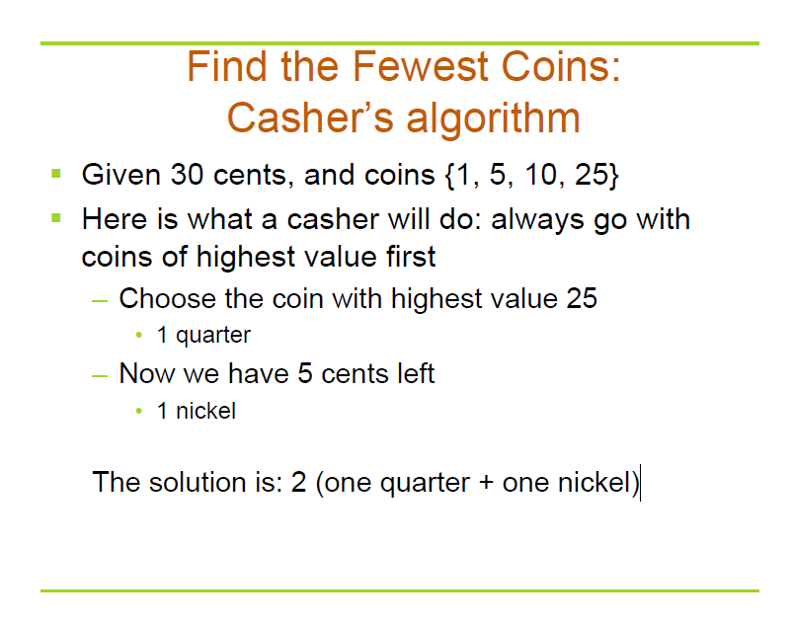

Slide 145
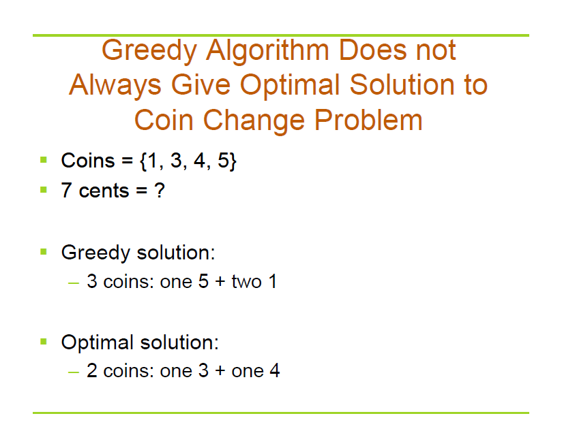

Slide 146
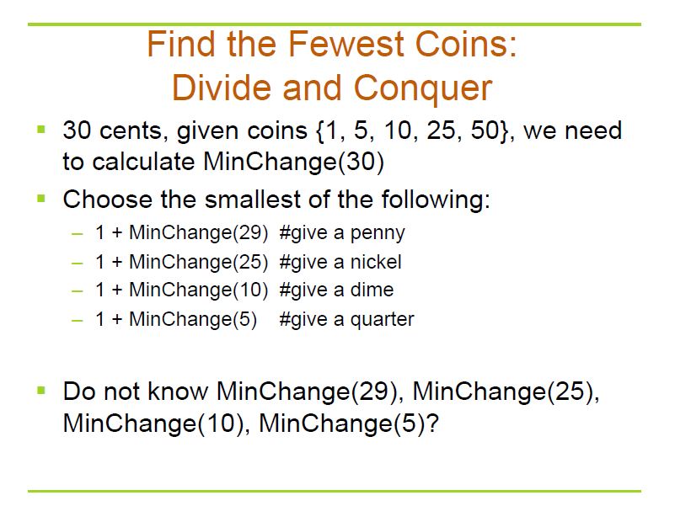

Slide 147
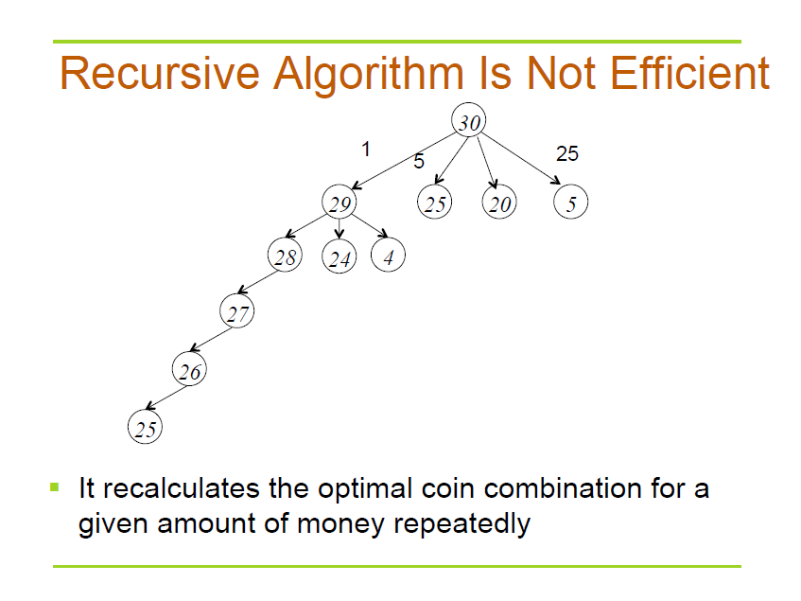

Slide 148
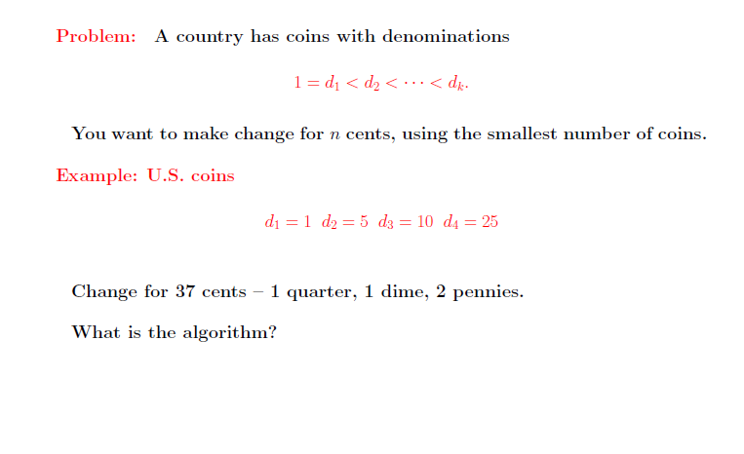
Dynamic Programming

Slide 149
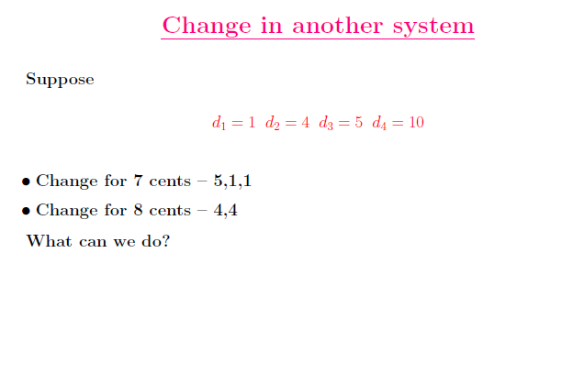
Dynamic Programming

Slide 150
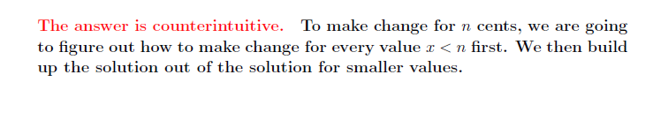
Dynamic Programming

Slide 151
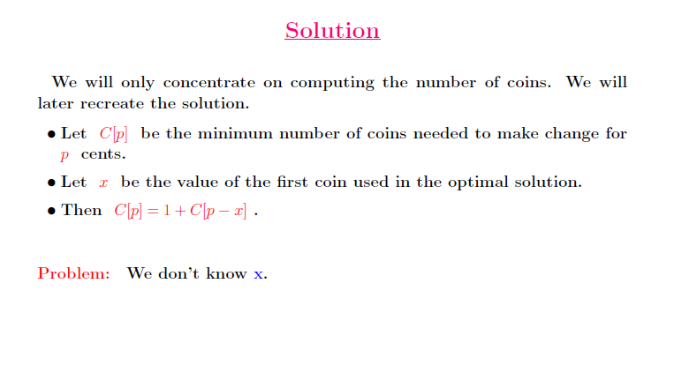
Dynamic Programming

Slide 152
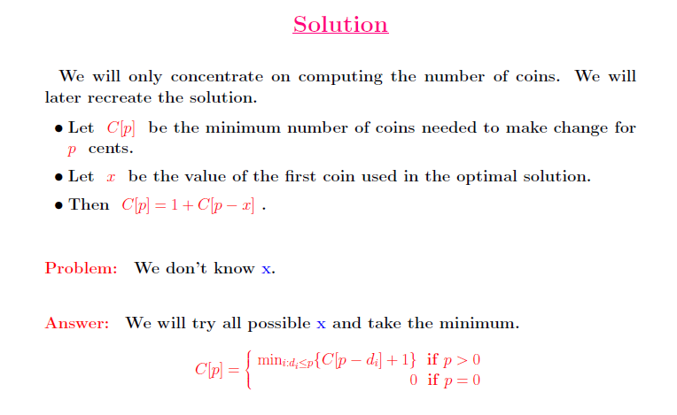
Dynamic Programming

Slide 153
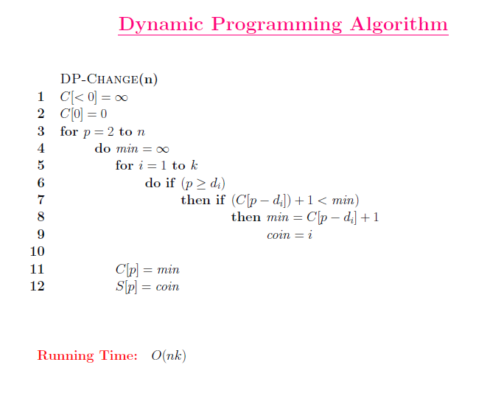

Slide 154
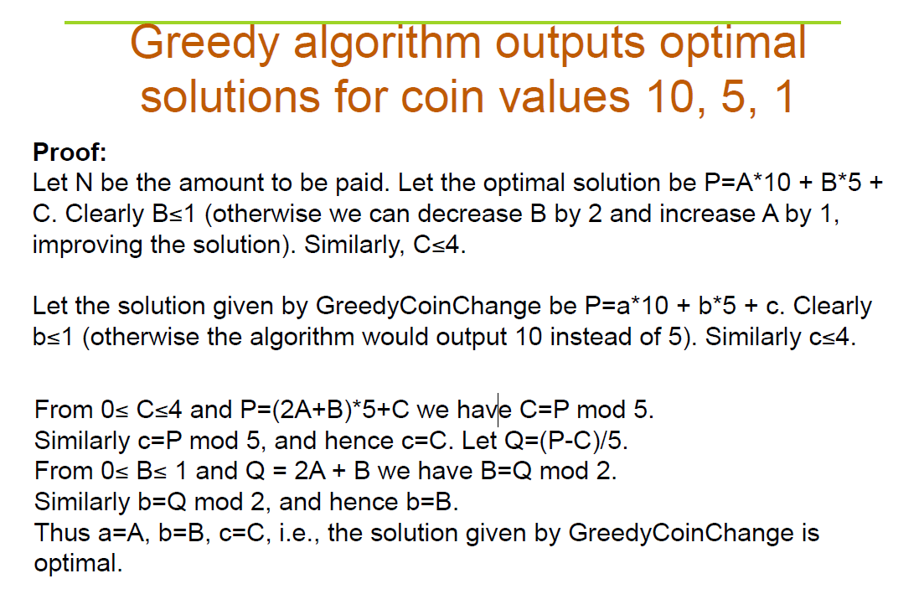

Slide 155
Homework
CLRS 16.1-2
CLRS 16.1-5
CLRS 16.2-7

Slide 156
Exercise in Class
Prove that Greedy algorithm outputs optimal solution for coin values 18,6,3,1

Slide 157
练习题
礼品分组
N个礼品，每个礼品的价格不一样。现要把所有礼品分组，每组的礼品数量不超过2个，且礼品总价格不超过C (C>0)，求分组的数目最少的分法。

Slide 158
练习题
堆积木
老师给每个小朋友分了些积木块，但每个小朋友手上的积木都不足以堆成想要的形状。现在你手上有一些积木，你可以全部交给某个小朋友让他有足够的积木堆成形状，堆完后再收回所有的积木。你最多可以让多少小朋友堆成积木。

Slide 159
练习题
PK赛
工科系男生寝室A和寝室B的人数都是N，为了争夺和文艺系女生寝室的联谊权，决定举行一场扳手劲的PK赛。比赛要进行N轮，每轮由双方寝室各派出一位男生参加，但每人只能比赛一次。假设寝室B的室长知道双方学生的实力，他如何安排寝室B学生的比赛顺序才能取得最多的胜利。

Slide 160
Huffman Codes

Slide 161
Data Compression
Q. Given a text that uses 32 symbols (26 different letters, space, and
some punctuation characters), how can we encode this text in bits?
Q. Some symbols (e, t, a, o, i, n) are used far more often than others.
How can we use this to reduce our encoding?
Q. How do we know when the next symbol begins?
Ex. c(a) = 01 What is 0101?
c(b) = 010
c(e) = 1

Slide 162
Data Compression
Q. Given a text that uses 32 symbols (26 different letters, space, and some punctuation characters), how can we encode this text in bits?
A. We can encode 32 different symbols using a fixed length of 5 bits per symbol. This is called fixed length encoding.
Q. Some symbols (e, t, a, o, i, n) are used far more often than others.
How can we use this to reduce our encoding?
A. Encode these characters with fewer bits, and the others with more bits.
Q. How do we know when the next symbol begins?
A. Use a separation symbol (like the pause in Morse), or make sure that there is no ambiguity by ensuring that no code is a prefix of another one.
Ex. c(a) = 01 What is 0101?
c(b) = 010
c(e) = 1

Slide 163
Prefix Codes
Definition. A prefix code for a set S is a function c that maps each x∈S to 1s and 0s in such a way that for x,y∈S, x≠y, c(x) is not a prefix of c(y).
Ex. c(a) = 11
c(e) = 01
c(k) = 001
c(l) = 10
c(u) = 000
Q. What is the meaning of 1001000001 ?
Suppose frequencies are known in a text of 1G:
fa=0.4, fe=0.2, fk=0.2, fl=0.1, fu=0.1
Q. What is the size of the encoded text?

Slide 164
Prefix Codes
Definition. A prefix code for a set S is a function c that maps each x∈S to 1s and 0s in such a way that for x,y∈S, x≠y, c(x) is not a prefix of c(y).
Ex. c(a) = 11
c(e) = 01
c(k) = 001
c(l) = 10
c(u) = 000
Q. What is the meaning of 1001000001 ?
A. “leuk”
Suppose frequencies are known in a text of 1G:
fa=0.4, fe=0.2, fk=0.2, fl=0.1, fu=0.1
Q. What is the size of the encoded text?

Slide 165
Prefix Codes
Definition. A prefix code for a set S is a function c that maps each x∈S to 1s and 0s in such a way that for x,y∈S, x≠y, c(x) is not a prefix of c(y).
Ex. c(a) = 11
c(e) = 01
c(k) = 001
c(l) = 10
c(u) = 000
Q. What is the meaning of 1001000001 ?
A. “leuk”
Suppose frequencies are known in a text of 1G:
fa=0.4, fe=0.2, fk=0.2, fl=0.1, fu=0.1
Q. What is the size of the encoded text?
A. 2*fa + 2*fe + 3*fk + 2*fl + 4*fu = 2.4G

Slide 166
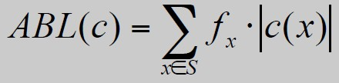
Optimal Prefix Codes
Definition. The average bits per letter of a prefix code c is the sum
over all symbols of its frequency times the number of bits of its
encoding:
We would like to find a prefix code that is has the lowest possible
average bits per letter.
Suppose we model a code in a binary tree…

Slide 167
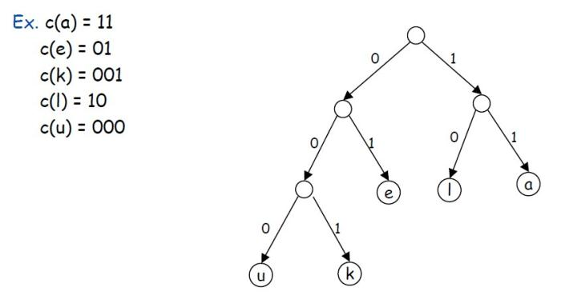
Representing Prefix Codes using Binary Trees

Slide 168
Representing Prefix Codes using Binary Trees
Q. How does the tree of a prefix code look?
A. Only the leaves have a label.
Pf. An encoding of x is a prefix of an encoding of y if and only if the
path of x is a prefix of the path of y.

Slide 169
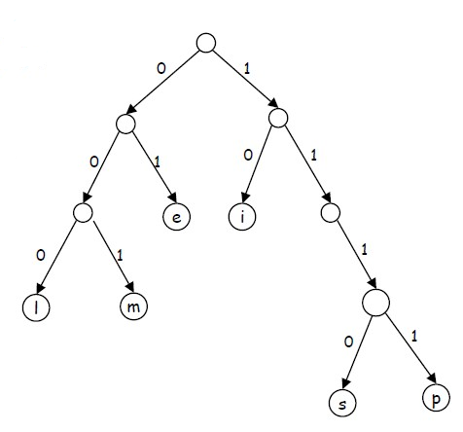

Representing Prefix Codes using Binary Trees
Q. What is the meaning of
111010001111101000 ?
A. “simpel”

Slide 170
Representing Prefix Codes using Binary Trees
Q. What is the meaning of
111010001111101000 ?
A. “simpel”
Q. How can this prefix code be made more efficient?

Slide 171
Representing Prefix Codes using Binary Trees
Q. What is the meaning of
111010001111101000 ?
A. “simpel”
Q. How can this prefix code be made more efficient?
A. Change encoding of p and s to a shorter one.
This tree is now full.

Slide 172
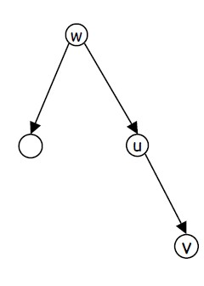
Representing Prefix Codes using Binary Trees
Definition. A tree is full if every node that is not a leaf has two
children.
Claim. The binary tree corresponding to the optimal prefix code is full.

Slide 173
Representing Prefix Codes using Binary Trees
Definition. A tree is full if every node that is not a leaf has two
children.
Claim. The binary tree corresponding to the optimal prefix code is full.
Pf. (by contradiction)
Suppose T is binary tree of optimal prefix code and is not full.
This means there is a node u with only one child v.
Case 1: u is the root; delete u and use v as the root
Case 2: u is not the root
– let w be the parent of u
– delete u and make v be a child of w in place of u
In both cases the number of bits needed to encode any leaf in the
subtree of v is decreased. The rest of the tree is not affected.
Clearly this new tree T’ has a smaller ABL than T. Contradiction.

Slide 174
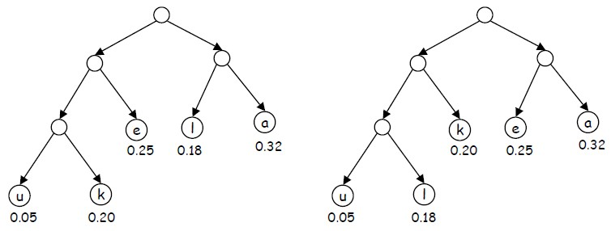
Optimal Prefix Codes: False Start
Q. Where in the tree of an optimal prefix code should letters be placed
with a high frequency?
A. Near the top.
Greedy template. Create tree top-down, split S into two sets S1 and S2
with (almost) equal frequencies. Recursively build tree for S1 and S2.
[Shannon-Fano, 1949] f_{a}=0.32, f_{e}=0.25, f_{k}=0.20, f_{l}=0.18, f_{u}=0.05

Slide 175
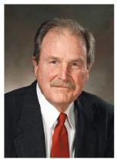
Optimal Prefix Codes: Huffman Encoding
Observation. Lowest frequency items should be at the lowest level in
tree of optimal prefix code.
Observation. For n > 1, the lowest level always contains at least two
leaves.
Observation. The order in which items appear in a level does not
matter.
Claim. There is an optimal prefix code with tree T* where the two
lowest-frequency letters are assigned to leaves that are siblings in T*.
Greedy template. [Huffman, 1952] Create tree bottom-up.
Make two leaves for two lowest-frequency letters y and z.
Recursively build tree for the rest using a meta-letter for yz.

Slide 176
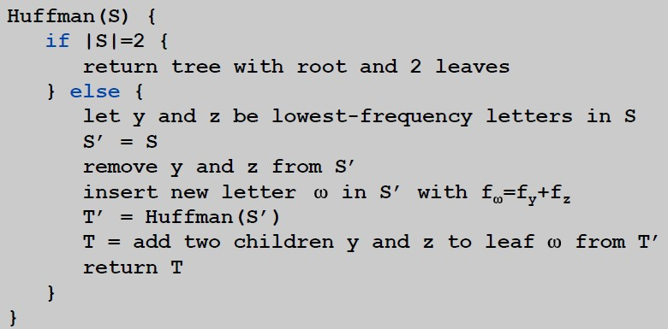
Optimal Prefix Codes: Huffman Encoding
Q. What is the time complexity?
A. T(n) = T(n-1) + O(n) so O(n²)
Q. How to implement finding lowest-frequency letters efficiently?
A. Use priority queue for S: T(n) = T(n-1) + O(log n) so O(n log n)

Slide 177
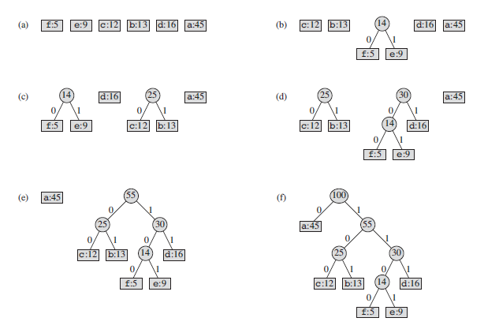

Slide 178
Huffman Encoding: Greedy Analysis
Claim. Huffman code for S achieves the minimum ABL of any prefix code.
Pf. by induction, based on optimality of T’ (y and z removed, ω added)

Slide 179
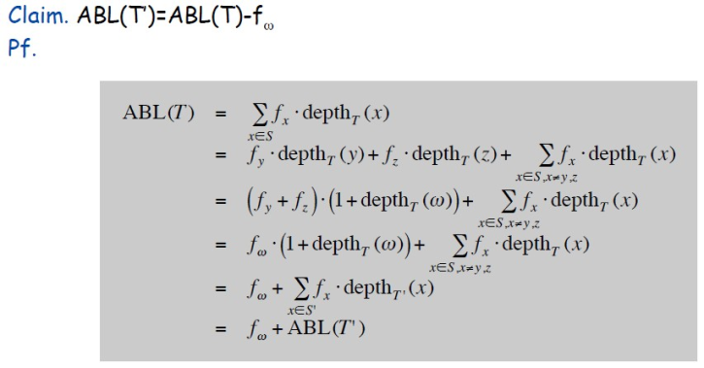
Huffman Encoding: Greedy Analysis
Claim. Huffman code for S achieves the minimum ABL of any prefix code.
Pf. by induction, based on optimality of T’ (y and z removed, ω added)

Slide 180
Huffman Encoding: Greedy Analysis
Claim. Huffman code for S achieves the minimum ABL of any prefix
code.
Pf. (by induction)
Base: For n=2 there is no shorter code than root and two leaves.
Hypothesis: Suppose Huffman tree T’ for S’ of size n-1 with ω instead of y and z is optimal. (IH)
Step: (by contradiction)
Idea of proof:
– Suppose other tree Z of size n is better.
– Delete lowest frequency items y and z from Z creating Z’
– Z’ cannot be better than T’ by IH.

Slide 181
Huffman Encoding: Greedy Analysis
Claim. Huffman code for S achieves the minimum ABL of any prefix
code.
Pf. (by induction)
Base: For n=2 there is no shorter code than root and two leaves.
Hypothesis: Suppose Huffman tree T’ for S’ with ω instead of y and z is optimal. (IH)
Step: (by contradiction)
Suppose Huffman tree T for S is not optimal.
So there is some tree Z such that ABL(Z) < ABL(T).
Then there is also a tree Z for which leaves y and z exist that are
siblings and have the lowest frequency (see observation).
Let Z’ be Z with y and z deleted, and their former parent labeled ω.
Similar T’ is derived from S’ in our algorithm.
We know that ABL(Z’)=ABL(Z)-fω, as well as ABL(T’)=ABL(T)-fω.
But also ABL(Z) < ABL(T), so ABL(Z’) < ABL(T’).
Contradiction with IH.

