Slide 1
Algorithm Analysis & Design Introduction to Algorithm
T&R Team of Algorithm Design
College of Computer Science and Engineering, CQU
Notes:
本人是国际视觉电生理学会(ISCEV)的会员。

Slide 2
Chapter 26: Maximum Flow

Slide 3
Outlines
Flow networks
Ford-Fulkerson method

Slide 4
Flow Networks

Slide 5
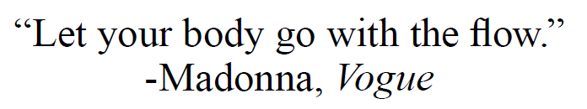
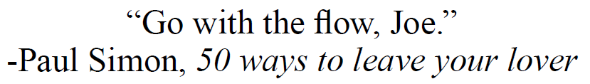

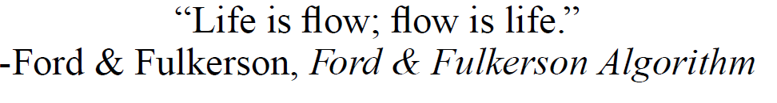
The Tao of Flow

Slide 6

The Tao of Flow

Slide 7
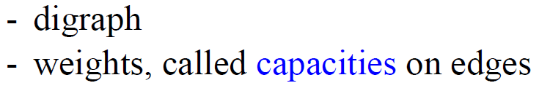




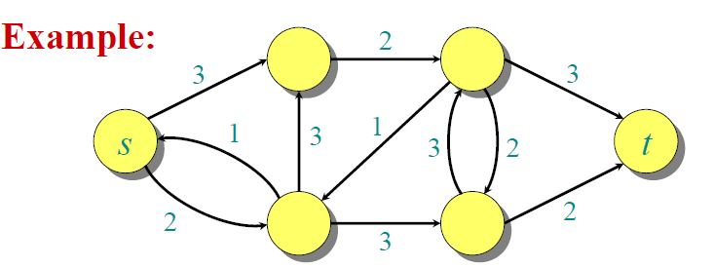
Flow Network
- two distinct vertices
- each vertex on some path from source to sink

Slide 8







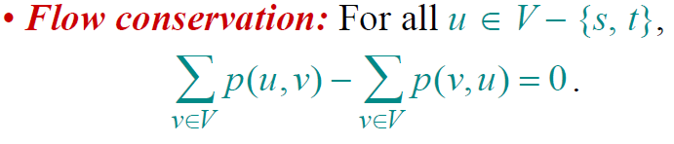
Capacity and Flow

Slide 9
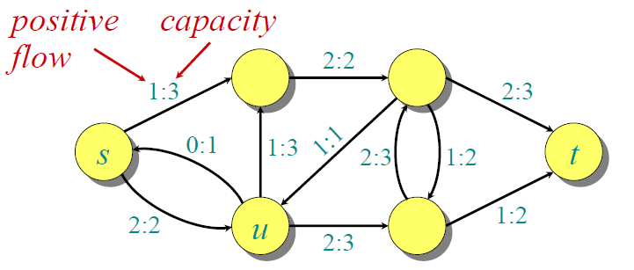
Capacity and Flow

Slide 10
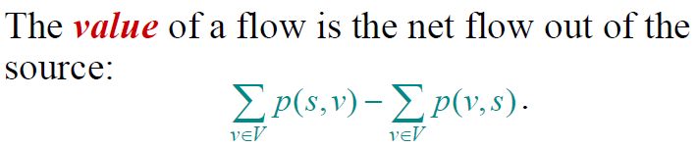
Flow Value

Slide 11
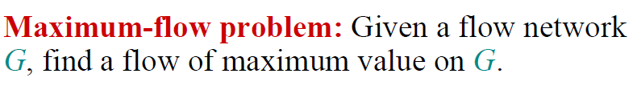
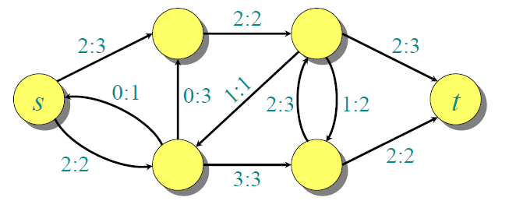

The Maximum-Flow Problem

Slide 12
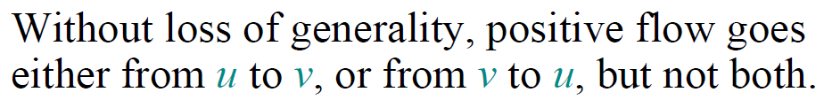
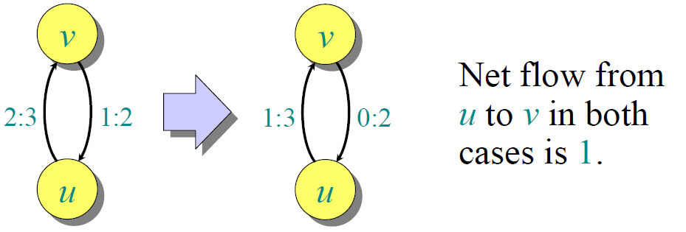
Flow Cancellation

Slide 13

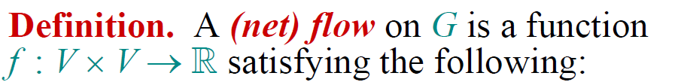
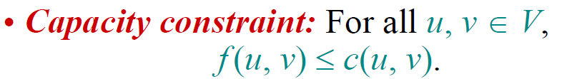
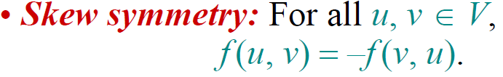
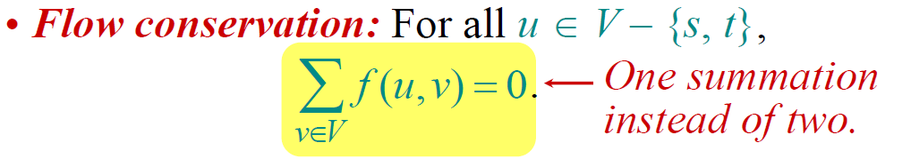
Net Flow Definitions

Slide 14
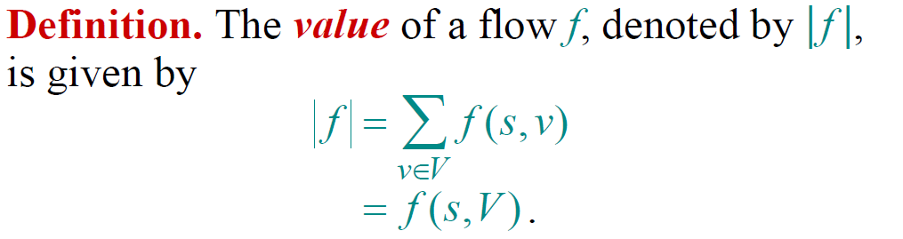
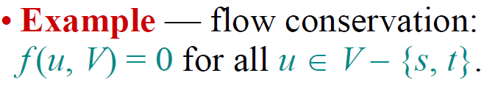
Net Flow Value

Slide 15


Simple Properties of Net Flow

Slide 16
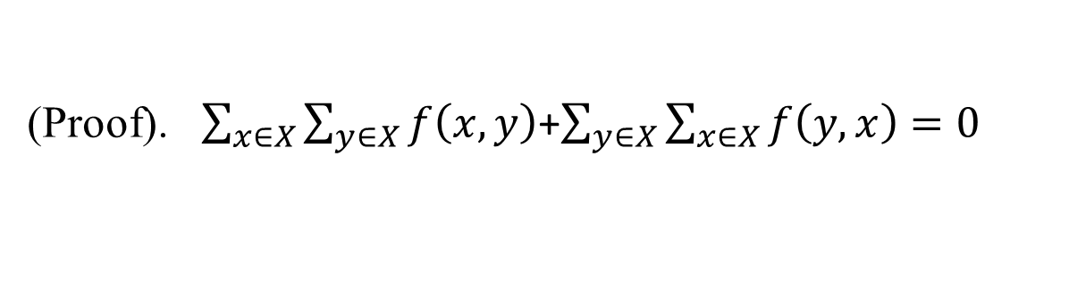
Simple Properties of Net Flow

Slide 17
Simple Properties of Net Flow

Slide 18
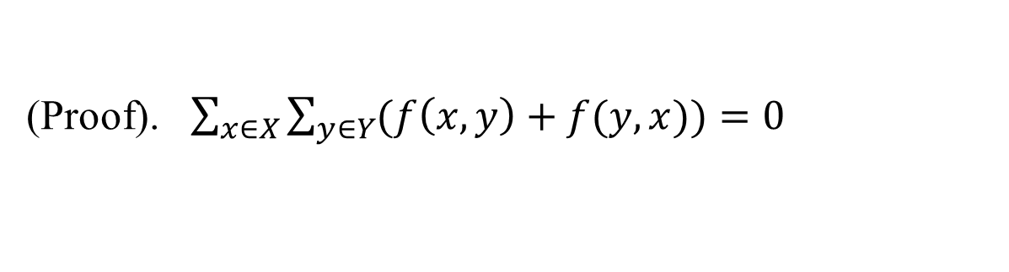
Simple Properties of Net Flow

Slide 19
Simple Properties of Net Flow

Slide 20
Simple Properties of Net Flow
(Proof). Exercise

Slide 21


Simple Properties of Net Flow

Slide 22

Simple Properties of Net Flow

Slide 23

Simple Properties of Net Flow

Slide 24

Simple Properties of Net Flow

Slide 25

Simple Properties of Net Flow

Slide 26
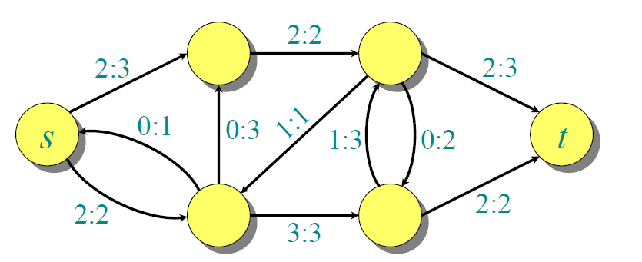

Net Flow into Sink

Slide 27
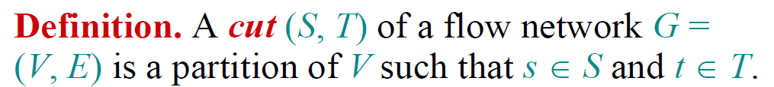
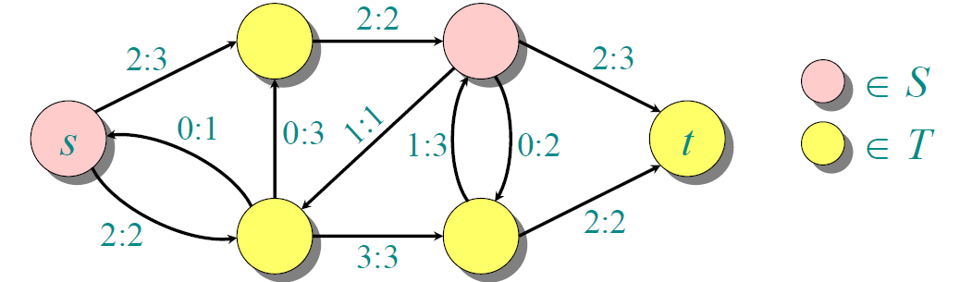

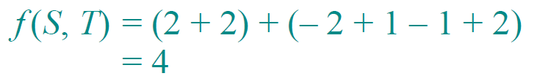
Cut

Slide 28


Flow of A Cut

Slide 29
Flow of A Cut

Slide 30

Flow of A Cut

Slide 31

Flow of A Cut

Slide 32

Flow of A Cut

Slide 33

Flow of A Cut

Slide 34
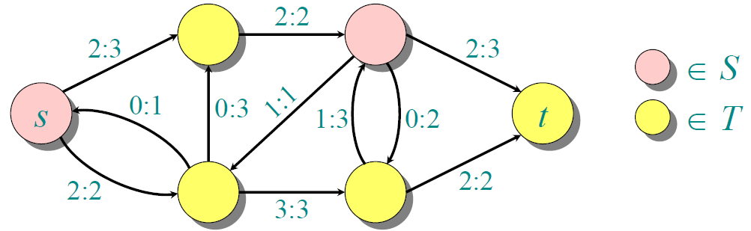
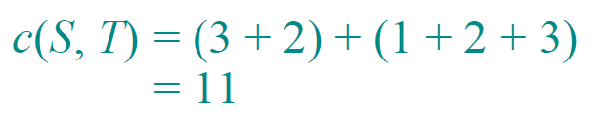
Capacity of A Cut

Slide 35

Upper Bound on Flow Value

Slide 36
Upper Bound on Flow Value

Slide 37

Upper Bound on Flow Value

Slide 38

Upper Bound on Flow Value

Slide 39

Upper Bound on Flow Value

Slide 40
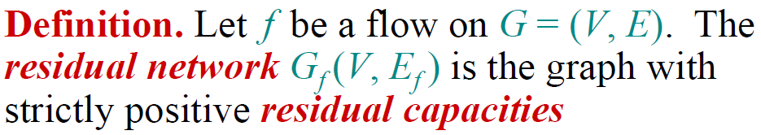
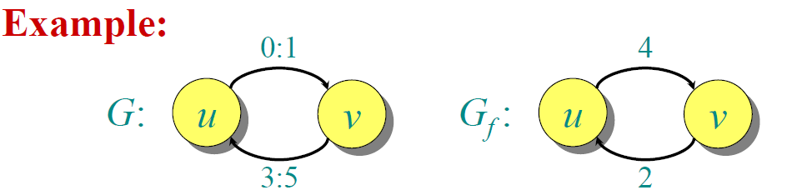

Residual Network

Slide 41

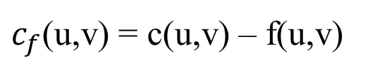
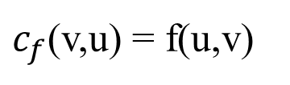
Residual Network
f(u,v) > 0
u
v
u
v
c(u,v)

Slide 42
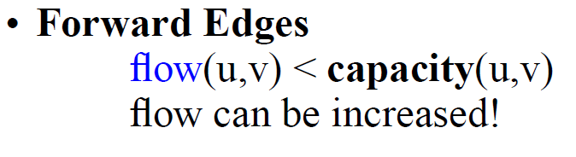
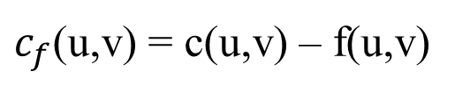
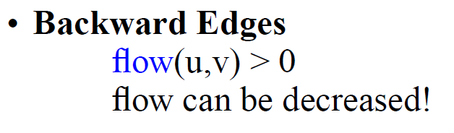
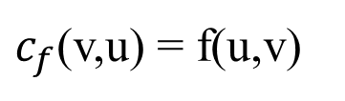
Residual Network
f(u,v) > 0
u
v
c(u,v)
u
v

Slide 43

Residual Network Example

Slide 44
Short Test in Class
Give the residual network of the next graph
12/12
v₁
v₃
11/16
15/20
s
1/4
7/7
t
0/10
4/9
8/13
v₂
v₄
4/4
11/14

Slide 45
Exercises
26.1-1
26.1-3

Slide 46
Augmenting Path
An augmenting path p is a simple path from s to t in the residual network Gf of a flow network G.
residual capacity of p
the maximum flow | f | can increased by increasing the flow on each edge in p

Slide 47
Augmenting Path Example
v₁
12/12
v₃
11/16
15/20
s
0/10
1/4
7/7
t
4/9
8/13
v₂
v₄
4/4
11/14

Slide 48
Augmenting Path Example
v₁
12/12
v₃
11/16
15/20
s
0/10
1/4
7/7
t
4/9
8/13
v₂
v₄
4/4
12
5
v₁
v₃
11/14
5
11
4
s
11
3
7
15
t
5
5
3
4
8
v₂
v₄
11

Slide 49
Augmenting Path Example
v₁
12/12
v₃
11/16
15/20
s
1/4
t
augmenting path p
0/10
4/9
7/7
8/13
v₂
v₄
4/4
12
5
v₁
v₃
11/14
5
11
4
s
11
3
7
15
t
5
5
3
4
8
v₂
v₄
11

Slide 50
Augmenting Path Example
v₁
12/12
v₃
11/16
15/20
s
1/4
t
augmenting path p
0/10
4/9
7/7
8/13
v₂
v₄
4/4
12
5
v₁
v₃
11/14
5
11
4
s
11
3
7
15
t
5
5
3
4
8
v₂
v₄
11
4

Slide 51
Augmenting Path Example
v₁
12/12
v₃
11/16
15/20
s
1/4
t
augmenting path p
0/10
4/9
7/7
8/13
v₂
v₄
4/4
12
5
v₁
v₃
11/14
5
11
4
s
11
3
7
15
t
5
5
3
4
8
v₂
v₄
11
v₁
v₃
4
11/16
19/20
s
0/10
1/4
7/7
t
0/9
12/13
v₂
v₄
4/4
11/14

Slide 52
Augmenting Path Example
v₁
12/12
v₃
11/16
15/20
s
1/4
t
augmenting path p
0/10
4/9
7/7
8/13
v₂
v₄
4/4
12
5
v₁
v₃
11/14
5
11
4
s
11
3
7
15
t
5
5
3
4
8
v₂
v₄
11
v₁
v₃
4
11/16
19/20
s
0/10
1/4
7/7
t
0/9
12/13
v₂
v₄
4/4
Maximum flow increased by 4!
11/14

Slide 53
Maximum Flow Theorem

Slide 54
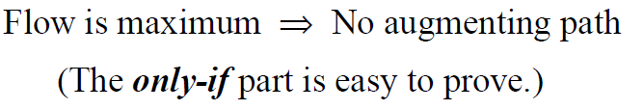
Maximum Flow Theorem

Slide 55
Maximum Flow Theorem

Slide 56

Max-Flow, Min-Cut Theorem

Slide 57
Max-Flow, Min-Cut Theorem

Slide 58
Max-Flow, Min-Cut Theorem

Slide 59
Max-Flow, Min-Cut Theorem

Slide 60
Max-Flow, Min-Cut Theorem
(S,T) is a cut! Why?

Slide 61
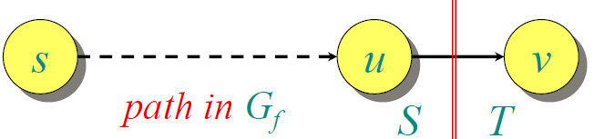
Max-Flow, Min-Cut Theorem

Slide 62
Max-Flow, Min-Cut Theorem

Slide 63
Max-Flow, Min-Cut Theorem

Slide 64
Max-Flow, Min-Cut Theorem

Slide 65
Max-Flow, Min-Cut Theorem

Slide 66
Max-Flow, Min-Cut Theorem
Maximum flow!

Slide 67
Ford-Fulkerson Algorithm

Slide 68
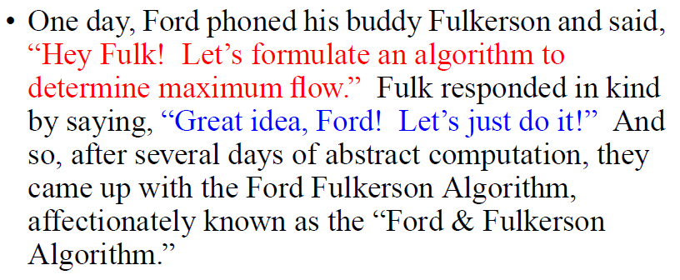
A Story

Slide 69

Rough Idea

Slide 70
Algorithm

Slide 71
Example—Basic Implementation
0/12
v₁
v₃
0/20
0/16
s
0/10
0/4
0/7
t
0/9
0/13
v₂
v₄
0/4
0/14
Flow initialization
v₁
12
v₃
16
20
s
10
4
7
t
9
13
v₂
v₄
4
14
Residual network

Slide 72
Example
Residual Networks
Flows
v₁
12
v₃
v₁
4/12
v₃
16
20
4/16
0/20
s
10
4
7
t
s
0/10
0/4
0/7
t
9
4/9
13
v₂
v₄
4
0/13
v₂
v₄
4/4
14
4/14
8
4/12
v₁
v₃
v₁
v₃
7/20
12
4
20
11/16
s
4
4
t
s
0/4
t
10
4
7
7/10
4/9
7/7
5
13
10
v₄
4
0/13
v₂
v₄
4/4
v₂
11/14

Slide 73
Example
Residual Networks
Flows
8
12/12
v₁
v₃
v₁
v₃
15/20
5
4
13
11/16
11
4
s
3
11
7
7
t
s
0/10
1/4
7/7
t
5
4/9
13
3
4
4/4
v₂
v₄
8/13
v₂
v₄
11
11/14
12
12/12
v₁
v₃
v₁
v₃
19/20
5
5
11/16
11
4
s
11
3
7
15
t
s
0/10
1/4
7/7
t
5
5
0/9
3
4
4/4
8
v₂
v₄
12/13
v₂
v₄
11
11/14

Slide 74
Example
Residual Networks
Flows
12/12
v₁
v₃
19/20
11/16
s
0/10
1/4
7/7
t
0/9
12/13
v₂
v₄
4/4
11/14
12
5
v₁
v₃
1
s
11
19
t
11
3
9
7
1
3
4
12
v₂
v₄
11

Slide 75
Example
Residual Networks
Flows
12/12
v₁
v₃
19/20
11/16
s
0/10
1/4
7/7
t
0/9
12/13
v₂
v₄
4/4
11/14
12
5
v₁
v₃
1
s
11
19
t
11
3
9
7
1
3
4
12
v₂
v₄
11
No augmenting path

Slide 76
Example
Residual Networks
Flows
12/12
v₁
v₃
19/20
11/16
s
0/10
1/4
7/7
t
0/9
12/13
v₂
v₄
4/4
11/14
12
5
v₁
v₃
Maximum flow |f| = 11+12 = 23
1
s
11
19
t
11
3
9
7
1
3
4
12
v₂
v₄
11
No augmenting path

Slide 77
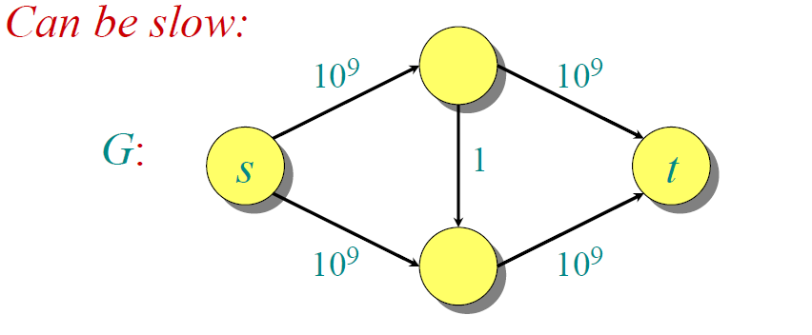
Problem：Time Complexity

Slide 78
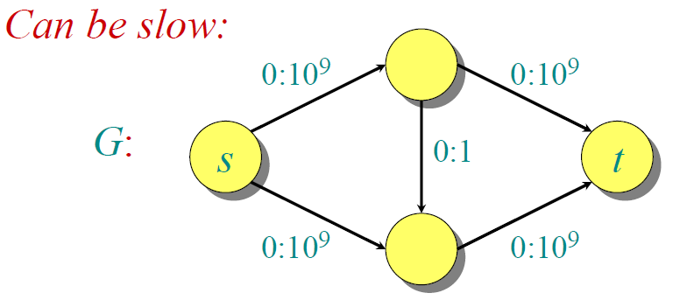
Problem：Time Complexity

Slide 79
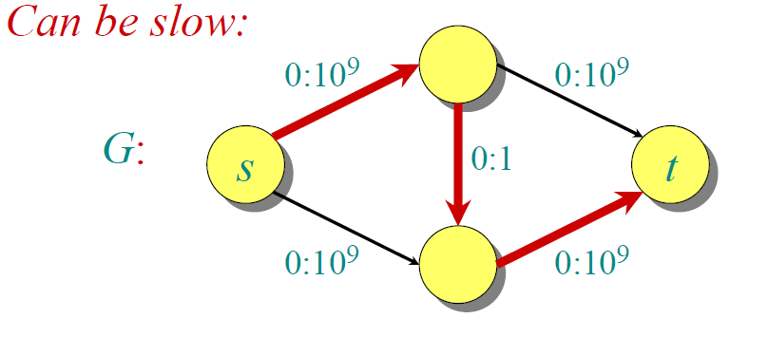
Problem：Time Complexity

Slide 80
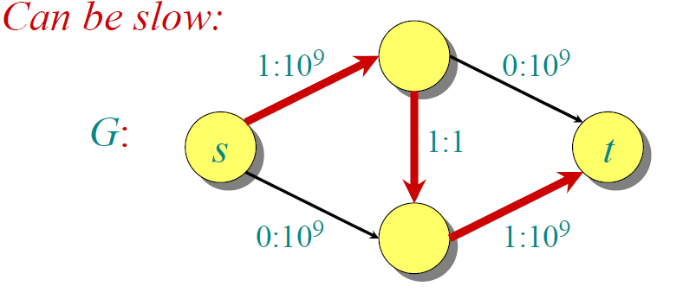
Problem：Time Complexity

Slide 81
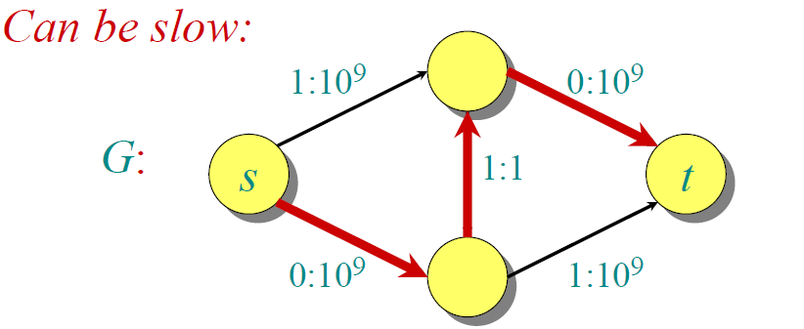
Problem：Time Complexity

Slide 82
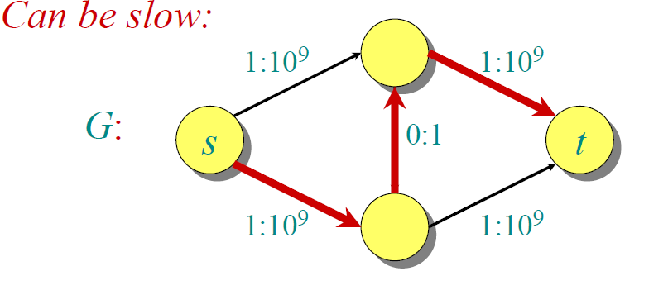
Problem：Time Complexity

Slide 83
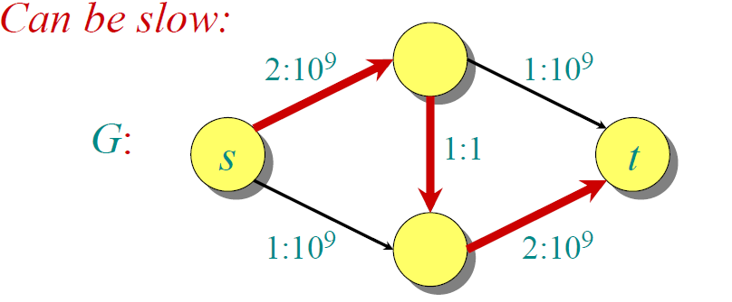
Problem：Time Complexity

Slide 84
Problem：Time Complexity

Slide 85




Time Complexity

Slide 86
Edmonds & Karp Algorithm

Slide 87
Breadth-First Search
Input:
- Graph G = (V, E), either directed or undirected, - source vertex s ∈ V.
Output: for all v ∈ V
d[v] = length of shortest path from s to v
(d[v] = ∞ if v is not reachable from s).
π[v] = u if (u, v) is last edge on shortest path s v.
u is v’s predecessor.
breadth-first tree = a tree with root s that contains all reachable vertices.

Slide 88
Definitions on BSF
Path between vertices u and v:
vertices (v₁, v₂, …, v_{k}) such that
u=v₁ and v =v_{k},
(v_{i},v_{i+1}) ∈ E, for all 1≤ i ≤ k-1.
Length of the path: Number of edges in the path.
Path is simple if no vertex is repeated.

Slide 89
Principle of Breadth-First Search
Expands the frontier between discovered and undiscovered vertices uniformly
across the breadth of the frontier.
A vertex is “discovered” the first time it is encountered during the search.
A vertex is “finished” if all vertices adjacent to it have been discovered.

Slide 90
BFS for Shortest Paths
Colors the vertices to keep track of progress.
Undiscovered
Discovered
S
Finished

Slide 91
BFS for Shortest Paths
Colors the vertices to keep track of progress.
Undiscovered
Discovered
S
Finished
1
S
1
1

Slide 92
BFS for Shortest Paths
Colors the vertices to keep track of progress.
Undiscovered
Discovered
S
Finished
2
2
2
1
S
2
S
1
1
2
2

Slide 93
BFS for Shortest Paths
Colors the vertices to keep track of progress.
Undiscovered
Discovered
S
Finished
2
3
3
2
2
3
1
S
S
S
2
1
1
2
2
3
3

Slide 94
BFS(G,s)
1. for each vertex u in V[G] – {s}
2 do color[u] ← white
3 d[u] ← ∝
4 π[u] ← nil
5 color[s] ← gray
6 d[s] ← 0
7 π[s] ← nil
8 Q ← Φ
9 enqueue(Q,s)
10 while Q ≠ Φ
11 do u ← dequeue(Q)
12 for each v in Adj[u]
13 do if color[v] = white
14 then color[v] ← gray
15 d[v] ← d[u] + 1
16 π[v] ← u
17 enqueue(Q,v)
18 color[u] ← black

Slide 95
BFS(G,s)
1. for each vertex u in V[G] – {s}
2 do color[u] ← white
3 d[u] ← ∝
4 π[u] ← nil
5 color[s] ← gray
6 d[s] ← 0
7 π[s] ← nil
8 Q ← Φ
9 enqueue(Q,s)
10 while Q ≠ Φ
11 do u ← dequeue(Q)
12 for each v in Adj[u]
13 do if color[v] = white
14 then color[v] ← gray
15 d[v] ← d[u] + 1
16 π[v] ← u
17 enqueue(Q,v)
18 color[u] ← black
white: undiscovered
gray: discovered
black: finished

Slide 96
BFS(G,s)
1. for each vertex u in V[G] – {s}
2 do color[u] ← white
3 d[u] ← ∝
4 π[u] ← nil
5 color[s] ← gray
6 d[s] ← 0
7 π[s] ← nil
8 Q ← Φ
9 enqueue(Q,s)
10 while Q ≠ Φ
11 do u ← dequeue(Q)
12 for each v in Adj[u]
13 do if color[v] = white
14 then color[v] ← gray
15 d[v] ← d[u] + 1
16 π[v] ← u
17 enqueue(Q,v)
18 color[u] ← black
white: undiscovered
gray: discovered
black: finished
Q: a queue of discovered vertices
color[v]: color of v
d[v]: distance from s to v
π[u]: predecessor of v

Slide 97
Example (BFS)
r
s
t
u
∞
0
∞
∞
∞
∞
∞
∞
v
w
x
y
Q: s
0
frontier

Slide 98
Example (BFS)
r
s
t
u
∞
0
∞
∞
∞
∞
∞
∞
v
w
x
y
Q: s
0
frontier

Slide 99
Example (BFS)
r
s
t
u
1
0
∞
∞
∞
1
∞
∞
v
w
x
y
Q: w r
1 1

Slide 100
Example (BFS)
r
s
t
u
1
0
2
∞
∞
1
2
∞
v
w
x
y
Q: r t x
1 2 2

Slide 101
Example (BFS)
r
s
t
u
1
0
2
∞
2
1
2
∞
v
w
x
y
Q: t x v
2 2 2

Slide 102
Example (BFS)
r
s
t
u
1
0
2
3
2
1
2
∞
v
w
x
y
Q: x v u
2 2 3

Slide 103
Example (BFS)
r
s
t
u
1
0
2
3
2
1
2
3
v
w
x
y
Q: v u y
2 3 3

Slide 104
Example (BFS)
r
s
t
u
1
0
2
3
2
1
2
3
v
w
x
y
Q: u y
3 3

Slide 105
Example (BFS)
r
s
t
u
1
0
2
3
2
1
2
3
v
w
x
y
Q: y
3

Slide 106
Example (BFS)
r
s
t
u
1
0
2
3
2
1
2
3
v
w
x
y
Q: ∅

Slide 107
Example (BFS)
r
s
t
u
1
0
2
3
2
1
2
3
v
w
x
y
BF Tree

Slide 108
Breadth-First Tree
Predecessor sub-graph of G = (V, E) with source s is
G_{π} = (V_{π} , E_{π}) where
V_{π} ={v∈V : π[v] ≠ NIL} + {s}
E_{π} ={(π[v],v)∈E : v ∈ V_{π} - {s}}
G_{π} is a breadth-first tree if:
V_{π} consists of the vertices reachable from s
for all v∈V_{π} , there is a unique simple path from s to v in G_{π}
the path is also a shortest path from s to v in G.
The edges in E_{π} are called tree edges. |E_{π} | = |V_{π} | - 1.

Slide 109
Analysis of BFS
Initialization takes O(|V|).
Traversal Loop
Each vertex is enqueued and dequeued at most once, so the total time for queuing is O(|V|).
The adjacency list of each vertex is scanned at most once.
The sum of lengths of all adjacency lists is Θ(|E|).
Total running time of BFS is O(|V|+|E|)
Correctness of BFS (see Dijkstra later)

Slide 110
Edmonds & Karp Algorithm
Find the augmenting path using breadth-first search.
Breadth-first search gives the shortest path for graphs (Assuming the length of each edge is 1.)
Time complexity of Edmonds-Karp algorithm is O(|V||E|²).
The proof is very hard!.

Slide 111
Example
Flows
0/12
v₁
v₃
Residual Networks
0/16
0/20
BFS
s
0/10
0/4
0/7
t
0/9
0/13
0/4
1
12
2
v₂
v₄
20
0/14
16
0
10
4
7
3
9
13
1
2
4
14

Slide 112
Example
Flows
12/12
v₁
v₃
Residual Networks
12/16
12/20
BFS
s
0/10
0/4
0/7
t
0/9
0/13
v₂
v₄
0/4
0/14
12
4
1
3
8
0
12
12
3
10
4
9
7
14
4
13
1
2

Slide 113
Example
Flows
12/12
v₁
v₃
Residual Networks
12/16
12/20
BFS
s
0/10
0/4
0/7
t
0/9
4/13
v₂
v₄
4/4
4/14
12
3
4
1
8
0
12
12
4
10
4
9
7
9
10
4
4
1
2
4

Slide 114
Example
Flows
12/12
v₁
v₃
Residual Networks
12/16
19/20
BFS
s
0/10
0/4
7/7
t
0/9
11/13
v₂
v₄
4/4
11/14
12
∞
4
1
1
0
12
19
∞
10
4
9
7
2
3
4
11
1
2
11

Slide 115
Example
Flows
12/12
v₁
v₃
Residual Networks
12/16
19/20
BFS
s
0/10
0/4
7/7
t
0/9
11/13
v₂
v₄
4/4
11/14
12
∞
4
1
1
0
12
19
∞
10
4
9
7
2
3
4
11
1
2
11
No path to sink

Slide 116
Example
Flows
12/12
v₁
v₃
Residual Networks
12/16
19/20
BFS
s
0/10
0/4
7/7
t
0/9
11/13
v₂
v₄
4/4
11/14
12
∞
4
1
1
Maximum!
0
12
19
∞
10
4
9
7
2
3
4
11
1
2
11
No path to sink

Slide 117
Exercises
26.2-3
26.2-8

Slide 118
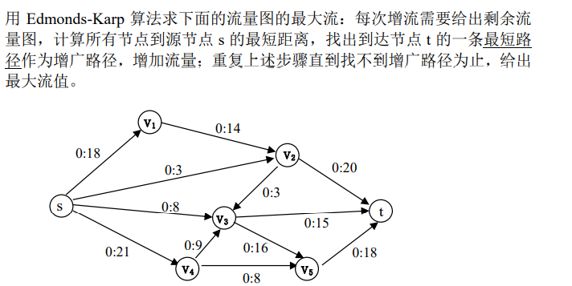

Slide 119
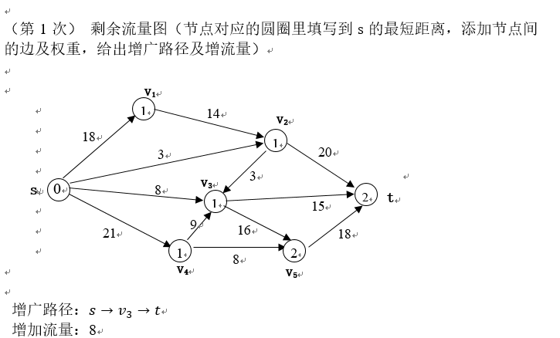

Slide 120
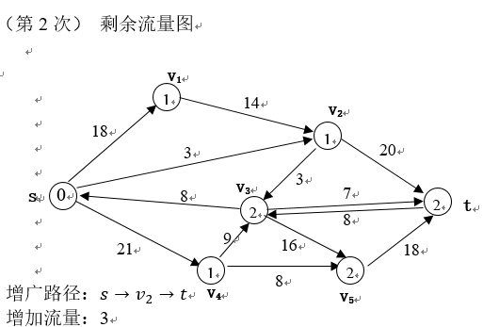
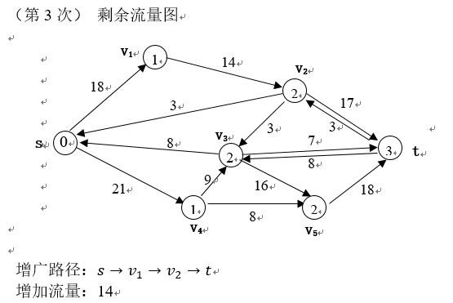
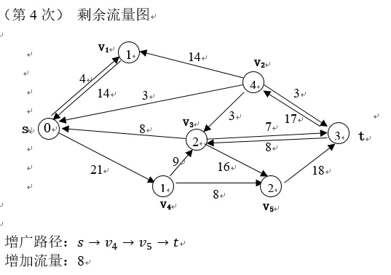
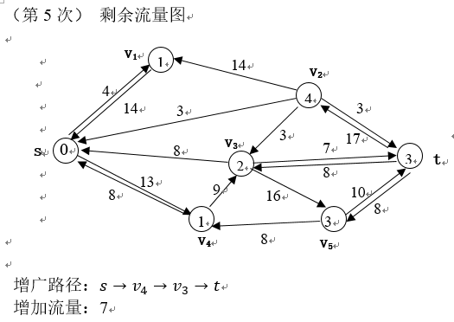

Slide 121



Slide 122
End of Section.
算法分析课程组
重庆大学计算机学院
Notes:
本人是国际视觉电生理学会(ISCEV)的会员。

