Slide 1
Algorithm Analysis & Design Introduction to Algorithm
T&R Team of Algorithm Design
College of Computer Science and Engineering, CQU
Notes:
本人是国际视觉电生理学会(ISCEV)的会员。

Slide 2
Chapter 3: Asymptotic Analysis for Algorithms
Notes:
2

Slide 3
Outline
3.1 ASYMPTOTIC ANALYSIS & LANDAU SYMBOLS
3.2 ANALYSIS of OPERATIONS

Slide 4
3.1 ASYMPTOTIC ANALYSIS & LANDAU SYMBOLS
Notes:
4

Slide 5
Background

Slide 6
Background
Suppose we have two algorithms, how can we tell which is better?

Slide 7
Background
Suppose we have two algorithms, how can we tell which is better?
We could implement both algorithms, run them both

Slide 8
Background
Suppose we have two algorithms, how can we tell which is better?
We could implement both algorithms, run them both
Expensive and error prone

Slide 9
Background
Suppose we have two algorithms, how can we tell which is better?
We could implement both algorithms, run them both
Expensive and error prone
Preferably, we should analyze them mathematically

Slide 10
Background
Suppose we have two algorithms, how can we tell which is better?
We could implement both algorithms, run them both
Expensive and error prone
Preferably, we should analyze them mathematically
Algorithm analysis

Slide 11
Background

Slide 12
Background
Without algorithm analysis, there will always be lingering questions:

Slide 13
Background
Without algorithm analysis, there will always be lingering questions:
Was the algorithm implemented correctly?

Slide 14
Background
Without algorithm analysis, there will always be lingering questions:
Was the algorithm implemented correctly?
Are there any bugs?

Slide 15
Background
Without algorithm analysis, there will always be lingering questions:
Was the algorithm implemented correctly?
Are there any bugs?
How much faster?

Slide 16
Background

Slide 17
Background
You may have heard that on your work-term reports, you should use quantitative analysis instead of qualitative analysis

Slide 18
Background
You may have heard that on your work-term reports, you should use quantitative analysis instead of qualitative analysis
The second refers to comparison of qualities, e.g., faster, less memory, etc.

Slide 19
Background
You may have heard that on your work-term reports, you should use quantitative analysis instead of qualitative analysis
The second refers to comparison of qualities, e.g., faster, less memory, etc.
Engineers must determine the actual costs (memory, time, monetary) involved with the algorithms they propose

Slide 20
Asymptotic Analysis

Slide 21
Asymptotic Analysis
In general, we will always analyze algorithms with respect to one or more variables

Slide 22
Asymptotic Analysis
In general, we will always analyze algorithms with respect to one or more variables
We will begin with one variable:

Slide 23
Asymptotic Analysis
In general, we will always analyze algorithms with respect to one or more variables
We will begin with one variable:
The number of items n currently stored in an array or other data structure
The number of items expected to be stored in an array or other data structure
The dimensions of an n × n matrix

Slide 24
Asymptotic Analysis
In general, we will always analyze algorithms with respect to one or more variables
We will begin with one variable:
The number of items n currently stored in an array or other data structure
The number of items expected to be stored in an array or other data structure
The dimensions of an n × n matrix
Examples with multiple variables:

Slide 25
Asymptotic Analysis
In general, we will always analyze algorithms with respect to one or more variables
We will begin with one variable:
The number of items n currently stored in an array or other data structure
The number of items expected to be stored in an array or other data structure
The dimensions of an n × n matrix
Examples with multiple variables:
Dealing with n objects stored in m memory locations
Multiplying a k × m and a m × n matrix
Dealing with sparse matrices of size n × n with m non-zero entries

Slide 26
Find the Key Index

Slide 27
Find the Key Index
For example, we can check the required time to search for a certain value in a sorted, n-element-array

Slide 28
Find the Key Index
For example, we can check the required time to search for a certain value in a sorted, n-element-array
We first apply the linear search
int find_keyIndex( int *array, int n, int key) {
int result = -1;
for ( int i = 1; i < n; ++i ) {
if ( array[i] == key) {
result = i;
break;
}
}
return result ;
}

Slide 29
Find the Key Index
For example, we can check the required time to search for a certain value in a sorted, n-element-array
We first apply the linear search
int find_keyIndex( int *array, int n, int key) {
int result = -1;
for ( int i = 1; i < n; ++i ) {
if ( array[i] == key) {
result = i;
break;
}
}
return result ;
}
The average comparison count for linear search would be n/2

Slide 30
Find the Key Index

Slide 31
Find the Key Index
And then we apply the binary search
int binary_search( int *a, int n, int key ) {
int mid, front=0, back=n-1;
while (front<=back) {
mid = (front+back)/2;
if (a[mid]==key)
return mid;
if (a[mid]<key)
front = mid+1;
else
back = mid-1;
}
return -1;
}

Slide 32
Find the Key Index
And then we apply the binary search
int binary_search( int *a, int n, int key ) {
int mid, front=0, back=n-1;
while (front<=back) {
mid = (front+back)/2;
if (a[mid]==key)
return mid;
if (a[mid]<key)
front = mid+1;
else
back = mid-1;
}
return -1;
}
The average comparison count for binary search would be log(n/2)

Slide 33
Linear and Binary Search
n
Notes:
33

Slide 34
Linear and Binary Search
This plot shows maximum and average number of comparisons to find an entry in a sorted array of size n
n
Notes:
34

Slide 35
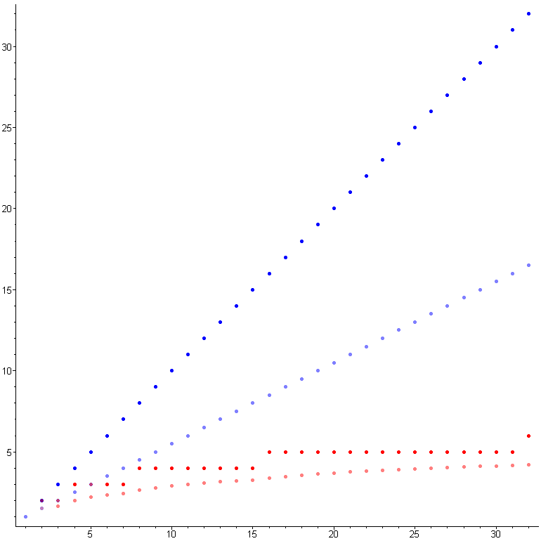
Linear and Binary Search
This plot shows maximum and average number of comparisons to find an entry in a sorted array of size n
Linear search
Binary search
n
Notes:
35

Slide 36
Linear and Binary Search
This plot shows maximum and average number of comparisons to find an entry in a sorted array of size n
Linear search
Binary search
We see that the growth of linear search and binary search are very different.
n
Notes:
36

Slide 37
Linear and Binary Search
This plot shows maximum and average number of comparisons to find an entry in a sorted array of size n
Linear search
Binary search
We see that the growth of linear search and binary search are very different.
How about the functions with the same order?
n
Notes:
37

Slide 38
Quadratic Growth

Slide 39
Quadratic Growth
Consider the two functions
f(n) = n²
g(n) = n² – 3n + 2

Slide 40
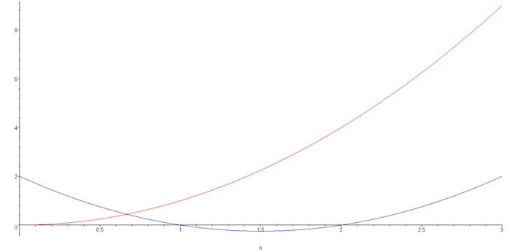
Quadratic Growth
Consider the two functions
f(n) = n²
g(n) = n² – 3n + 2
Around n = 0, they look very different

Slide 41
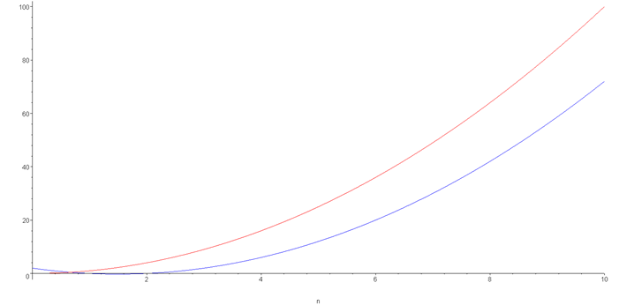
Quadratic Growth
If we look at a slightly larger range from n = [0, 10], we begin to note that they are more similar:

Slide 42
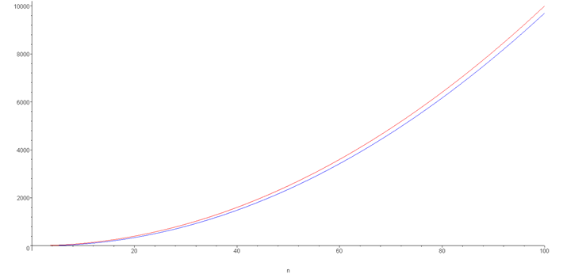
Quadratic Growth
Extending the range to n = [0, 100], the similarity increases:

Slide 43
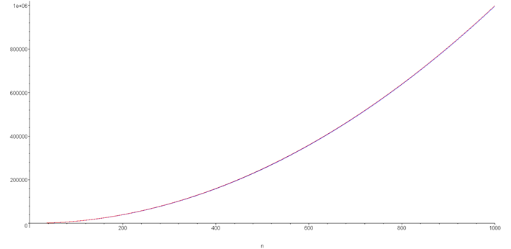
Quadratic Growth
And on the range n = [0, 1000], they are (relatively) indistinguishable:

Slide 44
Quadratic Growth
The are different absolutely, for example,
f(1000) = 1 000 000
g(1000) = 997 002

Slide 45
Quadratic Growth
They are different absolutely, for example,
f(1000) = 1 000 000
g(1000) = 997 002
However, this relative difference is very small:

Slide 46
Quadratic Growth
The are different absolutely, for example,
f(1000) = 1 000 000
g(1000) = 997 002
However, this relative difference is very small:
And this difference goes to zero as n → ∞

Slide 47
Polynomial Growth

Slide 48
Polynomial Growth
To demonstrate with another example,
f(n) = n⁶
g(n) = n⁶ – 23n⁵+193n⁴ –729n³+1206n² – 648n

Slide 49
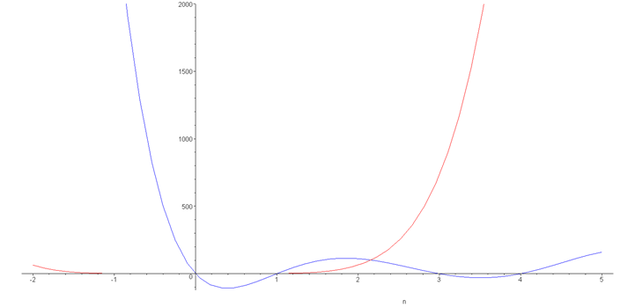
Polynomial Growth
To demonstrate with another example,
f(n) = n⁶
g(n) = n⁶ – 23n⁵+193n⁴ –729n³+1206n² – 648n
Around n = 0, they are very different

Slide 50
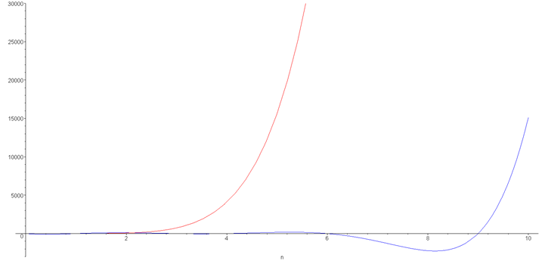
Polynomial Growth
Even extending the range to n = [0, 10] does not appear to give much similarity

Slide 51
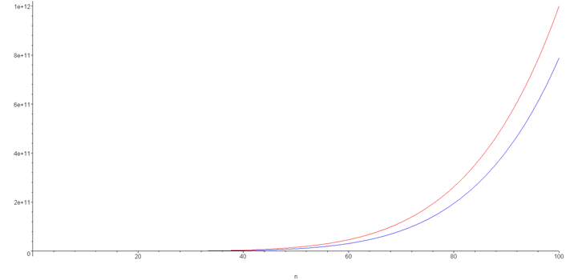
Polynomial Growth
However, as we extend the range to [0, 100], they appear to look a lot more similar:

Slide 52
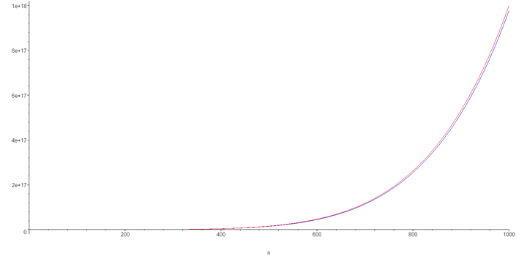
Polynomial Growth
And finally, around n = 1000, the relative difference is less than 3%

Slide 53
Polynomial Growth
The justification for both pairs of polynomials being similar is that, in both cases, they each had the same leading term:
n² in the first case
n⁶ in the second

Slide 54
Polynomial Growth
Suppose however, that the coefficients of the leading terms were different

Slide 55
Polynomial Growth
Suppose however, that the coefficients of the leading terms were different
In this case, both functions would exhibit the same rate of growth, however, one would always be proportionally larger

Slide 56
Counting Instructions

Slide 57
Counting Instructions
Suppose we had two algorithms which sorted a list of size n and the number of instructions is given by
b_{worst}(n) = 4.5n² – 0.5n + 5 Sort B
b_{best}(n) = 3.5n² + 0.5n + 5
s(n) = 4n² + 8n + 6 Sort S

Slide 58
Counting Instructions
Suppose we had two algorithms which sorted a list of size n and the number of instructions is given by
b_{worst}(n) = 4.5n² – 0.5n + 5 Sort B
b_{best}(n) = 3.5n² + 0.5n + 5
s(n) = 4n² + 8n + 6 Sort S
The smaller the value is, the fewer instructions are run
For n ≤ 17, b_{worst}(n) < s(n)
For n ≥ 18, b_{worst}(n) > s(n)

Slide 59
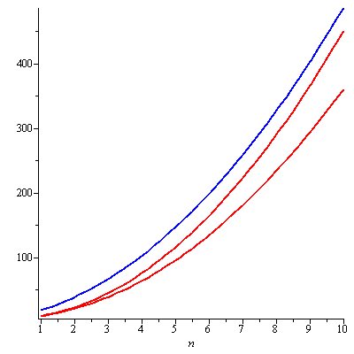
Counting Instructions
With small values of n, the algorithm described by s(n) requires more instructions than even the worst-case for sort b.

Slide 60
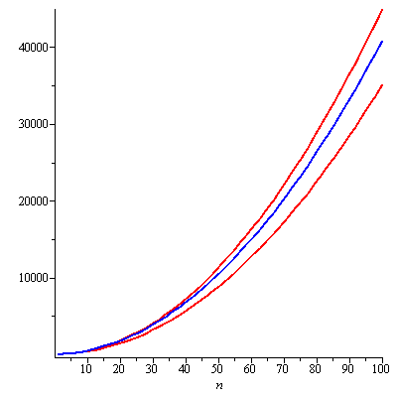
Counting Instructions
With larger and larger lists, the number of instructions is essentially proportional to the leading coefficients

Slide 61
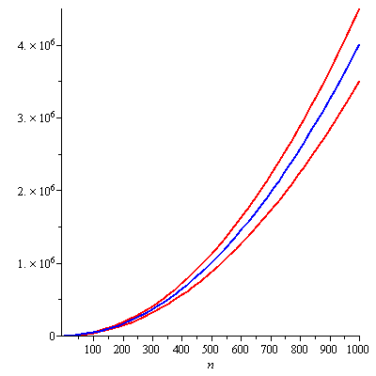
Counting Instructions
Near n = 1000,
b_{worst}(n) ≈ 1.125 s(n)
b_{best}(n) ≈ 0.875 s(n)
Is this a significant difference?

Slide 62
Asymptotic Analysis
Given an algorithm:
We need to be able to describe these values mathematically
We need a systematic means of using the description of the algorithm together with the properties of an associated data structure
We need to do this in a machine-independent way
For this, we need Landau symbols and the associated asymptotic analysis

Slide 63
Asymptotic Analysis
Big Idea
Ignore machine-dependent constants
Look at growth of T(n) as n → ∞ .
T(n): the Asymptotic Running Time
Neglects the fact that the time cost of each statement actually depends on the compiler, interpreter and the hardware platform
Stands for the worst case
T(n) can be denoted or approximated by a function f(n)

Slide 64
Landau Symbols
Before we begin, however, we will make some assumptions:
Our functions will describe the time or memory required to solve a problem of size n
We conclude we are restricting ourselves to certain functions:
They are defined for n ≥ 0 and n→∞
They are strictly positive for all n
In fact, f(n) > c for some value c > 0
That is, any problem requires at least one instruction and byte
They are non-decreasing (monotonic non-decreasing)

Slide 65
Landau Symbols - Big Θ
f(n) = Θ(g(n)) , if there exist positive constants c₁, c₂, and n₀ such that 0 ≤ c₁ g(n) ≤ f (n) ≤ c₂ g(n) for all n ≥ n₀ }
The function f(n) has a rate of growth equal to that of g(n)

Slide 66
Landau Symbols - Big Θ
These definitions are often unnecessarily tedious
Note, however, that if f(n) and g(n) are polynomials of the same degree with positive leading coefficients such that:
where

Slide 67
Landau Symbols - Big Θ
Suppose that f(n) and g(n) satisfy
From the definition, this means given c > ε > 0 there exists an n₀ > 0 such that whenever n > n₀
That is,

Slide 68
Landau Symbols - Big Θ
Thus, the statement says that f(n) = Θ(g(n))
Note that this only goes one way:
If where , it follows that f(n) = Θ(g(n))

Slide 69
Big Θ as an Equivalence Relation
Actually, f(n) = Θ(g(n)) describes an equivalence relation:
1. f(n) = Θ (g(n)) if and only if g(n) = Θ (f(n))
2. f(n) = Θ (f(n))
3. If f(n) = Θ (g(n)) and g(n) = Θ (h(n)), it follows that f(n) = Θ (h(n))
Consequently, we can group all functions into equivalence classes, where all functions within one class are big-theta Θ of each other

Slide 70
Big Θ as an Equivalence Relation
For example, all of n²
100000 n² – 4 n + 19
n² + 1000000
323 n² – 4 n ln(n) + 43 n + 10
42n² + 32
n² + 61 n ln²(n) + 7n + 14 ln³(n) + ln(n)
are big- Θ of each other
E.g., 42n² + 32 = Θ( 323 n² – 4 n ln(n) + 43 n + 10 )

Slide 71
Big Θ as an Equivalence Relation
For simple, we select one element to represent the class of these functions: n²
We could chose any function, but this is the simplest
Drop low-order terms
Ignore leading constants.
Example: 3n² + 90n – 5 log n + 6046 = Θ(n²)
Ignore
Drop

Slide 72
Big Θ as an Equivalence Relation
The most common classes are given names:
Θ (1) constant
Θ (log(n)) logarithmic
Θ (n) linear
Θ (n log(n)) “n log n”
Θ (n²) quadratic
Θ (n³) cubic
Θ (n!) factorial
2^{n}, e^{n}, 4^{n}, ... exponential

Slide 73
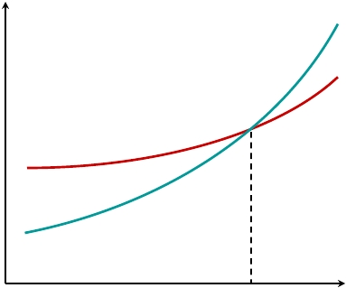
Big Θ as an Equivalence Relation
When n gets large enough, a Θ(n²) algorithm always beats a Θ(n³) algorithm.
Θ(n³)
Θ(n²)
T(n)
n
n₀

Slide 74
Big Θ as an Equivalence Relation
Recall that all logarithms are scalar multiples of each other:
Therefore log_{b}(n)= Θ(ln(n)) for any base b
Alternatively, there is no single equivalence class for exponential functions:
If 1 < a < b,
However, we will see that it is almost universally unacceptable to have an exponentially growing function!

Slide 75
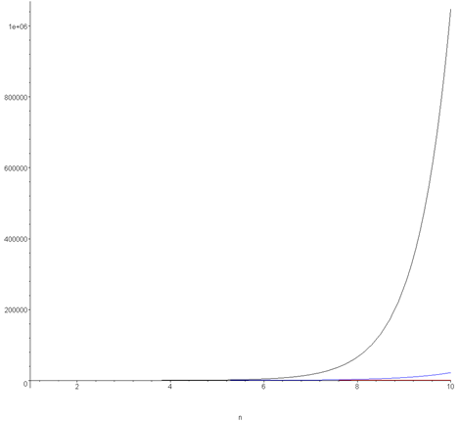
Big Θ as an Equivalence Relation
Plotting 2^{n}, e^{n}, and 4^{n} on the range [1, 10] already shows how significantly different the functions grow
Note:
2¹⁰ = 1,024
e¹⁰ ≈ 22,026
4¹⁰ = 1,048,576

Slide 76
Landau Symbols - Big O
f (n) = O(g(n)) , if there exist positive constants c and n₀ such that 0 ≤ f (n) ≤ c·g(n) for all n ≥ n₀ }
Similar to big Θ, we have another definition that If where , it follows that f(n) = O(g(n))

Slide 77
Landau Symbols - Big O
Example: 2n + 10 is O(n)
Proof:
2n + 10 ≤ cn => (c − 2) n ≥ 10 => n ≥ 10/(c − 2) Pick c = 3 and n₀ = 10

Slide 78
Landau Symbols - Big O
Example: n² is not O(n)
Proof: n² ≤ c·n => n ≤ c The above inequality cannot be satisfied since c must be a constant while n → ∞

Slide 79
Landau Symbols - Big O
3n³ + 20n² + 5 is O(n³)
need c > 0 and n₀ ≥ 1 such that 3n³ + 20n² + 5 ≤ cn³ for n ≥ n₀ => true for c = 4 and n₀ = 21
3 log n+5 is O(log n)
need c > 0 and n₀ ≥ 1 such that 3 log n+5 ≤ c log n for n ≥ n₀ => true for c = 8 and n₀ = 2

Slide 80
General Rules for calculating Big O
Ignore leading constants.
For d > 0, O(f(n)) = O(d·f(n)). Proof: O(f(n)) = g(n) => g (n) ≤ c·f(n) for all n ≥ n₀ => g (n) ≤ (c/d) ·(d·f(n)) for all n ≥ n₀
Thus, we practically prefer saying that the time complexity of program A is O(n) rather than O(6n).

Slide 81
General Rules for calculating Big O
Drop low-order terms.
2^{n}+n³ is O(2^{n}). Proof: need c > 0 and n₀ ≥ 1 such that 2^{n}+n³ ≤ c · 2^{n} for n ≥ n₀ => true for c = 2 and n₀ = 10 => actually, we can drop n³ at the beginning since
Every exponential grows faster than a polynomial.

Slide 82
Tightness of Big O
3n³ + 20n² + 5 is O(n³)
Naturally, we can prove that 3n³ + 20n² + 5 is O(n⁴)
We generally prefer a tight bound on big O (or else the big Θ), when we can prove it.
However, an upper bound is acceptable under many circumstances
Tight bound, = Θ(n³)
Not a tight bound

Slide 83
Big-Oh Operations
O(f(n))+O(g(n)) = O(max{f(n), g(n)})
O(f(n))+O(g(n)) = O(f(n)+g(n))
O(f(n)) ·O(g(n)) = O(f(n) ·g(n))
O(c·f(n)) = O(f(n))

Slide 84
Important Functions
The most common classes are given names:
O (1) constant
O (log(n)) logarithmic
O (n) linear
O (n log(n)) “n log n”
O (n²) quadratic
O (n³) cubic
O (n!) factorial
2^{n}, e^{n}, 4^{n}, ... exponential

Slide 85
O(n)
h = 0 for (i = 0; i < n; i++) { h += i; }

Slide 86
O(n²)
h = 0; for (i = 0; i < n; i++) { for (j = 0; j < n; j++) { h += i * j; } }

Slide 87
O(n²)
h = 0;
for (i = 0; i < n; i++) { for (j = 0; j < i; j++) { h += i * j; } }
Since the second loop depends on the first, we can denote the looping step number by which is O(n²).

Slide 88
O(log n)
h=0, k = 1;
while(k<=n) { h += k; k = 2*k; }
In this case, the index k jumps (i.e. k takes on values {1, 2, 4 …}) till n is exceeded.
There will be log (n) + 1 steps, therefore the complexity is O(log n).

Slide 89
Landau Symbols - Big O
f (n) = O(g(n)) , if there exist positive constants c and n₀ such that 0 ≤ f (n) ≤ c·g(n) for all n ≥ n₀ }
Similar to big Θ, we have another definition that If where , it follows that f(n) = O(g(n))

Slide 90
Landau Symbols - Big Ω
f(n) = Ω(g(n)) , if there exist positive constants c and n₀ such that 0 ≤ c·g(n) ≤ f(n) for all n ≥ n₀ }
Similar to big Θ, we have another definition that If where , it follows that f(n) = Ω(g(n))

Slide 91
The Relationship between Θ, O and Ω
O - Upper bounds.
f(n) is O(g(n)) if there exist constants c > 0 and n₀ ≥ 0 such that for all n ≥ n₀ we have f(n) ≤ c · g(n).
Ω - Lower bounds.
f(n) is Ω(g(n)) if there exist constants c > 0 and n₀ ≥ 0 such that for all n ≥ n0 we have f(n) ≥ c · g(n).
Θ - Tight bounds.
f(n) is Θ(g(n)) if f(n) is both O(g(n)) and Ω(g(n)).

Slide 92
Intuition for Θ, O and Ω
O
f(n) is O(g(n)) if f(n) is asymptotically less than or equal to g(n)
Ω
f(n) is Ω(g(n)) if f(n) is asymptotically greater than or equal to g(n)
Θ
f(n) is Θ(g(n)) if f(n) is asymptotically equal to g(n)

Slide 93
Another Intuition for Θ, O and Ω
O
f(n)= O(g(n)) ≈ a ≤ b
Ω
f(n)= Ω(g(n)) ≈ a ≥ b
Θ
f(n)= Θ(g(n)) ≈ a = b
f(n)
c · g(n)

Slide 94
Example for Θ, O and Ω
f(n) = 32n² + 17n + 32
f(n) is O(n²), O(n³)
f(n) is Ω(n²), Ω(n)
f(n) is Θ (n²)
f(n) is not O(n)
f(n) is not Ω(n³)
f(n) is neither Θ (n) nor Θ (n³)

Slide 95
Five Landau Symbols
We sometimes use these five possible descriptions:

Slide 96
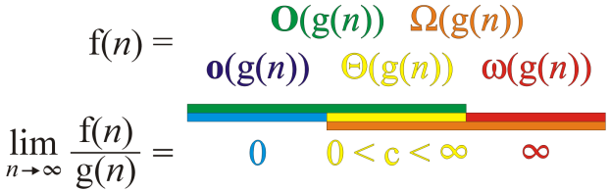
Five Landau Symbols
Graphically, we can summarize these as follows:
We say
if
In the following , we intend to use big O and big Θ mostly.

Slide 97
Outline
In this topic, we will examine code to determine the run time of various operations
We will calculate the run times of:
Operators +, -, =, +=, ++, etc.
Control statements if, for, while, do-while, switch
Functions
Recursive functions

Slide 98
3.2 ANALYSIS of OPERATIONS
Notes:
98

Slide 99
Motivation
The goal of algorithm analysis is to take a block of code and determine the asymptotic run time or asymptotic memory requirements based on various parameters
Given an array of size n:
Selection sort requires Θ(n²) time
Merge sort, quick sort, and heap sort all require Θ(n log(n)) time
However:
Merge sort requires Θ(n) additional memory
Quick sort requires Θ(log(n)) additional memory
Heap sort requires Θ(1) memory

Slide 100
Motivation
The asymptotic behaviors of algorithms indicates the ability to scale
Suppose we are sorting an array of size n
Selection sort has a run time of Θ(n²)
2n entries requires (2n)² = 4n²
Four times as long to sort
10n entries requires (10n)² = 100n²
One hundred times as long to sort

Slide 101
Motivation
The other sorting algorithms have Θ(n log(n)) run times
2n entries require (2n) log(2n) = (2n) (log(n) + 1) = 2(n log(n)) + 2n
10n entries require (10n) log(10n) = (10n) (log(n) + log(10)) = 10(n log(n)) + 10n*log(10)
In each case, it requires Θ(n) more time
However:
Merge sort will require twice and 10 times as much memory
Quick sort will require one or four additional memory locations
Heap sort will not require any additional memory

Slide 102
Motivation
If we are storing objects which are not related, the hash table has, in many cases, optimal characteristics:
Many operations are Θ(1)
I.e., the run times are independent of the number of objects being stored
If we are required to store both objects and relations, both memory and time will increase
Our goal will be to minimize this increase

Slide 103
Motivation
To properly investigate the determination of run times asymptotically, we will discuss
Operations
Control statements
Conditional statements and loops
Functions
Recursive functions

Slide 104
Operators
Because each machine instruction can be executed in a fixed time, we may assume each operation requires a fixed time
The time required for any operator is Θ(1) including:
Retrieving/storing variables from memory
Variable assignment =
Integer operations + - * / % ++ --
Logical operations && || !
Bitwise operations & | ^ ~
Relational operations == != < <= => >
Memory allocation and deallocation new delete

Slide 105
Operators
Of these, memory allocation and deallocation are the slowest by a significant factor
A quick test on unix shows a factor of over 100
They require communication with the operation system
This does not account for the time required to call the constructor and destructor
Note that after memory is allocated, the constructor is run
The constructor may not run in Θ(1) time

Slide 106
Blocks of Operations
Each operation runs in Θ(1) time and therefore any fixed number of operations also run in Θ(1) time, for example:
Swap variables a and b
int tmp = a;
a = b;
b = tmp;
Update a sequence of values
++index;
prev_modulus = modulus;
modulus = next_modulus;
next_modulus = modulus_table[index];

Slide 107
Blocks in Sequence
Suppose you have now analyzed a number of blocks of code run in sequence
template <typename T>
void update_capacity( int delta ) {
T *array_old = array;
int capacity_old = array_capacity; array_capacity += delta;
array = new T[array_capacity];
for ( int i = 0; i < capacity_old; ++i ) {
array[i] = array_old[i];
}
delete[] array_old;
}
To calculate the total run time, add the entries: Θ(1 + n + 1) = Θ(n)
Θ(1)
Θ(n)
Θ(1)

Slide 108
Blocks in Sequence
Other examples include:
Run three blocks of code which are Θ(1), Θ(n²), and Θ(n) total run time Θ(1 + n² + n) = Θ(n²)
Run two blocks of code which are Θ(n log(n)), and Θ(n^{1.5}) total run time Θ(n log(n) + n^{1.5}) = Θ(n^{1.5})
When considering a sum, take the dominant term

Slide 109
Control Statements
Next we will look at the following control statements
These are statements which potentially alter the execution of instructions
Conditional statements
if, switch
Condition-controlled loops
for, while, do-while
Count-controlled loops
for i from 1 to 10 do ... end do;
Collection-controlled loops
foreach ( int i in array ) { ... }

Slide 110
Control Statements
Given any collection of nested control statements, it is always necessary to work inside out
Determine the run times of the inner-most statements and work your way out

Slide 111
Control Statements
Given
if ( condition ) {
// true body
} else {
// false body
}
The run time of a conditional statement is:
the run time of the condition (the test), plus
the run time of the body which is run
In most cases, the run time of the condition is Θ(1)

Slide 112
Control Statements
In some cases, it is easy to determine which statement must be run:
int factorial ( int n ) {
if ( n == 0 ) {
return 1;
} else {
return n * factorial ( n – 1 );
}
}

Slide 113
Control Statements
In others, it is less obvious
Find the maximum entry in an array:
int find_max( int *array, int n ) {
max = array[0];
for ( int i = 1; i < n; ++i ) {
if ( array[i] > max ) {
max = array[i];
}
}
return max;
}

Slide 114
Analysis of Statements
In this case, we don’t know
If we had information about the distribution of the entries of the array, we may be able to determine it
if the list is sorted (ascending) it will always be run
if the list is sorted (descending) it will be run once
if the list is uniformly randomly distributed, then???

Slide 115
Condition-controlled Loops
The C++ for loop is a condition controlled statement:
for ( int i = 0; i < N; ++i ) {
// ...
}
is identical to
int i = 0; // initialization
while ( i < N ) { // condition
// ...
++i; // increment
}

Slide 116
Condition-controlled Loops
The initialization, condition, and increment usually are single statements running in Θ(1)
for ( int i = 0; i < N; ++i ) {
// ...
}

Slide 117
Condition-controlled Loops
The initialization, condition, and increment statements are usually Θ(1)
For example,
for ( int i = 0; i < n; ++i ) {
// ...
}
Thus, the run time is at Ω(1) , that is, at least the initialization and one condition must occur

Slide 118
Condition-controlled Loops
If the body does not depend on the variable (in this example, i), then the run time of
for ( int i = 0; i < n; ++i ) {
// code which is Theta(f(n))
}
is Θ(n f(n))
If the body is O(f(n)), then the run time of the loop is O(n f(n))

Slide 119
Condition-controlled Loops
For example,
int sum = 0;
for ( int i = 0; i < n; ++i ) {
sum += 1; Theta(1)
}
This code has run time
Θ(n·1) = Θ(n)

Slide 120
Condition-controlled Loops
Another example example,
int sum = 0;
for ( int i = 0; i < n; ++i ) {
for ( int j = 0; j < n; ++j ) {
sum += 1; Theta(1)
}
}
The previous example showed that the inner loop is Θ(n), thus the outer loop is
Θ(n·n) = Θ(n²)

Slide 121
Conditional Statements
Consider this example
void Disjoint_sets::clear() {
if ( sets == n ) {
return;
}
max_height = 0;
num_disjoint_sets = n;
for ( int i = 0; i < n; ++i ) {
parent[i] = i;
tree_height[i] = 0;
}
}
Θ(1)
Θ(1)
Θ(n)
Θ(1)

Slide 122
Analysis of Repetition Statements
Suppose with each loop, we use a linear search an array of size m:
for ( int i = 0; i < n; ++i ) {
// search through an array of size m
Execution Body
// O( m );
}
The inner loop is O(m) and thus the outer loop is
O(n·m)

Slide 123
Analysis of Repetition Statements
If the body does depends on the variable (in this example, i), then the run time of
for ( int i = 0; i < n; ++i ) {
// code which is Theta(f(i,n))
}
is ; and if the body is O(f(i, n)), then the result is

Slide 124
Analysis of Repetition Statements
For example,
int sum = 0;
for ( int i = 0; i < n; ++i ) {
for ( int j = 0; j < i; ++j ) {
sum += i + j;
}
}
The inner loop is Θ (1 + i(1 + 1) ) = Θ(i) hence the outer is

Slide 125
Analysis of Repetition Statements
As another example:
int sum = 0;
for ( int i = 0; i < n; ++i ) {
for ( int j = 0; j < i; ++j ) {
for ( int k = 0; k < j; ++k ) {
sum += i + j + k;
}
}
}
From inside to out:
Θ(1)
Θ(j)
Θ(i²)
Θ(n³)

Slide 126
Control Statements
Switch statements appear to be nested if statements:
switch( i ) {
case 1: /* do stuff */ break;
case 2: /* do other stuff */ break;
case 3: /* do even more stuff */ break;
case 4: /* well, do stuff */ break;
case 5: /* tired yet? */ break;
default: /* do default stuff */
}

Slide 127
Control Statements
Thus, a switch statement would appear to run in O(n) time where n is the number of cases, the same as nested if statements
Then why not use:
if ( i == 1 ) { /* do stuff */ }
else if ( i == 2 ) { /* do other stuff */ }
else if ( i == 3 ) { /* do even more stuff */ }
else if ( i == 4 ) { /* well, do stuff */ }
else if ( i == 5 ) { /* tired yet? */ }
else { /* do default stuff */ }

Slide 128
Control Statements
However, switch statements were included in the original C language... why?
First, you may recall that the cases must be actual values, either:
integers
characters
For example, you cannot have a case with a variable, e.g.,
case n: /* do something */ break; //bad

Slide 129
Control Statements
The compiler looks at the different cases and calculates an appropriate jump
For example, assume:
the cases are 0, 1, 2, 3, 4, 5, 6, 7, 8, 9, 10
each case requires a maximum of 24 bytes (for example, six instructions)
Then the compiler simply makes a jump size based on the variable, jumping ahead either 0, 24, 48, 72, ..., or 240 instructions

Slide 130
Serial Statements
Suppose we run one block of code followed by another block of code
Such code is said to be run serially
If the first block of code is O(f(n)) and the second is O(g(n)), then the run time of both two blocks is
O( f(n) + g(n) )
which usually (for algorithms not including function calls) simplifies to one or the other

Slide 131
Serial Statements
Consider the following two problems:
search through a random list of size n to find the maximum entry, and
search through a random list of size n to find if it contains a particular entry
What is the proper means of describing the run time of these two algorithms?

Slide 132
Serial Statements
Searching for the maximum entry requires that each element in the array be examined
thus, it must run in Θ(n) time
Searching for a particular entry may end earlier
for example, the first entry we are searching for may be the one we are looking for, thus, it runs in O(n) time

Slide 133
Serial Statements
Therefore,
if the leading term is big-Θ, then the result must be big-Θ, otherwise
if the leading term is big-O, we can say the result is big-O
For example,
O(n) + O(n²) + O(n⁴) = O(n + n² + n⁴) = O(n⁴)
O(n) + Θ(n²) = Θ(n²)
O(n²) + Θ(n) = O(n²)
O(n²) + Θ(n²) = Θ(n²)

Slide 134
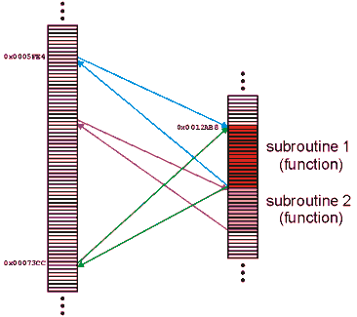
Functions
A function (or subroutine) is code which has been separated out, either to:
and repeated operations
e.g., mathematical functions
group related tasks
e.g., initialization

Slide 135
Functions
Because a subroutine (function) can be called from anywhere, we must:
prepare the appropriate environment
deal with arguments (parameters)
jump to the subroutine
execute the subroutine
deal with the return value
clean up

Slide 136
Functions
Fortunately, this is such a common task that all modern processors have instructions that perform most of these steps in one instruction
Thus, we can assume that the overhead required to make a function call and to return is Θ(1)

Slide 137
Functions
Because any function requires the overhead of a function call and return, we will always assume that
T_{f} = Ω(1)
That is, it is impossible for any function call to have a zero run time

Slide 138
Functions
Thus, given a function f(n) (the run time of which depends on n) we will associate the run time of f(n) by some function T_{f}(n)
We may write this to T(n)
Because the run time of any function is at least O(1), we will include the time required to both call and return from the function in the run time

Slide 139
Functions
Consider this function:
void Disjoint_sets::set_union( int m, int n ) {
m = find( m );
n = find( n );
if ( m == n ) {
return;
}
--num_disjoint_sets;
if ( tree_height[m] >= tree_height[n] ) {
parent[n] = m;
if ( tree_height[m] == tree_height[n] ) {
++( tree_height[m] );
max_height = std::max( max_height, tree_height[m] );
}
} else {
parent[m] = n;
}
}
2T_{find}
Θ(1)
T_{set_union}= 2T_{find} + Θ(1)

Slide 140
Recursive Functions
A function is relatively simple (and boring) if it simply performs operations and calls other functions
Most interesting functions designed to solve problems usually end up calling themselves
Such a function is said to be recursive

Slide 141
Recursive Functions
As an example, we could implement the factorial function recursively:
int factorial( int n ) {
if ( n <= 1 ) {
return 1;
} else {
return n * factorial( n – 1 );
}
}

Slide 142
Recursive Functions
Thus, we may analyze the run time of this function as follows:
We don’t have to worry about the time of the conditional (Θ(1)) nor is there a probability involved with the conditional statement

Slide 143
Recursive Functions
The analysis of the run time of this function yields a recurrence relation:
T!(n) = T!(n – 1) + Θ(1) T!(1) = Θ(1)
This recurrence relation has Landau symbols and we replace each Landau symbol with a representative function:
T!(n) = T!(n – 1) + 1 T!(1) = 1

Slide 144
Recursive Functions
We can examine the first few steps:
T!(n) = T!(n – 1) + 1
= T!(n – 2) + 1 + 1 = T!(n – 2) + 2
= T!(n – 3) + 3

Slide 145
Recursive Functions
We can examine the first few steps:
T!(n) = T!(n – 1) + 1
= T!(n – 2) + 1 + 1 = T!(n – 2) + 2
= T!(n – 3) + 3
From this, we see a pattern:
T!(n) = T!(n – k) + k
When k = n – 1, …
T!(n) = T!(n – k) + k

Slide 146
Recursive Functions
If k = n – 1 then
T!(n) = T!(n – (n – 1)) + n – 1
= T!(1) + n – 1
= 1 + n – 1 = n

Slide 147
Recursive Functions
If k = n – 1 then
T!(n) = T!(n – (n – 1)) + n – 1
= T!(1) + n – 1
= 1 + n – 1 = n

Slide 148
Recursive Functions
If k = n – 1 then
T!(n) = T!(n – (n – 1)) + n – 1
= T!(1) + n – 1
= 1 + n – 1 = n
Thus, T!(n) = Θ(n)

Slide 149
Recursive Functions
Suppose we want to sort a array of n items

Slide 150
Recursive Functions
Suppose we want to sort a array of n items
We could:
go through the list and find the largest item
swap the last entry in the list with that largest item
then, go on and sort the rest of the array

Slide 151
Recursive Functions
Suppose we want to sort a array of n items
We could:
go through the list and find the largest item
swap the last entry in the list with that largest item
then, go on and sort the rest of the array
This is called selection sort

Slide 152
Recursive Functions
void sort( int * array, int n ) {
if ( n <= 1 ) {
return; // special case: 0 or 1 items are always sorted
}
int posn = 0; // assume the first entry is the smallest
int max = array[posn];
for ( int i = 1; i < n; ++i ) { // search through the remaining entries
if ( array[i] > max ) { // if a larger one is found
posn = i; // update both the position and value
max = array[posn];
}
}
int tmp = array[n - 1]; // swap the largest entry with the last
array[n - 1] = array[posn];
array[posn] = tmp;
sort( array, n – 1 ); // sort everything else
}

Slide 153
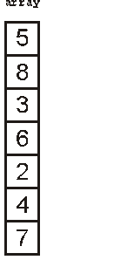
Recursive Functions
We could call this function as follows:
int *array = {5, 8, 3, 6, 2, 4, 7};
sort( array, 7 ); // sort an array of seven items

Slide 154
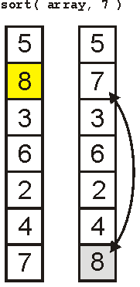
Recursive Functions
The first call finds the largest element

Slide 155
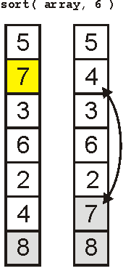
Recursive Functions
The next call finds the 2nd-largest element

Slide 156
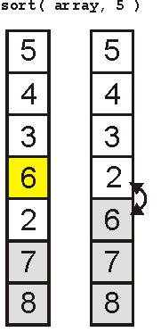
Recursive Functions
The third finds the 3rd-largest

Slide 157
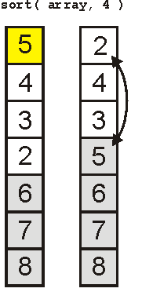
Recursive Functions
And the 4th

Slide 158
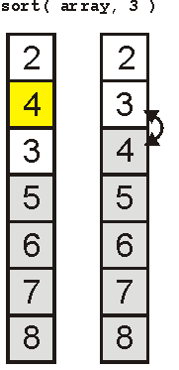
Recursive Functions
And the 5th

Slide 159
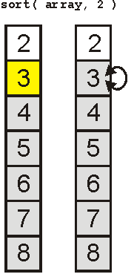
Recursive Functions
Finally the 6th

Slide 160
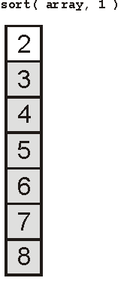
Recursive Functions
And the array is sorted:

Slide 161
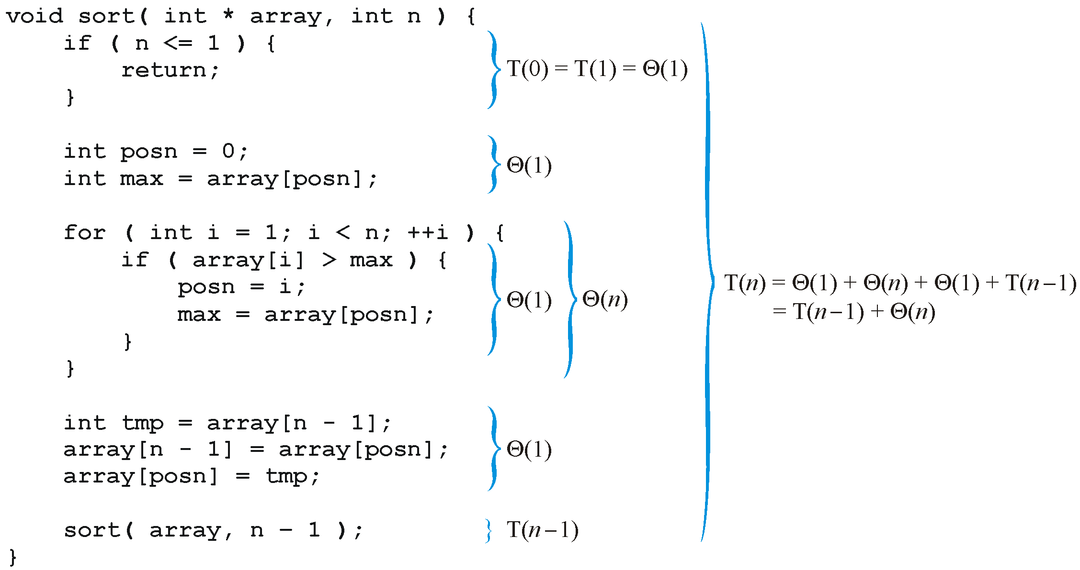
Recursive Functions
Analyzing the function, we get:

Slide 162
Recursive Functions
Thus, replacing each Landau symbol with a representative, we are required to solve the recurrence relation:
T(n) = T(n – 1) + n T(1) = 1

Slide 163
Recursive Functions
Consequently, the sorting routine has the run time
T(n) = Θ(n²)
To see this by hand, consider the following

Slide 164
Recursive Functions
Consider, instead, a binary search of a sorted list:
check the middle entry
if we do not find it, check either the left- or right-hand side, as appropriate
Thus, T(n) = T((n – 1)/2) + Θ(1)

Slide 165
Recursive Functions
Also, if n = 1, then T(1) = Θ(1); thus we have to solve:
Solving this can be difficult, in general, so we will consider only special values of n
Assume n = 2^{k} – 1 where k is an integer
Then (n – 1)/2 = (2^{k} – 1 – 1)/2 = 2^{k – 1} – 1

Slide 166
Recursive Functions
For example, searching a list of size 31 requires us to check the center
If it is not found, we must check one of the two halves, each of which is size 15
31 = 2⁵ – 1
15 = 2⁴ – 1

Slide 167
Recursive Functions
Thus, we can write

Slide 168
Recursive Functions
Notice the pattern with one more step:

Slide 169
Recursive Functions
Thus, in general, we may deduce that after k – 1 steps:
because T(1) = 1

Slide 170
Recursive Functions
Thus, T(n) = k, but n = 2^{k} – 1
Therefore k = lg(n + 1)
Further, recall that f(n) = Θ(g(n)) if for
Thus, T(n) = Θ(lg(n + 1)) = Θ (log(n))

Slide 171
Exercises
CRLS 3.1-1: Let f(n)and g(n)be asymptotically nonnegative functions. Using the basic definition of Θ notation, prove that max(f(n), g(n)) = Θ(f(n)+g(n))
CRLS 3.1-2: Show that for any real constants a and b, where b > 0, (n+a)^{b} = Θ(n^{b})
CRLS 3.1-3: Explain why the statement, “The running time of algorithm A is at least O(n²),” is meaningless.

Slide 172
Exercises
CRLS 3.2-1
CRLS 3.2-3
CRLS 3-1

Slide 173
End of Section.
算法分析课程组
重庆大学计算机学院
Notes:
本人是国际视觉电生理学会(ISCEV)的会员。

