Slide 1
Algorithm Analysis & Design Introduction to Algorithm
T&R Team of Algorithm Design
College of Computer Science, CQU
Notes:
本人是国际视觉电生理学会(ISCEV)的会员。

Slide 2
Chapter 4: Merge Sort and Recursion

Slide 3
Outline
2.1 Merge Sort
2.2 Recursion Analyzing

Slide 4
2.1 Merge Sort
Notes:
4

Slide 5
Merging Sort
A typical algorithm based on divide-and-conquer
Divide: divide the given n-element-array into two sub arrays of about n/2 elements either
Conquer: sort the two sub arrays recursively
Merge: merge the two sorted sub arrays to generate the final output

Slide 6
Merging Sort Pseudo Code
Input: the unsorted array A[p…r]
Output: the sorted array A’

Slide 7
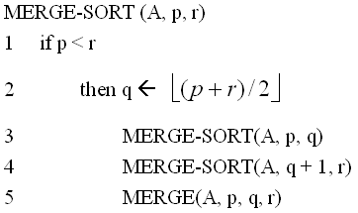
Merging Sort Pseudo Code
Input: the unsorted array A[p…r]
Output: the sorted array A’

Slide 8
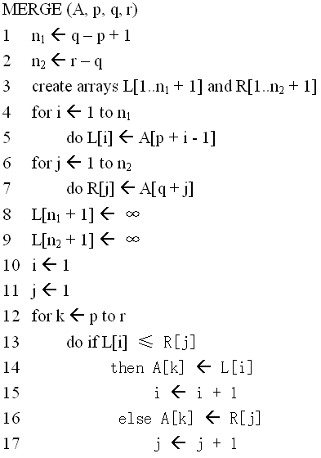
Pseudo Code of the Merge Procedure
R

Slide 9
Merge Sort - Split
L
A
R
O
G
I
T
M
H
S
Initial Input

Slide 10
Merge Sort - Split
L
A
R
O
G
I
T
M
H
S
Initial Input
split
L
A
R
O
G
I
T
M
H
S

Slide 11
Merge Sort - Split
L
A
R
O
G
I
T
M
H
S
Initial Input
split
L
A
R
O
G
I
T
M
H
S
split
split
L
A
R
O
G
I
T
M
H
S

Slide 12
Merge Sort - Split
L
A
R
O
G
I
T
M
H
S
Initial Input
split
L
A
R
O
G
I
T
M
H
S
split
split
L
A
R
O
G
I
T
M
H
S
split
split
split
split
L
A
R
O
G
I
T
M
H
S

Slide 13
Merge Sort - Split
L
A
R
O
G
I
T
M
H
S
Initial Input
split
L
A
R
O
G
I
T
M
H
S
split
split
L
A
R
O
G
I
T
M
H
S
split
split
split
split
L
A
R
O
G
I
T
M
H
S
split
split
L
A
I
T

Slide 14
Merge Sort - Merge
L
A
I
T
R
O
G
M
H
S

Slide 15
Merge Sort - Merge
L
A
I
T
merge
merge
A
L
R
O
G
I
T
M
H
S

Slide 16
Merge Sort - Merge
L
A
I
T
merge
merge
A
L
R
O
G
I
T
M
H
S
merge
merge
merge
merge
A
L
R
G
O
I
M
T
H
S

Slide 17
Merge Sort - Merge
L
A
I
T
merge
merge
A
L
R
O
G
I
T
M
H
S
merge
merge
merge
merge
A
L
R
G
O
I
M
T
H
S
merge
merge
A
G
L
O
R
H
I
M
S
T

Slide 18
Merge Sort - Merge
L
A
I
T
merge
merge
A
L
R
O
G
I
T
M
H
S
merge
merge
merge
merge
A
L
R
G
O
I
M
T
H
S
merge
merge
A
G
L
O
R
H
I
M
S
T
merge
Final Output
A
G
H
I
L
M
O
R
S
T

Slide 19
Merging Example
Merge.
Keep track of smallest element in each sorted half.
Insert smallest of two elements into auxiliary array.
Repeat until done.
smallest
smallest
A
G
L
O
R
H
I
M
S
T
auxiliary array

Slide 20
Merging Example
Merge.
Keep track of smallest element in each sorted half.
Insert smallest of two elements into auxiliary array.
Repeat until done.
smallest
smallest
A
G
L
O
R
H
I
M
S
T
A
auxiliary array

Slide 21
Merging Example
Merge.
Keep track of smallest element in each sorted half.
Insert smallest of two elements into auxiliary array.
Repeat until done.
smallest
smallest
A
G
L
O
R
H
I
M
S
T
A
auxiliary array

Slide 22
Merging Example
Merge.
Keep track of smallest element in each sorted half.
Insert smallest of two elements into auxiliary array.
Repeat until done.
smallest
smallest
A
G
L
O
R
H
I
M
S
T
A
G
auxiliary array

Slide 23
Merging Example
Merge.
Keep track of smallest element in each sorted half.
Insert smallest of two elements into auxiliary array.
Repeat until done.
smallest
smallest
A
G
L
O
R
H
I
M
S
T
A
G
auxiliary array

Slide 24
Merging Example
Merge.
Keep track of smallest element in each sorted half.
Insert smallest of two elements into auxiliary array.
Repeat until done.
smallest
smallest
A
G
L
O
R
H
I
M
S
T
A
G
H
auxiliary array

Slide 25
Merging Example
Merge.
Keep track of smallest element in each sorted half.
Insert smallest of two elements into auxiliary array.
Repeat until done.
smallest
smallest
A
G
L
O
R
H
I
M
S
T
A
G
H
auxiliary array

Slide 26
Merging Example
Merge.
Keep track of smallest element in each sorted half.
Insert smallest of two elements into auxiliary array.
Repeat until done.
smallest
smallest
A
G
L
O
R
H
I
M
S
T
A
G
H
I
auxiliary array

Slide 27
Merging Example
Merge.
Keep track of smallest element in each sorted half.
Insert smallest of two elements into auxiliary array.
Repeat until done.
smallest
smallest
A
G
L
O
R
H
I
M
S
T
A
G
H
I
auxiliary array

Slide 28
Merging Example
Merge.
Keep track of smallest element in each sorted half.
Insert smallest of two elements into auxiliary array.
Repeat until done.
smallest
smallest
A
G
L
O
R
H
I
M
S
T
A
G
H
I
L
auxiliary array

Slide 29
Merging Example
Merge.
Keep track of smallest element in each sorted half.
Insert smallest of two elements into auxiliary array.
Repeat until done.
smallest
smallest
A
G
L
O
R
H
I
M
S
T
A
G
H
I
L
auxiliary array

Slide 30
Merging Example
Merge.
Keep track of smallest element in each sorted half.
Insert smallest of two elements into auxiliary array.
Repeat until done.
smallest
smallest
A
G
L
O
R
H
I
M
S
T
A
G
H
I
L
M
auxiliary array

Slide 31
Merging Example
Merge.
Keep track of smallest element in each sorted half.
Insert smallest of two elements into auxiliary array.
Repeat until done.
smallest
smallest
A
G
L
O
R
H
I
M
S
T
A
G
H
I
L
M
auxiliary array

Slide 32
Merging Example
Merge.
Keep track of smallest element in each sorted half.
Insert smallest of two elements into auxiliary array.
Repeat until done.
smallest
smallest
A
G
L
O
R
H
I
M
S
T
A
G
H
I
L
M
O
auxiliary array

Slide 33
Merging Example
Merge.
Keep track of smallest element in each sorted half.
Insert smallest of two elements into auxiliary array.
Repeat until done.
smallest
smallest
A
G
L
O
R
H
I
M
S
T
A
G
H
I
L
M
O
auxiliary array

Slide 34
Merging Example
Merge.
Keep track of smallest element in each sorted half.
Insert smallest of two elements into auxiliary array.
Repeat until done.
smallest
smallest
A
G
L
O
R
H
I
M
S
T
A
G
H
I
L
M
O
R
auxiliary array

Slide 35
Merging Example
Merge.
Keep track of smallest element in each sorted half.
Insert smallest of two elements into auxiliary array.
Repeat until done.
first half exhausted
smallest
A
G
L
O
R
H
I
M
S
T
A
G
H
I
L
M
O
R
auxiliary array

Slide 36
Merging Example
Merge.
Keep track of smallest element in each sorted half.
Insert smallest of two elements into auxiliary array.
Repeat until done.
first half exhausted
smallest
A
G
L
O
R
H
I
M
S
T
A
G
H
I
L
M
O
R
S
auxiliary array

Slide 37
Merging Example
Merge.
Keep track of smallest element in each sorted half.
Insert smallest of two elements into auxiliary array.
Repeat until done.
first half exhausted
smallest
A
G
L
O
R
H
I
M
S
T
A
G
H
I
L
M
O
R
S
auxiliary array

Slide 38
Merging Example
Merge.
Keep track of smallest element in each sorted half.
Insert smallest of two elements into auxiliary array.
Repeat until done.
first half exhausted
smallest
A
G
L
O
R
H
I
M
S
T
A
G
H
I
L
M
O
R
S
T
auxiliary array

Slide 39
Merging Example
Merge.
Keep track of smallest element in each sorted half.
Insert smallest of two elements into auxiliary array.
Repeat until done.
first half exhausted
second half exhausted
A
G
L
O
R
H
I
M
S
T
A
G
H
I
L
M
O
R
S
T
auxiliary array

Slide 40
Merge Sort – Combine with Insertion Sort
Consider the following is of unsorted array of 23 entries
We will call insertion sort if the list being sorted is less than n = 8
13 | 77 | 49 | 35 | 61 | 48 | 3 | 23 | 95 | 73 | 89 | 37 | 57 | 99 | 94 | 28 | 15 | 55 | 7 | 51 | 88 | 97 | 62

Slide 41
Merge Sort – Combine with Insertion Sort
Consider the following is of unsorted array of 23 entries
The first and last entries are at indices first = 0 and last = 22
We will split the list at midpoint = (0 + 22)/2, which equals 11 and recursively call merge sort on entries 0 through 11 and 12 through 22
13 | 77 | 49 | 35 | 61 | 48 | 3 | 23 | 95 | 73 | 89 | 37 | 57 | 99 | 94 | 28 | 15 | 55 | 7 | 51 | 88 | 97 | 62

Slide 42
Merge Sort – Combine with Insertion Sort
We are now sorting positions 0 through 11, inclusive
Again, we calculate midpoint = (0 + 11)/2, which equals 5 and recursively sort entries 0 through 5 and 6 through 11
13 | 77 | 49 | 35 | 61 | 48 | 3 | 23 | 95 | 73 | 89 | 37 | 57 | 99 | 94 | 28 | 15 | 55 | 7 | 51 | 88 | 97 | 62

Slide 43
Merge Sort – Combine with Insertion Sort
This sub-list has only 6 entries, so we call insertion sort
13 | 77 | 49 | 35 | 61 | 48 | 3 | 23 | 95 | 73 | 89 | 37 | 57 | 99 | 94 | 28 | 15 | 55 | 7 | 51 | 88 | 97 | 62
13 | 35 | 48 | 49 | 61 | 77 | 3 | 23 | 95 | 73 | 89 | 37 | 57 | 99 | 94 | 28 | 15 | 55 | 7 | 51 | 88 | 97 | 62

Slide 44
Merge Sort – Combine with Insertion Sort
This sub-list also has only 6 entries: call insertion sort
13 | 35 | 48 | 49 | 61 | 77 | 3 | 23 | 95 | 73 | 89 | 37 | 57 | 99 | 94 | 28 | 15 | 55 | 7 | 51 | 88 | 97 | 62
13 | 35 | 48 | 49 | 61 | 77 | 3 | 23 | 37 | 73 | 89 | 95 | 57 | 99 | 94 | 28 | 15 | 55 | 7 | 51 | 88 | 97 | 62

Slide 45
Merge Sort – Combine with Insertion Sort
These first two lists are now sorted, so we merge them:
13 | 35 | 48 | 49 | 61 | 77 | 3 | 23 | 37 | 73 | 89 | 95 | 57 | 99 | 94 | 28 | 15 | 55 | 7 | 51 | 88 | 97 | 62
3 | 13 | 23 | 35 | 37 | 48 | 49 | 61 | 73 | 77 | 89 | 95 | 57 | 99 | 94 | 28 | 15 | 55 | 7 | 51 | 88 | 97 | 62

Slide 46
Merge Sort – Combine with Insertion Sort
We now proceed to the second half at positions 12 through 23
The midpoint is at midpoint = (12 + 23)/2, which equals 17 and recursively call merge sort on entries 12 through 17 and 18 through 22
3 | 13 | 23 | 35 | 37 | 48 | 49 | 61 | 73 | 77 | 89 | 95 | 57 | 99 | 94 | 28 | 15 | 55 | 7 | 51 | 88 | 97 | 62

Slide 47
Merge Sort – Combine with Insertion Sort
The sub-list from 12 through 17 has 6 entries: call insertion sort
3 | 13 | 23 | 35 | 37 | 48 | 49 | 61 | 73 | 77 | 89 | 95 | 57 | 99 | 94 | 28 | 15 | 55 | 7 | 51 | 88 | 97 | 62
3 | 13 | 23 | 35 | 37 | 48 | 49 | 61 | 73 | 77 | 89 | 95 | 15 | 28 | 55 | 57 | 94 | 99 | 7 | 51 | 88 | 97 | 62

Slide 48
Merge Sort – Combine with Insertion Sort
The sub-list from 18 through 22 has 5 entries: call insertion sort
3 | 13 | 23 | 35 | 37 | 48 | 49 | 61 | 73 | 77 | 89 | 95 | 15 | 28 | 55 | 57 | 94 | 99 | 7 | 51 | 88 | 97 | 62
3 | 13 | 23 | 35 | 37 | 48 | 49 | 61 | 73 | 77 | 89 | 95 | 15 | 28 | 55 | 57 | 94 | 99 | 7 | 51 | 62 | 88 | 97

Slide 49
Merge Sort – Combine with Insertion Sort
Merge the two lists together:
3 | 13 | 23 | 35 | 37 | 48 | 49 | 61 | 73 | 77 | 89 | 95 | 15 | 28 | 55 | 57 | 94 | 99 | 7 | 51 | 62 | 88 | 97
3 | 13 | 23 | 35 | 37 | 48 | 49 | 61 | 73 | 77 | 89 | 95 | 7 | 15 | 28 | 51 | 55 | 57 | 62 | 88 | 94 | 97 | 99

Slide 50
Merge Sort – Combine with Insertion Sort
Finally, merge both lists together:
3 | 13 | 23 | 35 | 37 | 48 | 49 | 61 | 73 | 77 | 89 | 95 | 7 | 15 | 28 | 51 | 55 | 57 | 62 | 88 | 94 | 97 | 99
3 | 7 | 13 | 15 | 23 | 28 | 35 | 37 | 48 | 49 | 51 | 55 | 57 | 61 | 62 | 73 | 77 | 88 | 89 | 94 | 95 | 97 | 99

Slide 51
Exercise
1. Write the pseudo code of the merge-insertion sort described above.
2. What is the computational complexity of merge-insertion sort?

Slide 52
2.2 Recursion Analyzing
Notes:
52

Slide 53
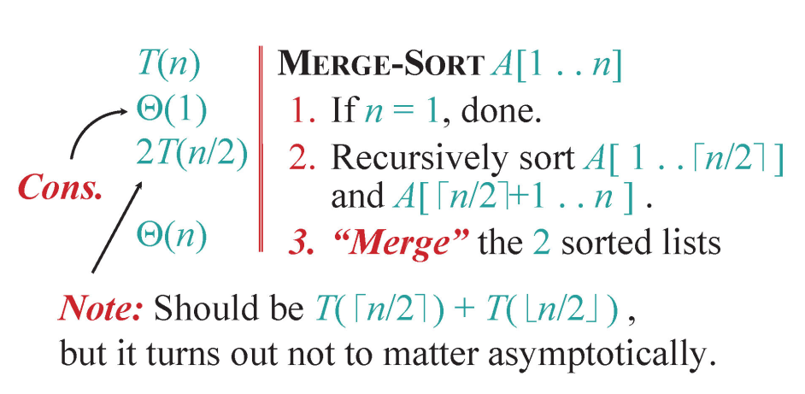
Analyzing Merge Sort

Slide 54
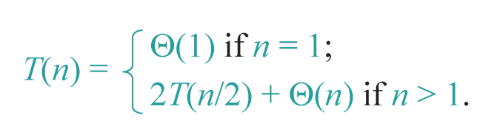
Recurrence for Merge Sort
Solution: the asymptotic running time of Merge Sort is T(n) = Θ(n log n).
We have several ways to prove this recurrence.

Slide 55
Contents
2.2.1 Expansion
2.2.2 Substitution
2.2.3 Recursion Tree

Slide 56
2.2.1 Expansion
Notes:
56

Slide 57
Expansion Method
Sometimes the expression of the recurrence is very simple.
Thus, we can expand the recurrence expression by replacing the current term with the decreasing-input-terms directly.

Slide 58
Expansion Method
E.g., given the following recurrence :
T(n) = T(n – 1) + Θ(n), T(1) = Θ(1)

Slide 59
Expansion Method
What if T(n) = T(n – 1) + Ο(n), T(1) = Ο(1)?
Thus, we can only get the upper bound.

Slide 60
Apply Expansion to Merge Sort

Slide 61
Apply Expansion to Merge Sort

Slide 62
Exercise in Class
T(n) = 4T(n/2) + Θ(n), T(1) = Θ(1)
Solve the above recurrence through expansion.

Slide 63
2.2.2 Substitution
Notes:
63

Slide 64
Substitution method
The most general method.
1. Guess the form of the solution.
2. Verify by induction.
3. Solve for constants.

Slide 65
Example of substitution
Example: T(n) = 4T(n/2) + Θ(n), T(1) = Θ(1)
Guess Ο(n³) .
Assume that T(n) ≤ c₁n³ for n ≥ n₀ .
Prove T(n) ≤ c₁n³ by induction.

Slide 66
Example of substitution
This is not a tight bound: We cannot prove the tightness!

Slide 67
Example of substitution
T(n) = 4T(n/2) + Θ(n), T(1) = Θ(1)
Ο(n³) is proven.
How about we want to prove Θ(n³)?
We need to prove Ω(n³) and Ο(n³)
Prove T(n) ≤ c₁n³ and T(n) ≥ c₃n³ for n ≥ n₀ simultaneously.

Slide 68
Example of substitution

Slide 69
Example of substitution
Then for T(n) = 4T(n/2) + Θ(n), T(1) = Θ(1)
Can we prove T(n) = Θ(n²) ?
Then we should prove T(n) = O(n²) and T(n) = Ω(n²) for n ≥ n₀
We firstly prove T(n) = O(n²) , and we choose to prove T(n) ≤ cn²

Slide 70
Example of substitution
Can we say that we have proven our inductive hypothesis (I.H.) which is denoted by T(n) ≤ cn² ?
NO, WE CANNOT
Since we have to prove the EXACT form of the I.H!
Thus, the above proof fails!

Slide 71
Example of substitution
Idea: strengthen the inductive hypothesis,
by subtracting a low-order term.
I.H.: T(n) ≤ c₁n² – c₂n for n ≥ n₀.
Proof :

Slide 72
Example of substitution
Then for T(n) = 4T(n/2) + Θ(n), T(1) = Θ(1)
We prove T(n) = Ω(n²) by proving T(n) ≥ c₃n² – c₄n for n ≥ n₀

Slide 73
Example of substitution
Thus, for T(n) = 4T(n/2) + Θ(n), T(1) = Θ(1),
We achieve that T(n) = Θ(n²)

Slide 74
Apply Substitution to Merge Sort
Guess Θ(n log n) .
Assume that T(n) ≤ c₁ · n log n and T(n) ≥ c₂ · n log n for n ≥ n₀ .
Prove T(n) ≤ c₁ · n log n and T(n) ≥ c₂ · n log n by induction.

Slide 75
Apply Substitution to Merge Sort
Proof :
T(n) = 2T(n/2) + dn
≤ 2c₁ · (n/2) · log(n/2) + dn
= c₁n · (log n-1) + dn
= c₁nlog n - (c₁ - d)n
→ if T(n) ≤ c₁nlog n for n ≥ n₀
then (c₁ - d)n ≥ 0
→ holds for c₁ ≥ d
→ T(n) = O(n log n) is proven.

Slide 76
Apply Substitution to Merge Sort
T(n) = 2T(n/2) + dn
≥ 2c₂ · (n/2) · log(n/2) + dn
= c₂n · (log n-1) + dn
= c₂nlog n - (c₂ - d)n
→ if T(n) ≥ c₂nlog n for n ≥ n₀
then (c₂ - d)n ≤ 0
→ holds for c₂ ≤ d
→ T(n) = Ω(n log n) is proven.
Thus, we have achieved that T(n) = Θ(n log n)

Slide 77
Exercise in Class
For T(n) = 4T(n/2) + Θ(n), T(1) = Θ(1)
Can we prove that T(n) = O(n)?

Slide 78
2.2.3 Recursion Tree
Notes:
78

Slide 79
Recursion-tree Method
Sometimes a good I.H. is intractable through guessing.
Fortunately, we can draw the recursion tree to help us obtain the I.H.
However, after achieving the I.H., we still need to prove the correctness of this I.H. by substitution.

Slide 80
Example of Recursion-tree
Solve T(n) = T(n/4) + T(n/2) + Θ(n²), T(1) =Θ(1)

Slide 81

Example of Recursion-tree
Solve T(n) = T(n/4) + T(n/2) + Θ(n²), T(1) =Θ(1)

Slide 82
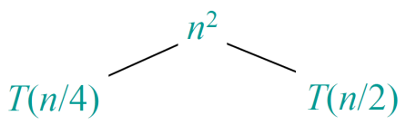
Example of Recursion-tree
Solve T(n) = T(n/4) + T(n/2) + Θ(n²), T(1) =Θ(1)

Slide 83
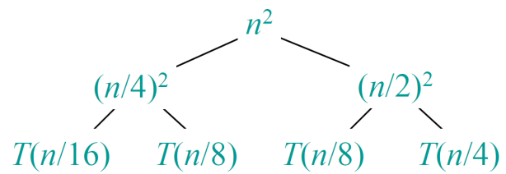
Example of Recursion-tree
Solve T(n) = T(n/4) + T(n/2) + Θ(n²), T(1) =Θ(1)

Slide 84
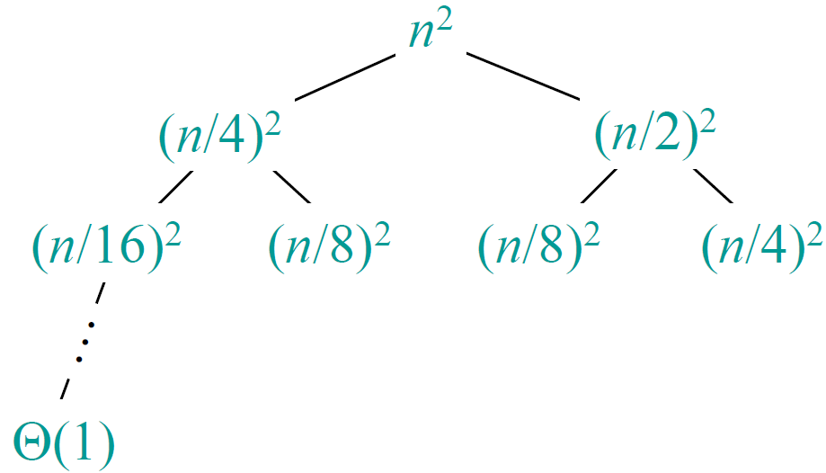
Example of Recursion-tree
Solve T(n) = T(n/4) + T(n/2) + Θ(n²), T(1) =Θ(1)

Slide 85
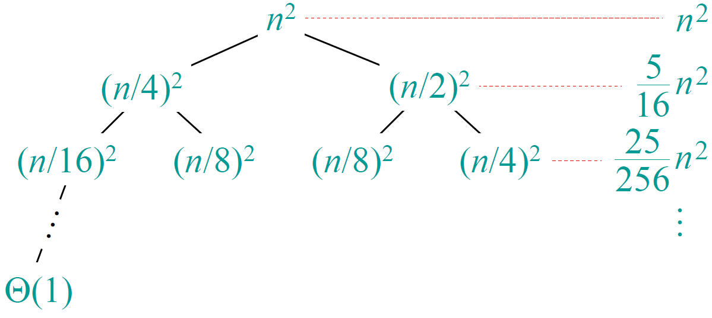
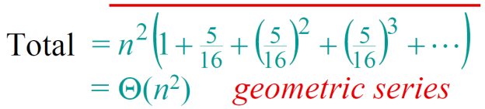
Example of Recursion-tree
Solve T(n) = T(n/4) + T(n/2) + Θ(n²), T(1) =Θ(1)

Slide 86
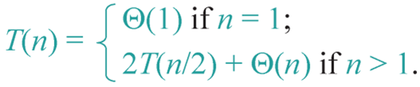
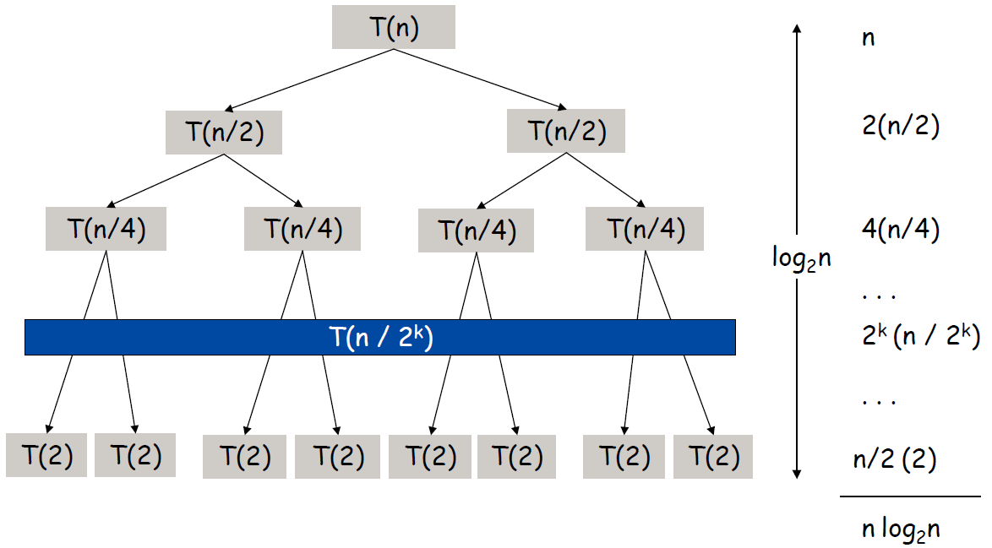
Apply Recursion-tree to Merge Sort

Slide 87
Run-time Summary of Merge Sort
The following table summarizes the run-times of merge sort
How can merge sort always have the computational complexity at Θ(1)?
Case | Run Time | Comments
Worst | Θ(n log(n)) | No worst case
Average | Θ(n log(n))
Best | Θ(n log(n)) | No best case

Slide 88
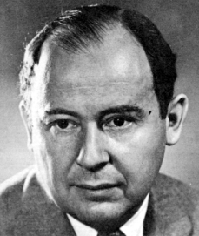
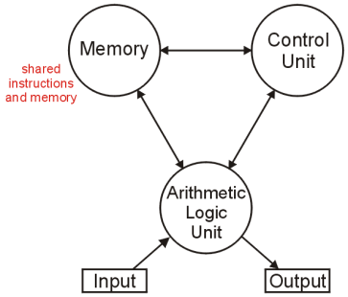
Aside
The (likely) first implementation of merge sort was on the ENIAC in 1945 by John von Neumann
The creator of the von Neumann architecture used by all modern computers:

Slide 89
Exercise in Class
For
T(n) = T(n/4) + T(n/2) + Θ(n²), T(1) = Θ(1)
Prove that T(n) = Θ(n²) through substitution.

Slide 90
Exercises
See homework at Sakai and QQ

Slide 91
End of Section.
算法分析课程组
重庆大学计算机学院
Notes:
本人是国际视觉电生理学会(ISCEV)的会员。

