Slide 1
Fast and Unified Local Search for Random Walk Based K-Nearest Neighbor Query in Large Graphs
Yubao Wu ¹, Ruoming Jin ², Xiang Zhang ¹
¹ Case Western Reserve University, ² Kent State University
Speaker: Yubao Wu
Notes:
Good morning, everyone. My name is Yubao. I am from Case Western Reserve University. I am gonna talk about fast and unified local search for random walk based K-nearest neighbor query in large graphs. This is a joint work with Ruoming Jin and Xiang Zhang.

Slide 2
K-Nearest Neighbor Query in Graphs
Which nodes are most similar to the query node ?
Query
Yubao Wu, Ruoming Jin, Xiang Zhang. Fast and Unified Local Search for Random Walk Based K-Nearest Neighbor Query in Large Graphs. SIGMOD, 2014.
Notes:
What is the nearest neighbor query in graphs? Suppose we have a graph. Some nodes are connected by some edges. Suppose we have a query node, we wanna find which other nodes are most similar to the query node.
For example, given the red query node, the green node should be similar to the query node, because it is adjacent to the query node. But the purple node should also be similar to the query node, because it has multiple paths connecting to the query node.

Slide 3
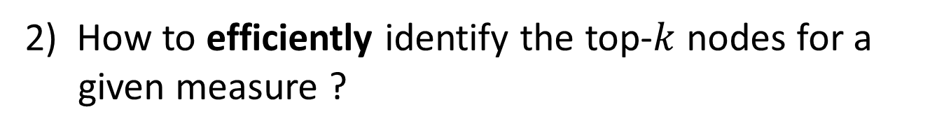
K-Nearest Neighbor Query —— Challenges
1) How to design proximity measures that can effectively capture the similarity between nodes ?
2) How to efficiently identify the top-$k$ nodes for a given measure ?
Yubao Wu, Ruoming Jin, Xiang Zhang. Fast and Unified Local Search for Random Walk Based K-Nearest Neighbor Query in Large Graphs. SIGMOD, 2014.
Notes:
There are two challenges in the K-nearest neighbor query problem.
One is how to design proximity measures that can effectively capture the similarity between nodes?
The other is how to efficiently identify the top-k nodes for a given proximity measure?

Slide 4
Proximity Measures
Shortest path distance
Network flow
Katz score
Random walk based:
Hitting time
Random walk with restart
Commute time
Discounted hitting time
Truncated hitting time
Penalized hitting probability
Degree normalized RWR
Yubao Wu, Ruoming Jin, Xiang Zhang. Fast and Unified Local Search for Random Walk Based K-Nearest Neighbor Query in Large Graphs. SIGMOD, 2014.
Notes:
For the first challenge, many proximity measures have been designed. For example, shortest path distance, network flow, and Katz score. Recently, the random walk based proximity measures have shown their advantages. So, in this work, we focus on the random walk based proximity measures. There are some well-known random walk based proximity measures, such as hitting time, random walk with restart, and commute time.
Some variants are also proposed, such as discounted hitting time, truncated hitting time, penalized hitting probability, and degree normalized random walk with restart.

Slide 5
Computational Methods for KNN Query
Methods | Key Idea | Pre-computation? | Applicability
Global iteration (GI) | Iterative method | No | Wide
Castanet [1] | Improved GI | No | RWR
Matrix based [2] | Matrix decomposition | Yes | RWR
Graph embedding [3] | Graph embedding | Yes | HT / RWR / CT
Disadvantages:
Iterating over the entire graph
Pre-computing step is expensive
[1] Y. Fujiwara, et al. SIGMOD’13
[2] Tong’ICDM’06; Fujiwara’KDD’12; Fujiwara’VLDB’12
[3] X. Zhao, et al. VLDB’13
Notes:
For the second challenge, many computational methods have been proposed to compute the top-k nodes.
The most basic one is the global iteration method. The random walk process can be represented as a linear system. So power iteration method can be used to solve the linear system. Recently, the Castanet method improves the global iteration method. But it is specially designed for random walk with restart. Both of them need to iterate over the entire graph. Therefore, they are costly.
The matrix based methods are specially designed for random walk with restart. They need to pre-compute the matrix inversion, thus the pre-computing step is expensive.
Graph embedding method embeds the graph into geometric space first. But the graph embedding step is approximate, and it is also time-consuming.

Slide 6
K-Nearest Neighbor Query —— Challenge
Challenge: An efficient local search method?
Guarantees the exactness
Applies to different measures
Yubao Wu, Ruoming Jin, Xiang Zhang. Fast and Unified Local Search for Random Walk Based K-Nearest Neighbor Query in Large Graphs. SIGMOD, 2014.
Notes:
Intuitively, the nodes near the query node should have high proximity values. Therefore, the question is that can we develop an efficient local search method, which not only guarantees the exactness of the top-k nodes, but also applies to different proximity measures?

Slide 7
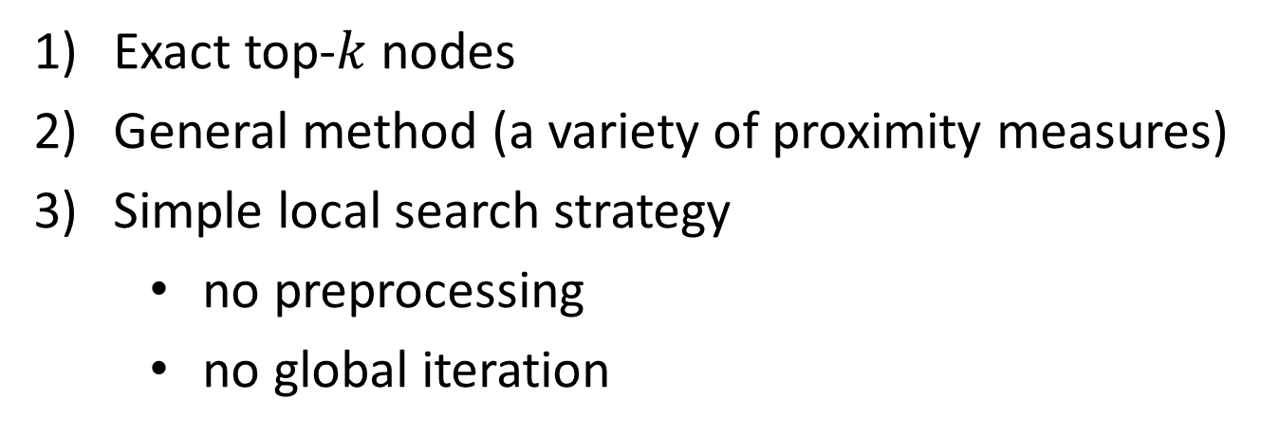
Our Method —— FLoS (Fast Local Search)
Contributions:
Exact top-$k$ nodes
General method (a variety of proximity measures)
Simple local search strategy
no preprocessing
no global iteration
Yubao Wu, Ruoming Jin, Xiang Zhang. Fast and Unified Local Search for Random Walk Based K-Nearest Neighbor Query in Large Graphs. SIGMOD, 2014.
Notes:
This paper gives a positive answer. We propose the fast local search algorithm. It has three nice properties.
First, it guarantees the exactness of the top-k nodes;
Second, it is a general method that can be applied to a variety of proximity measures;
Third, it uses a simple local search strategy that needs neither preprocessing nor iterating over the entire graph.

Slide 8
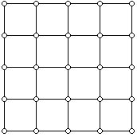
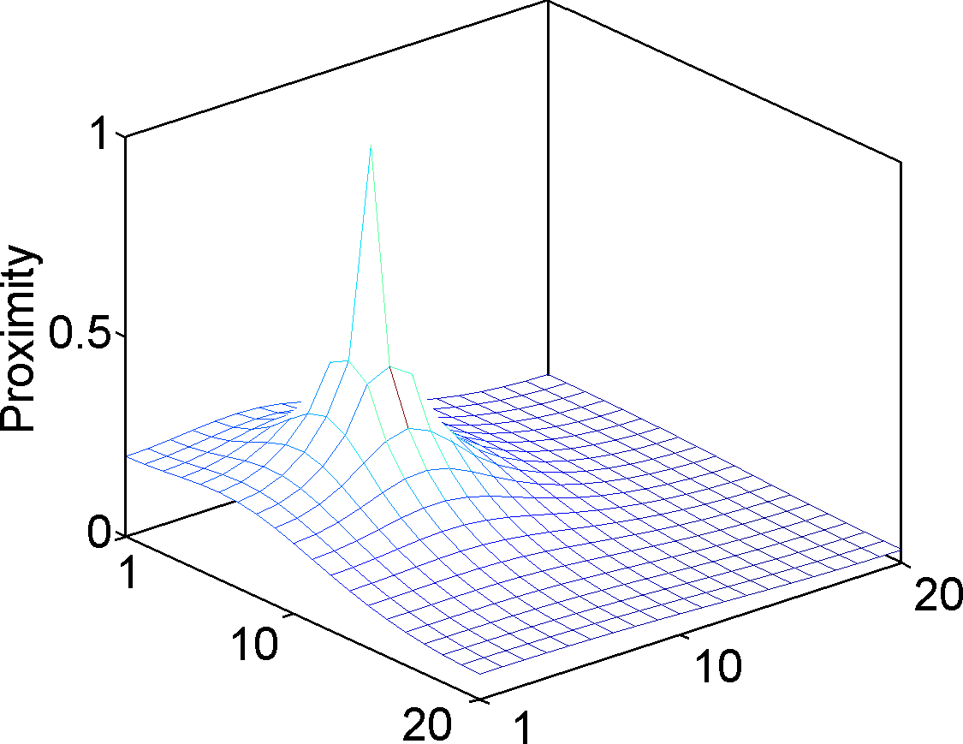
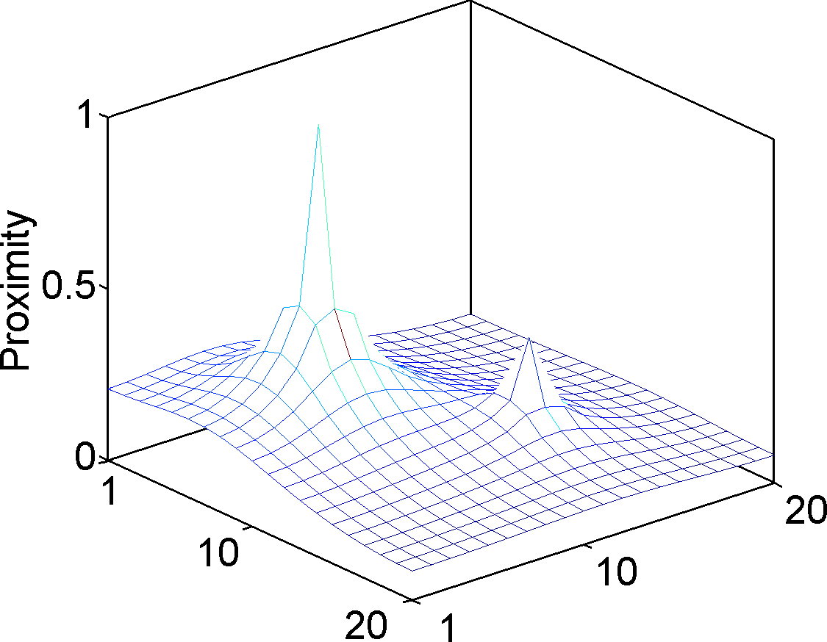
No Local Maximum Property
Grid graph
20
Query
Query
20
Local maximum
No local maximum
With local maximum
Yubao Wu, Ruoming Jin, Xiang Zhang. Fast and Unified Local Search for Random Walk Based K-Nearest Neighbor Query in Large Graphs. SIGMOD, 2014.
Notes:
How can we achieve these nice properties? Because we observe one key property: the no local maximum property. No local maximum means that for any node, we can always find a neighbor node with larger proximity value.
For example, the left figure shows the distribution of the proximity values in a grid graph, where the proximity measure has no local maximum. So, for any node, such as the green node, we can find one neighbor with larger proximity value.
On the other hand, if one proximity measure has local maximum, then we may find one node, which has larger proximity value than any neighbors. Such as the green node in the right figure has larger proximity value than all the neighbors.

Slide 9
Measures With and Without Local Maximum
Abbr. | Proximity measures | Local maximum ?
HT | Hitting time | No
DHT | Discounted hitting time | No
THT | Truncated hitting time | No
PHP | Penalized hitting probability | No
EI | Effective importance (degree normalized RWR) | No
RWR | Random walk with restart | Yes
CT | Commute time | Yes
Yubao Wu, Ruoming Jin, Xiang Zhang. Fast and Unified Local Search for Random Walk Based K-Nearest Neighbor Query in Large Graphs. SIGMOD, 2014.
Notes:
We examine the existing proximity measures. Some of them have no local maximum, such as hitting time, discounted hitting time, truncated hitting time, penalized hitting probability, and effective importance. Some of them do have local maximum, such as random walk with restart, and commute time.

Slide 10
Local Search Process
Query node
Visited node
Boundary node
Unvisited node
1
Yubao Wu, Ruoming Jin, Xiang Zhang. Fast and Unified Local Search for Random Walk Based K-Nearest Neighbor Query in Large Graphs. SIGMOD, 2014.
Notes:
The no local maximum property can be used to prune the search space in the local search process. Let’s first take a look at the local search process. We begin from the query node, and iteratively expand to the neighbors. We say that the expanded nodes are visited and the remaining nodes are unvisited. The boundary nodes of the visited nodes are the visited nodes which have at least one unvisited neighbors. For example, in this figure, the purple nodes are visited, the white nodes are unvisited, and the boundary nodes of the visited nodes are indicated by purple circles.

Slide 11
Bounding the Unvisited Nodes
Grid graph
20
Query
Query
20
Local maximum
Visited
Unvisited
Boundary
Boundary
No local maximum
With local maximum
Yubao Wu, Ruoming Jin, Xiang Zhang. Fast and Unified Local Search for Random Walk Based K-Nearest Neighbor Query in Large Graphs. SIGMOD, 2014.
Notes:
If one proximity measure has no local maximum, then, the maximum in the boundary of the visited nodes can be used as the upper bound of the proximity values of the unvisited nodes. For example, in the left figure, the green node is an unvisited node, and its proximity value can be upper bounded by the maximum in the boundary of the visited nodes.
If one proximity measure has local maximum, then, we do not have this nice property.

Slide 12
Bounding the Visited Nodes
Upper bound
Exact proximity value
Lower bound
Query
Visited node
Unvisited node
Yubao Wu, Ruoming Jin, Xiang Zhang. Fast and Unified Local Search for Random Walk Based K-Nearest Neighbor Query in Large Graphs. SIGMOD, 2014.
Notes:
Since we only have the local neighborhood information, we cannot compute the exact proximity values. Because the random walk process involves the entire graph. But, we can compute the lower and upper bounds.
In this figure, the red line segment represents the exact proximity value, the blue one represents the upper bound, and the green one represents the lower bound. For the visited nodes, we can compute the lower and upper bounds. For the unvisited nodes, we have the upper bound.
Why do we compute the lower and upper bounds? Because when the bounds are tight enough, we can identify the top-k nodes earlier. Therefore the search space can be pruned.

Slide 13
Bounding the Visited Nodes —— Monotonicity
Upper bound
Exact proximity value
Lower bound
Query
Visited node
Unvisited node
Yubao Wu, Ruoming Jin, Xiang Zhang. Fast and Unified Local Search for Random Walk Based K-Nearest Neighbor Query in Large Graphs. SIGMOD, 2014.
Notes:
We further discover that when we visit one more node, the upper and lower bounds become tighter. The lower bounds are monotonically increasing; the upper bounds are monotonically decreasing. And eventually they converge to the exact proximity values.

Slide 14
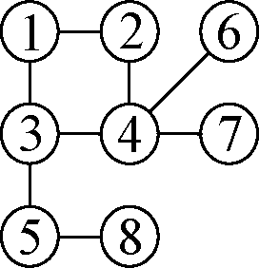
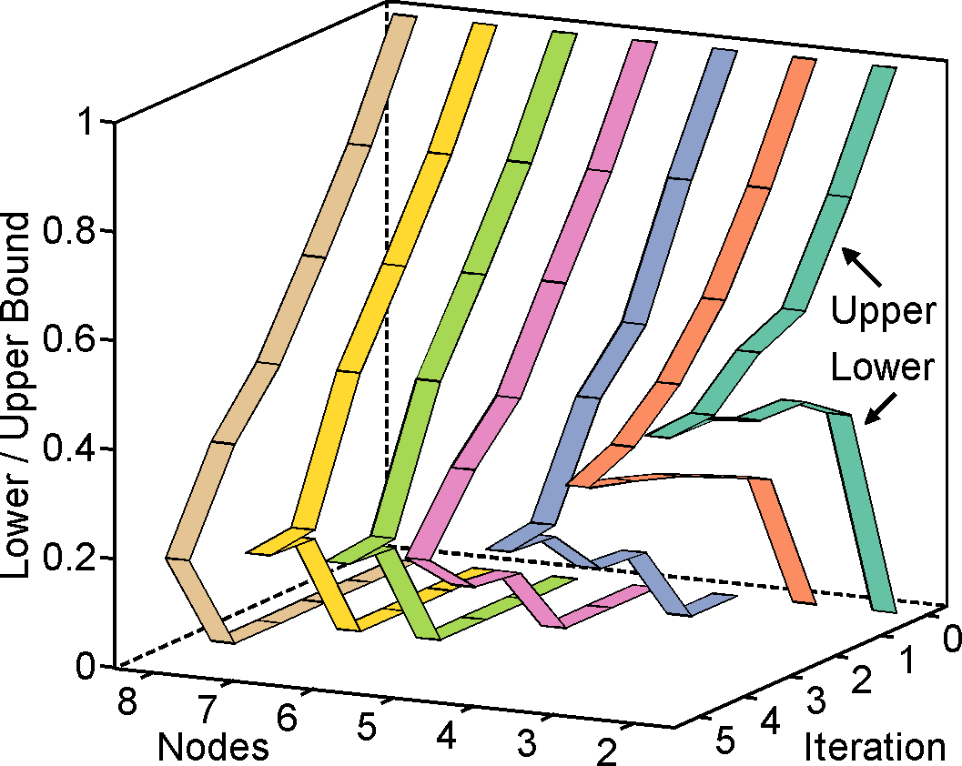
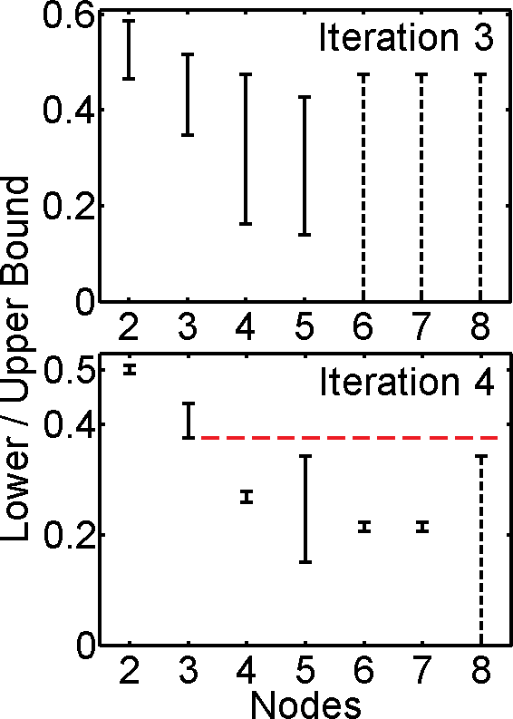
Running Example
Query
Iteration | 1 | 2 | 3 | 4 | 5
Newly visited nodes | {2,3} | {4} | {5} | {6,7} | {8}
Toy graph
Top-2 nodes
Trend of the bounds
Yubao Wu, Ruoming Jin, Xiang Zhang. Fast and Unified Local Search for Random Walk Based K-Nearest Neighbor Query in Large Graphs. SIGMOD, 2014.
Notes:
Let’s look at a running example. Suppose we have a toy graph, and node 1 is the query node. The algorithm visits the nodes in the order shown in the table. In the first iteration, nodes 2 and 3 are visited; in the second iteration, node 4 is visited, and so on so forth.
At each iteration, we compute the lower and upper bounds of each node, and we plot the bounds in this figure. The x axis represents the nodes, the y axis represents the iteration, and the z axis represents the lower and upper bounds. We can see that the lower and upper bounds are monotonically changing, and eventually converge to the exact proximity values.
Let’s take a closer look at the bounds at the fourth iteration. The interval between the lower and upper bounds are represented by the vertical line segment. We can see that the lower bounds of nodes 2 and 3 are greater than the upper bounds of the remaining nodes. Therefore, we guarantee that nodes 2 and 3 are the top-2 nodes. And the algorithm can terminate.
This running example illustrates the basic idea of the fast local search algorithm.

Slide 15
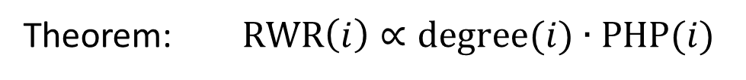
Relationships Among Proximity Measures
Penalized hitting probability
Effective importance
Discounted hitting time
Theorem: PHP, EI, and DHT give the same ranking results.
Random walk with restart
Theorem: $RWR\left(i\right)∝degree(i)∙PHP(i)$
Note: RWR has local maximum.
Yubao Wu, Ruoming Jin, Xiang Zhang. Fast and Unified Local Search for Random Walk Based K-Nearest Neighbor Query in Large Graphs. SIGMOD, 2014.
Notes:
The FLoS algorithm can be applied to a variety of proximity measures.
We first prove that the penalized hitting probability, effective importance, and discounted hitting time give the same ranking results. Therefore, we only need to develop the algorithm for one proximity measure. Then all of them can be solved.
We further discover that the random walk with restart has a simple relationship with penalized hitting probability. Based on this relationship, the FLoS algorithm can also be applied to random walk with restart. This is interesting. Because even though the random walk with restart has local maximum, the fast local search algorithm is still applicable.

Slide 16
Experiments —— Datasets
Datatsets |  | Abbr. | #nodes | #edges
Real | Amazon | AZ | 334,863 | 925,872
 | DBLP | DP | 317,080 | 1,049,866
 | Youtube | YT | 1,134,890 | 2,987,624
 | LiveJournal | LJ | 3,997,962 | 34,681,189
Synthetic | In-memory | -- | Varying size
 |  | -- | Varying density
 | Disk-resident | -- | Varying size
Yubao Wu, Ruoming Jin, Xiang Zhang. Fast and Unified Local Search for Random Walk Based K-Nearest Neighbor Query in Large Graphs. SIGMOD, 2014.
Notes:
In the experiments, we use 4 real large graphs with up to millions of nodes and tens of millions of edges. We also use in-memory and disk-resident synthetic graphs with different parameters, such as graph size, and graph density.

Slide 17
Experiments —— State-of-the-art Methods
Our methods (exact) | State-of-the-art methods
 | Abbr. | Key idea | Ref. | Exactness
FLoS_PHP | GI_PHP | Global iteration | -- | Exact
 | DNE | Local search | CIKM’12 | Approx.
 | NN_EI | Local search | CIKM’13 | Exact
 | LS_EI | Local search | KDD’10 | Approx.
FLoS_RWR | GI_RWR | Global iteration | -- | Exact
 | Castanet | Improved GI | SIGMOD’13 | Exact
 | K-dash | Matrix inversion | VLDB’12 | Exact
 | GE_RWR | Graph embedding | VLDB’13 | Approx.
 | LS_RWR | Local search | KDD’10 | Approx.
Yubao Wu, Ruoming Jin, Xiang Zhang. Fast and Unified Local Search for Random Walk Based K-Nearest Neighbor Query in Large Graphs. SIGMOD, 2014.
Notes:
We test the performance of FLoS algorithm for two proximity measures: penalized hitting probability and random walk with restart. We compare them with several state-of-the-art methods. For penalized hitting probability, we compare it with global iteration method, and 3 local search methods. For random walk with restart, we compare it with global iteration method, improved global iteration method, matrix inversion based method, graph embedding based method, and one local search method. Our methods guarantee the exactness of the results. Some of the existing methods are exact. Some of them are approximate.

Slide 18
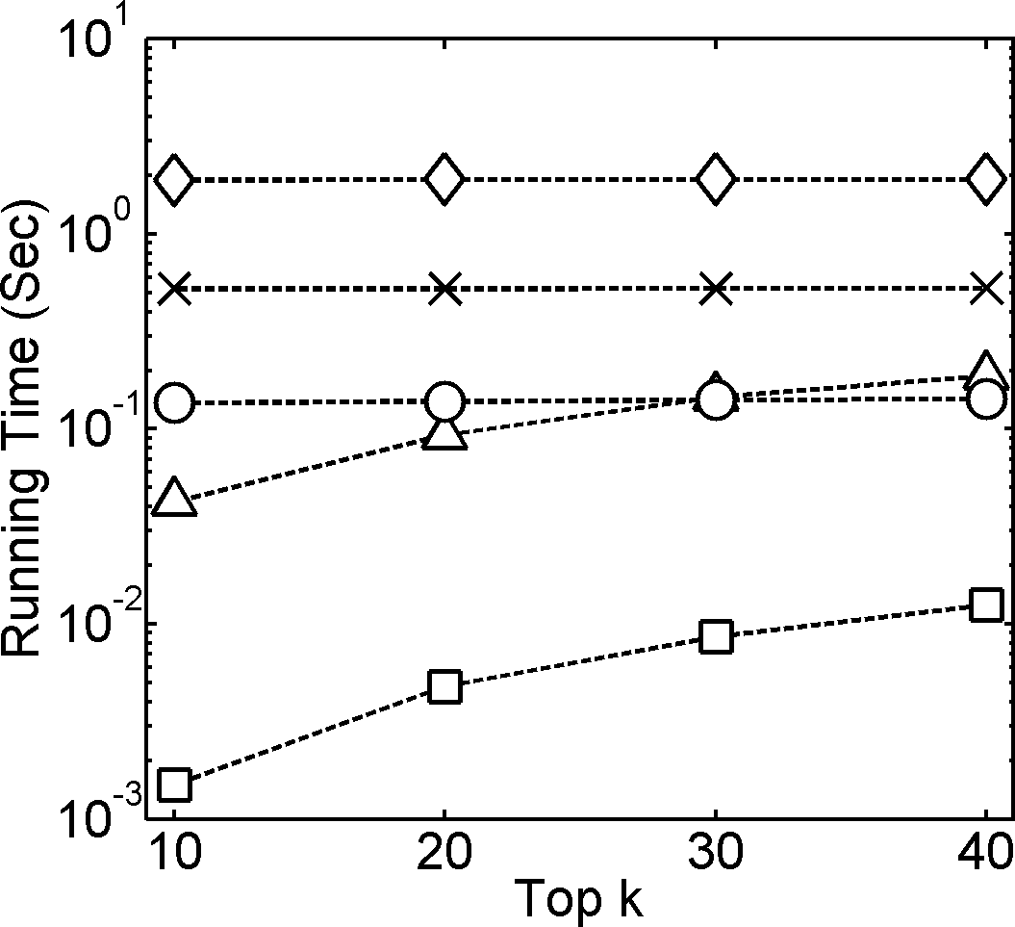
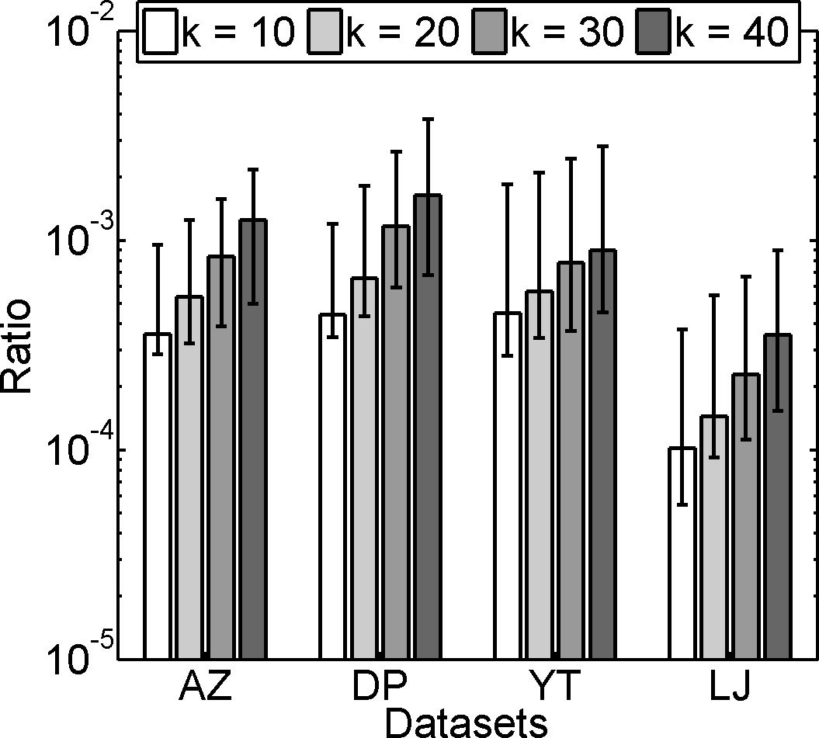
Experiments —— PHP, Real Graphs
Running time (AZ)
Visited nodes
1-3 orders of magnitude faster
A small portion of the nodes are visited
Yubao Wu, Ruoming Jin, Xiang Zhang. Fast and Unified Local Search for Random Walk Based K-Nearest Neighbor Query in Large Graphs. SIGMOD, 2014.
Notes:
These are the results for penalized hitting probability on real graphs.
The left figure shows the running time. The x axis represents the varying number K. The y axis represents the running time. The bottom curve shows the running time of our method. We can see that our method is 1 to 3 orders of magnitude faster than the existing methods.
The number of visited nodes is shown in the right figure. The x axis represents the datasets. The y axis represents the ratio between the number of visited nodes using FLoS and the total number of nodes in the graph. Only a small portion of nodes are visited.

Slide 19
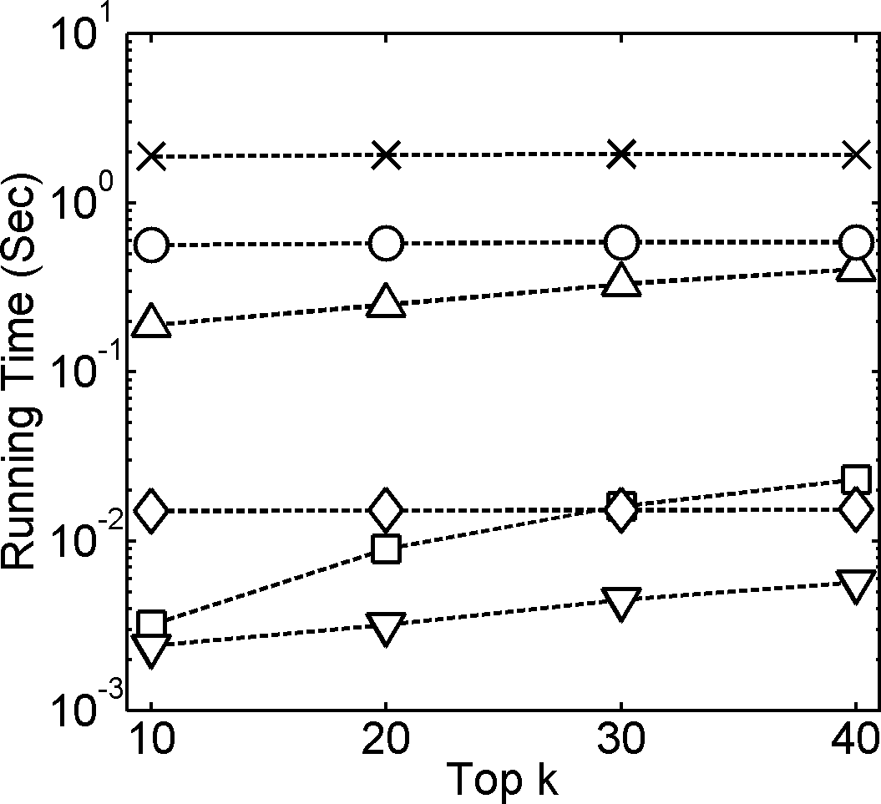
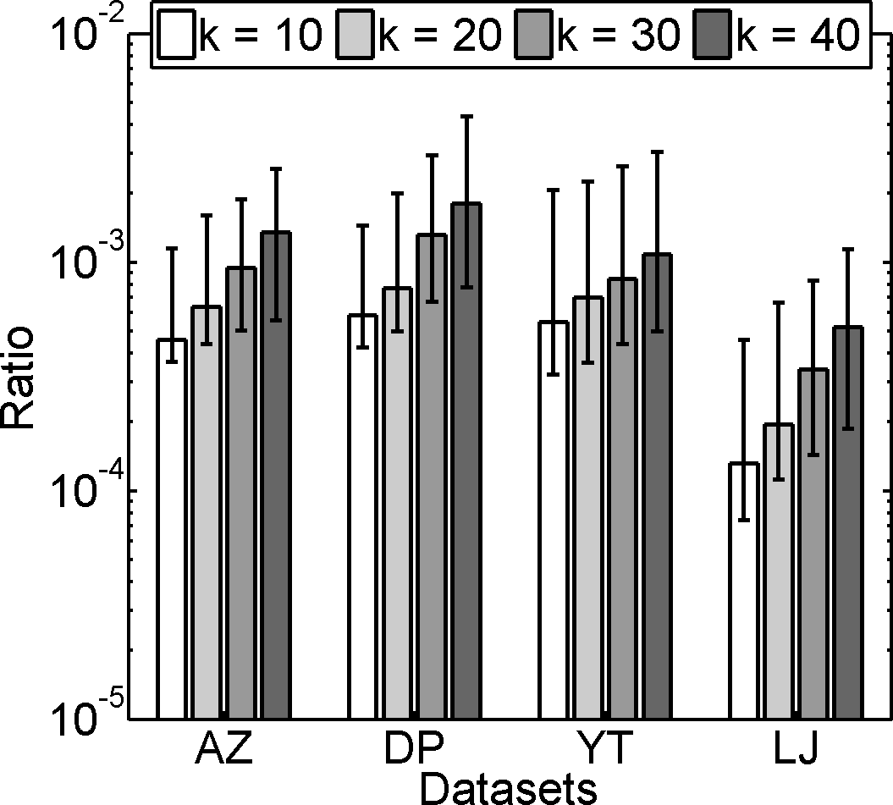
Experiments —— RWR, Real Graphs
Have long precomputing time
Running time (AZ)
Visited nodes
Fast
A small portion of the nodes are visited
Yubao Wu, Ruoming Jin, Xiang Zhang. Fast and Unified Local Search for Random Walk Based K-Nearest Neighbor Query in Large Graphs. SIGMOD, 2014.
Notes:
These are the results for random walk with restart on real graphs.
The left figure shows the running time. The running time of our method is indicated by the curve with square mark in the bottom region. We can see that our method is comparable to two existing methods with precomputation step. The first one is the graph embedding based method. But the graph embedding based method is approximate, and the graph embedding step is time consuming. The other one is the matrix based method. But precomputing the matrix inversion is time consuming. Both of these two methods have long precomputing time, which is not shown here.
The number of visited nodes is shown in the right figure. Only a small portion of nodes are visited.

Slide 20
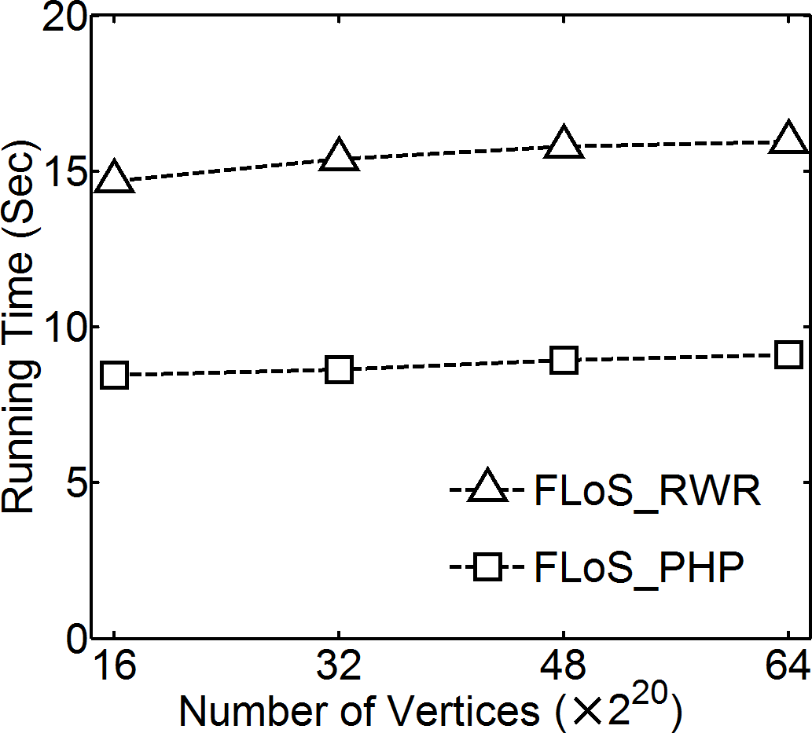
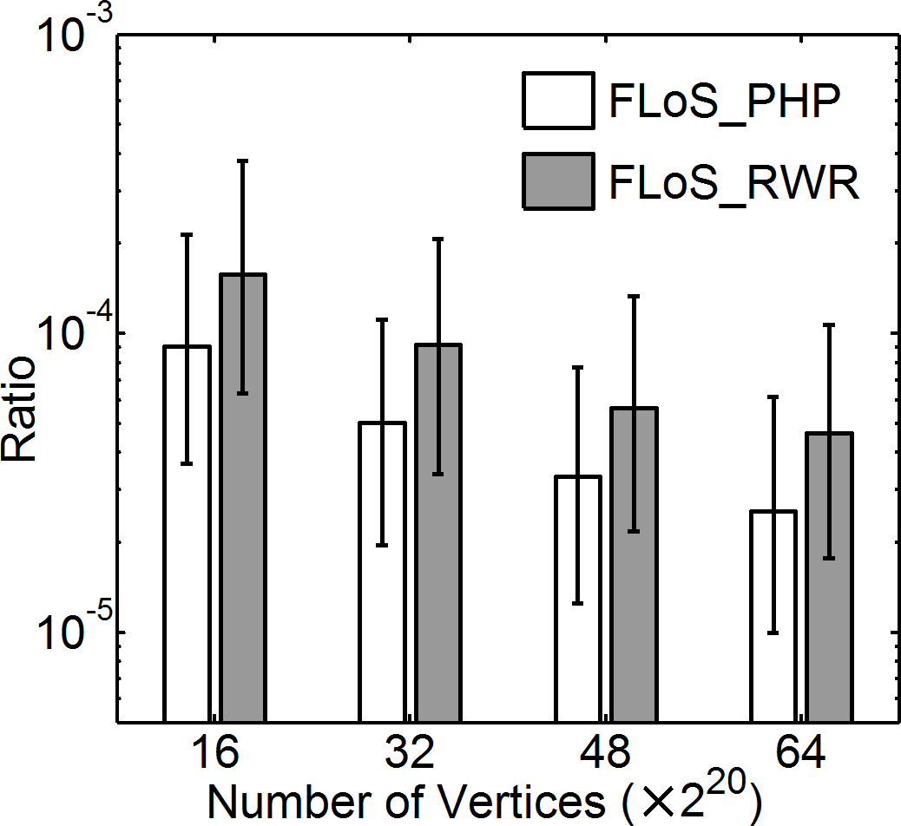
Experiments —— PHP/RWR, Disk-Resident Syn. Graphs
Running time
Visited nodes
Process disk-resident graph in seconds
Yubao Wu, Ruoming Jin, Xiang Zhang. Fast and Unified Local Search for Random Walk Based K-Nearest Neighbor Query in Large Graphs. SIGMOD, 2014.
Notes:
What if the graphs are too large to fit into memory? We test the performance of FLoS algorithm on disk-resident graphs. The left figure shows the running time of FLoS algorithm. The x axis represents the graph size. The y axis represents the running time. We can see that our methods can process disk-resident graphs in seconds. We also observe that our methods have constant running time when the graph size increases. Because our methods only search locally. The right figure shows that only a small portion of the nodes are visited.
We wanna emphasize that our methods are especially suitable for disk-resident graphs, because our methods only search locally.

Slide 21
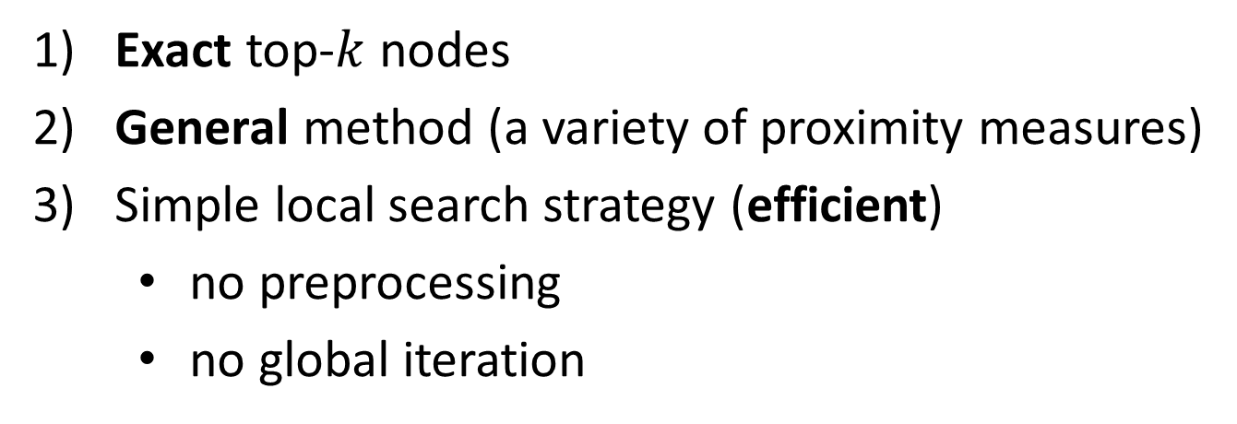
Conclusions
FLoS (fast local search) algorithm
Exact top-$k$ nodes
General method (a variety of proximity measures)
Simple local search strategy (efficient)
no preprocessing
no global iteration
Yubao Wu, Ruoming Jin, Xiang Zhang. Fast and Unified Local Search for Random Walk Based K-Nearest Neighbor Query in Large Graphs. SIGMOD, 2014.
Notes:
In conclusion, the fast local search algorithm has three nice properties.
First, it guarantees to find the exact top-k nodes;
Second, it is a general method that can be applied to a variety of proximity measures;
Third, it uses a simple local search strategy that needs neither preprocessing nor iterating over the entire graph. Therefore, it is efficient.

Slide 22
Thank You!
Questions?
Yubao Wu, Ruoming Jin, Xiang Zhang. Fast and Unified Local Search for Random Walk Based K-Nearest Neighbor Query in Large Graphs. SIGMOD, 2014.
Notes:
Thank you. Welcome questions.

Slide 23
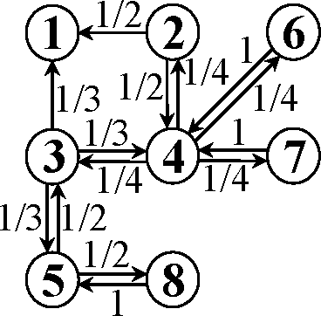
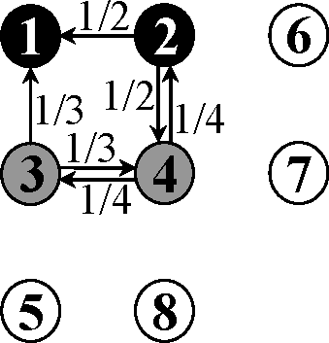
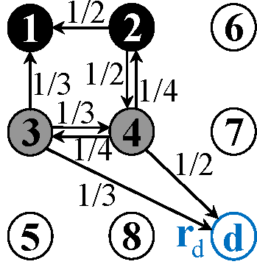
Backup Slides : Bounding the Visited Nodes
Lower Bound: Deleting all transition probabilities incident to unvisited nodes
Upper Bound: Adding one dummy node
Original graph
Transition graph
Transition graph (lower bound)
Transition graph (upper bound)
Nodes 1,2,3,4 are visited;
Nodes 5,6,7,8 are unvisited.
Yubao Wu, Ruoming Jin, Xiang Zhang. Fast and Unified Local Search for Random Walk Based K-Nearest Neighbor Query in Large Graphs. SIGMOD, 2014.
Notes:
How to compute the lower and upper bounds?
The basic idea is that we manipulate the transition probabilities in the transition graph. For the lower bound, we delete all the transition probabilities incident to unvisited nodes. For the upper bound, we add one dummy node.

