Slide 1
Finding Dense and Connected Subgraphs in Dual Networks
Yubao Wu
Ruoming Jin
Xiaofeng Zhu
Xiang Zhang
(EECS, CWRU)
(CS, Kent State U)
(EPBI, CWRU)
(EECS, CWRU)
Notes:
Hello, everyone. My name is Yubao Wu. I am a fourth year PhD student at Case Western Reserve University. I am glad to present my work: finding dense and connected subgraphs in dual networks. This is a joint work with professor Ruoming Jin, professor Xiaofeng Zhu, and my advisor, professor Xiang Zhang.

Slide 2
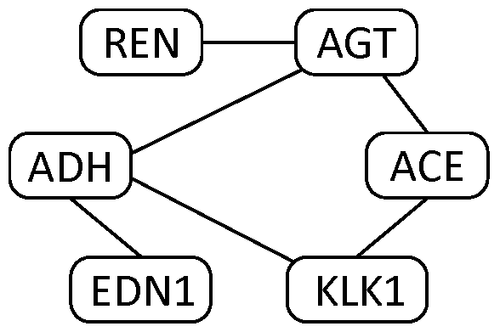
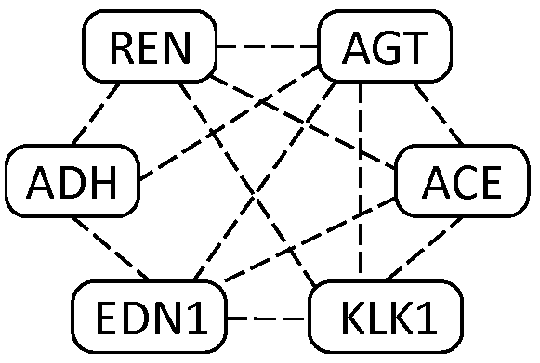
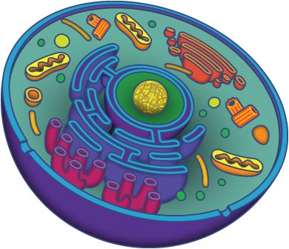
Dual Biological Networks
(a) protein interaction network
(b) genetic interaction network
Edge: physical bounding interaction
Edge: conceptual statistical interaction
(likelihood ratio test)
membrane
How to use the physical protein interaction to interpret the conceptual genetic interaction?
nucleus
Yubao Wu, Ruoming Jin, Xiaofeng Zhu, and Xiang Zhang. Finding Dense and Connected Subgraphs in Dual Networks. ICDE, 2015.
Notes:
We can observe dual networks in real life. For example, we have protein interaction network. From the genome-wide association study dataset, we can construct the genetic interaction network. The edge in the protein interaction network represents the physical bounding interaction. While the edge in the genetic interaction network represents the statistical interaction. These two types of edges are over the same set of nodes. We call this data structure “the dual networks”. In genetics, the key question is how to use the physical protein interaction to interpret the conceptual genetic interaction.

Slide 3
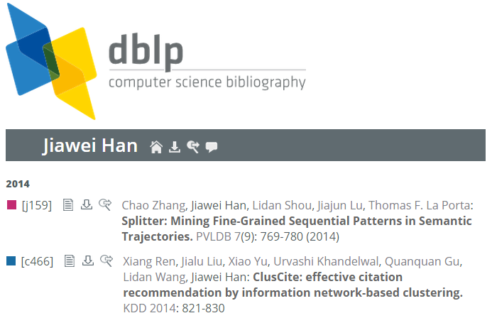
Dual Co-author Networks
(a) Co-author network
(b) Research interest similarity network
Yubao Wu, Ruoming Jin, Xiaofeng Zhu, and Xiang Zhang. Finding Dense and Connected Subgraphs in Dual Networks. ICDE, 2015.
Notes:
We also observe dual co-author networks. In addition to the traditional co-author network, we can build the research interest similarity network based on the paper title.

Slide 4

Dual Social Networks
(a) Social network
(b) Interest similarity network
Yubao Wu, Ruoming Jin, Xiaofeng Zhu, and Xiang Zhang. Finding Dense and Connected Subgraphs in Dual Networks. ICDE, 2015.
Notes:
We could observe dual social networks. For example, in the Flixster website, there is a social network among the users. The users can rate the movies. Based on the ratings, we can construct the interest similarity network among the users.

Slide 5
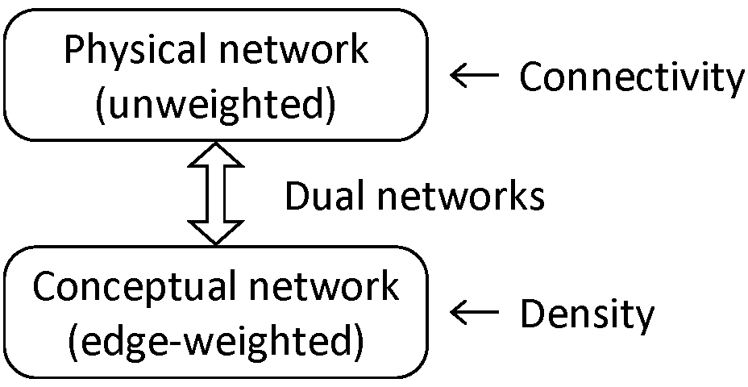


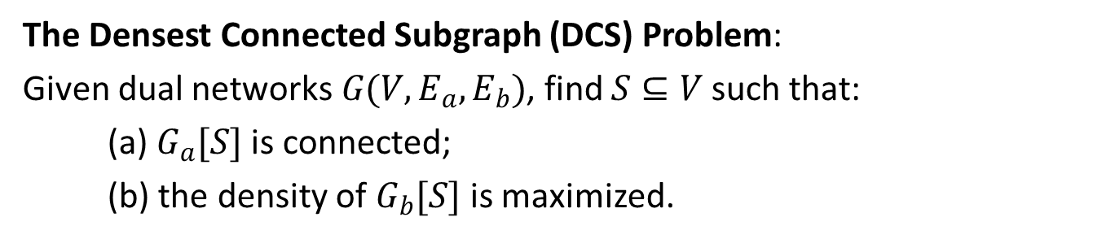

Densest Connected Subgraph
$$G_{a}(V, E_{a})$$
: $\frac{\left|E(S)\right|}{\left|S\right|}$
$$G_{b}(V, E_{b})$$
The Densest Connected Subgraph (DCS) Problem:
Given dual networks $G(V, E_{a},E_{b})$, find $S⊆V$ such that:
(a) $G_{a}[S]$ is connected;
(b) the density of $G_{b}[S]$ is maximized.
Yubao Wu, Ruoming Jin, Xiaofeng Zhu, and Xiang Zhang. Finding Dense and Connected Subgraphs in Dual Networks. ICDE, 2015.
Notes:
There exist so many dual networks. So, we propose the dual networks model, which contains two networks: physical network, and conceptual network. Then, we study the densest connected subgraph problem, also called the DCS problem. In the DCS problem, we want to find a subgraph, which is connected in the physical network, and dense in the conceptual network.

Slide 6
DCS in Dual Networks
Dual networks | Dual biological | Dual co-author | Dual social
DCS | Disease pathway | Research group | Consumer group (advertising)
Connectivity | Signal transduction | Collaboration pattern | Posts (word-of-mouth)
Density | Statistical association | Similar research interest | Consumer interest
Theorem: The DCS problem is NP-hard.
Yubao Wu, Ruoming Jin, Xiaofeng Zhu, and Xiang Zhang. Finding Dense and Connected Subgraphs in Dual Networks. ICDE, 2015.
Notes:
Why DCS pattern? Because it is meaningful. For example, in the dual biological networks, the DCS can be interpreted as the disease pathway. The connectivity in the protein interaction network represents the signal transduction process; the density in genetic interaction network represents the strong statistical association.
DCS also has practical meanings in other types of dual networks.
($: click for the animation)
Even though the densest subgraph problem in a single network can be solved in polynomial time, the DCS problem is NP-hard. Therefore, we develop a two-step approach to solve the DCS problem.

Slide 7




Optimality Preserving Pruning
$$G_{a}$$
Leaf
$$G_{a}$$
Pruning
$$G_{b}$$
Low degree
$$G_{b}$$
Densest connected subgraph
Yubao Wu, Ruoming Jin, Xiaofeng Zhu, and Xiang Zhang. Finding Dense and Connected Subgraphs in Dual Networks. ICDE, 2015.
Notes:
In the first step, we effectively prune the dual networks while guarantee that the optimal solution is contained in the remaining networks.
($: click for the animation)
Specifically, we first identify the low degree leaf nodes, which are defined as the nodes which are leaf nodes in the physical network, and have low degree in the conceptual network.
($: click for the animation)
These low degree leaf nodes are guaranteed to not belong to the optimal solution, thus they can be safely removed.
($: click for the animation)
The optimal solution is retained during this process.

Slide 8
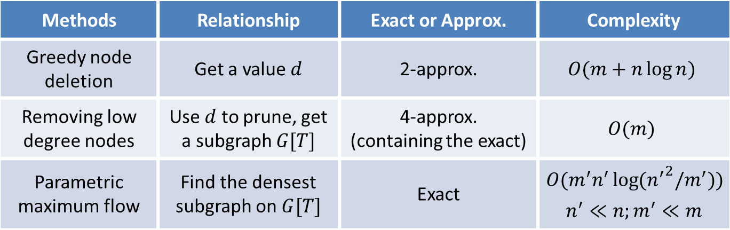


DCS_RDS Algorithm : Finding the Densest Subgraph
Methods | Relationship | Exact or Approx. | Complexity
Greedy node deletion | Get a value $d$ | 2-approx. | $$O(m+n\log{n})$$
Removing low degree nodes | Use $d$ to prune, get a subgraph $G[T]$ | 4-approx. (containing the exact) | $$O(m)$$
Parametric maximum flow | Find the densest subgraph on $G[T]$ | Exact | $$O(m^{′}n^{′}\log{({n^{′}}^{2}/m^{′})})$$ $$n^{′}≪n;m^{′}≪m$$
$$d=2.5$$
$$G_{b}$$
Yubao Wu, Ruoming Jin, Xiaofeng Zhu, and Xiang Zhang. Finding Dense and Connected Subgraphs in Dual Networks. ICDE, 2015.
Notes:
After the optimality preserving pruning, we develop two heuristic algorithms to find the DCSs. The first heuristic algorithm is called refining densest subgraph algorithm. There are two steps.
($: click for the animation)
In the first step, we find the densest subgraph in conceptual network. The densest subgraph problem can be solved in polynomial time by use of the parametric maximum flow method, however, the computational complexity is high. We thus develop a removing low degree nodes method to effectively prune the search space. The key observation is that the densest subgraph does not contain any low degree node.
Specifically, we first use the greedy node deletion method to get a density threshold, then we remove all the nodes whose degrees are smaller than the threshold. The densest subgraph is guaranteed to be retained in the remaining subgraphs.
For example, in this example graph, suppose the threshold is 2.5, thus we can safely remove the nodes whose degrees are smaller than 2.5, and we can see that the densest subgraph is retained.

Slide 9
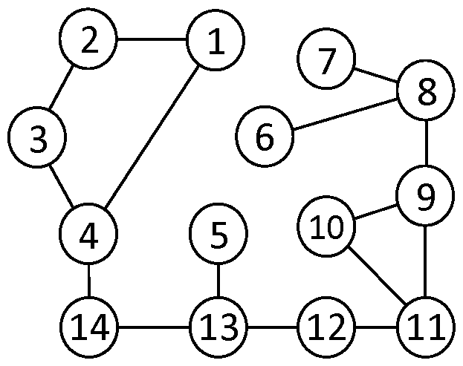
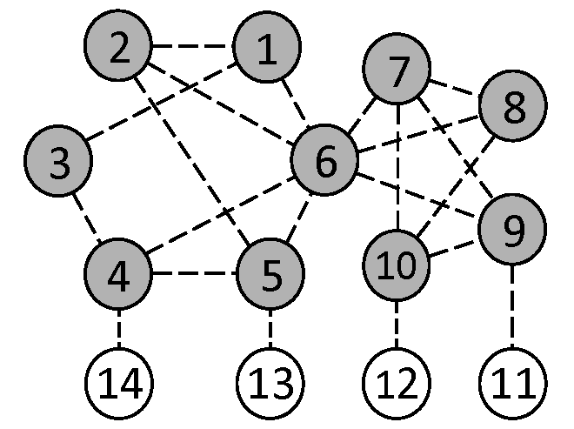
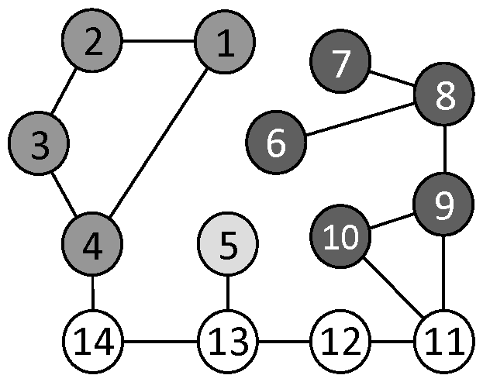
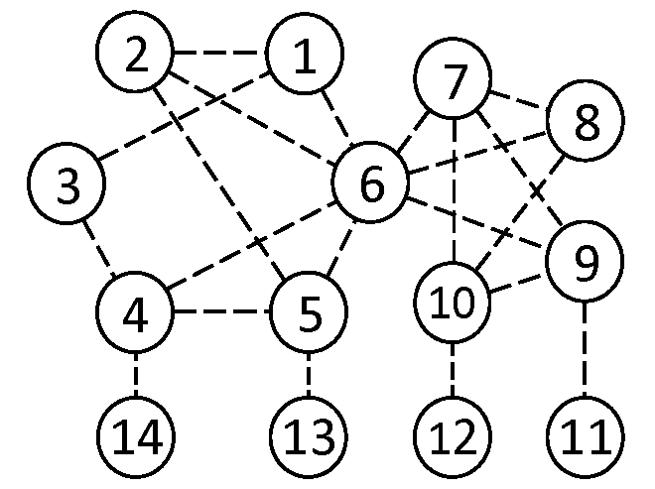




DCS_RDS Algorithm : Refining Densest Subgraph
$$G_{b}$$
$$G_{a}$$
$$G_{a}$$
Find the densest subgraph
in conceptual network
Refine the densest subgraph
in physical network
$$G_{b}$$
Yubao Wu, Ruoming Jin, Xiaofeng Zhu, and Xiang Zhang. Finding Dense and Connected Subgraphs in Dual Networks. ICDE, 2015.
Notes:
($: click for the animation)
After we get the densest subgraph in the conceptual network, we put it into the physical network. ($: click for the animation)
Usually, the subgraph is disconnected in the physical network, we thus make it connected by adding the nodes on the shortest paths connecting the disconnected components.

Slide 10
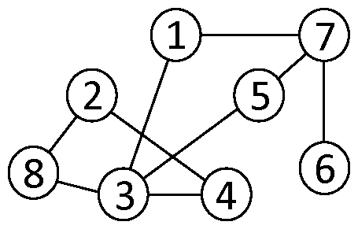
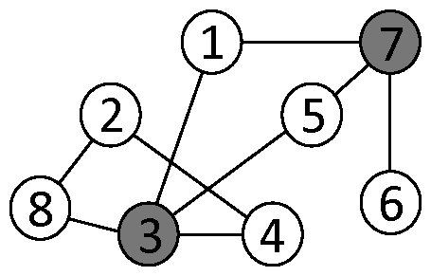
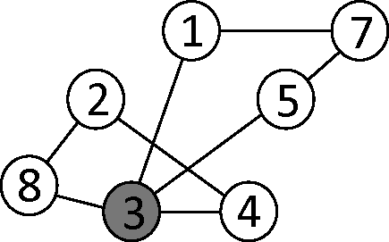
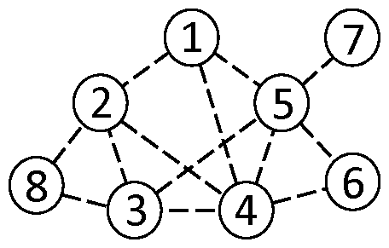
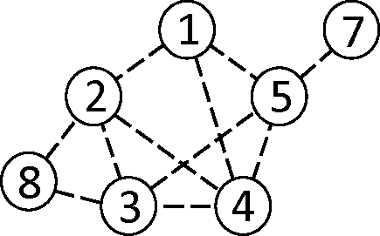






DCS_GND Algorithm —— Basic
Delete the minimum degree non-articulation nodes
Articulation nodes
$$G_{a}$$
$$G_{a}$$
$$G_{a}^{′}$$
$$G_{b}$$
$$G_{b}$$
$$G_{b}^{′}$$
Minimum degree node
Compute the density
Yubao Wu, Ruoming Jin, Xiaofeng Zhu, and Xiang Zhang. Finding Dense and Connected Subgraphs in Dual Networks. ICDE, 2015.
Notes:
The second heuristic algorithm is called the greedy node deletion algorithm. The basic idea is that we iteratively delete the low degree nodes in the conceptual network, while we keep the physical network connected.
($: click for the animation)
Specifically, we first compute the articulation nodes in the physical network. The articulation node is defined as the node whose deletion will disconnect the graph.
($: click for the animation)
In the conceptual network, we select the node with the minimum degree. For example, node 6 has the minimum degree and its deletion will not disconnect the physical network. So, node 6 can be deleted.
($: click for the animation)
After the deletion of the minimum degree non-articulation node, we compute the density of the remaining subgraph.
We repeat this process until the graph becomes empty. The subgraph with the maximum density is returned as the DCS pattern.

Slide 11
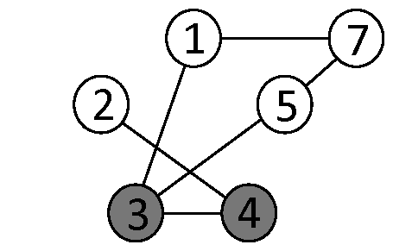
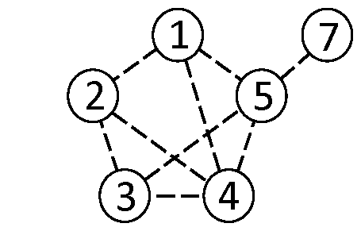
DCS_GND Algorithm —— Fast
Delete the low degree non-articulation nodes
Articulation nodes
$$G_{a}$$
$$G_{a}$$
$$G_{a}^{′}$$
$$G_{b}$$
$$G_{b}$$
$$G_{b}^{′}$$
Low degree nodes
Compute the density
Yubao Wu, Ruoming Jin, Xiaofeng Zhu, and Xiang Zhang. Finding Dense and Connected Subgraphs in Dual Networks. ICDE, 2015.
Notes:
To accelerate the computation process, we could delete multiple low degree nodes at each iteration as long as the deletion of these nodes will not disconnect the physical network. ($: click for the animation)
For example, nodes 6 and 8 both have low degree, and their deletions will not disconnect the physical network. Therefore, they can be deleted together.
($: click for the animation)

Slide 12
Experiments —— Datasets
Dual networks | Physical network | Conceptual network | Data sources
Biological | protein interaction | genetic interaction | BioGrid; WTCCC
Co-author | co-author network | research interest similar. | DBLP ( DB / DM )
Social | social network | interest similarity | Flixster / Epinions
Yubao Wu, Ruoming Jin, Xiaofeng Zhu, and Xiang Zhang. Finding Dense and Connected Subgraphs in Dual Networks. ICDE, 2015.
Notes:
In the experiments, we use three types of dual networks to evaluate the effectiveness and efficiency. They are dual biological networks, dual co-author networks, and dual social networks.
In the dual biological networks, the physical network is downloaded from the BioGrid database, and the conceptual network is constructed from the Wellcome Trust genome-wide association study dataset.
We construct two dual co-author networks from the DBLP bibliographic dataset, one for database research community and one for data mining research community. We construct two dual social networks, one from the Flixster dataset and one from the Epinions dataset.

Slide 13
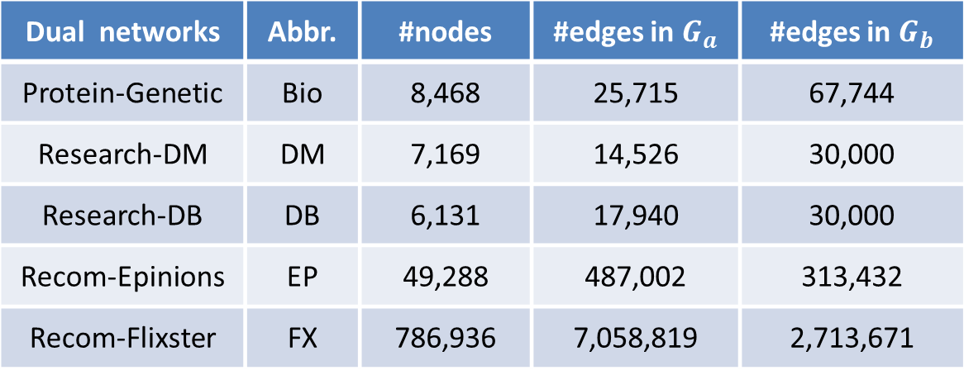
Experiments —— Datasets Statistics
Dual networks | Abbr. | #nodes | #edges in $G_{a}$ | #edges in $G_{b}$
Protein-Genetic | Bio | 8,468 | 25,715 | 67,744
Research-DM | DM | 7,169 | 14,526 | 30,000
Research-DB | DB | 6,131 | 17,940 | 30,000
Recom-Epinions | EP | 49,288 | 487,002 | 313,432
Recom-Flixster | FX | 786,936 | 7,058,819 | 2,713,671
Yubao Wu, Ruoming Jin, Xiaofeng Zhu, and Xiang Zhang. Finding Dense and Connected Subgraphs in Dual Networks. ICDE, 2015.
Notes:
The statistics of the constructed dual networks are shown in this table.

Slide 14
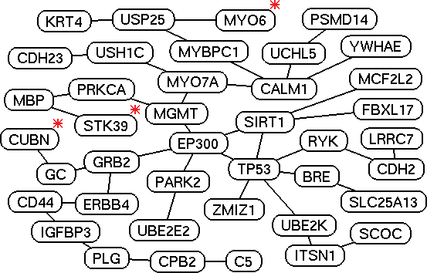
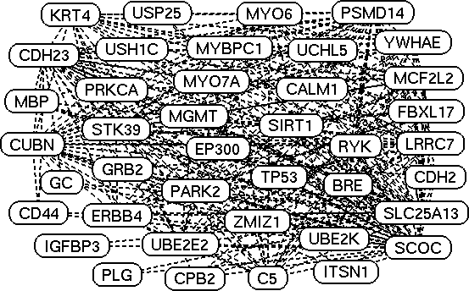
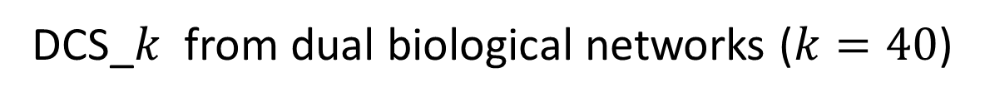
DCS_$k$ from dual biological networks ($k=40$)
(a) Subgraph in protein interaction network
(b) Subgraph in genetic interaction network
MYO6, CUBN, and STK39 have been reported to be associated with hypertension disease.
Yubao Wu, Ruoming Jin, Xiaofeng Zhu, and Xiang Zhang. Finding Dense and Connected Subgraphs in Dual Networks. ICDE, 2015.
Notes:
This is the DCS pattern discovered from the dual biological networks. From the figure, we can see that the subgraph is sparsely connected in the protein interaction network, and densely connected in the genetic interaction network. We also find some interesting genes that have been reported to be associated with the disease.

Slide 15
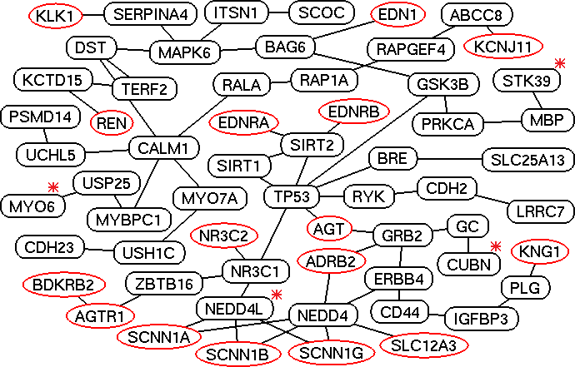
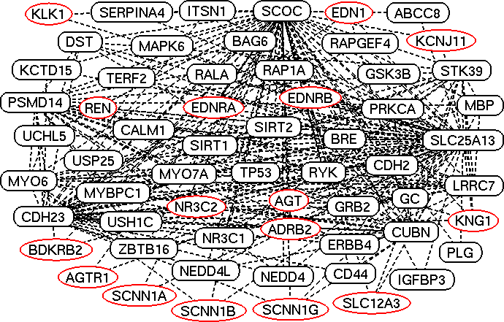
DCS_seed from dual biological networks
(a) Subgraph in protein interaction network
(b) Subgraph in genetic interaction network
Renin pathway genes are in red ellipses.
NEDD4L has been reported to be associated with hypertension disease.
Yubao Wu, Ruoming Jin, Xiaofeng Zhu, and Xiang Zhang. Finding Dense and Connected Subgraphs in Dual Networks. ICDE, 2015.
Notes:
We take the genes in the renin pathway as the seed nodes. Because the renin pathway is known to be associated with the hypertension disease.
We identify the DCS pattern near the seed nodes, which is shown in the Figures. The genes in the red ellipses are the seed genes.
We can see that the seed genes originally are not connected in the protein interaction network. After we add some new genes, they become connected in the protein interaction network and they are densely connected in genetic interaction network.

Slide 16
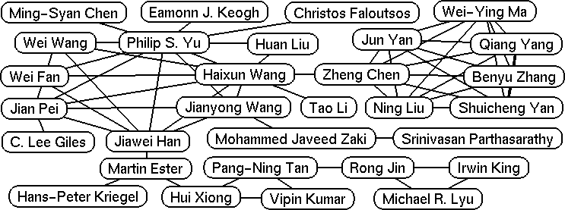
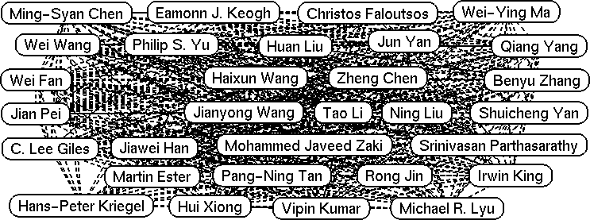
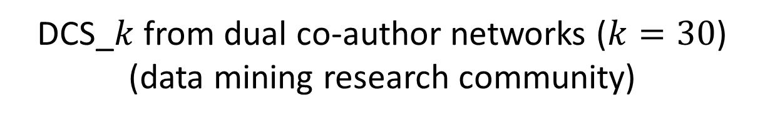
DCS_$k$ from dual co-author networks ($k=30$) (data mining research community)
(a) Subgraph in co-author network
(b) Subgraph in research interest similarity network
Yubao Wu, Ruoming Jin, Xiaofeng Zhu, and Xiang Zhang. Finding Dense and Connected Subgraphs in Dual Networks. ICDE, 2015.
Notes:
This is the DCS pattern from the dual co-author networks. The subgraph in the co-author network shows the collaboration pattern among the researchers. The subgraph in the research interest similarity network represents that they have similar research interests.

Slide 17
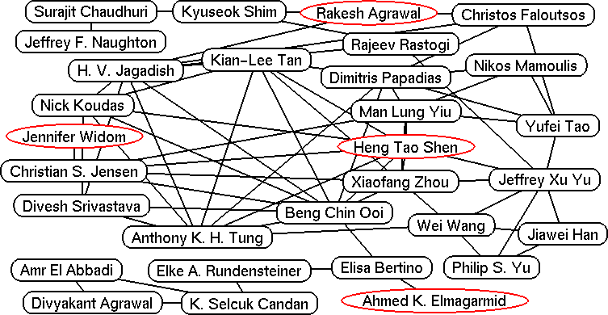
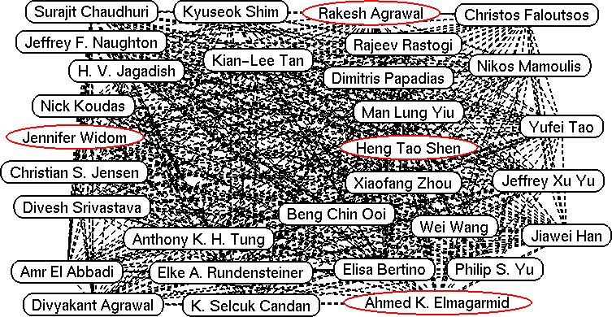
DCS_seed from dual co-author networks
(database research community)
(a) Subgraph in co-author network
(b) Subgraph in research interest similarity network
Yubao Wu, Ruoming Jin, Xiaofeng Zhu, and Xiang Zhang. Finding Dense and Connected Subgraphs in Dual Networks. ICDE, 2015.
Notes:
This is the DCS pattern discovered from the database research community. Similarly, the subgraph is connected in the collaboration network, and dense in the research interest similarity network.
The DCS pattern is very interesting, and it cannot be discovered by existing methods in either single network.

Slide 18
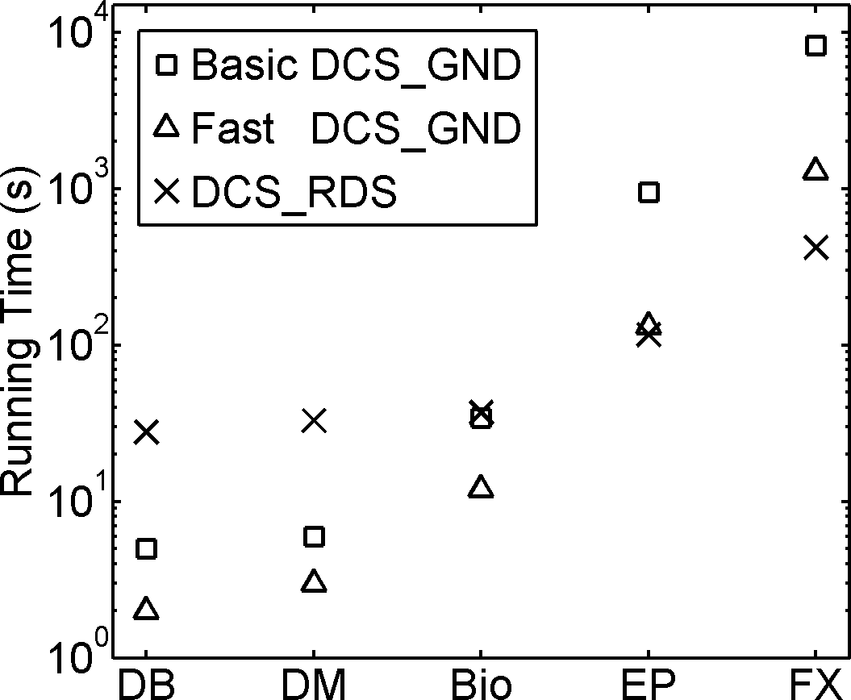
Running time and approximation ratios
Datasets | DCS_RDS | Basic DCS_GND | Fast DCS_GND
DBLP-DB | 1.48 | 1.53 | 2.21
DBLP-DM | 1.42 | 1.44 | 2.10
Biology | 1.94 | 2.11 | 2.35
Epinions | 1.23 | 1.26 | 1.87
Flixster | 2.25 | 2.34 | 2.62
Figure 1. Running time
Table 1. Approximation ratios
Yubao Wu, Ruoming Jin, Xiaofeng Zhu, and Xiang Zhang. Finding Dense and Connected Subgraphs in Dual Networks. ICDE, 2015.
Notes:
We further evaluate the efficiency of the algorithms.
The left figure shows the running time of the algorithms. The x-axis represents different datasets; the y-axis represents the running time. We can see that our method can process large graphs efficiently.
The right table shows the approximation ratios of the algorithms. We can see that the approximation ratios are around 2. This demonstrates that the algorithm has tight approximation ratios in practice.

Slide 19
Conclusion:
1) Densest connected subgraph is an interesting pattern;
2) A new way to think about how to integrate multiple networks.
Future work:
1) Multiple edge types?
2) Applications in real world?
Yubao Wu, Ruoming Jin, Xiaofeng Zhu, and Xiang Zhang. Finding Dense and Connected Subgraphs in Dual Networks. ICDE, 2015.
Notes:
In conclusion, the DCS pattern is very interesting. This work provides a novel way to think about how to integrate multiple networks.
In future, we may extend the DCS pattern to networks with multiple edge types. And we also want to look for more applications. Thank you. Any question?

