Slide 1
Robust Local Community Detection:
On Free Rider Effect and Its Elimination
Yubao Wu¹, Ruoming Jin², Jing Li¹, Xiang Zhang¹
¹Case Western Reserve University
²Kent State University
Notes:
Good afternoon, everyone. My name is Yubao. I am from Case Western Reserve University. I am gonna talk about robust local community detection: on free rider effect and its elimination. This is a joint work with Dr. Ruoming Jin, Dr. Jing Li, and my advisor, Dr. Xiang Zhang.

Slide 2
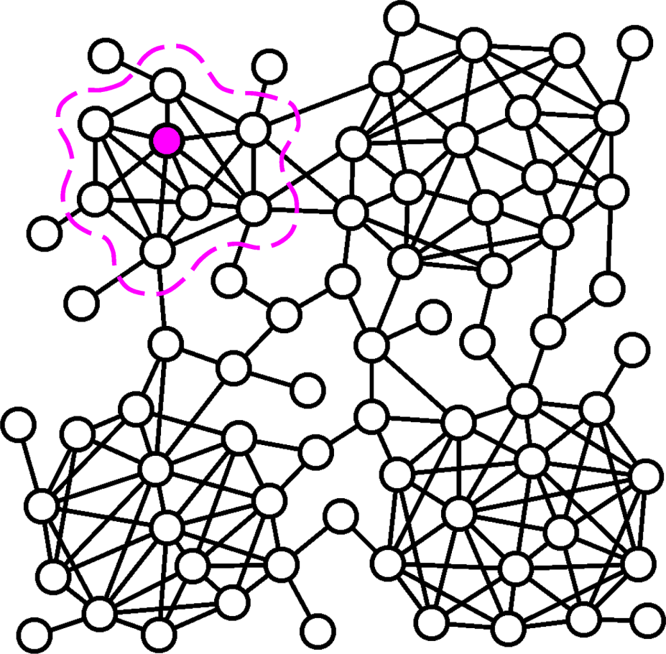
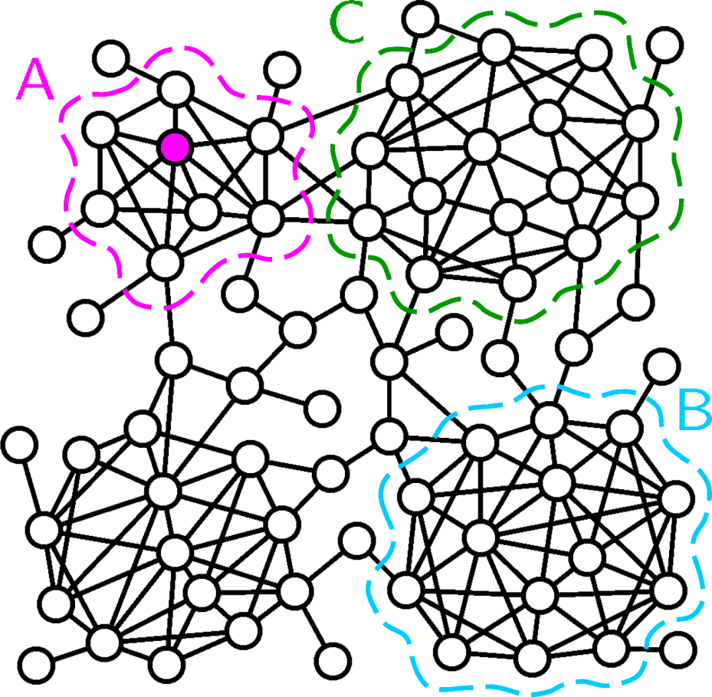
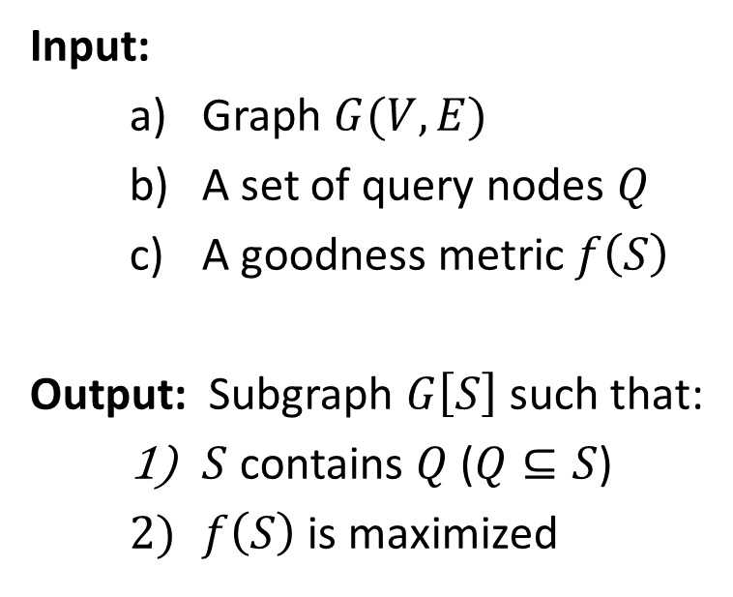
Generic Local Community Detection Problem
Input:
Graph $G(V,E)$
A set of query nodes $Q$
A goodness metric $f\left(S\right)$
Output: Subgraph $G\left[S\right]$ such that:
$S$ contains $Q$ ($Q⊆S$)
$f\left(S\right)$ is maximized
A
[1] M. Sozio, et al. KDD’10.
[2] W. Cui, et al. SIGMOD’14.
[3] L. Ma, et al. DaWak’13.
[4] B. Saha, et al. RECOMB’10.
[5] C. Tsourakakis, et al. SIGMOD’14.
[6] A. Clauset, PRE’05.
[7] F. Luo, et al. WIAS’08.
[8] R. Andersen, et al. FOCS’06.
Notes:
A community is usually defined as a subgraph that is densely connected inside and sparsely connected outside.
Given a graph and a query node, the local community detection problem aims at finding a community near the query node. In this example, the purple node is the query node, and subgraph A is the local community to be detected.
But all the existing methods tend to include irrelevant subgraphs, such as subgraph B or C, in the detected community. In this work, we try to solve this problem.
The local community detection problem can be defined in this generic form. The inputs include a graph, a set of query nodes, and a goodness metric. The goodness metric is used to measure the goodness of a community. The output is a subgraph such that the subgraph contains the query nodes, and the goodness metric is maximized.

Slide 3
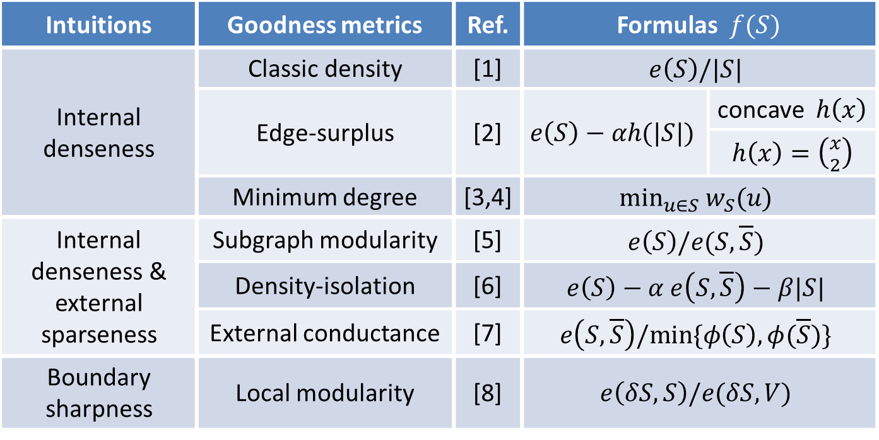
Community Goodness Metrics
Intuitions | Goodness metrics | Ref. | Formulas $f(S)$
Internal denseness | Classic density | [1] | $$e\left(S\right)/|S|$$
 | Edge-surplus | [2] | $$e\left(S\right)−αh(|S|)$$ | concave $h\left(x\right)$
 |  |  |  | $h\left(x\right)=\left({x \atop 2}\right)$
 | Minimum degree | [3,4] | $$\min_{u∈S} w_{S}(u)$$
Internal denseness & external sparseness | Subgraph modularity | [5] | $$e\left(S\right)/e(S,\overline{S})$$
 | Density-isolation | [6] | $$e\left(S\right)−α e\left(S,\overline{S}\right)−β|S|$$
 | External conductance | [7] | $$e\left(S,\overline{S}\right)/min⁡\{φ\left(S\right),φ(\overline{S})\}$$
Boundary sharpness | Local modularity | [8] | $$e\left(δS,S\right)/e(δS,V)$$
[1] B. Saha, et al. RECOMB’10.
[2] C. Tsourakakis, et al. SIGMOD’14.
[3] M. Sozio, et al. KDD’10.
[4] W. Cui, et al. SIGMOD’14.
[5] F. Luo, et al. WIAS’08.
[6] K. J. Lang, CIKM’07.
[7] R. Andersen, et al. FOCS’06.
[8] A. Clauset, PRE’05.
Notes:
Many goodness metrics have been proposed. This table shows some existing goodness metrics. They can be categorized into three classes.
The first class optimizes the internal denseness. It includes classic density, edge-surplus, and minimum degree. For example, the classic density is defined as the summation of the internal edge weights divided by the number of nodes. It measures the average degree.
The second class optimizes both internal denseness and external sparseness. It includes subgraph modularity, density-isolation, and external conductance. For example, subgraph modularity is defined as the summation of the internal edge weights divided by the summation of the external edge weights.
The third class optimizes the boundary sharpness. It includes local modularity.

Slide 4
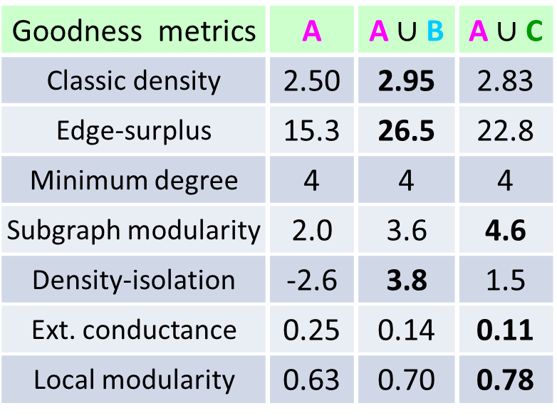
Free Rider Effect
Goodness metrics | A | A $\text{∪}$ B | A $\text{∪}$ C
Classic density | 2.50 | 2.95 | 2.83
Edge-surplus | 15.3 | 26.5 | 22.8
Minimum degree | 4 | 4 | 4
Subgraph modularity | 2.0 | 3.6 | 4.6
Density-isolation | -2.6 | 3.8 | 1.5
Ext. conductance | 0.25 | 0.14 | 0.11
Local modularity | 0.63 | 0.70 | 0.78
[1] B. Saha, et al. RECOMB’10.
[2] C. Tsourakakis, et al. SIGMOD’14.
[3] M. Sozio, et al. KDD’10.
[4] W. Cui, et al. SIGMOD’14.
[5] F. Luo, et al. WIAS’08.
[6] K. J. Lang, CIKM’07.
[7] R. Andersen, et al. FOCS’06.
[8] A. Clauset, PRE’05.
Notes:
But all the existing methods tend to include irrelevant subgraphs in the detected local community.
This toy graph contains four communities. Suppose that the purple node is the query node and subgraph A is the local community to be detected. Suppose that we use the classic density as the goodness metric. Classic density measures the average degree of the nodes in the subgraph. In this example, the density of subgraph A is 2.5, but the density of the union of subgraphs A and B is 2.95, which is greater than the density of subgraph A.
Because we only want to maximize the goodness value, the union of subgraphs A and B is a better solution than subgraph A. This is counter-intuitive.
We study other goodness metrics. This table shows the results. We can see that all of them suffer from the same problem. For example, let’s consider the external conductance. The smaller the external conductance value, the better the performance. We can see that the external conductance of subgraph A is 0.25. But the external conductance value of the union of subgraph A and C is 0.11, which is smaller than that of subgraph A.
We call subgraph B or C the free rider subgraph. And we call this phenomenon the free rider effect. We theoretically prove that all the existing goodness metrics suffer from the free rider effect.

Slide 5
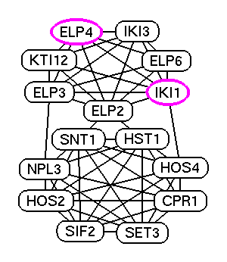
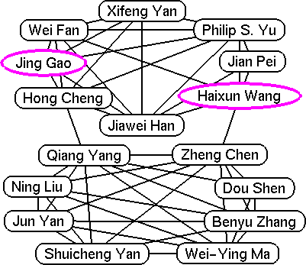
Free Rider Effect in Real Networks
(a) Co-author network
(b) Biological network
One existing method: classic density
Barna, Saha, et al. Dense subgraphs with restrictions and applications to gene annotation graphs. RECOMB, 2010.
Notes:
The free rider effect exists in many real networks. The example on the left is detected from the co-author network. The purple nodes are the query authors. This subgraph is detected by the existing method using the classic density as the goodness metric. The subgraph in the upper part is the local community that we want to detect. We can see that the lower part is a free rider subgraph that should not have been included in the results. The example on the right is detected from the biological network. Each node is a protein. The subgraph in the upper part is the protein complex to be detected. However, the irrelevant protein complex in the lower part is included in the existing method.

Slide 6

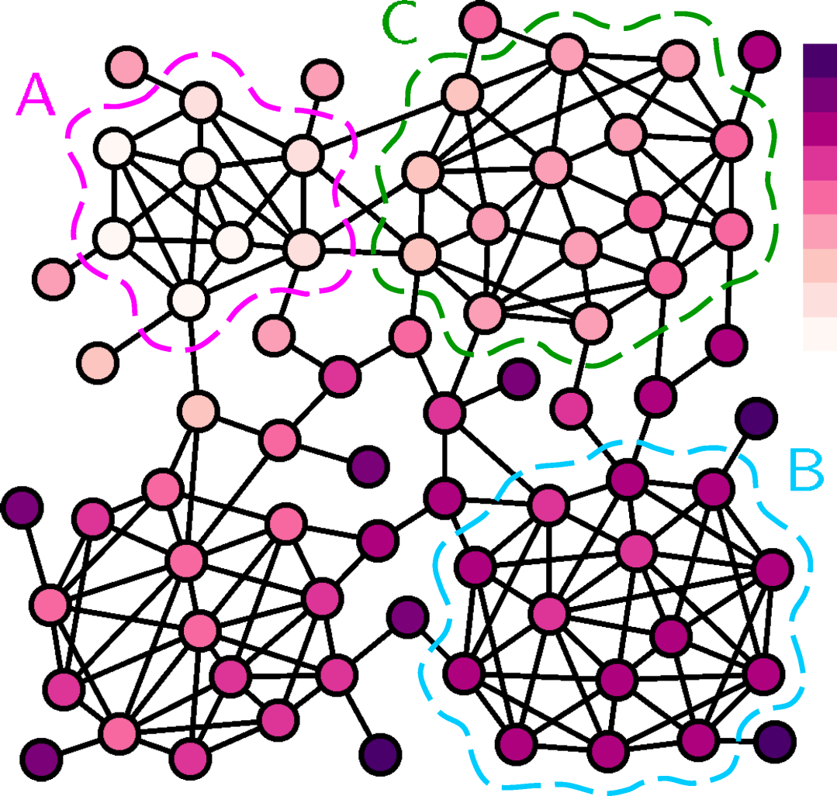
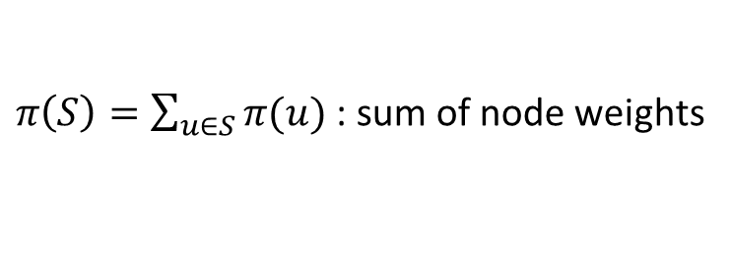
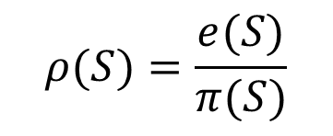
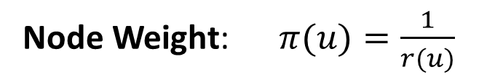

Query Biased Node Weighting
Node Weight: $π(u)=\frac{1}{r(u)}$
$r\left(u\right)$ : proximity value w.r.t. the query
Query biased density:
$$ρ(S)=\frac{e(S)}{π(S)}$$
$π\left(S\right)=\sum_{u∈S}{π(u)}$ : sum of node weights
Subgraph A becomes the
query biased densest subgraph
Yubao Wu, Ruoming Jin, Jing Li, and Xiang Zhang. Robust local community detection: on free rider effect and its elimination. PVLDB, 8(7):798-809, 2015.
Notes:
To eliminate the free rider effect, we propose a query biased node weighting scheme. Given a graph and a query node, we first compute the proximity value of each node with regard to the query node. Then, the node weight is defined as the inverse of the proximity value. This figure visualizes the distribution of the node weights. The darker the node color, the larger the node weight. We can see that if one node is far away from the query node, it has large node weight.
After we get the node weights, we define a new goodness metric: the query biased density. It equals the summation of edge weights divided the summation of node weights. The denominator is the sum of node weights. Thus, if one subgraph contains many nodes that are far away from the query node, the query biased density will be small. Because those nodes have large node weights.
In this example, subgraph A is the query biased densest subgraph. Previously, subgraph B is the densest subgraph.

Slide 7
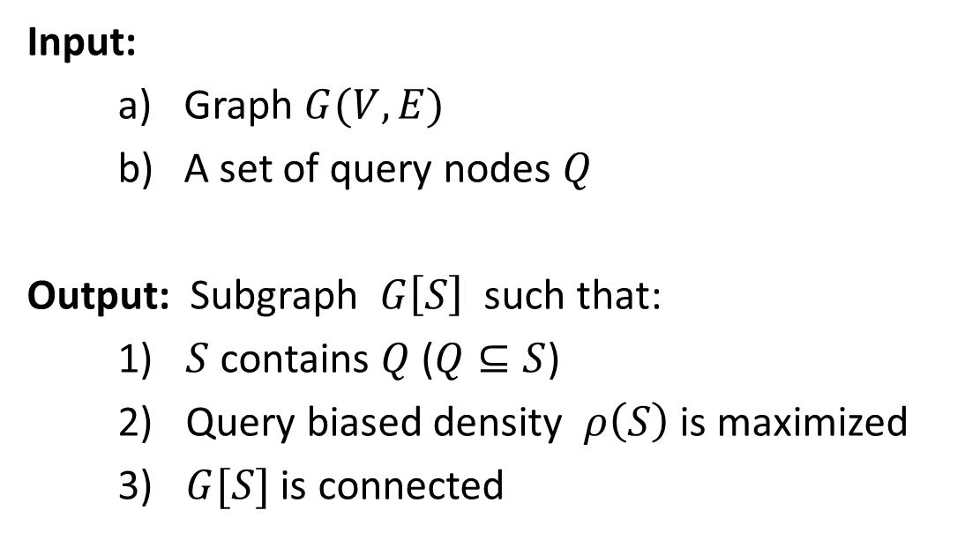
QDC Problem
Query biased densest connected subgraph (QDC) problem:
Input:
Graph $G(V,E)$
A set of query nodes $Q$
Output: Subgraph $G\left[S\right]$ such that:
$S$ contains $Q$ ($Q⊆S$)
Query biased density $ρ\left(S\right)$ is maximized
$G[S]$ is connected
Yubao Wu, Ruoming Jin, Jing Li, and Xiang Zhang. Robust local community detection: on free rider effect and its elimination. PVLDB, 8(7):798-809, 2015.
Notes:
Based on the query biased density, we define a new problem: the query biased densest connected subgraph problem. It is also called the QDC problem.
The inputs include a graph and a set of query nodes. The output is a subgraph such that the subgraph contains the query nodes, the query biased density is maximized, and the subgraph is connected.

Slide 8
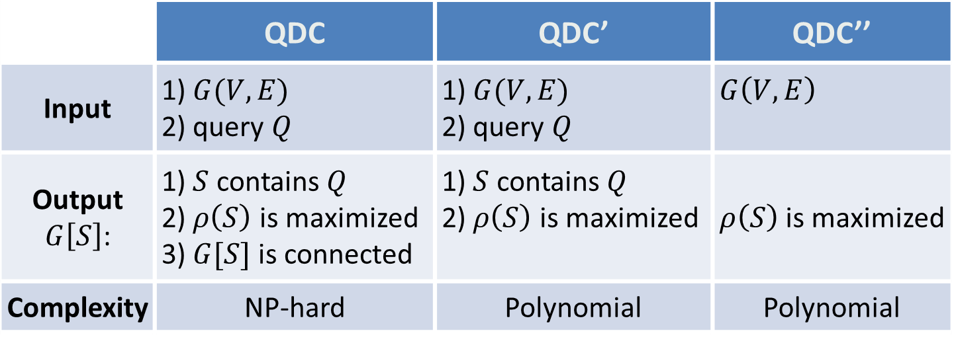
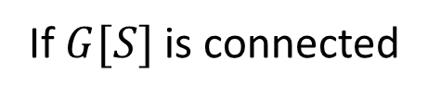
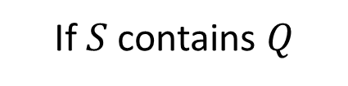
QDC Problem and Two Related Problems
 | QDC | QDC’ | QDC’’
Input | 1) $G(V,E)$ 2) query $Q$ | 1) $G(V,E)$ 2) query $Q$ | $G\left(V,E\right)$
Output $G\left[S\right]$: | 1) $S$ contains $Q$ 2) $ρ\left(S\right)$ is maximized 3) $G[S]$ is connected | 1) $S$ contains $Q$ 2) $ρ\left(S\right)$ is maximized | $ρ\left(S\right)$ is maximized
Complexity | NP-hard | Polynomial | Polynomial
Optimal
Optimal
If $G[S]$ is connected
If $S$ contains $Q$
Yubao Wu, Ruoming Jin, Jing Li, and Xiang Zhang. Robust local community detection: on free rider effect and its elimination. PVLDB, 8(7):798-809, 2015.
Notes:
The QDC problem is NP-hard. Therefore, we study two related problems that have fewer constraints than the QDC problem.
The first related problem aims at finding the query biased densest subgraph that contains the query nodes. The resulting subgraph maybe disconnected. The second related problem aims at finding the query biased densest subgraph without any constraint. These two related problems can be solved in polynomial time.
If the solutions of these two related problems satisfy some additional constraints, they will become the optimal solution of the original QDC problem.
Intuitively, the query biased densest subgraph should be in the neighborhood of the query node. Therefore, it is very likely that the query biased densest subgraph contains the query node and is connected. The experimental results also demonstrate that with a high probability of 0.95, the solutions of these two related problems satisfy the additional constraints and become the optimal solution of the original QDC problem.

Slide 9
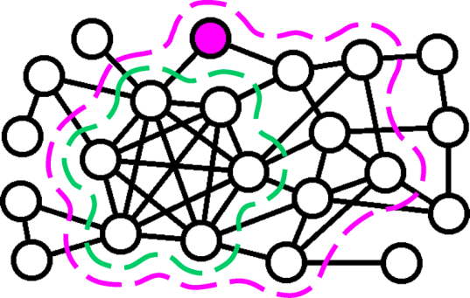
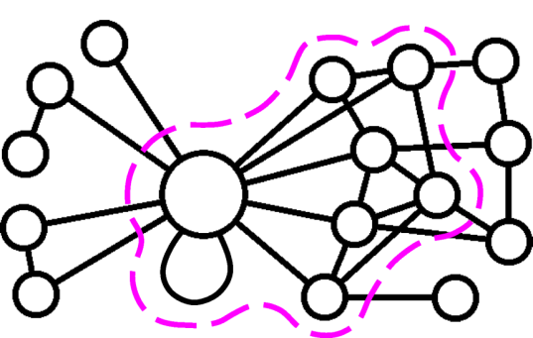
Finding the QDC’’
Finding the QDC’
1. Removing Low Degree Nodes
Reduce the search space
Retain the densest subgraph
Subgraph contraction
2. Detect the Densest Subgraph
On the reduced search space
Yubao Wu, Ruoming Jin, Jing Li, and Xiang Zhang. Robust local community detection: on free rider effect and its elimination. PVLDB, 8(7):798-809, 2015.
Notes:
We provide polynomial time algorithms for these two related problems first.
For the query biased densest subgraph problem, the developed algorithm contains two steps. First, we remove low degree nodes to reduce the search space, but the densest subgraph is guaranteed to be retained in the remaining subgraph. And then, we find the densest subgraph on the reduced search space.
For the problem with seed constraint, we call the densest subgraph algorithm repeatedly. If the resulting densest subgraph does not contain the query node, we contract them together into a super node, and call the densest subgraph algorithm again. In this example, the subgraph in the green curve is the densest subgraph, but it does not contain the query node. So we contract them into a super node and call the densest subgraph algorithm again. The subgraph in the purple curve is the densest subgraph that contains the query node.

Slide 10
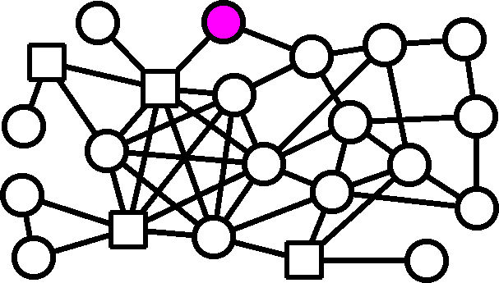
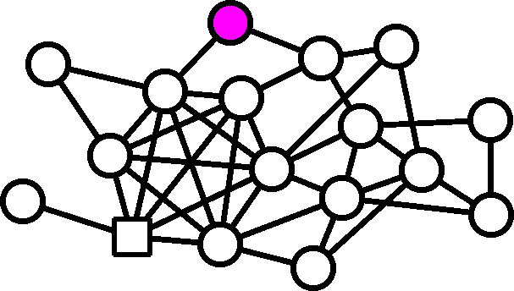
Finding the QDC
Greedy Node Deletion
Local Expansion
Connect the query nodes with a Steiner tree
Greedy local expansion
Delete low degree nodes
Maintain the connectivity
Yubao Wu, Ruoming Jin, Jing Li, and Xiang Zhang. Robust local community detection: on free rider effect and its elimination. PVLDB, 8(7):798-809, 2015.
Notes:
The QDC problem is NP-hard. Therefore, we develop two heuristic algorithms.
The first one deletes low degree nodes at each iteration, and at the same time, it maintains the connectivity of the remaining graph.
The second one is a local expansion algorithm. It first connects the query nodes with a Steiner tree. And then, at each iteration, it expands to one neighbor node that can increase the density most.

Slide 11
Experiments——Datasets
Dataset | # Nodes | # Edges | # Communities
Amazon | 00,334,863 | 0,000,925,872 | 0,151,037
DBLP | 00,317,080 | 0,001,049,866 | 0,013,477
Youtube | 01,134,890 | 0,002,987,624 | 0,008,385
Orkut | 03,072,441 | 0,117,185,083 | 6,288,363
LiveJournal | 03,997,962 | 0,034,681,189 | 0,287,512
Friendster | 65,608,366 | 1,806,067,135 | 0,957,154
[1] J. Yang and J. Leskovec. Defining and evaluating network communities based on ground-truth. In ICDM, 2012.
[2] snap.stanford.edu
Notes:
In the experiments, we use a set of real large graphs. This table shows the basic statistics of the graphs. The graphs contain up to tens of millions of nodes and billions of edges. The graphs also contain the ground truth communities.

Slide 12
Experiments——State-of-the-Art Methods
Classes | Abbr. | Ref. | Key Idea
Internal denseness | DS | [1] | Densest subgraph with query constraint
 | OQC | [2] | Optimal quasi-clique; edge-surplus
 | MDG | [3] | Minimum degree
Internal denseness & external sparseness | PRN | [4] | External conductance
 | LS | [5] | Local spectral
 | EMC | [6] | More internal edges than external edges
 | SM | [7] | Subgraph modularity
Boundary | LM | [8] | Local modularity
[1] B. Saha, et al. RECOMB’10.
[2] C. Tsourakakis, et al. SIGMOD’14.
[3] M. Sozio, et al. KDD’10.
[4] R. Andersen, et al. FOCS’06.
[5] M. W. Mahoney, et al. JMLR’12.
[6] G. W. Flake, KDD’00.
[7] F. Luo, et al. WIAS’08.
[8] A. Clauset, PRE’05.
Notes:
We compare our method with several state-of-the-art methods. These methods can be categorized into three classes based on the goodness metrics they are optimizing. The first class of methods optimizes the internal denseness. The second class of methods optimizes both the internal denseness and external sparseness. And the third class of methods optimizes the boundary sharpness.

Slide 13

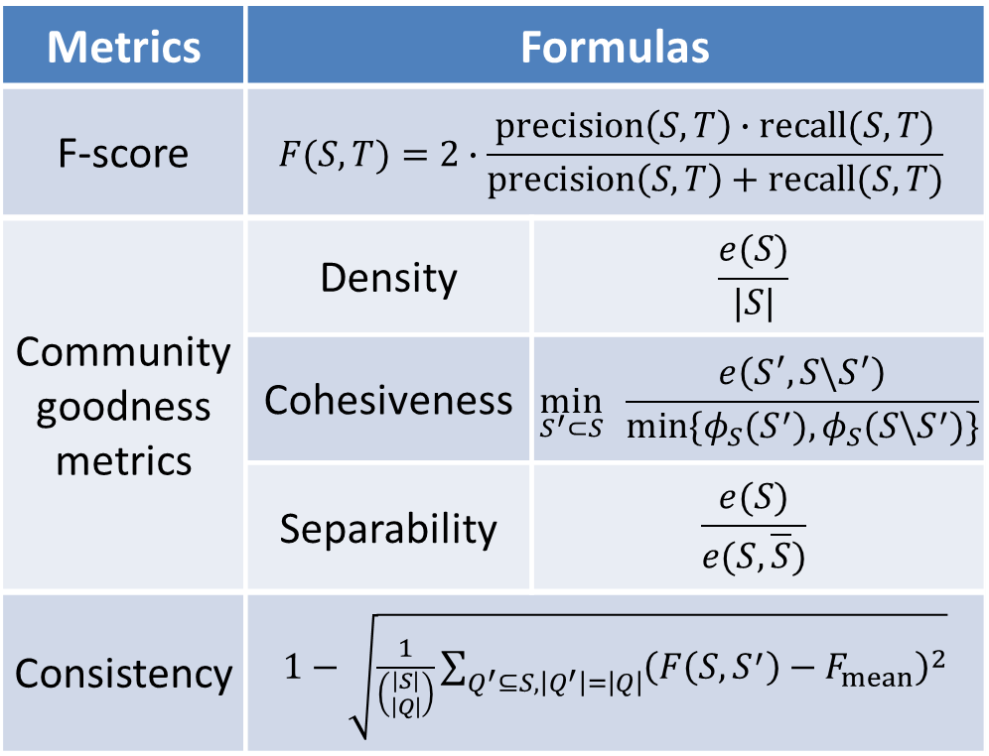
Experiments——Effectiveness Evaluat. Metrics
Metrics | Formulas
F-score | $$F(S,T)=2∙\frac{precision\left(S,T\right)∙recall(S,T)}{precision\left(S,T\right)+recall(S,T)}$$
Community goodness metrics | Density | $$\frac{e(S)}{|S|}$$
 | Cohesiveness | $$\min_{S^{′}⊂S}{ \frac{e\left(S^{′},S\backslash S^{′}\right)}{min⁡\{φ_{S}(S^{′}),φ_{S}({S\backslash S}^{′})\}}}$$
 | Separability | $$\frac{e(S)}{e(S,\overline{S})}$$
Consistency | $1−\sqrt{\frac{1}{\left({\left|S\right| \atop \left|Q\right|}\right)}\sum_{Q^{′}⊆S,\left|Q^{′}\right|=\left|Q\right|}{{\left(F\left(S,S^{′}\right)−F_{mean}\right)}^{2}}}$
[1] J. Yang and J. Leskovec. Dening and evaluating network communities based on ground-truth. In ICDM, pages 745-754, 2012.
[2] Ma, Lianhang, et al. GMAC: A seed-insensitive approach to local community detection. In DaWak, pages 297-308, 2013.
Notes:
We use three metrics to evaluate the effectiveness.
The first one is F-score. It measures the accuracy given the ground truth community.
The second one is a set of community goodness metrics, which includes density, cohesiveness, and separability. Density measures the internal denseness. Cohesiveness measures the minimum cut within the subgraph. Separability measures external cut within the subgraph.
The third one is consistency. Intuitively, if we pick any node from one community as the query node, the method should always return the same community. Given the detected community, we randomly pick one node as the query node, detect the local community and compute the F-score. We repeat this process and can get a set of F-scores. If the algorithm is consistent, the variance of the F-scores should be small. Therefore, we use the variance of F-scores to define the consistency.

Slide 14
Effectiveness Evaluation —— F-Score
F-score | QDC | DS | OQC | MDG | PRN | LS | EMC | SM | LM
Amazon | 0.83 | 0.52 | 0.54 | 0.46 | 0.69 | 0.66 | 0.61 | 0.60 | 0.58
DBLP | 0.46 | 0.31 | 0.33 | 0.32 | 0.48 | 0.42 | 0.34 | 0.36 | 0.37
Youtube | 0.43 | 0.23 | 0.22 | 0.17 | 0.26 | 0.24 | 0.21 | 0.21 | 0.22
Orkut | 0.47 | 0.15 | 0.16 | 0.13 | 0.21 | 0.17 | 0.19 | 0.16 | 0.18
LiveJournal | 0.64 | 0.48 | 0.47 | 0.40 | 0.52 | 0.51 | 0.47 | 0.48 | 0.49
Friendster | 0.32 | -- | 0.14 | 0.12 | 0.17 | 0.16 | -- | 0.14 | 0.13
Avg. F-score | 0.53 | 0.3 | 0.31 | 0.27 | 0.39 | 0.36 | 0.33 | 0.33 | 0.33
Avg. Precision | 0.65 | 0.46 | 0.45 | 0.29 | 0.51 | 0.41 | 0.34 | 0.38 | 0.48
Avg. Recall | 0.78 | 0.61 | 0.58 | 0.69 | 0.67 | 0.64 | 0.66 | 0.63 | 0.59
Yubao Wu, Ruoming Jin, Jing Li, and Xiang Zhang. Robust local community detection: on free rider effect and its elimination. PVLDB, 8(7):798-809, 2015.
Notes:
This table shows the F-score results. Each row corresponds to a dataset; each column corresponds to a method. We can see that our method has the best performance on most datasets.

Slide 15
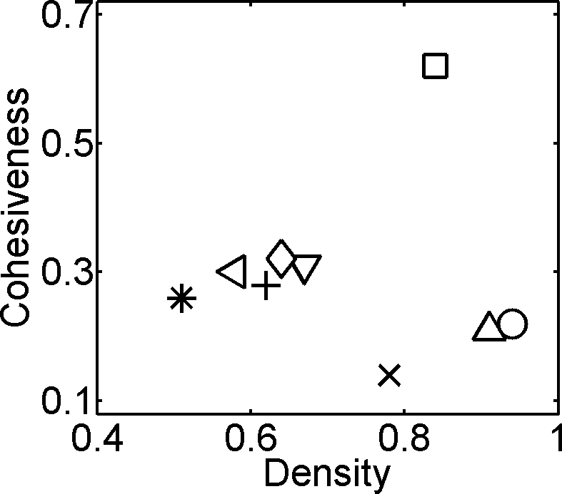
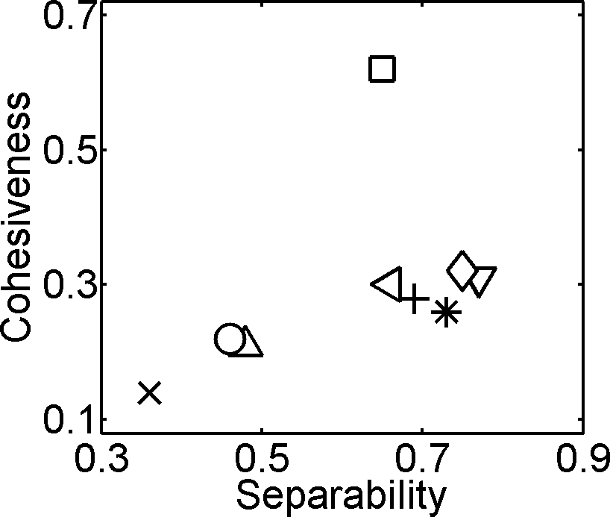
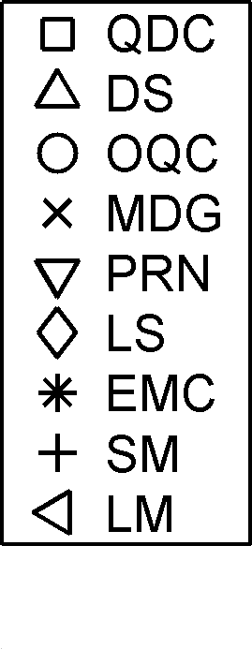
Effectiveness Evaluation——Goodness Metrics
Community goodness metrics on LiveJournal graph
Yubao Wu, Ruoming Jin, Jing Li, and Xiang Zhang. Robust local community detection: on free rider effect and its elimination. PVLDB, 8(7):798-809, 2015.
Notes:
These figures show the distribution of community goodness metrics. They are cohesiveness, density and separability. The larger the goodness value, the better the performance. The square marker denotes our QDC method. We can see that our method has high cohesiveness, high density, and high separability. The remaining methods have low cohesiveness value because they suffer from the free rider effect.

Slide 16
Effectiveness Evaluation——Consistency
Consistency | QDC | DS | OQC | MDG | PRN | LS | EMC | SM | LM
Amazon | 0.94 | 0.77 | 0.76 | 0.58 | 0.79 | 0.69 | 0.74 | 0.67 | 0.61
DBLP | 0.88 | 0.62 | 0.64 | 0.37 | 0.65 | 0.53 | 0.56 | 0.43 | 0.56
Youtube | 0.85 | 0.61 | 0.54 | 0.46 | 0.71 | 0.41 | 0.57 | 0.37 | 0.36
Orkut | 0.83 | 0.56 | 0.52 | 0.32 | 0.68 | 0.43 | 0.51 | 0.54 | 0.47
LiveJournal | 0.93 | 0.74 | 0.67 | 0.43 | 0.84 | 0.64 | 0.73 | 0.58 | 0.52
Friendster | 0.78 | -- | 0.56 | 0.45 | 0.65 | 0.49 | -- | 0.32 | 0.39
Average | 0.87 | 0.64 | 0.62 | 0.44 | 0.72 | 0.53 | 0.61 | 0.49 | 0.49
Yubao Wu, Ruoming Jin, Jing Li, and Xiang Zhang. Robust local community detection: on free rider effect and its elimination. PVLDB, 8(7):798-809, 2015.
Notes:
This table shows the consistency results. Each row corresponds to a dataset; each column corresponds to a method. We can see that our method is the most consistent method.

Slide 17
Conclusions
1) Free rider effect is a serious problem;
2) Query biased node weighting scheme can effectively eliminate the free rider effect thus improve the accuracy.
Yubao Wu, Ruoming Jin, Jing Li, and Xiang Zhang. Robust local community detection: on free rider effect and its elimination. PVLDB, 8(7):798-809, 2015.
Notes:
In conclusion, the free rider effect is a serious problem in local community detection. The proposed query biased node weighting scheme can effectively eliminate the free rider effect thus improve the accuracy. Thank you. Any questions?

