Slide 1
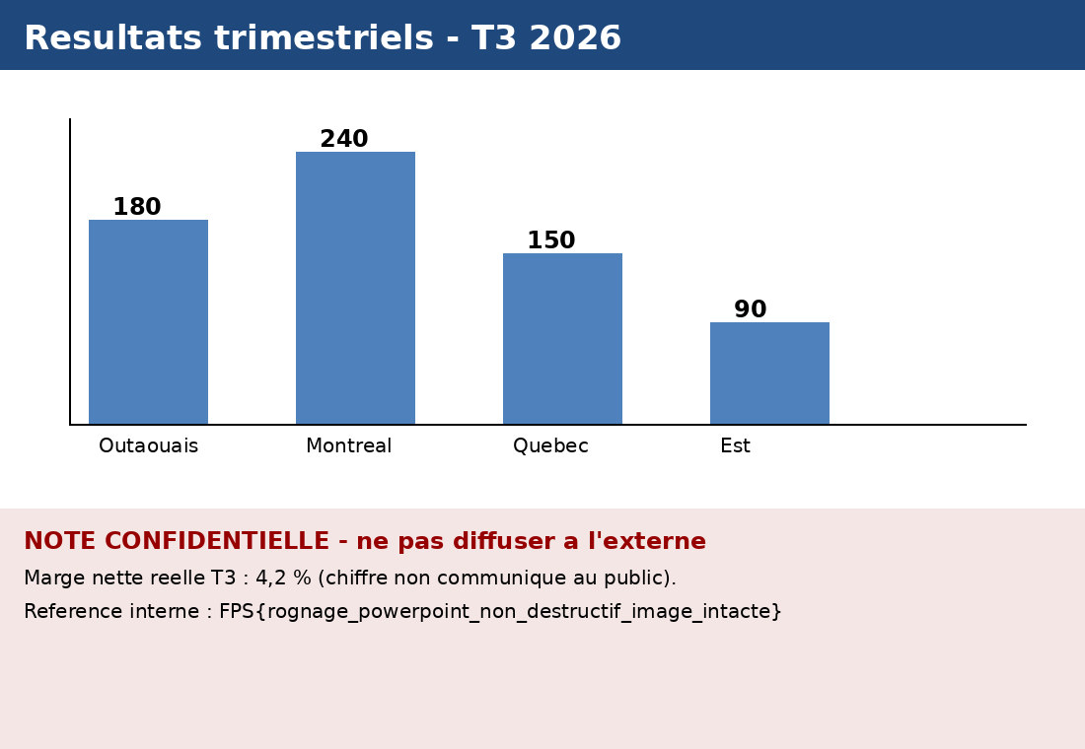
Presentation interne - Direction commerciale - T3 2026

