Slide 1
Vote Tabulation Service
Receives votes collected by voting machines
Communicates with TCP packets over TLS
Implemented in Lua 5.3
Compiled with symbolic names obfuscated
Can be decompiled:
https://github.com/viruscamp/luadec
https://luadec.metaworm.site/
Contains 5 vulnerabiities

Slide 2
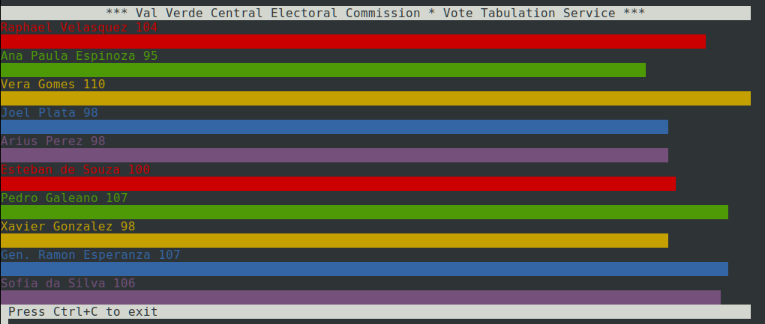
Runs as a service and console app

Slide 3
Vote package structure
Machine ID – 16-character hex number
Number of vote records – uint8
Vote record:
Candidate ID - uint8
Candidate Name – uint8 length followed by string characters
Voter ID - uint32
Voter Name – uint8 length followed by string characters
Vote Count - int8

Slide 4

Vulnerability 1 – Voter impersonation
We check that the voter name is known
But we don’t check the voter ID
One could send a record with known voter name without specifying the valid ID

Slide 5
Vulnerability 2 - SQLi
We do not validate the Candidate name and an SQLi payload can sneak in
We can create payload that applies to all candidates
SELECT votes FROM candidates WHERE name='Pedro Galeano'/*J*/oR/*ZDM9m 0f*/'3829';

Slide 6
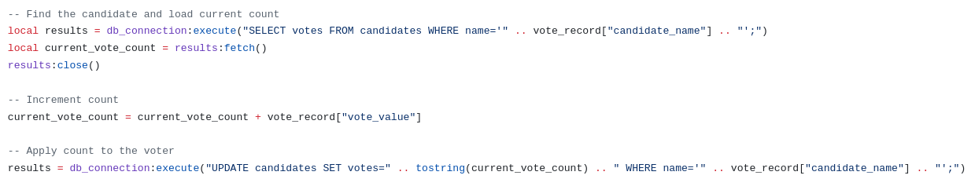
Vulnerability 2 – SQLi (continued)
SQLi payload can be used to mess up records
Vote count from one candidate is applied to all

Slide 7

Vulnerability 3- Device ID hash collisions
Machine IDs are checked by CRC32 (which is vulnerable to hash collisions)
CRC32(“0d97fb6b2e894966”) = 0x3aef1e89
CRC32(“bdb430e2b1b9c0fe”) = 0x3aef1e89

Slide 8
Vulnerability 4 – Duplicate voter records
We do not check if the same person votes only once as part of the vote package

Slide 9

Vulnerability 5 – Vote count
We reject records with more than 1 vote
But we accept negative numbers of votes (the value is int8 not uint8)

