Slide 1
Voter Registry Walkthrough
Central Electoral Commission hosts a Voter Registration website that they asked us to test. The attacks that we tried have yielded a number of vulnerabilities that you need to help us fix.
Please use the Attack Portal at http://10.0.2.50 to launch attacks.
Voter Registration website is hosted at https://10.0.2.52

Slide 2

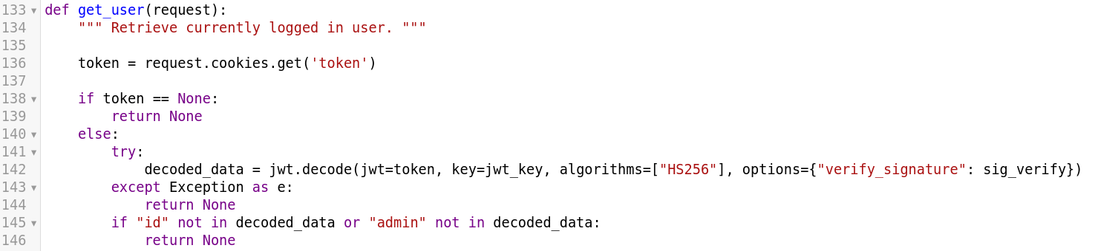
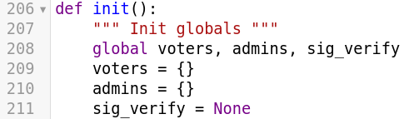
Vulnerability 1

Slide 3
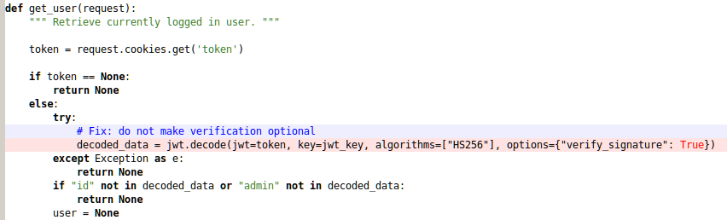

Slide 4
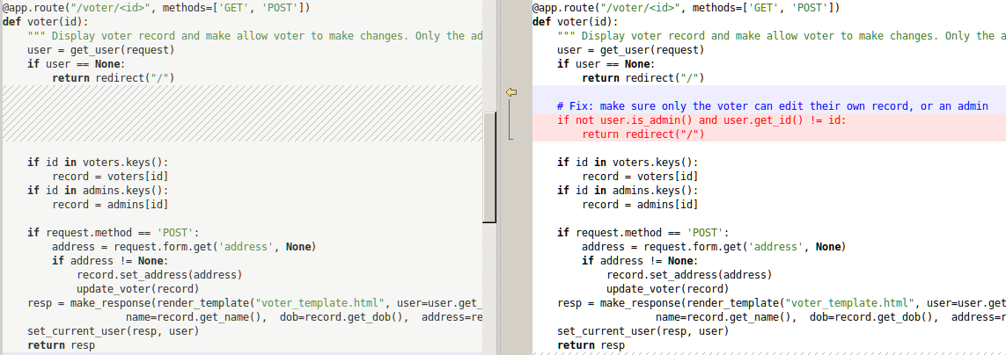
Vulnerability 2

Slide 5
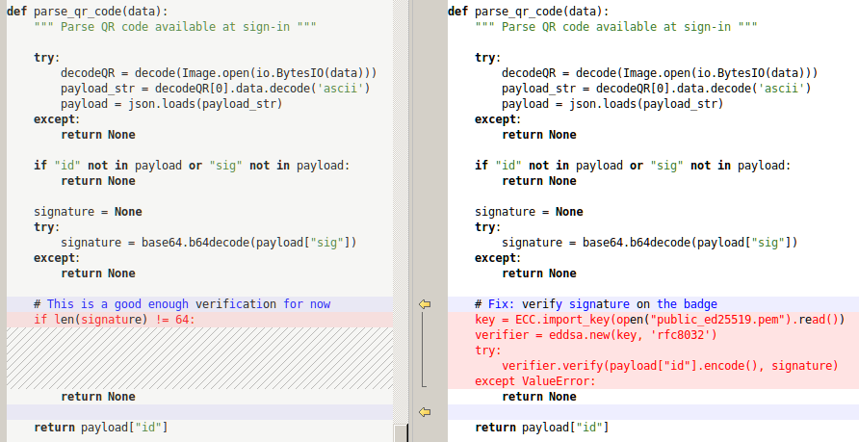
Vulnerability 3

