Slide 1
Spyware Challenge Walkthrough
We have received intelligence that someone has planted a malicious application on the Electoral Commission's server (10.0.2.52).
Please help us identify it and figure out what it does.

Slide 2
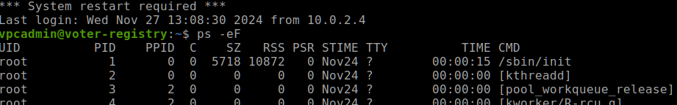
Step 1 – Locate the malware

Slide 3
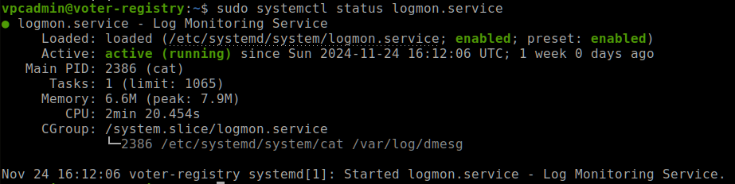

Slide 4
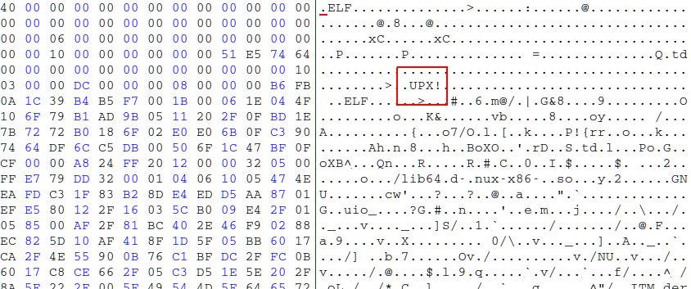

Slide 5
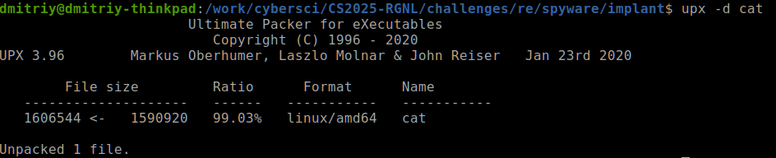

Slide 6
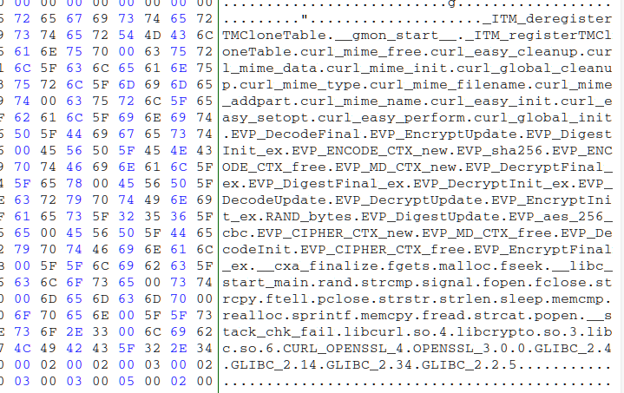

Slide 7
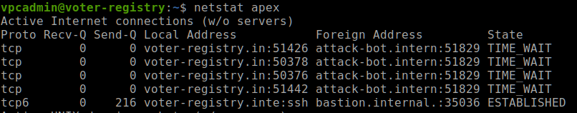

Slide 8
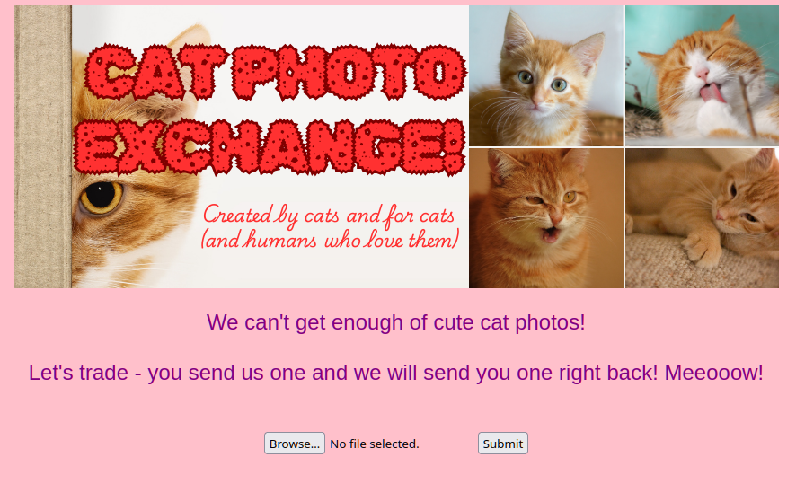

Slide 9
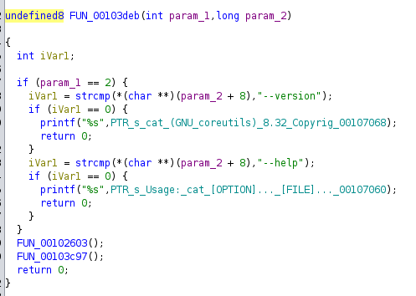
Step 2 – Determine the encryption key

Slide 10
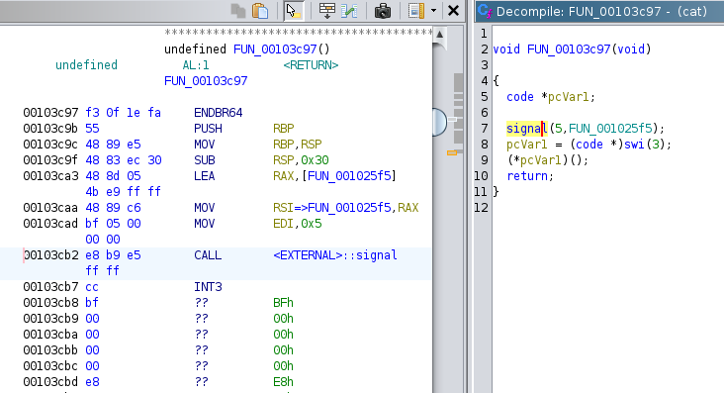

Slide 11
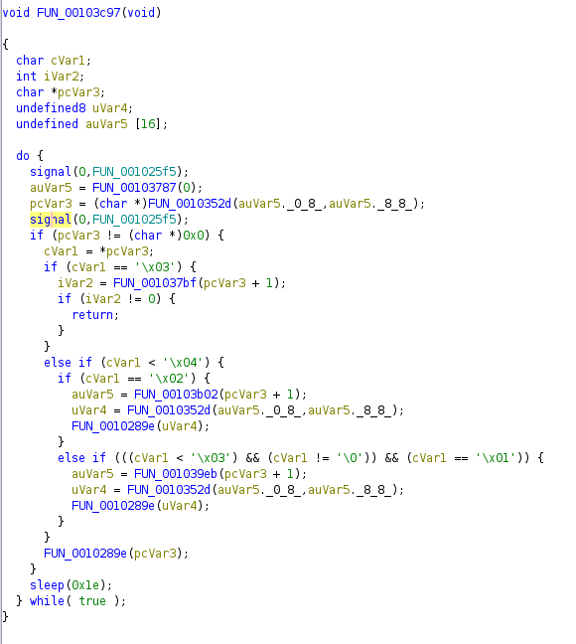

Slide 12
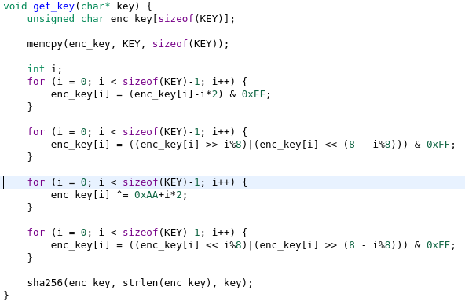


Slide 13
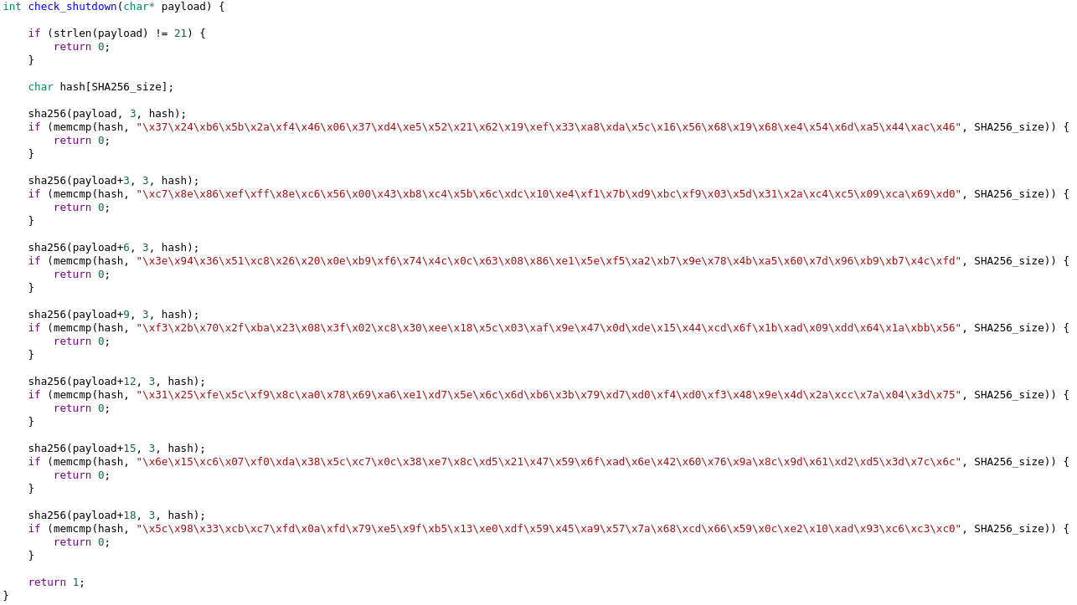

Step 3 – Solving shutdown key

