Slide 1

WEED DETECTION
Submitted by:
Sayan Das (13000117053)
Sayak Das (13000117054)
Satyaki Sett (13000117055)
Nilay Chowdhury (13000117083)

Slide 2

Introduction
In an agricultural land, weeds drain in the nutrition from the ground and the application of weedicides can hamper the fertility of the field. The only way to detect these weeds is by human interaction.
If machine intelligence is used as an add-on over a robot then it can eliminate the usage of weedicide.

Slide 3
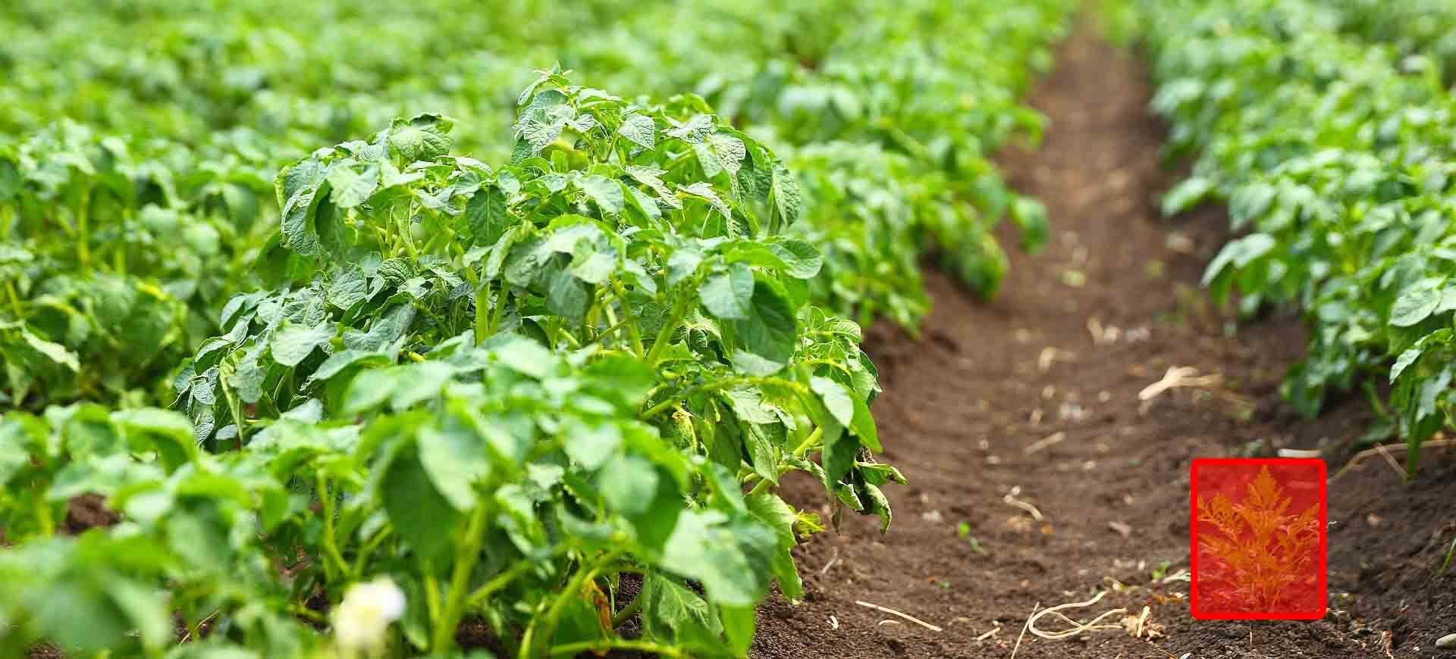
Problem Statement
We are making a ML model with the implementation of computer vision - it will identify weeds in an image from an agricultural field.
A model which can identify weeds in a field without human intervention will help further work of developing a robot that will traverse throughout the field and pluck out the weeds.

Slide 4

Related Studies
Machine vision system for weed detection using image filtering in vegetable crops. ^{[1]}
We got to know about the flowchart of image processing using computer vision.
The whole detection algorithm in this paper is based on area covered by the green plant. Moreover, this research work didn't use machine learning to train any data on weeds.

Slide 5
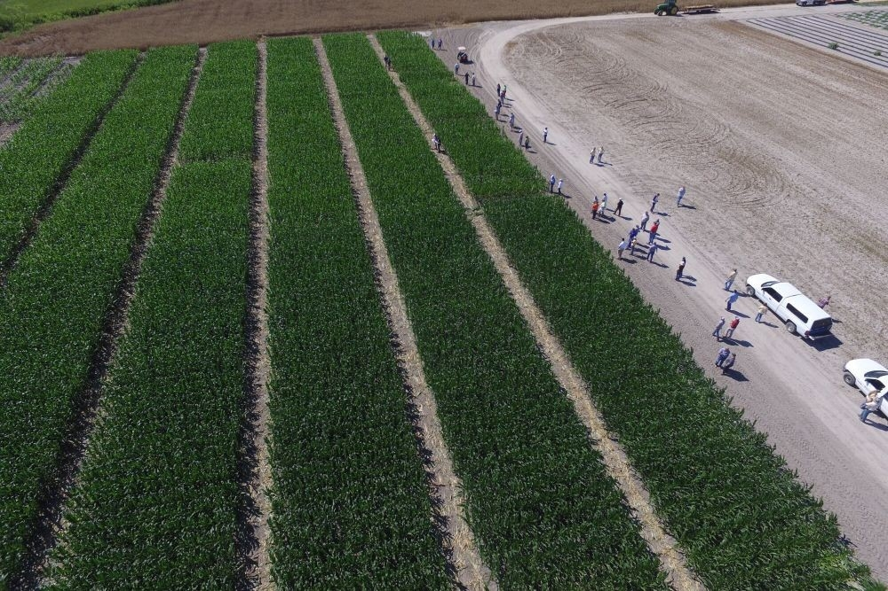
Weed detection using image processing. ^{[3]}
In this paper, the weeds are classified into two types:
(i) Weeds with narrow leaves
(ii) Weeds with wide leaves
To detect weeds, the model in this paper uses edge detection.

Slide 6

Weed detection using image processing under different illumination for site-specific areas spraying. ^{[5]}
The algorithm depends a lot on the weather status (sunny, cloudy) of that day.
The images are needed to be converted into grayscale.

Slide 7
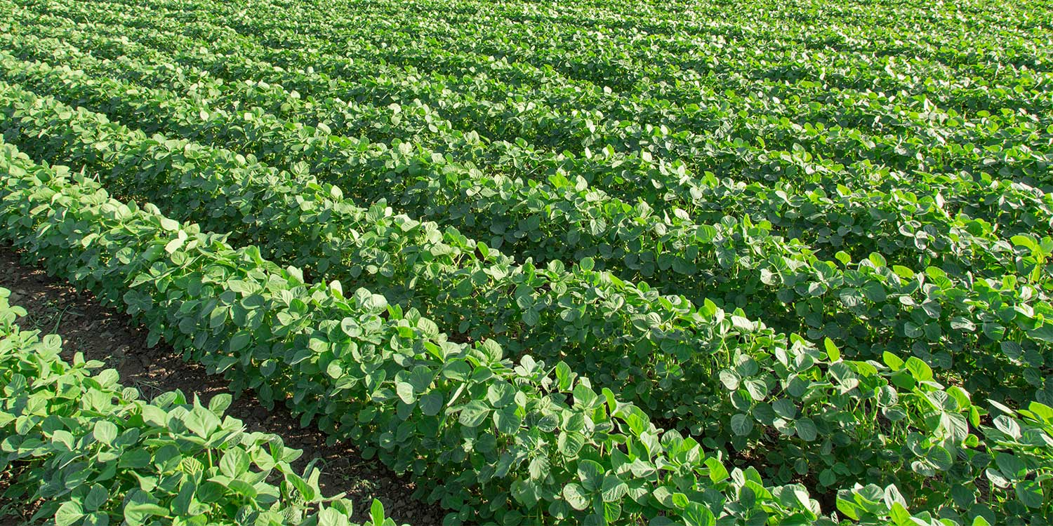
Alternate Solutions
Using image processing without any learning algorithm. ^{[1]}
Using edge detection technique on grayscale image and match with weed frequency range. ^{[3]}
Train a model to detect grey scale image with large weed image data set. ^{[5]}
Use tensorflow object detection algorithms To train images of different kinds of plants and predict weed. ^{[6]}

Slide 8
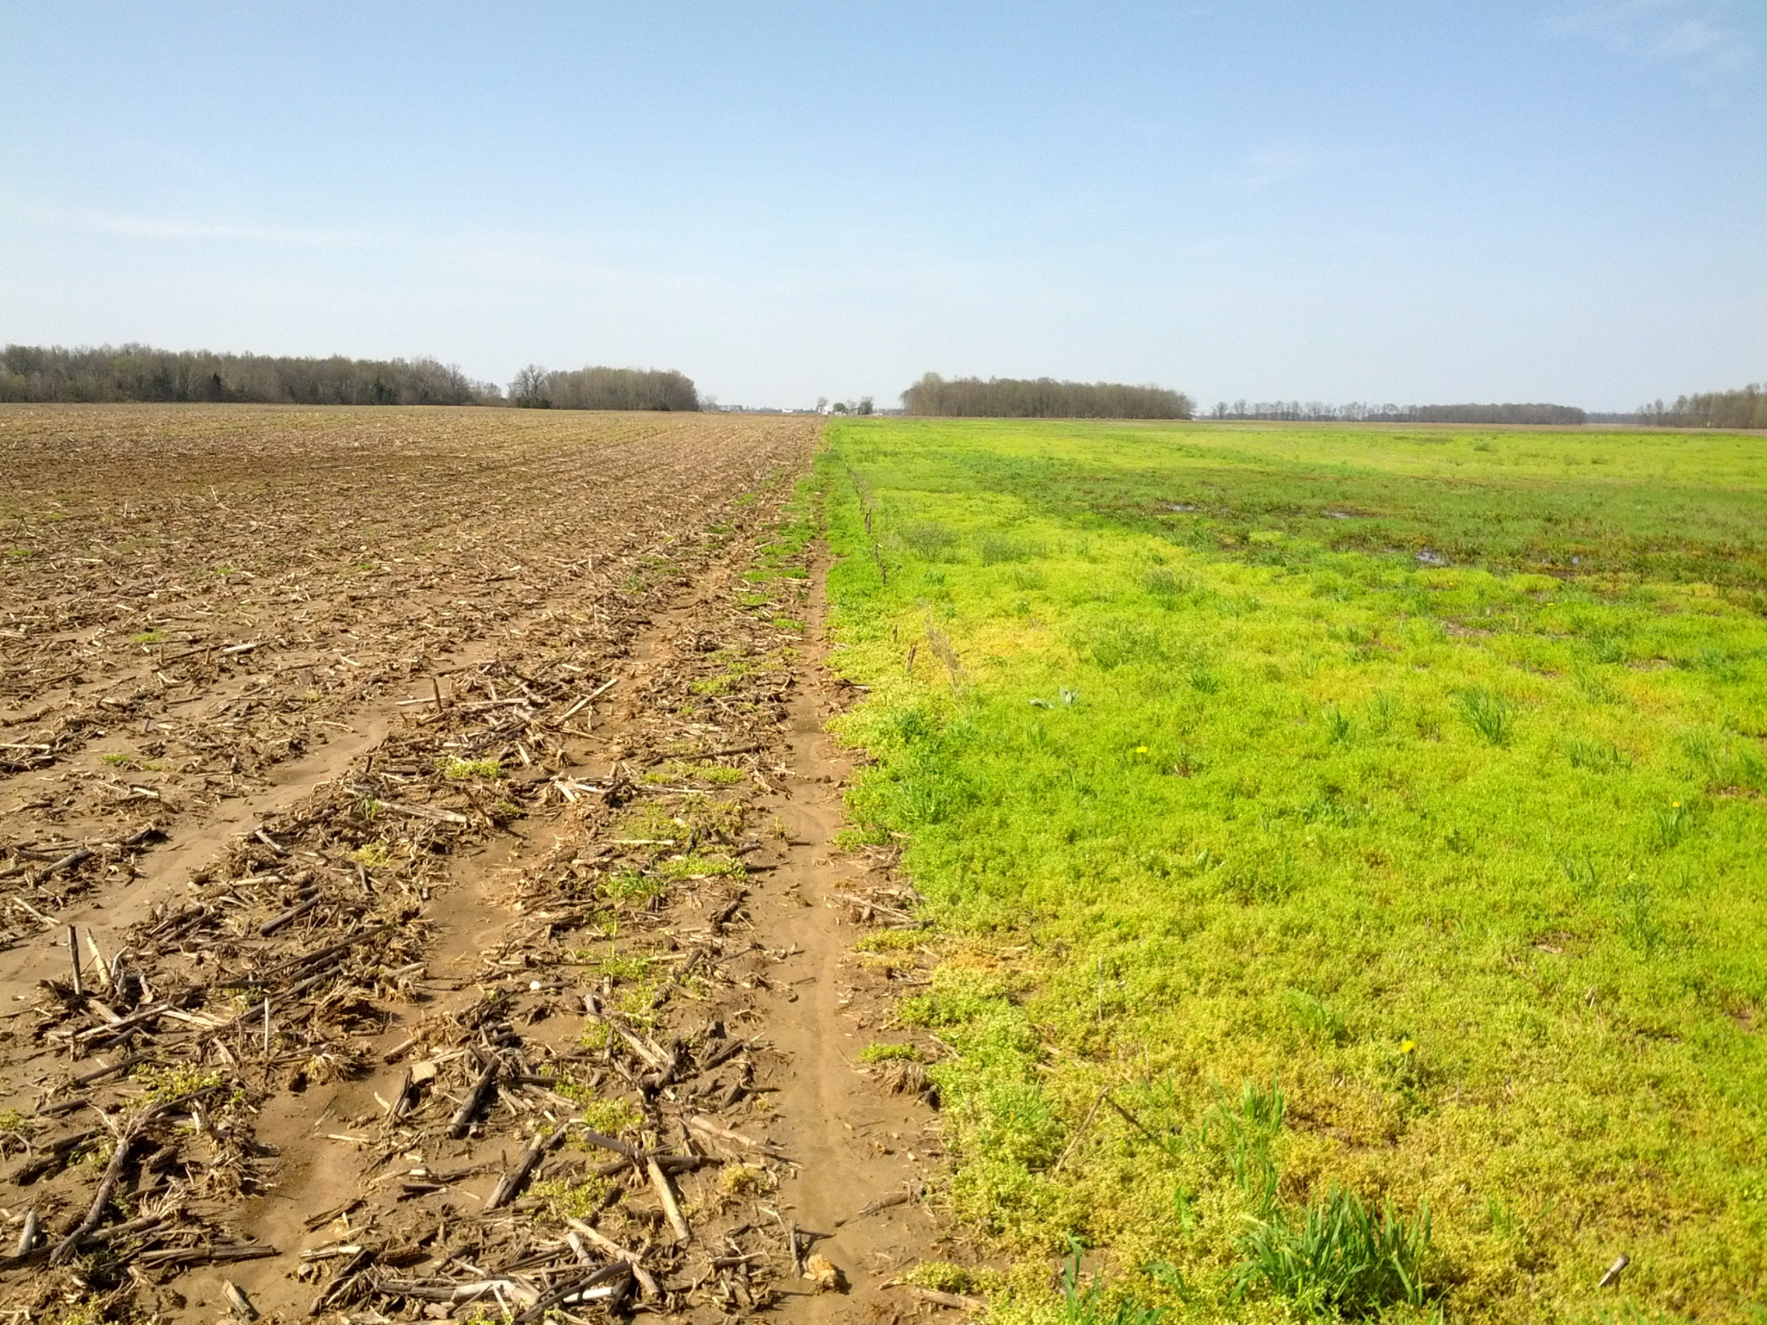
Recommended Solution
We will be using object detection algorithm from TensorFlow.
We have decided to detect the plants of agricultural field rather than weeds, such that everything else remaining other the target plant is considered to be weed.
In this way a test image will give result target plants identified as both specific plant with name and generalized plant and all other plants will only be identified as generalized “plants” only.
Hence we will be able to conclude that the generalized plants are not required in the field and can be tagged as weed for that particular field.

Slide 9

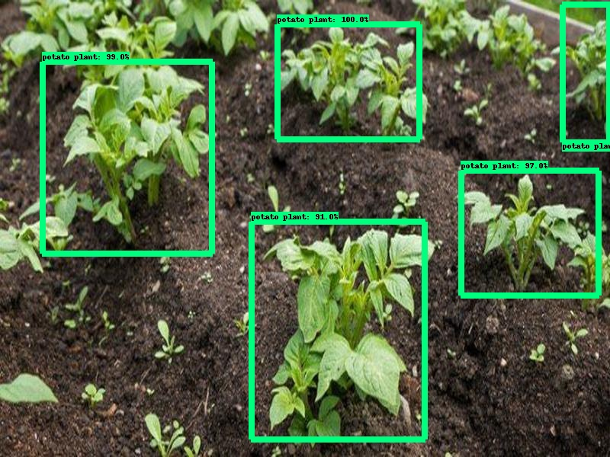
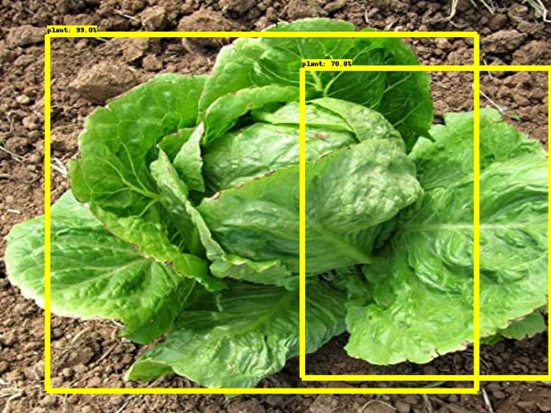
Proof of concept
We have considered potato plant as our target plant, so all other plants are considered as weeds.
From the above demo, we can see that pictures of potato plants (Figure 1) is detected as “potato plants”.
From Figure 2 we can see that the picture of a cabbage plant is detected as “plants”.
Figure 1
Figure 2

Slide 10

Benefits
It can be used widely in agricultural projects to remove the weeds from the field using a robot.
With current technology scenario, such a robot has not yet been prepared that will detect and remove the weeds without human intervention. But if our project is treated as an add-on over an existing robot, then the robot can detect and pluck the weeds without human intervention.

Slide 11
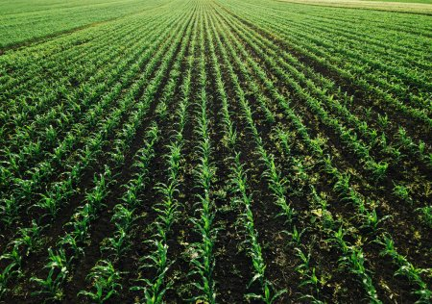
THANK YOU

